Slide 1
TIK 5.1 Primary water cooling systems
TIK 5.2 Intermediate water cooling systems
TIK 5.3 Target station HVAC
Jan Černý
TTB meeting, Lund 3 October, 2019

Slide 2
Project Schedule
TIK 5.1 Primary Water Cooling System
  Milestone 1 – CDR completed - DONE 31. 8. 2017

Slide 3



Current status
Heat exchangers – type was confirmed, now discussing possibility to reduce pressure drop to avoid underpressure in the system.
Pumps, valves – ESS requirements were discussed and clarified, now we are waiting for updated offers.
General problems:
  Requirements from adjacent systems
  Poor communication with suppliers

Slide 4
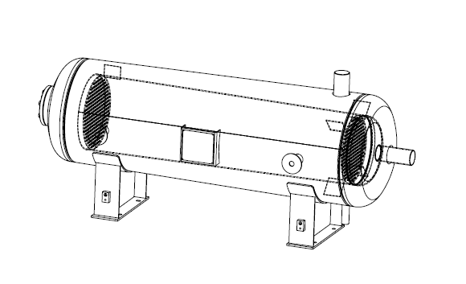
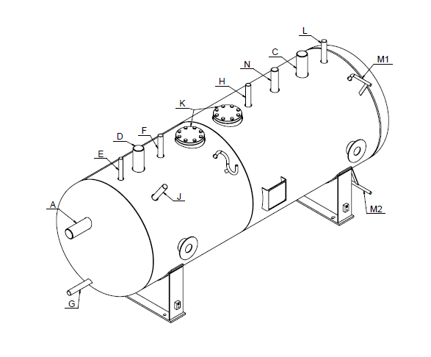
Current status
Discussion about tanks parameters was closed. Development of manufacturing documentation is in progress, manufacturing should start in October.
Delay tank
GLS tank

Slide 5
Current status
Component | Status
Heat exchangers | Inquiry phase
Delay tanks | Manufacturing phase
GLS tanks | Manufacturing phase
Pumps | Inquiry phase
Valves | Inquiry phase
Piping | Design phase
Level measurement | Design phase
Temperature measurement | Design phase
Pressure measurement | Design phase
Flow measurement | Design phase
Filters | Design phase

Slide 6
Project Planning
TIK 5.1 Primary Water Cooling System
  Milestone 2 – Manufacturing completed 31. 3. 2020
  Milestone 3 – Delivery to ESS site completed 30. 4. 2020
  Milestone 4 – Final report completed 31. 5. 2020

Slide 7
Project Schedule
TIK 5.2 Intermediate water cooling systems
  Milestone 1 – CDR completed - DONE 30. 6. 2017 

Slide 8
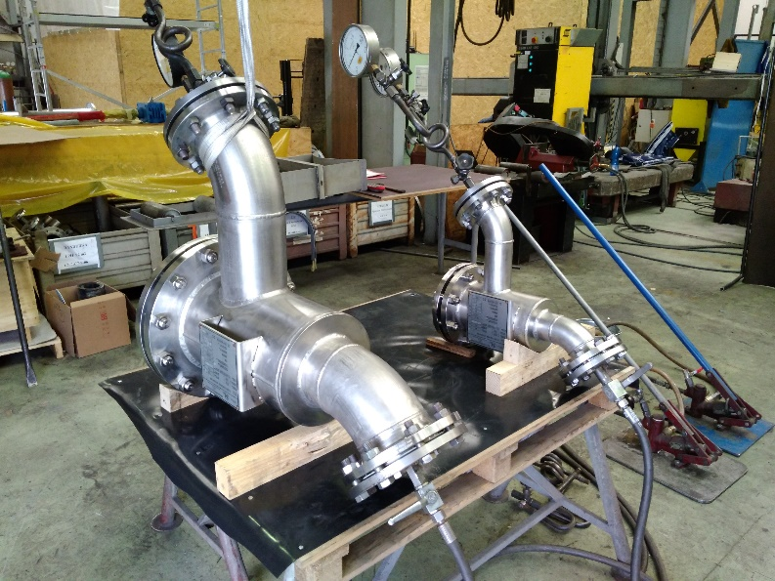
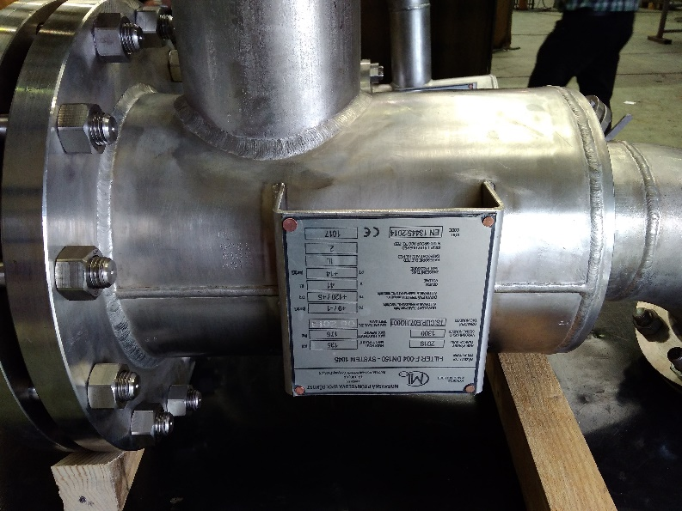
Current status
ESS decided to replace safety valves with needle valves – discussion about parameters is ongoing.
Most important components are already in stock and ready for transport.
Filters manufacturing was completed in May (ready for transport).

Slide 9
Current status
Component | Status
Heat exchangers | Ready for transport to ESS
Expansion tanks | In stock, preparing QC documentation
Level tanks | Ready for transport to ESS
Pumps | Ready for transport to ESS
Ball valves, Butterfly valves, Control valves | In stock, preparing QC documentation
Solenoid valves, Check valves | Ready for transport to ESS
Needle valves | Inquiry phase (replacement of safety valves)
Piping | In stock, preparing QC documentation
Level measurement, Pressure measurement | Ordered
Temperature measurement, Flow measurement | Ready for transport to ESS
Filters | Ready for transport to ESS

Slide 10
Project Planning
TIK 5.2 Intermediate water cooling systems
  Milestone 2 – Manufacturing completed 30. 11. 2019
  Milestone 3 – Delivery to ESS site completed 31. 12. 2019
  Milestone 4 – Installation and commissioning completed 30. 6. 2020
  Milestone 5 – SAR completed 31. 8. 2020
  Milestone 6 – Final report completed 30. 9. 2020

Slide 11
Project Schedule
TIK 5.3 TS HVAC System
  Milestone 1 – CDR completed - DONE 30. 8. 2017 

Slide 12
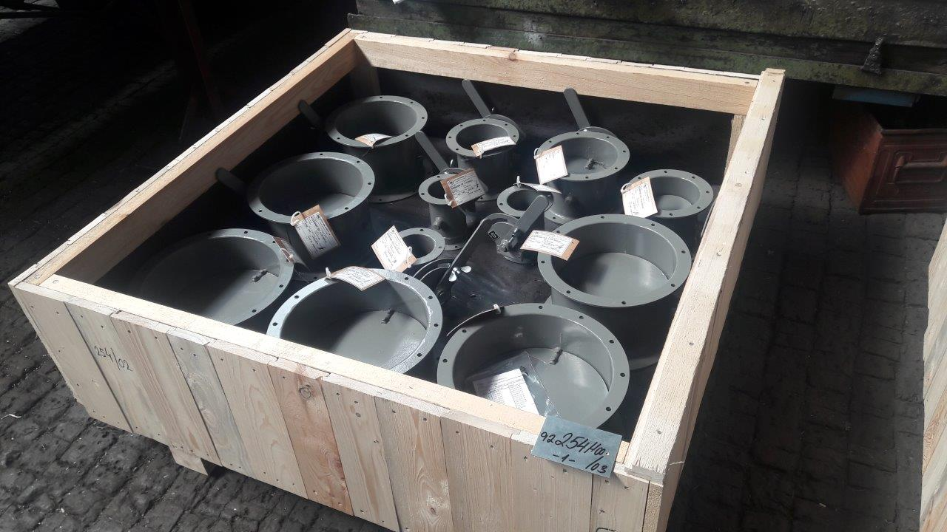
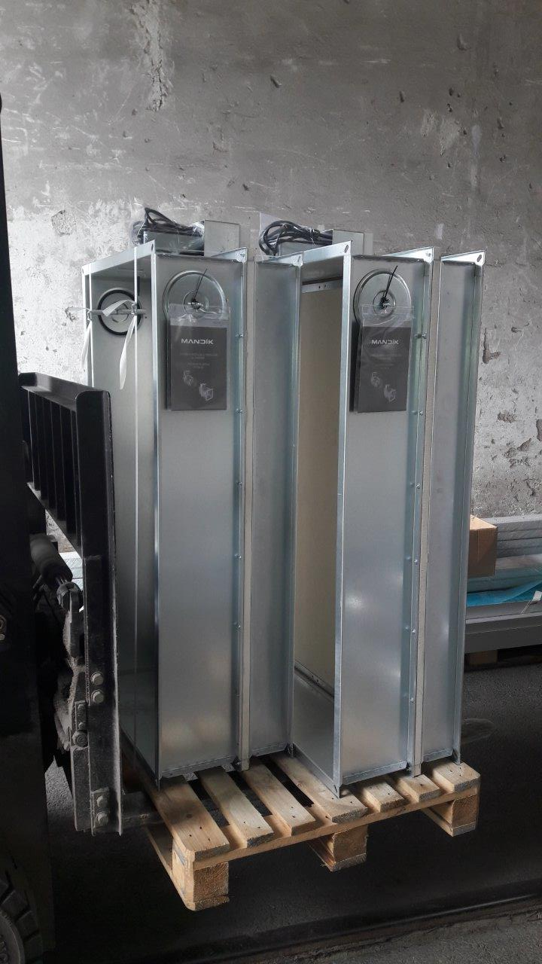
Current status
Equipment delivery to Lund is in progress.
  32 trucks arrived to Lund.

Slide 13
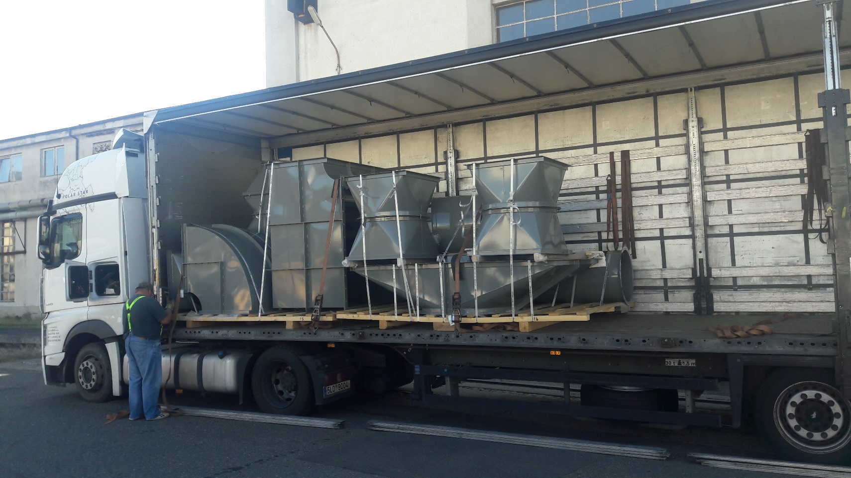
Current status

Slide 14
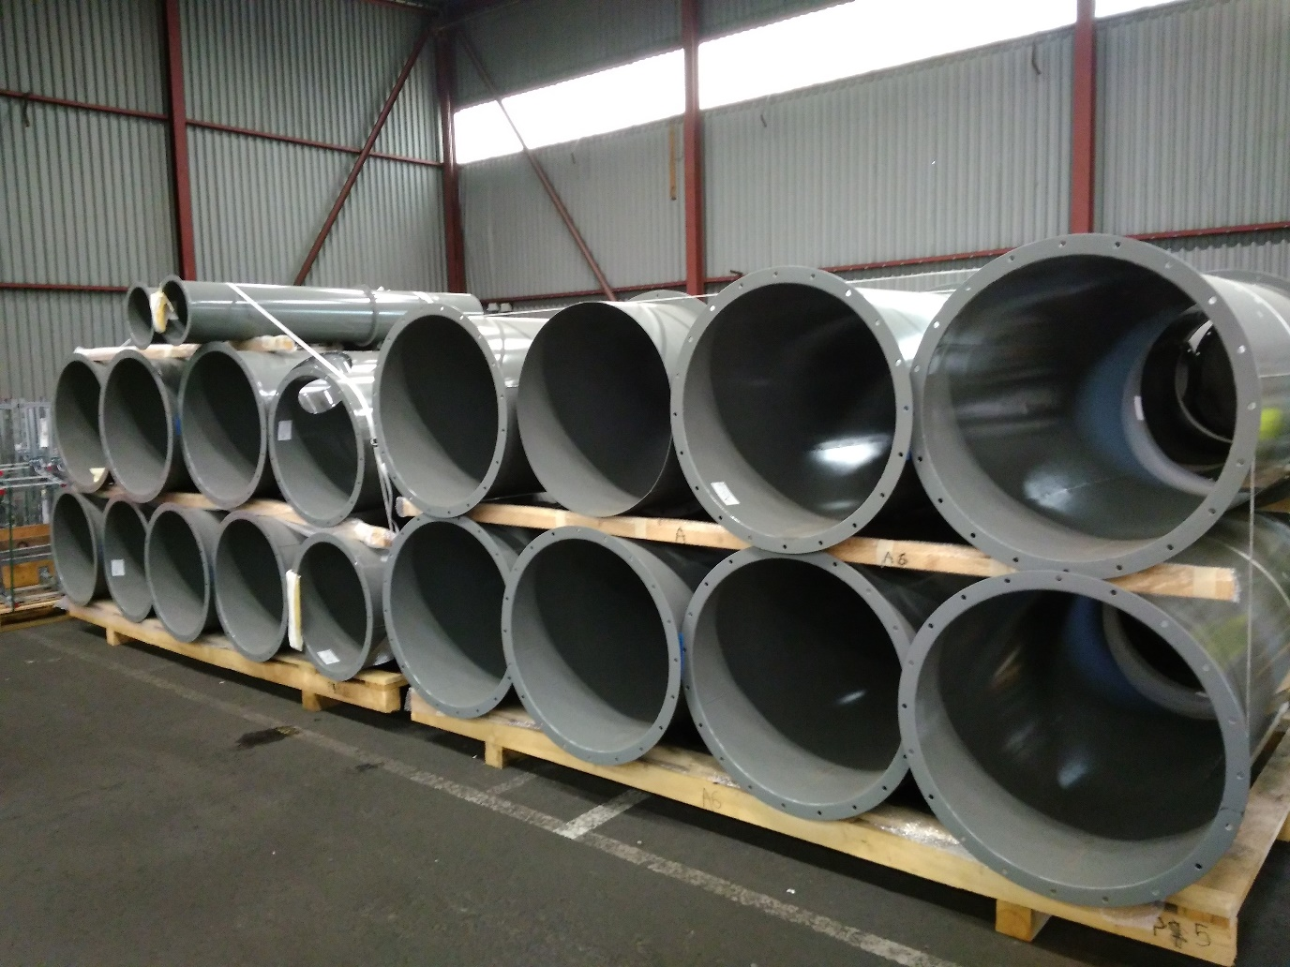
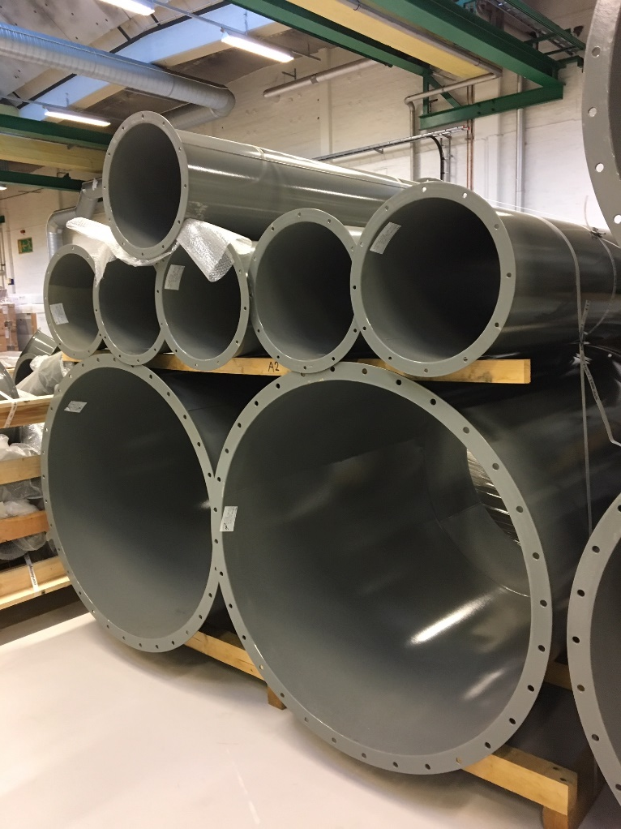
Current status

Slide 15
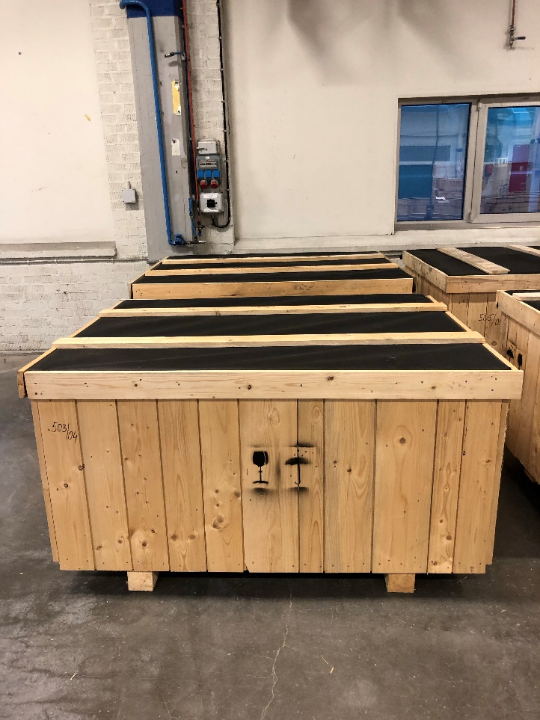
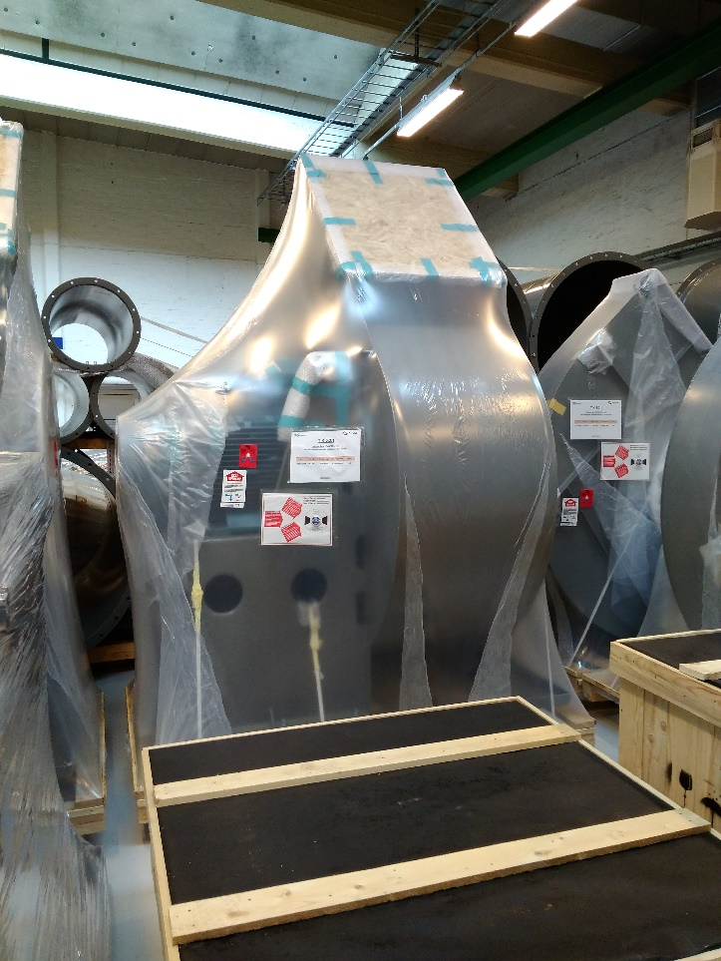
Current status

Slide 16
Current status
Most of mechanical components are already in ESS storage.
Last minor modifications were discussed and incorporated into documentation.
Water circuits documentation is complete and should be submitted for ESS review.
Electrical components are under review now and should be delivered until the end of 2019.
Documentation of electrical part is now being converted into EPLAN.

Slide 17
Project Planning
TIK 5.3 TS HVAC System
  Milestone 2 – Manufacturing completed 30. 11. 2019
  Milestone 3 – Delivery to ESS site completed 31. 12. 2019
  Milestone 4 – Final report completed 31. 12. 2019

Slide 18
Summary
TIK 5.1 – start of manufacturing and procurement.
TIK 5.2 – close to finish delivery, preparing for installation.
TIK 5.3 – close to finish delivery, preparation of Final report should start soon.

