Slide 1
ESS Visit @ Elettra Sincrotrone Trieste October 14th – 15th, 2019

Slide 2
Status of ESS Project and IK Contributions
ESS @ Elettra Sincrotrone Trieste S.C.p.A.
Mauro Zambelli
European Spallation Source ERIC
Trieste, 14th / 15th October 2019

Slide 3
Status of the ESS Project Construction, towards Operations & First Science

Slide 4
Journey to deliver the world’s leading facility for research using neutrons
Construction project is 61% complete
2025
ESS Construction Phase Complete
2019
TODAY
2014
Construction Starts on Green Field Site
2023
ESS Starts
User Program
2009
Decision to Site ESS in Lund
2019
Start of Initial Operations Phase
2012
ESS Design Update Phase Complete
2003
European Design of ESS Completed

Slide 5
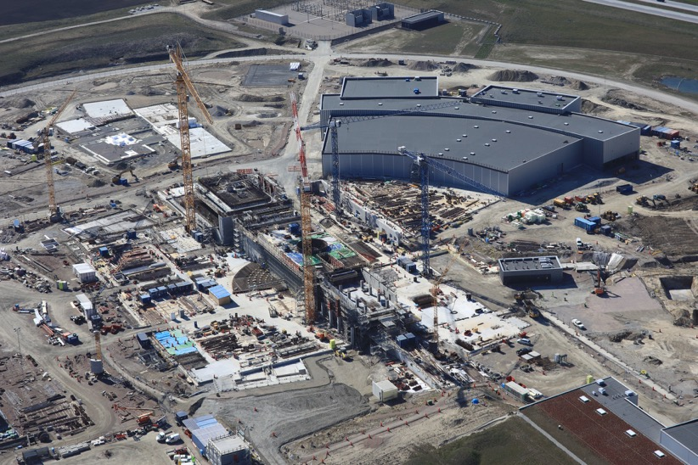
ESS highlights
Progress continues
No major new technical issues of concern have arisen
Rapid growing of installation and commissioning activities
Licensing application for commissioning of the Normal Conducting Linac submitted on schedule
Two new members of senior management team in place; reorganisation underway
Positive decision made at June 2019 Council meeting on completion of construction funding (240 M€₂₀₁₃)

Slide 6
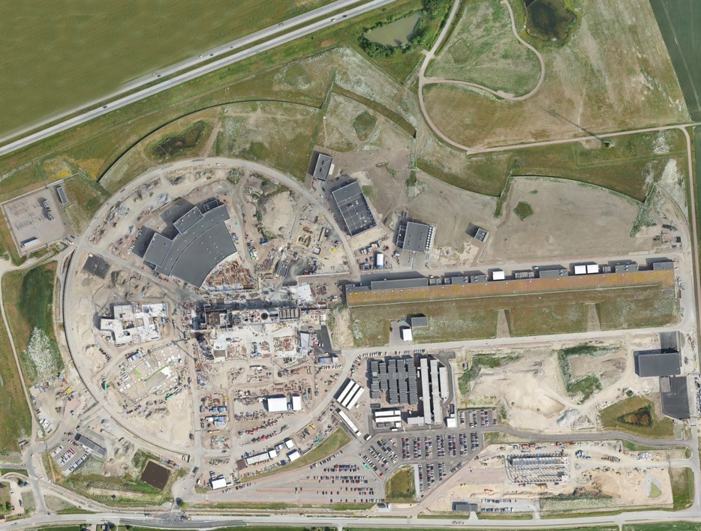
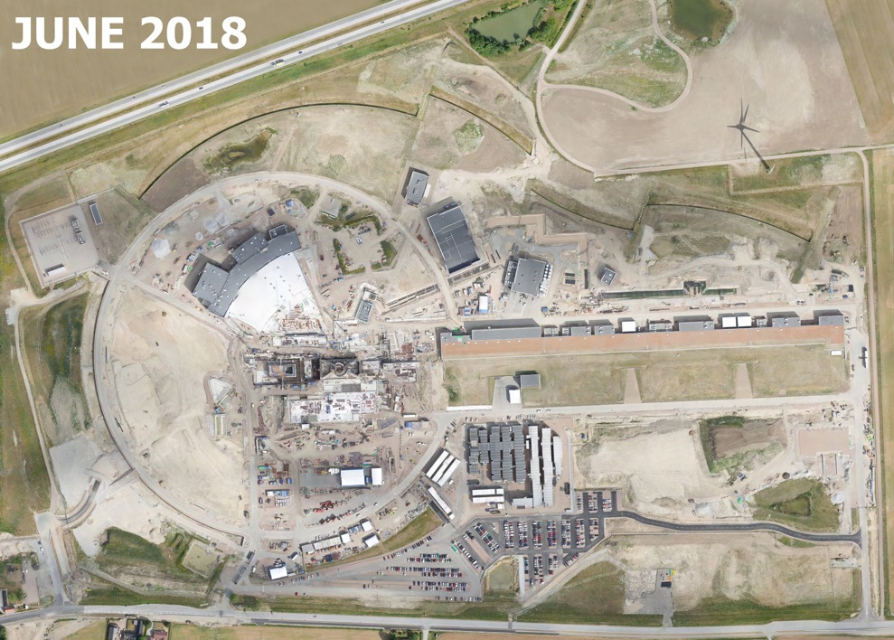
Flight scannings 2019/2018
April 2019
March 2018
JUNE 2019

Slide 7
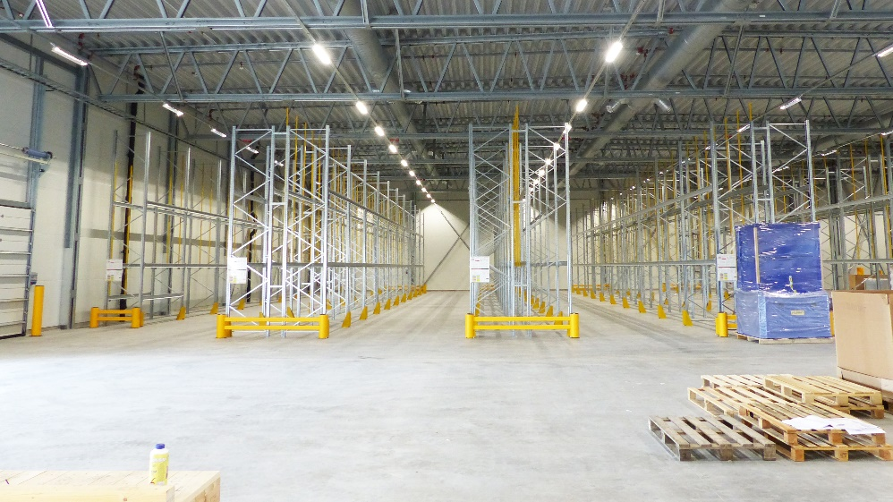
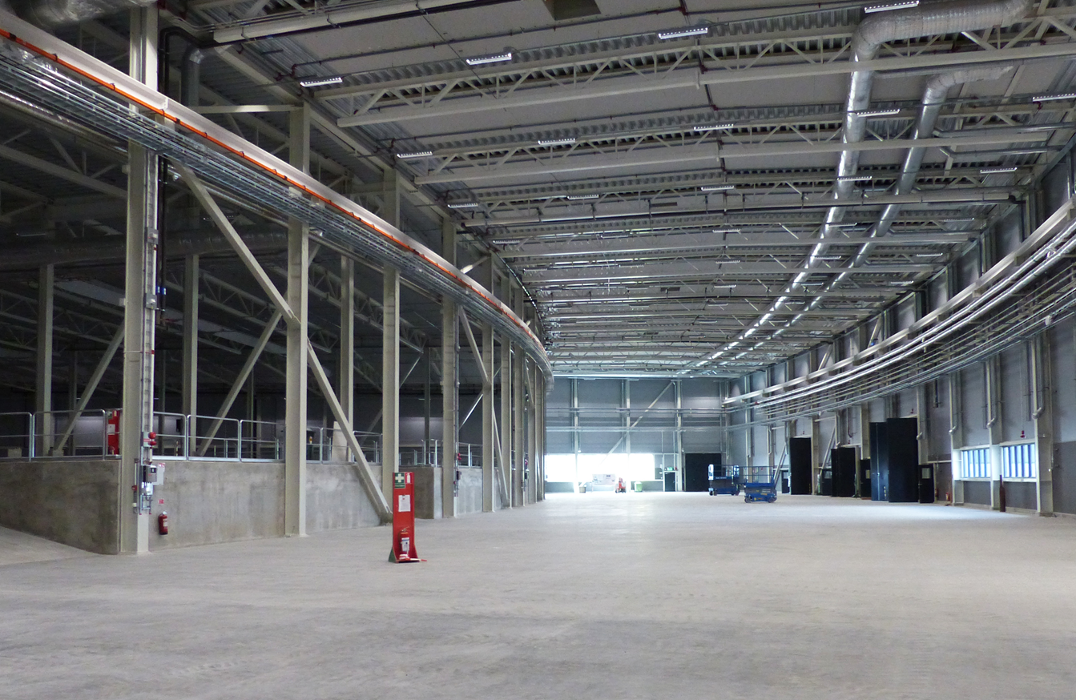
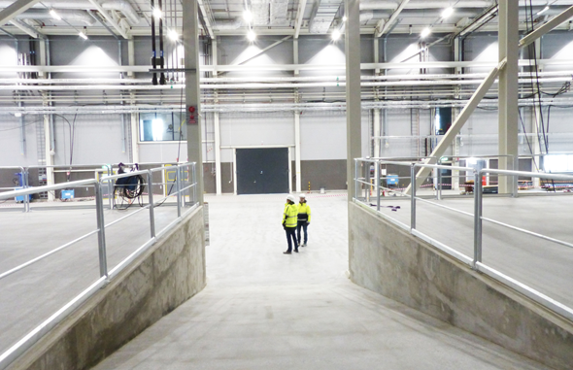
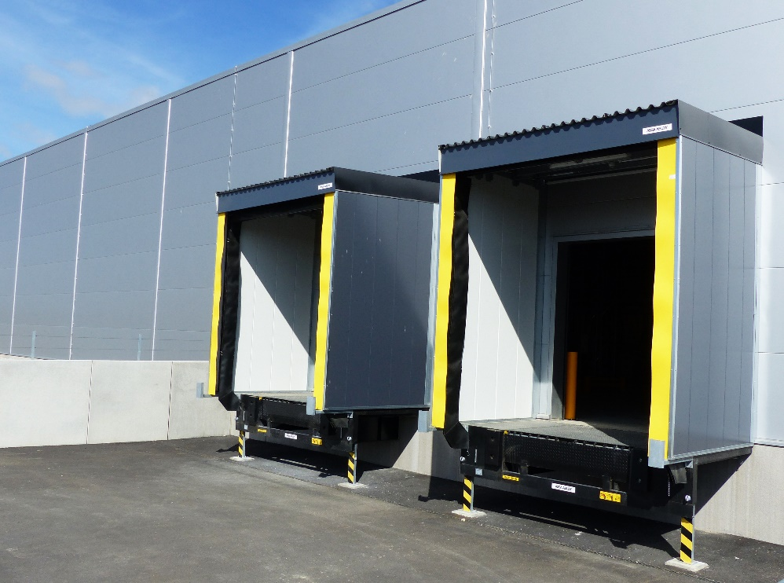
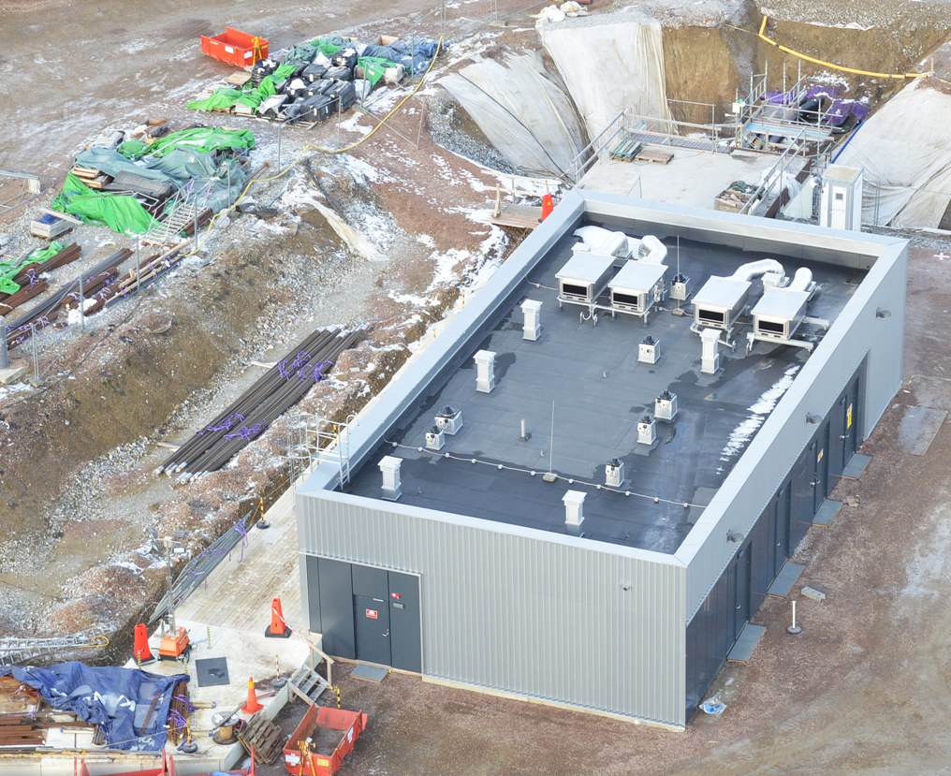
ESS Highlights
Civil construction and delivery of conventional facilities according to schedule
Notes:
CF and Skanska have kept all critical access dates since the Rebaseline
CP is temporary Target High bay crane operational for vessel installation Dec 16th
Subprojects will give more, the tour is best

Slide 8
A reminder of the ESS Critical Path
2018
2019
2020
2021
2022
2023
2024
2025
BOT
FS
SOUP
EOC
Warm LINAC Commissioning Steps
0.8 GeV Capability Installed
Main focus on delivering First Science with three instruments by the end of 2023
Schedule date (no float) is March 2023
Accelerator + ICS
Hi -Beta Install
Beam on Dump
(570 MeV)
Accel RBOT
Accelerator Schedule Float
CF + Target + NSS (Bunker+TBL) + ICS
Access for Monolith Installation
Target RBOT
Bunker & TBL RBOT
15th Instrument Complete (Ready for hot commissioning)
NSS Instruments + ICS
BOT - Beam on Target
RBOT - Ready for Beam on Target
FS - First Science
SOUP - Start of User Programme
EOC - End of Construction project
Instrument Hall Access for Start of Installation
Start beam commissioning for 1st Instruments

Slide 9
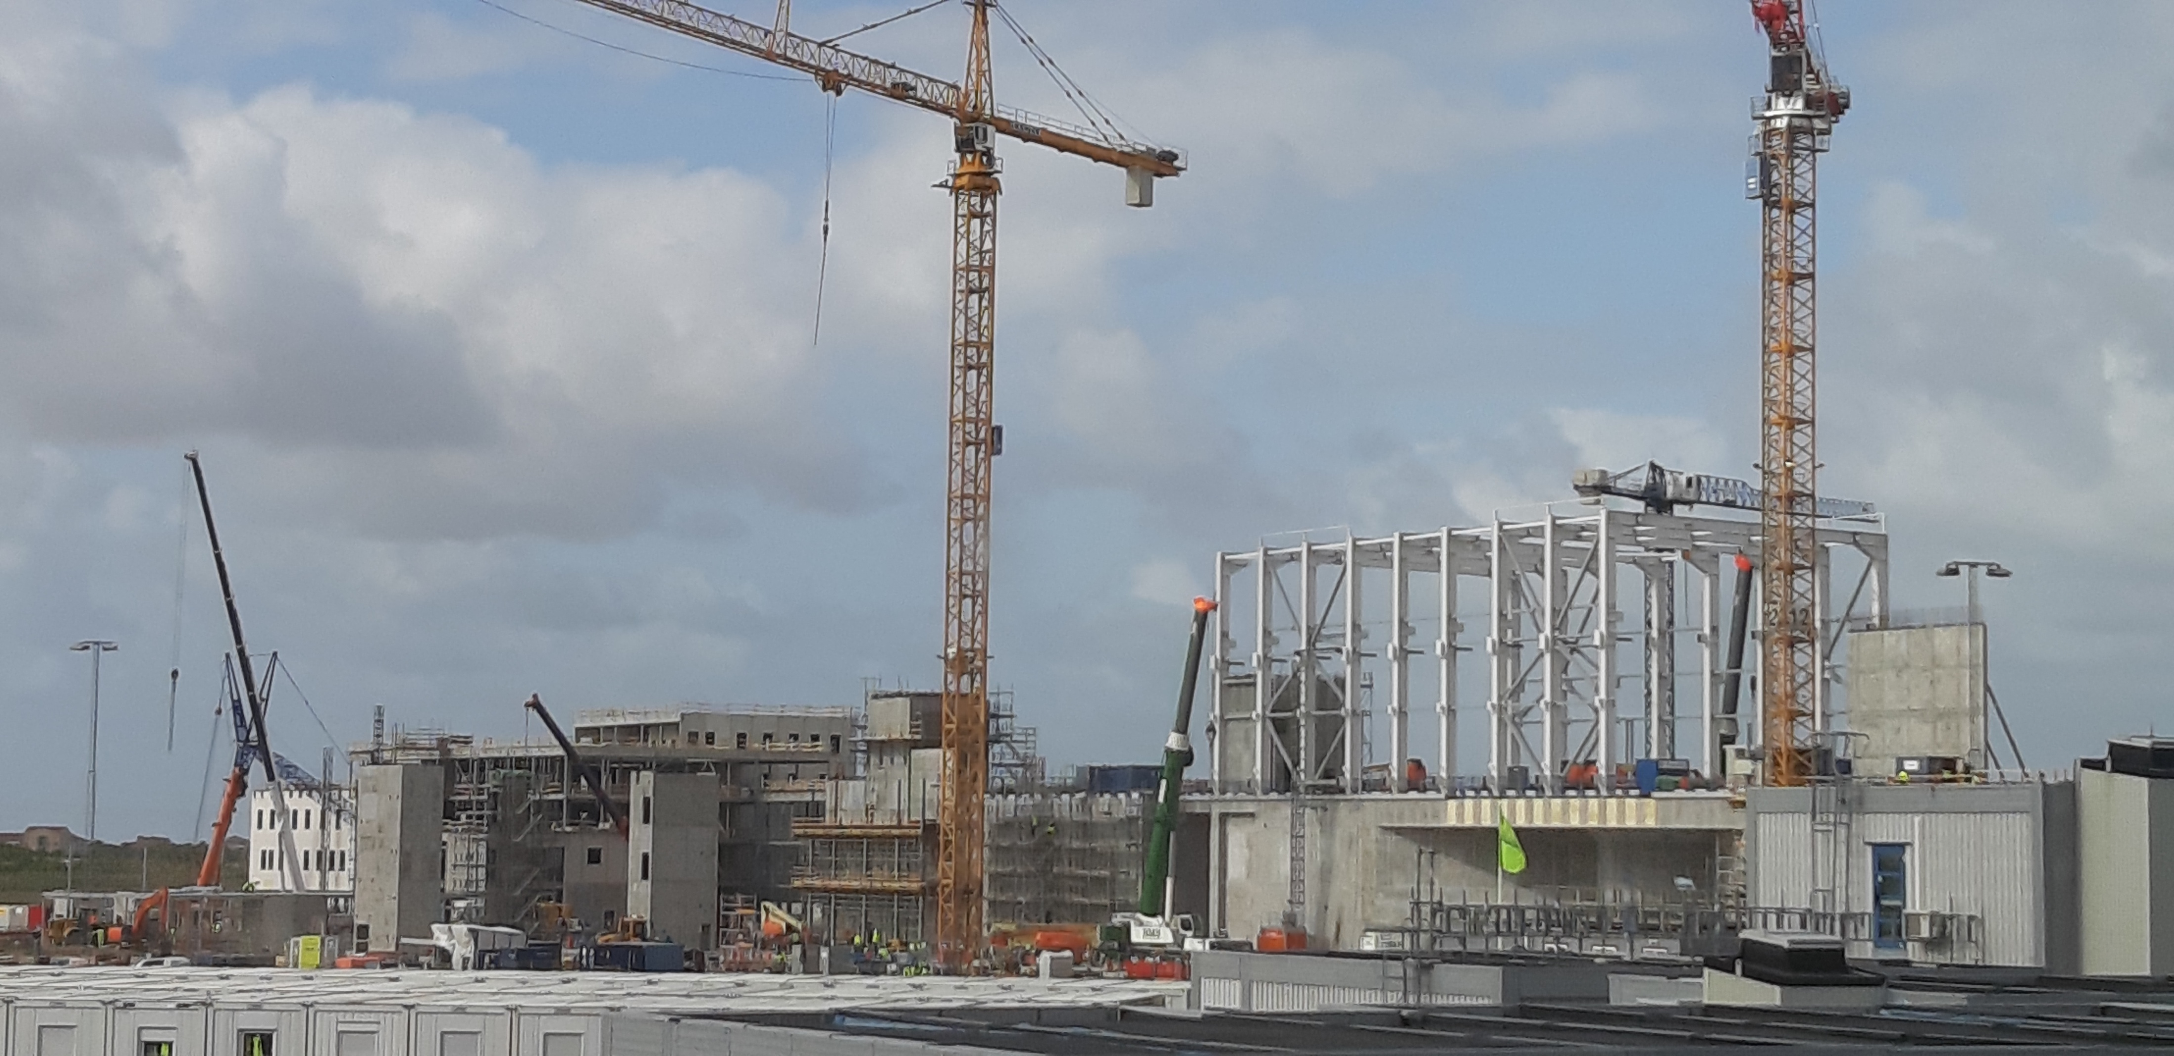
ESS Highlights
Conventional facilities
Civil construction remains on or ahead of schedule
Steelwork erection for target building high-bay and for D buildings now underway

Slide 10
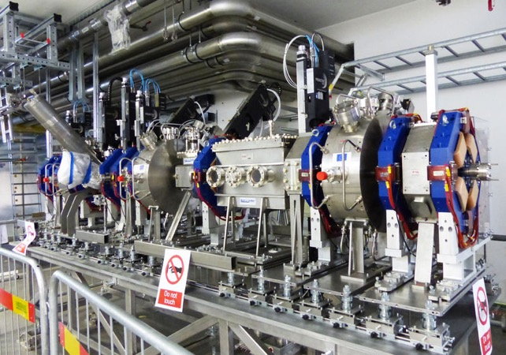
ESS highlights
Accelerator
Accelerator installation proceeding
Ion source and LEBT commissioned
MEBT installed
DTL received and being integrated
RFQ on site
Cryo-test stand permit received

Slide 11
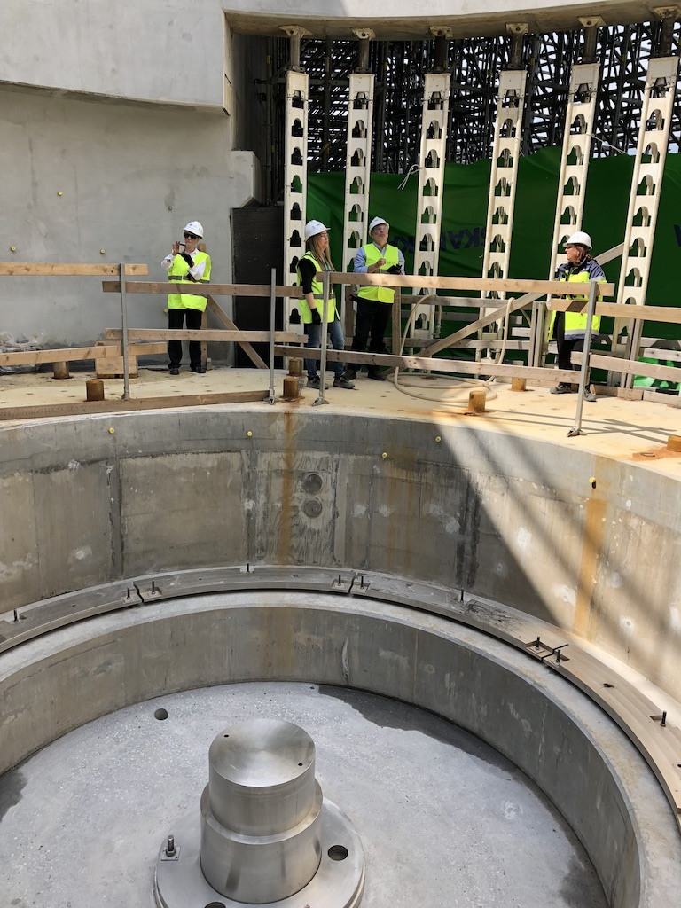
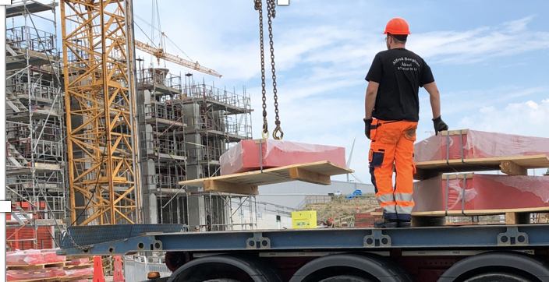
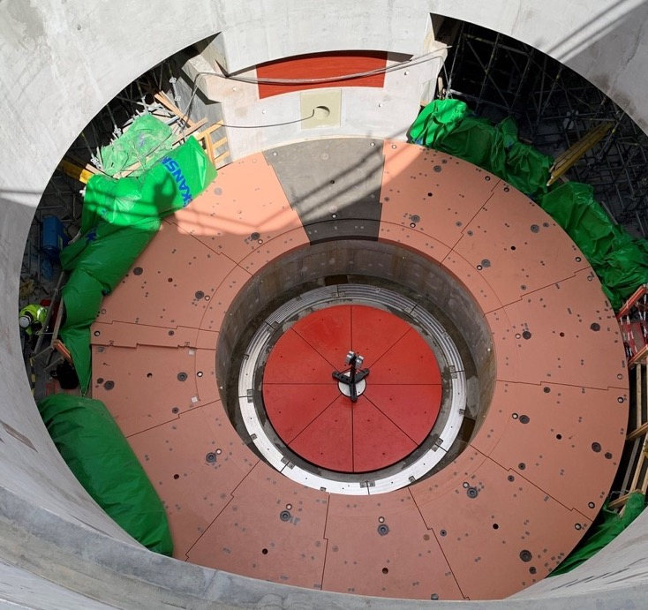
ESS highlights
Target
Target installation proceeding
High bay steelwork
Monolith shielding
Major components in manufacturing
Monolith vessel on track for delivery by end 2019

Slide 12
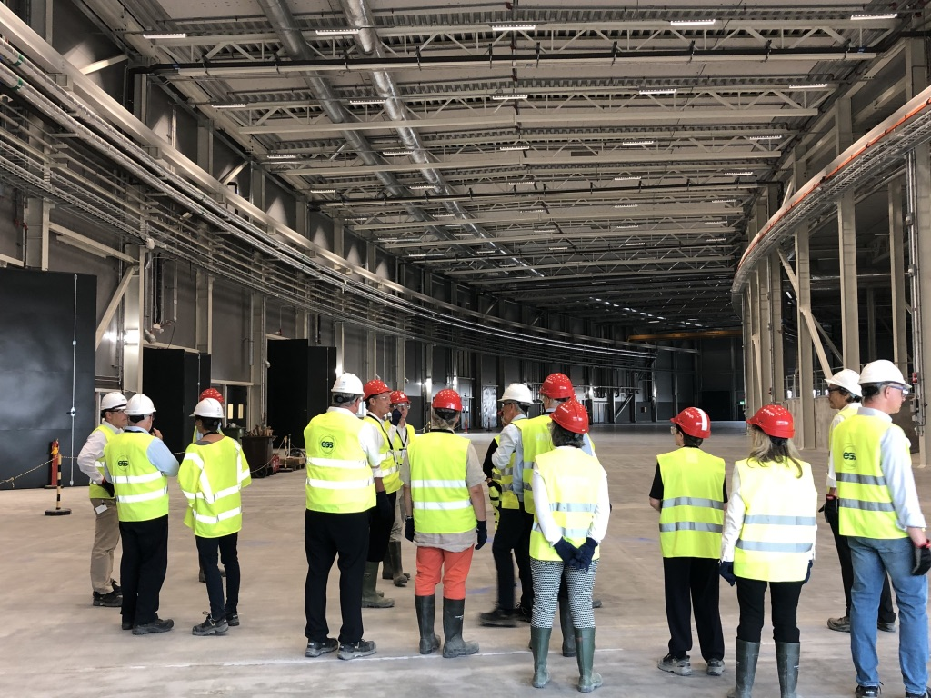
ESS highlights
Instruments
Bunker is in manufacturing
Instruments design phase complete – moving into construction
“First 3” instruments endorsed by IKRC
Common shielding, chopper and beam monitor designs developed to save time and money
Schedule mitigations implemented to reduce impact of port blocks on first science by modifying bunker installation sequence

Slide 13
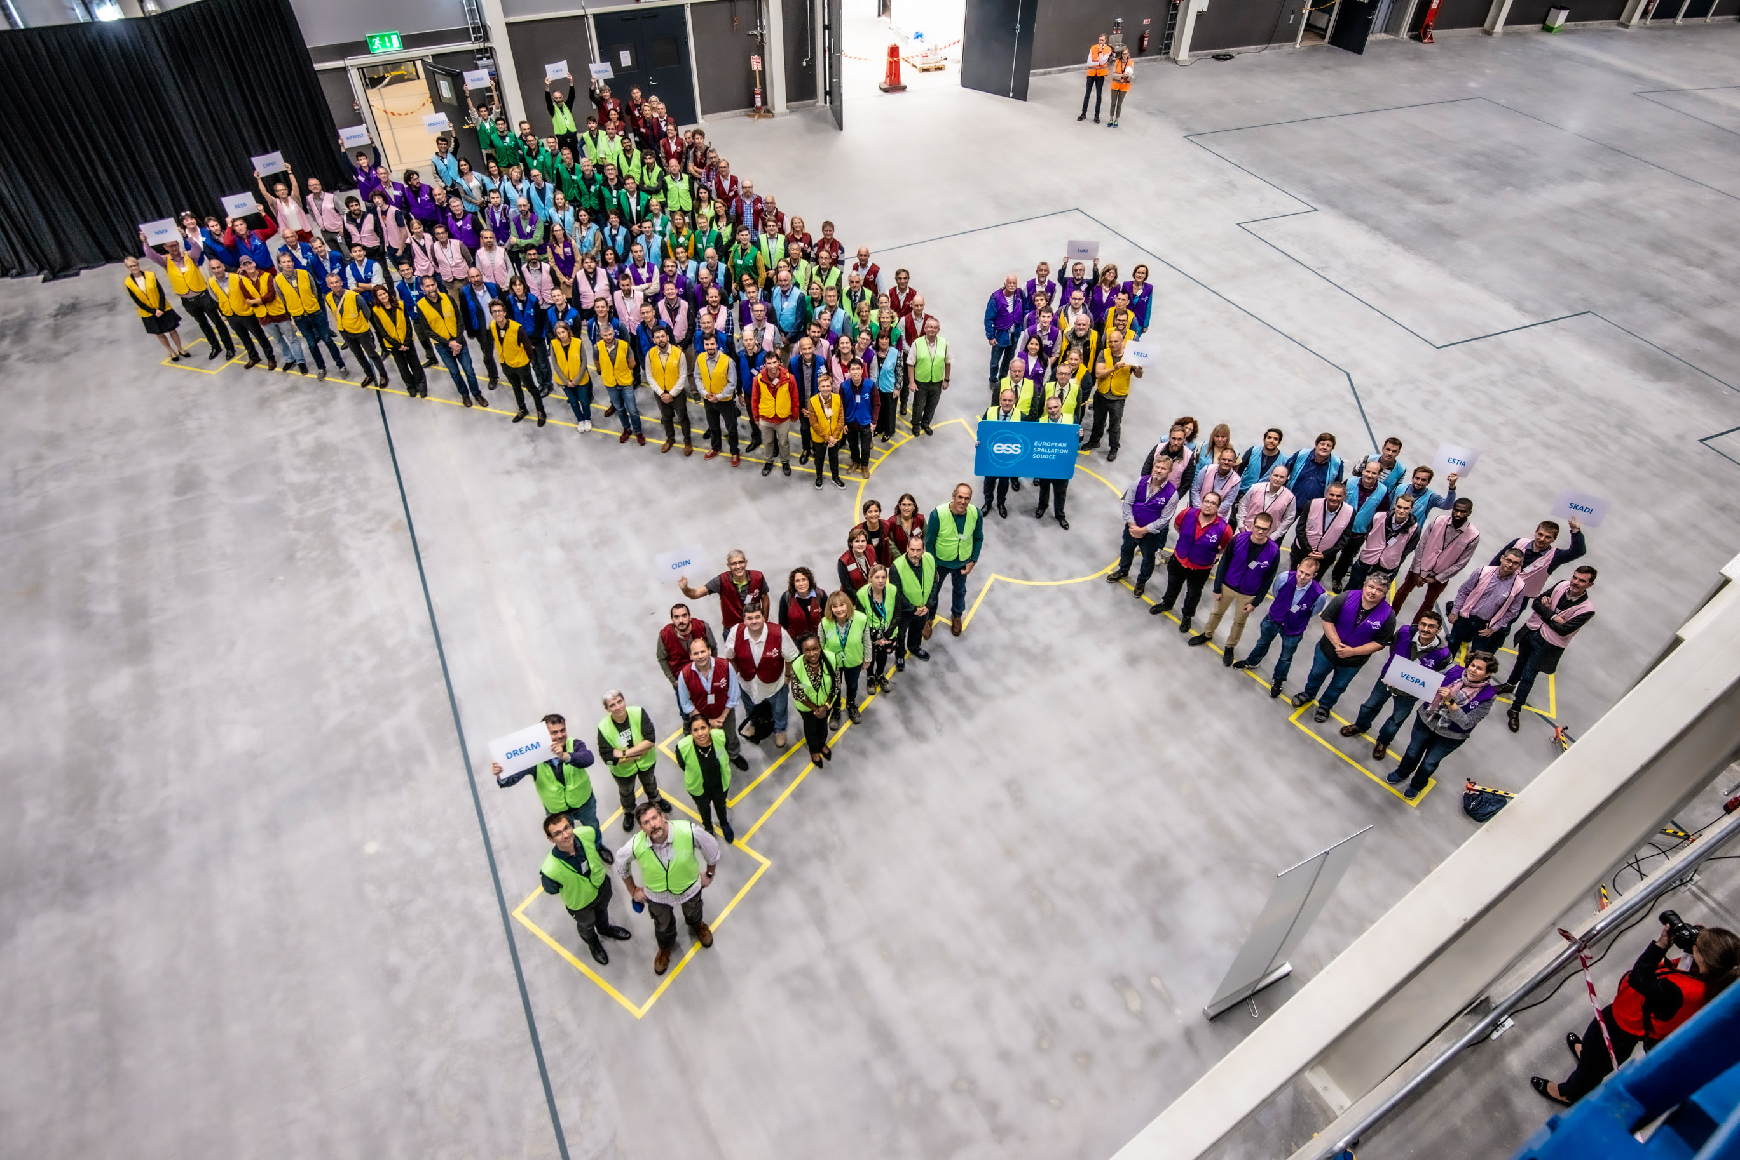
Inauguration of the E01 Experimetal Hall
September 9th, 2019

Slide 14
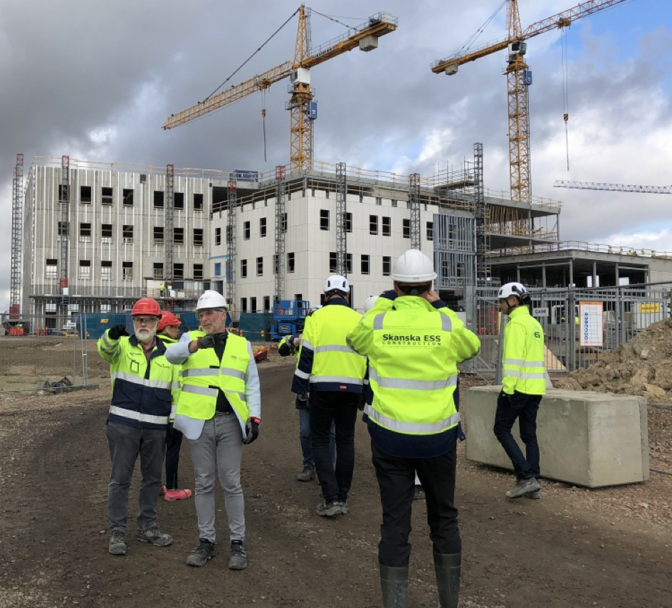
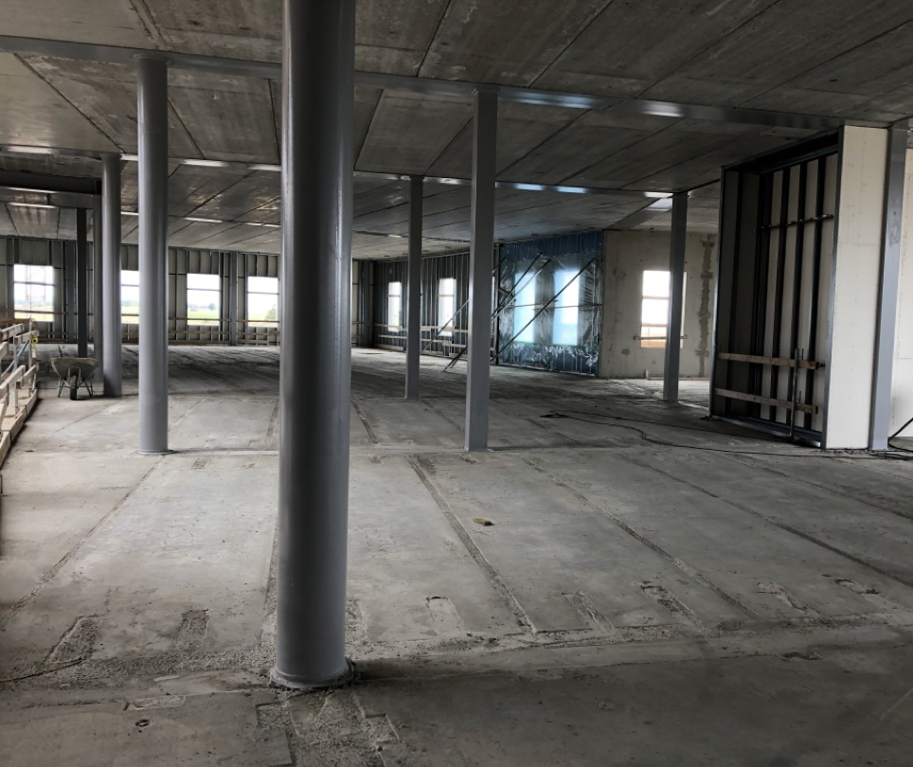
ESS Highlights
ESS offices and laboratory campus

Slide 15
First eight instruments planned to be ready for commissioning by end of 2022
Diffractometers | Spectrometers | Reflectometers | SANS | Engineering & Imaging
DREAM | BIFROST | ESTIA | LOKI | BEER
MAGIC | C-SPEC |  |  | ODIN
May 2021 Access
BEER
C-SPEC
ODIN
BIFROST
DREAM
MAGIC
Jun 2021 Access
Aug 2019 Access
LOKI
Jan 2021 Access
Preferred first
three instruments
ESTIA
Notes:
There is risk with this plan and we need to revisit it
2 of the 3 choices for first science has the last area access

Slide 16
New Organization @ ESS Focus on delivery First Science in 2023

Slide 17
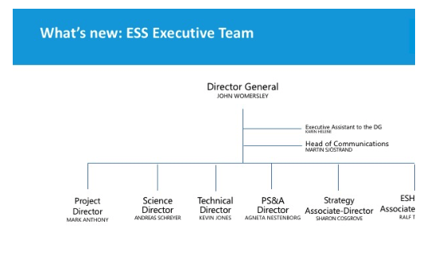
ESS New Organization - 1

Slide 18
ESS New Organization - 2

Slide 19
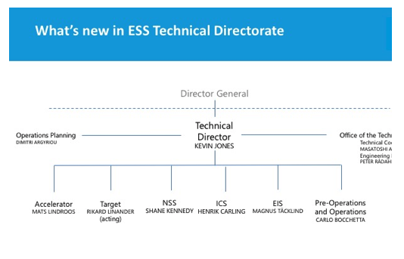
ESS New Organization - 3

Slide 20
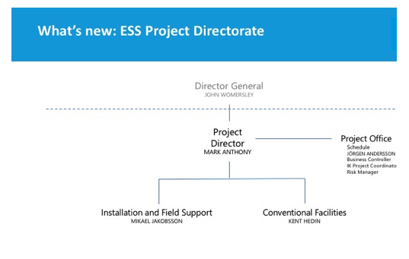
ESS New Organization - 4

Slide 21
In-Kind Contributions @ ESS Contracts, Construction, Operation

Slide 22
New challenges for IK management
IK Management @ ESS is rapidly moving from the Contractual phase to the Implementation phase, starting to look forward to the Operation phase
This requires a progressively different approach to the relationship both with the IK Partners and with the relevant Functions inside ESS
Complex issues are now coming into play: logistics, VAT on delivery and installation, quality documentation, CE marking

Slide 23
ESS – IK Provider relationship
The operative relationship between ESS and the IK Provider is essentially (and usefully) focused on the scientific/technical channel (WP Leader)
However, IK is a far more complex process, which requires a “multi-channel” communication and comprehensive interaction between ESS and the IK Partners / IK Provider

Slide 24
Multi-channel communication
IK Contribution Agreements
Technical Annexes and TA amendments
Relationship with Ministries and Funding Agencies
Administrative issues (i.e. Call-Offs payments)
VAT issues (particularly on delivery and installation)
Technical specifications
Project schedule
Logistics (transport, delivery)
Quality Control and quality documentation
CE marking / DOI
Installation and commissioning

Slide 25
ESS – IK Provider relationship
The IK Partners and the specific IK Providers must be supported by ESS in order to accomplish their contracts on spec, on time and on budget
ESS must be assured by the IK Provider about its capability to deliver equipment and services according to the specifications and to the schedule agreed

Slide 26
ESS – Organizational issues
In order to increase the effectiveness of the co-operation between ESS and the IK Partners, improvement in the internal organization for IK management are currently under way
In particular the two following concepts have been introduced:
IN-KIND FRAMEWORK MANAGEMENT
IN-KIND SUPPLY CHAIN MANAGEMENT

Slide 27
IK Framework vs. IK Supply Chain
European Spallation
Source ERIC
IKFR (Support)
ESS Project
Partner’s Issues
IK
Partner
ESS Requirements
IKSC (Control)

Slide 28
ESS – Organizational issues
IN-KIND FRAMEWORK MANAGEMENT
General and organizational issues: contracts, amendments, legal issues, liabilities, warranties, VAT, quality, contacts with Funding Agencies, Ministries, National Bodies
Responsibility: Strategy Directorate
IN-KIND SUPPLY CHAIN MANAGEMENT
Schedule and budget control
Responsibility: Project Directorate

Slide 29
ESS In-Kind System
FC
FC
FC
FC
FC
BrightnESS² WP3
ESS Work Package Leader
In-Kind
Provider
IK
ACCSYS
IK
ICS
In-Kind
SUPPLY CHAIN
Management
IK
TARGET
IK
NSS
In-Kind FRAMEWORK
Management

Slide 30
ESS In-Kind System – The Stakeholders
Research Infrastructures Universities
Partner States
FC
FC
FC
FC
FC
BrightnESS² WP3
ESS Council
IKRC
ESS Work Package Leader
In-Kind
Provider
Funding Agencies
Industry
IK
ACCSYS
IK
ICS
In-Kind
SUPPLY CHAIN
Management
IK
TARGET
IK
NSS
In-Kind FRAMEWORK
Management
In-Kind Partner
Institutions
EMT
AFC
National and European Research Centres and Institutes
PAC

Slide 31
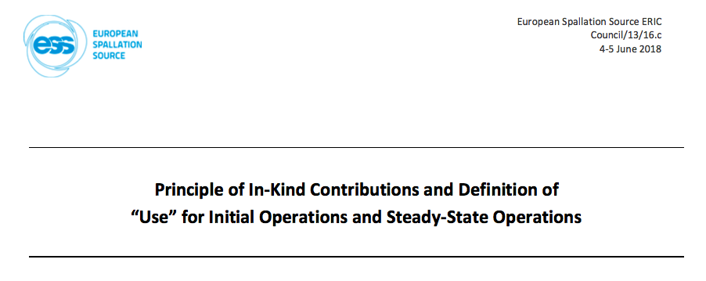
In-Kind in Operations
Principles presented to and approved by Council#15 – 19/02/2019

Slide 32
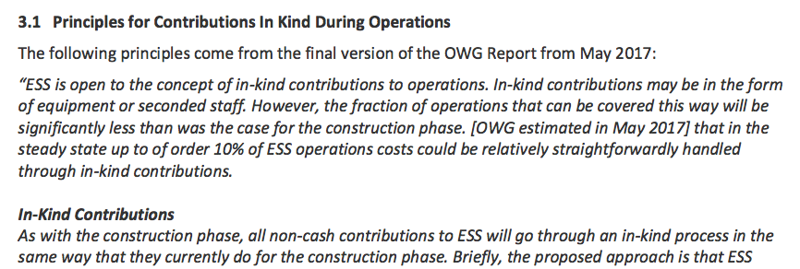
In-Kind in Operations
Principles presented to and approved by Council#15 – 19/02/2019

Slide 33
In-Kind Contributions @ ESS Facts & Figures

Slide 34
IK Status
Key Points
To date
242 M€ (85 TAs) approved by Council (including 19 accredited).
178 M € (53 TAs) endorsed by IKRC.
Almost all IK for Accelerator, ICS and Target is approved by Council or endorsed by IKRC.
2015
2017
Ongoing
126 M€ to be agreed for NSS – mostly Instruments (Sample Environment + Neutron Technologies)
Agree 3 remaining IKCAs; STFC (UK), ESS Bilbao (ES) and CNR (IT).
Following 15th Council approval of IK Principles, next step is to establish Procedures for IK Contributions during Operations
End of ESS Construction
550 M€ estimated IK.
Additional c.28 M€ in collaborations (SE/DK) and c.13 M€ in direct contracts placed with German Institutes.

Slide 35
IK Status
Status of Agreements

Slide 36
Yearly progress of In-Kind

Slide 37
In-Kind Contributions @ ESS Conclusions

Slide 38
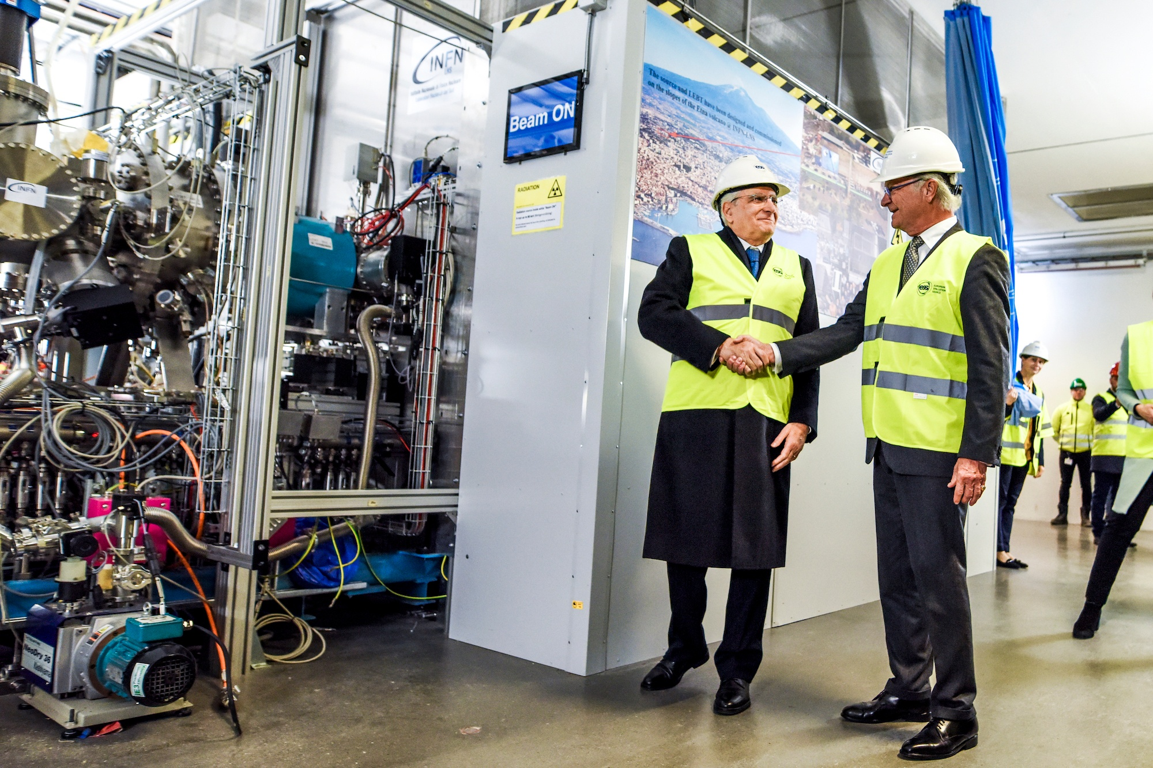
Conclusions
New management for and special focus to IK
Alignment of IK to implementation
IK during Operations being established
Specific issues to be solved (VAT, etc.)

Slide 39
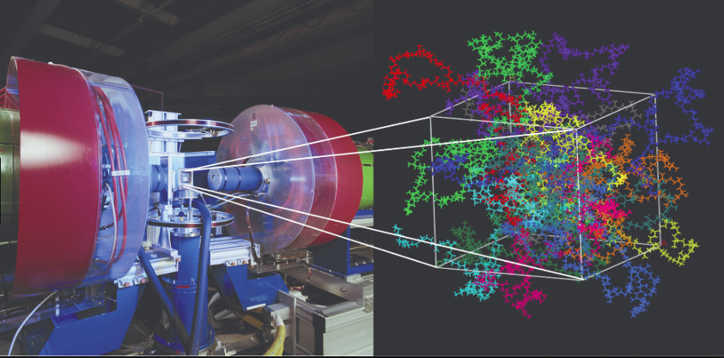
The commitment
ESS In-Kind System
is fully committed to achieve
FIRST SCIENCE in 2023

Slide 40
Thank you!
Mauro.Zambelli@esss.se

