Slide 1
European Spallation Source
Equipment Certification
Mattias Skafar
Head of Quality Division
European Spallation Source ERIC
2019-10-14

Slide 2
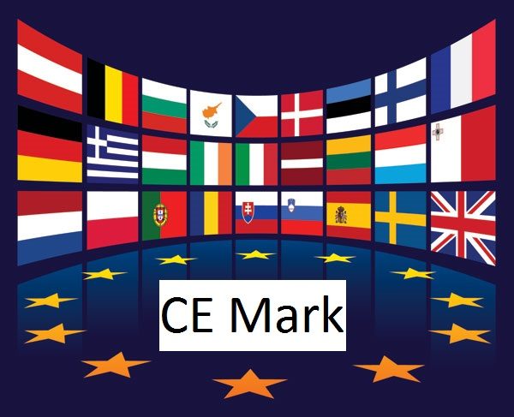
Equipment Certification at ESS
Agenda
What is CE marking
How is it performed
Benefits and Challenges with CE

Slide 3
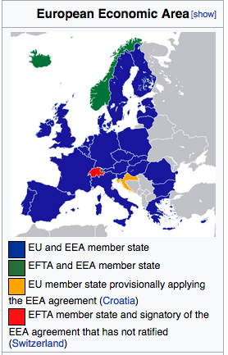
CE Marking
Purpose and Meaning
“There are two main benefits CE marking brings to
businesses and consumers within the EEA*:
Businesses know that products bearing the
CE marking can be traded in the EEA without restrictions.
Consumers(users) enjoy the same level of health, safety, and environmental protection throughout the entire EEA.
CE marking also supports fair competition by holding all
companies accountable to the same rules.
*EEA – European Economic Area

Slide 4
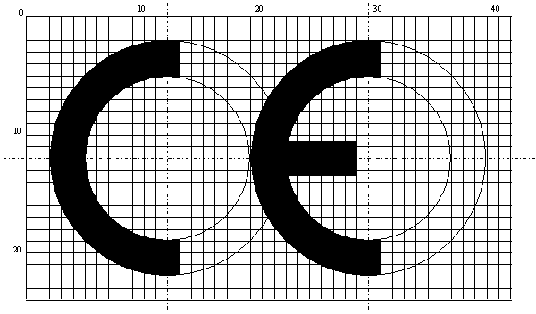
CE Marking
Manufacturers Process
Manufacturers are responsible for checking
that their products meet EU safety, health and
environmental protection requirements.
By affixing the CE marking to a product, a manufacturer declares* that the product meets all the legal requirements for CE marking and can be sold throughout the EEA. This also applies to products made in other countries that are sold in the EEA.”
*Note: In most cases performed as an self assessment, only notified body for equipment with specific requirements

Slide 5
CE Marking
Legal requirements
... the product meets all the legal requirements for CE marking ...
The product complies with all applicable EU directives!
Active implantable medical devices
Measuring instruments
Pyrotechnics
Very diverse directives…
Medical devices
Personal protective equipment
Explosives for civil uses
Low voltage
In vitro diagnostic medical devices
Construction products
Equipment and protective systems intended for use potentially explosive atmospheres
Non-automatic weighing instruments
Eco-design of energy related products
Electromagnetic compatibility
Low voltage
Noise emission in the environment
Appliances burning gaseous fuels
Machinery
Electromagnetic compatibility
Simple pressure vessels
Hot-water boilers
Restriction of Hazardous Substances in Electrical and Electronic Equipment
Restriction of Hazardous Substances in Electrical and Electronic Equipment
Pressure equipment
ATEX
Recreational craft
Lifts
Safety of toys
Radio equipment
Cableway installations designed to carry persons
Machinery
ATEX – ATmosphères EXplosives.

Slide 6
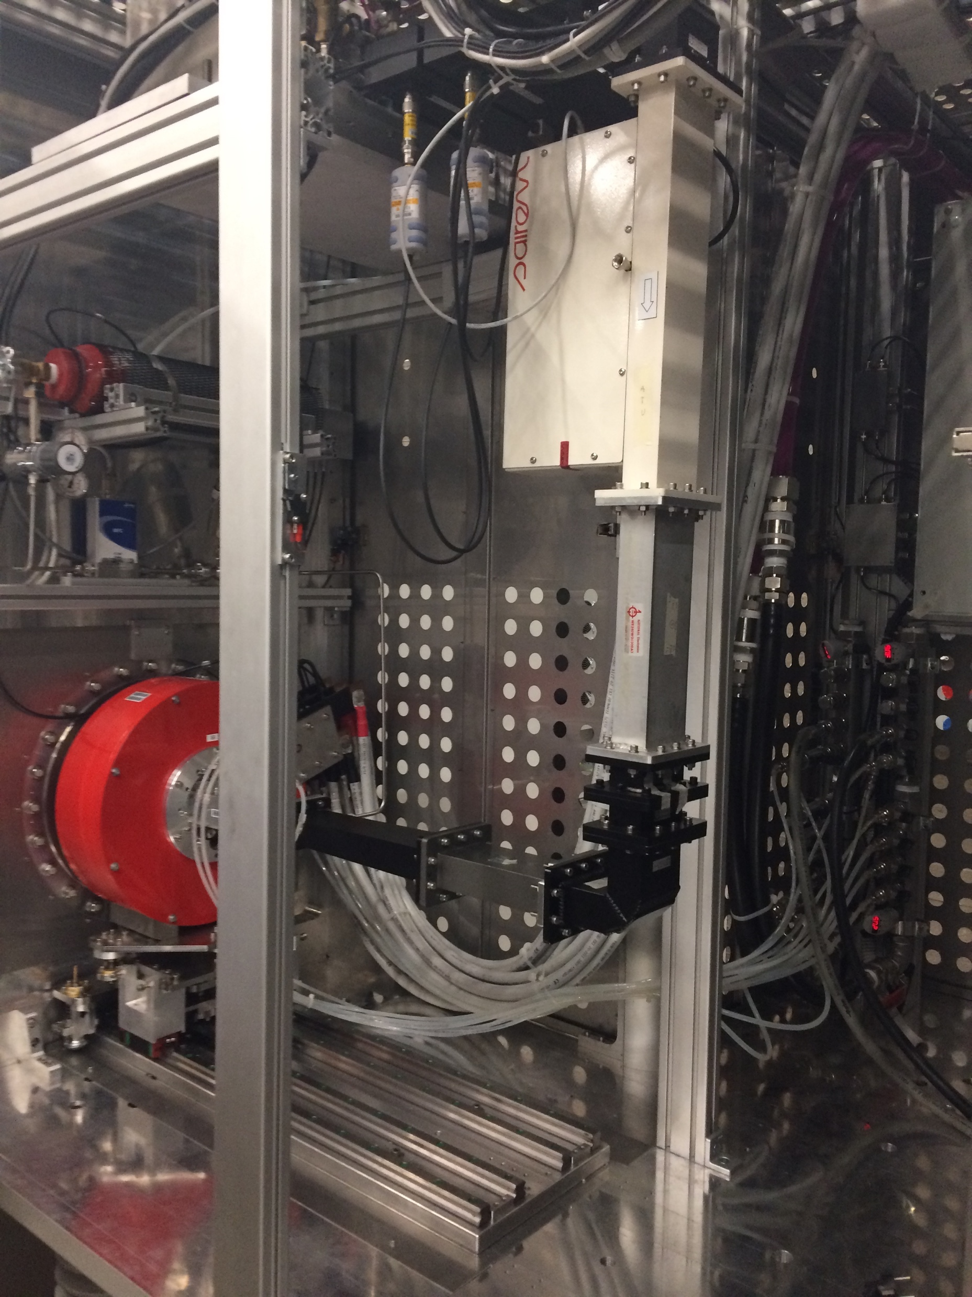
ESS Strategy for CE Marking
Approved by DG and ESS Management Team
The Strategy (ESS-0103087) applies to:
  Internal deliverables
  Commercial contracts
  In-Kind Contributions
CE marking is mandatory.
  when there is an applicable European Directive.
It states that deliveries shall include:
  Risk assessment (preferably according to ISO 12100)
  Technical File, drawings, wiring diagram, P&ID, etc.
  Operations Manual, in English
  Declaration of Conformity
Ion Source INFN - LNS

Slide 7
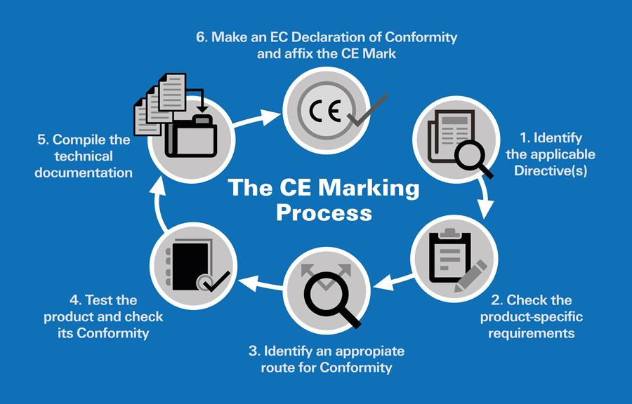
The CE Marking process
Six steps to compliance

Slide 8


Example for Machinery
1. Identify applicable Directives
Is CE marking necessary?
  In some cases CE marking is not required, or even forbidden.
  No applicable directives no CE marking
What Directive(s) applies?
  Identify the scope
    read definitions
    ask fundamental questions
  Identify the applicable directive(s)
  Identify related Harmonised standards.
Machinery Directive 2006/42/EC

Slide 9
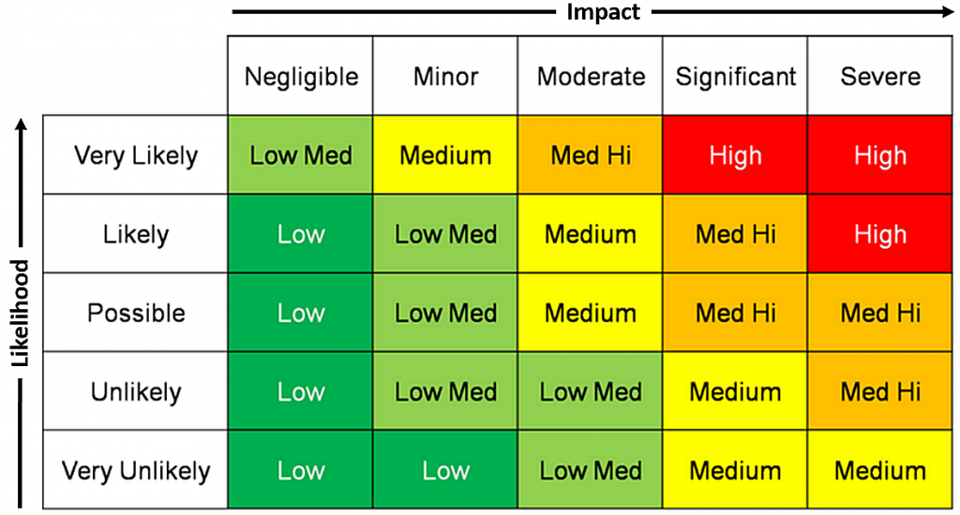
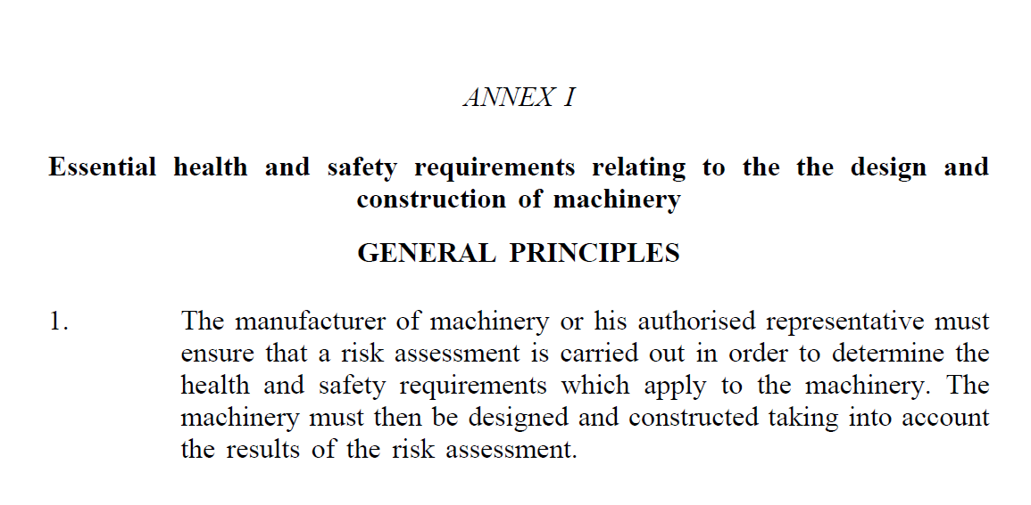

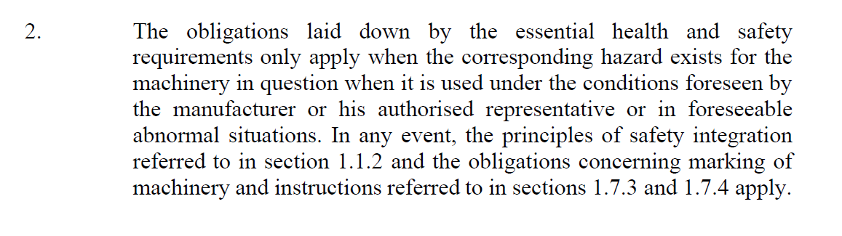
Example for Machinery
2. Specific requirements (based on risks)
Primary requirement: carry out risk assessment and design and build ‘machine’ accordingly
Rest of Annex I: Guidance for RA and a long list of things to consider…

Slide 10
Example for Machinery
Essential safety and health requirements, Annex 1
Section | Topic / Requirement | Applicable / Not applicable / Fulfilled by…
1.1 | General Remarks
1.1.1 | Definitions
1.1.2 | Principles of safety integration
1.1.3 | Materials and products
1.1.4 | Lighting
1.1.5 | Design of machinery to facilitate its handling
1.1.6 | Ergonomics
1.1.7 | Operating positions
1.1.8 | Seating
1.2 | Control Systems
1.2.1 | Safety and reliability of control systems
1.2.2 | Control devices
1.2.3 | Starting
1.2.4 | Stopping
1.2.5 | Selection of control or operating modes
1.2.6 | Failure of the power supply
1.3 | Protection against mechanical hazards
1.3.1 | Risk of loss of stability
1.3.2 | Risk of break-up during operation
1.3.3 | Risks due to falling or ejected objects
1.3.4 | Risk due to surfaces, edges or angles
1.3.5 | Risks related to combined machinery
1.3.6 | Risks related to variations in operating conditions
1.3.7 | Risks related to moving parts
1.3.8 | Choice of protection against risks arising from moving parts
1.3.9 | Risks of uncontrolled movement
1.4 | Required characteristics of guards and protective devices
Section | Topic / Requirement | Applicable / Not applicable / Fulfilled by…
1.5 | Risk due to other hazards
1.5.1 | Electricity supply
1.5.2 | Static electricity
1.5.3 | Energy supply other than electricity
1.5.4 | Errors of fitting
1.5.5 | Extreme temperatures
1.5.6 | Fire
1.5.7 | Explosion
1.5.8 | Noise
1.5.9 | Vibrations
1.5.10 | Radiation
1.5.11 | External radiation
1.5.12 | Laser radiation
1.5.13 | Emissions of hazardous materials and substances
1.5.14 | Risk of being trapped in a machine
1.5.15 | Risk of slipping, tripping, falling
1.5.16 | Lightning
1.6 | Maintenance
1.6.1 | Machinery maintenance
1.6.2 | Access to operating positions and servicing points
1.6.3 | Isolation of energy sources
1.6.4 | Operator intervention
1.6.5 | Cleaning of internal parts
1.7 | Information
1.7.1 | Information and warnings on the machinery
1.7.2 | Warning of residual risks
1.7.3 | Marking of machinery
1.7.4 | Instructions
Example areas:
Control system
Protection against Mechanical Hazards
Guards and protective devices
Risks due to other hazards (el, fire etc.)
Maintenance
Information
For each applicable requirement of Annex I, declare how you are fulfilling it, e.g.:
by using a harmonized standard
by using any other standard
by applying any specific solution fulfilling the state of the art

Slide 11

Example for Machinery
3. Rout to conformity
In rare cases a notified body needs to be brought in to act as a third party (see chapter 2 and Annex IV in MD (2006/42/EC))
Obvious dangerous equipment
A typical case would be under Pressure Directive in certain classes
ISO 9001 certified companies
Most CE marking is done as self assessment

Slide 12
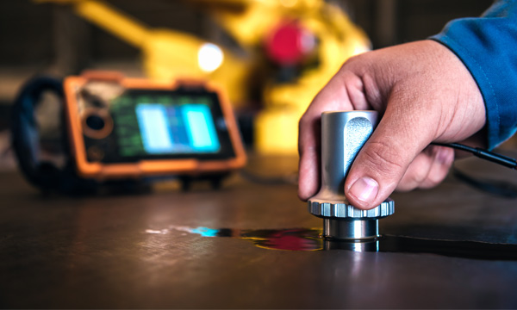
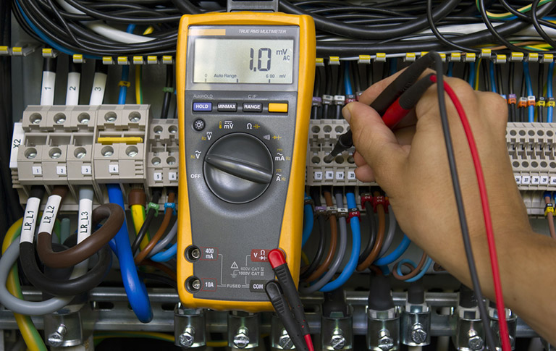

Example for Machinery
4. Test to verify conformity
Test according to agreed test and inspection plan
Functional tests (FAT/SAT)
High voltage test
Non Destructive Testing
  X-ray, Penetrant testing etc.
Measurements
  Electrical, physical, Electro Magnetic Conductivity
Pressure test with fluids or gas

Slide 13

Example for Machinery
5. Compile the Technical Documentation – Technical File
Compile technical documentation
  The technical file contains all documentation needed for the Declaration.
  Drawings, wiring diagrams, inspection plan, test reports
  This is the technical documentation needed in most cases anyway

Slide 14
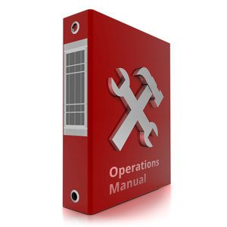

ESS approach – step by step to compliance
Instructions – Operations & Maintenance Manual
Operations & Maintenance Manual
  Directives gives clear guidance on how t write
  First issue needs to be released before a DoC is signed. Living document.
  All official documentation shall be written in English (will be translated to Swedish if needed)
  Fines from Work authority for not having manuals

Slide 15

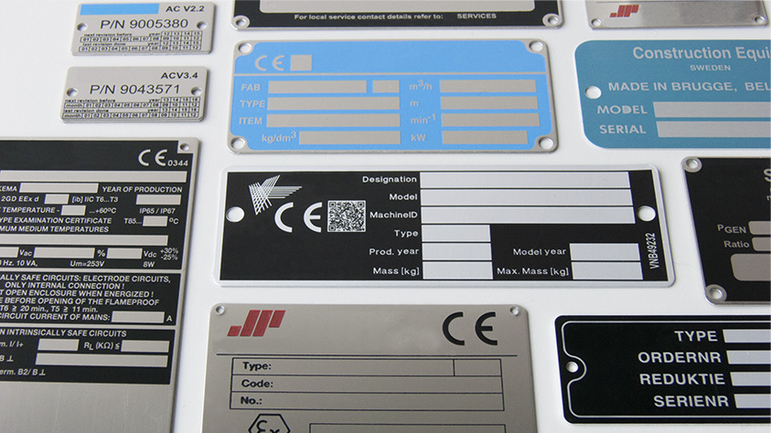
Example for Machinery
6. Issue Declaration of Conformity
Produce a Declaration of Conformity(DoC)
  Produce a DoC according to applicable directive(s)
  DoC needs to be signed by a person appointed by Highest Manager or him/herself
Produce and affix the CE-sign
  CE-Sign needs to be produced according to applicable directive(s)
  CE-sign needs to be permanently affixed to the equipment,
  In cases of Machinery, blind rivet is preferred.

Slide 16
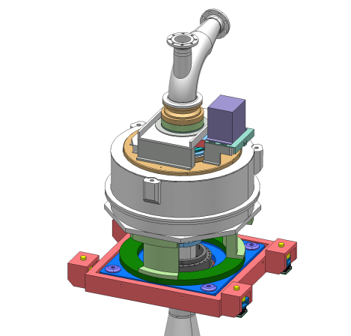
How is CE marking performed
Example
Type of delivery:
  In house design
  In-kind Contribution
  External provider
  Of the shelf, CE marked
Declaration of Conformity*
ESS/IKC
Declaration of Conformity*
Declaration of Conformity*
Partner institute
Supplier
* Declaration of Conformity for part of machine (to be incorporated) or a complete machine

Slide 17
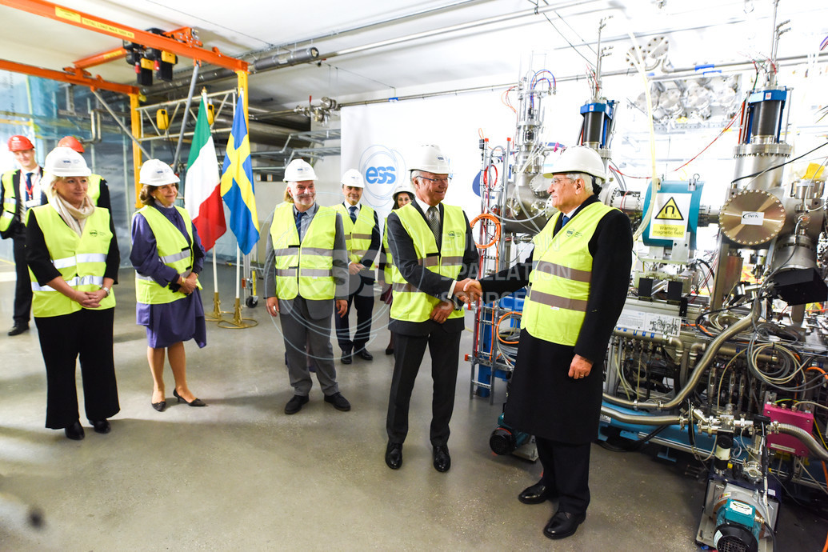
ESS CE marking project
Performed:
Ion Source & LEBT
Stub lift – Acc.
Ongoing:
Lifting device for Waveguides – Acc.
RFQ – Acc.
70 ton sliding shielding door – TS2
Welding robot – NSS
Spider cage – NSS
Etc…
Italian President and Swedish King inaugurates the ion source during the Italian State visit to Sweden.

Slide 18

Result
Ion Source and LEBT
Updated general risk assessment after delivery and assembly at site
High voltage test performed (1,2 times working load)
Improved EMC shielding
Improved grounding
Risk assessment with specific focus on ATEX*
ATEX zones defined and established
Hydrogen bottle moved to zone
Re-design of Hydrogen piping
Installation of permanent Hydrogen alarm
Issuing of Hydrogen bottle exchange procedure
ATEX – ATmosphères EXplosives.

Slide 19
Challenges and Benefits with CE marking
Challenges
ESS has a multitude of interfaces
  Both internal and external (and a mix)
ESS has a very large proportion of In-kind deliverables
Sometimes unclear who has the overall responsibility in deliveries
The CE marking approach is still not obvious in the Research community
Benefits
Equipment is made as safe as possible – by the manufacturer
Remaining risks are known and exposed to user
Documentation (Technical file) is compiled and easily accessible
Compliant to European Directives – if anything happens

Slide 20
Conclusion
CE marking is very useful in projects with many interfaces
  Everybody takes responsibility for their deliverable
  Easier for the receiving party to get and overall picture
  Better structure on technical documentation
Six steps to follow
Benefits:
  Early identified risks can be mitigated already in the design
  Manufacturer owns its own risks
  Many of the task that will be done anyway is done with a clear
  structure
  Compliant to relevant directives
  Higher safety, availability and maintainability

Slide 21

Thank YOU for your time!

