Slide 1
ECMC Open Source Motion Control
Based on the Etherlab open source EtherCAT master (www.etherlab.org)
Anders Sandström
ESS Motion Control and Automation Group
www.europeanspallationsource.se

Slide 2
Outline
What is ECMC
EtherCAT Overview
ECMC Basic Features:
  Architecture
  Hardware Configuration Tree
  Axis, Trajectory, Monitor, Controller, Drive, Encoder
  Data links
  Configurations
ECMC Advanced Features:
  PLC:s
  Synchronization
  ECMC and EtherCAT data access
  Commands from EPICS records
  Motion Interlocks
  Distributed Clocks
Acknowledgments
2

Slide 3
ECMC: EtherCAT Motion Control
ECMC is an open source motion control module for EPICS environment:
General functionalities:
  All data accessible in EPICS PVs:
    Motion
    EtherCAT
    ECMC System status
  => Acquisition and control from EPICS possible
  PLC functionalities in ECMC by scriptable language:
    General I/O (Several libs available)
    Motion control possible (motion library)
  SDO (Settings in EtherCAT slaves)
  Oversampling terminals (analogue <=100kHz, digital <=1Mhz)
Motion (with EPICS Motor Record support):
  Positioning (absolute, relative)
  Constant speed
  Referencing sequences
  Limits, softlimits
Motion (extension to Motor Record)
  Synchronization axis to axis
  Synchronisation to external source (timing system)
  Motion interlocks
  Triggering, latching positions
3
Notes:
Will focus on the talk on motion functionalities
3

Slide 4
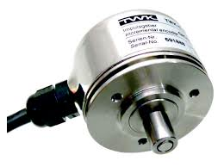
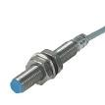
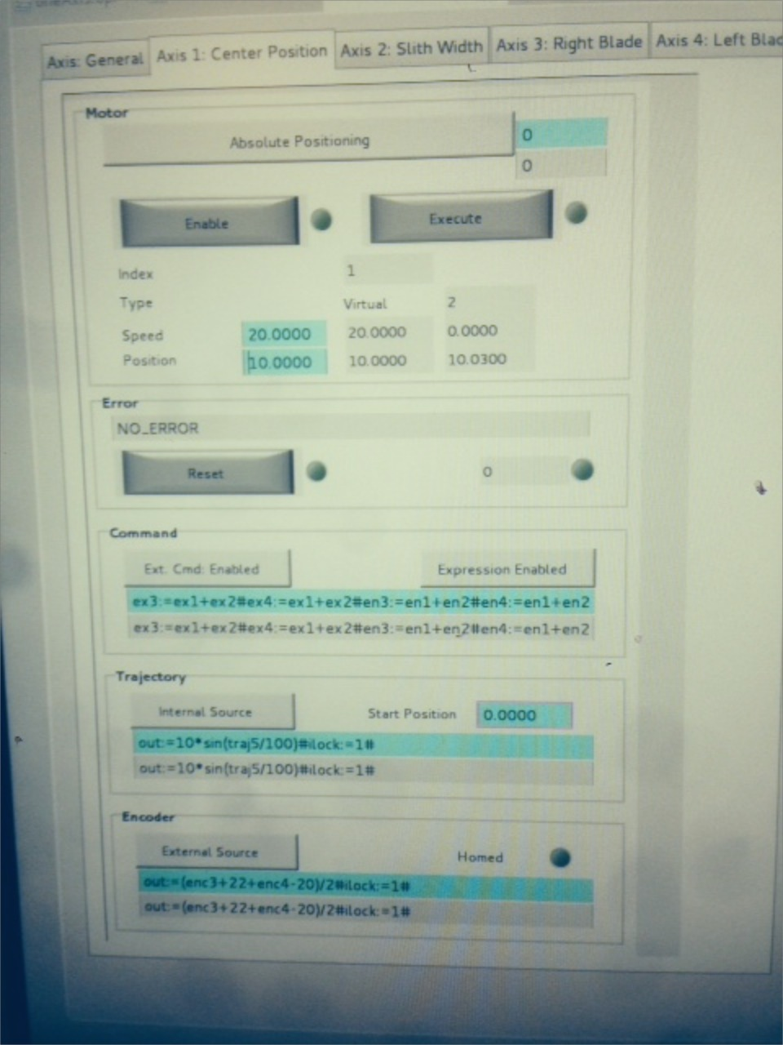
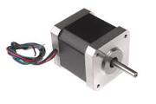
Motion: Overview
Electronics
Mechanics

Slide 5
Motion: Control Loops
Current Control Loop:
  Needed for both open and closed loop setups (however depends on actuator)
  Functionality depends on motor type (phase shift output for commutation)
  Current is related to torque via the motor K_{T} constant for rotary motors or to a force for linear motors.
  Common sample rate range: 10-50kHz
  Type: PI controller (maybe filters, observer)
Velocity Control Loop:
  Needed for closed loop, sometimes used for open loop (frequency control)
  Common sample rate range: 1-10kHz
  Type: PI controller
Position Control Loop:
  Needed for closed loop, sometimes used for open loop (for consistency)
  Common sample rate range100-5kHz
  Type: P or PI controller (if P the stationary error will be handled by velocity PI)
Notes:
Normally in a motion system you have these control loops.

Slide 6
Motion: Control Loops cont.
Position Control
Speed Control
Current Control
O_{Position}
SP_{Speed} =FF_{Speed}
FF_{I}
+
+
+
+
+
+
SP_{Position}
P(ID)_{Position}
PI(D)_{Speed}
PI(D)_{I}
Process
-
-
PV_{Speed}
PV_{Position}
SP_{Position} Position setpoint
O_{Position} Position offset
PV_{Position} Actual position
SP_{Speed} Speed Setpoint
FF_{speed} Speed feed forward
PV_{Speed} Actual speed
Mech., motor, feedback
Notes:
Cascaded loops

Slide 7
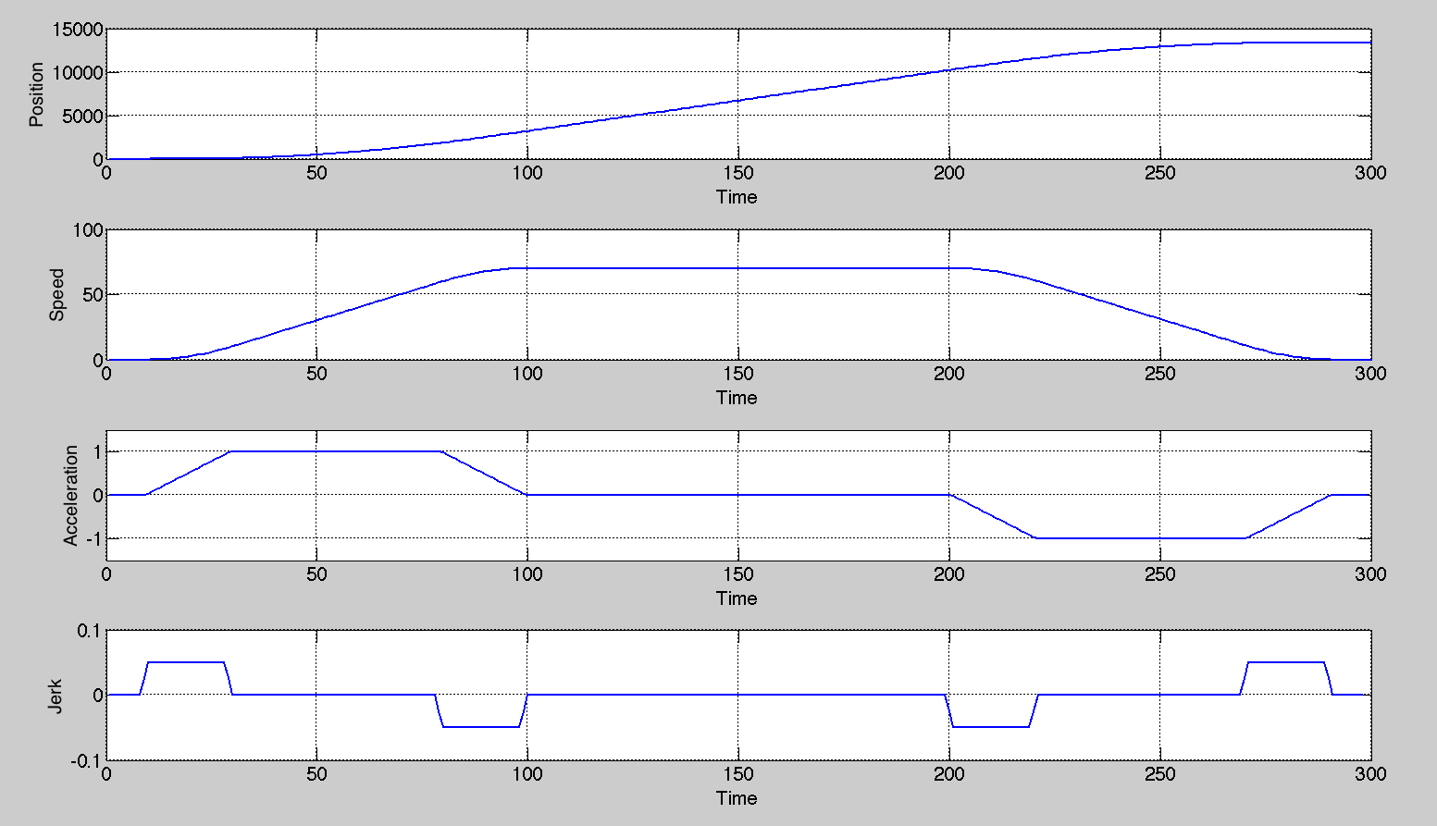
Motion: Feed Forward and Trajectory
Already known changes can be fed forward. The error for the controller to handle will be less. Scaling of velocity feed forward is made by setting the drive scale parameters.
P(ID)_{Position}
+
PI(D)_{Speed}
+
PI(D)_{I (torque)}
Process
Notes:
Important for good tracking (small following error)
Picture show trajectory in position, veloccity, acc, jerk
Since this is the setoiunts ofcource this information is valuable and should be fed forward. Different for different drives. However the top one is most imortant and can be used for most drives.

Slide 8
Motion: Feed Forward
Target position
Already known changes can be fed forward to increase performance.
➔The error for the controller to handle will be smaller.
Actual position
Trajectory generator set-point
Position Controller output
Feed Forward output (to speed PID)
No Feed Forward
Feed Forward
Feed Forward handles
main part of the control
Position / Output
Position / Output
Position controller
only handles small
deviations
Time
8
Time
Notes:
Trajectory in order to guide motion.
Since we know the trajectiry we can also feedforward the velocity (differentiation of position)
Main part will be handles by ff but the world is not ideal so the position controller is needed to handle small error.

Slide 9


EtherCAT: Control Loop Execution Options
CSP-Mode
Cyclic Sync. Position
CSV-Mode
Cyclic Sync. Velocity
CST-Mode
Cyclic Sync. Torque
- Trajectory gen.
- No control
-Trajectory gen.
-Position cont.
-Trajectory gen.
-Position cont.
-Velocity cont.
Act. position
Position setp.
Act. position
Velocity setp.
Act. position
Torque setp.
Amplifier
Level
Control:
Pos.
Velo.
Torque
Control:
Velo.
Torque
Control:
Torque
Controller: No loops needed
Drive: All control loops
Controller: Position loop
Drive: Velocity and current loop
Controller: Position, velocity loop
Drive: Current loop
Notes:
With EtherCAT hardware it looks like this..
VELOCITY MODE is what we use right now. This can change..
Why velocity? Very generic. Feedback from different terminals.
Also position interface.. Where traj is made in card! Good for open loop..

Slide 10
ECMC: EtherCAT Overview
EtherCAT = Ethernet for Control Automation Technology
Open fieldbus standard originally developed by Beckhoff GmbH
Maintained by EtherCAT Technology Group (www.EtherCAT.org).
Hardware requirements:
  Master: standard computer hardware (NIC)
  Slaves: dedicated hardware, EtherCAT Slave Controller (ESC)
Masters: Several commercial and open source masters available
Slaves: Several 100 manufacturers of slaves (drives, I/O, sensors, robots)
Topologies: Line, Star, Ring
Media: Cat 5 cable, plastic fiber, glass fiber
Supports Distributed Clock (DC) in slaves
Bandwidth utilization: 80%-97% (100 Mbit/s , Ethernet, Full-Duplex)
Applications: Motion, large or long distance systems, synchronized systems
Cycle times > 50μs (ECMC 1ms)
Notes:
Abbrevation
General
Released 2004 (stable standard from the beginning=> hardware from 2004 is still compliant)
Opened up and maintained by EtherCat Technology Group (www.ethercat.org)
10 year old standard
Commercial and open source masters:
Commercial: Beckhoff, ABB, Aerotech, Vipa, Omron (at least 100 suppliers)
Open Source: EtherLab, SOEM (Simple Open EtherCat Master)
Topoligies:
Line
Star (hot swap fuctionality of slaves)
Ring (for redundancy).
Typical Applications:
Motion (real-time, synchronization, robotics)
Large systems (theoretical max 65535 slaves)
Systems with high demands of speeds and reaction times (compared to other PLC systems).
Cycle times > 50micro sec (default in most masters is 1ms )
Comment time to transfer at 100mbit one frame 1500b rougly 100micro sec
NIC= Network interface cards
Time-Sensitive Networking
AVB
10

Slide 11
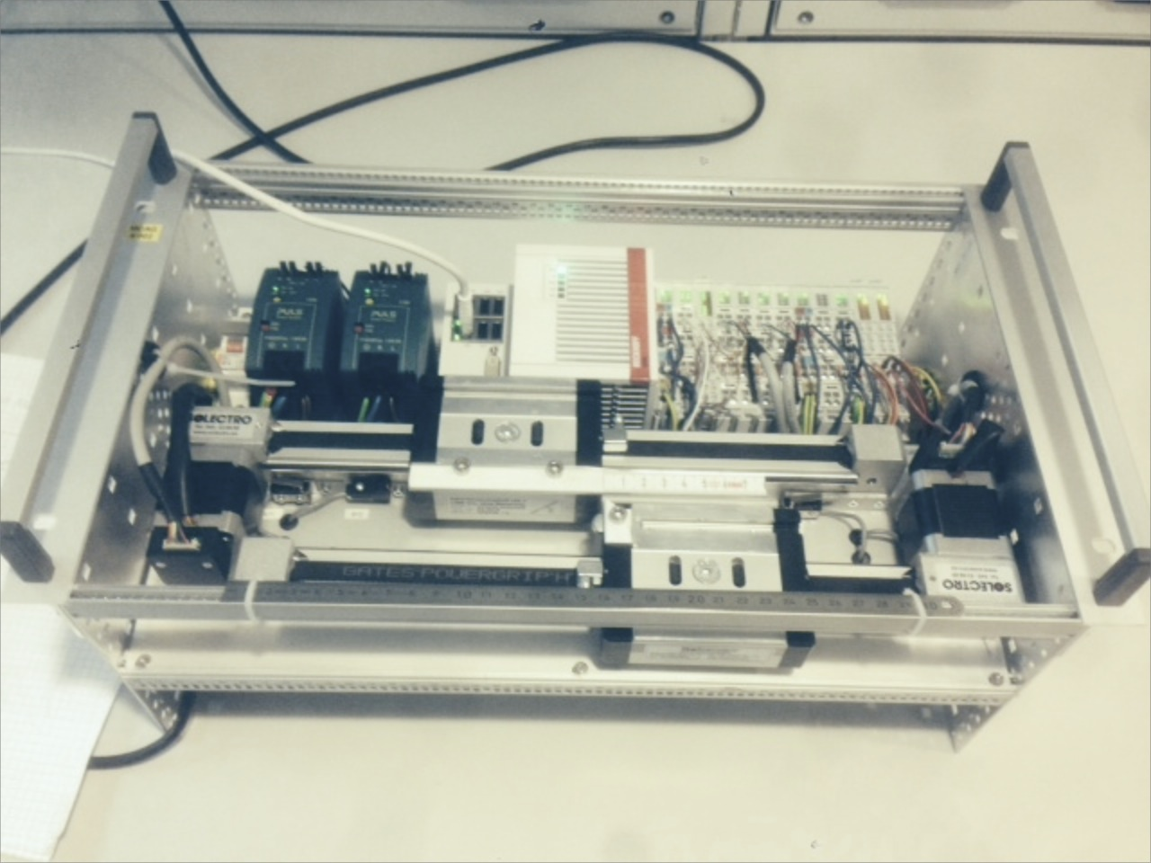



ECMC: Overview
HMI (CSS, BOB)
PV Access
Linux Controller (Centos)
EPICS IOC
asynPortDriver
Motion Control
(ECMC)
Igh open source EtherCAT master
(www.etherlab.org)
EtherCAT
EtherCAT Terminals
EtherCAT Terminals
EtherCAT Drive
Analog
Analog
Drive
Digital
XXXX
Drive
Digital
XXXX
11
Notes:
This slide shows an overview of our current system architecture.
The Motion Control algorithms then links to the open source EtherCAT master from Etherlab.
The EtherCAT master is used for configuring the ethercat bus and sending/reciving data from EtherCAT slaves. Typical slaves could be drives (stepper BLCD, pulse direction, analog or digital data)
All softwares in the controller is open source EPCIS, drivers, ECMC and etherlab.

Slide 12
ECMC: Architecture
Linux Controller
Iocsh conf. cmd:
“ecmcConfigOrDie()”
EPICS motor records
EPICS records
EthercatMC
Motor model 3 drv.
asynPortDriver
Interfaces
asynoctet
asynint32
asynfloat64
asynarrayxxx
command parser
ECMC Core
Real Time Thread (1kHz)
Axis 1
Axis 2
Axis n
PLC 1
PLC n
EtherCAT process image
EtherCAT master / User space
EtherCAT
Kernel
12
Notes:
Slide shows ECMC architecture.
ECMC is integrated into EPICS using asynportdriver base class which is part if the asyn framework.
Configuration is made through the ioc shell command ecmcConfiOrDie(). This command I communicating to ecmc through the asyn octet if which forwards the commands to a command parser. The command parser then reads/writes the setting according to the current command.
Motor record is also using the asynoctet interface and command parser.
All other EPICS record types are communicating to ecmc through the standard dedicated asyn interfaces for the different data types (also arrays and I/O intr).
ECMC holds a copy of the current process image to where the axis-and plc objects and epicsrecords can read and write to.
The process image is updated (read and write) through a user space interface supplied by the etherlab master.

Slide 13
ECMC: Real Time Thread Execution
Sleep (next ms)
EtherCAT
Read from EC
Axis PLC 1
Axis 1
Axis PLC 2
Motion
Axis 2
Axis PLC n
Axis n
PLC 1
PLC 2
General PLC
PLC n
EtherCAT
Write to EC

Slide 14
ECMC: Axis object
“Cfg.CreateAxis(…)”
Axis
Types: Normal / Virtual
Encoder
Trajectory
PID-Control
Monitor
Drive
Normal, Virtual
Normal, Virtual
Normal
Normal, Virtual
Normal
Optional Axis PLC for syncronization / control (executed in sync with axis object)
ECPdoEntry
Axis object executes and links objects:
  Encoder
  Trajectory Generation
  PID-Controller
  Monitor
  Drive
Sequences
  Homing (different types)
ECPdoEntry
ECPdoEntry
ECPdoEntry
ECPdoEntry
ECPdoEntry
ECPdoEntry
ECPdoEntry
ECPdoEntry
EC master
EC master
EC master
14
Notes:
Like I said, the axis object links and executes certain other objects like Encoder, trajectory, PID-control, monitor and Drive.
The encoder typically links to an analog input value from a slave. Could be an encoder, analog input or any input.
The Trajectory object generates trajectory setpoints for the motion.
The PID- controller controls based on the error between the trajectory generated setpoint and the actual value from the encoder object.
The monitor object monitors the motion and the drive links to an output value of a slave. Could be a stepper module or analogoutput, pulse direction.
Different versions of axis object have been implemented: Normal, Virtual, Encoder, Trajectory.
Each axis also have a dedicated PLC object allocated that could be used for synchronizations and other tasks. Will talk later about that..

Slide 15
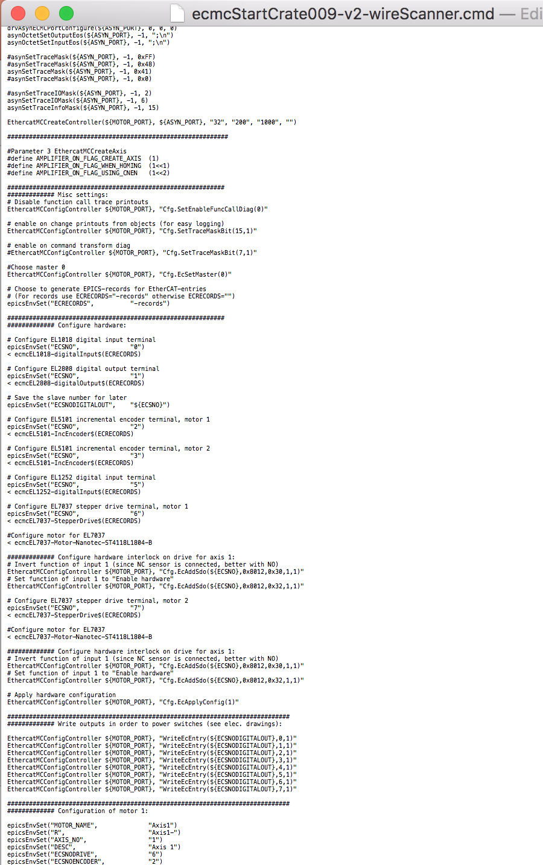
ECMC: Configuration
All configuration in EPICS startup file:
ECMC configurations
(speed, acceleration…..)
Terminal configurations
(Service Data Object access:
max current, mode…)

Slide 16
ECMC: Configuration cont.
Configuration iocsh command:
ecmcConfigOrDie “command” : Exits if return code !=0
ecmcConfig “command” : Accepts return codes !=0
Returns: 0 for success or otherwise error code.
Example 1: Create Axis 1 object:
ecmcConfigOrDie ”Cfg.CreateDefaultAxis(1)”
Example 2: Set position controller gain for axis 1 to 0.1
ecmcConfigOrDie ”Cfg.SetAxisCntrlKp(1,0.1)”
Example 3: Read max current of EL7041 drive at bus position 1:
ecmcConfig ”EcReadSdo(1,0x8010,0x1)”
16
Notes:
Later also CCDB

Slide 17
Terminal Configurations (SDO)
Access to terminal specific settings is over SDO access:
EcAddSdo() write and verify SDO (Written at transition PREOP->OP)
EcWriteSdo() write directly SDO (Only in PREOP)
EcReadSdo() read directly SDO (Only in PREOP)
“Cfg.EcAddSdo( slaveBusPosition, // Slave position on EtherCAT bus
sdoIndex, // Sdo index address (see manual for terminal)
sdoSubIndex, // Sdo sub index address (see manual for terminal)
value, // value to write
byteSize // number of bytes to write
)”
Example 1: Set maximum current to 1000mA on EL7037 (slave 6):
ecmcConfigOrDie "Cfg.EcAddSdo(6,0x8010,0x1,1000,2)”
17
Notes:
ater also CCDB

Slide 18
ECMC: Configuration with ecmccfg
Configuration is made by adding commands to the ioc startup file.
In order to simplify, a configuration framework called ecmccfg have been developed (originally at PSI):
  Main repo: https://github.com/paulscherrerinstitute/ecmccfg
  Local fork: https://github.com/icshwi/ecmccfg.
ecmccfg contains:
  Hardware configuration files for:
    EtherCAT slaves
    Motors, encoders, and sensors
  Default database files
  Extensive set of examples for different hardware's and applications
ecmccfg will be presented in detail in a separate presentation by Niko
18

Slide 19
Part 2 Advanced
Based on the Etherlab open source EtherCAT master (www.etherlab.org)
Anders Sandström
ESS Motion Control and Automation Group
www.europeanspallationsource.se

Slide 20
Outline
PLC:s
Synchronization
ECMC and EtherCAT data access
Commands from EPICS records
Motion Interlocks
Distributed Clocks
20

Slide 21
PLCs
PLC functionality can be added by PLC objects
PLC source files can be transferred and executed in the PLC object. Syntax based on exprtk parser (however extended with many additional features)
PLC objects can execute in custom frequencies.
Accessible Variables:
  EtherCAT pdo entries: ec<id>.s<id>.alias: ec0.s1.POSITION
  Motion data: ax<id>.<obj>.<data> ax1.enc.actpos
  PLC variables: plc<id>.<data> plc0.error
  Local variables: var <any name> var errorCode
  Static variables: static.<any name> static.cycleCounter
  Global variables: global.<any name> global.scaleFactor
Accessible functions:
  Expr tk functions: math (sin,cos,ln,…), println,…., see exprtk readme
  MC Lib: Motion functions
  DS Lib: Access to data storages (buffers)
  EC Lib: Bit functions and ec status
Macros can be used in source files (if ecmccfg is used, same syntax as iocsh macros):
  Example: $(DBG=“#”), $(AXIS_ID=“1”) , ${PLC_ID=“1”}
Execution flow:
Read from EC
Axis PLC 1
Axis 1
Axis PLC 2
Axis 2
Axis PLC n
Axis n
PLC 1
PLC 2
PLC n
Write to EC
21

Slide 22
PLCs: Simple Example Code:
if(plc0.firstscan){ # Initiations
plc3.enable:=0; # Block other plc
ax1.blockcom:=1; # Block Epics Communication for axis 1
$(DBG=”#”)println('Startup seq. PLC0 starting!’); # Print Diagnostics if DBG is set to””
};
var blink_cycles:=1/plc0.scantime; # Local variable (losses value between cycles)
var warning_light:=ec0.s2.OUPIN_4.0;
ec0.s2.BO_8:=ec0.s1.BI_1 and ax1.enc.actpos>0; # Set output
static.counter+=1; # Static variable (keeps value between cycles)
if(static.counter>=blink_cycles)
{
warning_light:=not(warning_light);
static.counter:=0;
plc0.error:=123; # PLC error code
};
global.test:=warning_light; # global.test is accessible in all PLC objects
ec0.s2.BO_4.0:= warning_light; # Output will flash in 1Hz
# This is a comment
return [] # Returns
$(DBG=”#”)println(‘Never here!!!’); # Will never execute since return before
22

Slide 23
PLCs: Variables
1. static.<varname> Static variable. Initiated to 0. (rw)
Access only in the PLC where defined.
Will keep value between execution loops.
Example: static.cycleCounter+=1; # Add one each execution
2. global.<varname> Global variable. Initiated to 0. (rw)
Access from all PLCs.
Will keep value between execution loops.
Example: global.enableAll:=1; # Global var set to 1
3. var <varname> Local variable (exprtk syntax) (rw)
Will NOT keep value between execution loops.
Example: var errorCode:=100; # Local var set to 100
23

Slide 24
PLCs: PLC
PLC variables:
1. plc<id>.enable plc enable (rw)
(end exe with "plc<id>.enable:=0"
Could be usefull for startup sequences)
2. plc<id>.error plc error (rw)
Will be forwarded to user as controller error.
3. plc<id>.scantime plc sample time in seconds (ro)
4. plc<id>.firstscan true during first plc scan only (ro)
usefull for initiations of variables
Example: plc1.enable:=0; Disable PLC 1 (stop execution)
24

Slide 25
PLCs: EtherCAT
Direct access to ethercat data
1. ec<mid>.s<sid>.<alias> ethetcat data (rw)
mid: ethercat master index
sid: ethercat slave bus position
alias: entry name as defined in "Cfg.EcAddEntryComplete()
Example: ec0.s1.POSITION:=100; # Set ethercat value to 100;
Function Lib: EC
1. retvalue := ec_set_bit(<value>, <bitindex>); Sets bit at bitindex position of value. Returns the new value.
2. retvalue := ec_wrt_bit(<value>, <wrtValue>,<bitindex>); Write ”wrtvalue” to bit at bitindex position of value. Returns the new value.
3. retvalue := ec_clr_bit(<value>, <bitindex>); Clears bit at bitindex position of value. Returns the new value.
4. retvalue := ec_flp_bit(<value>, <bitindex>); Flips bit at bitindex position of value. Returns the new value.
5. retvalue := ec_chk_bit(<value>, <bitindex>); Checks bit at bitindex position of value. Returns the value of bit.
6. retvalue := ec_get_err(): Returns error code from last lib call.
7. …. More availble….
Example: ec0.s2.CONTROL:=ec_wrt_bit(ec0.s2.CONTROL,1,5); # Write 1 to bit 5 of ”ec0.s2.CONTROL”
25

Slide 26
PLCs: Motion Variables
Variables (struct only refreshes one time per execution):
1. ax<id>.id axis id (ro)
2. ax<id>.reset reset axis error (rw)
3. ax<id>.counter execution counter (ro)
4. ax<id>.error error (ro)
5. ax<id>.enc.actpos actual position (ro), (rw if ax<id>. enc.source =1)
6. ax<id>.enc.actvel actual velocity (ro)
7. ax<id>.enc.rawpos actual raw position (ro)
8. ax<id>.enc.source internal source or expressions (ro)
source = 0: internal encoder
source > 0: actual pos from plc
9. ax<id>.enc.homed encoder homed (rw)
10. ax<id>.enc.homepos homing position (rw)
11. ax<id>.traj.setpos current trajectory setpoint (ro), (rw if ax<id>.traj.source =1)
12. ax<id>.traj.targetpos target position (rw)
13. ax<id>.traj.targetvel target velocity setpoint (rw)
14. ax<id>.traj.targetacc target acceleration setpoint (rw)
15. ax<id>.traj.targetdec target deceleration setpoint (rw)
16. ax<id>.traj.setvel current velocity setpoint (ro)
17. ax<id>.traj.setvelffraw feed forward raw velocity (ro)
18. ax<id>.traj.command command (rw)
command=1: move velocity
command=2: move rel. pos
command=3: move abs. pos
command=10: homing
19. ax<id>.traj.cmddata cmddata Homing procedure (rw)
only valid if ax<id>.traj.command=10
cmddata=1 : ref low limit
cmddata=2 : ref high limit
cmddata=3 : ref home sensor (via low limit)
cmddata=4 : ref home sensor (via high limit)
cmddata=5 : ref center of home sensor (via low limit)
cmddata=6 : ref center of home sensor (via high limit)
cmddata=15 : direct homing
cmddata=21 : ref partly abs. Encoder (via low limit). ref at abs bits over/under-flow..
cmddata=22 : ref partly abs. Encoder (via high limit). ref at abs bits over/under-flow..
26

Slide 27
PLCs: Motion Variables Cont.
20. ax<id>.traj.source internal source or expressions (ro)
source = 0: internal traj
source > 0: setpoints from plc
21. ax<id>.traj.execute execute motion command (rw)
22. ax<id>.traj.busy axis busy (ro)
23. ax<id>.traj.dir axis setpoint direction (ro)
ax<id>.traj.dir>0: forward
ax<id>.traj.dir<0: backward
ax<id>.traj.dir=0: standstill
24. ax<id>.cntrl.error actual controller error (ro)
25. ax<id>.cntrl.poserror actual position error (ro)
26. ax<id>.cntrl.output actual controller output (ro)
27. ax<id>.drv.setvelraw actual raw velocity setpoint (ro)
28. ax<id>.drv.enable enable drive command (rw)
29. ax<id>.drv.enabled drive enabled (ro)
30. ax<id>.seq.state sequence state (homing) (ro)
31. ax<id>.mon.ilock motion interlock (rw)
ax<id>.mon.ilock=1: motion allowed
ax<id>.mon.ilock=0: motion not allowed
32. ax<id>.mon.attarget axis at taget (ro)
33. ax<id>.mon.lowlim low limit switch (ro)
34. ax<id>.mon.highlim high limit switch (ro)
35. ax<id>.mon.homesensor home sensor (ro)
36. ax<id>.mon.lowsoftlim low soft limit (rw)
37. ax<id>.mon.highsoftlim high soft limit (rw)
38. ax<id>.mon.lowsoftlimenable low soft limit enable (rw)
39. ax<id>.mon.highsoftlimenable high soft limit enable (rw)
40. ax<id>.blockcom enables/disables "set" commands (rw)
via command parser (ascii commands)
Statuses can still be read.
Exceptions ("set"-commands) that will work:
- "StopMotion(axid)"
- "Cfg.SetAxisBlockCom(axid,block)"
27

Slide 28
PLCs: Motion Lib Functions
Function Lib: MC
1. retvalue := mc_move_abs(<axIndex>, <execute>, <pos>, <vel>, <acc>, <dec>); Absolute motion of axis.
Motion is triggerd with a positive edge on <execute> input.
returns 0 if success or error code.
2. retvalue := mc_move_rel(<axIndex>, <execute>, <pos>, <vel>, <acc>, <dec>); Relative motion of axis <axIndex>.
Motion is triggerd with a positive edge on <execute> input.
returns 0 if success or error code.
3. retvalue := mc_move_vel(<axIndex>, <execute>, <vel>, <acc>, <dec>); Constant velocity motion of axis <axIndex>.
Motion is triggerd with a positive edge on <execute> input.
returns 0 if success or error code.
4. retvalue := mc_home(<axIndex>, <execute>, <seqId>, <velTwoardsCam>, <velOffCam>); Perform a homing sequence of axis <axIndex>.
Motion is triggerd with a positive edge on <execute> input.
returns 0 if success or error code.
5. retvalue := mc_halt(<axIndex>, <execute>); Stop motion of axis <axIndex>.
returns 0 if success or error code.
6. retvalue := mc_power(<axIndex>, <enable>); Enable power of axis <axIndex>. returns 0 if success or error code.
7. retvalue := mc_get_busy(< axIndex >); returns busy state of axis <axisindex>
8. retvalue := mc_get_homed(<axIndex>); returns homed state of axis <axisindex>
9. retvalue = mc_get_err(); Returns error code for last lib call.
Example:
retvalue:=mc_power(2,1); # Set power on amplifier of axis 2
28

Slide 29
PLCs: General ECMC commands
Create a new PLC:
"Cfg.CreatePLC(<plcindex>,<rate_ms>)”
Load PLC code text file (and compile and enable):
"Cfg.LoadPLCFile(<plcIndex>,<filename>)"
Add code line by line:
"Cfg.AppendPLCExpr(<plcIndex>)= <code>”
Compile PLC code:
"Cfg.CompilePLC(<plcindex>)"
Enable/Disable PLC:
"Cfg.SetPLCEnable(<plcindex>,<enable>)"
29

Slide 30
PLCs: Motion Example Code:
if(static.seqStep==1) # State 1. Put power on axis (run mc_power())
{
if(not(ax1.error))
{
errorCode=mc_power(1,1); # Put power on axis 1
if(errorCode)
{
println('Function mc_power() returned error: ', errorCode); # Printout in iocsh window
plc3.error:=errorCode; # Error code
};
}
else
{
mc_reset(1); # Reset error on axis 1
};
if(ax1.drv.enabled){
static.seqStep:=2; # Start homing if enabled
println('2. Function mc_home() triggered!');
};
};
if(static.seqStep==2) # State 2. Do homing sequence (run mc_home())
{
var homingSeq:=3;
var velTwoardsCam:=5;
var velOffCam:=4;
errorCode=mc_home(1,1,homingSeq,velTwoardsCam,velOffCam); # Home axis 1
if(errorCode){
println('Function mc_home() returned error: ', errorCode);
plc3.error:=errorCode;
};
if(mc_get_homed(1) and not(mc_get_busy(1))) # Homing ready?..
{
static.seqStep:=3;
println('3. Function mc_move_abs() triggered!');
};
};
…
30

Slide 31
Synchronization
Normal axis:
  Controller
  Drive
  Trajectory
  Encoders
  Monitor
Virtual axis:
  Trajectory
  Encoder
  Monitor
Synchronization is handled through PLCs objects.
  Each axis object have a dedicated “Axis PLC”-object that is executed just before the axis object.
  Axis PLC objects behave exactly as normal PLC objects.
  Any Axis PLC or Normal PLC object can be used for synchronization (or other PLC code).
Execution flow:
Read from EC
Axis PLC 1
Axis 1
Axis PLC 2
Axis 2
Axis PLC n
Axis n
PLC 1
PLC 2
PLC n
Write to EC
31
Notes:
Encoder axis could be a timing system
Future ideas:
Axis group..

Slide 32
ECMC: Synchronization
Execution flow:
Synchronization of axes is handled by a axis synchronous PLC:
  ax<id>.traj.setpos = Trajectory generated setpoint for axis <id>
  ax<id>.enc.actpos = Actual position of axis <id>
  ax<id>.drv.enable = Enable amplifier of axis <id>
  ax<id>.mon.ilock = Motion interlock of axis <id> (allowed to move if 1)
  ax<id>.mon.ilockfwd = Motion interlock of axis fwd <id> (allowed to move if 1)
  ax<id>.mon.ilockfwd = Motion interlock of axis bwd <id> (allowed to move if 1)
  ….. Any plc expression can be entered.
Axis PLCs are recalculated / refreshed in 1kHz
Examples:
Slaving: ax2.traj.setpos := ax1.enc.actpos;
Synchronization: ax2.traj.setpos := ax1.traj.setpos;
Gearing: ax2.traj.setpos := 0.5 * ax1.traj.setpos;
Phasing: ax3.traj.setpos := ax1.traj.setpos + ax2.traj.setpos;
Advanced: ax1.traj.setpos := 10*sin(ax2.traj.setpos + ec0.s3.VALUE);
Timing system: ax1.traj.setpos := ec0.s3.VALUE * 0.5 + ec0.s4.AO_1;
Interlocks: ax1.mon.ilock := ax2.mon.ilock and ax5.mon.ilock and ax4.enc.actpos > ax3.enc.actpos;
Enable: ax2.drv.enable := ax1.drv.enable;
Enable alternative: mc_power(1,ax1.drv.enable);
Read from EC
Axis PLC 1
Axis 1
Axis PLC 2
Axis 2
Axis PLC n
Axis n
PLC 1
PLC 2
PLC n
Write to EC
32
32

Slide 33
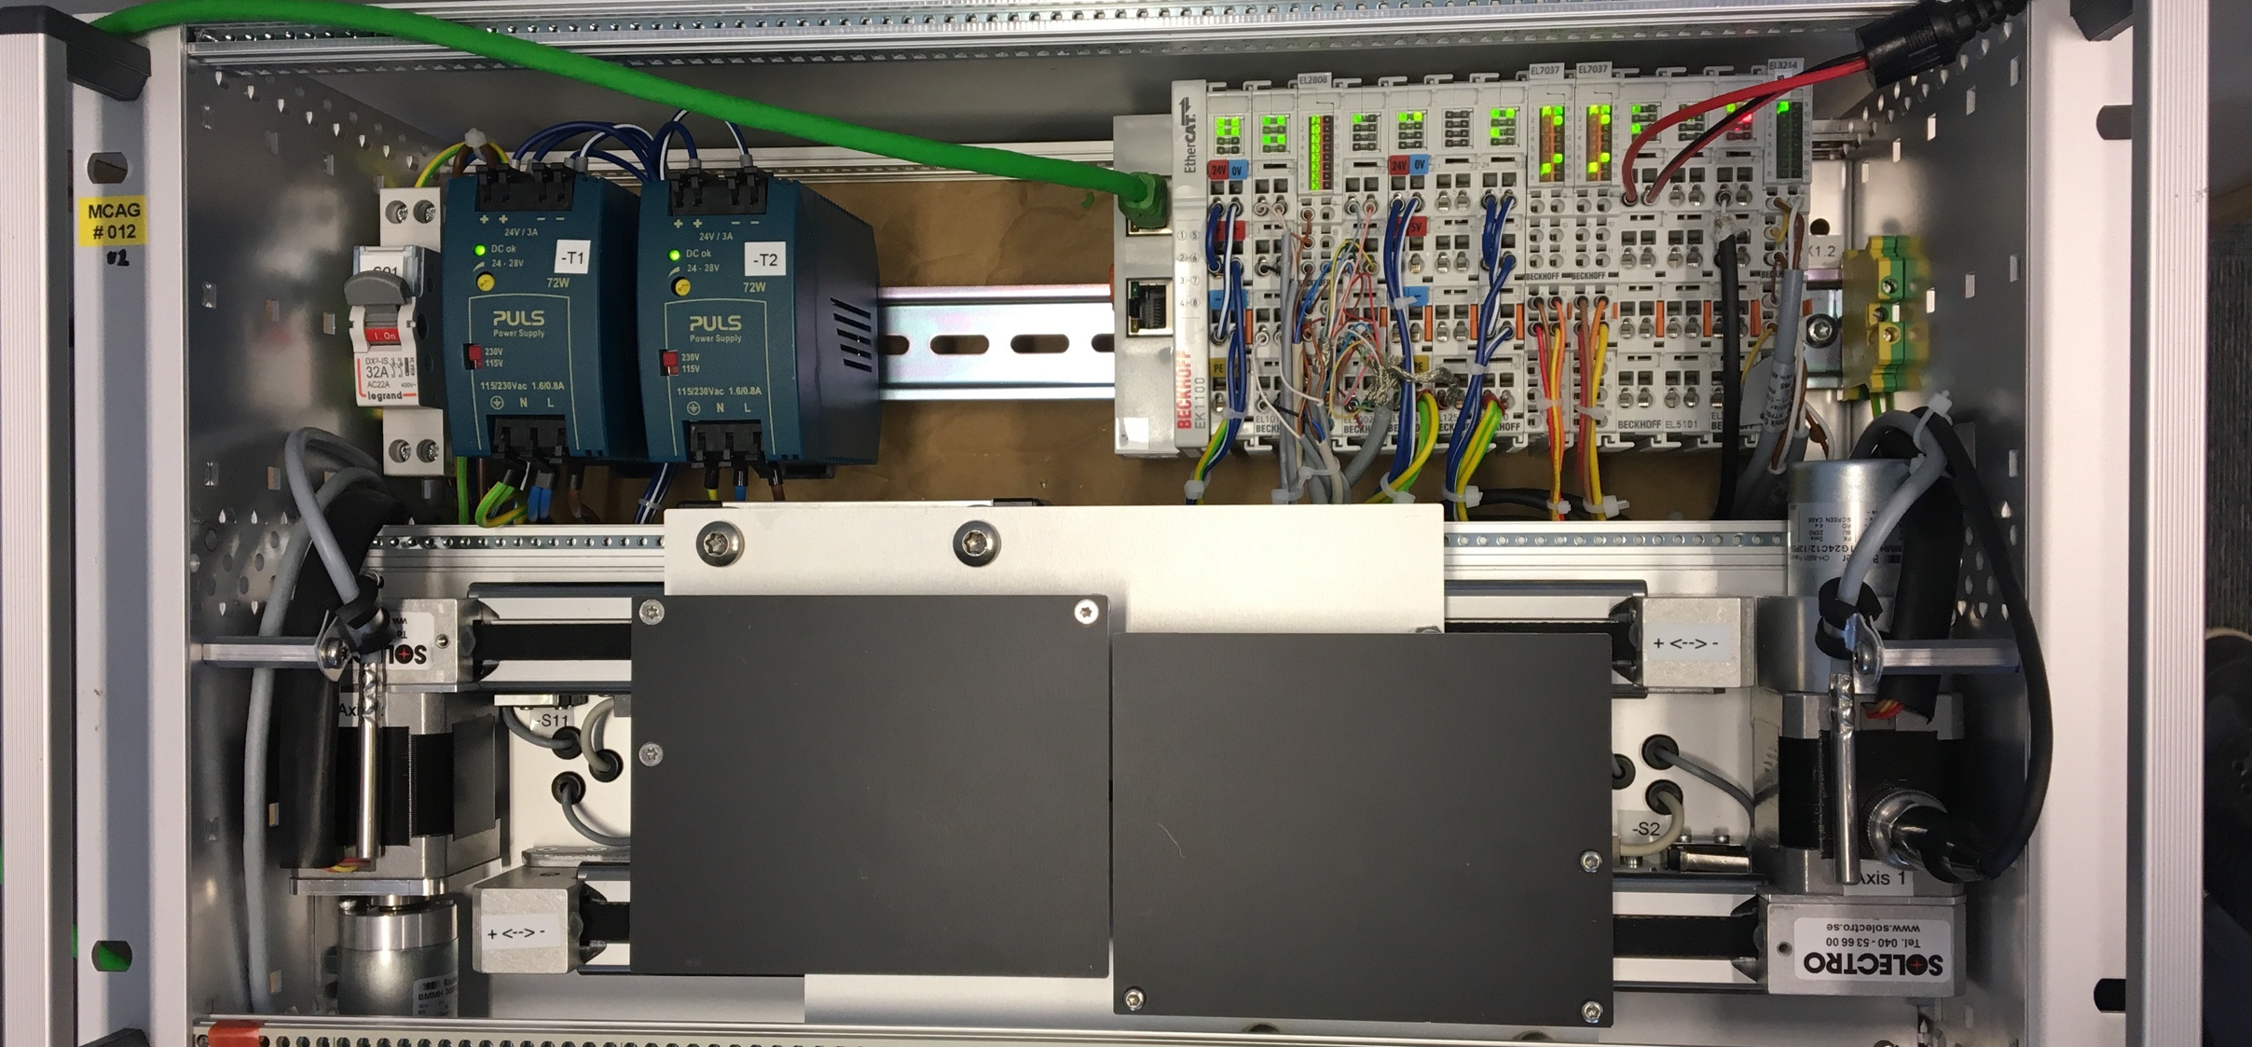
Application: 2-Axes Slit Set
2 virtual axes
  Slit center position
  Slit gap/opening
2 normal axes (blade positions)
Axis 1 (Virt: Center position)
Forward Kinematics:
ax3.traj.setpos:=ax1.traj.setpos - ax2.traj.setpos/2;
ax4.traj.setpos:=ax1.traj.setpos + ax2.traj.setpos/2;
Inverse Kinematics:
ax1.enc.actpos:=(ax3.enc.actpos+ax4.enc.actpos )/2;
ax2.enc.actpos:=(ax4.enc.actpos – ax3.enc.actpos);
Amplifier enable:
ax3.drv.enable:=ax1.drv.enable or ax2.drv.enable;
ax4.drv.enable:=ax1.drv.enable or ax2.drv.enable;
Or:
mc_power(3, ax1.drv.enable or ax2.drv.enable);
mc_power(4, ax1.drv.enable or ax2.drv.enable);
Axis 2 (Virt: Gap)
Axis 3 (Normal: Blade position)
Axis 4 (Normal: Blade position)
Blade
Axis 3
Blade
Axis 4
33

Slide 34
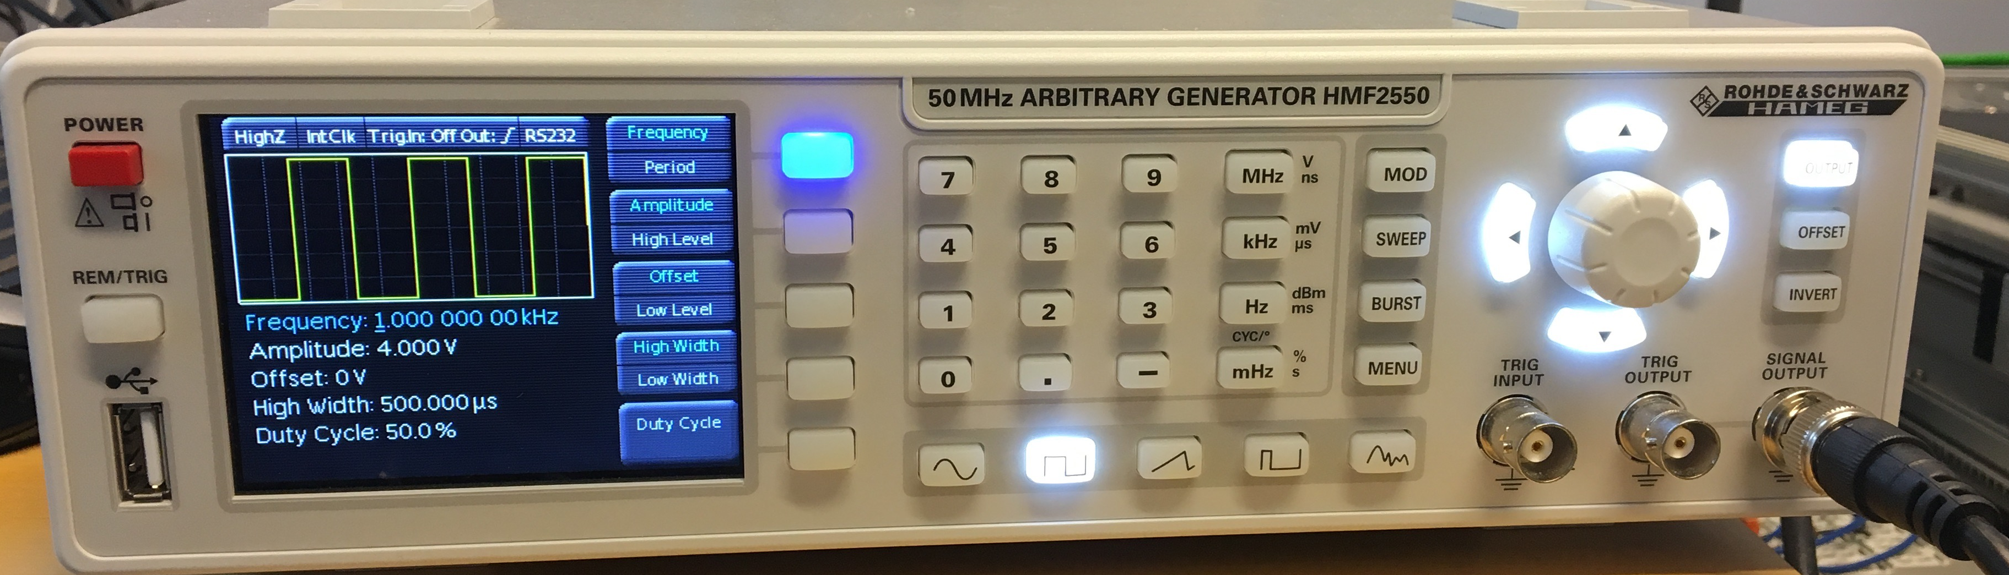
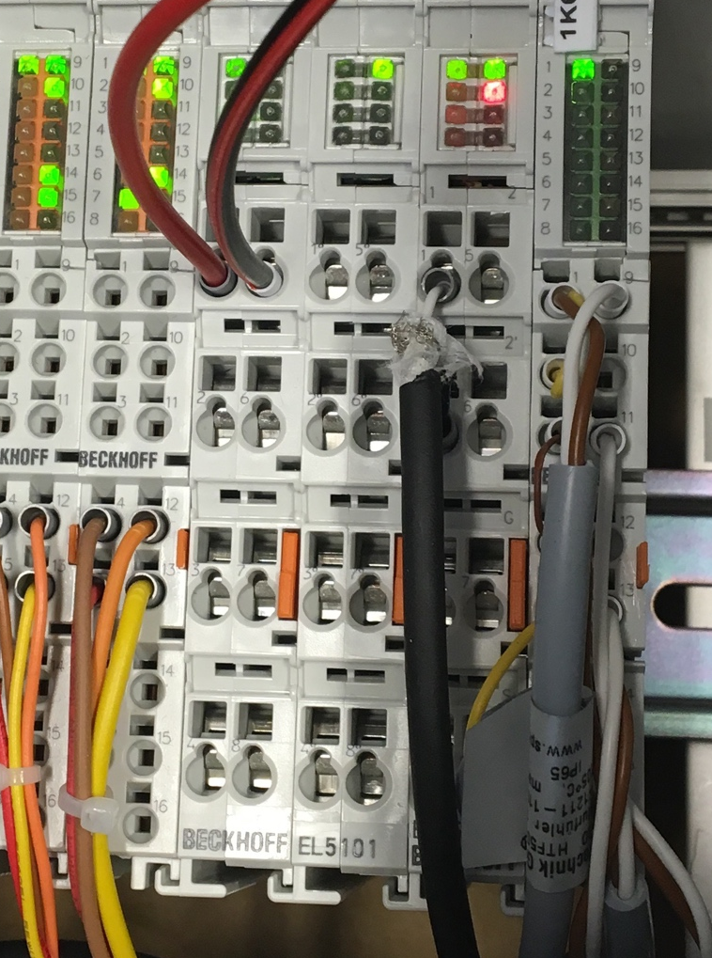
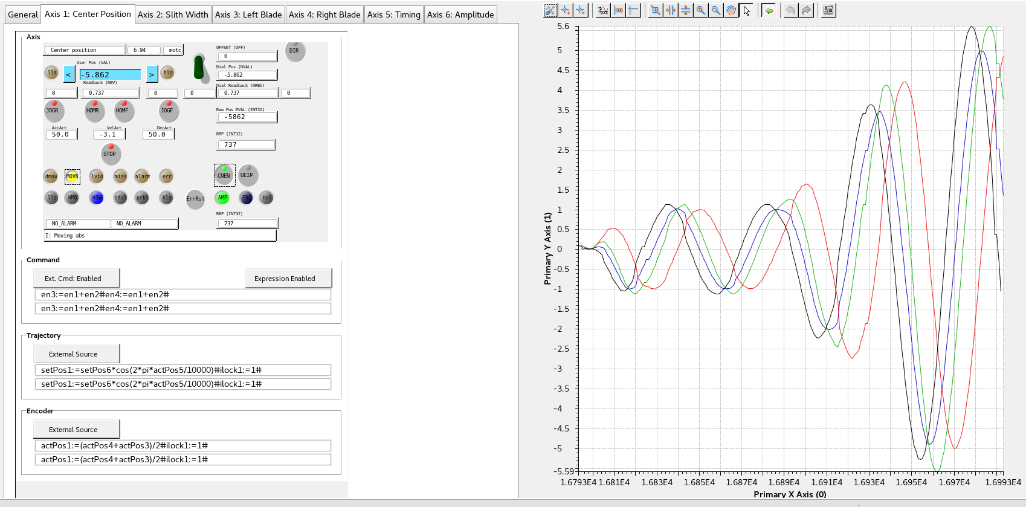
Application: 2-Axes Slit Set, External Sync.
Add 2 virtual axes
  Timing system (Signal Generator connected to EL5101)
  Amplitude
Axis 1 (Centre)
Axis 2 (Gap)
Axis 3 Left blade
Axis 4 Right blade
34
Old syntax..
2 virtual axes:
  External timing system (function generator)
  Amplitude
§
2 virtual axes:
  External timing system (function generator)
  Amplitude
§
2 virtual axes:
  External timing system (function generator)
  Amplitude
§
2 virtual axes:
  External timing system (function generator)
  Amplitude
§

Slide 35
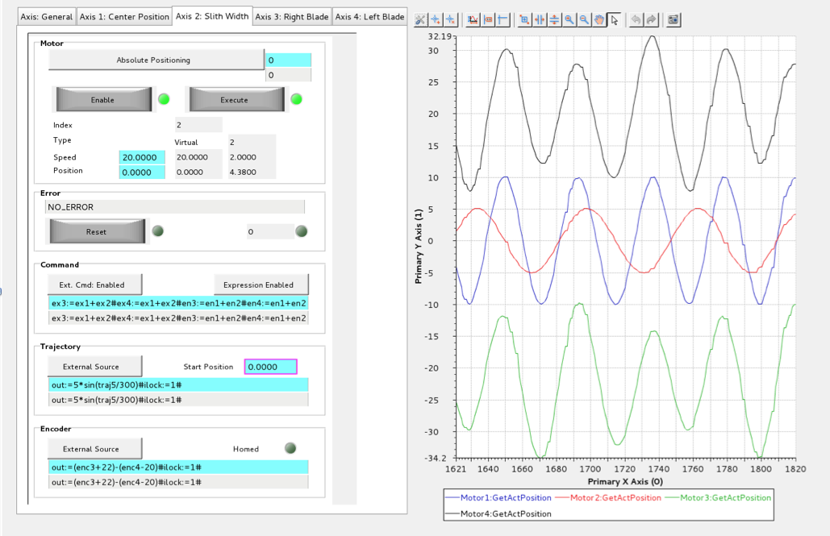
Application: 2-Axes Slit Set, External Sync.
Axis 4
Axis 1 (Centre)
Axis 2 (Gap)
Axis 3
Old syntax..

Slide 36
ECMC data access over Asyn:
Note: ECMC data are transferred to EPICS records by default if ecmccfg is used but can also be customized.
Data in ECMC can be exposed to EPICS records over Asyn framework (“I/O Intr”):
EtherCAT:
  EtherCAT entries (also waveforms for oversampling cards)
  EtherCAT slave diagnostics
  EtherCAT master diagnostics
Diagnostics:
  Motion thread time jitter
Motion Axis:
  Trajectory generated setpoint
  Actual position
  Following error
  Diagnostic string (containing most info of axis)
PLC vatriables
Available data can be listed with the iocsh command ”ecmcReport <detail>”
  ecmcReport 0 : Display basic information
  ecmcReport 1 : Display all parameters that are linked to records
  ecmcReport 2 : Display all available parameters (that can be accessed)
Note: “asynReport” can be used in the same way but will also list information from other loaded asyn modules like EthercatMC
36

Slide 37
ECMC data access over Asyn: EtherCAT
Record INP/OUTP field syntax:
"@asyn(<asynPort>,<address>,<timeout>)ecmcInfoStr)”
ecmcInfoStr:
CMD=<cmd>/T_SMP_MS=<sampletime>/TYPE=<type>/<parameter name><read/write>"
CMD (optional):
  “UINT64TOFLOAT64”: Converts 64bit uint data to float64 before push to EPICS (64 bit positions and time)
  “FLOAT64TOINT32”: Converts float 64 to int32 before push to epics (binary PLC values)
T_SMP_MS (optional): Record update rate in milliseconds
TYPE (mandatory): Type of data to transfer (asynInt32, asynFloat64, asynInt32ArrayIn..)
<parameter name> (mandatory):
  Example for Ec data: “ec<master index>.s<slave index>.<data alias>”
  Use “ecmcReport 3” to see available parameter names
<read/write> (mandatory)
read “?”
write “=”
37

Slide 38
ECMC data access over Asyn: Example
Example of analog input EL3002:
master=0, slave=2, data alias = “CH1_VALUE”, T_SMP_MS=1:
Record definition:
record(ai,”IOC:ec0-s2-EL3002-AI1")
{
field(INP, "@asyn(TEST,0,1)T_SMP_MS=1/TYPE=asynInt32/ec0.s2.CH1_VALUE?")
field(DTYP, "asynInt32")
field(SCAN, "I/O Intr")
………
…..
}
38

Slide 39
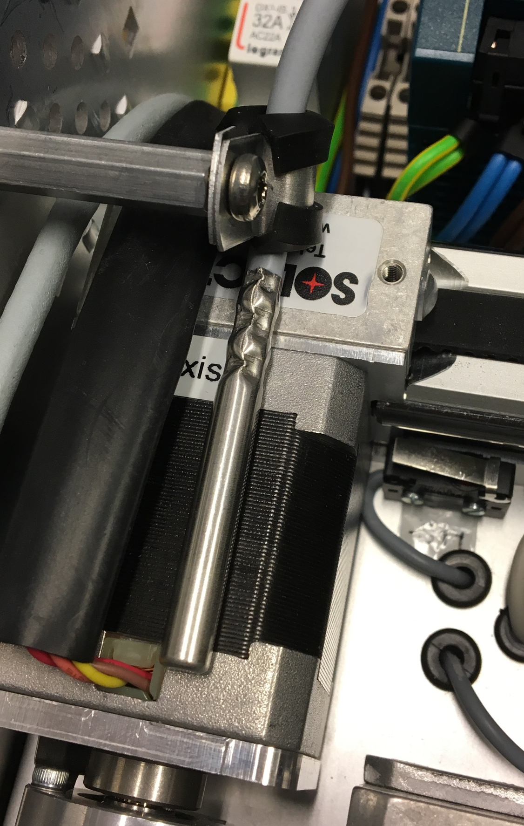
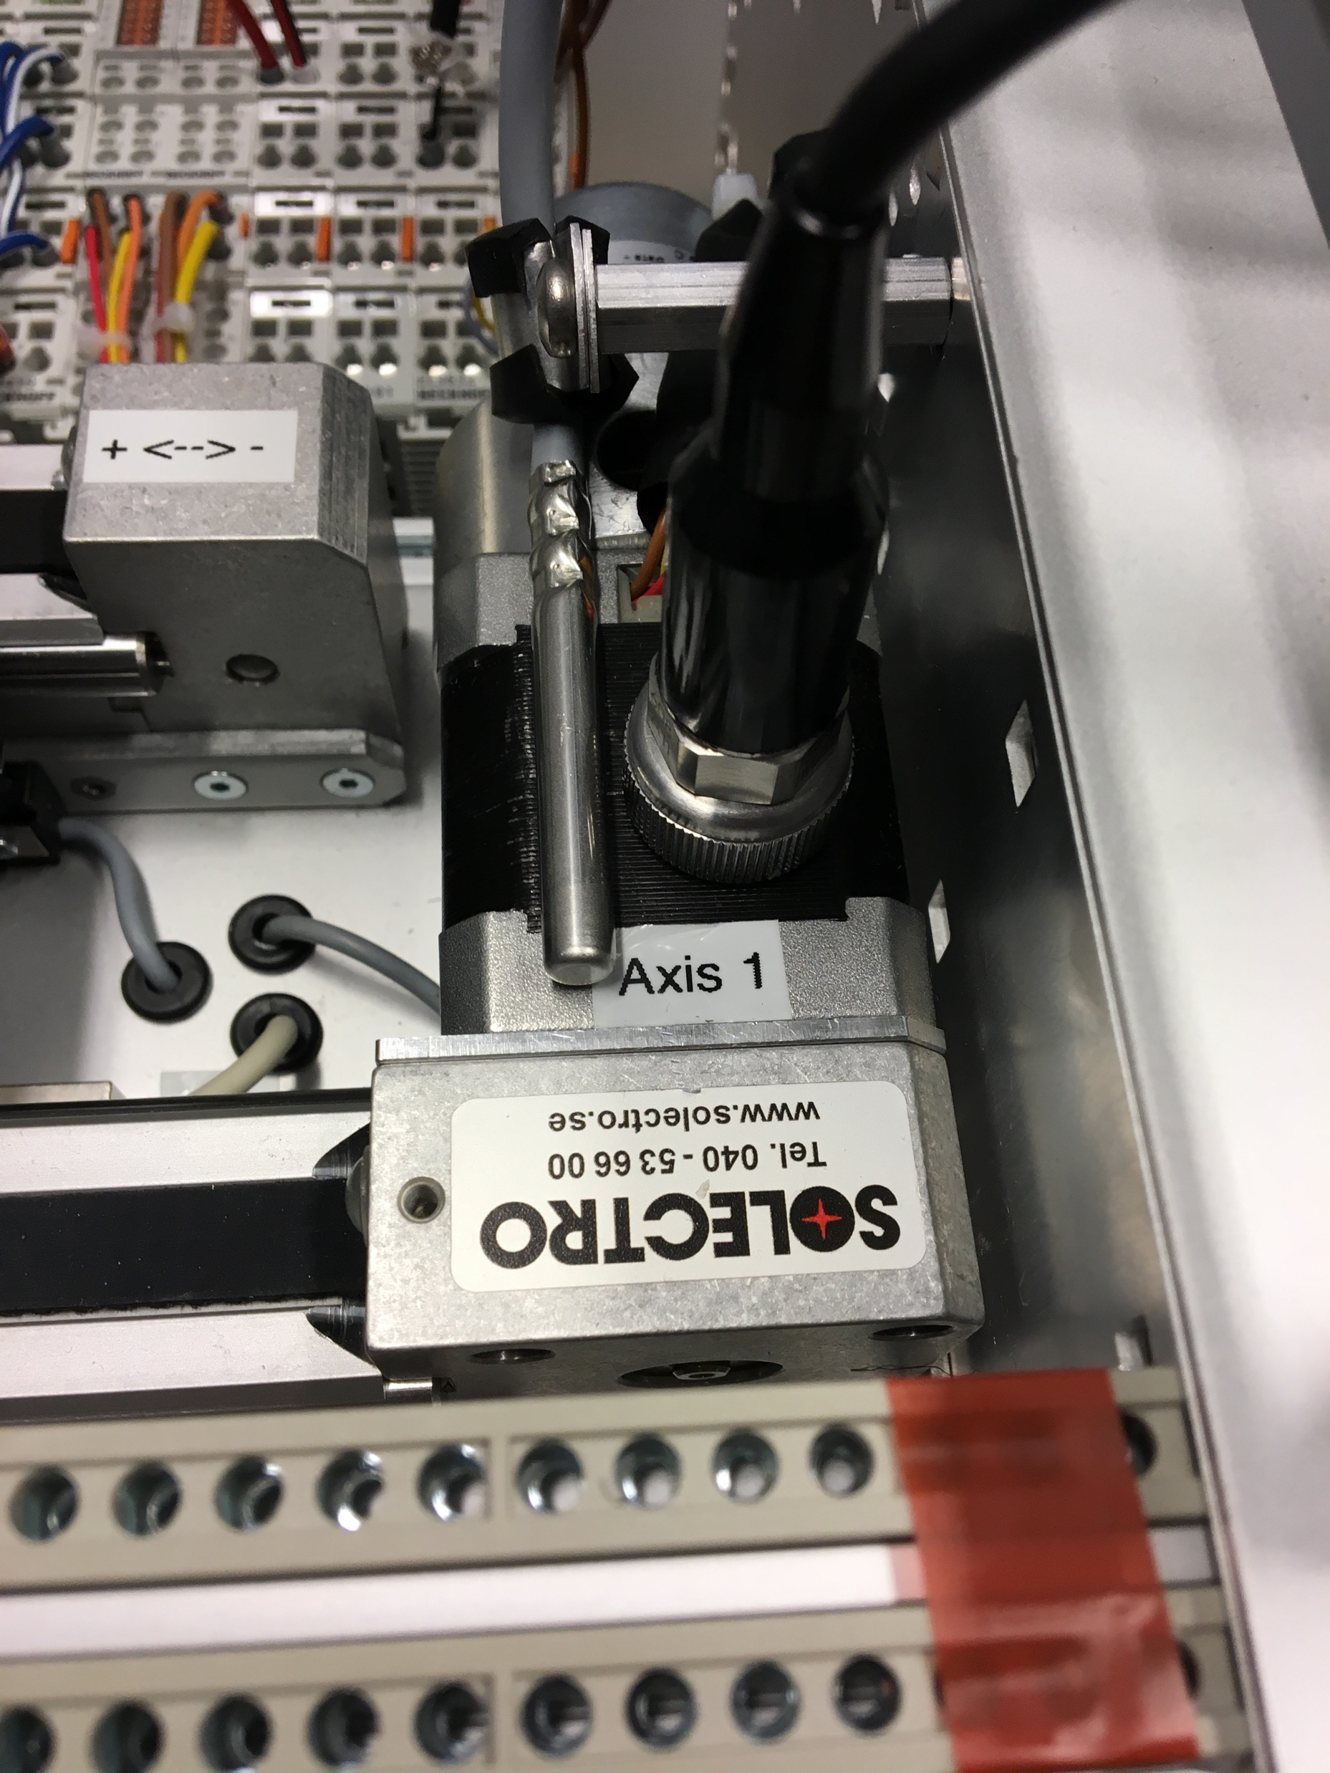
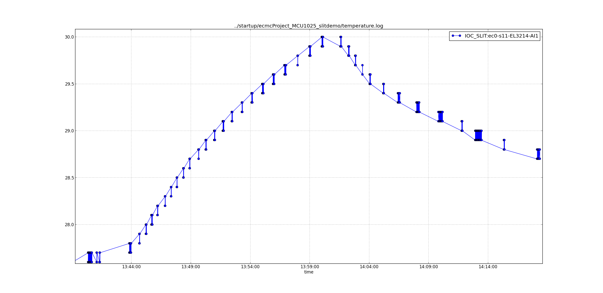
Example: Temperature
Analog Data Acquisition:
Example: Motor temperature (PT100 or similar)
Data accessible through EPICS PV (AI record)
Update EPICS PV on change
Resolution 0,1ºC (standard)
Temperature [ºC]
Stepper
Temperature Sensor
(PT1000)
Temperature Sensor
(PT100)
Time
39
Motor in Operation
Motor Idle
Notes:
Will be used in accc and BD

Slide 40
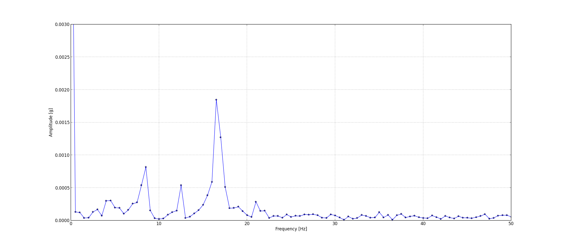
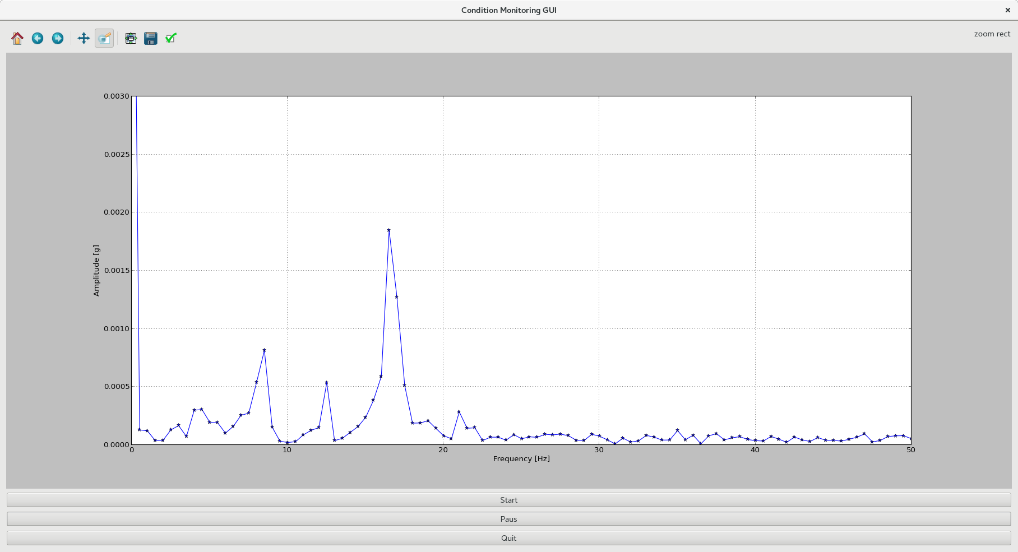
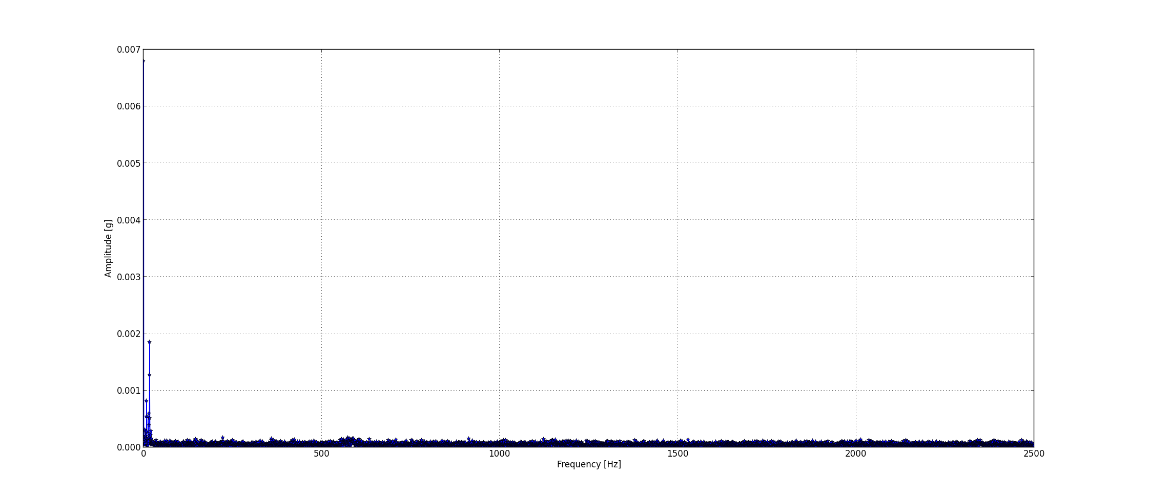
Example: Vibration Analysis
Vibration measurement:
IEPE interface (or normal analog)
Oversampling max 50kHz (other analog 100kHz)
Data accessible through EPICS PV (waveform record)
Accelerometer
Stepper
FFT Stepper Motor Vibrations
Stepper motor full step freq.
0
40
Analysis in Python (pyepics, scipy, numpy, and matplotlib)
2.5kHz

Slide 41
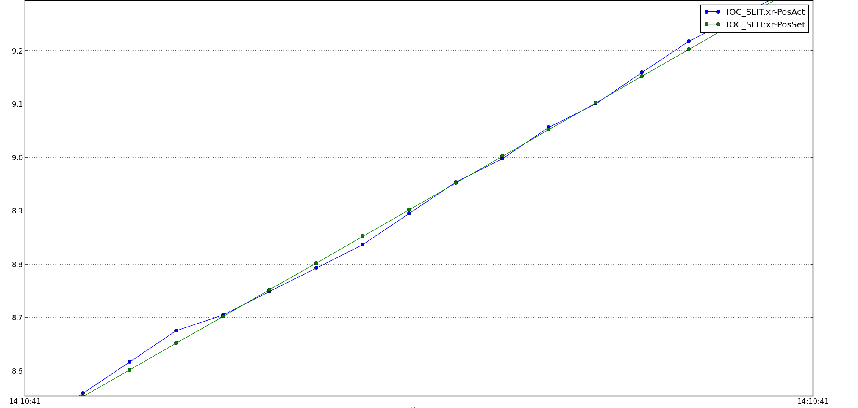
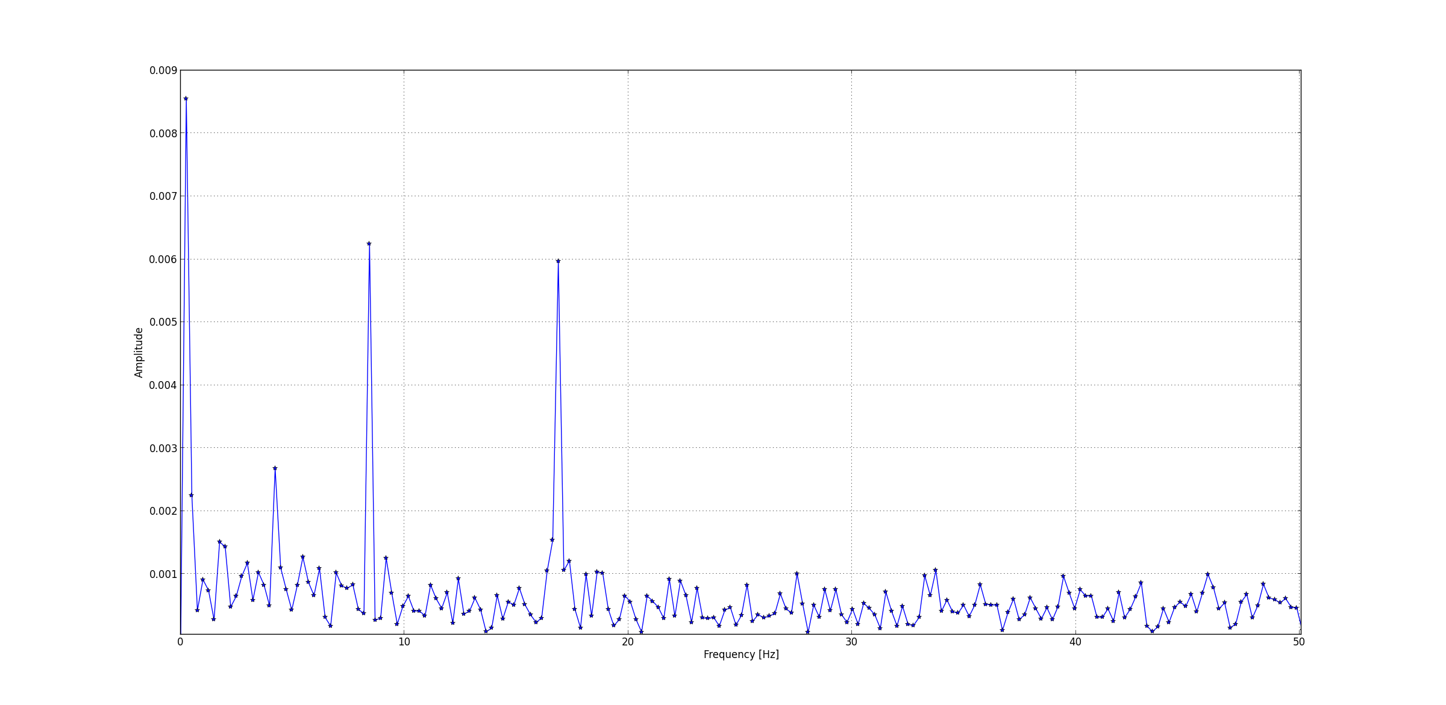
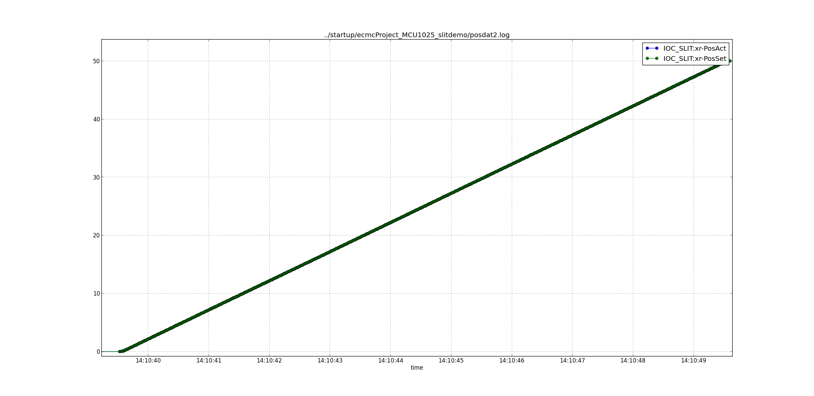
Data Acquisition: Position Data Analysis
Positioning 0 to 50 mm
Analysis of position error during move:
Data accessible in EPICS PVs (AI records)
Example: Positioning task from 0mm to 50mm
Position [mm]
FFT of Position Error
Time
Stepper motor full step freq.*
Amplitude [mm]
Frequency [Hz]
41
*5mm/s , 60mm/rev, 200 steps/rev=> 16.67Hz full step freq
Notes:
5mm/s , 60mm/rev, 200 steps/rev=> 16.66666Hzfull step freq

Slide 42
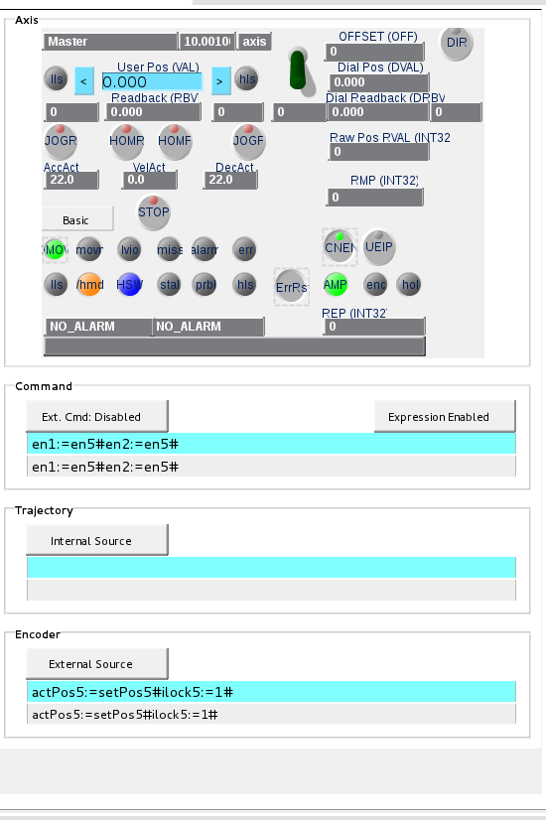
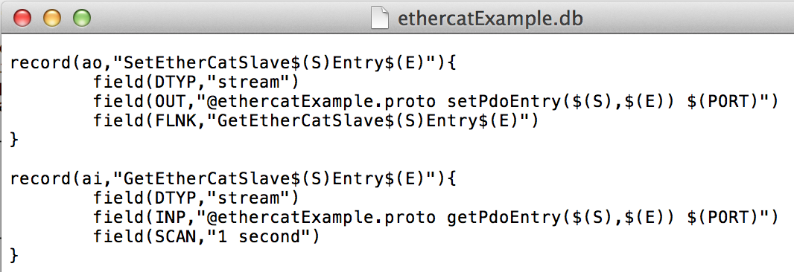
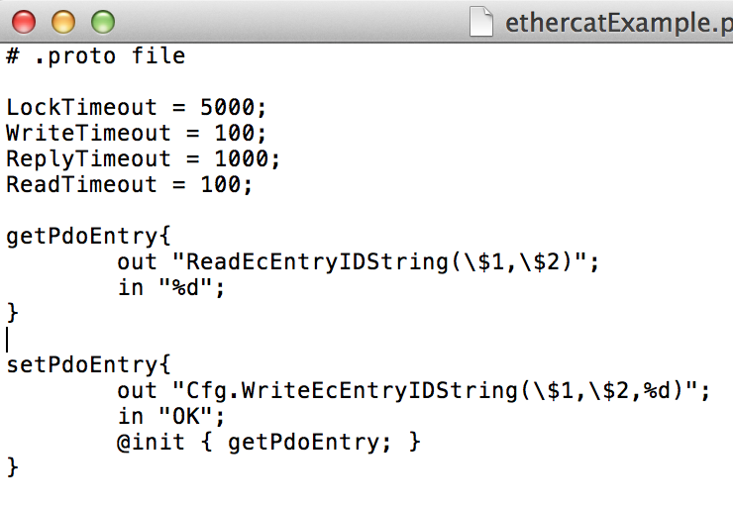
Commands from EPICS records:
All commands can be executed from EPICS records using stream device or asyn-record.
Typically settings and communication that are not handled by motor record or model 3 driver can be applied through stream device or ASYN record.
Example:
Motor
record
Stream
Device
42

Slide 43
Motion Interlocks
1. Interlock by I/O:
  Any digital EtherCAT entry can be linked to interlock motion
Example: Link I/O to interlock axis n
ecmcConfigOrDie "Cfg.LinkEcEntryToAxisMonitor(0,INPUT_7,n,3,0)"
ecmcConfigOrDie "Cfg.SetAxisMonEnableExtHWInterlock(n,1)”
2. Interlock by I/O in motion terminal:
Inputs of some motion terminals, like Beckhoff Stepper terminals, can be configured to disable power of amplifier.
Example: Hardware enable on input 1 of EL7037 (slave bus position m)
ecmcConfigOrDie "Cfg.EcAddSdo(m,0x8012,0x32,1,1)"
3. Interlocks from PLC:
Example: Interlock axis 1 from plc:
ax1.mon.ilock:=ax2.enc.actvel<2 and ax4.mon.ilock and ax3.enc.actpos<1000;
4. Safe Torque Off: The drives IPOS8020 and IPOS4808 have safety rated STO inputs (SIL3/Ple)
43

Slide 44
Data Storage
Data storage objects is a basically a data buffer/array. Types:
  Normal: Fill from beginning stop when full
  Ring: Fill from beginning start over when full
  FIFO: Fill from end. Oldest value are “pushed” out when full
Can be accessed from waveforms from EPICS records (r/w)
Can be accessed from PLCs (r/w)
Useful for:
  latching fast data.
  Implementation of simple filters
  Storing custom trajectories
Data Storage Commands:
“Cfg.CreateDataStorage (….)”
“Cfg.ClearStorage (….)”
“ReadStorageBuffer(….)”
“Cfg.SetStorageEnablePrintouts (….)”
“Cfg.PrintStorageBuffer (….)”
44

Slide 45
Data Storage: PLC access
Variables (struct only refreshes one time per execution):
ds<id>.size Set/get size of data storage (set will clear the data storage) (rw)
ds<id>.append Add new data at end, current position index will be increased (rw)
ds<id>.data Set/get data ar current position (rw)
ds<id>.index Set/get current position index (rw)
ds<id>.error Data storage object error error (ro)
ds<id>.clear Data buffer clear (set to zero) (ro)
ds<id>.full True if data storage is full (ro)
Function Lib: DS
retvalue := ds_append_data(<dsIndex>,<data>); Append data to data storage
retvalue := ds_clear_data(<dsIndex>); Clear data to data storage.
retvalue := ds_get_data(<dsIndex>, <bufferIndex>); Returns data from buffer.
retvalue := ds_set_data(<dsIndex>, <bufferIndex>); Sets data in data storage buffer.
retvalue := ds_get_buff_id(<dsIndex>); Returns current buffer index.
retvalue := ds_set_buff_id(<dsIndex>, <bufferIndex>); Sets current buffer index in data storage buffer.
retvalue := ds_is_full(<dsIndex>); Returns true if buffer is full.
retvalue := ds_get_size(<dsIndex>); Returns buffer size of data storage.
retvalue := ds_push_asyn(<dsIndex>); Push data storage to EPICS
retvalue := ds_get_avg(<dsIndex>); Returns average value of stored values
retvalue := ds_get_min(<dsIndex>); Returns min value of stored values
retvalue := ds_get_max(<dsIndex>); Returns max value of stored values
retvalue := ds_get_err(); Returns error code for last lib call.
Example:
retvalue := ds_get_avg(1); # Returns average of all values in buffer (can be used as simple filter).
45

Slide 46
Distributed Clocks
Commands:
“Cfg.EcSlaveConfigDC(….)”
“Cfg.EcSelectReferenceDC (….)”
46

Slide 47
Etherlab EtherCAT tool:
EtherCAT tool from www.etherlab.org
Display master status:
ethercat master
Display slaves and status:
ethercat slaves
Display available PDOs for slave 3:
ethercat –p3 pdos
Display available SDOs for slave 3:
ethercat –p3 sdos
Display help:
ethercat –h
47

Slide 48
Acknowledgments
Igh open source EtherCAT master (www.etherlab.org)
EPICS community (base, motor, asyn, stream device)
ExprTK C++ Mathematical Expression Library
Questions?
48
Notes:
Thanks

