Slide 1


Latest developments on beamline geometry
Damian Martin Rodriguez

Slide 2
Introduction
We need to establish guidelines to design guides depending on the instrument requirements.
The main objective is to have highest performance and reliability at lowest COST (building materials, maintenance, ...)
Long instruments will be a significant part of the instrument suite of ESS and we need to find guidelines to design them.

Slide 3
Neutron transport at long distances
A ballistic guide concept is a low cost alternative to elliptic guides and leads to standardization (the guide sections of straight part can be easily exchangeable between instruments).
  Beam extraction: It should extract us much of the beam as possible and convert it in a way to make it easily transported whilst minimising unwanted neutrons.
  Straight part: it should transport the beam and filter the unwanted radiation.
  Focusing part: It should focus the beam into the sample following the flux and resolution needs of the sample.

Slide 4

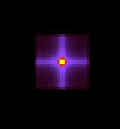
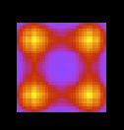
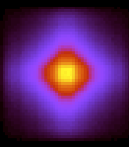
Beam extraction: Phase space transformation
A focus-defocus system can be used for beam extraction or optical elements in instruments, like in SANS.
Detector
Source
Sample

Slide 5
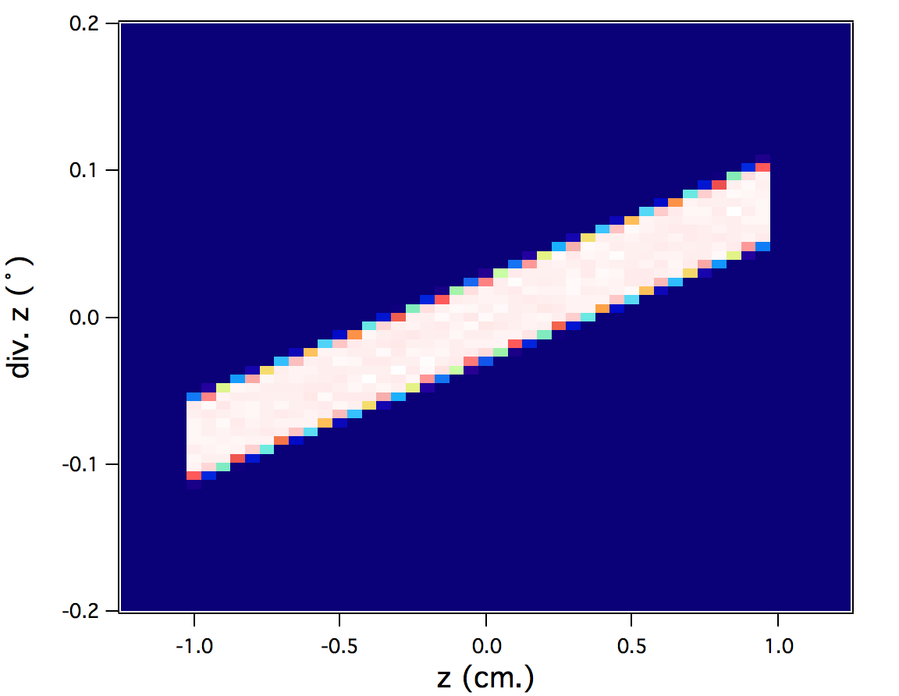
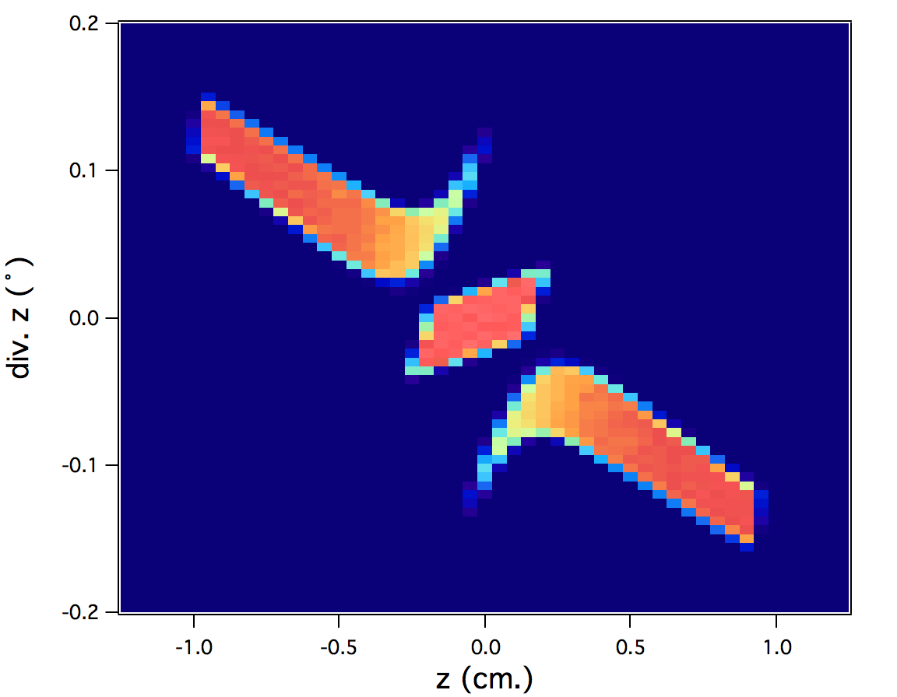
Beam extraction: Phase space transformation
A focus-defocus system in a SANS can substitute a refraction lens system in a TOF SANS. This can be applied to the beam extraction system.
Detector
Source
Sample
Entrance
Exit

Slide 6
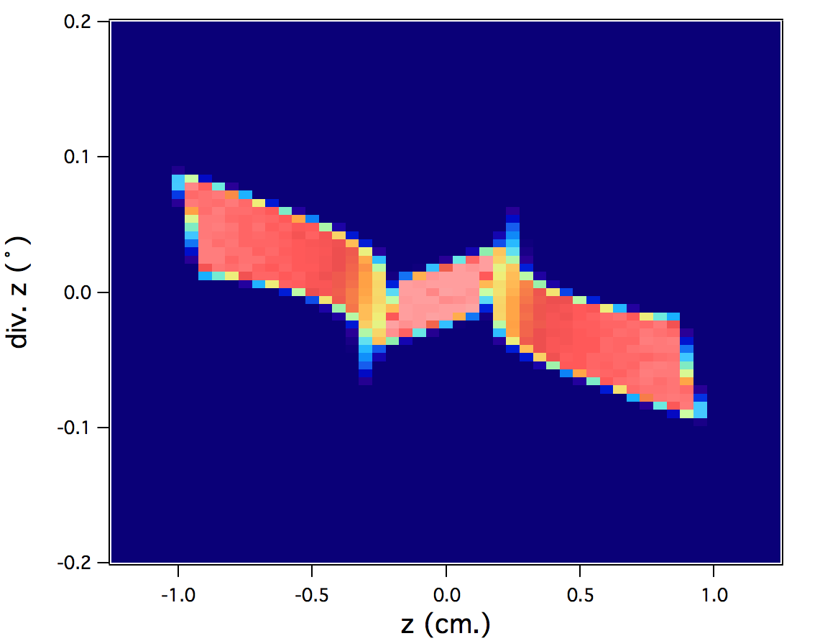
Beam extraction: Phase space transformation
A focus-defocus system in a SANS can substitute a refraction lens system in a TOF SANS. This can be applied to the beam extraction system.
Detector
Source
Sample
Entrance
Exit

Slide 7
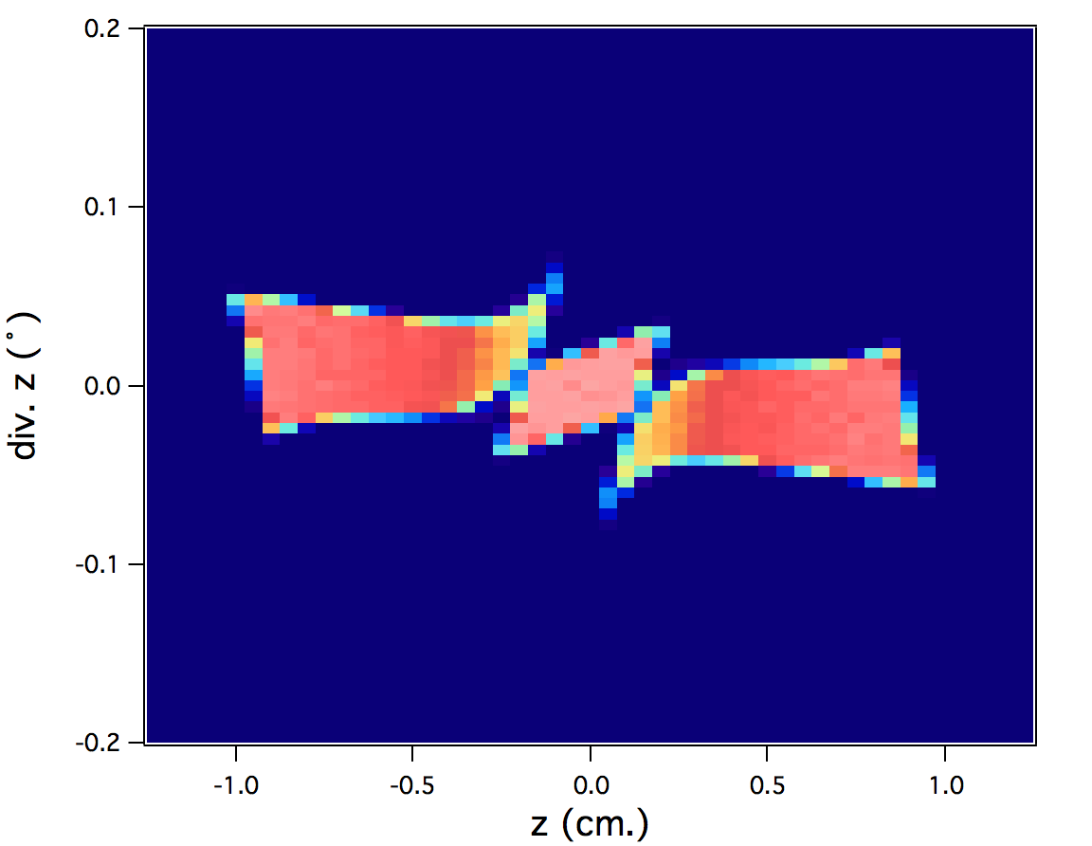
Beam extraction: Phase space transformation
A focus-defocus system in a SANS can substitute a refraction lens system in a TOF SANS. This can be applied to the beam extraction system.
Detector
Source
Sample
Entrance
Exit

Slide 8
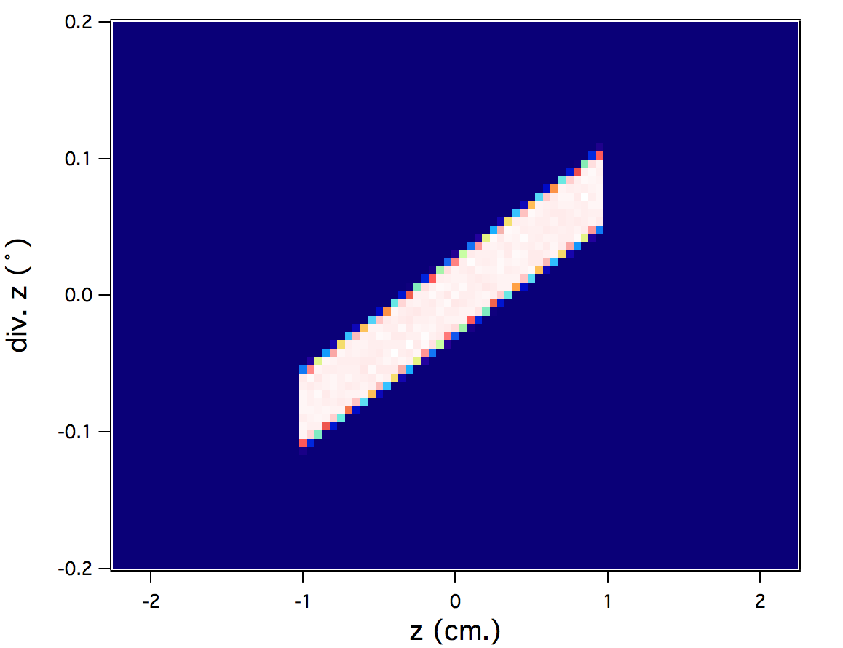
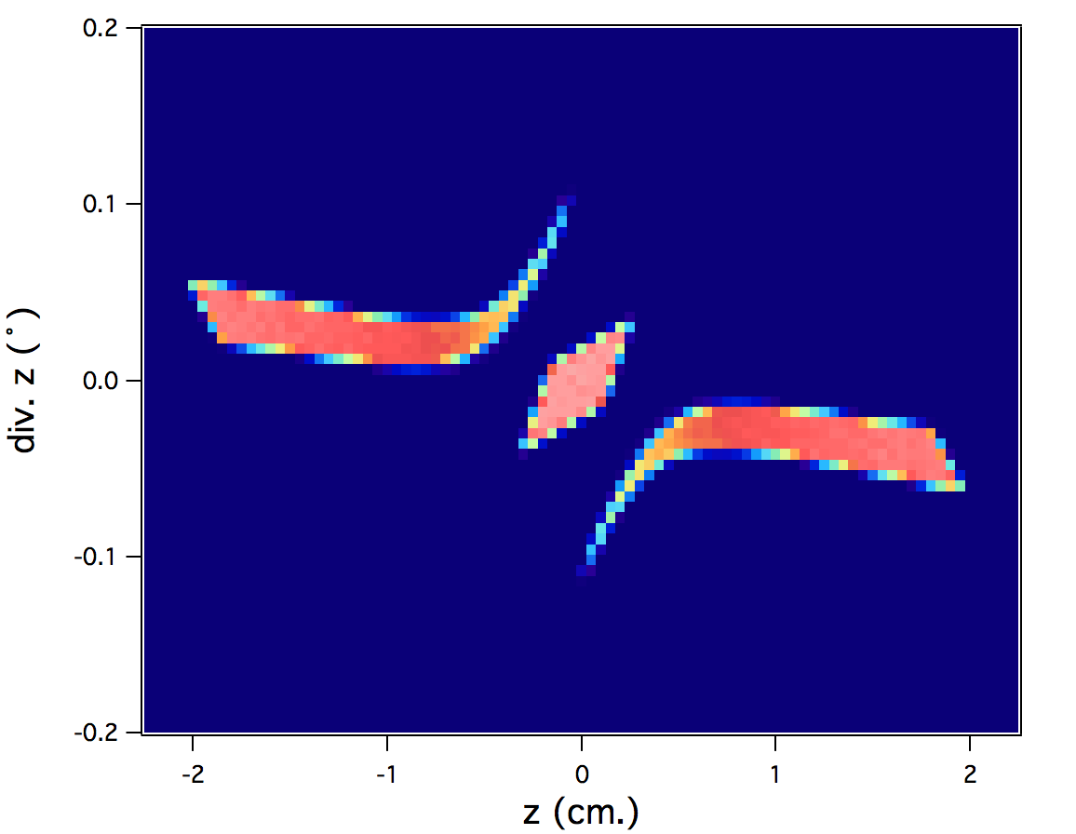
Beam extraction: Phase space transformation
A focus-defocus system in a SANS can substitute a refraction lens system in a TOF SANS. This can be applied to the beam extraction system.
Sample
Source
Entrance
Exit

Slide 9
Beam extraction: Particle swarm optimisations (PSO)
We use PSO in order to optimise the extraction system. As an example we will use as an optimisation criterion the highest intensity obtain for a maximum divergence of 0.8°. There will be some physical constraints (inside the bunker max. 10 x 10 cm², maximum end aperture 20 x 20 cm²).
Source
Focus-defocus system (eye-of-the-needle)
≈ 20 m.
Source
Defocus system
≈ 35 m.
The focus-defocus system needs a shorter set-up to have the optimal conditions

Slide 10
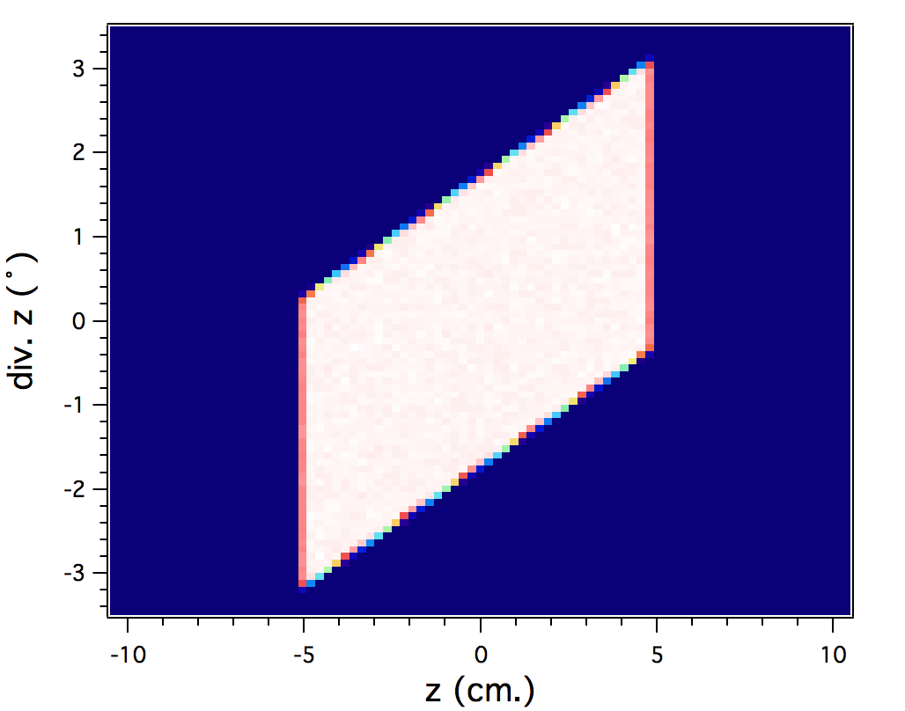
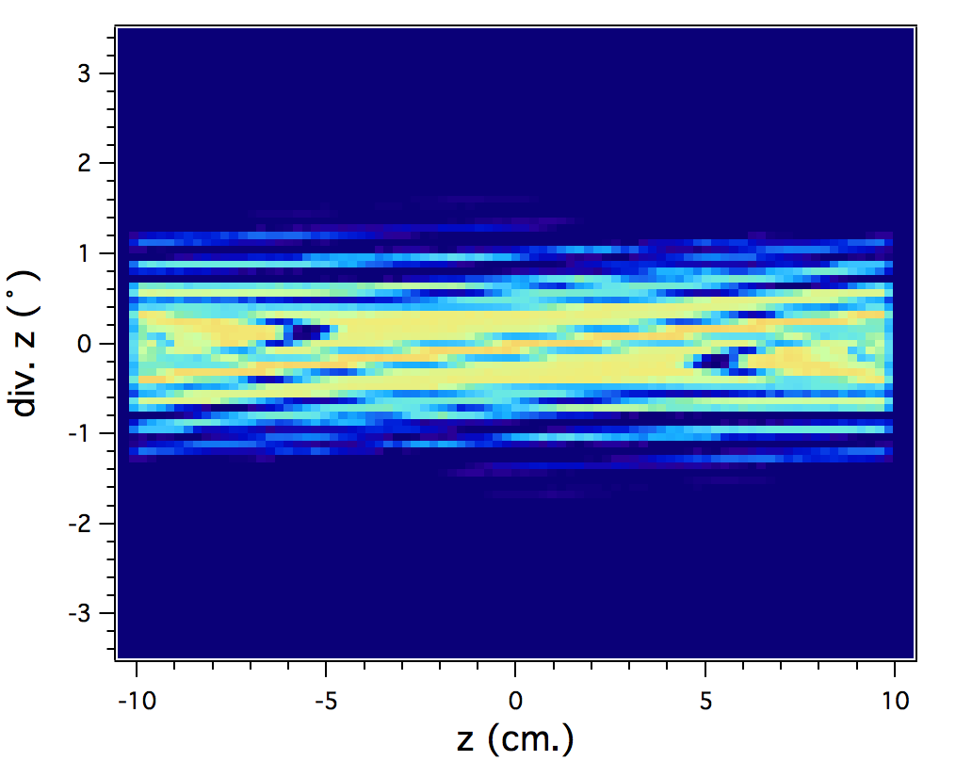
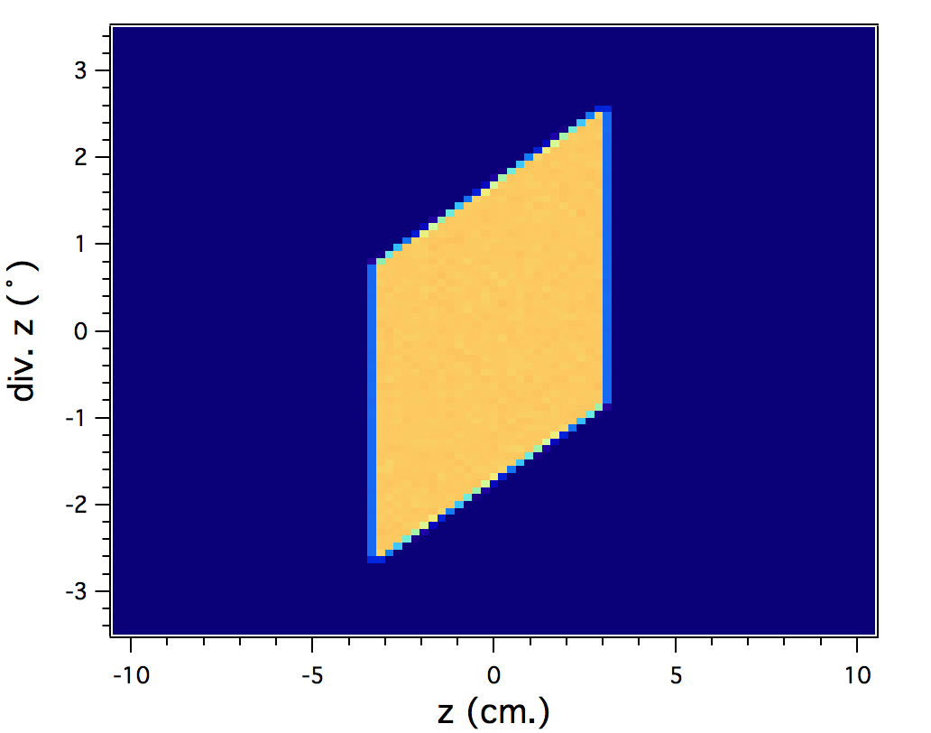
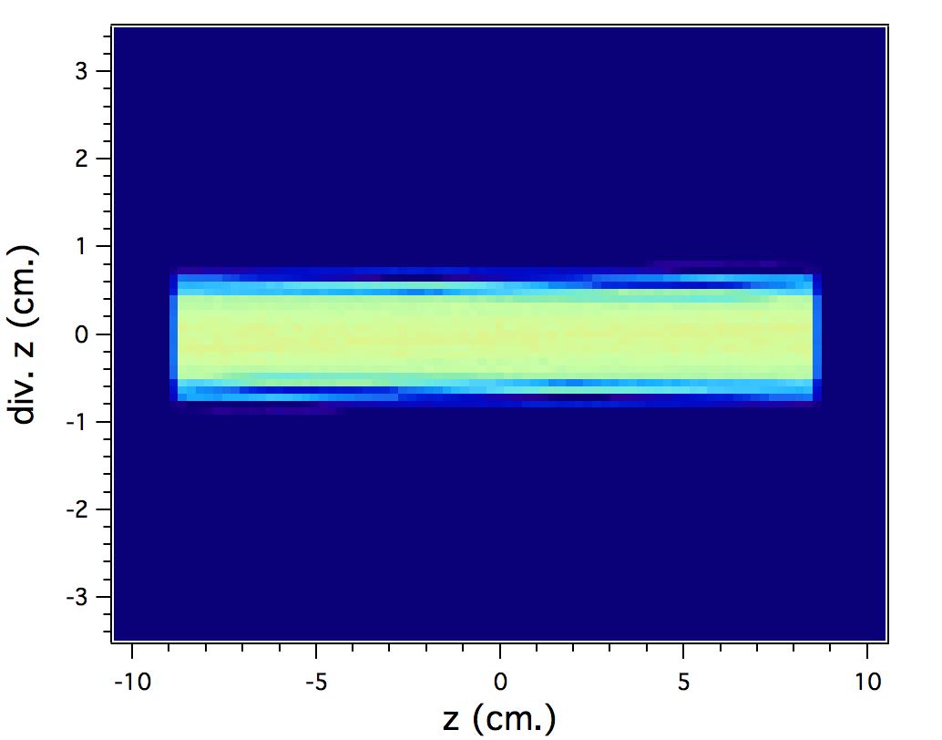
Beam extraction: Particle swarm optimisations (PSO)
We use PSO in order to optimise the extraction system. As an example we will use as an optimisation criterion the highest intensity obtain for a maximum divergence of 0.8°. There will be some physical constraints (inside the bunker max. 10 x 10 cm², maximum end aperture 20 x 20 cm²).
Source
Source

Slide 11
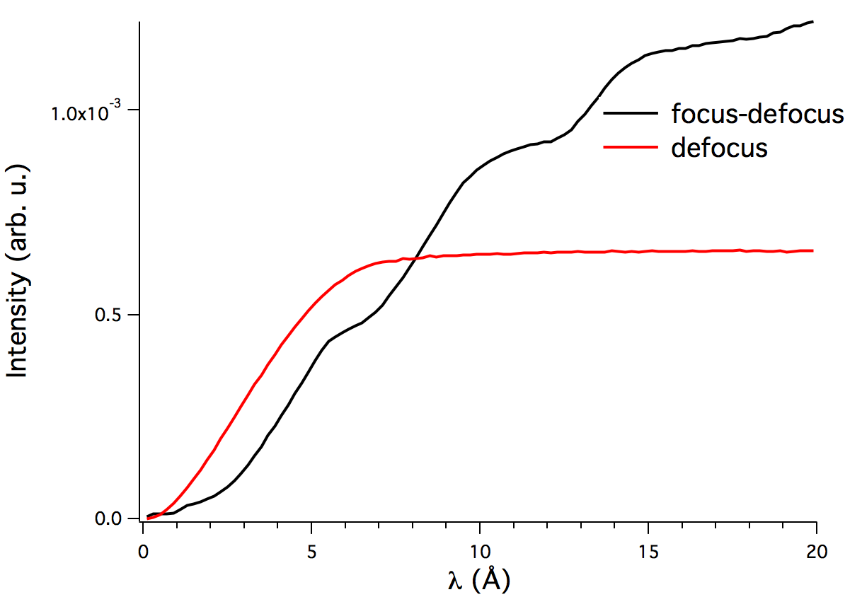
Beam extraction: Particle swarm optimisations (PSO)
We use PSO in order to optimise the extraction system. As an example we will use as an optimisation criterion the highest intensity obtain for a maximum divergence of 0.8°. There will be some physical constraints (inside the bunker max. 10 x 10 cm², maximum end aperture 20 x 20 cm²).
Source
Source
A focus-defocus system gives a better performance for long wavelengths while a defocus system gives a better performance for short wavelengths

Slide 12
Focusing system: Properties of elliptic focusing guides
It is possible to have a low divergence and uniform beam from the extraction system. From there, we need to study the properties of elliptic focusing guides.

Slide 13
Focusing system: Properties of elliptic focusing guides
The optimal focusing guide will depend in several factors: sample size and distance, operating wavelength range and beam characteristics.
If we only take into account the effects of geometry and there is no λ dependence in the divergence, a point source approach can be taken:
Point source
PSO 1
The parameters of the guide will be pretty similar in both cases.
α_{max}=0.6°
1 x 1 cm² sample
D = 50 cm.
z (cm.)

Slide 14
Focusing system: Properties of elliptic focusing guides
Considering a more realistic system changes the parameters of the optimised guide comparing with the former one. However, they will be between two recognisable limits (Point source and zigzag limit)
Incoming beam
The only change in parameters is the length:
PSO 1: L = 4.10 m.
PSO 2: L= 5.10 m.
PSO 2
PSO 1

Slide 15
Future work
Continue working on simple ballistic guide concept.
Work on double ballistic guide concept
Methods to go out of the line of sight (especially in short instruments): Double mirror, multichannel bender, etc.

