Slide 1
Paul Scherrer Institut
Swiss-ESS Collaboration on Neutron Optics and Background Investigations
U.Filges
PSI,
January 23, 2014

Slide 2
Topics
Neutron Optics
Developing and validation of neutron optical devices (Adaptive Optics) - focusing neutrons on small samples
Neutron lenses within sample environment
Outlook
Background investigations
Sapphire neutron filters
Full instrument simulations – Selene concept for ESS
Outlook

Slide 3
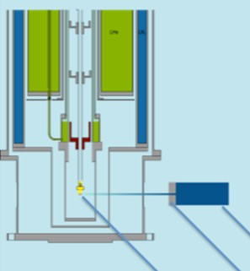
Focusing neutrons on small samples - Adaptive Optics
Samples are often very small/tiny (< 1 mm³)
Focusing important for these small samples
  Maximum beam on small sample with minimum parasitic scattering
  Significant better neutron flux or/and signal-to-noise ratio
Samples are located inside different kind of sample environments (like cryostats)
Use of non-adaptive parabolic/elliptic shaped supermirror neutron lenses are common but usual these lenses are optimized for a pre-defined setup
neutron beam
sample
aperture
PSI,
Seite 3
PSI,
January 23, 2014
January 23, 2014

Slide 4
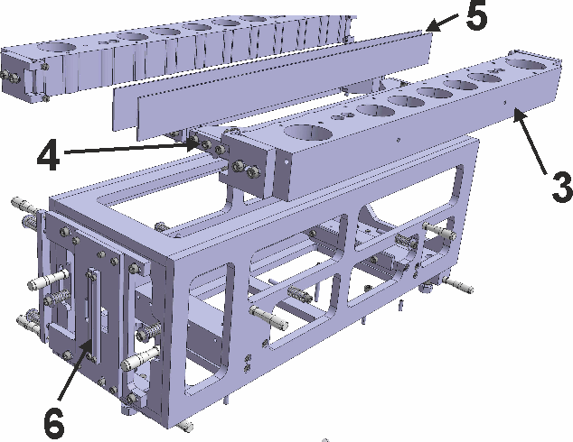
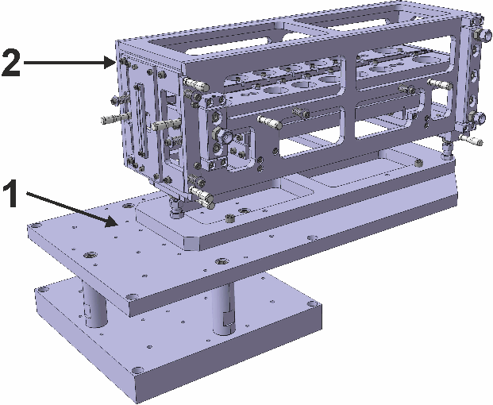
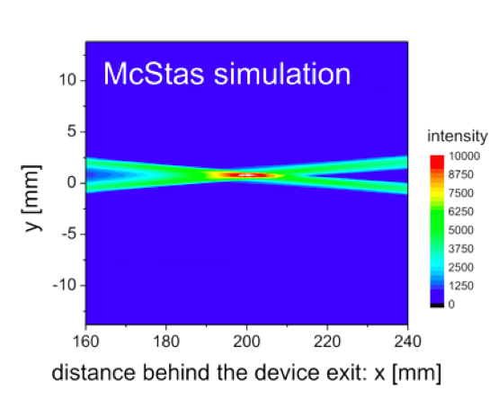
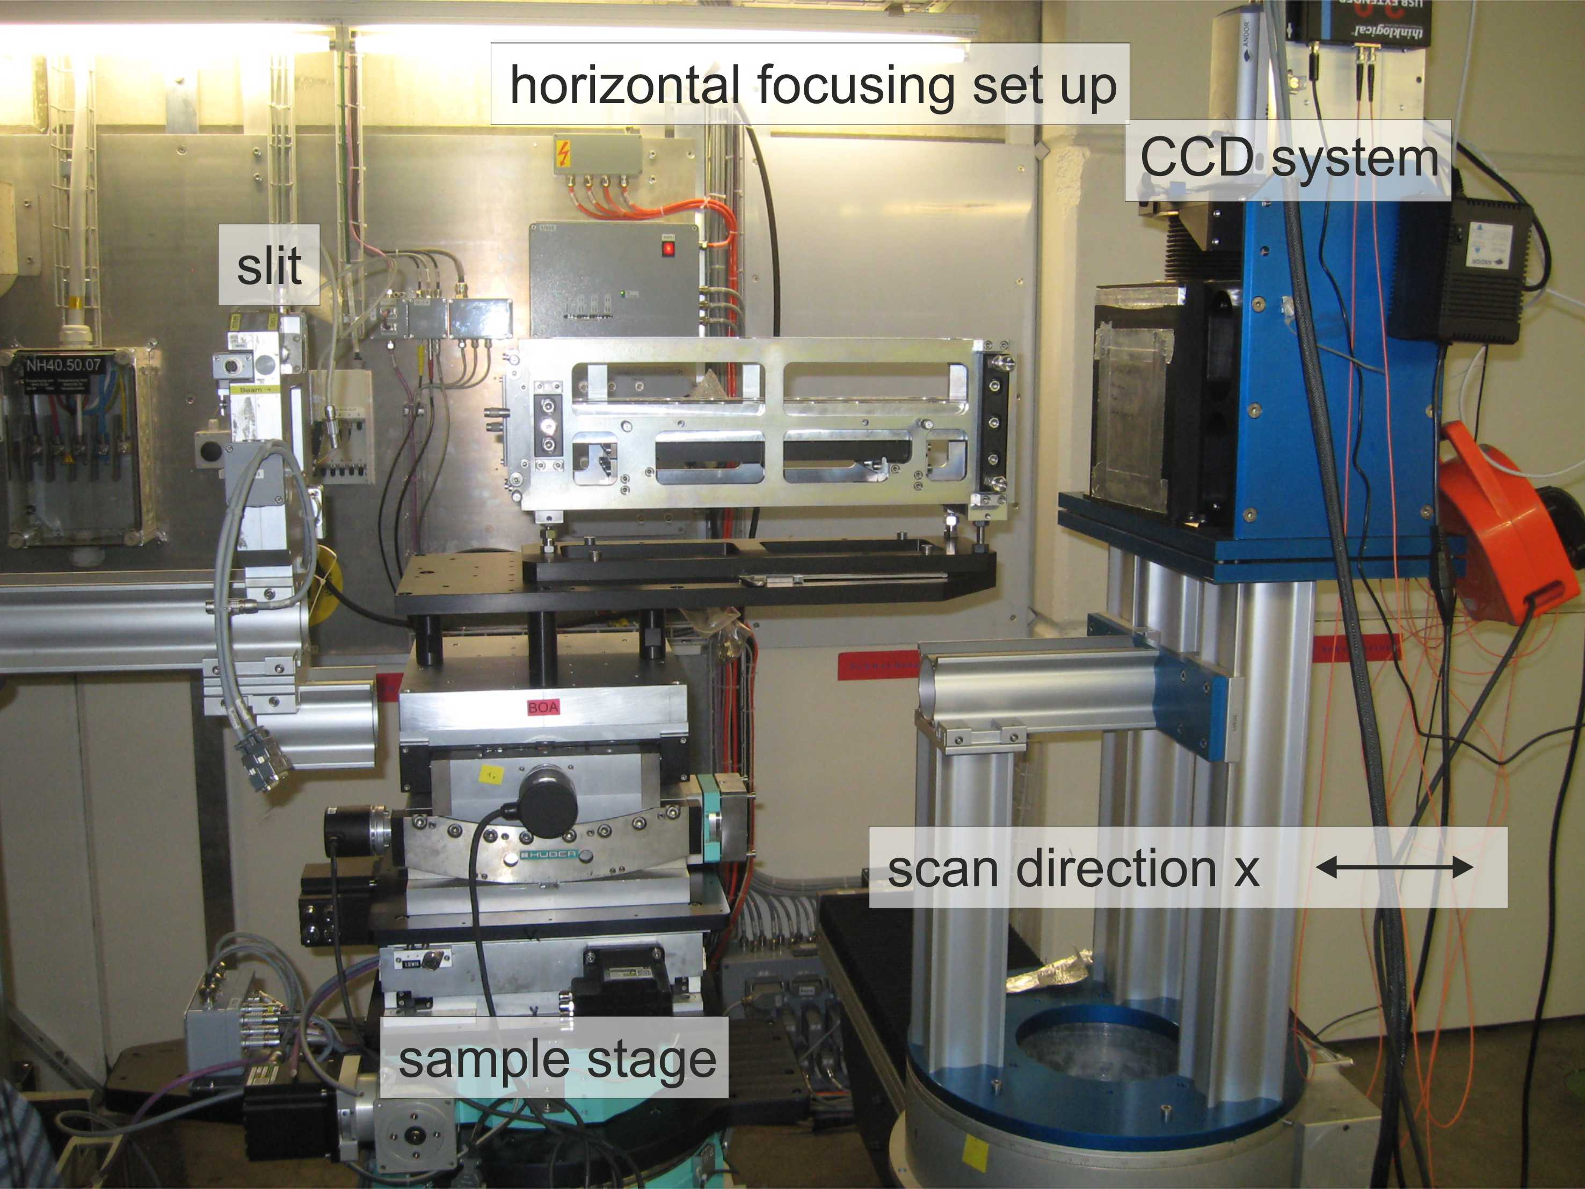
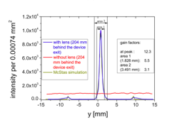
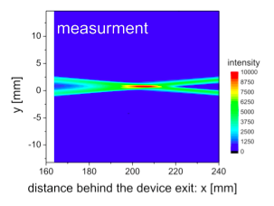
Quasi-adaptive lens system
design without any motor
1- base plate
2 - adjustment box
3 - aluminum frame
4 - adjustment carrier
5 - super mirror coated substrate
6 - beam stop pair
experimental set up at BOA
gain factor > 12
peak size (FWHM) < 0.17 mm
Notes:
Profiles are eroded with a precision of 1-2 mum. Turning machine …

Slide 5
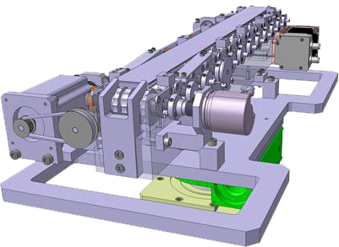
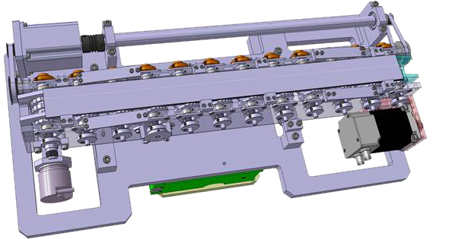
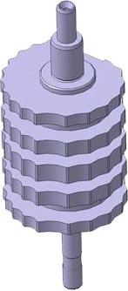
Motorized adaptive optics
enhancement of previous prototype to a fully motorized variant by
using the same principles (number of motors kept as small as possible):
12 camshafts to realize 16
different parabolic functions
buckle line
every buckle line on the camshaft represents a different parabolic function
all camshafts will be moved at the same time with only one motor
here 10 functions with different focal lengths but same entrance and 6 functions
with different entrance openings but same focal lengths can be realized by the
used camshafts
January 23, 2014
page 5

Slide 6
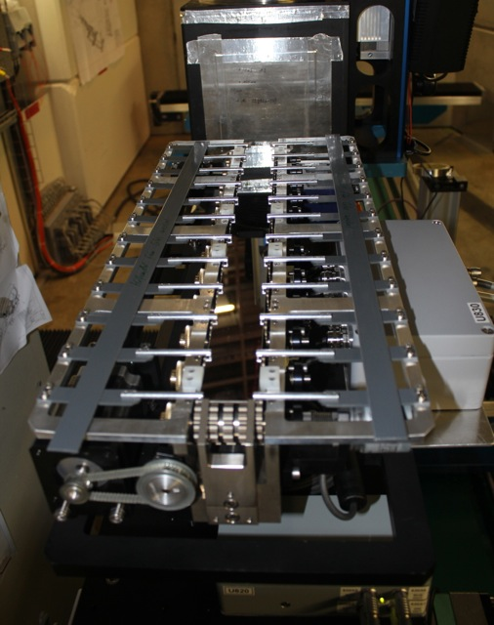
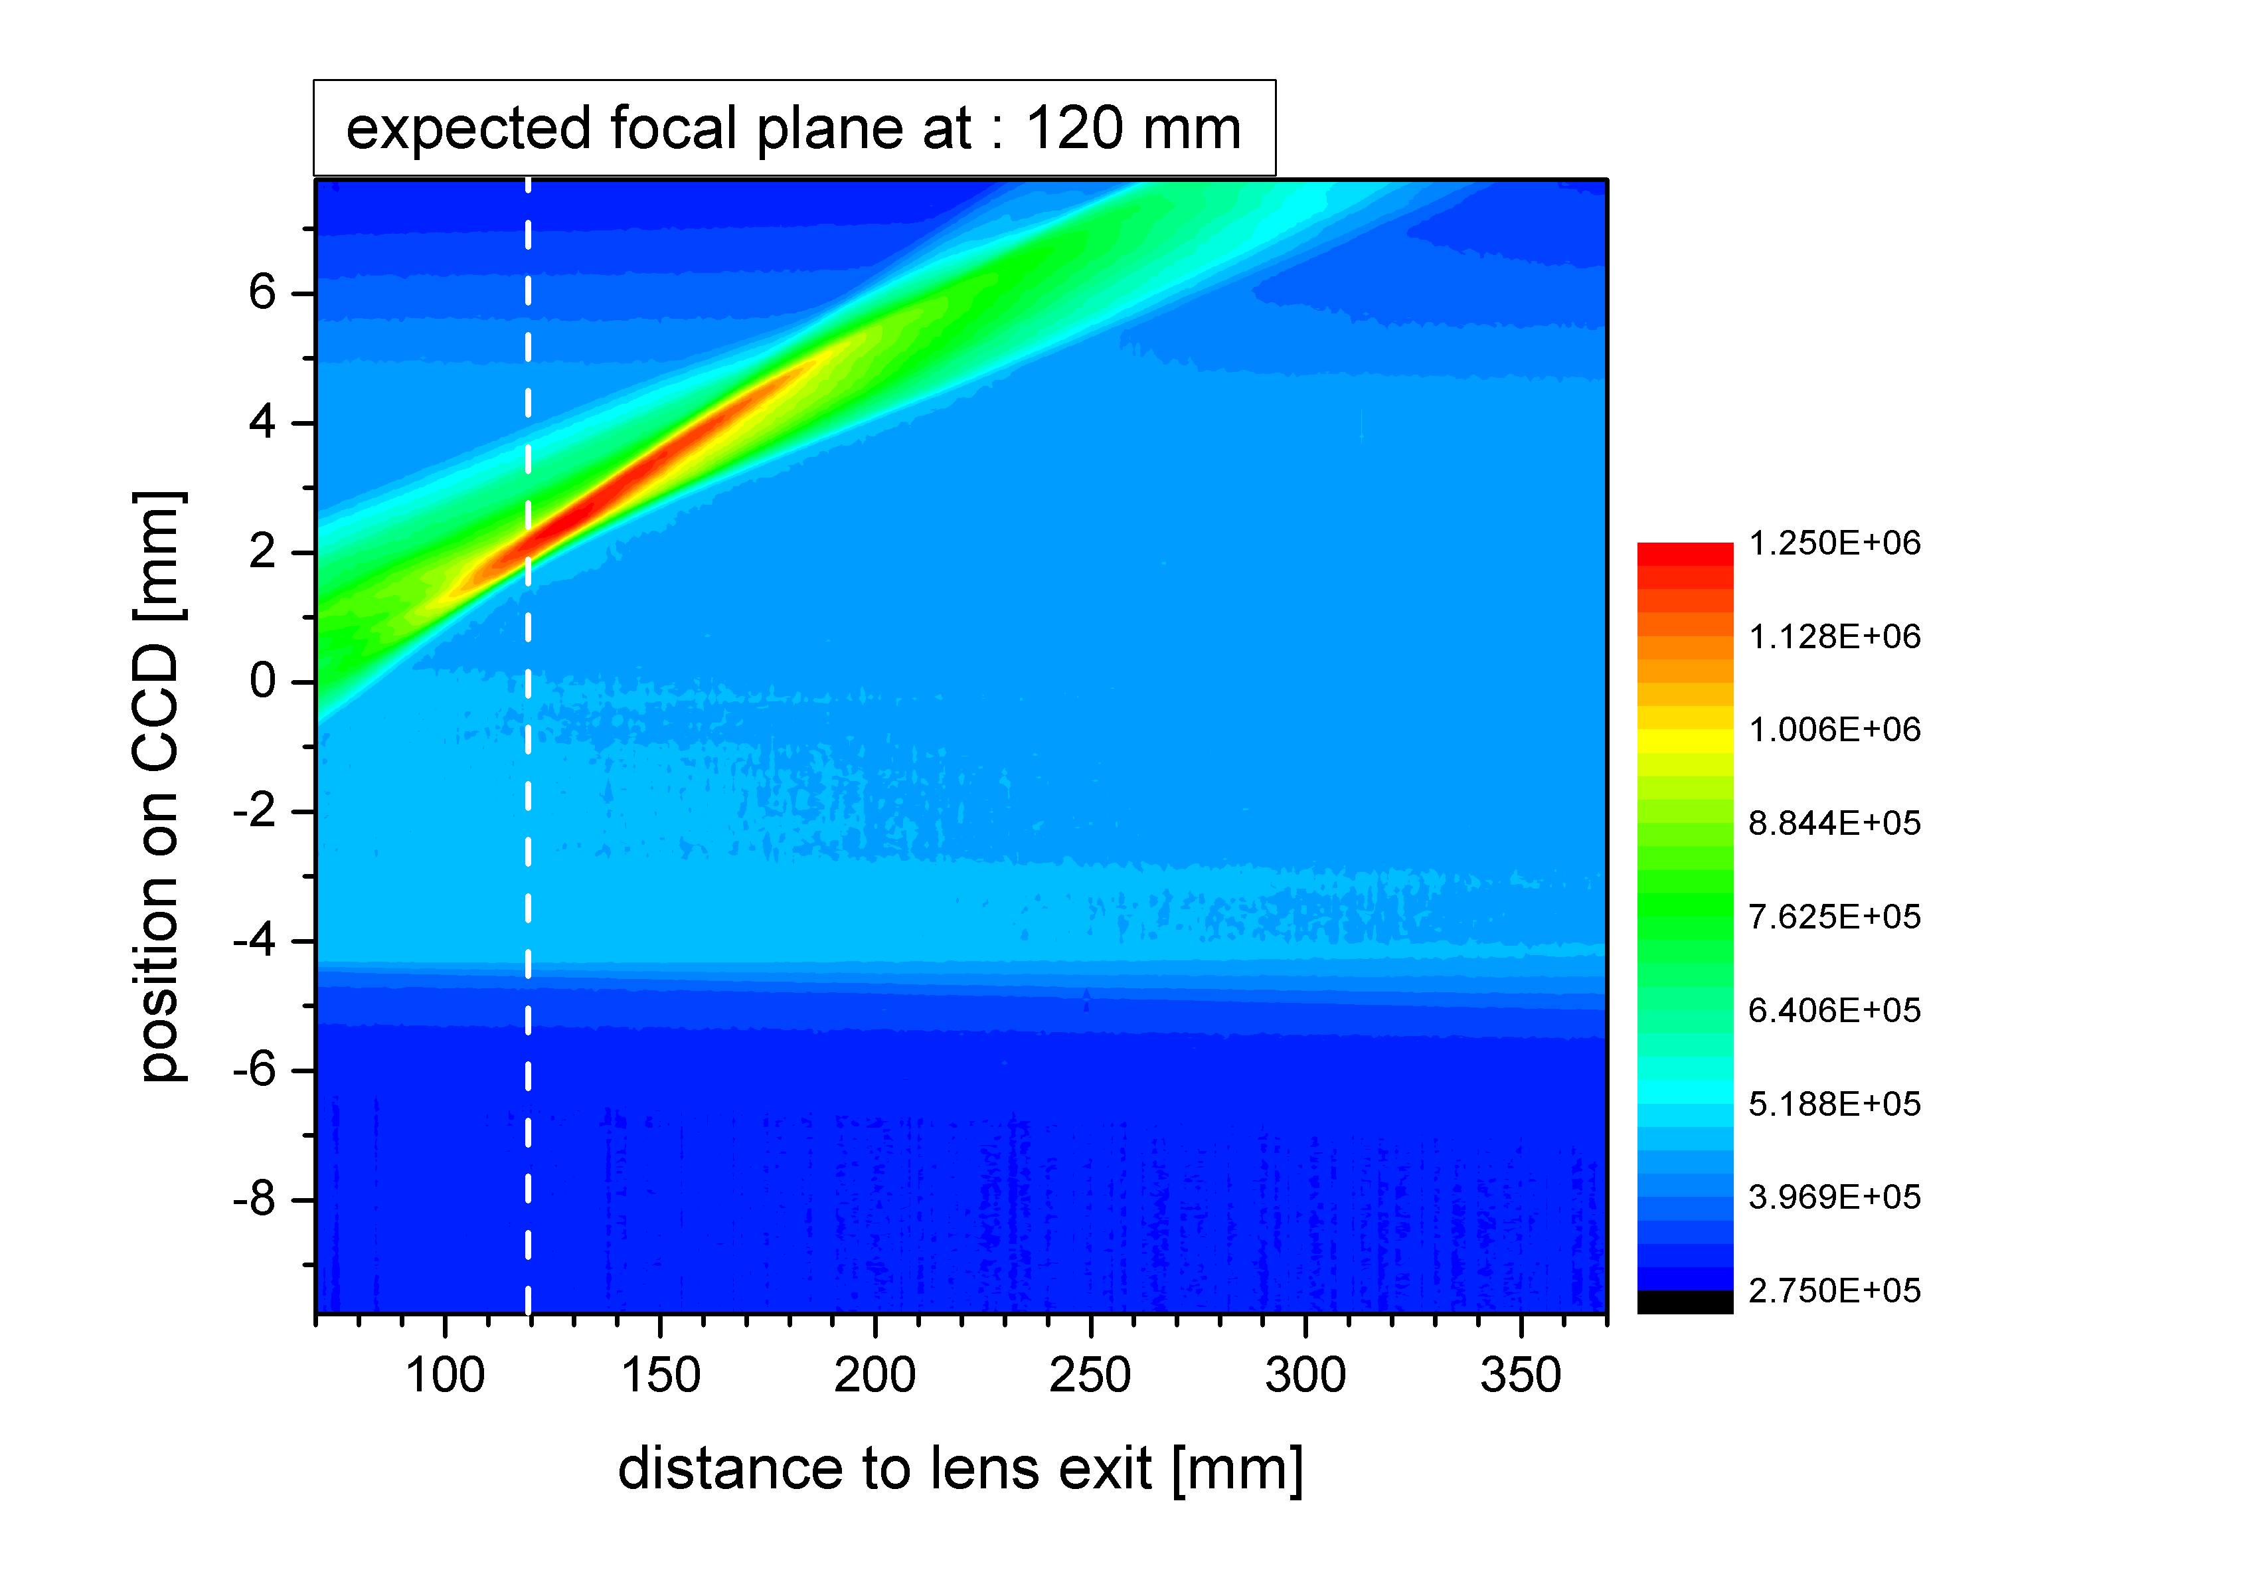
Test Series with motorized adaptive optics (improved version)
Validation of the focal points for 10 different lens configurations
Phase space for the lens setup with a focal length of 120 mm

Slide 7
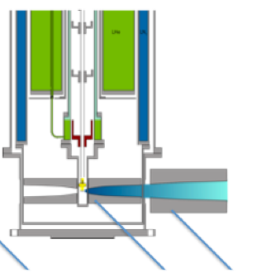
Focusing neutrons within sample environment
NEW: Coupling of two neutron lenses
Pressure cell inside cryostat
l=90 mm; f=13 mm; a=7.2 mm; b=40 mm
Conditions:
Focusing neutrons inside the pressure cell (opening d=1.2 mm)
Pressure cell: until 100 kbar
Temperature: until 4K
Precision: better 0.1 mm (height); tilting: 0.1 deg
elliptic
cryo-lens
neutron
lens outside
(Adaptive optics)

Slide 8
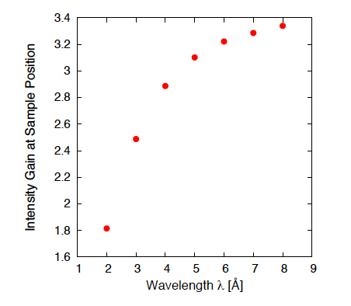
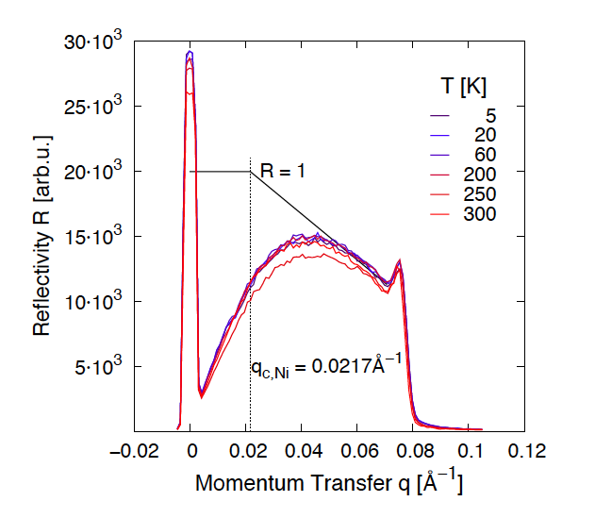
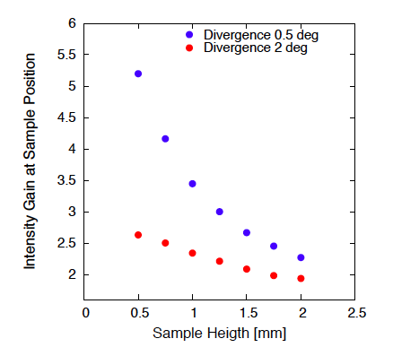
Pre-tests with “cooled” neutron lenses
Simulated performance of an ideal cryo-lens setup (divergence: 1 deg)
Measurement of Supermirror reflectivity for
different temperatures
Simulated intensity gain as a function of divergence and sample size
between 300 K and 250 K a small change of the reflectivity behaviour was observed -> thermal contraction of the sample holder tube

Slide 9
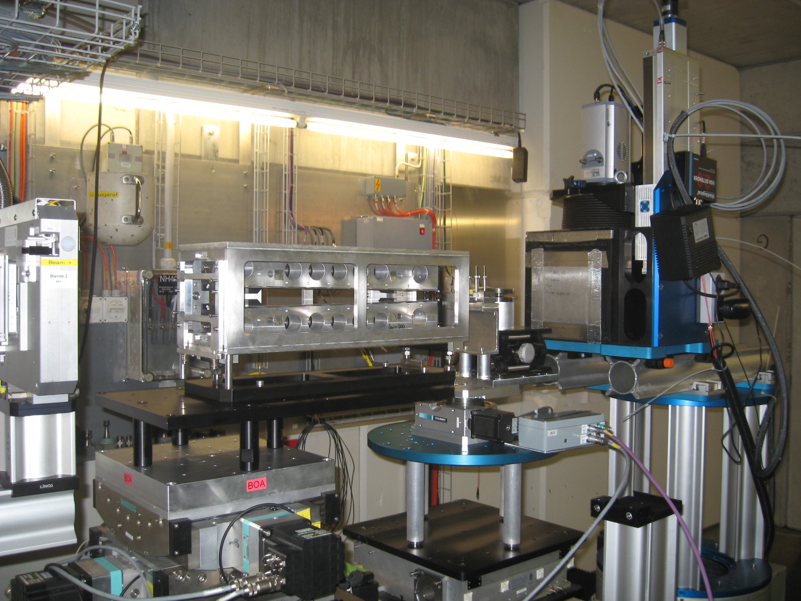
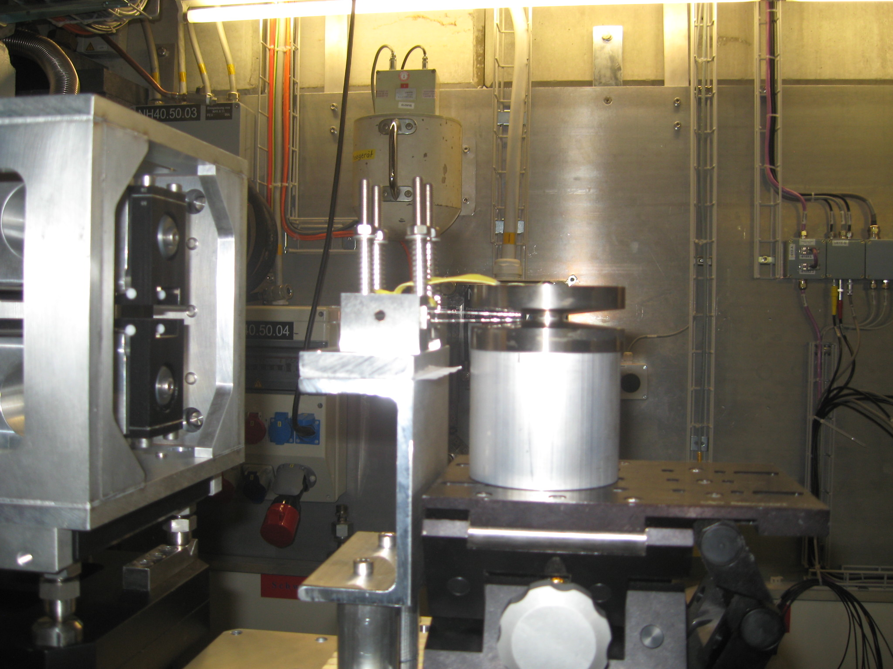
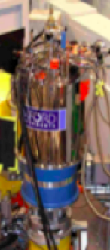
Extensive measurement series on the BOA beamline
CCD camera with a
neutron scintillator
slit
Parabolic lens
outside
neutron lens
inside pressure cell
BOA - Cold neutron spectrum
SINQ cryostat

Slide 10
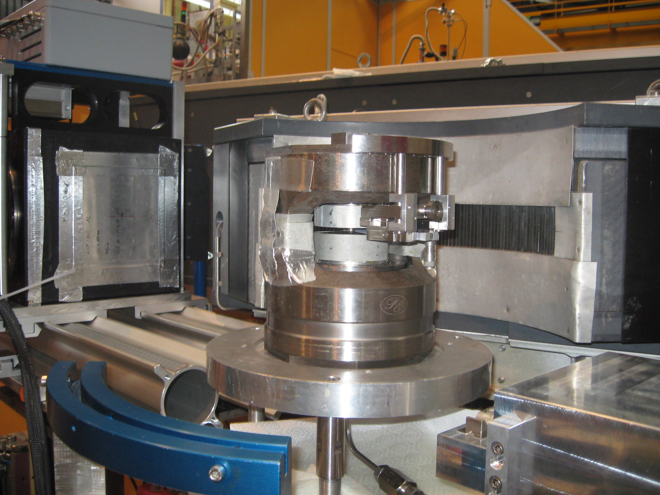
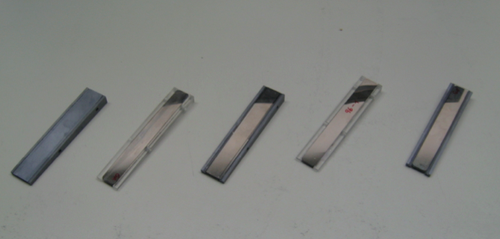
Cryo-Lens design
Investigation of Si, glass or a composite based cryo lens system
Key-point: assembling of the lenses (special device & choice of glow)
Cryo-lens holder (precision under extrem conditions (4K, 100 kbar)
Neutron lens fixed at the Pressure cell anvils
Different neutron lenses of Si and glass
Length: 90 mm Openings: entrance 6mm; exit 1.5 mm

Slide 11
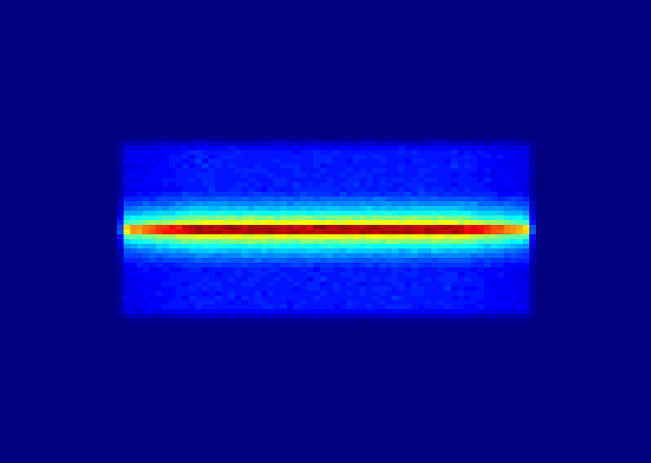
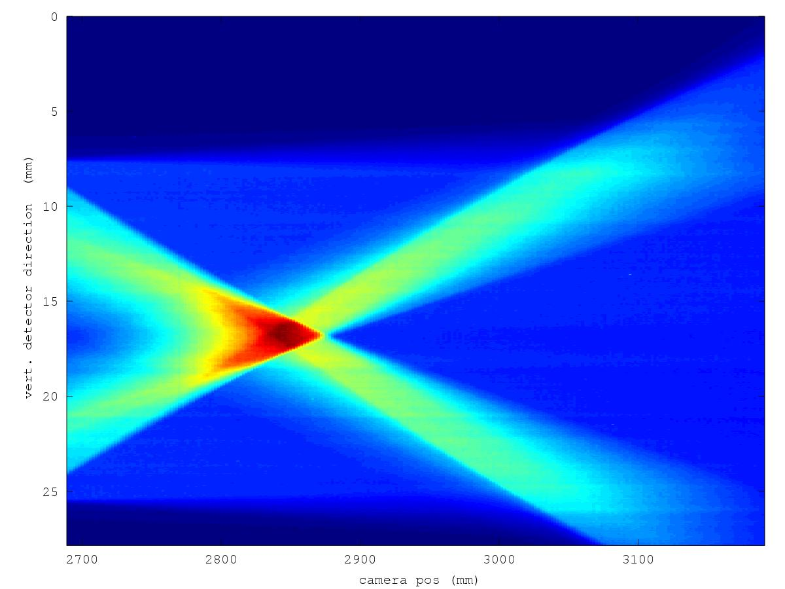
Step1: Adjustment of the first elliptic-shaped neutron lens
Goal: characterization of the sample position
A : Profile at sample position (focus point)
measurement neutron phase space (data are integrated in horizontal plane) along the neutron flight path (behind the exit of the first neutron lens)
Peak width: < 1.2 mm
B : Profile at 9.4 cm behind the exit of the lens
A : Profile at sample position
B : Profile at 9.4 cm behind the exit
of the lens

Slide 12
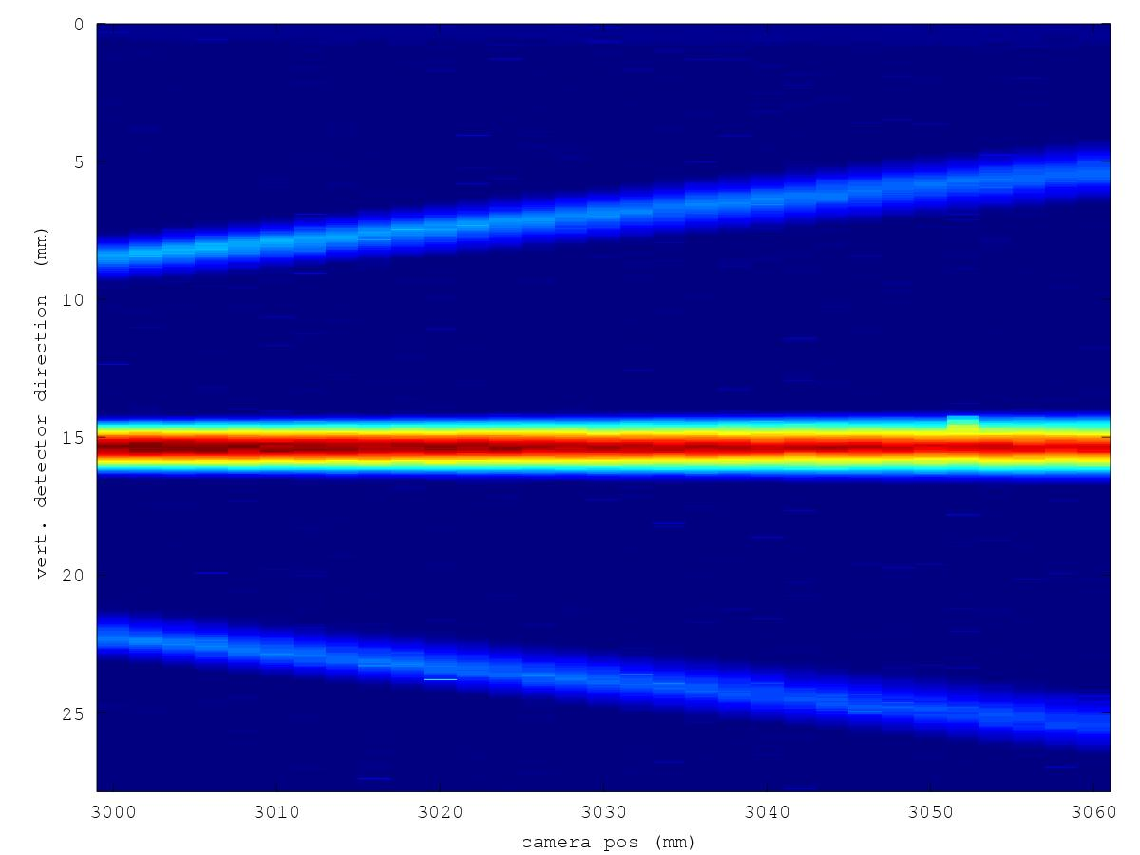
Step 2: Alignment of the cryo-lens (inside pressure cell)
at the focal point (sample position) of the first elliptic-shaped lens
A : Profile at 12 cm behind sample position
B : Profile at 17 cm behind sample position
B : Profile at 17 cm behind
sample position (focal point)
A : Profile at 12 cm behind
sample position (focal point)
Alignment of the cryo-lens setup
closed to perfect !

Slide 13
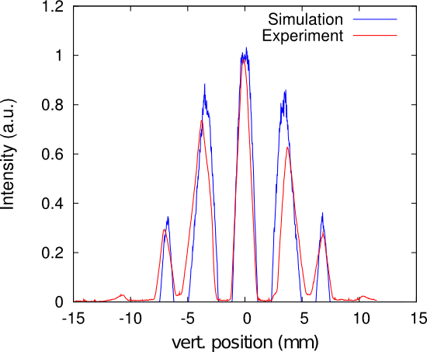
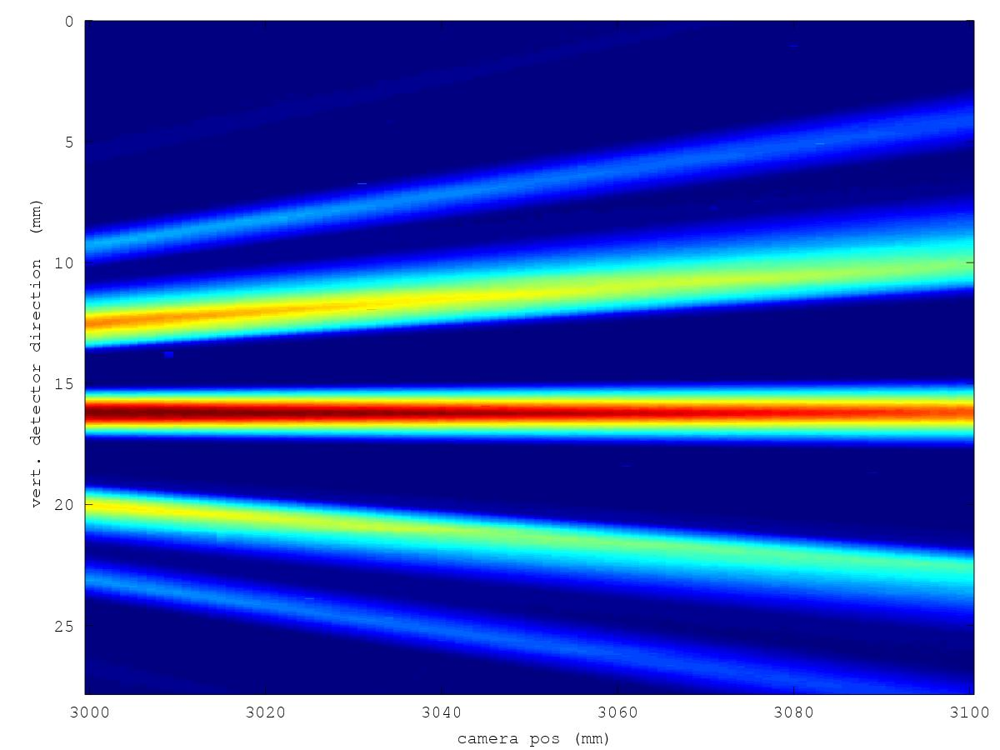
Step 3: Combined setup of the cryo-lens (inside pressure cell)
and the upstream adaptive neutron lens
A : Profile at 12 cm behind sample position
B : Profile at 17 cm behind sample position
B : Profile at 17 cm behind
sample position
A : Profile at 12 cm behind
sample position
Measured intensity gain: 3.1(3.7)

Slide 14
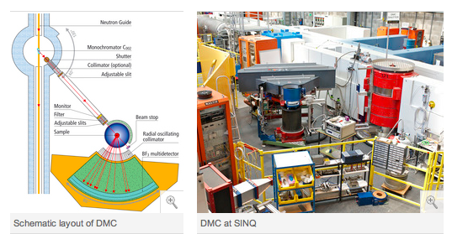
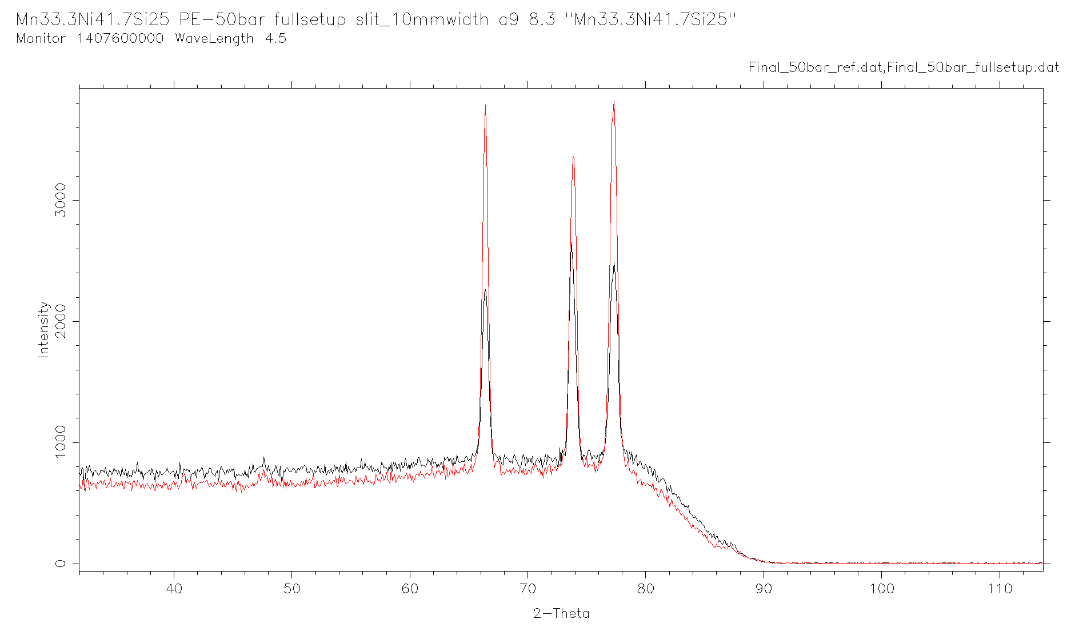
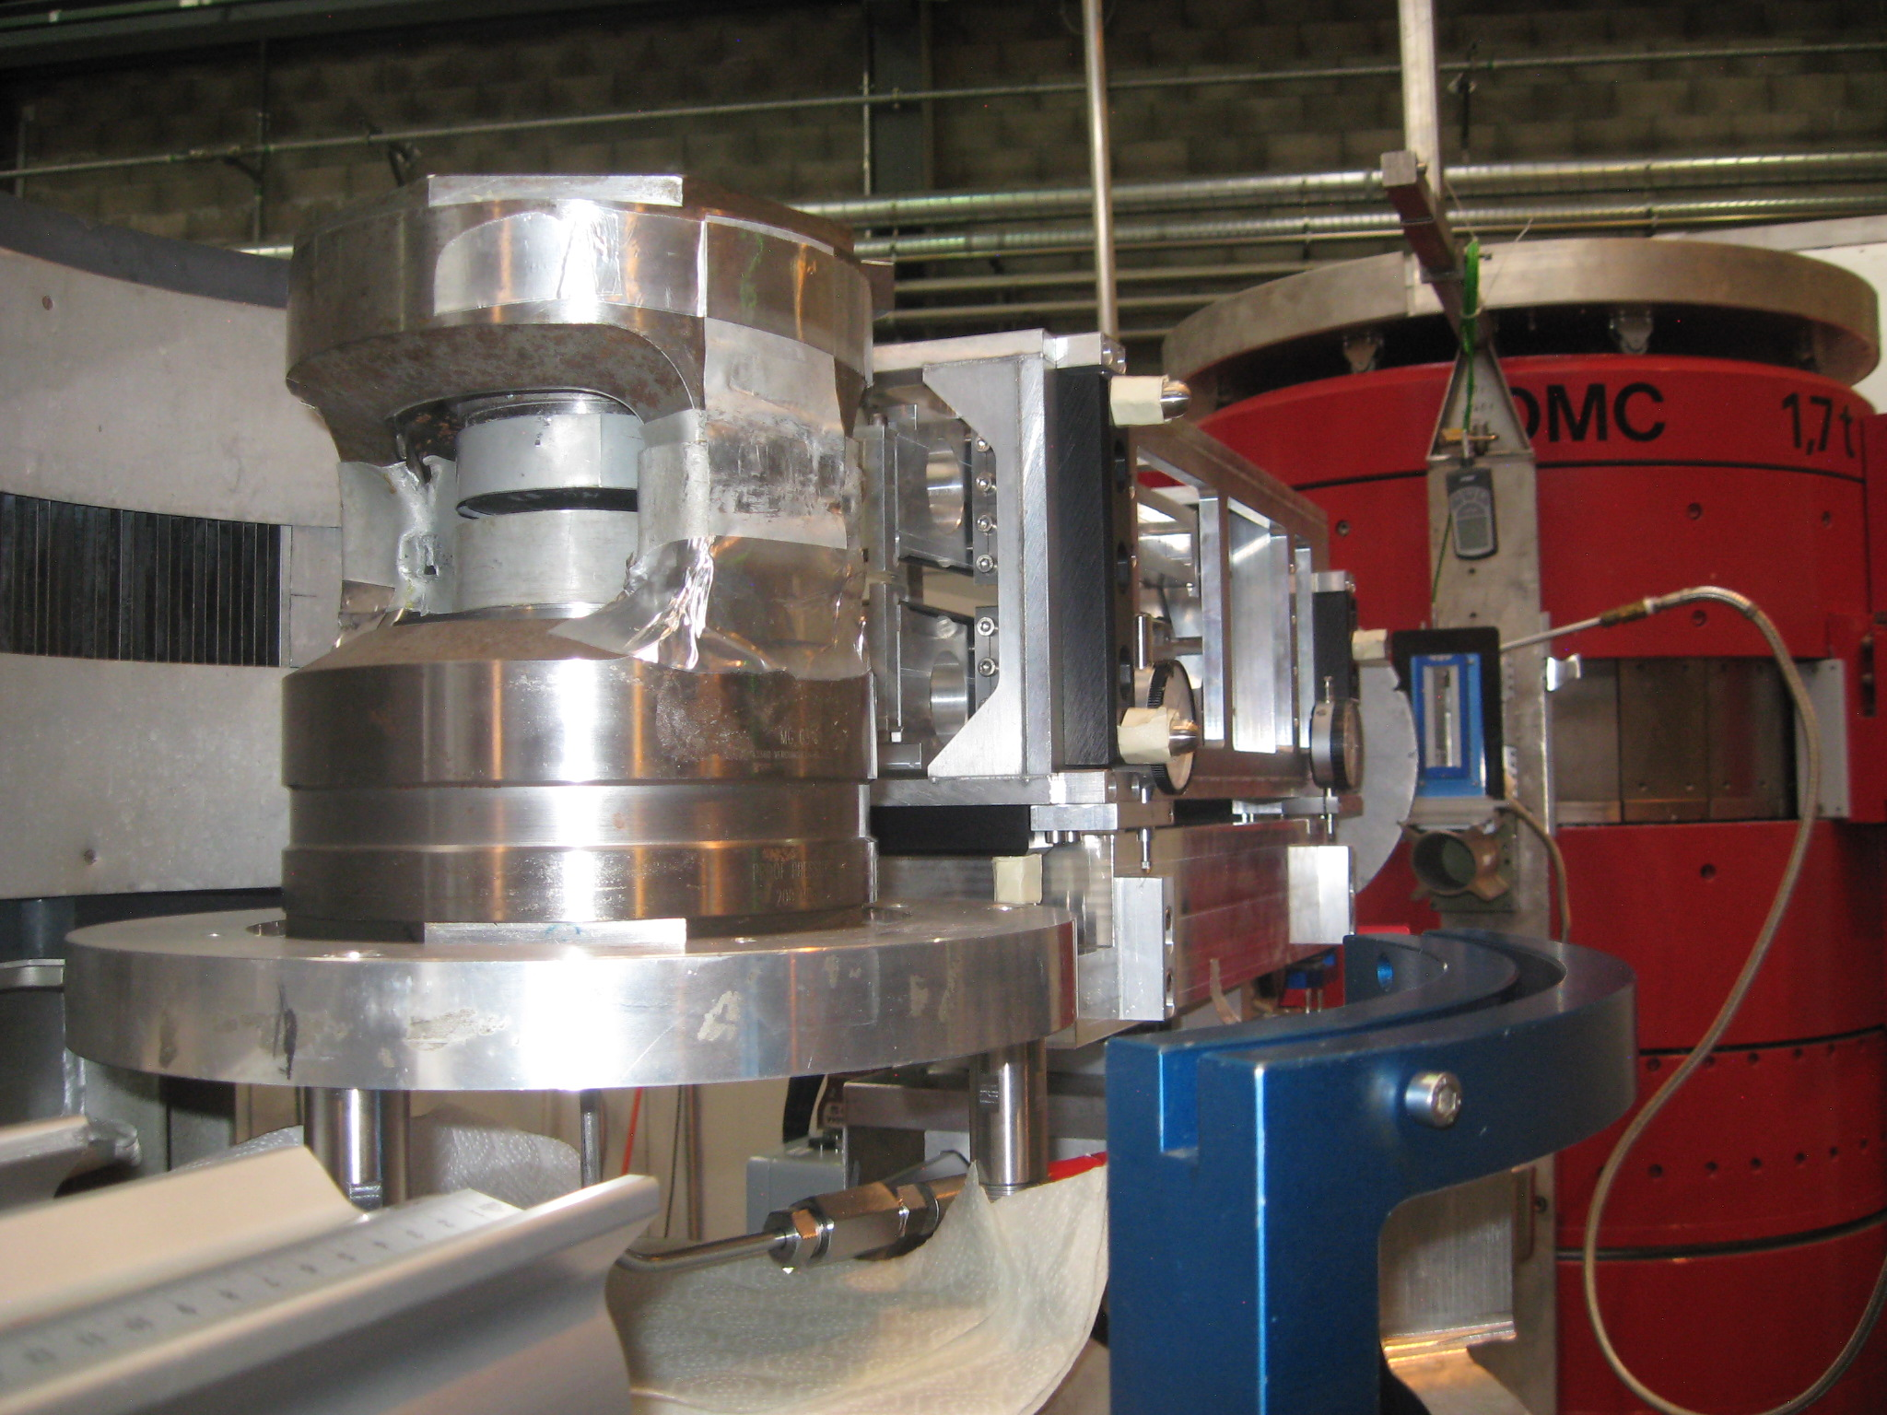
First powder experiments at the instrument DMC/SINQ
Comparison of measured data with (black) and without (red) neutron lenses
DMC Layout
Sample: Mn_{33.3}Ni_{41.7}Si₂₅ at 4.5 A
Measurement was done until a pressure of 60 kbar.
A gain factor (signal/noice) of 2.5 was measured without a loss in resolution.
Experimental setup

Slide 15
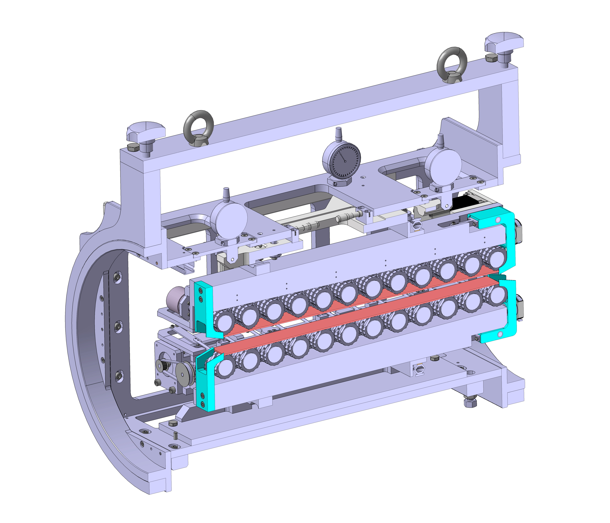
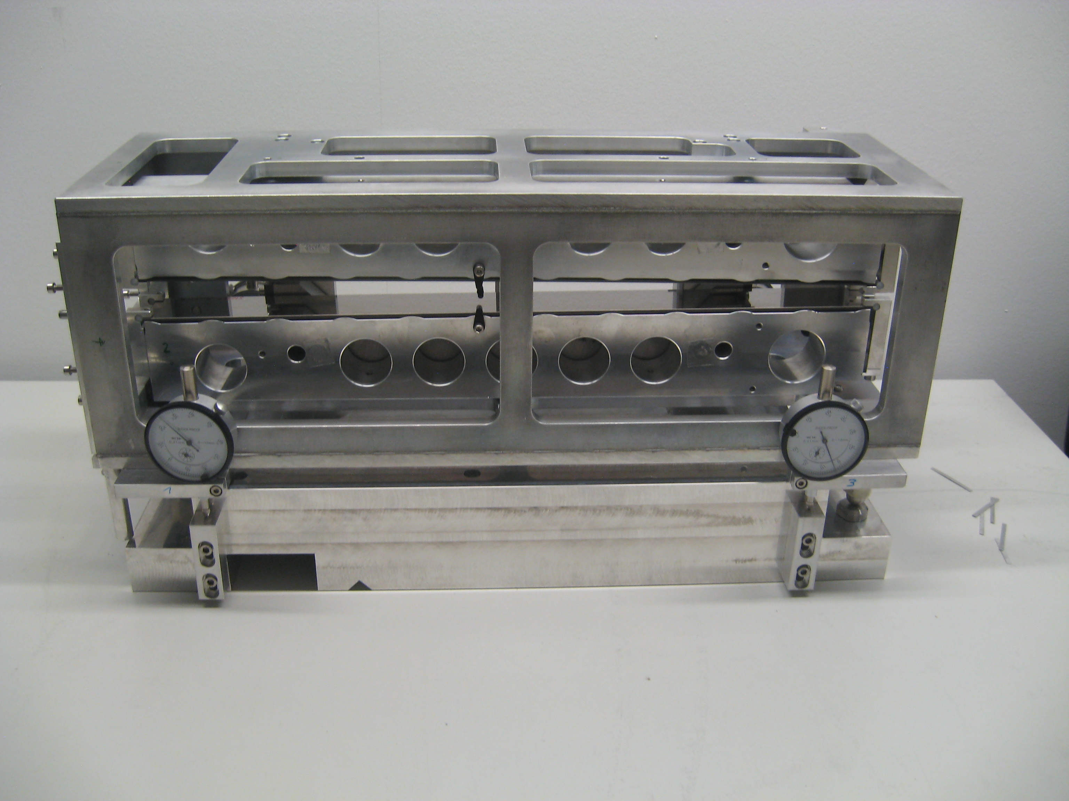
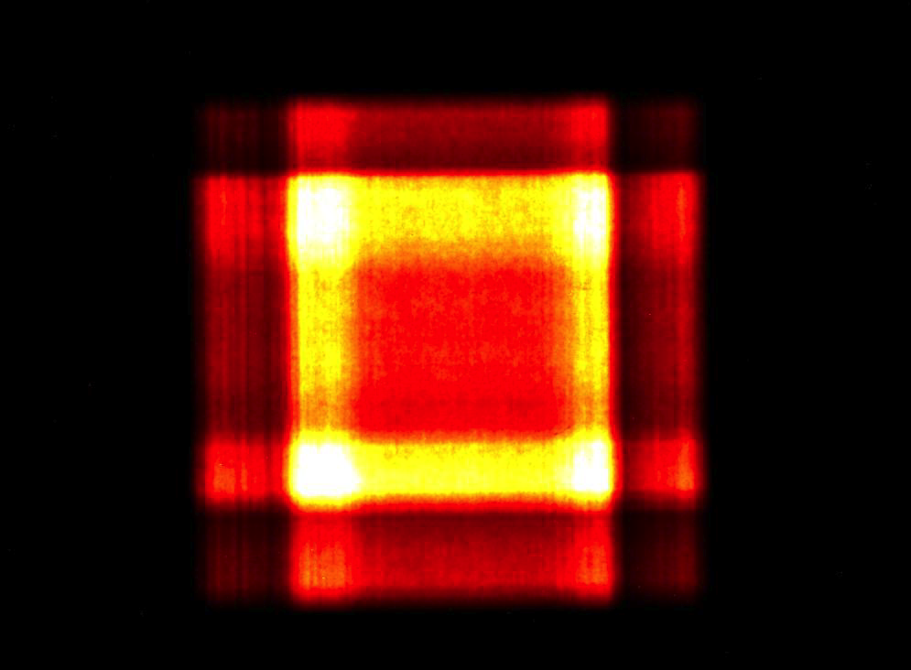
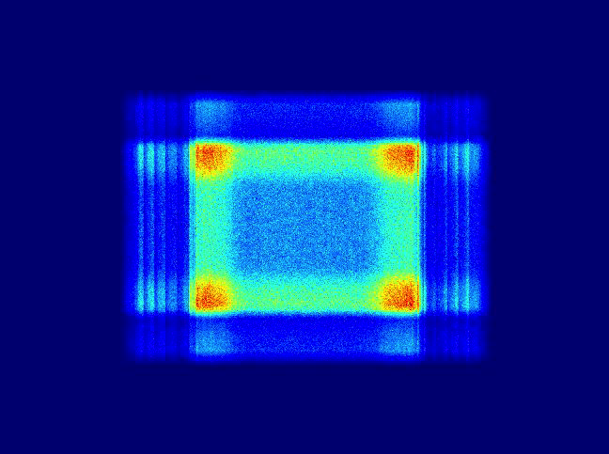
Outlook – Neutron Optics
Adaptive Neutron Optics
Automatic alignment system for high precision optics – coupling of several adaptive optic elements (sequence of adaptive lenses)
Full version of motorized adaptive optics
(tests in May 2014)
within vacuum
Developing software for automatic alignment
Experiment
Simulation
How much the experiment is misaligned ?

Slide 16
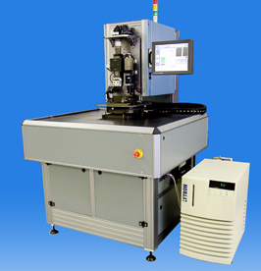
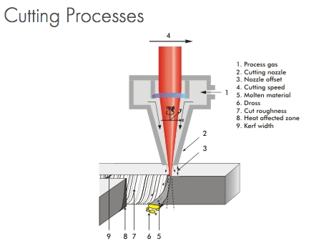
cont. Outlook – Neutron Optics
Cryo-lens Neutron Optics
Motorized axes inside the cryostat (tilt and z-translation)
- new design version will be available in the next weeks
Manufacturing cryo-lenses – focus on shaping the lens substrates
- a very interesting option would be: Laser cutting
Comparison to a multi-channel setup (Phils work)

Slide 17
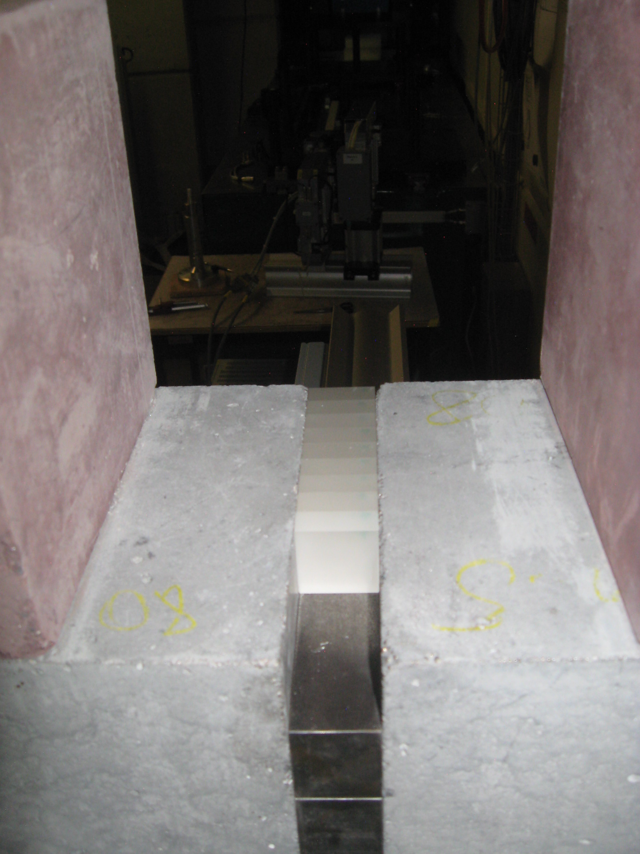
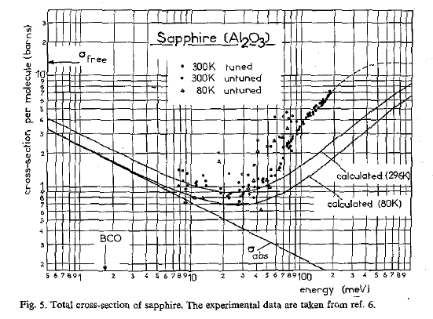
Sapphire - Neutron filters for Fast Neutrons
Sapphire – Al₂O₃
Sapphire crystals
within shielding
12 crystals from 3 different suppliers (Stettler – 4 crystals; Korth – 4 crystals; Kyburz – 4 crystals)
Dimension: 26 mm x 26 mm x 10 mm
Orientation: c-plan
Precision of orientation: 1 and 3 deg
TASK: validating background reduction; neutron transmission of useful neutrons

Slide 18
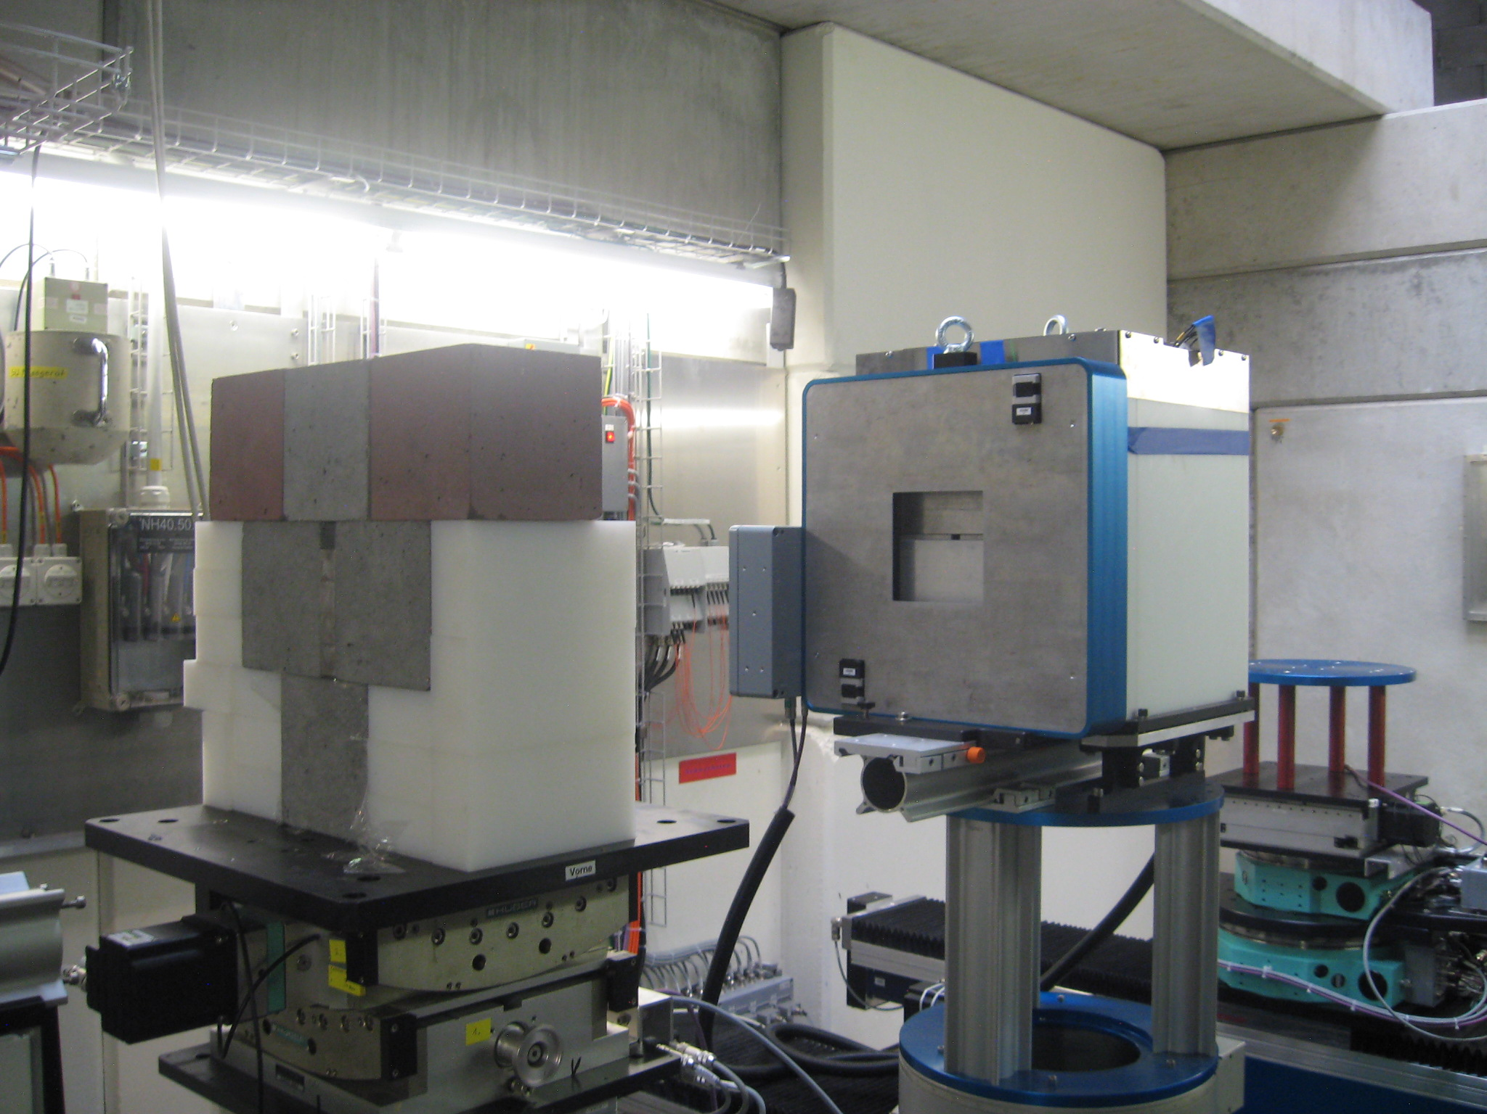
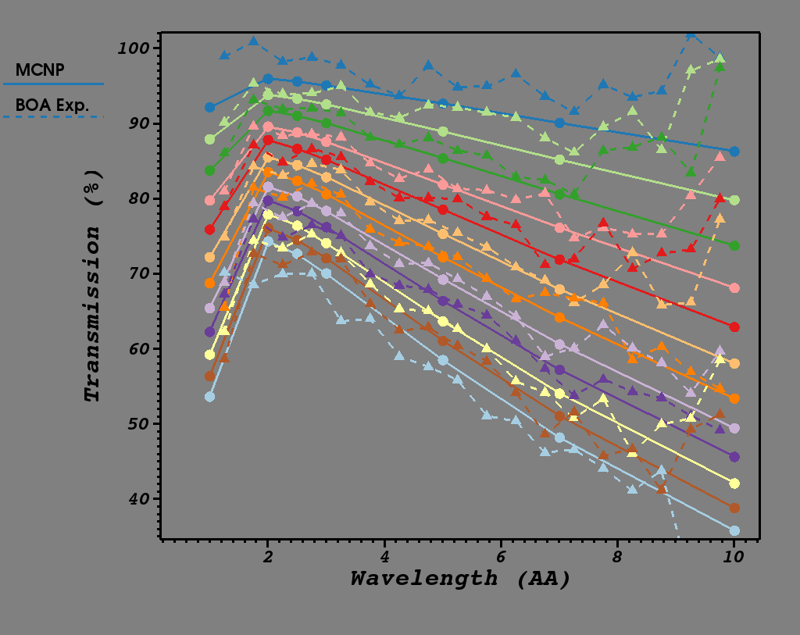
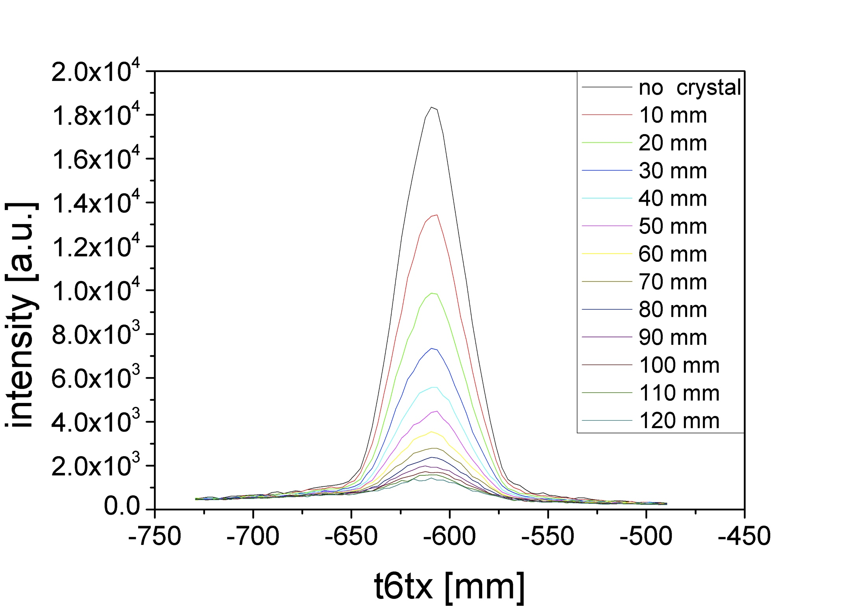
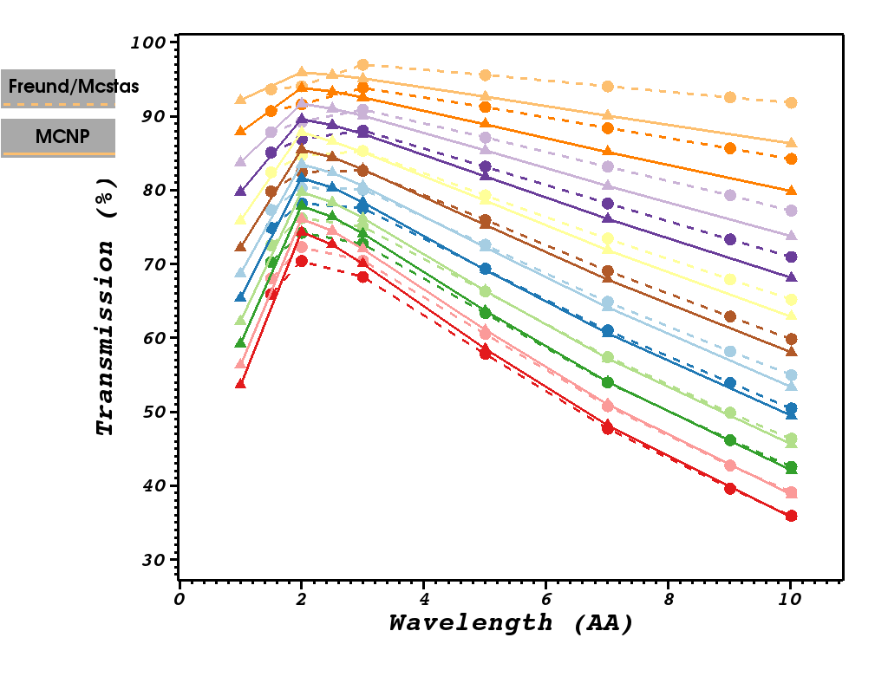
Background simulations/validation - Sapphire Filters
Sapphire filter setup on BOA
Measurement of fast and cold neutrons depending from the crystal thickness
Cold neutron transmission spectra
Integrated fast neutron count rate
MCNPX/MCStas Simulations
Fast neutron flux was reduced by a
factor of 12.5 (12 crystals) – Peak Intensity
cold neutrons were absorbed by 4 mm Cd
Transmission of used neutrons depends from wavelength and thickness

Slide 19
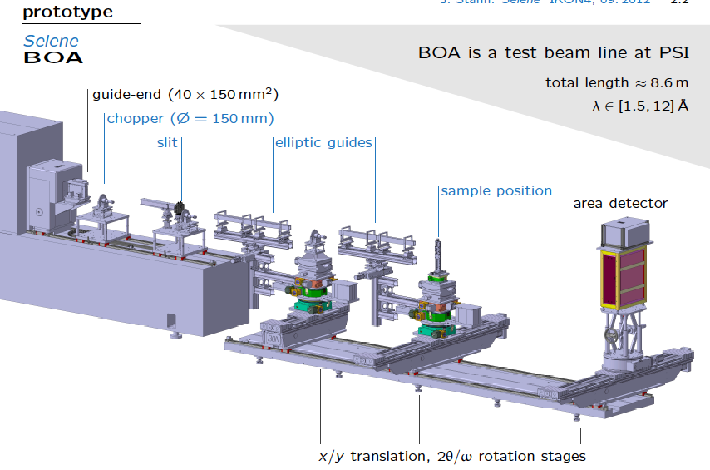
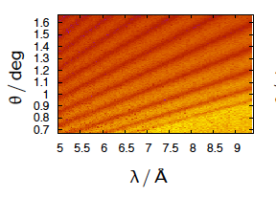
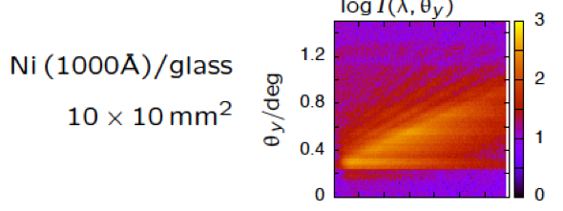
McStas - Virtual experiments of the Selene reflectometer setup on BOA
McStas Simulation Ni(1000 A)
Measurements

Slide 20
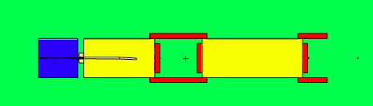
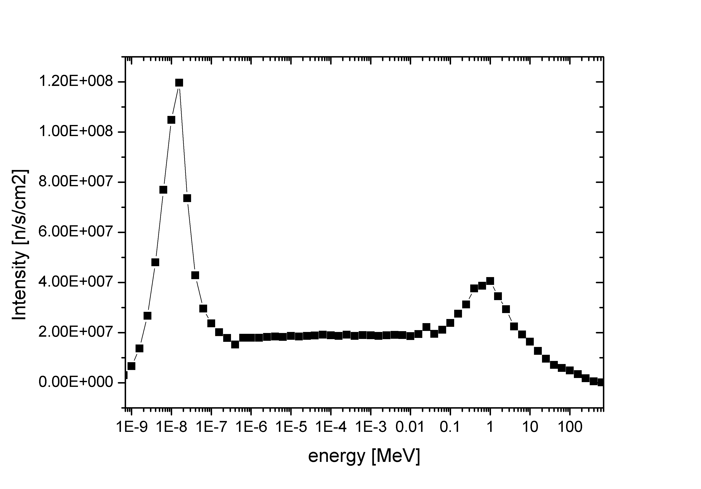
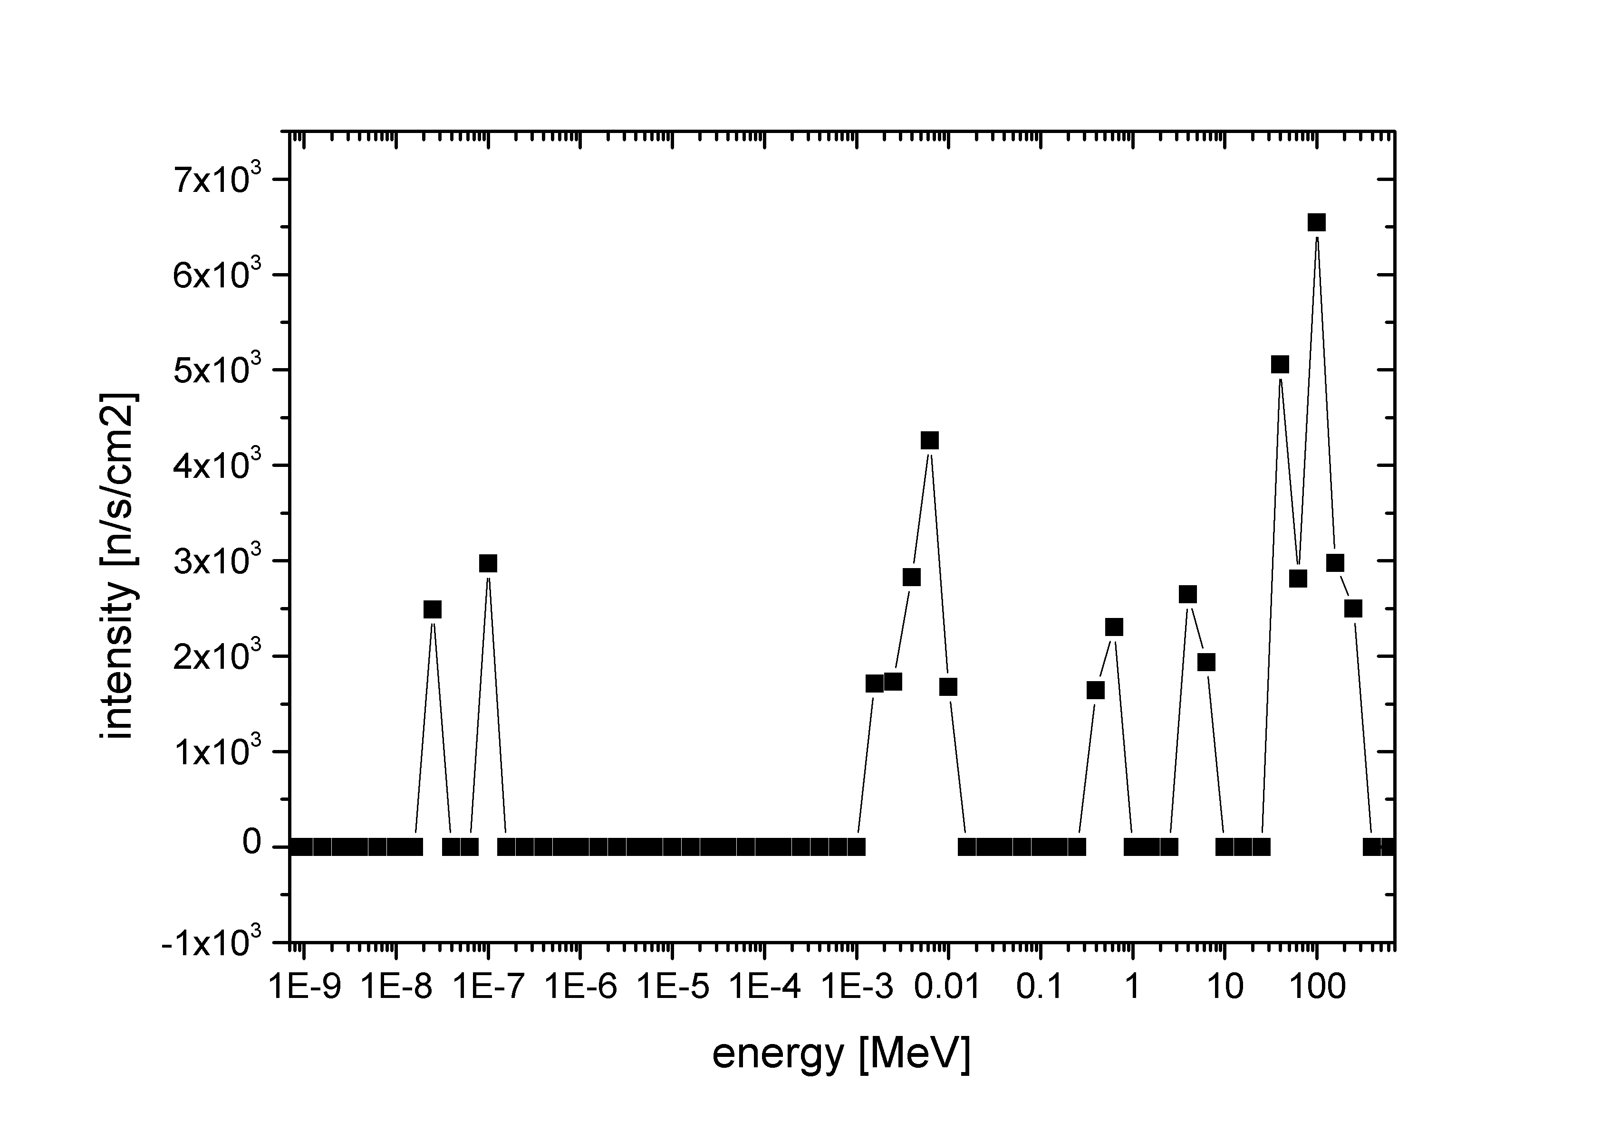
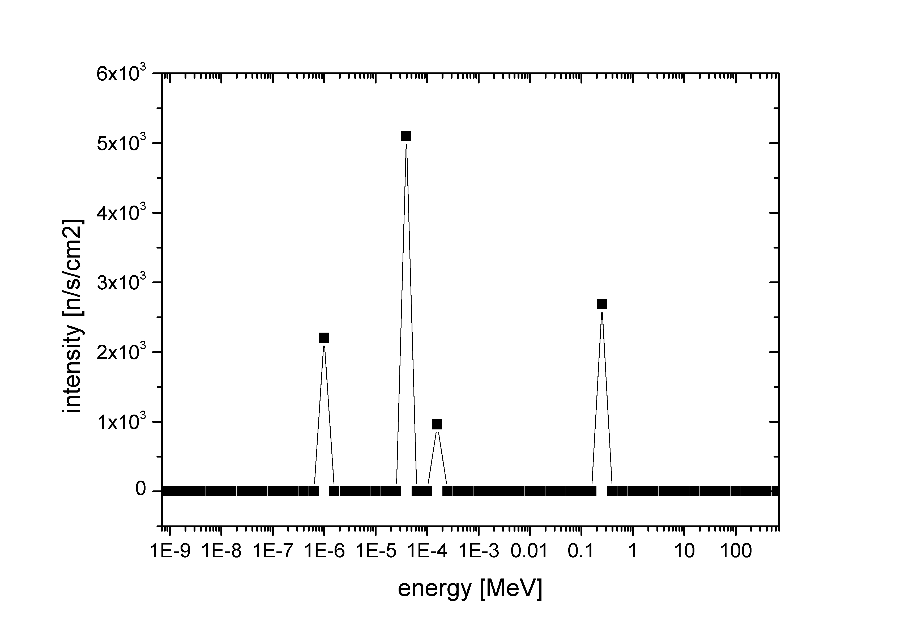
Shielding concepts for a complete instruments – Selene reflectometer
7.2 m heavy
concrete
Position for
Instrument
Devices – 4.8m
7.2 m heavy
concrete
4 m steel
Outgoing beam
shifted by 44 cm
in x & y
Shielding DIMS: r= 2 m
1.4 E9 n/s/cm2
around 4.6 E4 n/s/cm2
Low Background

Slide 21
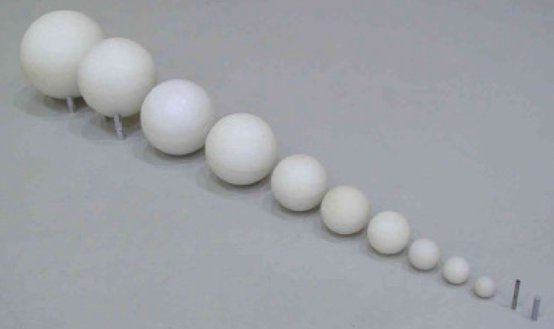
Outlook – Background Topic
Establishment of a background measurement system for fast neutrons (e.g. Bonner Sphere spectrometer)
Extension of the energy range to 100 MeV or more.
Possible solution: adding a tungsten/lead layer
(Wendy2 design)
Standard BSS setup – energy range 10⁻⁸ to 20 MeV
Developing new shielding materials/concepts for high energy particles (PSI – expertise in heavy concrete)

