Slide 1
Instrument Construction and Interfaces
Rob Connatser
Chief Instrument Project Engineer
www.europeanspallationsource.se
November 12, 2013

Slide 2
Organization
Instrument Construction
R. Connatser
Engineers
(matrix)
Project Planners
(matrix)
Scientists
(matrix)
Construction Management
(2016+)
S. Ossowski
S. Ossowski
S. Ossowski
E. Oksanen
A. Jackson
M. Strobl
G. Aprigliano
S. Pullen
C. Lopez
Z. Lazic
P. Bentley
S. Ossowski

Slide 3
Organization
Instrument Construction
R. Connatser
Engineers
(matrix)
Project Planners
(matrix)
Scientists
(matrix)
Construction Management
(2016+)
S. Ossowski
S. Ossowski
S. Ossowski
E. Oksanen
A. Jackson
M. Strobl
G. Aprigliano
S. Pullen
C. Lopez
Z. Lazic
P. Bentley
S. Ossowski
NMX Instrument Project
LOKI Instrument Project
ODIN Instrument Project
Bunker Project

Slide 4
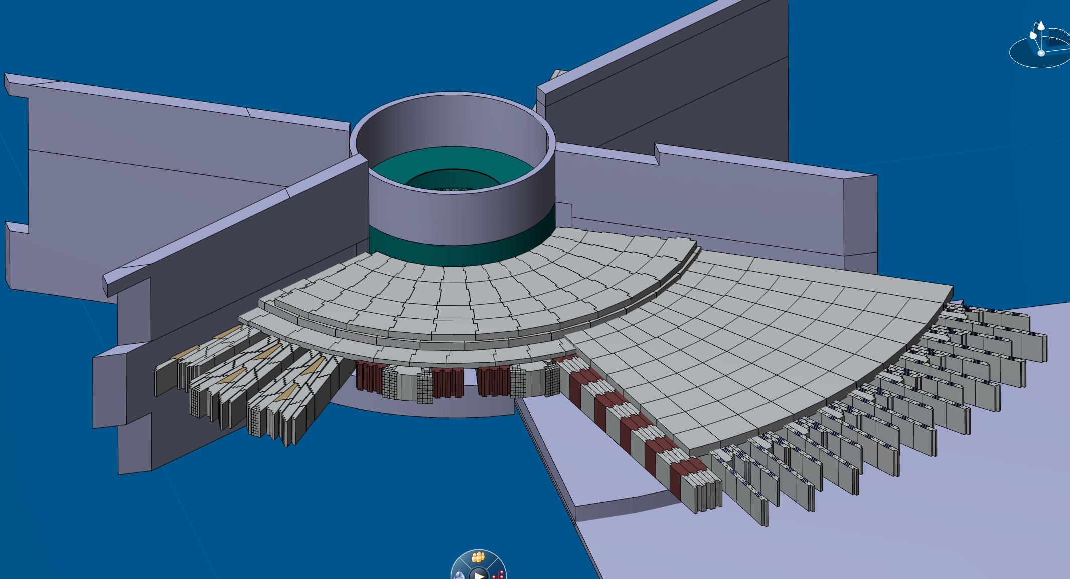
Bunker – Preliminary view

Slide 5
Shielding Bunker Functional Requirements
Primary: Provide radiation shielding for human protection, with dose rates of < 2 μSv/h in areas where persons may work.
Requirement Source: ESS-0003520
Secondary: Reduce background levels of radiation for neutron scattering instruments by limiting emittance to ≤ 5x10^4 hadrons greater than 10MeV energy per square meter per second.
Requirement Source: Optics and Shielding Group
Notes:
----- Meeting Notes (10/25/13 10:16) -----
greater 10 MeV;2 uSv

Slide 6
Bunker Plan 2014
Design
  Preliminary modeling
  Shape (including structural)
  Layout
Materials Development
  Concrete types/evaluation of TUM shielding mix
  Find cheap/free materials (military/civil eng. waste, blast furnace waste?)
Project Plan refinement

Slide 7
Bunker Plan Risks
Engineering does not fit with instrument layout details
Complexity – impact on operations and maintenance
Earthquake surety impacts capability

Slide 8
Bunker Plan 2015+
2015
  Prototyping
  Final design and full drawing
  Begin Procurements
2016
  Procurements continue
  Installation Plan
  Construction of base shielding in Experiment Hall
2017
  Install stacked portion of bunker to load floor

Slide 9
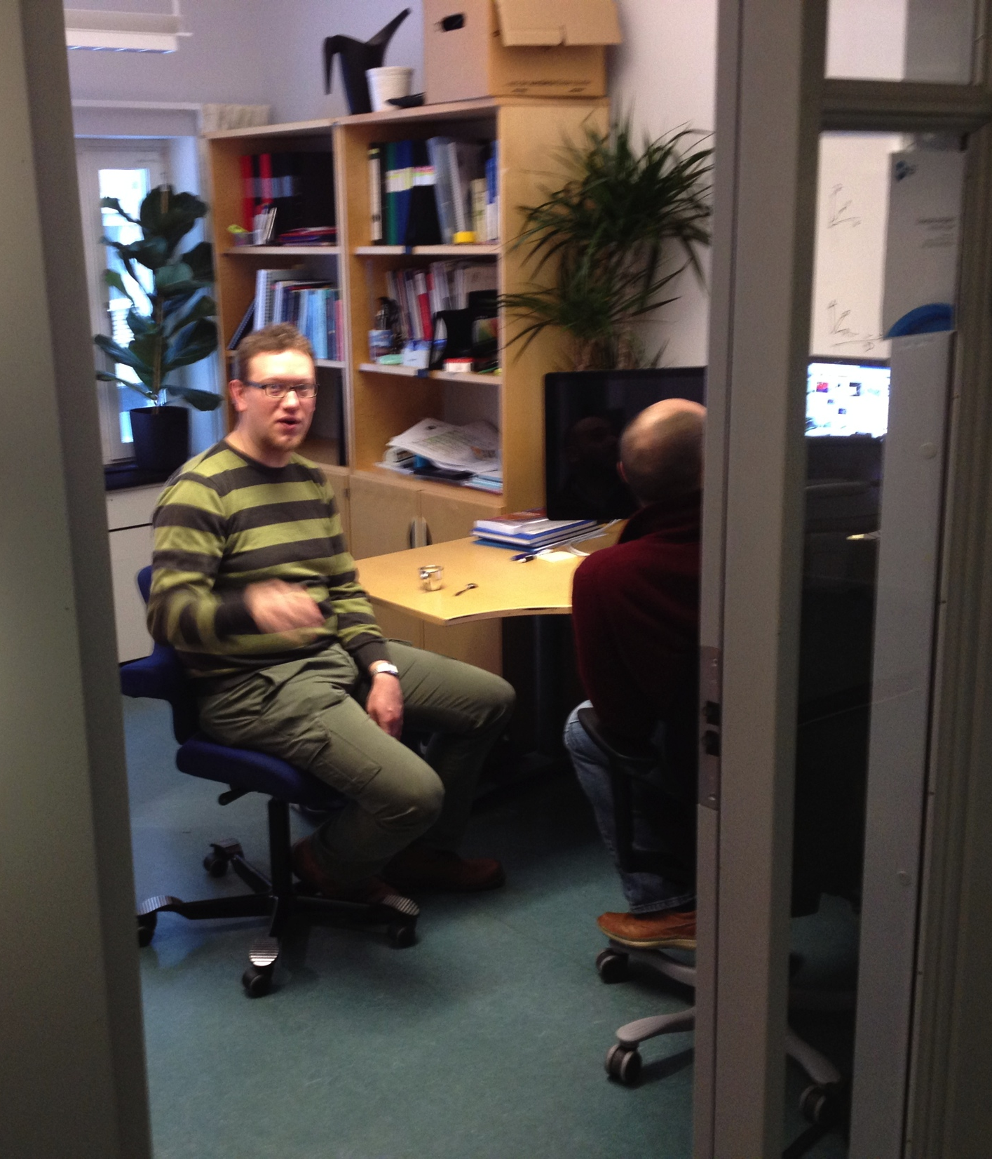
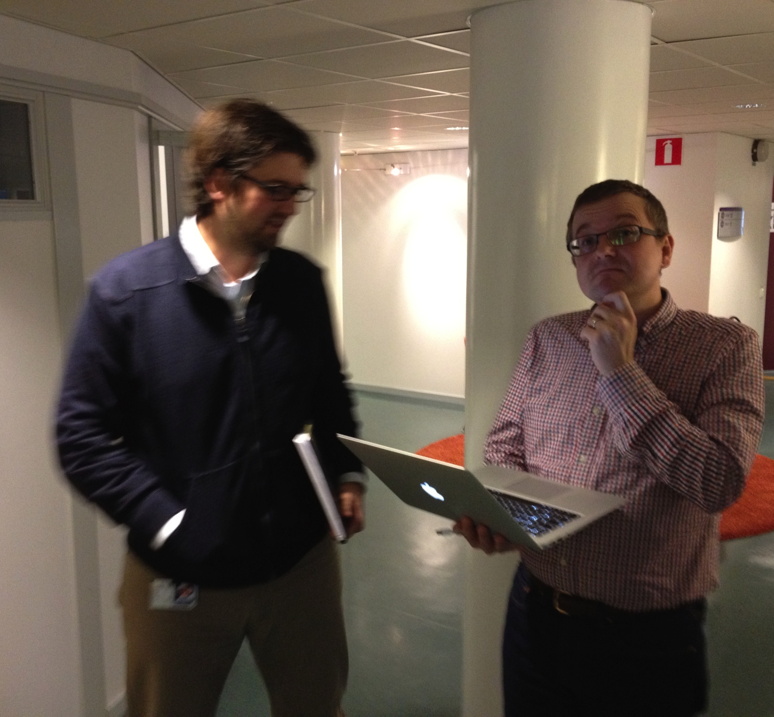
Instrument Construction
Work beginning on first instrument projects

Slide 10
Phase 1 Resources
Resources Person-years/value Funding Source
Lead Instrument Scientist 0.9 Instrument WP
Lead Engineers 1.0 Instrument WP
Planner 0.33 Programme Office
Chopper Team Member 0.25 Instrument WP
Detector Team Member 0.5 Instrument WP
Electr. Eng. Team Member 0.25 Instrument WP
Optics Team Member 0.5 Instrument WP
DMSC Team Member 0.1 DMSC SP
Travel budget 10k€ Instrument WP
Equipment budget 10k€ Instrument WP
STAP mid-year meeting 6k€ Instrument Concepts WP
STAP Review 1 6k€ Instrument Concepts WP
Engineering Review 1 8k€ Instrument WP

Slide 11
Optics and Shielding
Instrument Specifics
Proposed Concept: Verification and adaptation to engineering constraints
Option 1: High Performance Adaptation
Option 2: Cost optimization adaptation

Slide 12
Baseline Documents
Baseline Documents:
Instrument Work Package Specification
  P&ID of Instrument
  System Engineering (requirements & interface) documents
  Schedule
  Budget
  Work unit documents for distribution to in-kind partners
3D CAD model of instrument envelope
Technical Group design documents
Draft Commissioning Plan

Slide 13
Instrument Installation
 | 2014 | 2015 | 2016 | 2017 | 2018 | 2019 | 2020 | 2021 | 2022 | 2023 | 2024 | 2025 | 2026 | 2027 | 2028
Operations Schedule
#1
#2
#3
#4
#5
#6
#7
#8
#9
#10
#11
#12
#13
#14
#15
#16
Initial Design | Final Design | Procurement & Fabrication | Construction | Installation | Cold Commissioning | Hot Commissioning

Slide 14
High Level Milestones
Instrument Construction Preparation Starts | 07-Jan-16
Begin Guide Bunker Construction in Experimental Hall | 5-Dec-16
Early access to experiment hall 1 | 3-Jul-17
Early access to experiment hall 3 | 4-Sep-17
Early access to experiment hall 2 | 4-Sep-17
Internal decision to fund Instrument 16 within Construction | 15-Dec-17
Target Systems ready for installation of in-monolith optics package #1 | 28-Mar-18
Instrument guide installations begins (Instrument Construction) | 29-Jun-18
Control box (first instrument) ready for installation (ICS) | 12-Dec-18
Production of timing signal (ICS) | 12-Dec-18
First Proton on Target | 28-May-19
Instrument hall ready for neutrons | 10-Sep-19
TG5 Readiness for "Hot" Commissioning and Operations Instrument #1/#2/#3 | 17-Dec-19
Commencement of User Program on first instruments | 31-Mar-23
END of Instrument Construction WP - Construction Phase | 15-Dec-25

Slide 15
Interfaces with Target Systems
Monthly management meeting between Target and Science (encouraging regular full communications)
Target Monolith and Instrument Bunker meetings (to come to common definitions about the space)
Weekly meeting on shutter related issues
  Currently a two party meeting to ensure clarity and begin to define the questions
  Will shortly become a larger, detail engineering meeting
Notes:
The purpose of this Target/Instrument/Conventional Facilities meeting is to discuss the monolith and near-monolith beam line shielding with the goal of optimizing the overall shielding system. For this initial effort we should not get hung up on who has budget for which parts of the system. The goal is to provide adequate shielding as efficiently as possible.

Slide 16
Long Term Goals
Have an integrated shielding plan throughout the facility
Once a full plan is defined, determine scope and cost responsibility for each party.
Have harmonious relations between Science and Target
Notes:
The purpose of this Target/Instrument/Conventional Facilities meeting is to discuss the monolith and near-monolith beam line shielding with the goal of optimizing the overall shielding system. For this initial effort we should not get hung up on who has budget for which parts of the system. The goal is to provide adequate shielding as efficiently as possible.

