Slide 1

Update on
Instruments and Concepts
Ken Andersen
Neutron Optics TAP Meeting
22 January 2014

Slide 2
Instrument Selection Process
Choose instruments to maximise Early Success
First three instruments endorsed by Steering Committee
  Loki broadband SANS
  Odin multi-purpose imaging
  NMX macromolecular crystallography
16 proposals submitted this round
  6+ next year

Slide 3
Early Success Strategy
ESS will be judged a success or a failure in the early years
The first instruments need to:
  Attract a wide user community
  Provide scientific impact
  Work as expected
  High quality user service (software, sample environment, science support)
Prioritise the right instruments
Prioritise the support for those instruments

Slide 4
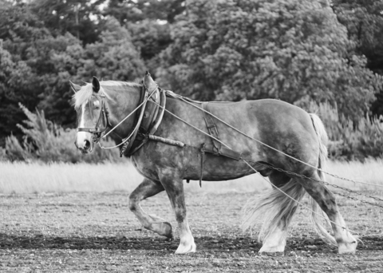
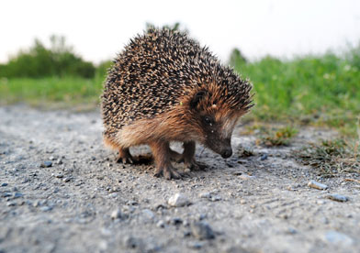
Workhorses vs Hedgehogs

Slide 5
Workhorses vs Hedgehogs
D1B powder diffractometer 1973

Slide 6
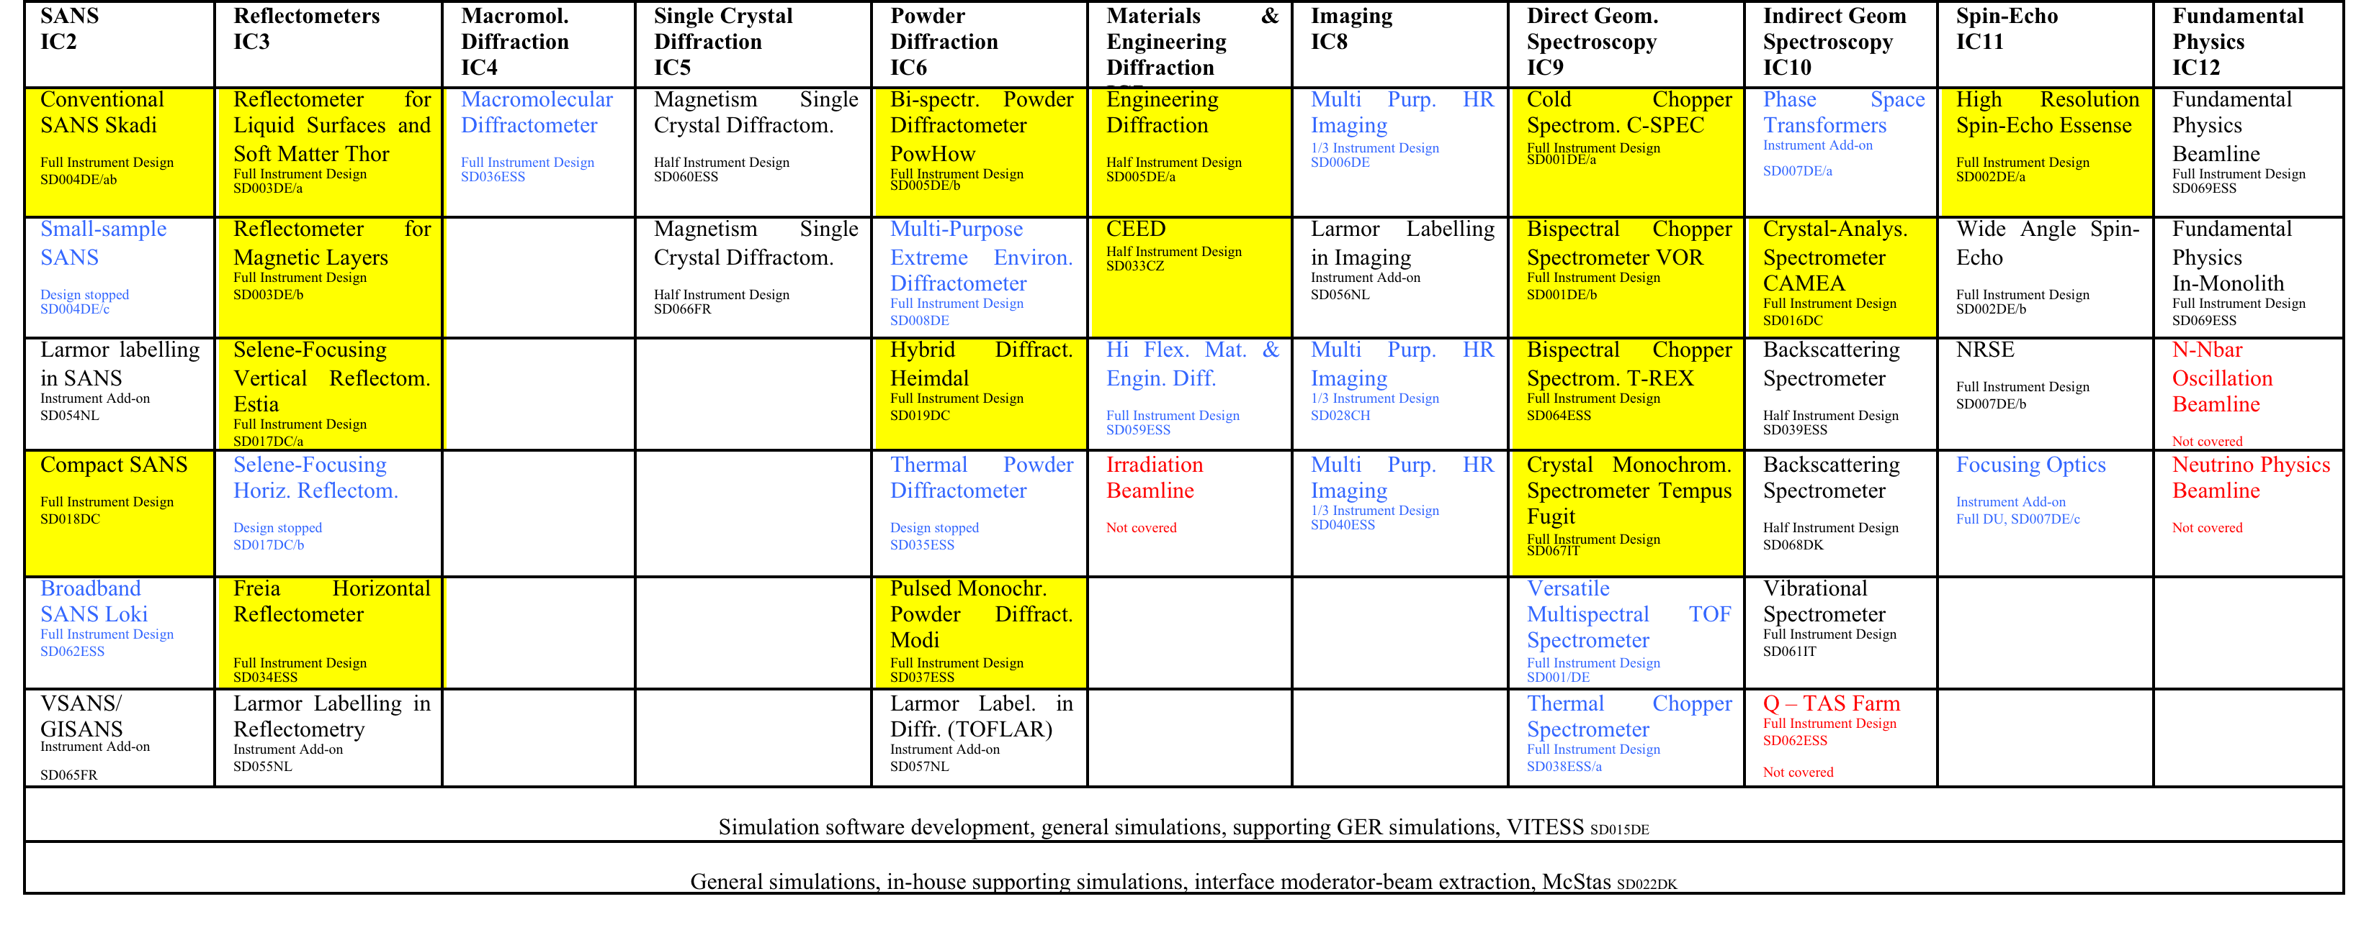
Instrument Concepts Overview
Macromolecular
Crystallography
Single Crystal
Diffraction
Mat. & Engin.
Diffraction
Direct Geometry
Spectroscopy
Indirect Geometry
Spectroscopy
Fundamental &
Particle Physics
Reflectometry
Powder
Diffraction
Spin Echo
Spectroscopy
SAN
SANS
Imaging
Blue = Stopped
Red = Not Covered

Slide 7
Organization
 | 2011 | 2012 | 2013 | 2014 | 2015 | 2016 | 2017 | 2018 | 2019
liquids reflectometer
magnetism reflectometer
3/4
16
4
2
3
bispectral chopper spectrometer T-rex
cold chopper spectrometer
extreme-environments diffractometer
bispectral powder diffractometer
Number of instrument construction proposals (expected)
engineering diffractometer SPEED
small-sample SANS
DE
conventional polarized SANS
high-resolution spin-echo
wide-angle spin-echo
Mieze-type spin-echo
imaging
phase-space transformers
focusing for spectrometers
Vitess simulation support
DK
McStas simulation support
compact SANS
Selene-type vertical reflectometer
CH-DK
Selene-type horizontal reflectometer
hybrid diffractometer Heimdal
crystal-analyser spectrometer Camea
CH
imaging
CZ
engineering diffractometer CEED
Larmor labelling for SANS
NL
Larmor labelling for reflectometry
Larmor labelling for diffraction
IT
monochromator spectrometer Tempus Fugit
vibrational spectroscopy
liquids reflectometer Freia
broadband SANS Loki
multi-purpose imaging Odin
macromolecular diffractometer NMX
thermal powder diffractometer
monochromator diffractometer Modi
wide-angle spin-echo
magnetism single-crystal diffractometer
ESS
materials & engineering diffractometer
bispectral chopper spectrometer Vor
thermal chopper spectrometer
backscattering spectrometer
fundamental physics beamline
fundamental physics in-monolith
surface scattering
extreme-environments diffractometer
HZB test beamline
FR
V-SANS add-on
magnetism single-crystal diffractometer
Future: new 1
Future: new 2

Slide 8

SANS
Compact SANS
C-SANS
LOKI
SKADI
SKADI

Slide 9
Reflectometry: Horizontal samples
FREIA
THOR

Slide 10
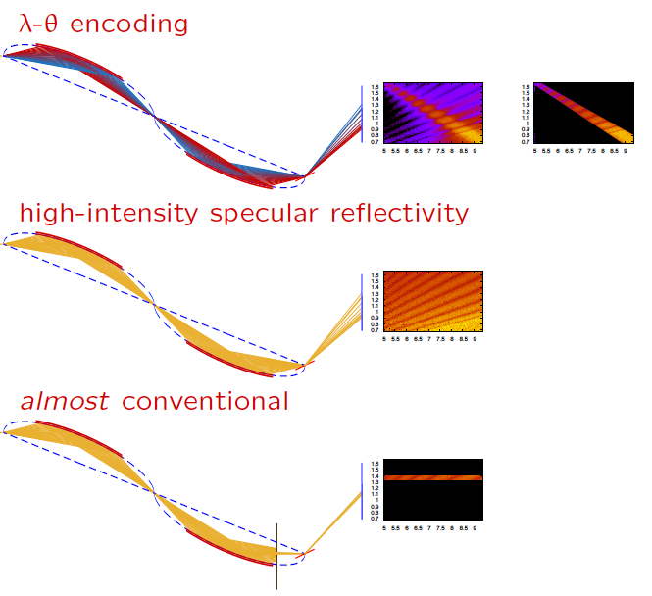
Reflectometry: Vertical samples
ESTIA
VOLDEMORT

Slide 11
Powder Diffraction
POWHOW
D20
POWGEN
WISH

Slide 12
Powder Diffraction
HEIMDAL
MODI

Slide 13
Materials & Engineering Diffraction
BEER

Slide 14
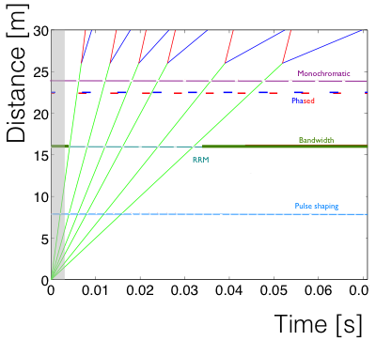
Direct Geometry Spectroscopy
VOR
Tempus Fugit

Slide 15
Direct Geometry Spectroscopy
C-SPEC
T-REX

Slide 16
Indirect Geometry Spectroscopy
CAMEA

Slide 17
Neutron Spin Echo
ESSENS
Compared to IN15:
Larger guide: flux gain 3-4
Larger Δλ: flux gain 5
Improved coils: field gain 2-3
Total gain factor: ~100

Slide 18
Instrument Concepts Overview
Macromolecular
Crystallography
Single Crystal
Diffraction
Mat. & Engin.
Diffraction
Direct Geometry
Spectroscopy
Indirect Geometry
Spectroscopy
Fundamental &
Particle Physics
Reflectometry
Powder
Diffraction
Spin Echo
Spectroscopy
SAN
SANS
Imaging
Blue = Stopped
Red = Not Covered

Slide 19
Proposal Review Process
Proposals sent for internal review
  Overall: Ken Andersen, Arno Hiess, Oliver Kirstein, Mark Hagen, Sindra Petersson
  Technical: engineering, choppers, detectors, neutron optics, electrical engineering
  produce written internal reviews
Proposals sent for STAP review
Proposal review meeting
  Chaired by STAP
  Presentation of internal reviews
  Discussion can be direct. Disagreements need to be addressed
The preliminary review report (audience is proposers)
  As soon as possible (15th Feb latest)
  (1) Review report (SAC-style)
  (2) Recommendations on changes
  Traffic light is deciding

Slide 20
Proposal Review Process
Proposals sent for internal review
  Overall: Ken Andersen, Arno Hiess, Oliver Kirstein, Mark Hagen, Sindra Petersson
  Technical: engineering, choppers, detectors, neutron optics, electrical engineering
  produce written internal reviews
Proposals sent for STAP review
Proposal review meeting
  Chaired by STAP
  Presentation of internal reviews
  Discussion can be direct. Disagreements need to be addressed
The preliminary review report (audience is proposers)
  As soon as possible (15th Feb latest)
  (1) Review report (SAC-style)
  (2) Recommendations on changes
  Traffic light is deciding

Slide 21
Proposal Review Process
Proposals sent for internal review
  Overall: Ken Andersen, Arno Hiess, Oliver Kirstein, Mark Hagen, Sindra Petersson
  Technical: engineering, choppers, detectors, neutron optics, electrical engineering
  produce written internal reviews
Proposals sent for STAP review
Proposal review meeting
  Chaired by STAP
  Presentation of internal reviews
  Discussion can be direct. Disagreements need to be addressed
The preliminary review report (audience is proposers)
  As soon as possible (15th Feb latest)
  (1) Review report (SAC-style)
  (2) Recommendations on changes
  Traffic light is deciding
Proposal resubmission 31st March (audience is SAC)
  Produce final review report (audience is SAC)
  No traffic light. Just clear recommendation on construction
Scientific Advisory Committee (SAC) meeting in May
  Presentations by proposer, STAP chair, ESS management
  SAC gives high level ranking

Slide 23
An Aside: Pancake Moderators
Baseline
Flattened

Slide 24
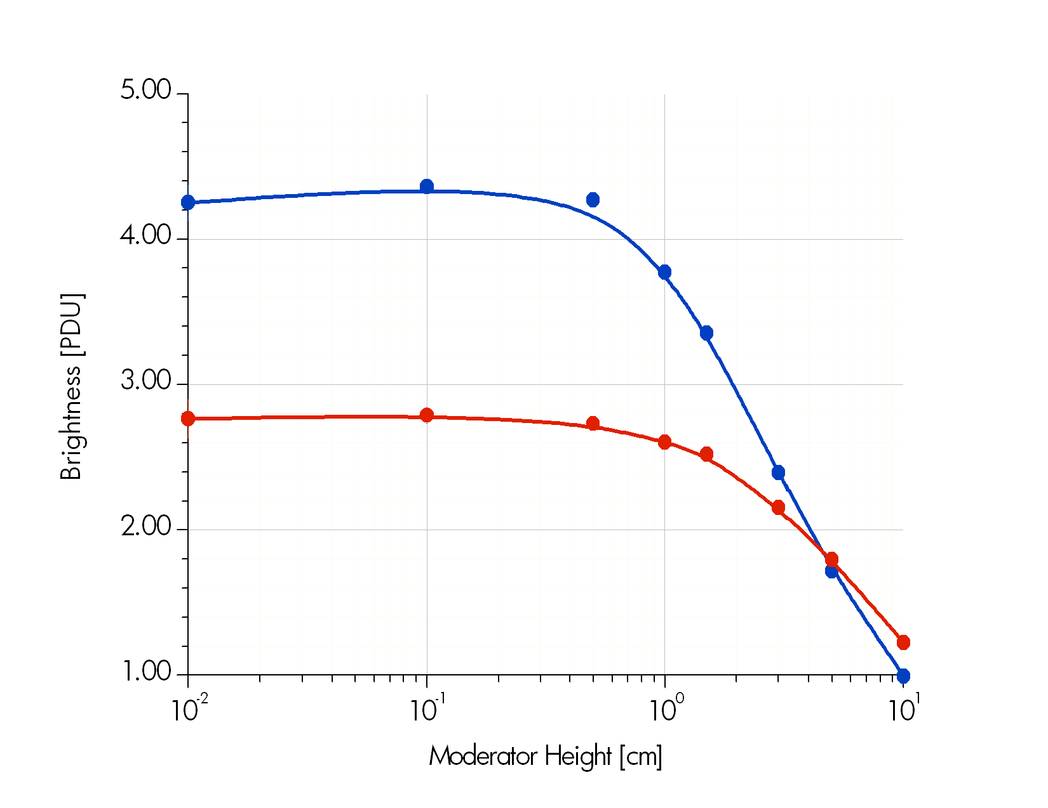

An Aside: Pancake Moderators
4x10¹³ n/cm²/s/sr
H₂ mod, 0-5meV integral
2cm H₂O, 20-100meV integral
1 PDU = 1.75x10¹² n/cm²/s/sr/MW

Slide 25
The Reference Instrument Suite

Slide 26
Plan of action for pancake optimization
FoM
N
22 x
A
B
h
h
Instrument results by mid-January
Freeze moderator design by end-April
  arrive at global optimum for all instruments
  arrive at new reference suite layout

