Slide 1

Latest Developments on Shielding and Backgrounds
Neutron Optics & Shielding group
Nataliia Cherkashyna
TAP meeting
23rd of January, 2014

Slide 2
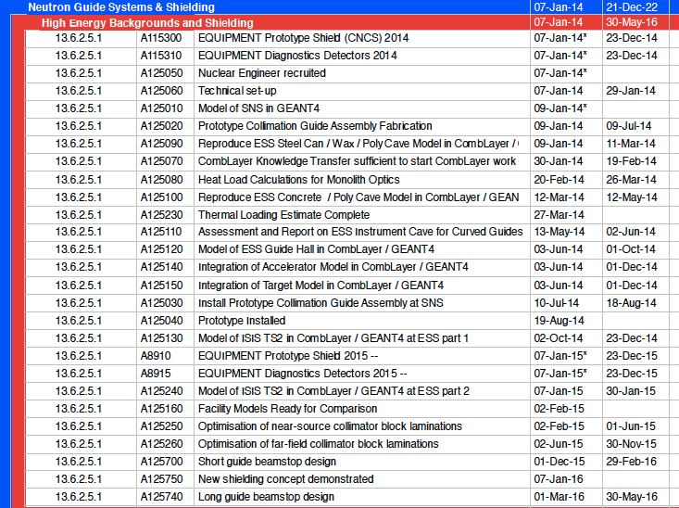
Projects
&
Plans

Slide 3
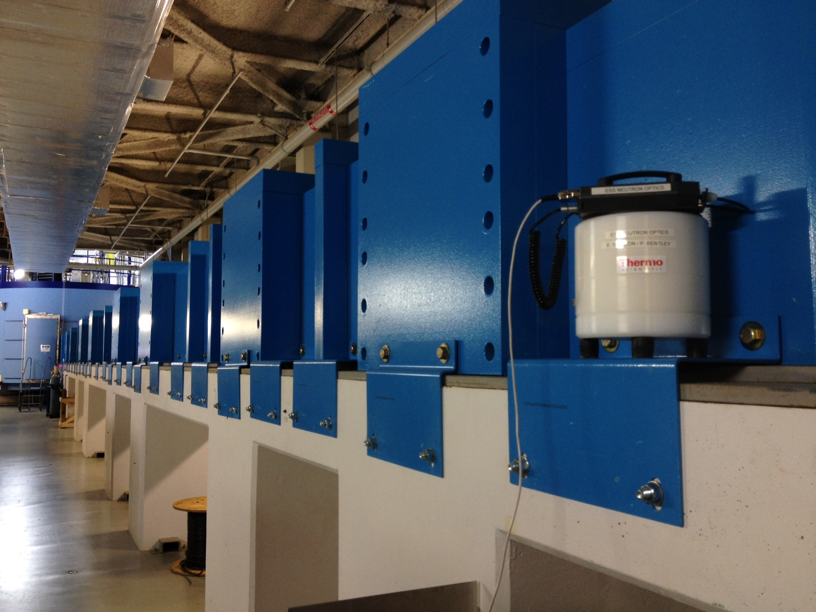
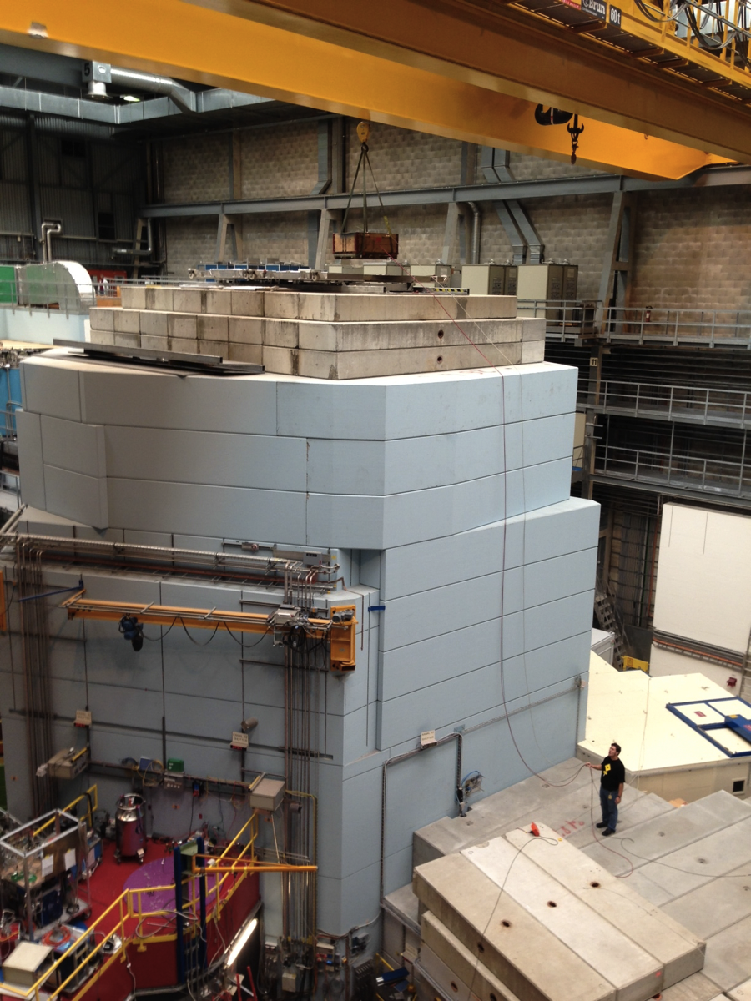
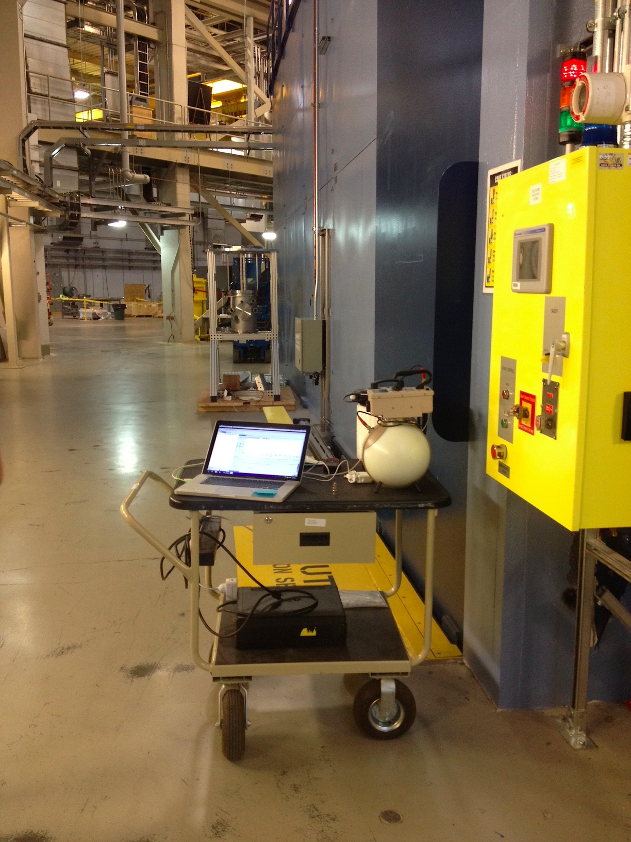
Shielding at ESS

Slide 4
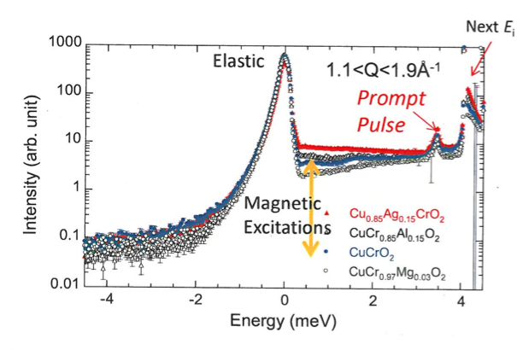
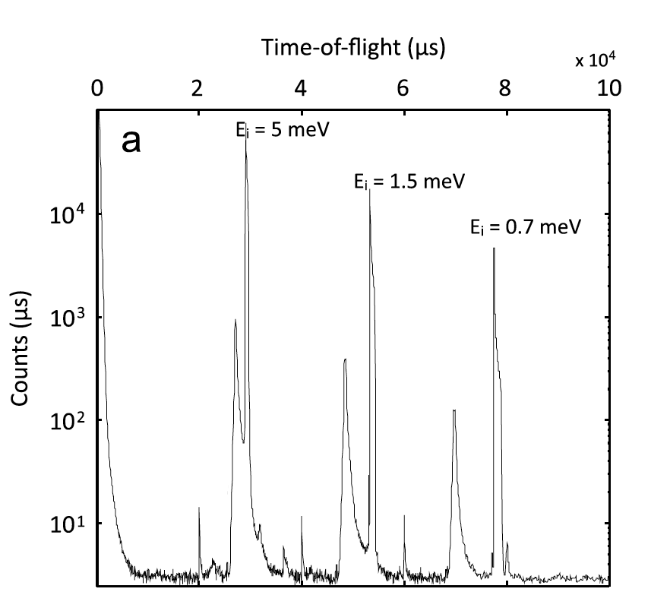
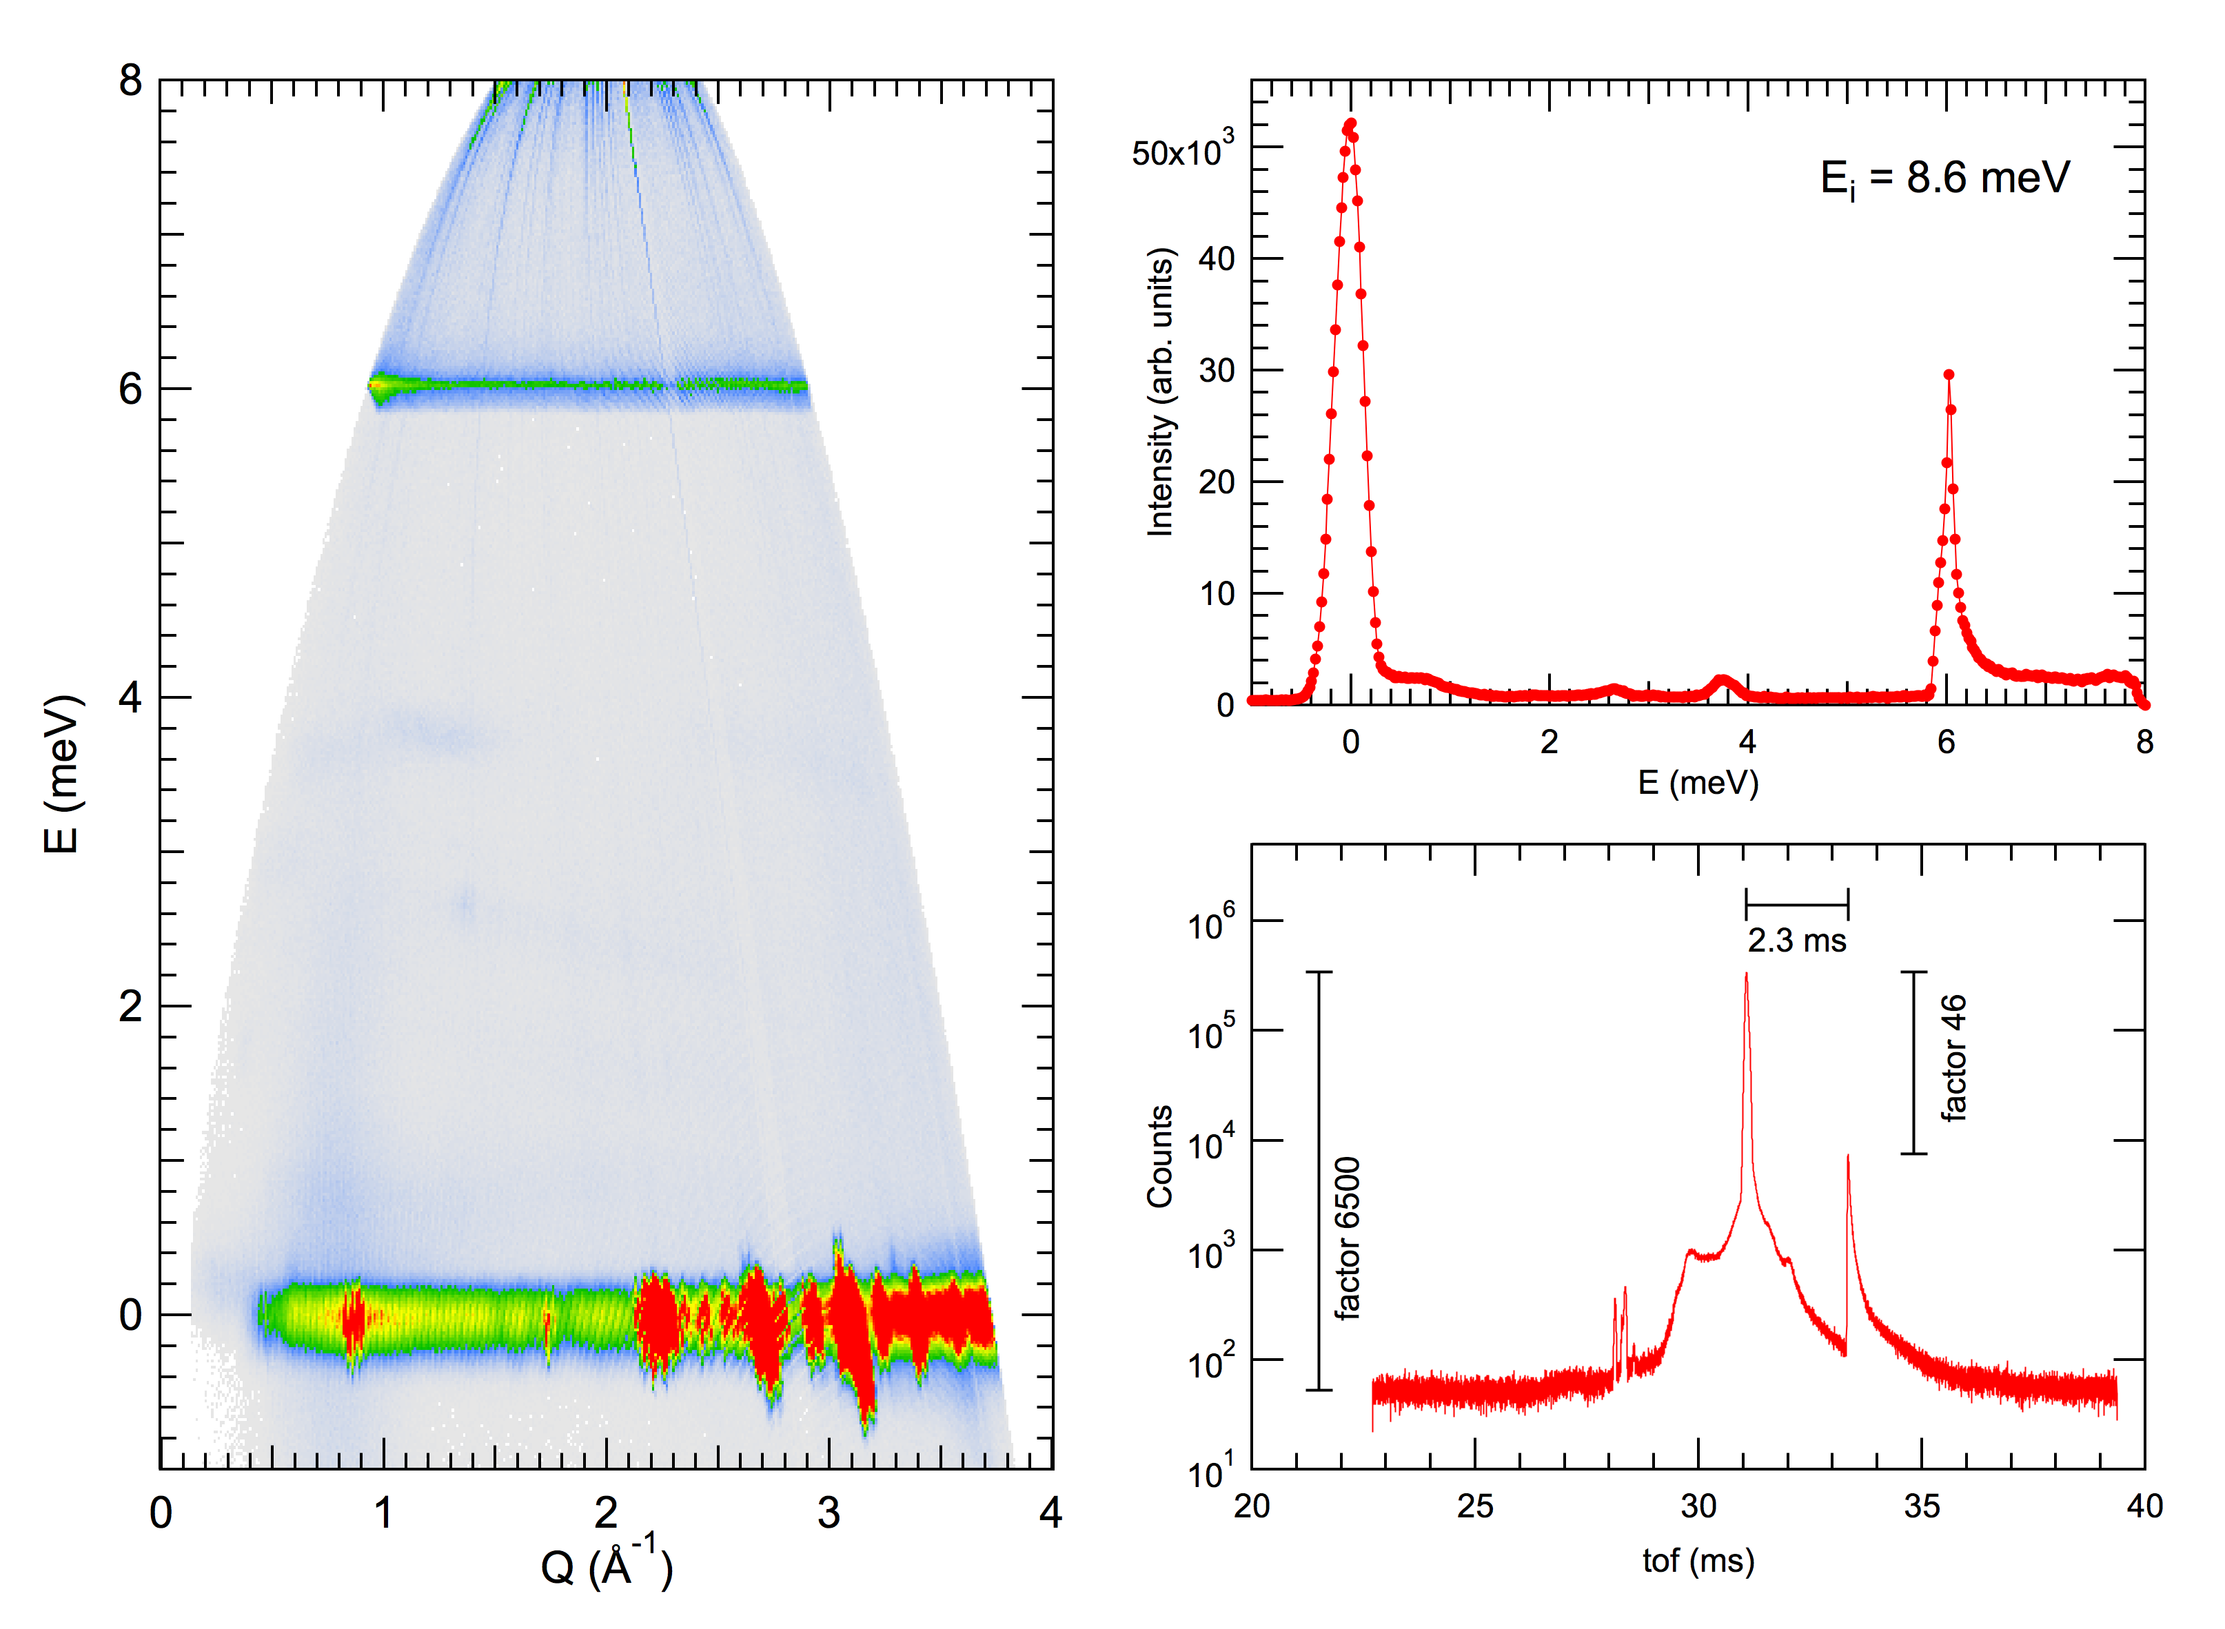
Background issues: SNS, J-PARC, ISIS

Slide 5
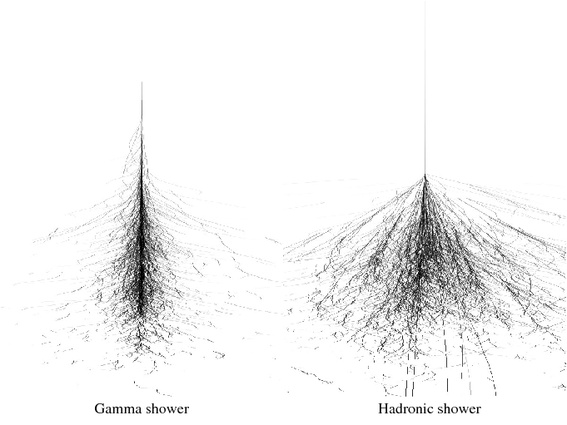
Particle showers: electromagnetic vs. hadronic
Notes:
The reason of that problem are the particle showers. That are the cascades of secondary particles, created by high-energy particles interacting with dense matter
There are 2 tyoes of showers:
1 ….. Localized
2 ….. More spread

Slide 6
Particle shower: electromagnetic & hadronic
Hadronic
Electromagnetic
nucleons &
other quark-composite particles
Fundamental interactions involved:
strong nuclear
photons, electrons, positrons
Fundamental interactions involved:
electromagnetism
Notes:
Forces
Typically includes - -CLICK

Slide 7
Particle shower
Proton:
Quarks:
=
u
d
Photon:
Neutron:
Gluons:
Charged particles:
=

Slide 8
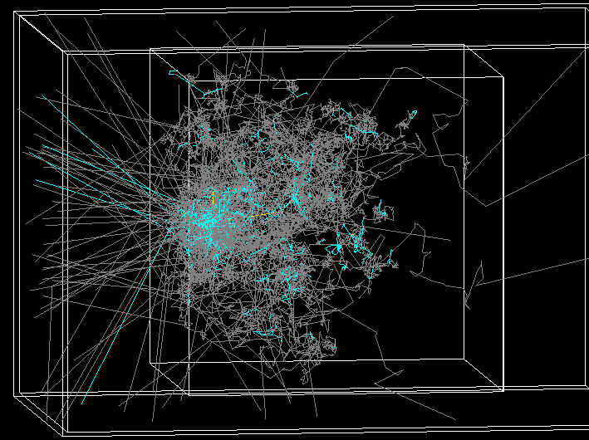
General idea
GEANT4
10⁶ neutrons →
2.5 GeV
Size:
2m x 2m x Z
Z:
from 0.1m to 3m
Notes:
From minimizing high-energy flux to stopping it.
There were some simulations done to investigate shielding properties of different materials.
and here is the main idea
.. .. .. .. .. Ideal detector. Development of shower in block of iron

Slide 9





Collaboration

Slide 10
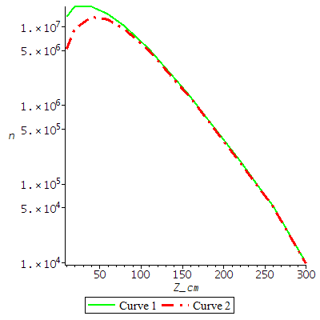
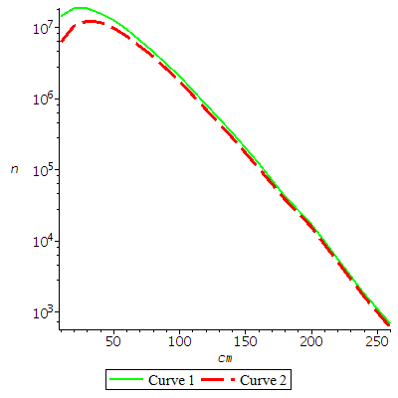
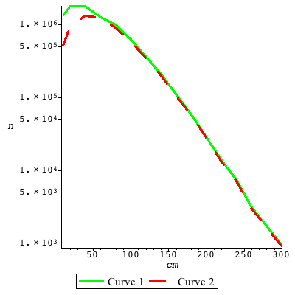
Shielding materials
Iron
Copper
Steel

Slide 11
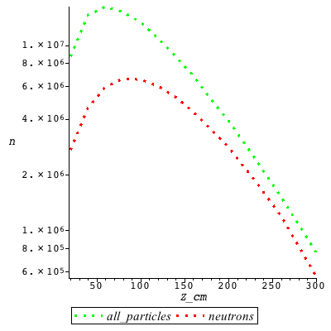
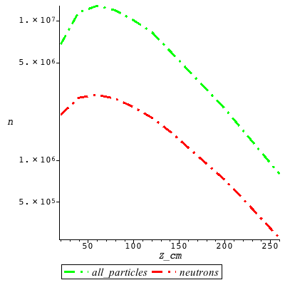
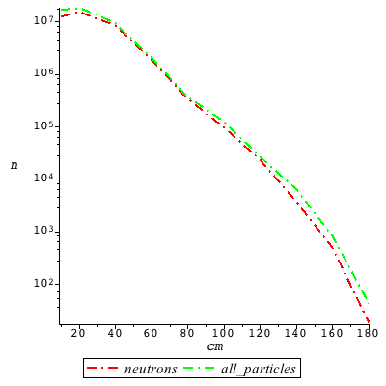
Shielding materials
Aluminum
Concrete
Tungsten

Slide 12
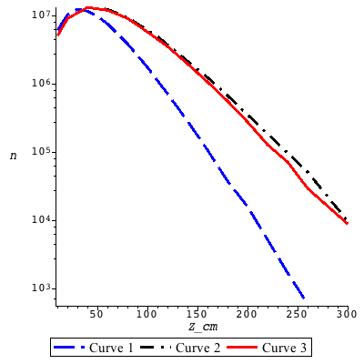
Iron, copper and steel
Copper
Steel
Iron

Slide 13

2m Fe + 0.7m Cu + 0.3m W

Slide 14
Z₁ = 3m Fe + 1m Cu + 0.4m W
Combinations of different materials
Z₂ = 2.5m Fe + 0.7m Cu + 0.3m W
Z₃ = 2m Fe + 0.7m Cu + 0.3m W
Z₄ = 2m C + 0.7m Cu + 0.3m W
Z₅ = 1m Fe + 2m Concrete
What’s next?
Optimization algorithm coming soon
Notes:
Taking into account, that different materials can be attractive for possible shielding solutions, the combinations of different materials were invstigated

Slide 15
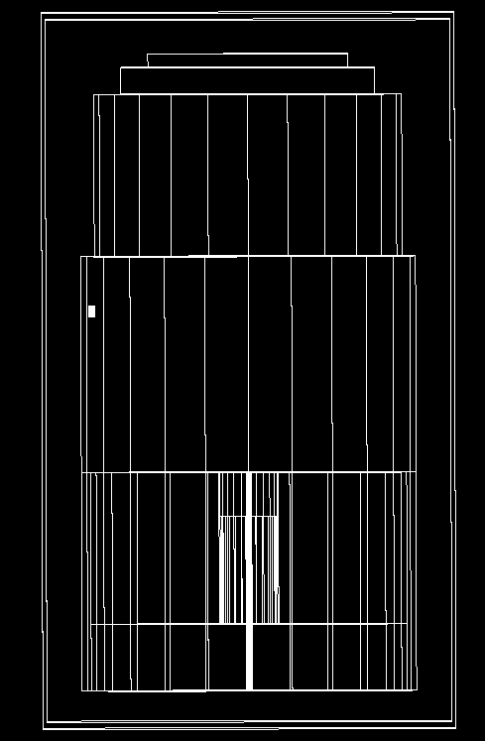
PSI (SINQ)

Slide 16
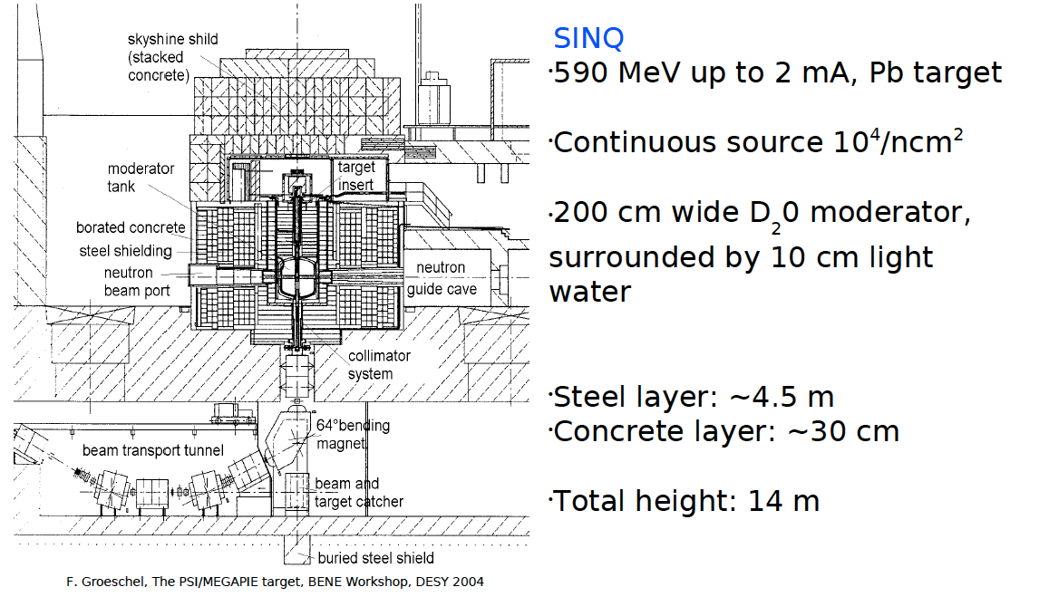
SINQ

Slide 17
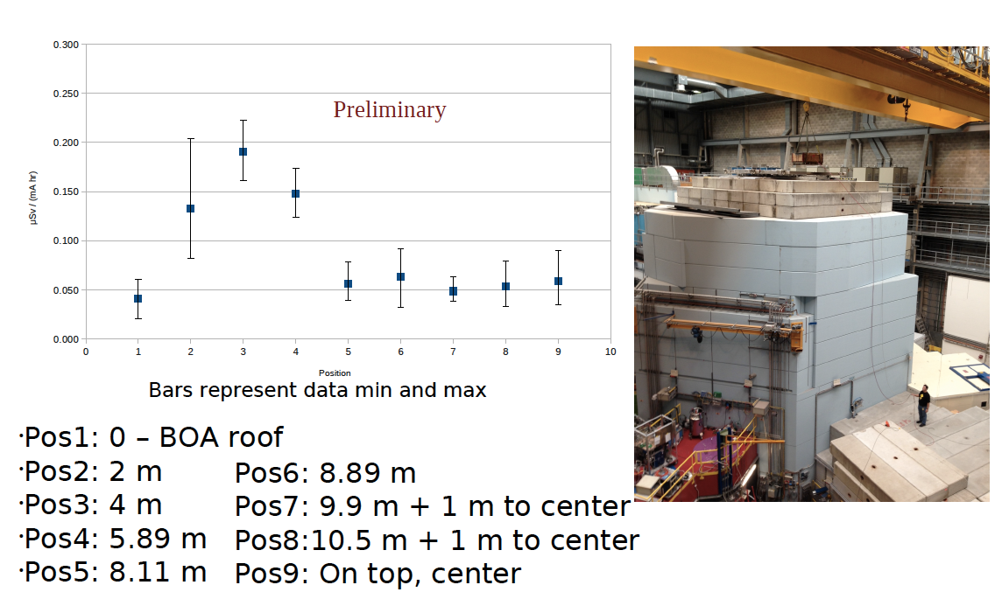
Measurements at PSI (SINQ)

Slide 18
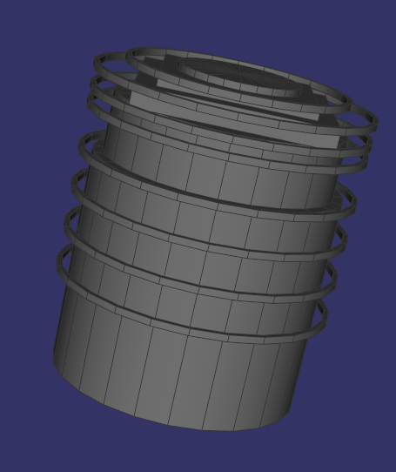
GEANT4 simulations
Bands
Modeling of a symmetric problem
Energy cuts
More details in geometry
Running to improve the statistics

Slide 19
Not the end!
… to be continued by Douglas Di Julio

