Slide 1
Gamma radiation from neutron guides
Carsten Cooper-Jensen, Phil Bentley
Notes:
Traditional m=1 Ni and Ni/Ti multilayer
3 time less led for 0.5 MeV than 8 MeV
Diamond and Be

Slide 2
“m=1” coatings for neutron guides
Measurements made at SUPER-ADAM at ILL using 4.41 Å neutrons

Slide 3
MCNPX calculation of emitted gamma radiation from a 250 nm thick film at 0.3 degree
 | Total gamma ray emitted (probability)
Be | 1.8*10⁻⁷
Diamond | 2.0*10⁻⁷
Ni | 6.6*10⁻⁵
Notes:
Ni 4.5 absorbtion cross sectiomn
Be 0.0088
C 0.0035

Slide 4
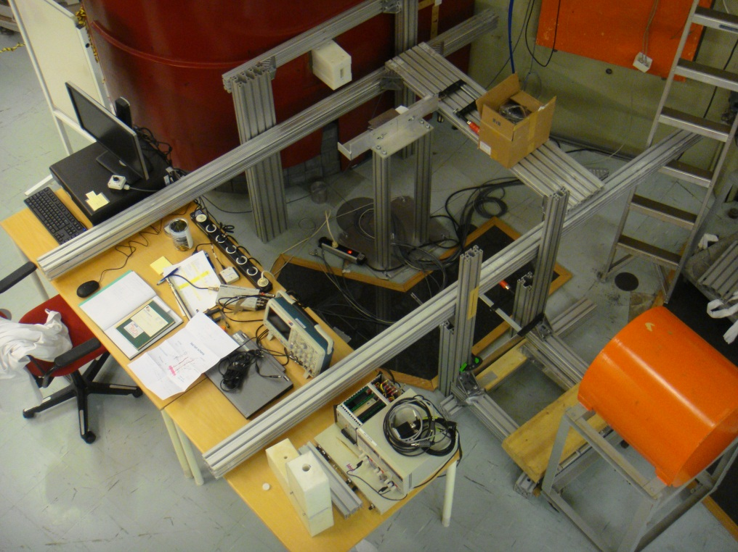
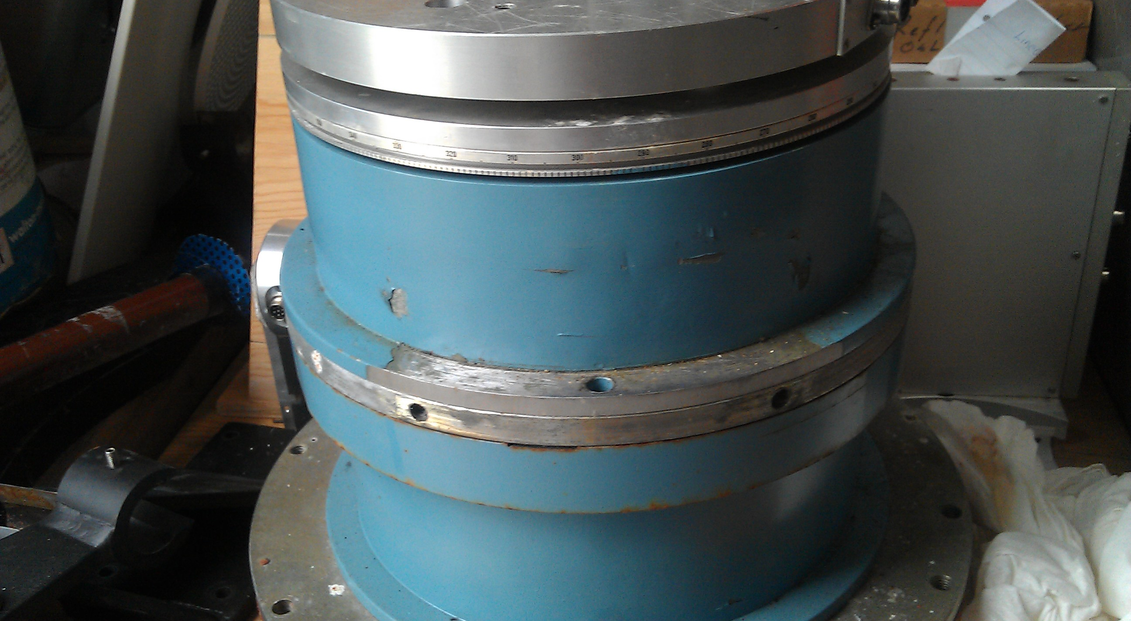
R2D2 beam line at IFE, Norway

Slide 5
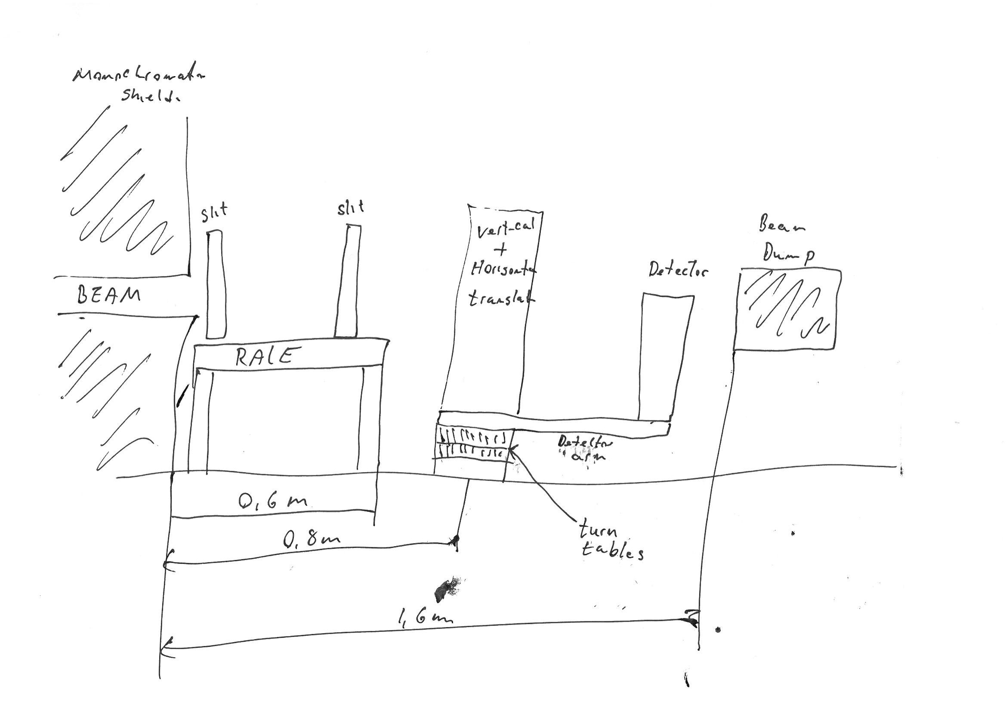
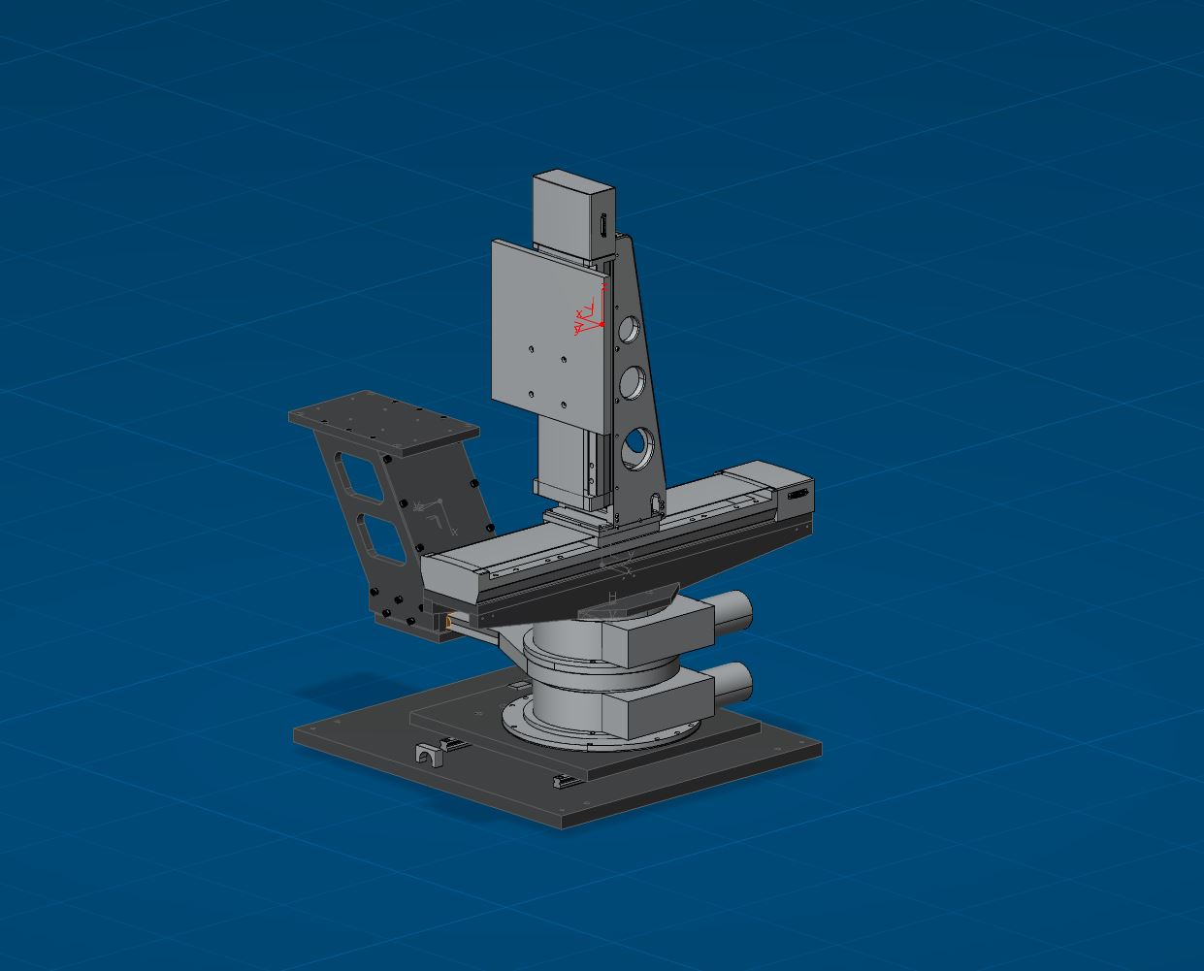
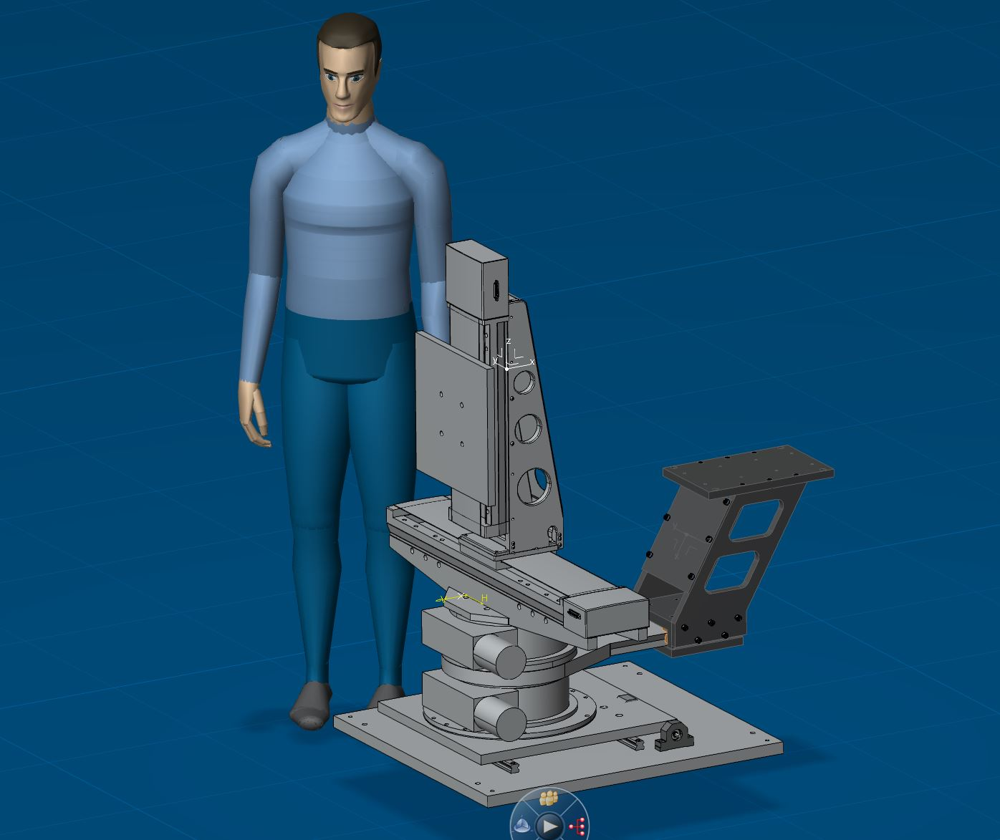
Reflectometer

Slide 6
Gamma ray background from substrate
Glass is not only SiO₂ and B but also Al, Na, K, Mg, Ca, Zn
Float, Borofloat, Borkron (N-ZK7), N-BK7, Fused silica
Gamma ray measurements with 3” NaI and 1.5” LaBr3
Geant4 simulations

Slide 7
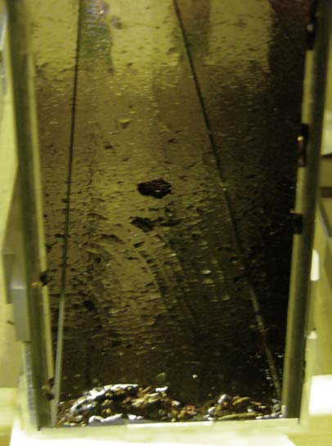
Life time measurements
  HFIR, Oak Ridge, TN, USA
  LANSCE, Los Alamos, USA
H113, ILL - the world’s first Borofloat guide at high n-flux after ≈5 y of operation;
Notes:
Los Alamos Spallation Radiation Effects Facility at Los Alamos Meson Physics Facility now Los Alamos Neutron Science Center

