Slide 1
ESS status and plan
Valentina Santoro
ESS
nnbar at ESS workshop 12,13 December 2019

Slide 2
Acknowledgements
Most of these slides are taken from previous talks by John Womersley and Andreas Schreyer
nnbar at ESS workshop 12,13 December 2019

Slide 3
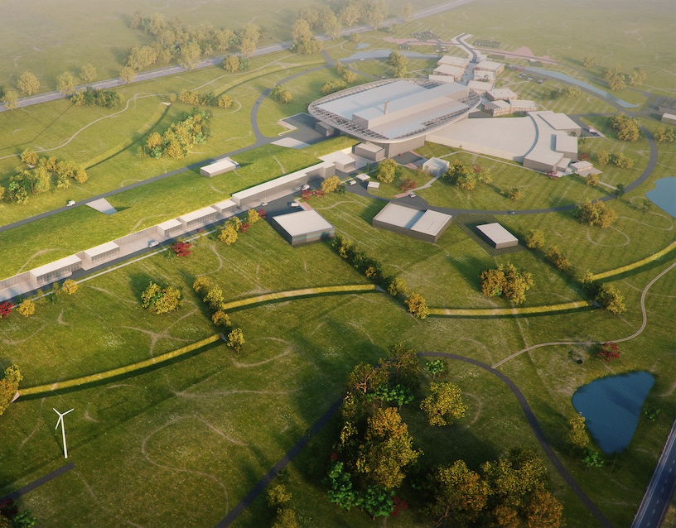
Journey to delivering the world’s leading facility for research using neutrons
2025
ESS Construction Phase Complete
2019
TODAY
2014
Construction Starts on Green Field Site
2023
ESS Starts
User Program
2009
Decision to Site ESS in Lund
2019
Start of Initial Operations Phase
2012
ESS Design Update Phase Complete
2003
European Design of ESS Completed
3

Slide 4
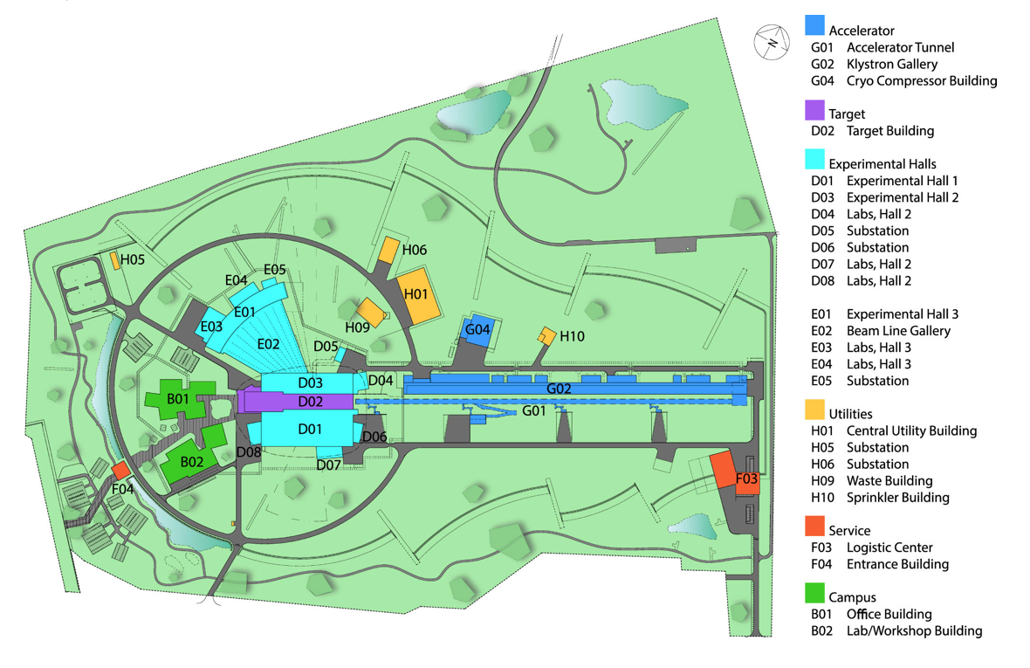
Site Layout
nnbar at ESS workshop 12,13 December 2019

Slide 5
Upgradeability of ESS
Primary upgrade path: more instruments
42 beamports with ~6° separation
Upgrade areas
~80% beamport use
  60% for short instruments
  100% for long instruments
>1 instrument on some beamports?
  Monochromator instruments?
35-40 instruments possible
Lower moderator not yet defined
  all beamports can view both moderators
All beamports allow cold and/or thermal spectrum
Freely tunable wavelength resolution
  adapt resolution to experimental needs
n-nbar
HEIMDAL
W9
W10
upgrade
T-REX
MAGIC
MIRACLES
West
BIFROST
West
C-SPEC
BEER
NMX
WA-NSE
Sleipnir
LOKI
FREIA
North
Mono-farm 2
HR-NSE
Mono-farm 1
ESTIA
South
East
ODIN
SKADI
DREAM
VOR
ANNI
VESPA
scale
ESPRESSO
GI-SANS
S5
upgrade
(K. Andersen)
S6
S7
S8
S10
S9

Slide 6
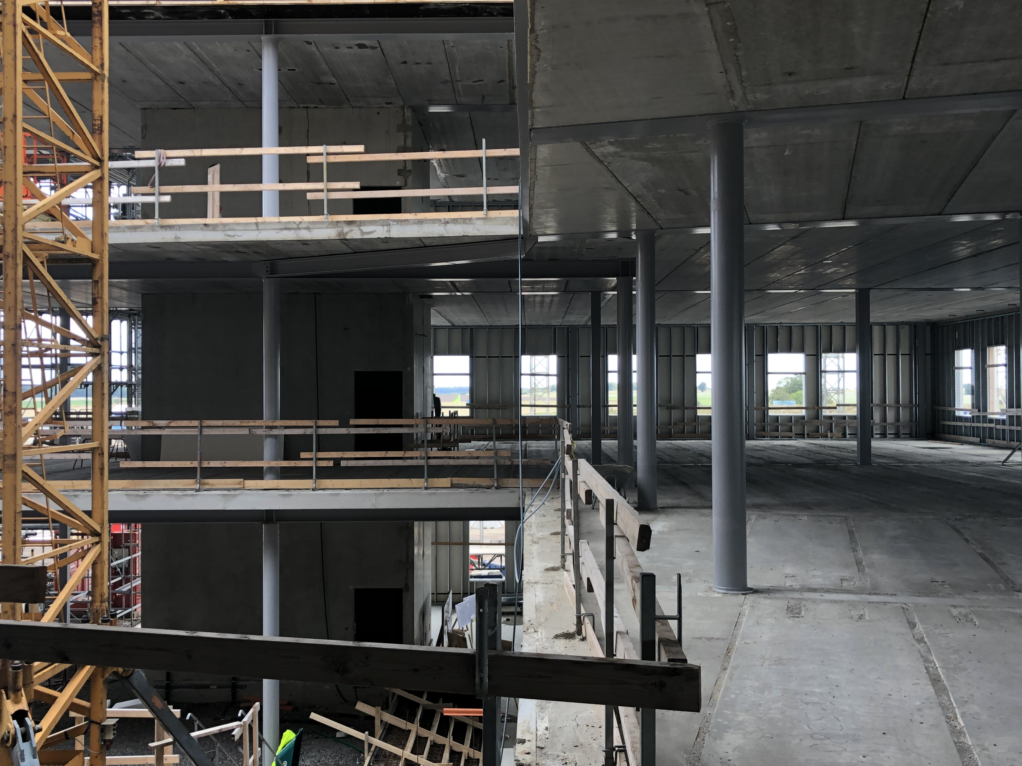
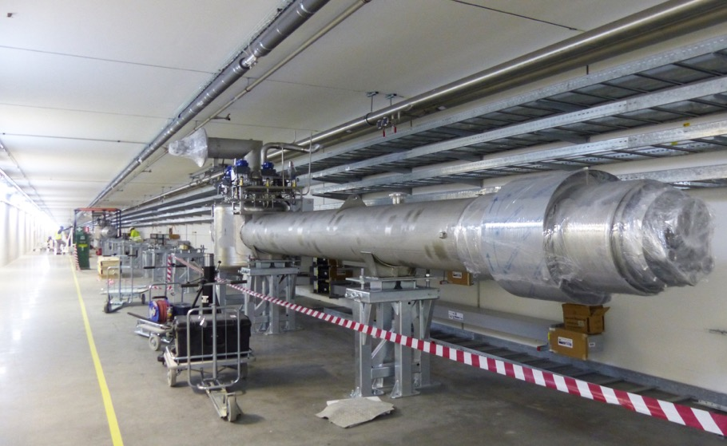
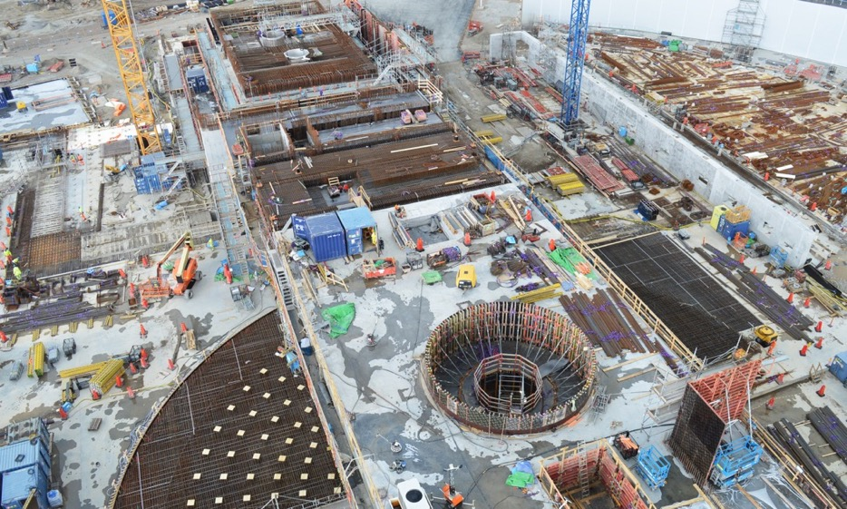
ESS is 60 % complete
ESS is 60 % complete
2019 is peak of construction activity
Accelerator commissioning underway
First Instrument hall complete and handed over
Working hard to deliver first science in 2023
nnbar at ESS workshop 12,13 December 2019

Slide 7
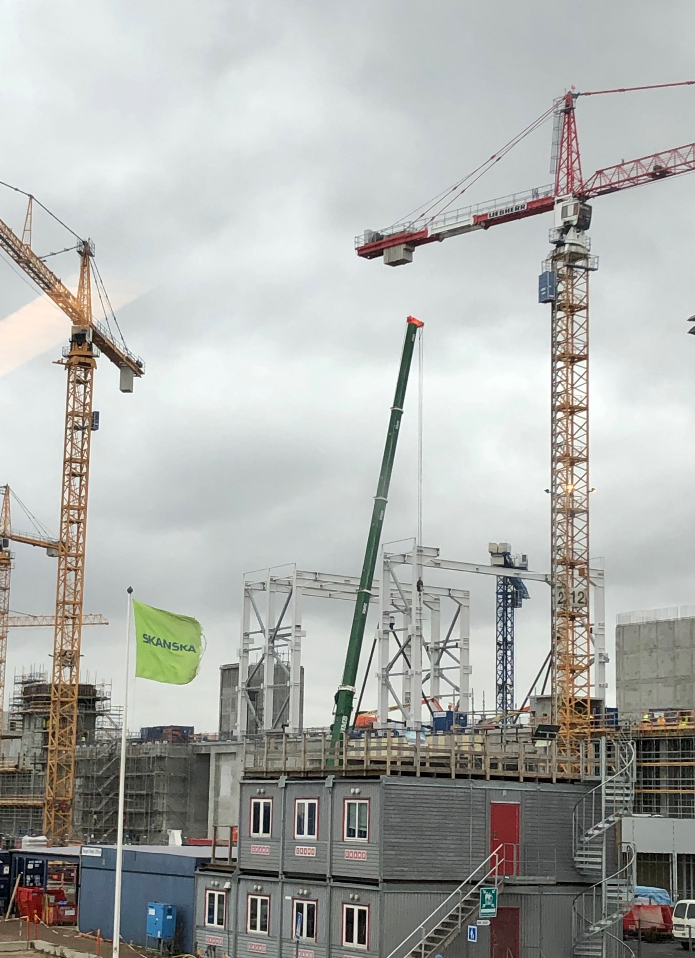
Conventional Facilities
Civil construction remains on (or ahead of) schedule
Handover of logistics building F03 and Instrument Hall E01
Steelwork erection for target building
high-bay and for D buildings now underway
ESS offices and laboratory campus making rapid progress
Key challenges
Transitioning CF into basis of future ESS facilities
management function
Onsite cooling water purity is an issue
nnbar at ESS workshop 12,13 December 2019

Slide 8
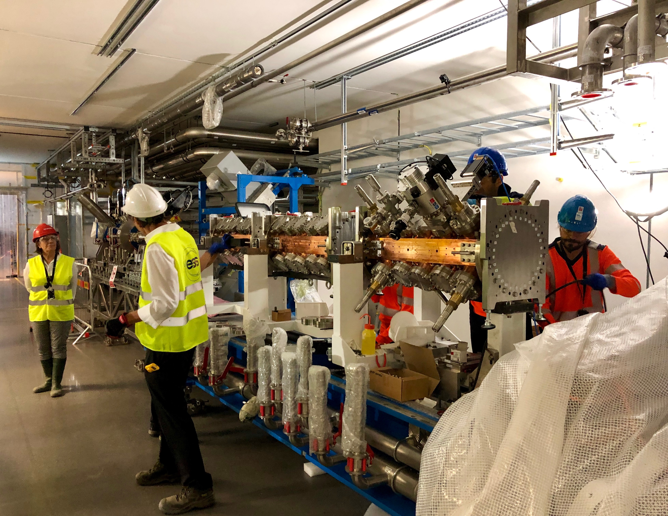
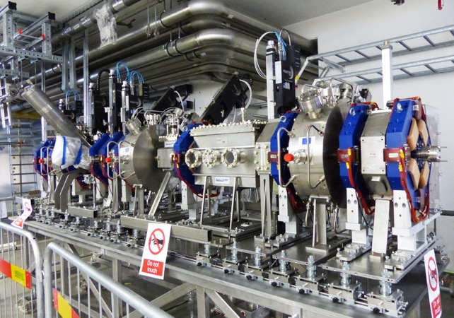
Accelerator
Accelerator installation making rapid progress
  Ion source and LEBT commissioned
  MEBT installed
  DTL received and being integrated
  RFQ delayed, but final components expected this week
Cryo-test stand permit received
Key challenges
Spoke cavity fabrication delays
Accelerator is not on critical path for ESS BOT but
float is being eroded
nnbar at ESS workshop 12,13 December 2019
Notes:
Low energy beam transport
MEBT - medium beam transport
DTL - drift tube linac

Slide 9
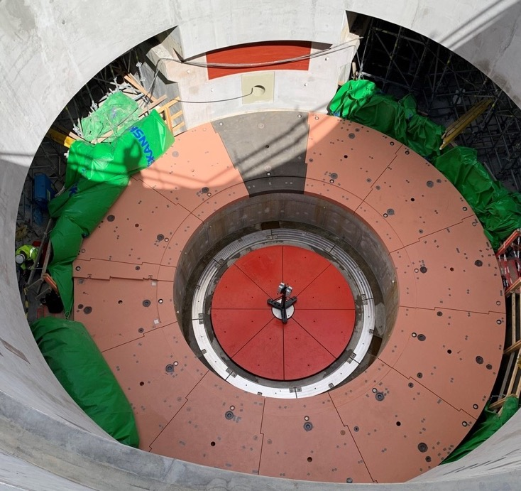
Target
Target installation now underway
  High bay steelwork
  Monolith shielding
Major components in manufacturing
Monolith vessel on track for delivery by end 2019
Key challenges
Target RBOT showing 6-7 months delay due to neutron beam port blocks
(steel shielding)
  High level intervention with manufacturer in June-July
  Dramatically increased production rate, but unlikely to recover the full delay
nnbar at ESS workshop 12,13 December 2019

Slide 10
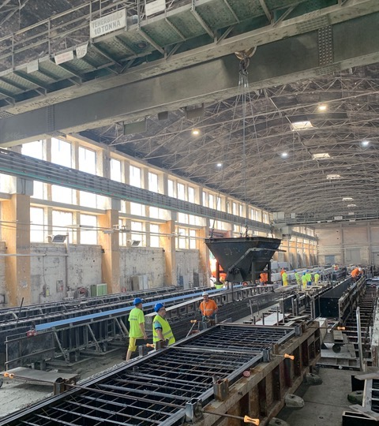
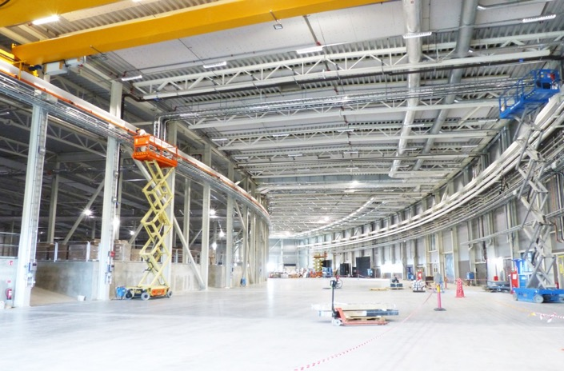
Instruments
Bunker is in manufacturing
Instruments design phase complete – moving into construction in IK partners
All “First 3” instruments (and 7 of first 8) endorsed by IKRC
Common shielding, chopper and beam monitor designs developed to save time and money
Reduced delay caused by port blocks on first science to
3 months by modifying bunker installation sequence
Key Challenges
Need to move ahead with large procurements in IK partners
nnbar at ESS workshop 12,13 December 2019
Notes:
IKRC in-kind review commitee

Slide 11
A reminder of the ESS Critical Path
2018
2019
2020
2021
2022
2023
2024
2025
BOT
FS
SOUP
EOC
Warm LINAC Commissioning Steps
0.8 GeV Capability Installed
We are focused on delivering First Science with three instruments by the end of 2023
Schedule date (no float) is March 2023
Accelerator + ICS
Hi -Beta Install
Beam on Dump
(570 MeV)
Accel RBOT
Accelerator Schedule Float
CF + Target + NSS (Bunker+TBL) + ICS
Access for Monolith Installation
Target RBOT
Bunker & TBL RBOT
15th Instrument Complete (Ready for hot commissioning)
NSS Instruments + ICS
BOT - Beam on Target
RBOT - Ready for Beam on Target
FS - First Science
SOUP - Start of User Programme
EOC - End of Construction project
Instrument Hall Access for Start of Installation
Start beam commissioning for 1st Instruments
nnbar at ESS workshop 12,13 December 2019

Slide 12
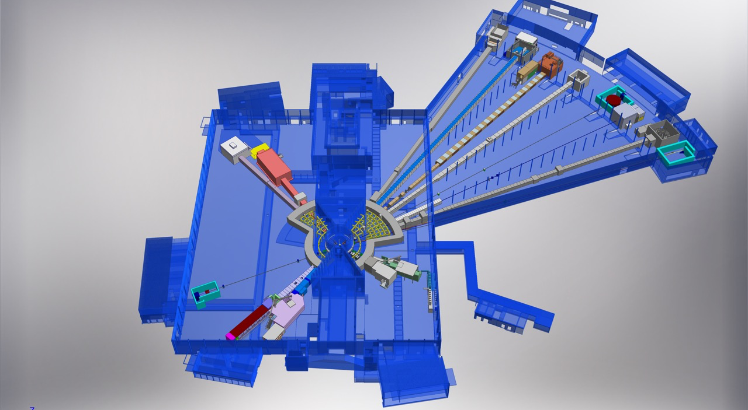
ESS Neutron Instruments 1-15
E03
Hall 1
D07 1 × Life Science,
1 × Cold room
D08 1 × Chemistry,
1 x Radioactive Mat. L.
NMX
BEER
C-SPEC
D08
BIFROST
E04
MIRACLES
MAGIC
T-REX
CR on deferral
of D07 (only) to early
Initial Operations
ODIN
DREAM
HEIMDAL
Hall3
E03 1 × Engineering
E04 1 × Life Science,
1 × Cold room
1 × Instrument room
1 × Chemistry,
1 × Characterization
TEST-BEAMLINE
LoKI
VESPA
D07
ANNI
FREIA
SKADI
50 m
ESTIA
Hall 2
D04 1 × Life Science,
1 × Cold room
2 × Instrument room
D04
100 m
150 m
nnbar at ESS workshop 12,13 December 2019

Slide 13

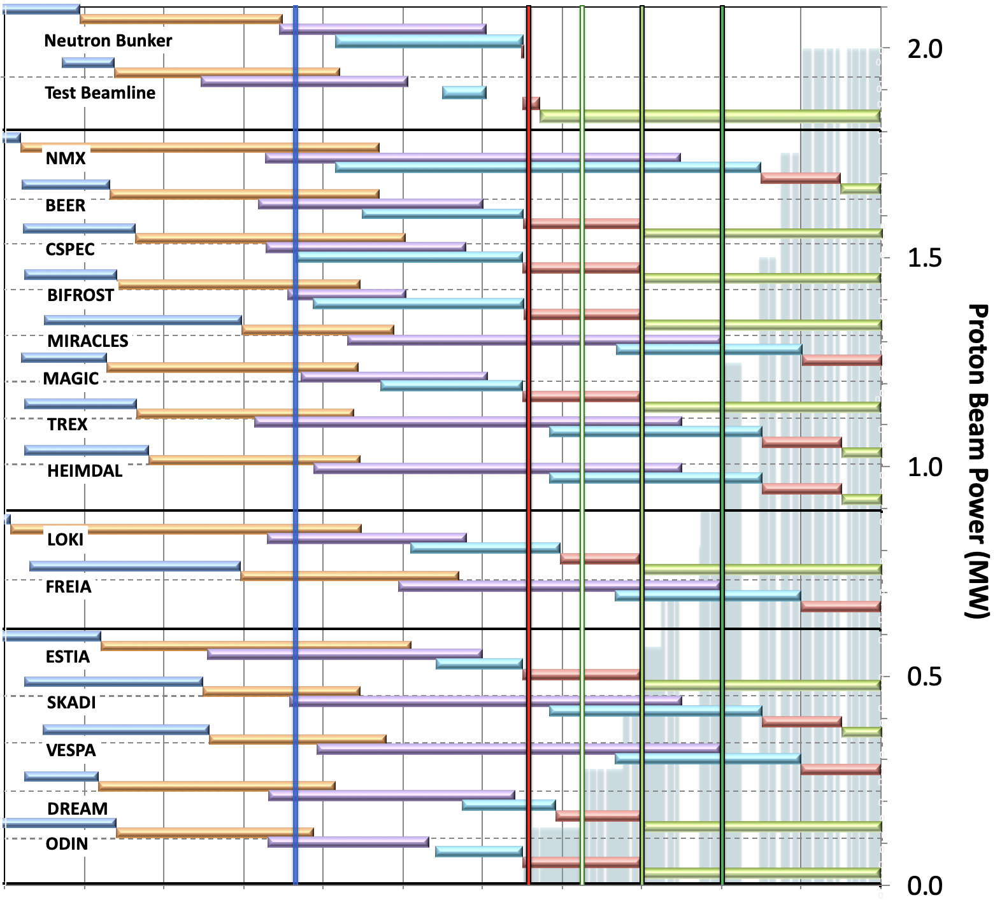
Baseline schedule for Neutron Beam Instruments
(NSS MS V4.2)
Preliminary Design
Detailed Design
Manufacturing & Procurement
Installation & Integration
Hot Commission/Early science
Operation
Current date
BOT
& HC
SOUP
(3NBI*)
8NBI* in User Program
FS
FS
First 3 NBI selected for SOUP: DREAM, LOKI & ODIN (best chance for early impact, as agreed by NSS, SAC and ESS Council)
Back-up instruments: (for risk of late access to D01 & D03) BEER, CSPEC, MAGIC or BIFROST, ESTIA
West sector
North sector
March 2023:
First Science (FS) with expert teams on some of instruments above
Review progress of first 3 NBI for SOUP, implement backup plan if needed.
East and South sectors
2016 2017 2018 2019 2020 2021 2022 2023 2024 2025 2026
* NBI = Neutron Beam Instrument
nnbar at ESS workshop 12,13 December 2019

Slide 14
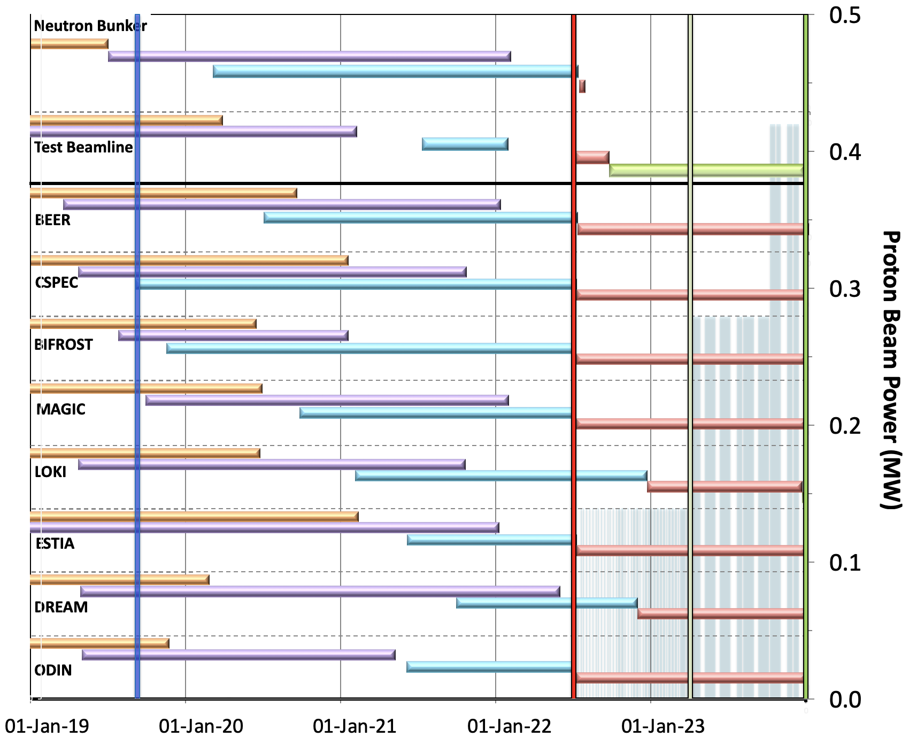
NSS Schedule detail (Bunker, & first instruments)
Preliminary Design
Detailed Design
Manufacturing & Procurement
Installation & Integration
Hot Commission/Early science
Operation
Current date
BOT
& HC
FS
SOUP
(3NBI*)
Bunker Installation:
CP for BOT
Test Beamline Installation:
116 days float for BOT
Schedules updated for LOKI, ODIN, DREAM, CSPEC, MAGIC & ESTIA all updated with new TA agreements and/or monthly reports
Instrument 1-3 Commissioning:
CP for First Science & SOUP
Detailed Schedules for BEER & BIFROST currently under review
nnbar at ESS workshop 12,13 December 2019

Slide 15
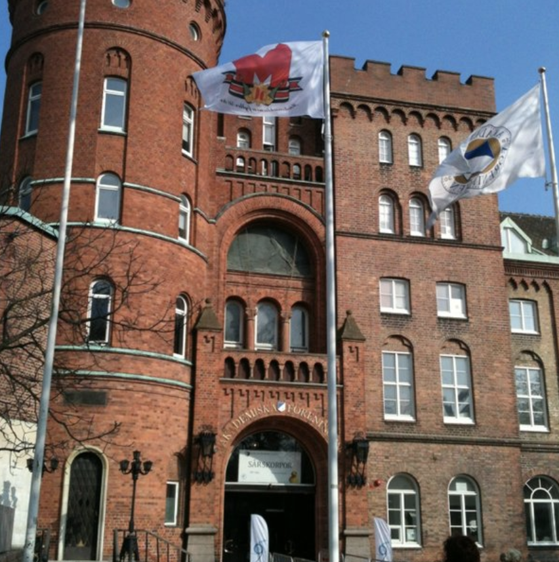
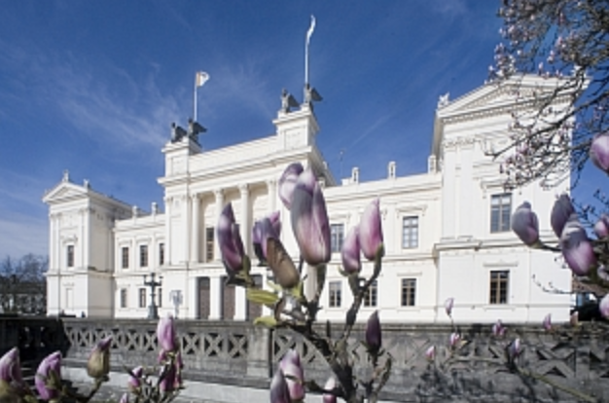
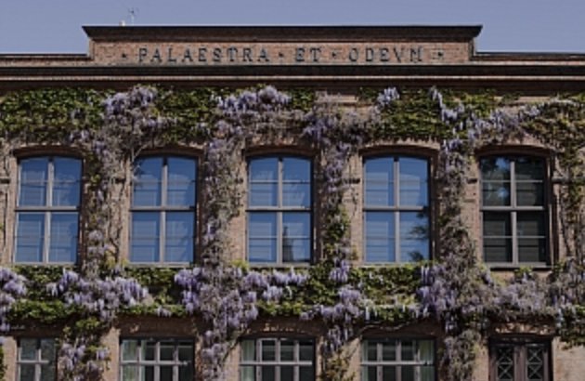
Joint ESS ILL User Meeting 2020
Date and Venue
Wed 23rd – Fri 25th September 2020
Lund: Rooms in AF Borgen, Universitetshusest and Palaestra
There will be a least one session about fundamental physics I think it is important that nnbar or HIBEAM/ANNi will have a talk
15
nnbar at ESS workshop 12,13 December 2019

Slide 16
Special case: substantial external funding for a particle physics experiment
No procedure exists for this so far
Needs to be developed and approved by Council
Support for such a project from ESS: no funding foreseen in Operations budget (-> 22 instruments), to be provided by proposers
Contingent ESS approval should be possible – would involve SAC and Council
Installation needs to minimise disruption to user programme
  cannot compromise early science success
  length of installation shutdown will drive construction start
nnbar at ESS workshop 12,13 December 2019

Slide 17
BACK-UP SLIDES

