Slide 1
Lower moderator
n-nbar at ESS Workshop
12th-13th December 2019
Luca Zanini
Contains a lot of material from HighNESS proposal (V. Santoro)

Slide 2
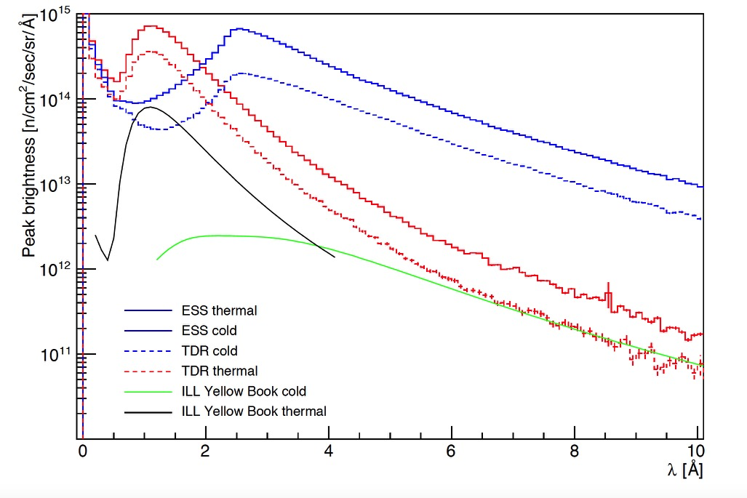
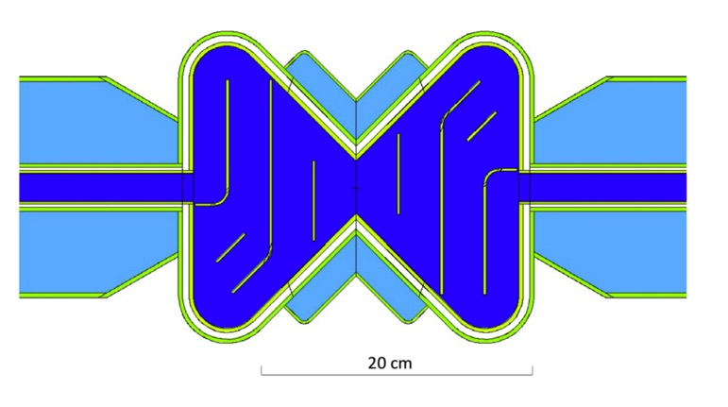
The ESS current moderator
The design of ESS moderator was based on the novel concept of low-dimensional moderators . It is a single high-brightness moderator system placed on top of the spallation target.
All of the first 15 instruments built, plus a test beam line, will view that moderator
Time average brightness averaged over 42 beamports.
Butterfly Moderator
Hydrogen moderator of 3 cm height above the target
Notes:
The plot shows the improvement respect to the TDR and comparison with ILL

Slide 3
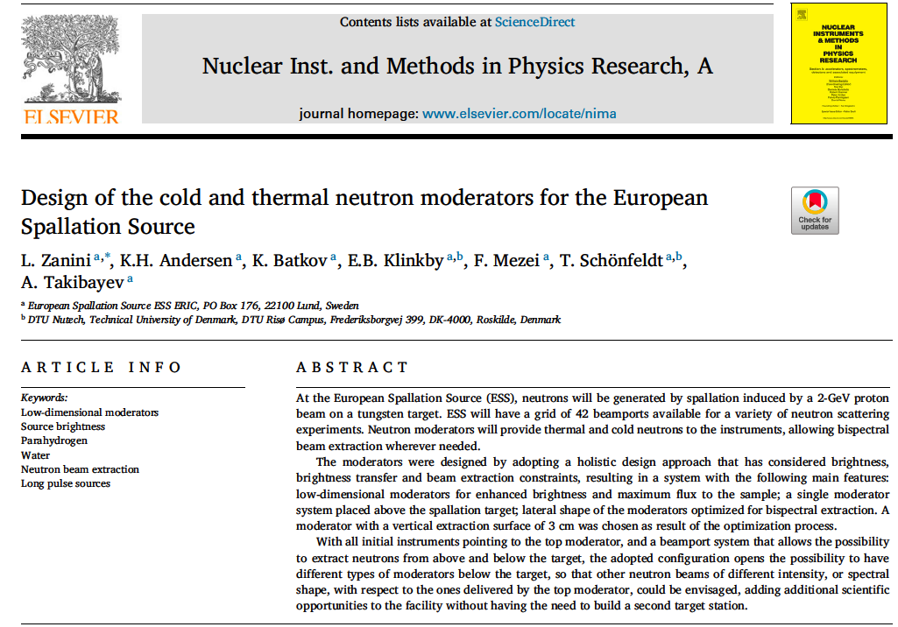

The path to ESS upgrade
Notes:
This is the final paper that describe the ESS current moderator if you look carefully to the bottom of the abstract

Slide 4
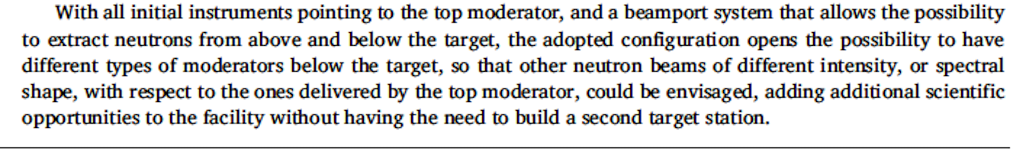
The path to ESS upgrade
Notes:
You can say that this is like building the second ESS target station

Slide 5
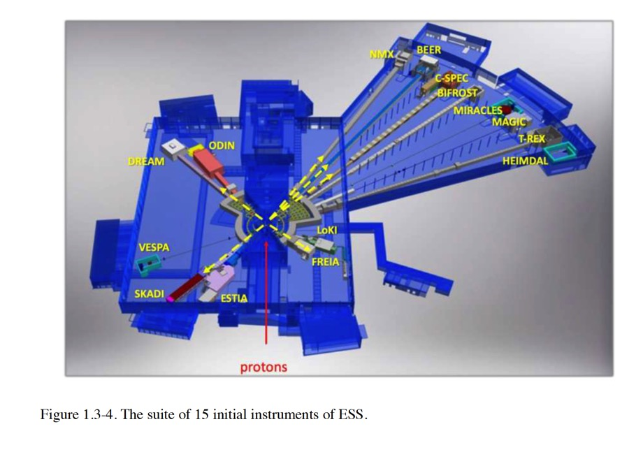

Slide 6
Upgradeability
Primary upgrade path: more instruments
42 beamports with ~6° separation
Upgrade areas
upgrade
HEIMDAL
MAGIC
T-REX
MIRACLES
BIFROST
West
C-SPEC
West
BEER
NMX
LOKI
FREIA
North
TBL
ESTIA
South
East
ODIN
SKADI
DREAM
VESPA
scale
upgrade
(K. Andersen)

Slide 7
Upgradeability
n-nbar
Primary upgrade path: more instruments
42 beamports with ~6° separation
Upgrade areas
~80% beamport use
  60% for short instruments
  100% for long instruments
>1 instrument on some beamports?
  Monochromator instruments?
35-40 instruments possible
W9
W10
upgrade
HEIMDAL
MAGIC
T-REX
MIRACLES
BIFROST
West
C-SPEC
West
BEER
NMX
WA-NSE
Sleipnir
LOKI
FREIA
North
Mono-farm 2
HR-NSE
Mono-farm 1
ESTIA
South
East
ODIN
SKADI
DREAM
VOR
ANNI
ESPRESSO
GI-SANS
VESPA
scale
S5
upgrade
S6
S7
S8
S10
S9

Slide 8
Upgradeability
n-nbar
Primary upgrade path: more instruments
42 beamports with ~6° separation
Upgrade areas
~80% beamport use
  60% for short instruments
  100% for long instruments
>1 instrument on some beamports?
  Monochromator instruments?
35-40 instruments possible
Lower moderator not yet defined
  all beamports can view both moderators
All beamports allow cold and/or thermal spectrum
Freely tunable wavelength resolution
  adapt resolution to experimental needs
W9
W10
upgrade
HEIMDAL
MAGIC
T-REX
MIRACLES
BIFROST
West
C-SPEC
West
BEER
NMX
WA-NSE
Sleipnir
LOKI
FREIA
North
Mono-farm 2
HR-NSE
Mono-farm 1
ESTIA
South
East
ODIN
SKADI
DREAM
VOR
ANNI
ESPRESSO
GI-SANS
VESPA
scale
S5
upgrade
S6
S7
S8
S10
S9

Slide 9
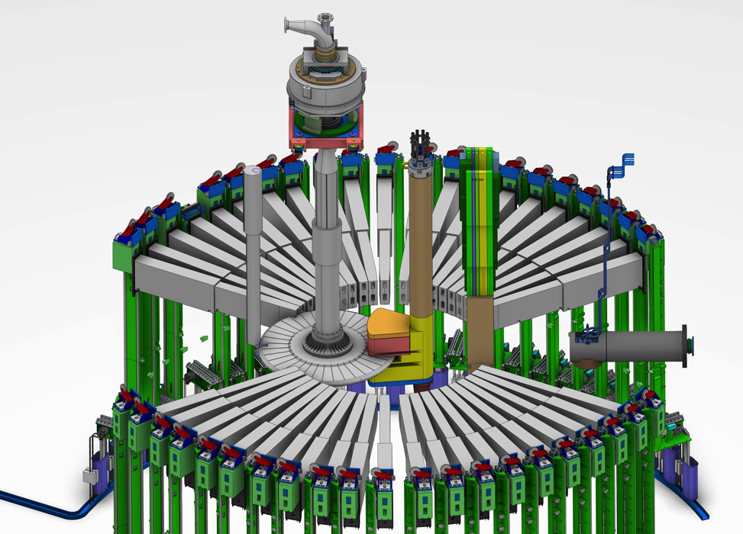
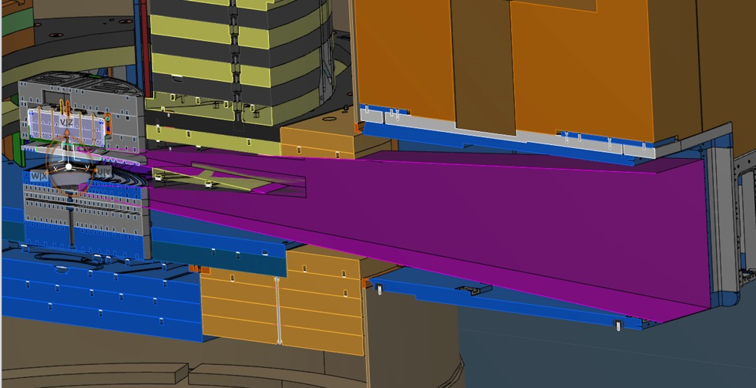
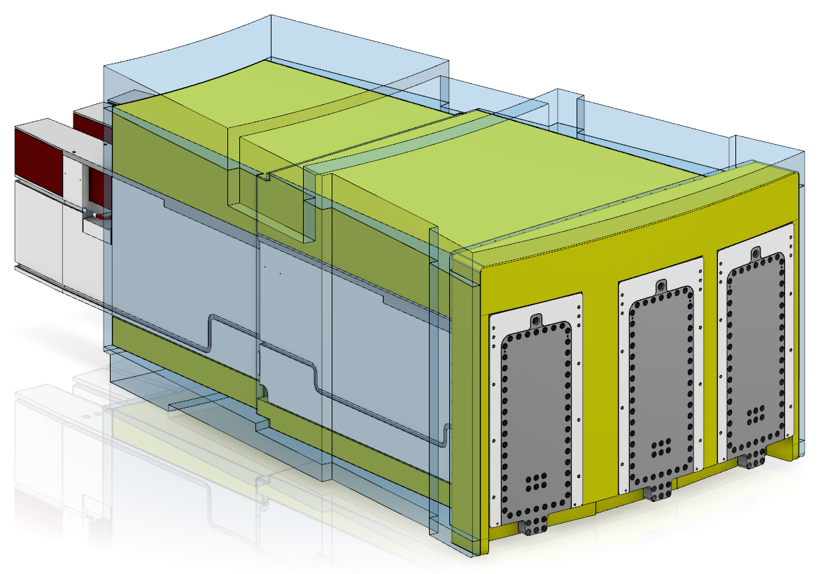
Provisions in Target monolith for source upgrade:
Double decker
Neutron antineutron (NNbar) oscillation experiment openings
Twister elements below target (currently with a steel plug)
Larger space in inner shielding below target wrt to above
Notes:
Double decker means that you can extract neutrons from above and below target

Slide 10
From High Brightness to High Intensity

Slide 11
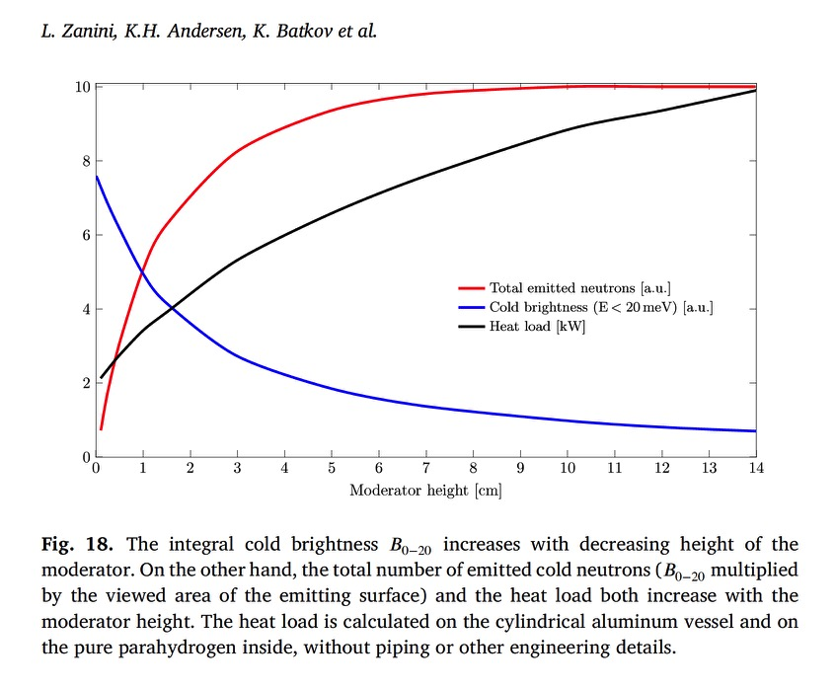
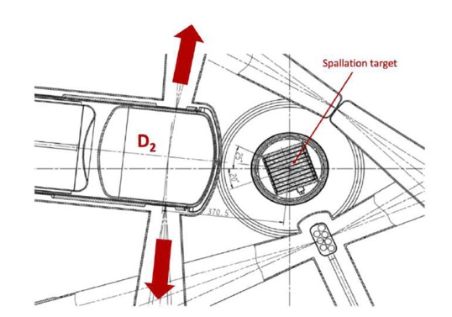
Why liquid deuterium?
Intensity vs brightness
Maximum intensity achievable with parahydrogen
To increase the intensity (total number of neutrons), parahydrogen is not viable
(3 cm moderator delivers 80% of the max intensity).
A better way is to use voluminous D2 moderator (factor 3-4 more intense)
Upper moderator
Zanini et al NIM A 925 (2019) 33-52
PSI D2 moderator

Slide 12
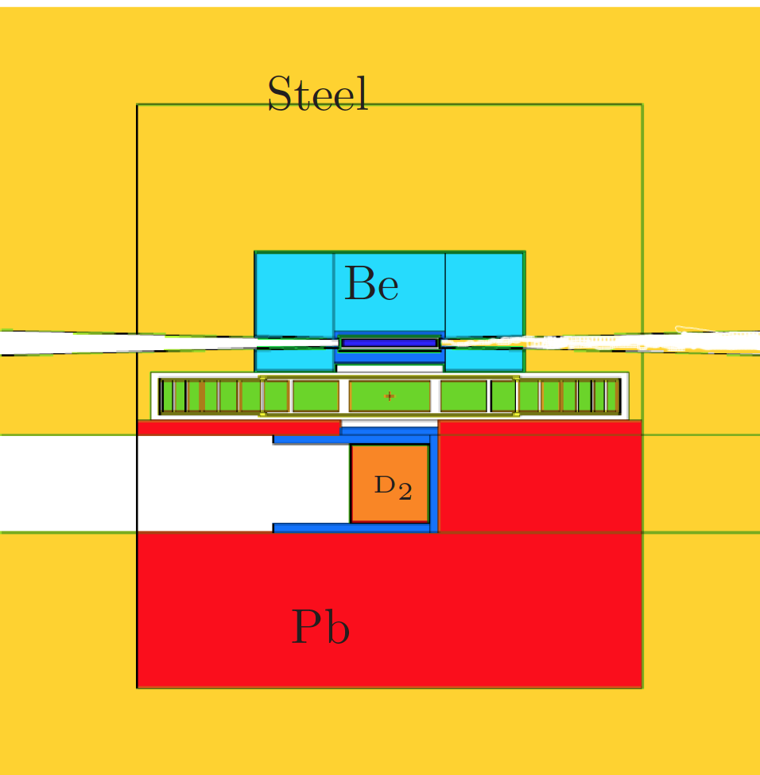
For the ESS lower moderator we propose a D₂ moderator
It has higher intensity than top moderator.
It can serve several beam lines with cold neutrons
It can serve a second moderator or converter
  UCN moderator (in beam or in pile)
  VCN moderator
Reflector
Preliminary studies done already in 2014
E. Klinkby et al.,https://arxiv.org/pdf/1401.6003.pdf

Slide 13
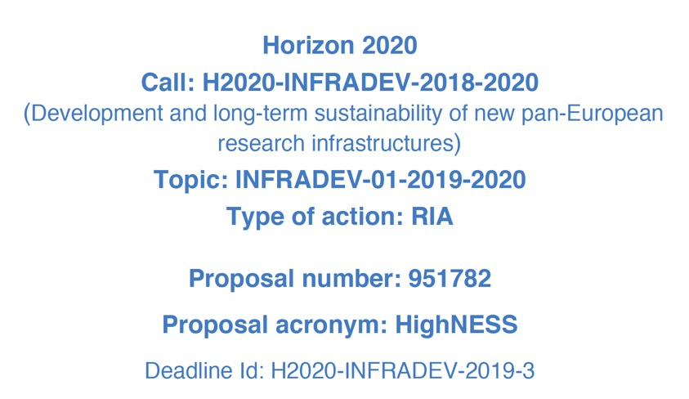
EU Grant proposal
Initiated and led by V. Santoro

Slide 14
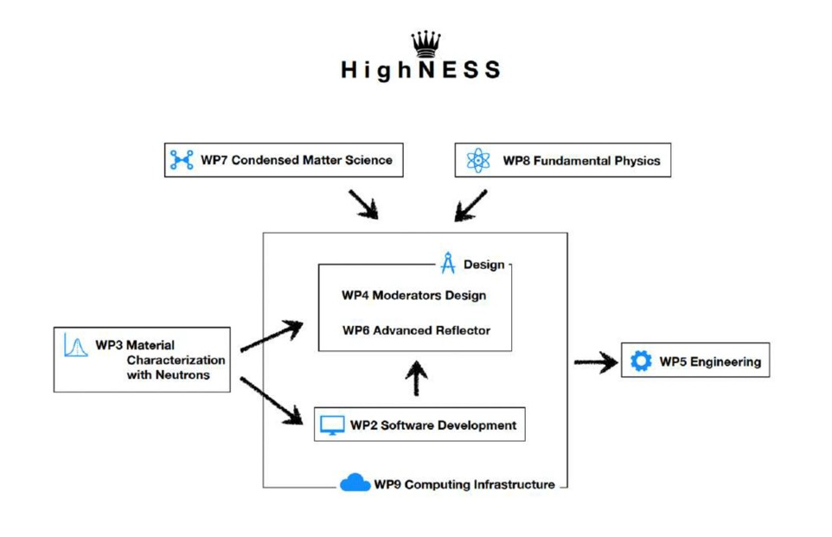
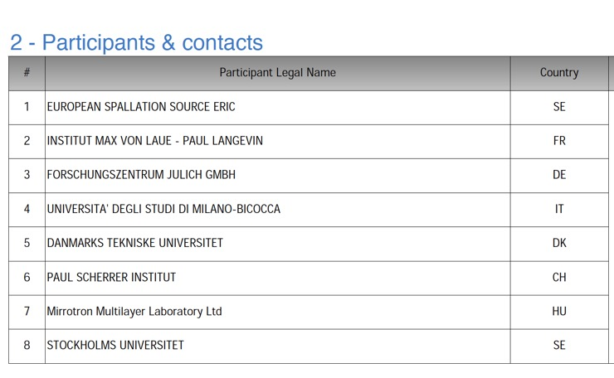
3 MEURO project, consortium with many EU partners, possible external participants

Slide 15
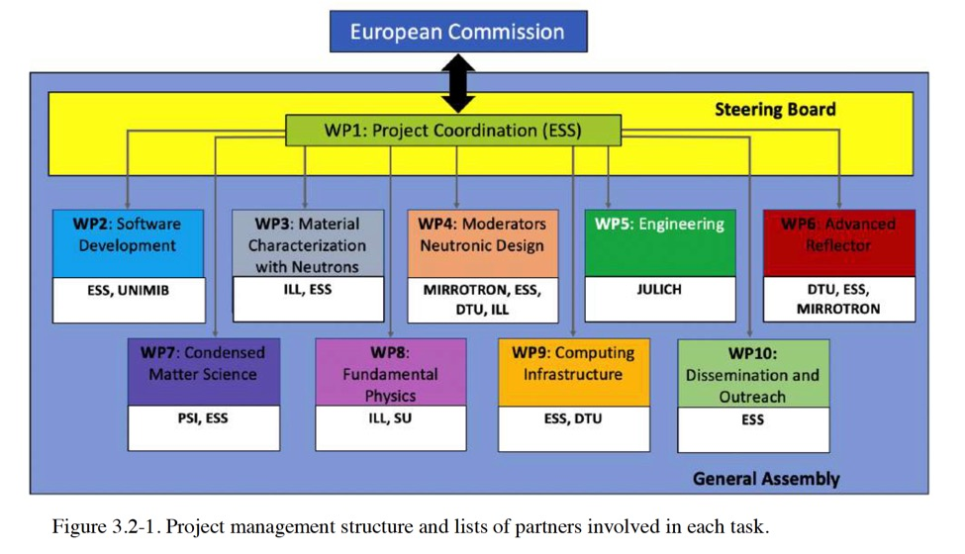
Project management structure

Slide 16
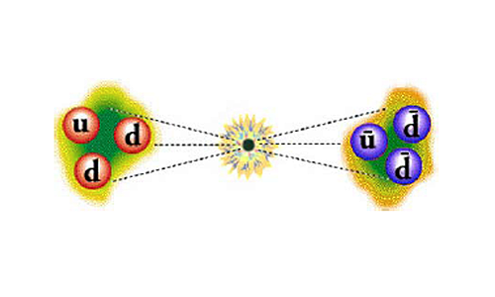
Scientific case
The High intensity moderator will boost several applications
Fundamental Physics (n->n oscillations, E.D.M. measurement)
Imaging
Spin-echo
SANS
Notes:
EDM is electric dipole momentum of the neutron to improve the sensitivity of this measurement you want to have the best possibile UCN source. To have a UCN source you need to have a cold intense source and then a UCN converter. SANS small angle neutron scattering

Slide 17
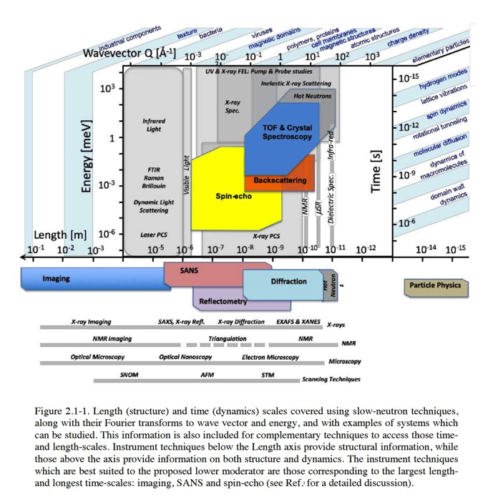
Motivation for neutron scattering

Slide 18
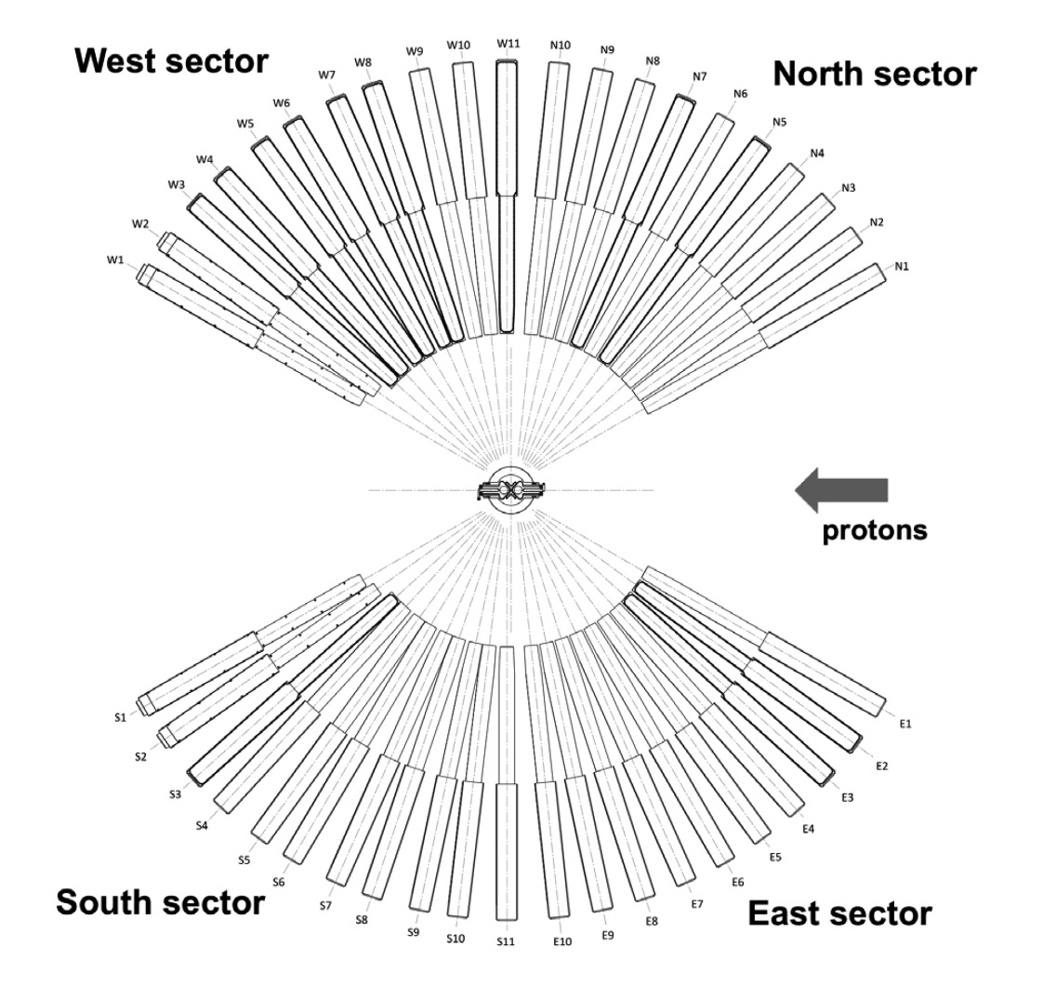
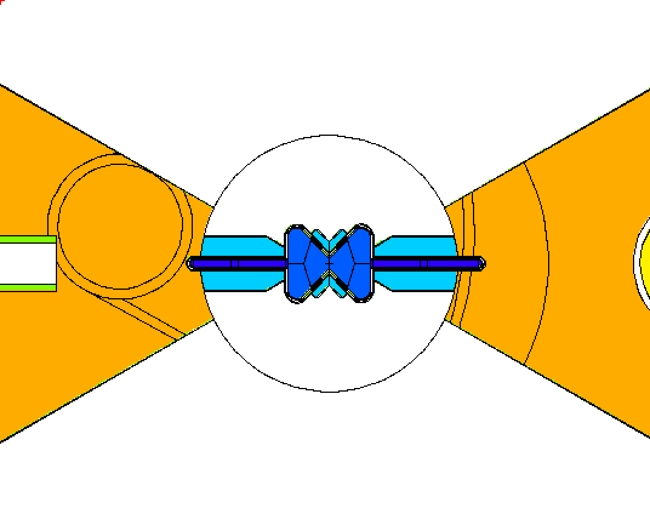
Top moderator
Unprecedented brightness available to all beam ports

Slide 19
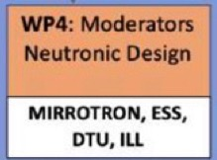
LD₂ Bottom moderator
Higher intensity and different wavelength
n-nbar
HEIMDAL
W9
W10
upgrade
T-REX
MAGIC
MIRACLES
D2
West
BIFROST
West
C-SPEC
BEER
NMX
WA-NSE
Sleipnir
LOKI
FREIA
North
Mono-farm 2
HR-NSE
Mono-farm 1
ESTIA
South
East
ODIN
SKADI
DREAM
VOR
ANNI
VESPA
scale
ESPRESSO
GI-SANS
UCN
S5
upgrade
S6
S7
S8
S10
S9
Notes:
The liquid deuterium moderator can also serve a second moderator one possibility is to a UCN converter. The UCN converter will be made of liquid Helium. The instrument plot show the layout of the nnbar experiment is 200m long beamline

Slide 20
LD₂ Bottom moderator
The Liquid deuterium moderator can serve a VCN moderator
D2
VCN
UCN
Notes:
Tecnology ot he VCN moderator not known at the moment but we will study it

Slide 21
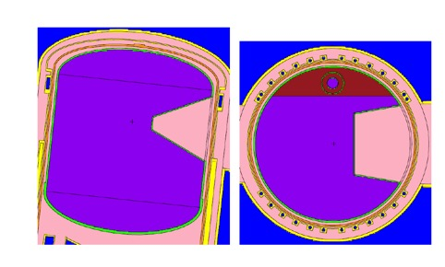
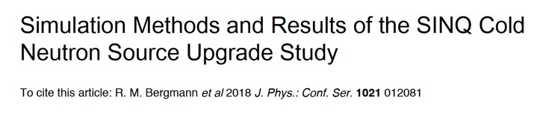
Reentrant hole can increase intensity
Average factor 1.3-1.4 increase (PSI study, R. Bergmann)

Slide 22
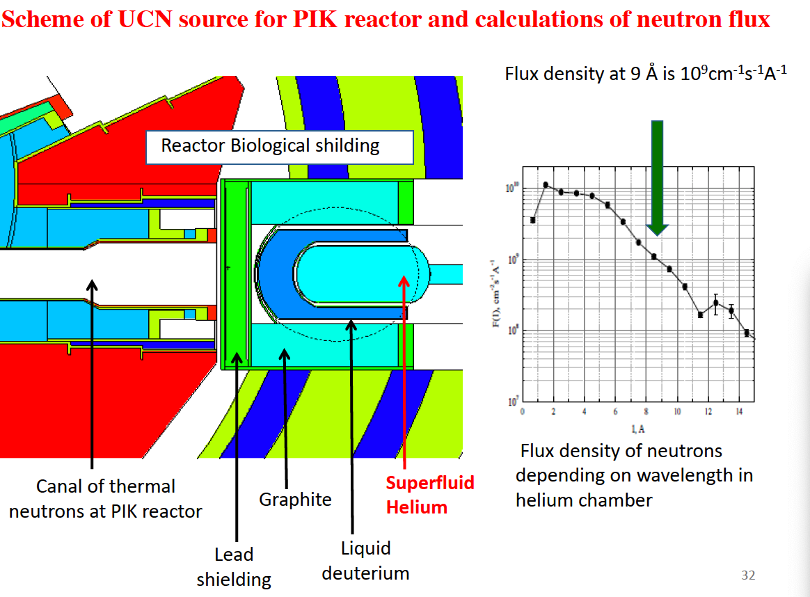
UCN converter
Technology is UCN converters is known and used
Possibilities at ESS: in beam and in pile
Both will be studied.
Engineering feasibility increasingly difficult if He converter is placed close to the target. We will determine how close we can go
(courtesy A. Serebrov)
Notes:
The main difficult to go close to the target are cooling inssue that are not easy to solve for this reason we will study how close we could go

Slide 23
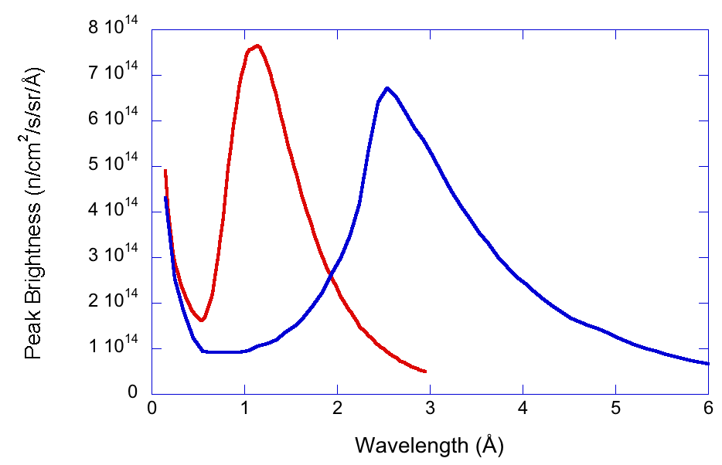
VCN moderator
thermal
(water)
cold
(hydrogen)
very cold
(??)
NB this is an example not a real calculation!
(K. Andersen)
For increase of VCN there are two possibilities:
Enhancement of the cold tail of the LD2 via quasi-specular reflection from nanodiamonds or other reflectors
Development of a dedicated VCN moderator. For this, the research is at an early stage
Study of candidate material
-theory (O. Zimmer)
-Cross section measurements

Slide 24
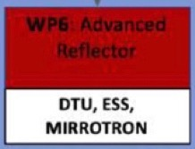
Increased beam extraction using advanced reflectors
In addition to the development of the future ESS moderator we plan also to study novel beam extraction techniques
In recent years some very promising developments has been done in the field of reflectors.
For the reflector we do not only consider the bulky material around the moderator but also thin layer of materials to provide a reflection of the cold neutron that could be used in the beam extraction system

Slide 25
Advanced reflectors of interest
Nanodiamonds are suitable for use as a quasi-specular reflector for cold and very cold neutrons (CNs and VCNs) and are expected to be an asset for a beam extraction channel at the exit of the moderator. Used as a reflector material around the LD2 moderator or around a separate VCN source, they are expected to enhance the yield of VCNs.
Graphite intercalation compounds and MgH2 both show great promise as potential CN and VCN reflector materials. They are potentially useable for enhancing the VCN brightness of moderators19.
Theoretical studies on clathrate hydrides indicate these materials as excellent candidates for moderation to VCN energies, and for reflection of cold and very cold neutrons .

Slide 26
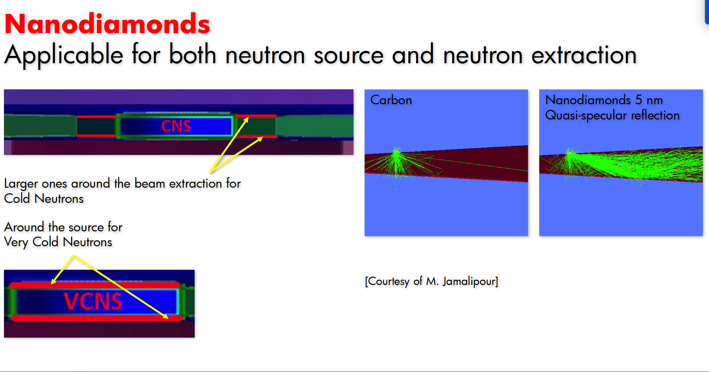
Nanodiamonds
Notes:
Here you can say that there is studiyng ongoin both to include the nanodiamonds in simulation code like GEANT4 or MCNP and also several experiments to measure cross sections

Slide 27
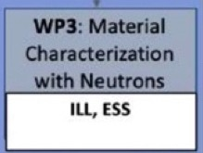
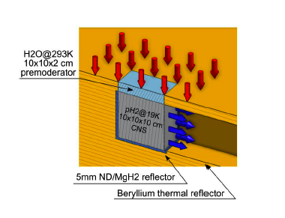
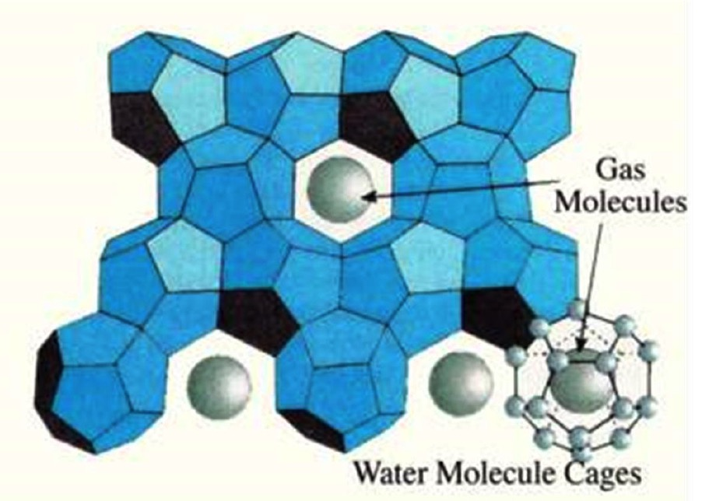
Other interesting material to study for cold neutron reflection
MgH₂ (Rolando Granada et al. ) ENS 2019
Cold neutron reflector (no upscattering)
Deuterated clathrate hydrates
Oliver Zimmer (Phys. Rev. C 93, 035503)
Possible use for VCN moderator and/or advanced reflector
Notes:
Here you can say that the MgH2 has been presented at ENS used as reflector and we also want to study it for the ESS reflector same of the clathrate hydrates

Slide 28
Q: is a VCN moderator good for NNBAR?
would nnbar benefit from having more VCN ( > 10 å)?
would nnbar benefit from a dedicated VCN moderator (i.e. with clathrates material)?
If the answer is YES, then both condensed matter and fundamental physics will benefit from VCNs

Slide 29
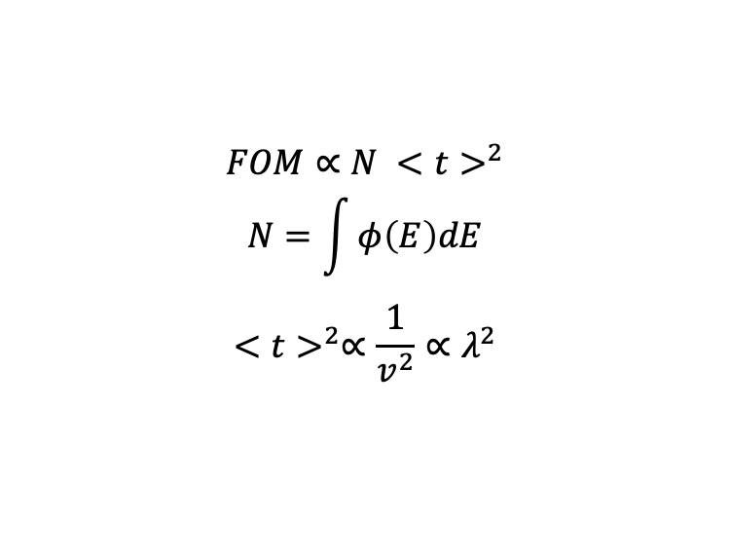
Answer from Yuri
Nnbar sensitivity is N*t², where N is integral of spectrum reaching the target (spectrum at moderator multiplied by transport function) times averaged time square.
thermal
(water)
cold
(hydrogen)
very cold
(??)
S(v) = S0(v)*T(v)
$$FOM∝N {<t>}^{2}$$
$$N=\int{φ\left(E\right)dE}$$
$${<t>}^{2}∝\frac{1}{v^{2}}∝λ^{2}$$
Therefore VCN moderator is good for nnbar
as long as does not decrease with λ faster than λ²
NOTE: Transport by super-mirror reflector is also lambda dependent: lowering velocity one will also lower v_T to the mirror surface and mirror will reflect larger fraction of spectrum.

Slide 30
Conclusions
ESS will start the User Program with one moderator of unprecedented brightness placed above the spallation target
ESS supports the design of a high-intensity moderator for the upgrade of the facility.
The new moderator, would boost the performance of applications such as imaging, spin-echo, small-angle scattering and fundamental physics by an order of magnitude or more, compared to the top (high-brightness) moderator and state-of-the-art.
Use of advanced reflectors might give extra gain.

Slide 31
Engineering design aspects
n-nbar at ESS Workshop
12th-13th December 2019
Luca Zanini
with material from Y. Bessler, M. Frost, R. Holmberg, M. Kickulies, D. Lyngh, V. Santoro

Slide 32
contents
Engineering design of the lower moderator is part of the HighNESS proposal
In this presentation I show the available space for the lower D2 moderator according to the latest drawings and compare with previous analysis
  Moderator
    Space available
  Inner shielding

Slide 33
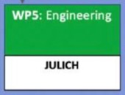
Engineering design of the lower moderator is part of the HighNESS proposal
Performed by Jülich team (designed upper moderator)
From the engineering point of view the cooling of such a large cryogenic pressure vessel in a high power spallation source is critical and must be analyzed in combination with the mechanical design.
This engineering work will include selection of structural materials, mechanical calculations, manufacturability verification, weldability analysis, definition of fluid parameters, cooling process concept design and integrability into the ESS facility to be analyzed within the framework of this proposal.
For the design of the moderators, the heating of the structural components due to neutron radiation will be calculated in WP4
Engineering of the UCN source will also be performed
Engineering design and construction of a prototype to be tested at suitable facility

Slide 34
Concept for process plant & analysis on whether existing cryogenic infrastructure can be used
The existing ESS cryoplant was sized and designed for a bottom and top moderator, which means there is additional cryogenic cooling power available - as only the top moderator is currently being installed.
However, the needed cryogenic cooling power for the foreseen LD2 moderator needs to be analyzed and will possibly need to be upgraded.

Slide 35
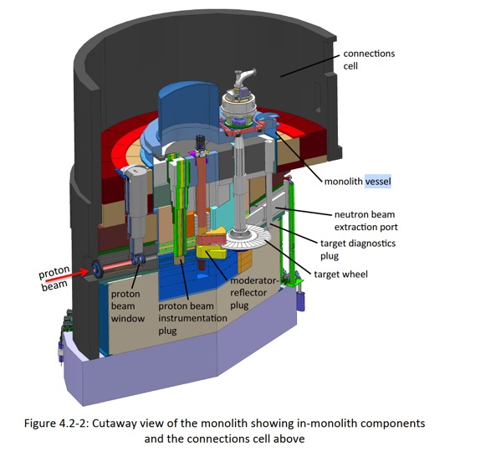

Slide 36
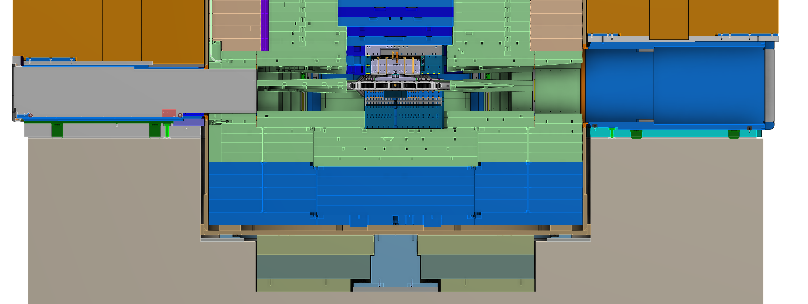
Upper moderator and reflector
target
steel plug
Inner shielding
5.5 m

Slide 37
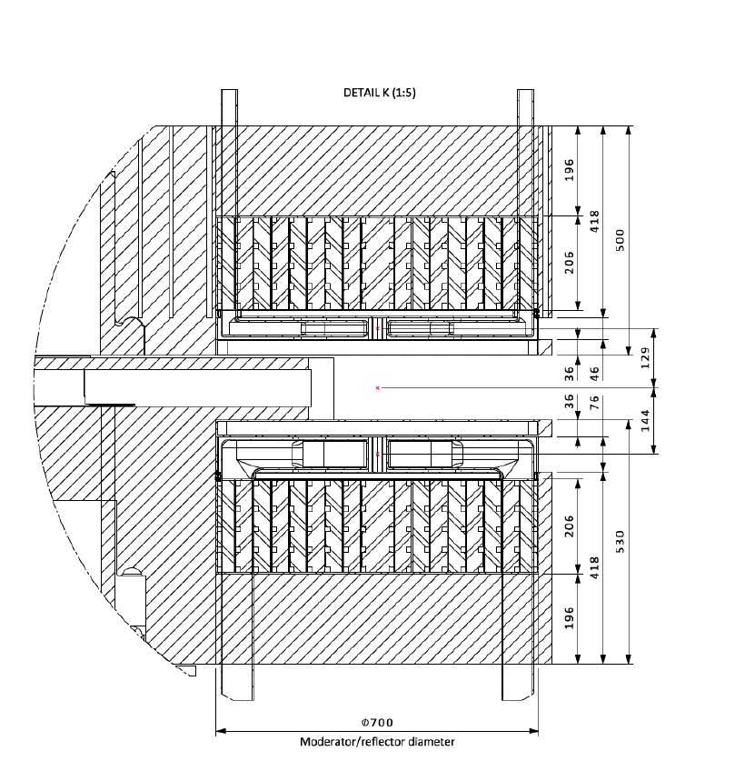
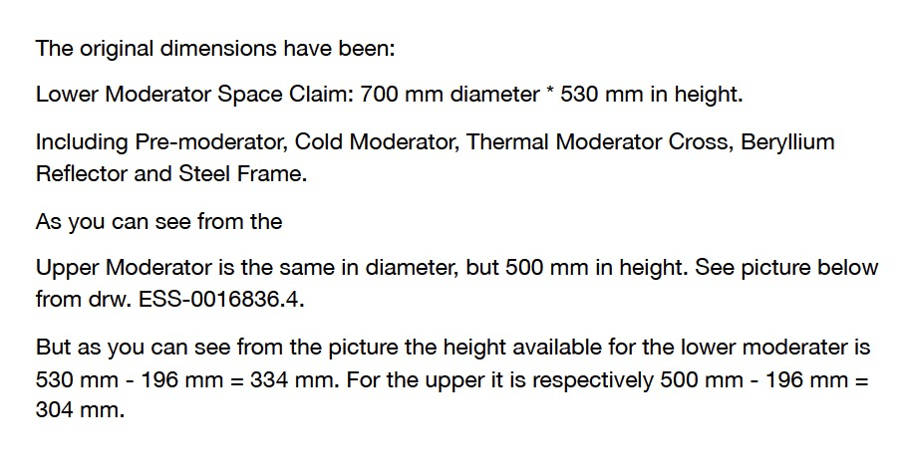
Current design of moderator and lower steel plug
334
Available space for reflector and moderator:
692 mm
334 mm
(M. Kickulies, 12/2019)

Slide 38
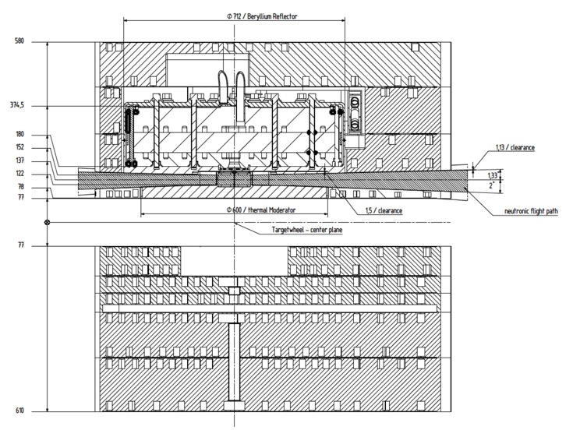
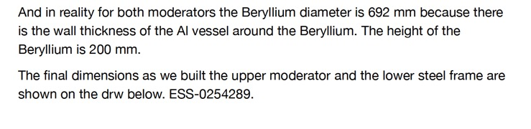
Current design of moderator and lower steel plug
(M. Kickulies, 12/2019)

Slide 39
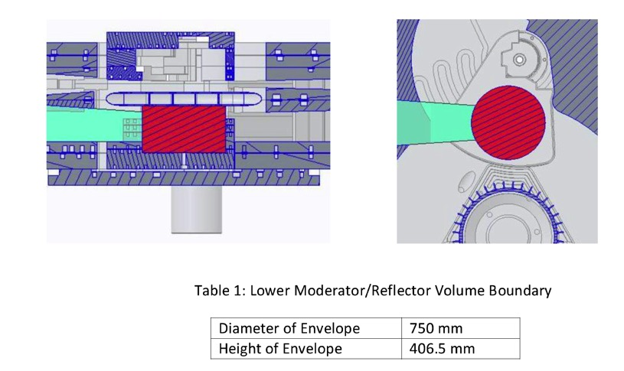

Cf. M. Frost (2/2018)

Slide 40
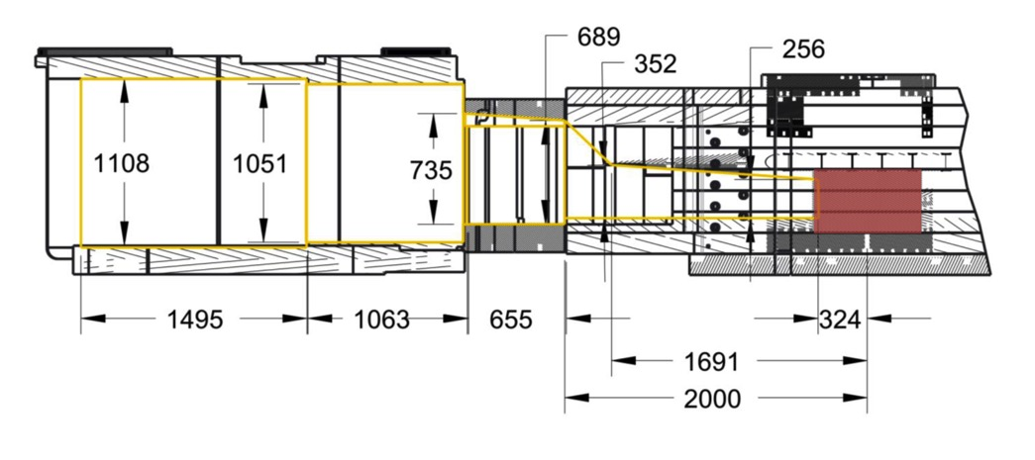
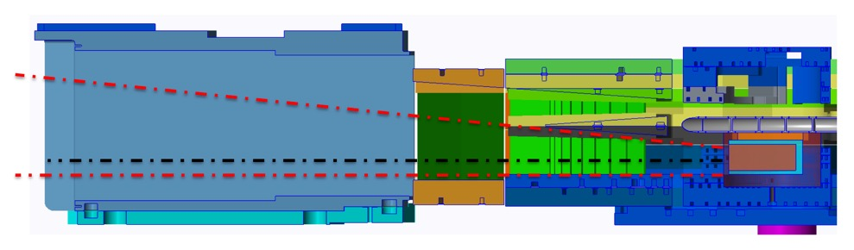
M. Frost analysis

Slide 41
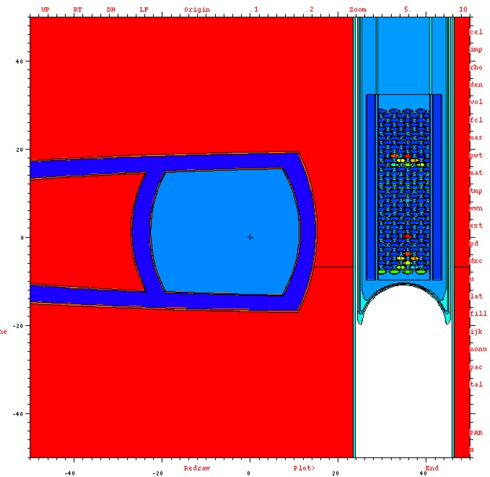
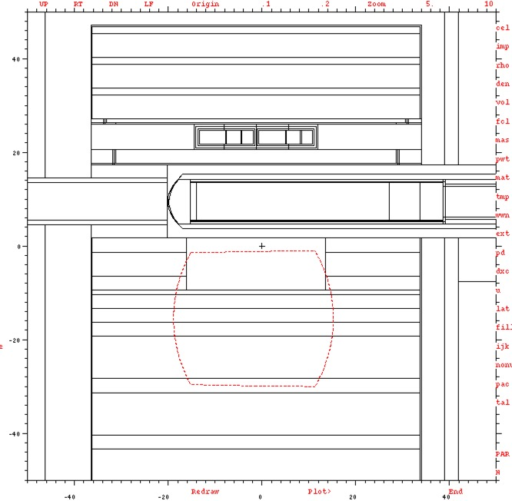
A 20 liter D₂ moderator à la PSI and ILL will occupy most a large fraction of the available volume
Window at reflector exit (approximate position)
-11 cm < Z < -40 cm
MCNP models
PSI moderator inserted at ESS (for size comparison)

Slide 42
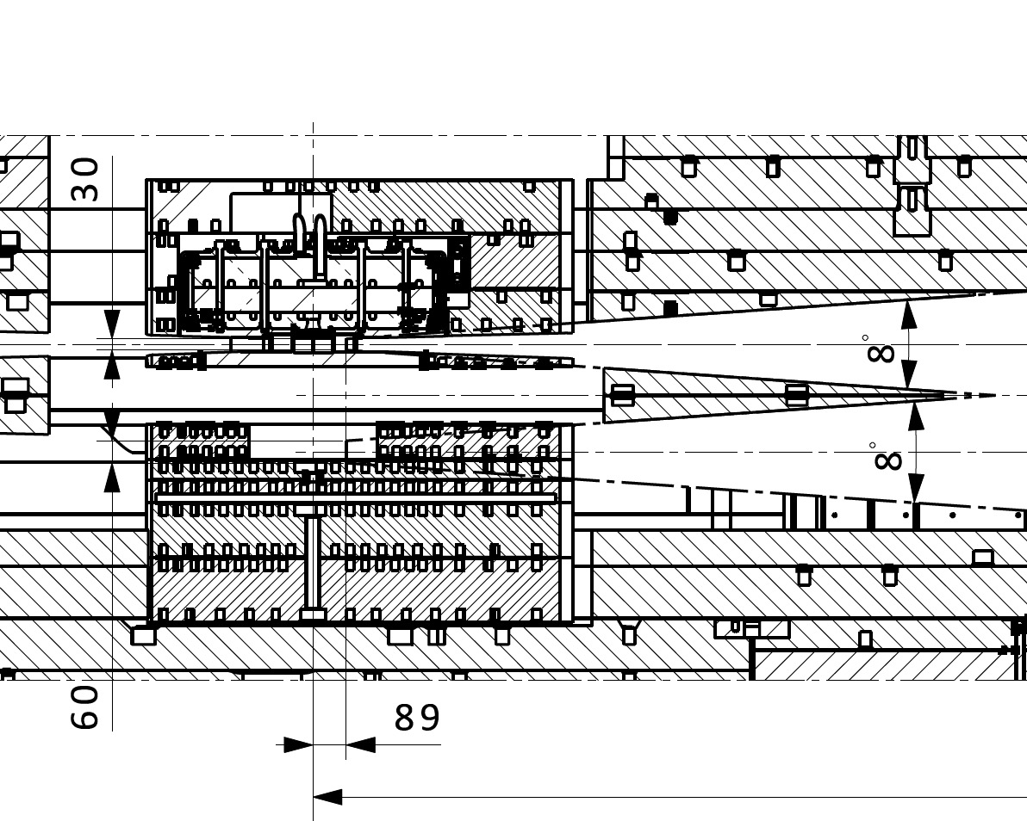
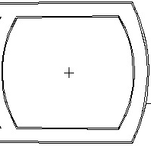
D2
reflector
42

Slide 43
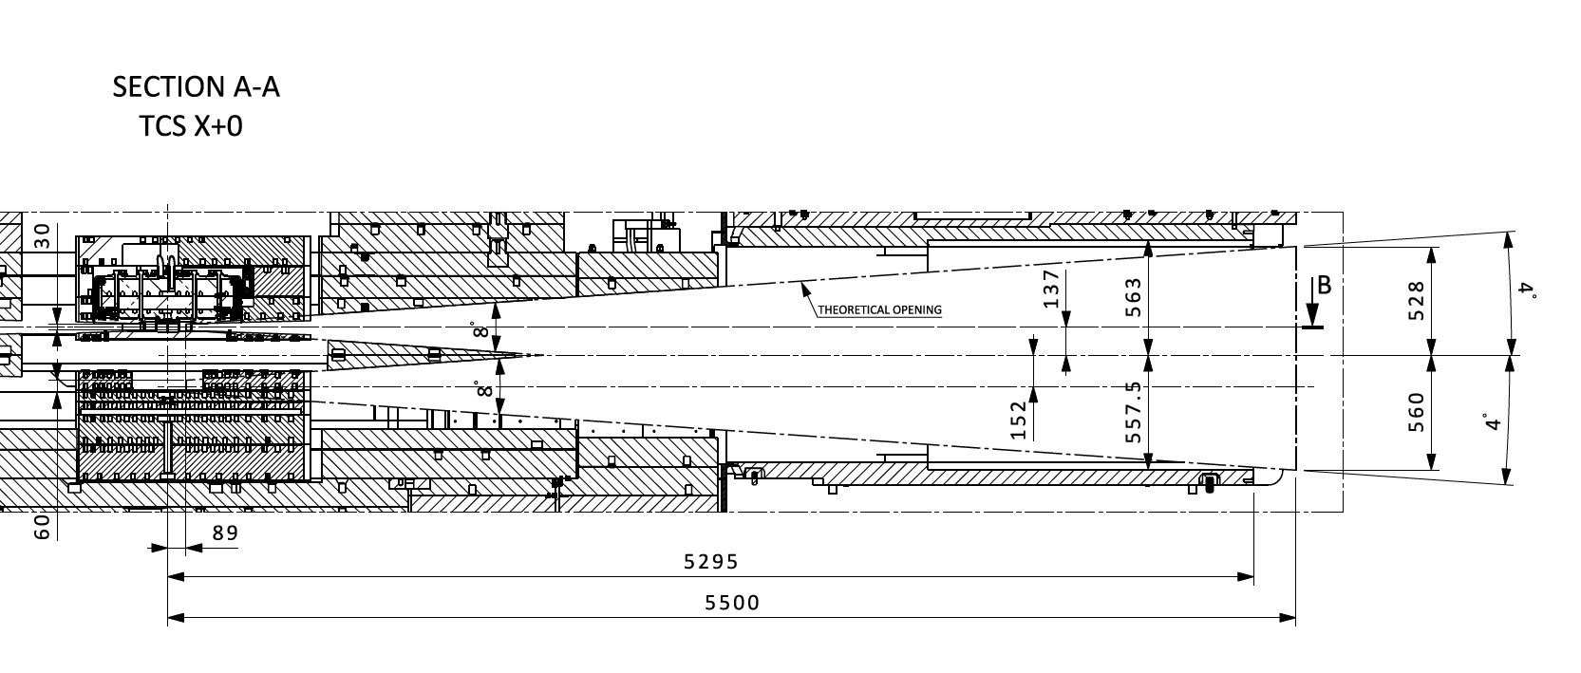
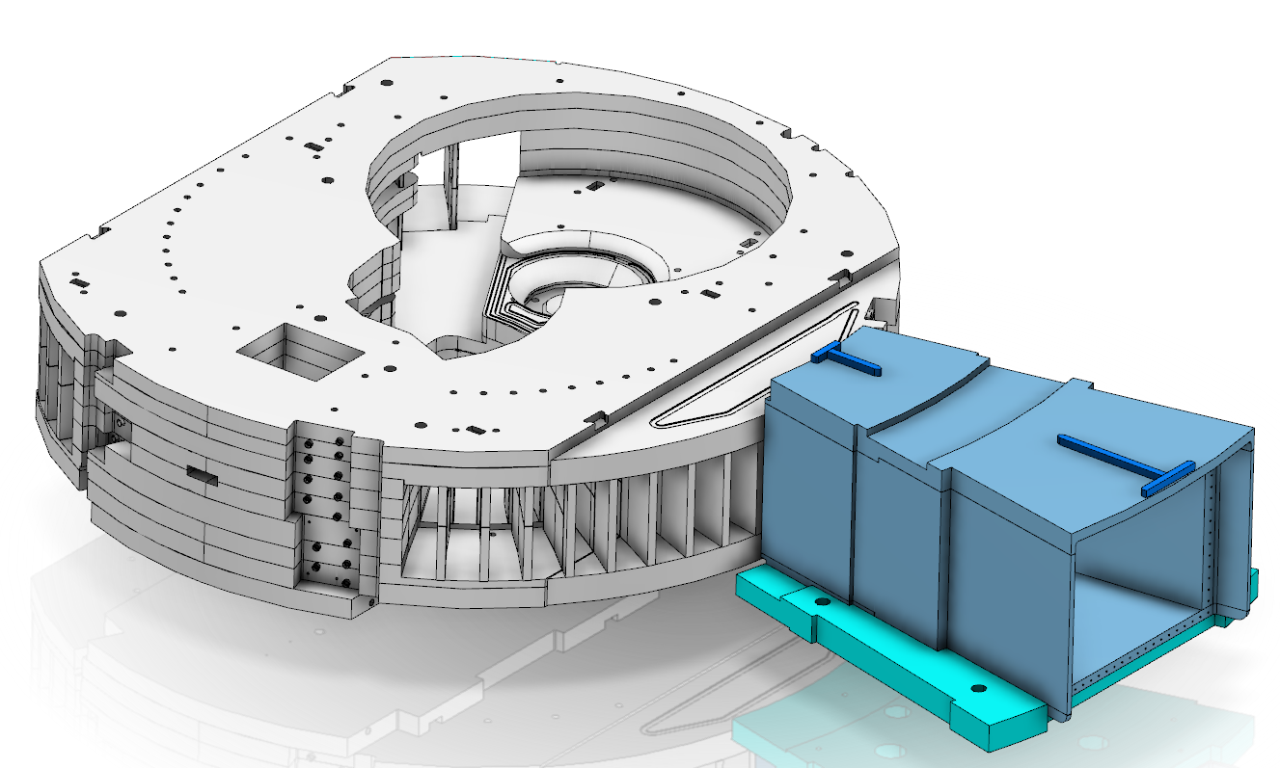

Slide 44
Summary
Available space for D2 moderator is almost consistent with previous analysis of M. Frost.
The neutronic and engineering design will consider with precision these constraints
Engineering of the D2 moderator will be performed within HighNESS project, if the grant is awarded

Slide 45
Backup slides

Slide 46
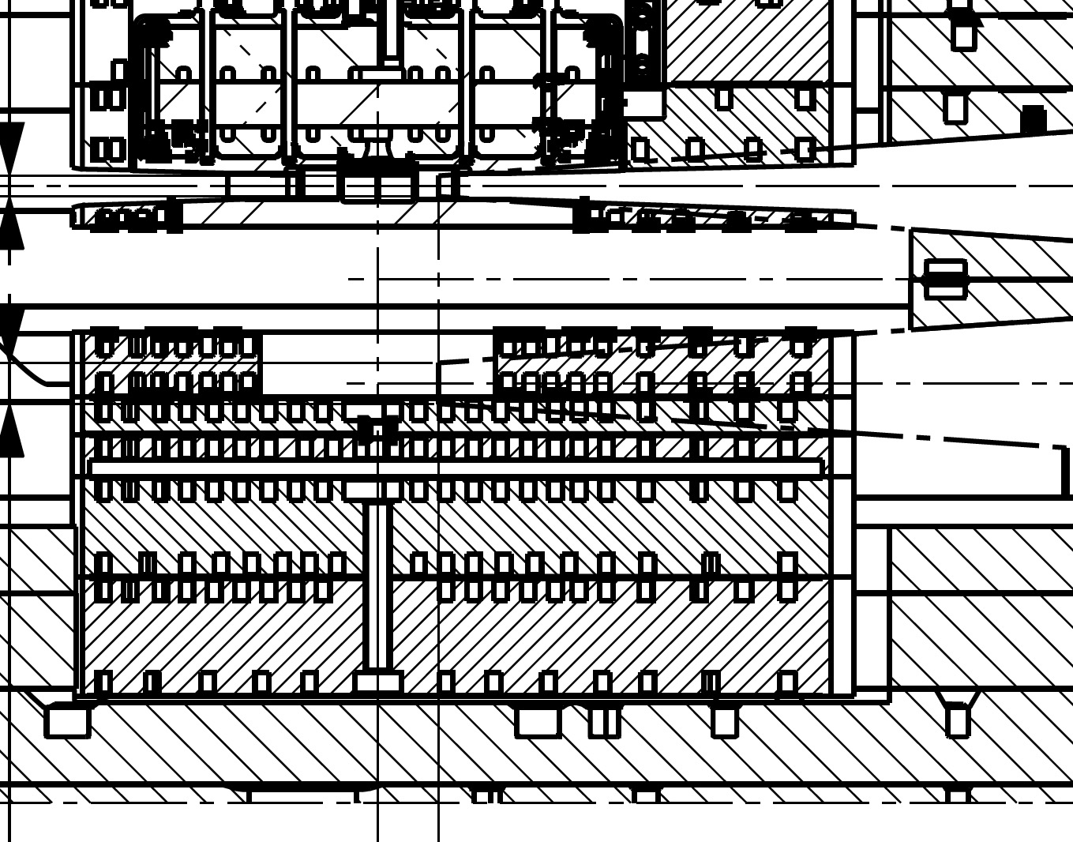

Slide 48
