Slide 1
Rare decays at HIBEAM ?

Slide 2
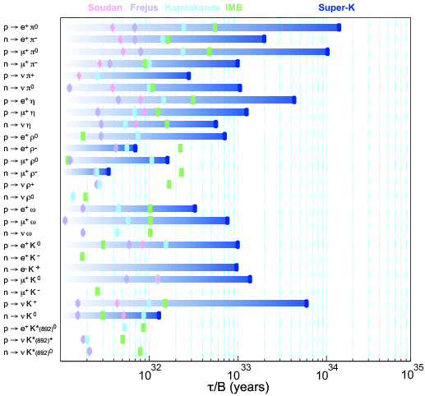
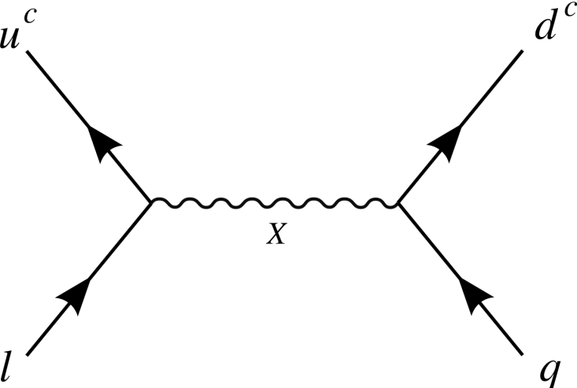
Single nucleon decay searches

Slide 3
Can an exotic neutron decay be suppressed for bound neutrons ?

Slide 4
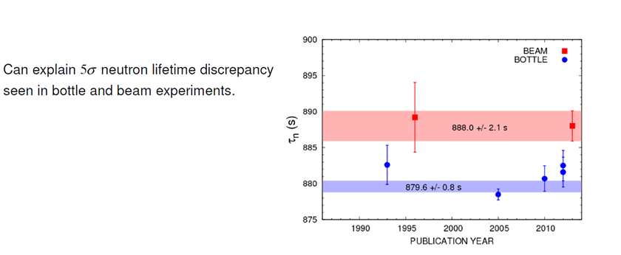
Neutron lifetime and decays
A non-neutron physicist’s perspective.
Precision on neutron lifetime ~0.1% is fairly low and not well understood
(Or there is mirror matter or some other exotic physics)
Cf muon lifetime resolution: 0.001%

Slide 5
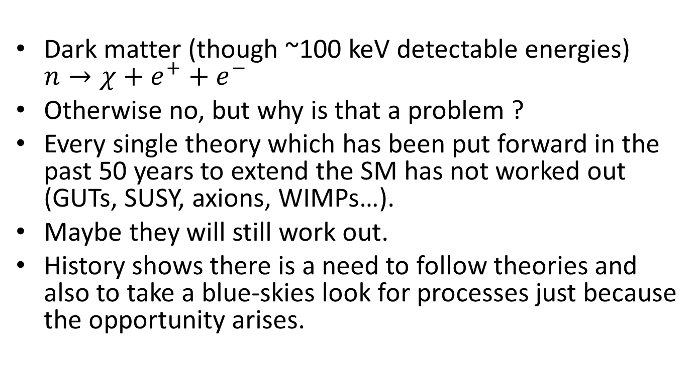
Are there theories predicing exotic neutron decays at low scales ?
Dark matter (though ~100 keV detectable energies) $n→χ+e^{+}+e^{−}$
Otherwise no, but why is that a problem ?
Every single theory which has been put forward in the past 50 years to extend the SM has not worked out (GUTs, SUSY, axions, WIMPs…).
Maybe they will still work out.
History shows there is a need to follow theories and also to take a blue-skies look for processes just because the opportunity arises.

Slide 6
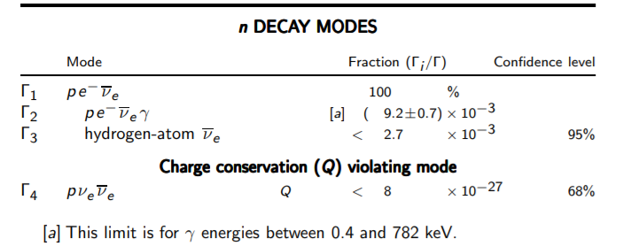
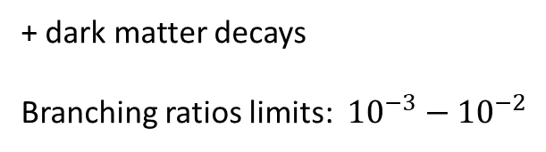
Searches with free neutrons
+ dark matter decays
Branching ratios limits: ${10}^{−3}−{10}^{−2}$

Slide 7
Back of envelope
N-pairs
HIBEAM
50m
Sensitive region
M(epi)

Slide 8
Backgrounds
n->p + e- + nu
Use the functionality of the detector for a new signal
Eg n->pi + e , n->pi + mu
  TPC pi, p discrimination, calo shower for e
  Veto for mu
  Precision timing for outward going muon
  Pointing/vertex capability.

Slide 9
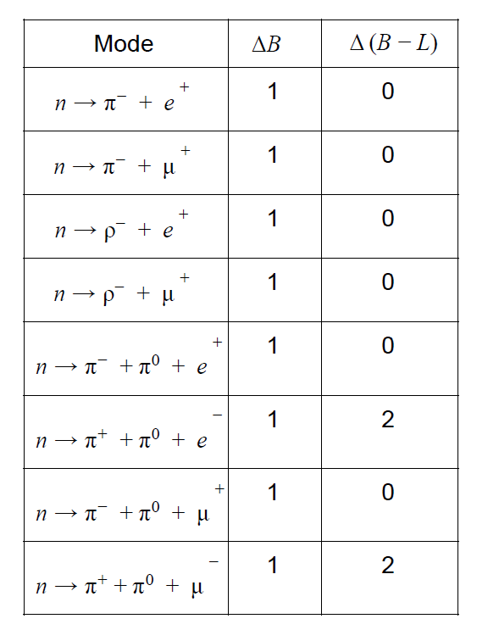
Possibility for a range of B,L violating processes.

Slide 10
MC
Use a GUT generator for some simple decays
Interface to Geant model as for the NNBAR generator
What does the signature look like ?

Slide 11
Summary
All baryons cascade down to the lightest baryon states (n,p)
BNV would be most likely to be seen from these states decaying
The neutron has a greater potential for BNV decays than the proton
Bound neutron limits may *not* be applicable to free neutrons for decays.
We will have a detector that can measure more than a nnbar annihilation.
Can we use it for more ?

