Slide 1
Laura MacDonald, CEO ASTP
ENRIITC Launch Meeting, Naples, Jan 2020
laura.macdonald@astp4kt.eu

Slide 2
What is ASTP?
ASTP is the premier, pan-European association for professionals involved in knowledge transfer between universities and industry.
Knowledge transfer professionals are from the public and private sectors
We strive to initiate, inspire, involve and influence individuals and collectives
www.astp4KT.eu

Slide 3
Who is ASTP?
Members: 1000 + individuals from 53 countries, 650 institutions
National Associations Advisory Council (NAAC) delivers input from 29 different countries
www.astp4KT.eu

Slide 4

Strategies
Professionalisation
Collective: conferences, peer review, mentoring
Individual: master classes, training courses
National association development
Participation in EU Projects
Policy Development
International Certification
Benchmarking
www.astp4KT.eu

Slide 5
What we do
We represent the interests of our members in innovation, K/TT policies and other relevant matters across Europe.
We facilitate the exchange of best practices among K/TT professionals and strengthen their network.
NAAC: We provide a cooperative platform for national associations of K/TT in Europe.
www.astp4KT.eu

Slide 6
What we do
Organise networking events in many countries:
Annual Conference (2018 Liege, 2019 Dublin, 2020 Lisbon)
Fall Meeting (2016 Stockholm, 2017 Guimaraes, 2018/19 Leiden)
14 Different Training Courses (3 each days)
Half-day / one-day Masterclasses
Site Visits (KTOs, industry, innovation ecosystems)
Customised On-Site Trainings (also outside Europe)
Collect data and publish an annual survey on K/TT activities, as well as sharing success stories and other relevant activities in K/TT field.
www.astp4KT.eu

Slide 7
What we do
We promote further “experience sharing”:
We help the KT community to connect and share in even more ways :
Peer Review (by critical friends)
Onsite Training
KT & Innovation Network of Expertise
Knowledge Stock Exchange
Special Interest Groups
www.astp4KT.eu

Slide 8
Annual Events
Annual Conference | May 2020 | Lisbon, Portugal
21st Annual Conference
Europe’s biggest meet-up for KT Professionals
From 40+ countries
Sponsorship and networking opportunities
Internationally renowned speakers
www.astp4KT.eu

Slide 9
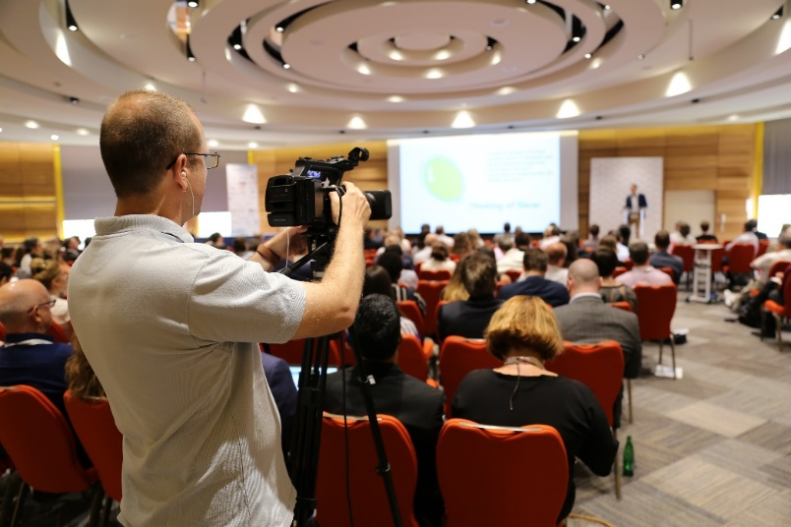
Knowledge Stock Exchange (KSE)
Initiative Sharing TTOs present their initiative or problem they are facing. - source of inspiration - identify a new partners
Marketplace Institutions and companies present their activities.
Ecosystem Insights Stakeholders from diverse parts of the ecosystem shed their light on the knowledge transfer spectrum.
www.astp4KT.eu

Slide 10
ASTP Training Courses Overview
Organised four times per year
Various European cities
Normally in batches of 3 for optimal networking and as learning
Numbers limited to 35 (max) per course
Since mid-2018 most courses have been over subscribed
Currently 14 topics
www.astp4KT.eu

Slide 11
2020 Training Courses
22-24 January 2020 | Sitges, Spain
Software Specific Challenges in Technology Transfer
Fundamentals of Technology Transfer
Marketing & Business Development
Financial Tools
18-20 March 2020 | Cracow, Poland
Technology Licensing
Fundamentals of Technology Transfer
Negotiation Skills for KTOs
Financial Tools
Research & Development Collaborations
16-18 September 2020 |
Zagreb, Croatia
Fundamentals of Technology Transfer
Organising your KTO for Growth and Success
Creating Successful Spin-outs
www.astp4KT.eu

Slide 12
International Certification
Founder member of ATTP, which manages the RTTP process
Professional recognition known as RTTP
- accredited training courses
- assessment of individuals seeking RTTP status
ATTP : 14 members across all continents www.attp.info

Slide 13
How can you get involved?
Volunteers are the heart of ASTP:
Lots of opportunities to get involved
Expert role for training /course development
Expert role for peer review/customised services
Being an active member sharing news, feeding in suggestions and ideas
Digital resources group: enhanced activity to create, curate and gather resources for members
Special Interest Groups
What else?
www.astp4KT.eu

Slide 14
On-Site Training
Experienced trainers: qualified KT experts
On-request service
Customised a curriculum built on your topic selection
Quality training on your doorstep
www.astp4KT.eu

Slide 15
ENRIITC Community
Engage in our events
E.g. Bring a mission to our AC/KSE participation/pre-day events?
HEPTECH membership deal model
Promote your news/awareness raising via newsletters/website
Customised training
Access to networks/experts..
www.astp4KT.eu

Slide 16
ENRIITC:more ideas!
SSHA community connections
Comms: newsletter/website/booths/KSE
Physics domain:HEPTECH model
Training in KT :general/ customised
Access to networks/experts.
Industry engagement: NAAC WG/network
Policy: roadmapping/legacy tools/add voices
www.astp4KT.eu

Slide 17
ENRIITC:more ideas!
Metrics/impact: sharing existing activities/collaborate via our VP metrics
Leverage your voice (your lobby recommendations)
……also to help deliver messages to added audiences E
Brokerage events-access to networks/experts.
We are a “community driven” network so can we connect on “sustainability/strong network development” ?
www.astp4KT.eu

Slide 18
KTO landscapes: key trends
KT profession is broadening to serve the knowledge economy’s requirements
KT profession is embracing SSHA as well as STEM sectors
Social acceptance of technologies of high importance
Social impact of science to be demonstrated
Start ups are overtaking spin offs in rate of formation
Social entrepreurship is gaining momentum
www.astp4KT.eu

Slide 19
KTO landscapes: key trends
Open innovation is driving complexity of collaborative R&D relationships
National ecosystems (Academia, Transfer, Industry) are growing, but independently
The importance of facilitating relationships between ecosystems is increasing due to the political developments
Increased understanding of the role and impact of strong KTOs and of national networks of KT professionals
More sophisticated relationships across industry/academia for novel innovation due to EU collaborative projects with enhanced multi-national familiarity
Emerging template agreement structures, e.g. Lambert portfolio
Much greater upstream engagement of academic innovations with serial entrepreneurs, with angels, VCs and corporate VC. See J&J and Merck
Strong sophisticated consortia working with complex scientific challenges
www.astp4KT.eu

Slide 20

Contact us:
E: HQ@astp4KT.eu
T: +31 71 711 3511
Follow us: Twitter | LinkedIn | Flickr | YouTube
#astp4KT

