Slide 1

ENRIITC WP 2 Mapping Industry-RI collaboration
Stazione Zoologica di Napoli, Villa Comunale, Napoli
21st of January, 2020

Slide 2
Introduction to WP2
WP2 aims at mapping the key elements to enact the envisaged collaborative framework between the ESFRI RIs and industry players to bring technological innovation about.

Slide 3
Introduction to WP2
Industry as users of the RI « techKnowledge » portfolio
Industry as providers of techKnowledge (T2.1) to be utilised to improve the RI services towards an enhanced user experience and advances in the investigation capabilities of researchers at the ESFRI RIs, towards a greater service offer and enhanced competitiveness of the EU RIs, ultimately serving the EU competitiveness as well as general advances in societal key challenges.

Slide 4
Introduction to WP2
Two surveys on both ILO and ICO networks ➔ inform on the current state of play and support the production of specific strategic recommendations (WP3) and actions (WP4).
Analyse the available instruments for match-making of industry-RI needs ➔ Evaluate the need to refurbish some of the match-making tools, or the basis for a new effort, based on a prioritisation exercise.
Investigate the barriers/drivers to RI-Industry engagement ➔ define appropriate strategies and actions for the establishment of the envisaged collaborative framework.

Slide 5
WP2: Industry Mapping - Identify needs and opportunities
T2.1 - Mapping of “industry as a supplier”
T2.2 - Mapping of “industry as a user”
T2.3 - Analysis of national indicators for ILO/ICO performances
T2.4 Assessment of information portals on opportunities with Ris
T2.5 Drivers and barriers in industry-RI engagement and business relationships”

Slide 6
WP2: Partners (ILOs and ICOs)
SZN – WP2 Leader
ESS
DTI
ESRF
CDTI
CLARIN
EATRIS
EMSO
NWO
WPT

Slide 7
Deliverables
WP2 - Mapping of research infrastructure-industry collaborations (Leader: I.Nardello, SZN)
Task | Description | Co. Leader 1 | Co. Leader 2 | Milestones | Deliverables
2.1 | Mapping of "industry as a supplier" | WPT Sylwia Wojtowicz | EMSO Paola Materia | M3: Questionnaire ready | M9 D2.1.a: Report on the mapping of industry as a supplier
2.2 | Mapping of "industry as a user" | DTI Nikolaj Zangenberg | EATRIS Nigel Wagstaff | M3: Questionnaire ready | M9: D2.1.b: Report on the mapping of industry as a user
2.3 | Analysis of national indicators for ILO/ICO performances | NWO Gerard Cornet | CLARIN Franciska de Jong |  | M14: D2.3: Analysis of performance indicators of ILOs/ICOs across countries and domains
2.4 | Assessment of information portals on opportunities with Ris | DTI Nikolaj Zangenberg | SZN Ilaria Nardello |  | M14: D2.2: Report on information portals and opportunities with Ris
2.5 | Analysis of drivers and barriers in industry-RI engagement and business relationships | SZN Ilaria Nardello | ESRF Ed Mitchell |  | M24: D2.4: Report on drivers and barriers (M24)

Slide 8
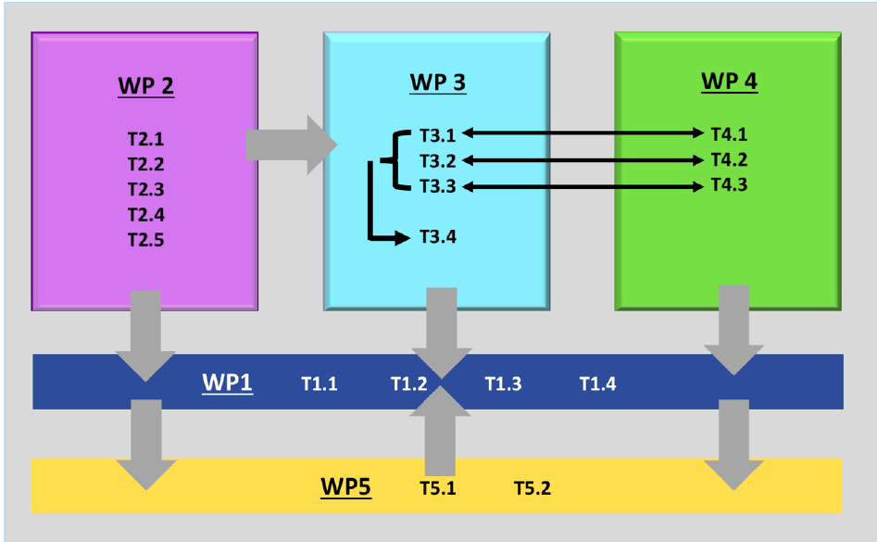
Relations to other WPs

Slide 9
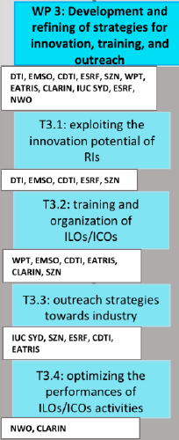
WP2 ➔ WP3
WP2 results will inform WP3 on the “Development and refining of strategies for innovation, training, and outreach”. In particular:
Development of strategy and best practices for exploiting the innovation potential of Ris (T3.1)
Development of strategy for the training of ILOs/ICOs (T3.2).
Outreach strategies towards industry (T3.3)
Recommendations on sets of indicators on industry-RI connection (T3.4)

Slide 10
WP2 ➔ WP4
The mapping exercises (T1.1-2) will feed directly into WP4, as the basis for the collection of case studies (T4.2), the realisation of pilot brokering events (T4.3).
Information from T2.3 on key indicators to measure ILO/ICO performances will flow into WP4, with its tasks related to the measuring and reporting of impact (T4.4).

Slide 11
WP2 ➔ WP5
WP2 mapping excercises (T1.1-2) will provide WP5 with most relevant communication network to disseminate the project results.

Slide 12
Task 2.1: Mapping of “industry as a supplier” (WPT, EMSO; CDTI, ESRF, SZN)

Slide 13
Task 2.1 - Objective
The goal of Task 2.1 is to identify the main areas of competence of current suppliers to RIs (including SMEs) and from this to create a general map of needed supplier competences. Such an approach will help facilitate the work of ILOs and RIs in finding suitable suppliers and enable to establish a cooperation framework for building international consortia. It could be also the basis for creating consortia of large companies with SMEs.

Slide 14
Task 2.1 – Methodology
Surveying the ILOs. The survey will include questions addressing the ILO core business such as: the way the ILOs are set-up in their country (size, scope, funding streams etc.), the industries they are dealing with, the performance metrics they are measured against. Data from purchasing departments of RI, regional innovation centres as well as individual innovation development strategies will be taken into account.

Slide 15
Task 2.1 – Workplan and expected outcome
..
WP2 - Mapping of research infrastructure-industry collaborations (Leader: I.Nardello, SZN)
Task | Description | Co. Leader 1 | Co. Leader 2 | Milestones | Deliverables
2.1 | Mapping of "industry as a supplier" | WPT Sylwia Wojtowicz | EMSO Paola Materia | M3: Questionnaire ready | M9 D2.1.a: Report on the mapping of industry as a supplier

Slide 16
Task 2.2: Mapping of “industry as a user” (DTI, EATRIS; SZN, ESRF, CLARIN, EMSO, ESS)

Slide 17
Task 2.2: Objective
The industrial usage of RIs is investigated and documented with the purpose of establishing a data bank to be used for establishing the strategic platform towards potential industry user awareness in WP3.

Slide 18
Task 2.2: Methodology
A survey and a qualitative approach using phone interviews with industrial users currently registered at the partner RIs. The interviews will cover both direct industrial users and intermediary users (users who engage with RI and have a company as end-user).
The qualitative mapping will be supplemented by a focused collection of data from partner/non-partner RIs mapping current industrial usage. Existing data (mapping, surveys, etc.) from RI and regional development offices will be included if actual and accurate.

Slide 19
Task 2.2 – Workplan and expected outcome
Audience: - Ask the RIs and they should ask their nodes; See the innovation report by Eatris;
- Questions to RIs;
How to submit the questionnaire: provide some incentive for answering the
Phone interviews:
WP2 - Mapping of research infrastructure-industry collaborations (Leader: I.Nardello, SZN)
Task | Description | Co. Leader 1 | Co. Leader 2 | Milestones | Deliverables
2.2 | Mapping of "industry as a user" | DTI Nikolaj Zangenberg | EATRIS Nigel Wagstaff | M3: Questionnaire ready | M9: D2.1.b: Report on the mapping of industry as a user

Slide 20
Task 2.3: Analysis of national indicators for ILO/ICO performances (NWO, CLARIN)

Slide 21
Task 2.3: Objectives
Analyse the indicators for the performance of ILOs and ICOs that are active in the realm of research infrastructures in order to deepen the insight what determines the success of ILOs and ICOs, and in the diversity of the expectations for the effect and impact of ICOs and ILOs

Slide 22
Task 2.3: Methodology
Methods: The work will take the survey results from T 2.1 and T 2.2., and existing studies.
The focus on the various ecosystems and governance structures in which context the development of (large-scale) scientific infrastructures is undertaken, (ii) insight in existing models for the collaboration of RIs and ICOs with ILOs, (iii) insight in the financial instruments available to support the collaboration, and (iv) best practices for this collaboration. The diversity across countries and domains will be carefully taken into account.

Slide 23
Task 2.3 – Workplan and expected outcome
..
WP2 - Mapping of research infrastructure-industry collaborations (Leader: I.Nardello, SZN)
Task | Description | Co. Leader 1 | Co. Leader 2 | Milestones | Deliverables
2.3 | Analysis of national indicators for ILO/ICO performances | NWO Gerard Cornet | CLARIN Franciska de Jong |  | M14: D2.3: Analysis of performance indicators of ILOs/ICOs across countries and domains

Slide 24
Task 2.4: Assessment of information portals on opportunities with RIs (DTI, SZN)

Slide 25
Task 2.4: Objectives
Assess the current state of information-flow between RIs and industry.
Procurement-related opportunities (e.g., call for tenders and related procedures published on RIs own websites, on TED-tenders electronics daily, disseminated via ILOs, etc.),
Services and access to the RI-user community (e.g., access to experimental facilities, scientific resources/data, expert advice, engineering & logistics, training services, etc.),
Technology/Knowledge transfer opportunities and services (e.g., industry-RI partnerships, licensing opportunities, commercialisation strategies, IPR consulting, etc.).

Slide 26
Task 2.4: Methodology
This assessment will be done by:
Analysing the already existing initiatives/portals both in Europe (e.g., TED, European Commission’s “Funding & Tender opportunities” portal, ILO websites, etc.) and when relevant at global level (e.g., navigator.innovation.ca),
The analysis of a survey, organised through task 2.1 and 2.2., in order to get direct inputs from the key stakeholders (RIs, industry representatives, ILOs/ICOs, other industry intermediaries, the European Commission) as to gain an insight on the unmet needs and feasibility of proposed modifications or new initiatives.

Slide 27
Task 2.4 – Workplan and expected outcome
..
WP2 - Mapping of research infrastructure-industry collaborations (Leader: I.Nardello, SZN)
Task | Description | Co. Leader 1 | Co. Leader 2 | Milestones | Deliverables
2.4 | Assessment of information portals on opportunities with Ris | DTI Nikolaj Zangenberg | SZN Ilaria Nardello |  | M14: D2.2: Report on information portals and opportunities with Ris

Slide 28
Task 2.5: Analysis of drivers and barriers in industry-RI engagement and business relationships (SZN, ESRF)

Slide 29
Task 2.5: Objective
Objective: get a real insight on what drives or hinders the reciprocal engagement of industry and RI, whether as suppliers or users, based on their real experience. Done as a survey, this will identify the reasons for industry not being adequately prone to be involved with RIs in their innovation plans.

Slide 30
Task 2.5: Methodology
Interview a sample of relevant target companies covering the whole spectrum from micro-small enterprises to multinationals and the spectrum of possible RI use across the ESFRI RI “families”. In parallel, we shall interview RIs from different domains. The methodology will draw upon existing material including the ESFRI Innovation Working Group, and CALIPSOplus, NMI3 and EIRISS.
A meeting shall validate results with representatives of relevant stakeholders

Slide 31
Task 2.5 – Workplan
Partners to inventorise and discuss similar work already produced (ABT, ..) (M1-5)
Creation of a questionnaire and of a submission platform (M6-12)
Submission of questionnaire and analysis of results (M13-18)
Validation with stakeholder Forum - can we align to any initiative to organise this? (M18-20)
«Report on drivers and barriers in Industry-RI enagement» (M21-24)

Slide 32
Task 2.5 – Expected outcome
Provide insights and leverages to overcome the EU innovation paradox, with the Identification of main obstacles and drivers to RI-Industry engagement, towards innovation @RIs, @Policy makers/shapers, @Industry, @ICOs, @ILOs;
Raise awareness of obstacles and drivers to RI-Industry engagement @RIs, @Policy makers/shapers, @Industry, @ICOs, @ILOs;
Others?
WP2 - Mapping of research infrastructure-industry collaborations (Leader: I.Nardello, SZN)
Task | Description | Co. Leader 1 | Co. Leader 2 | Milestones | Deliverables
2.5 | Analysis of drivers and barriers in industry-RI engagement and business relationships | SZN Ilaria Nardello | ESRF Ed Mitchell |  | M24: D2.4: Report on drivers and barriers (M24)

Slide 33
THANKS!

