Slide 1

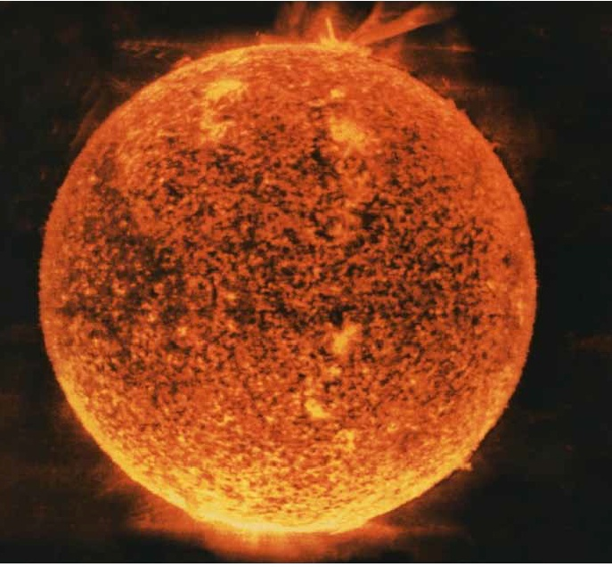
ILOs in Europe
Paolo ACUNZO
Chair of PERIIA Network
Pan-European Research Infrastructure
ILOs Association
www.periia.eu
ENEA – Department FSN - EUFUS
Italian ILO – Industrial Liaison Officer F4E/ITER
Paolo.Acunzo@enea.it

Slide 2
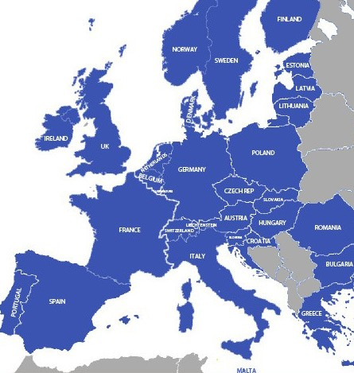






ILOs from Big Sciences projects across Europe
Barcelona, Garching, Ginevre, Grenoble, Lund and Schenefeld .

Slide 3
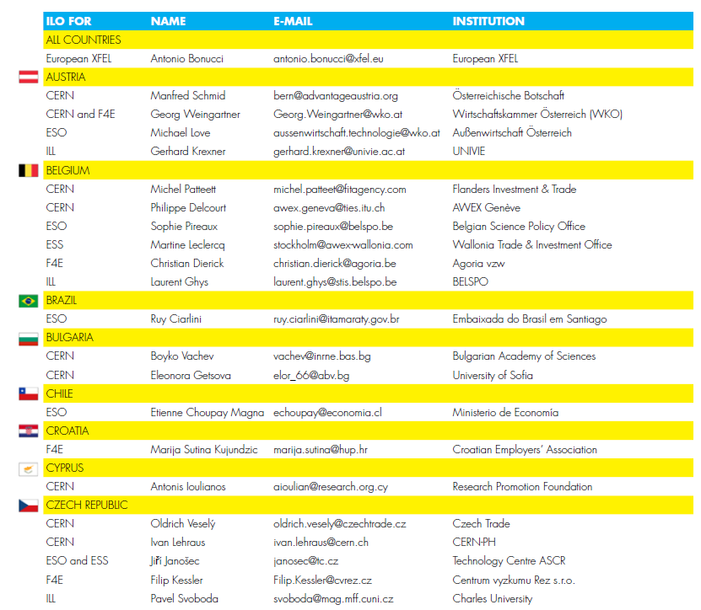
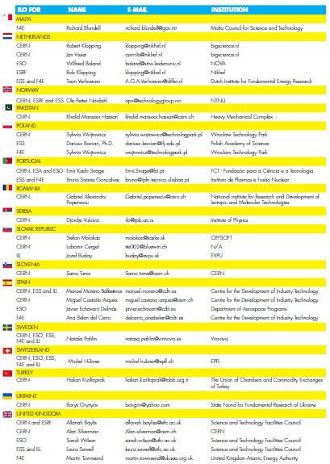
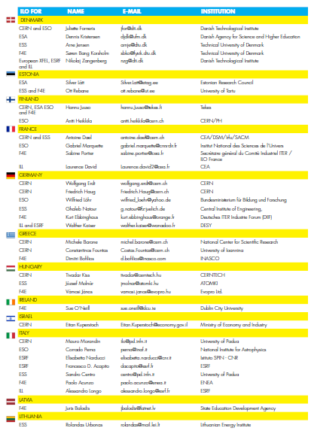
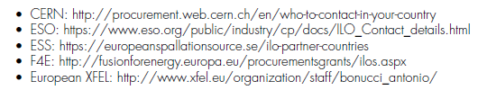
ILOs in Europe

Slide 4

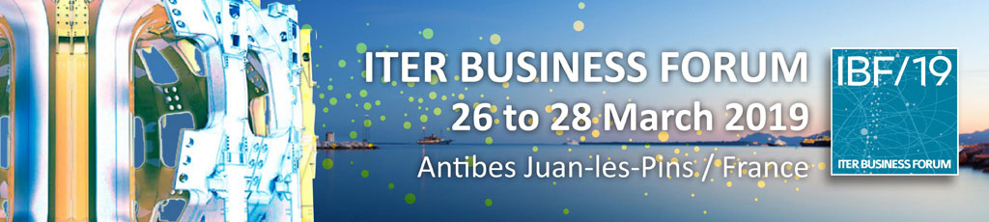
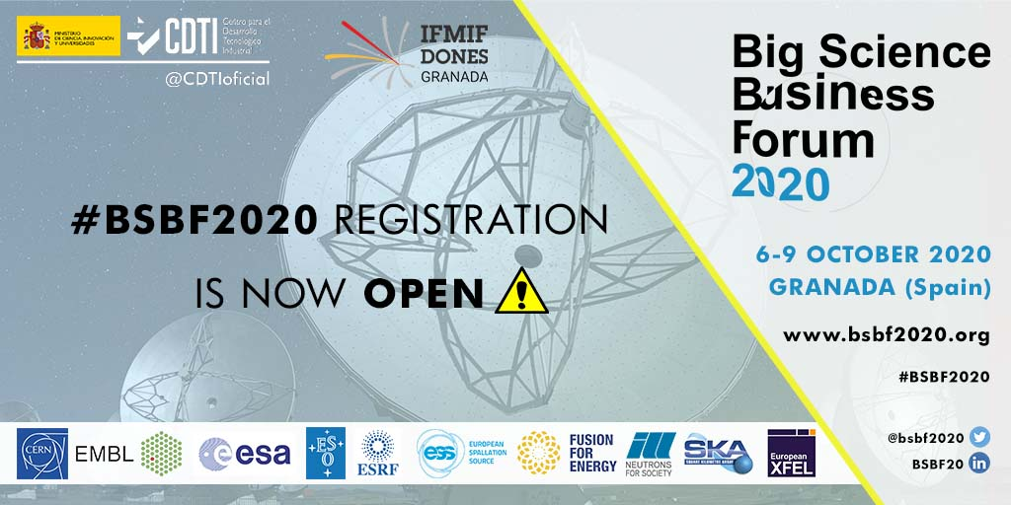
PERIIA short story
I ILOs General Assembly,
Copenhagen (DK) 26th February 2019
Launch of PERIIA Network
II ILOs General Assembly, Antibes (FR), 25th March 2019
Election of PERIIA Network Board
III ILOs General Assembly,
Granada (ES), 6th October 2020
Main PERIIA activities for BSBF20 preparation:
Participation in IOC BSBF
Individuation of 14 ILO moderators for BSBF Parallel sessions
Selection of 21 companies for BSBF SME Track
Technology Transfer Track
National booths and Sponsorships
Diffusion and registration

Slide 5
PERIIA Objectives & Membership
The main objectives of PERIIA are:
Be a key intermediary between the European supplier business/industry and big science-organisations for matters related to procurement, innovation and tech-transfer opportunities.
Enhance the big science-organisations’ interaction with business/industry in order to create an integrated and sustainable big science-market.
Raise awareness and improve access for business/industry (particularly SMEs) entering and acting on the big science-market.
Provide a forum for the exchange of best practices on how to work as an ILO.
Enhance the cohesion and functioning of ILO networks at relevant big science-organisations.
Act as a consultative reference body for other European/International stakeholders.
PERIIA Membership condition:
Membership of the PERIIA Network is on an individual personal basis. A person is eligible for membership if he/she is a nationally appointed (in a country being a member of the council of Europe) Industrial Liaison Officer (ILO) or Purchasing Advisor (PA) to any of the European Big Science Organisations, such as ESO, ESS, ESA, F4E/ITER, CERN, ESRF, XFEL, EMBL, and ILL.

Slide 6
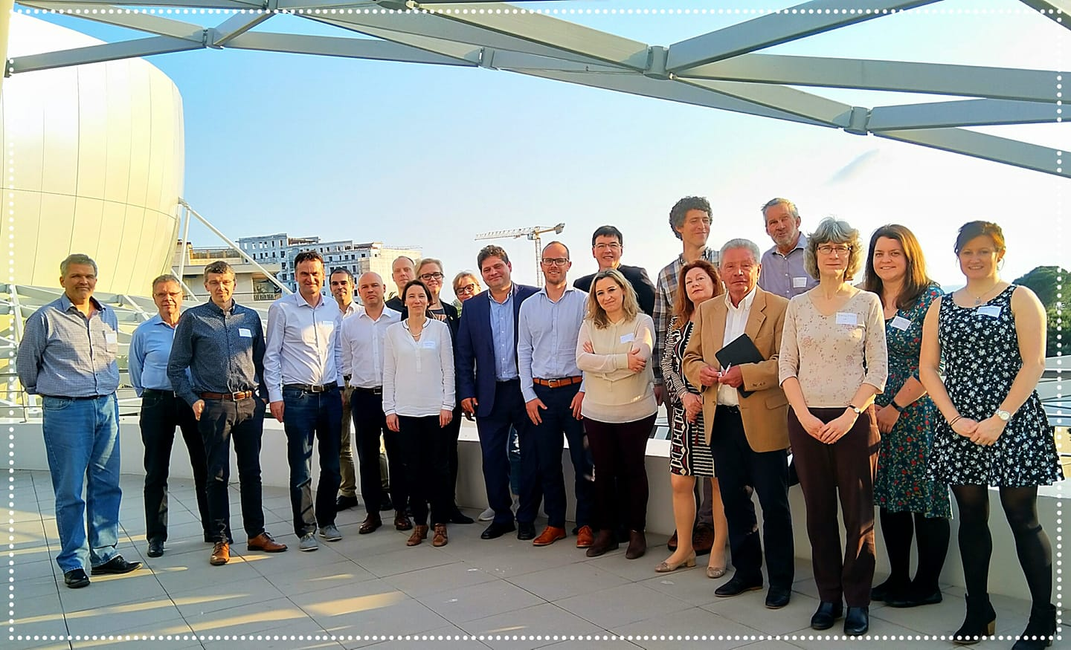
PERIIA Network Board
The Board of the PERIIA Network is elected at the General Assembly and has five to nine members taking into consideration balance among the represented big science organisations and the geographical distribution of participants. The board itself will elect a Chair, Deputy Chair, Secretary, as well as a new memberships responsible.
Paolo ACUNZO, ILO for F4E/ITER, ENEA, Italy (Chair)
Ana Belén DEL CERRO GORDO, ILO for F4E/ITER, CDTI, Spain (Deputy Chair)
Anna HALL, ILO for ESS, IUC Syd, Sweden. (Secretary – Communication)
Laurent JAMMES, ILO for ESO, CNRS – INSU, France
Martin TOWNSEND, ILO for F4E/ITER, UKAEA, UK
Toon VERHOEVEN, ILO for ESS & F4E/ITER, DIFFER, Netherlands (New memberships)
Nikolaj ZANGENBERG, ILO for CERN, ESRF & XFEL, DTI, Denmark

Slide 7
PERIIA Working Groups
1. Facilitating pan-European partnering between companies on the big science market
Open questions: Can ILOs play a role in the formation of consortia?
Can ILOs build their own new database to enable this?
Can ILOs organize info events for interesting CfTs/topics?
Can ILOs arrange early info from BSOs to have more time for arranging cooperations?
Can ILOs have an informal ILO-only meeting at each ILO-BSO meeting to discuss potential cooperations?
Can ILOs build upon “Market Surveys”?
Can ILOs exchange their “booklets on potential suppliers per country” or exchange their website?
Can ILOs invite other ILO’s to their own meetings with national industry?
Can ILOs share best practices regarding GDPR-issues linked to sharing information with other firms or other ILOs?
2. Bringing down entry barriers for SME on the Big Science market.
Identify what are the benefits for Research facilities to work with SMEs.
Gather information on what has been done in order to bring down entry barriers for SMEs on the Big Science market.
Gather and compare policies for SMEs for different research facilities.
Analysis of data for SME Business by using the data from different countries. Use the data ILOs can provide.
Identify what funding and support needed in order to bring down entry barriers for SME on the Big Science market.
3. The role of the ILO in facilitating technology transfer.
How ILOs could add value avoiding duplicities with large Scientific Facilities Technology Transfer responsibles?
How ILOs can support Technology transfer from one industrial sector to another?
How PERIIA network can support technology transfer programmes adopted by different Big Science organizations?

Slide 8
PERIIA & ENRIITC
What PERIIA Network can do for ENRIITC project ?
Collaborate throughout PERIIA expertise, network and working groups.
What ENRIITC Project can do for PERIIA Network?
Structuring PERIIA, support communication and plan common activities.
Any other suggestion?
Thank You
www.periia.eu

