Slide 1
Project Management & Administrative Requirements
Anne-Charlotte Joubert, ENRIITC Project Manager
Naples, 21st January 2020

Slide 2
Governance
Reporting and project review(s)
Rules & procedures, incl. Financials
How do we work together??
What are our commitments?
How does it work?
Sharing Documents
Documents
Database

Slide 3

ENRIITC Project Management: All you need to know!

Slide 4
Governance
General Assembly
Steering Board
Main decision making body of the consortium
One representative on the project from each beneficiary
Convenes at least once a year (tele-conference) for the duration of the project
Approval by the General Assembly is needed for, inter alia: Major strategic decisions
composed of all WP leaders.
executive body responsible for the project on day-to-day working level.
implementing project strategy, monitoring project progress, budget, and communication strategy, as well as the general project direction.
meet regularly (once a month), in person or through video conference.

Slide 5
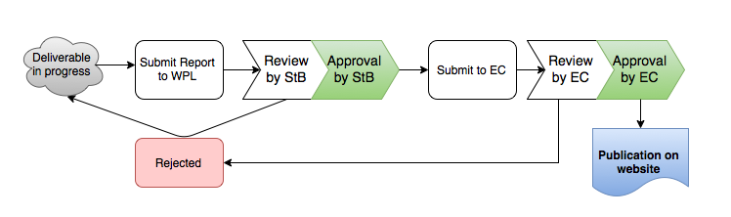
Review & Approval Procedures
Workflow of content deliverables and reports

Slide 6

Project coordination team
Adrameh Gaye
Project Administrator
Ute Gunsenheimer
Project Coordinator
Anne-Charlotte Joubert
Project Manager
Madison Bell
Project Assistant

Slide 7
European
Commission
Innovation
Advisory Committee
WP1: PROJECT COORDINATION
Steering Board
WP 2: Industry Mapping: identify needs and opportunities
WP 3: Industry engagement: create best practices & strategies
WP 4: Demonstrating: quality, performance and impact
WP 5: Communication & dissemination
EMBRC, PL ILO, EMSO, ES ILO, ESRF, EMBRC, DTI, EATRIS, CLARIN, ESS, NL ILO
DTI, EMSO, ES ILO, ESRF, EMBRC, PL ILO, EATRIS, CLARIN, SE ILO, ESRF, NL ILO
ESRF, DTI, EMBRC, ES ILO, EATRIS, EMSO, SE ILO, CLARIN, ESRF, ESS
EATRIS, ESS, EMBRC
Task 2.1: Mapping of ”industry as a supplier”
Task 3.1: Development of strategy and best practices for exploiting the innovation potential of RIs
Task 4.1: Implementation of RI-initiated innovation show case studies
Task 5.1: Communication (website, SoMe, and information material)
PL ILO, EMSO, ES ILO, ESRF, EMBRC
DTI, EMSO, ES ILO, ESRF, EMBRC
DTI, EMBRC, ES ILO
ESS, EATRIS
Task 2.2: Mapping of ”industry as a user”
Task 3.2: Development of strategy for the training and organization of ILOs/ICOs
Task 4.2: Implementation of ILO/ICO training and organisation activities
Task 5.2: Dissemination
DTI, EATRIS, EMBRC, ESRF, CLARIN, EMSO, ESS
EMBRC, EATRIS
Task 2.3: Analysis of national indicators for ILO/ICO performances
PL ILO, EMSO, ES ILO, EATRIS, CLARIN, EMBRC
ES ILO, EATRIS, EMSO, SE ILO, CLARIN
Task 3.3: Outreach strategies towards industry
Task 4.3: Implementation of industry event
NL ILO, CLARIN
ES ILO, ESRF, SE ILO, EMBRC, EATRIS, ESS
Task 2.4: Assessment information portals on opportunities with RIs
ES ILO, EMBRC, SE ILO, ESRF, EATRIS
Task 3.4: Policy recommendations for optimizing the performances of ILOs/ICOs activities
DTI, EMBRC
NL ILO, CLARIN
Task 2.5: Survey of the drviers and barriers in industry-RI engagement and business relationships
EMBRC, ESRF
General Assembly

Slide 8
Reporting to the European Commission
WHERE
WHAT
WHEN

Slide 9
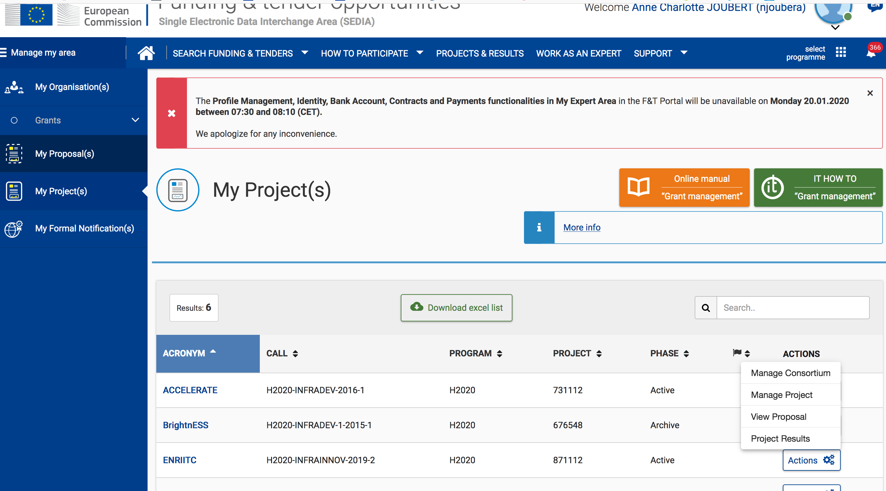
ENRITC on the Funding & Tenders Portal

Slide 10
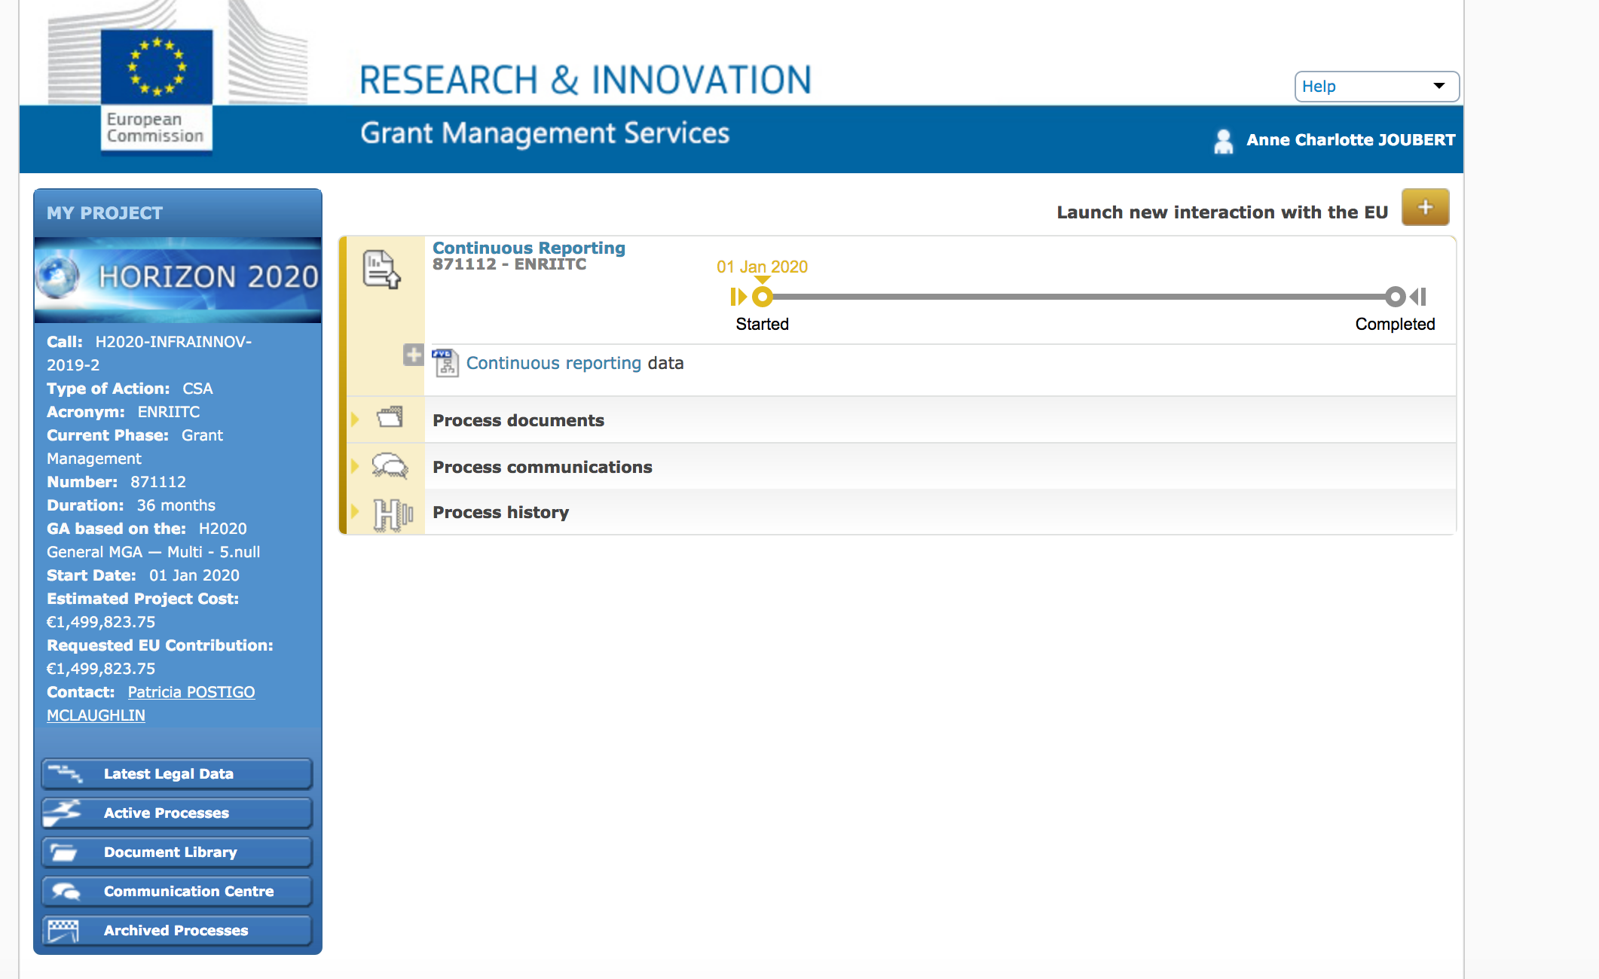
ENRIITC on the Funding & Tenders Portal

Slide 11
Content Reporting
Deliverables & Milestones
  Timing and conditions defined in Annex 1 of Grant Agreement
Periodic Technical Report containing
  An ‘explanation of the work carried out’ by the beneficiaries
  An ‘overview of the progress’ towards the objectives of the action, including milestones and deliverables
  An ‘executive summary’ for publication by the Commission
  Answers to questionnaire on issues related to economic and societal impact

Slide 12
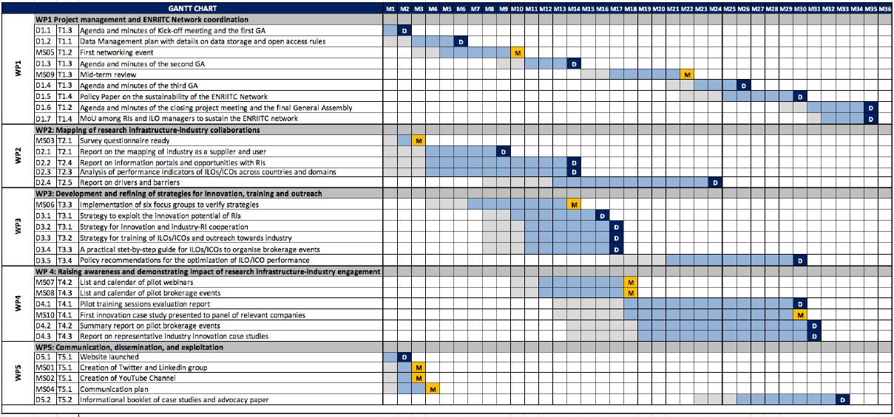
Gantt Chart
X
D
X

Slide 13
Financial Report
Each Periodic Financial Report must contain:
An ‘individual financial statement’ (Form C) from each beneficiary for the reporting period concerned:
  Detailing the eligible costs for each budget category
  Declaring all eligible costs, even if they exceed the amounts indicated in the estimated budget.
Each beneficiary must provide an ‘explanation of the use of resources’ including information on subcontracting and in-kind contributions provided by third parties for the reporting period.

Slide 14
Periodic Reports & Final Report
Reporting Period 1
01/01/2020 - 30/06/2021
Reporting period 2
01/07/2021 - 31/12/2022
Periodic reports consist of a technical and a financial report
An additional final report must be submitted with the last periodic report
All reports must be submitted within 60 days following the end of each reporting period

Slide 15
EC Financial Rules and Procedures
WHERE
WHAT
WHEN

Slide 16
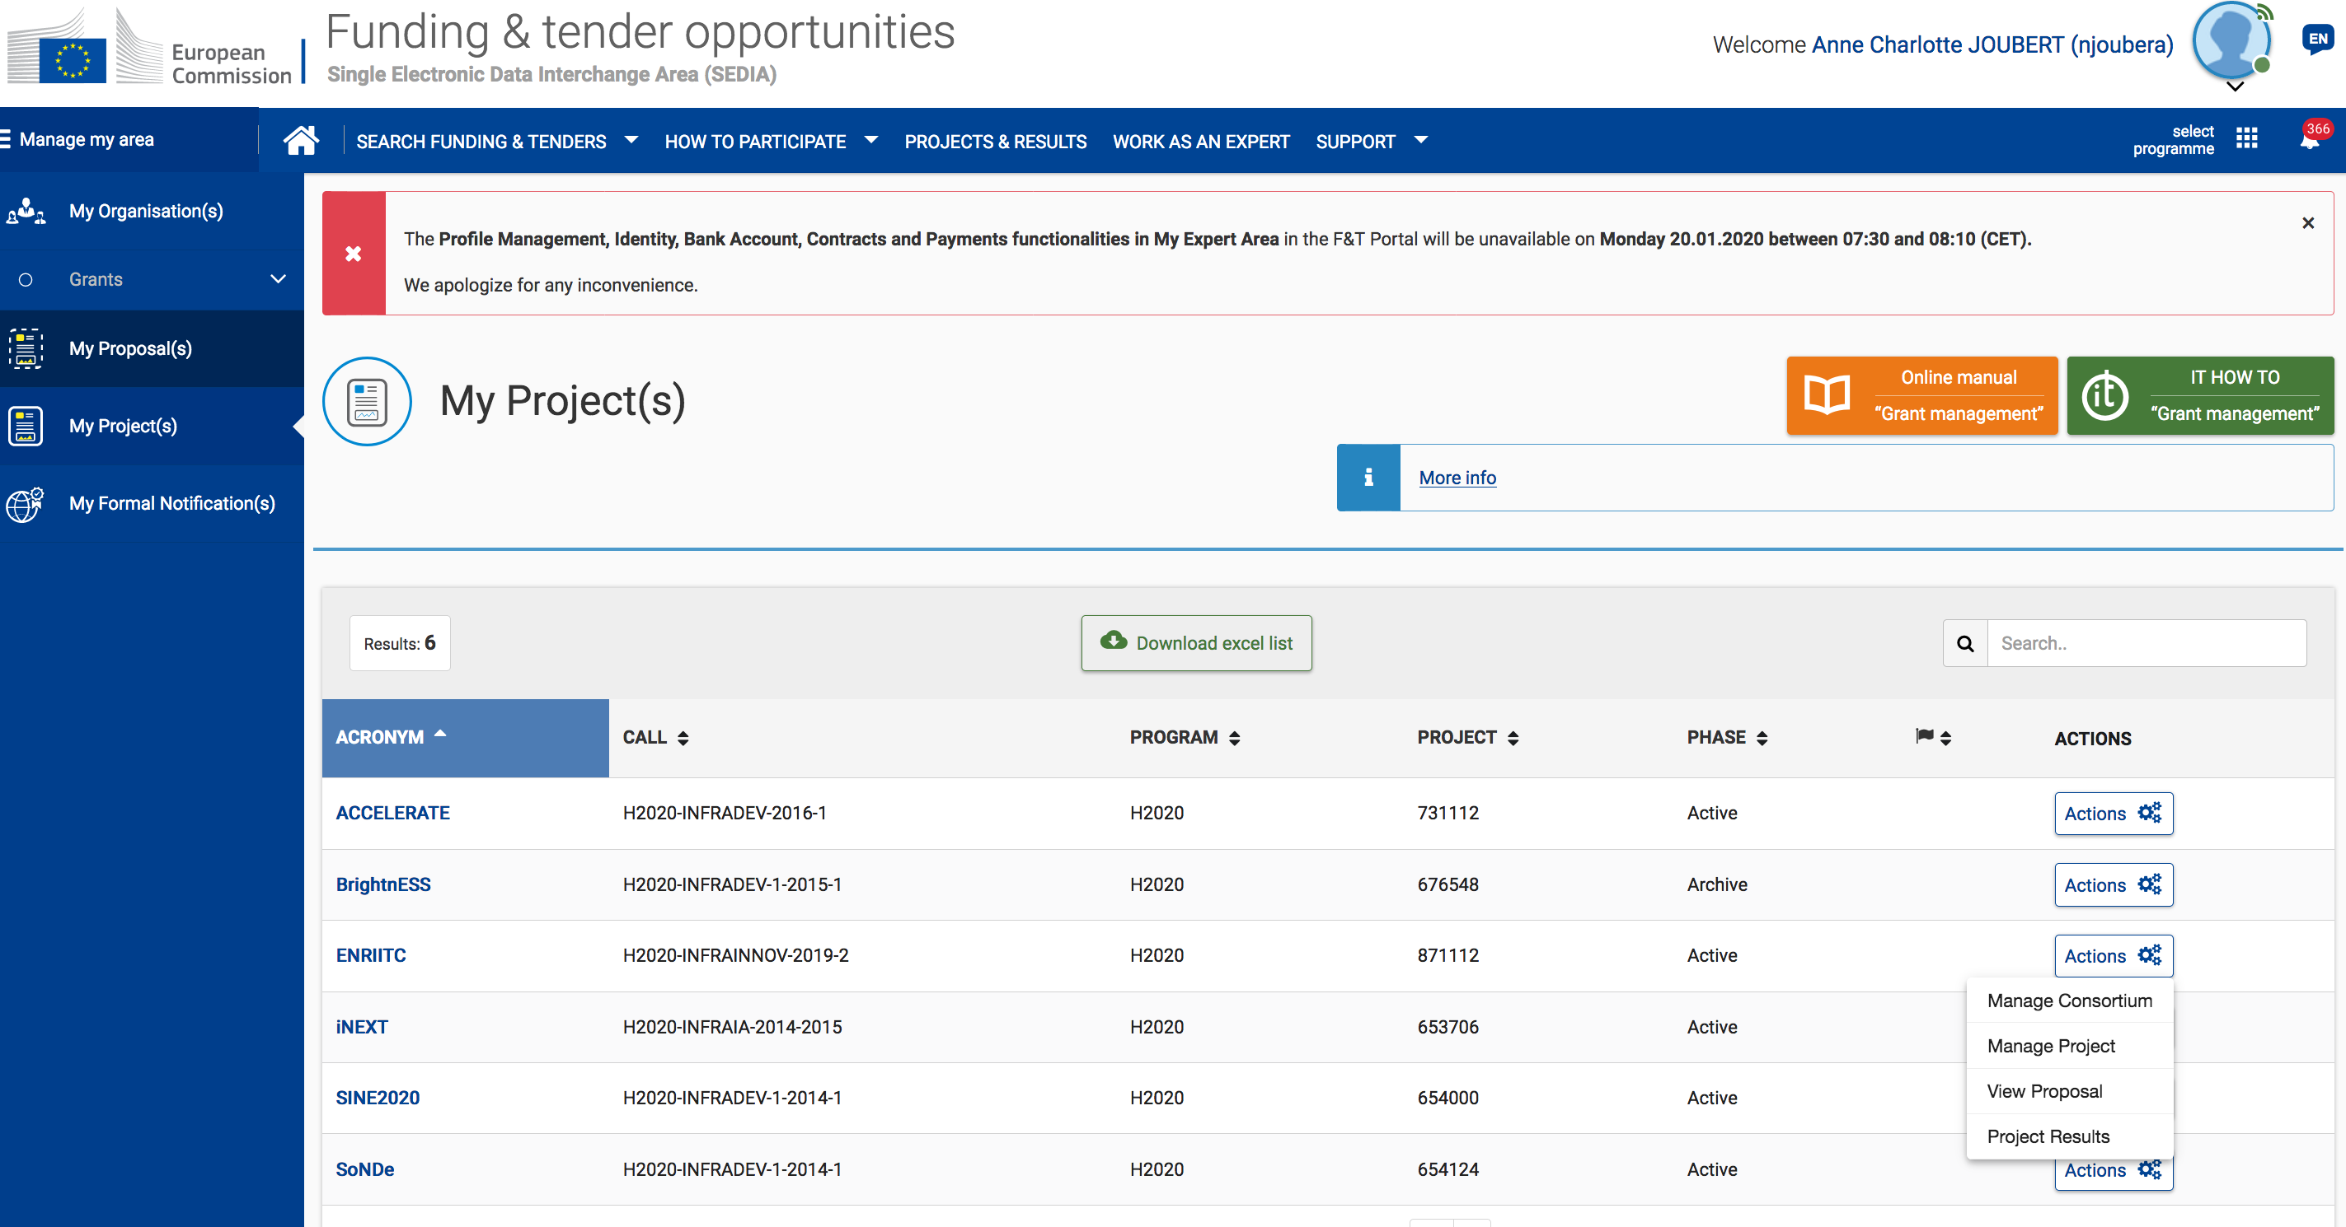
Grant Agreement – Funding & Tenders Portal

Slide 17
Cost Categories & Eligibility criteria for actual costs
DELIVERED
ELIGIBLE
AUDITABLE
Personnel costs
    Specific calculations apply
    Hourly rate x Hours worked on the Action
Other Direct Costs
    travel costs and related subsistence allowance
    equipment (depreciation value) infrastructures and other assets
    costs of other goods and services
Cost of subcontracting
Indirect Cost – Flat Rate 25%
Don’t invoice between partners

Slide 18
Responsibilities
Each beneficiary is required to:
Inform the PC immediately of any circumstances likely to affect significantly or delay the implementation of the action
Submit to the PC in good time:
  individual financial statements
  the data needed to draw up the technical reports
  ethics committee opinions and notifications for activities raising ethical issues
  any other documents or information required under the Agreement.

Slide 19

Visibility of EU Funding
ENRIITC is funded by the European Union Framework Programme for
Research and Innovation Horizon 2020, under grant agreement 871112

Slide 20
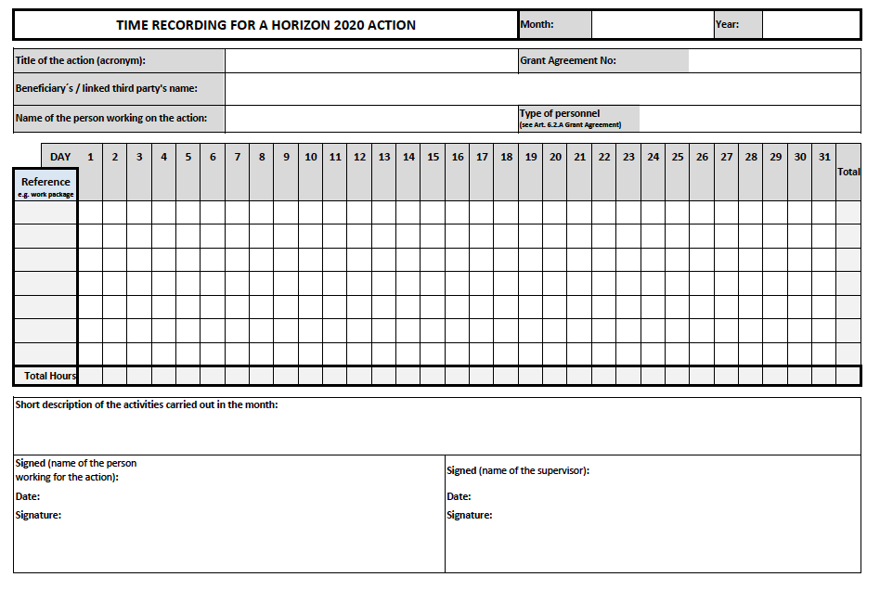
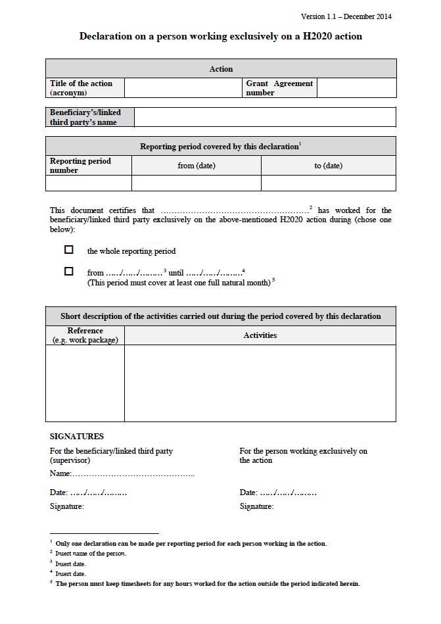
Record Keeping
Staff working part time on the action needs to keep signed time sheets in accordance with EC template (Vademecum Attachment 2)
Staff working full time on the action needs to sign ‘declaration on exclusive work for the action’ per reporting period. Now need WP number and description of Actions in this document .

Slide 21
Internal monitoring
Regular contact with each partner organisation, work closely with the persons responsible for the technical, financial and administrative delivery of their part of the activities and deliverables.
Via Google form, twice a year, requesting inter alia:
  Person Months
  Costs
  Justification of costs
ENRIITC Project Management Vademecum

Slide 22
`Brand-new section for H2020 Audits
must be archived for 2 years after ENRIITC finalisation
Record
keeping
Time sheets /‘declaration on exclusive work for the action’ for staff working on ENRIITC Essential to archive file supporting evidence like: (electronic) agenda’s, travel documents and other project documents that underpin time sheet entries.
Record
keeping
Travel bookings and approvals in line with usual practices
Essential to archive original receipts, boarding passes, train tickets as well as conference/meeting agendas, minutes and participants lists for all events
Direct costs must comply with the applicable national law on public procurement. and in line with the beneficiaries’ internal procurement procedures and rules
Essential to archive relevant records of the claimed costs. procurement documentation, original invoices and additional receipts or documentation proving the necessity of the cost claim, such as signed participants lists for meeting costs.
Record
keeping

Slide 23
Payments
EC transfers funding to the ENRIITC coordinator who distributes the funds among the consortium members.
The following payments are made to the Project Coordinator:
  one pre-financing payment equivalent to the share in the estimated budget
  one interim payment, on the basis of the request(s) for an interim payment
  one payment of the balance, on the basis of the request for payment of the balance

Slide 24
No such thing as a Free Lunch
Adhere to reporting requirements
Eligible Costs related to the Action (Annex 1 GA)
Identifiable in Organisations Accounts
Supporting Documentation Archived
Keep ENRIITC Coordination Team “in the loop”
”It always seems impossible until it's done.”
_{Nelson Mandela}

Slide 25
Sharing documents
Database
Own Cloud
-> to be tested to share documents only and review after summer 2020 if it is worth using.
Dropbox
Google docs
Any other suggestions?
Indico as a starting point
!!!Need to be GDPR compliant!!!

Slide 26
Big expectations / Very ambitious
Tight schedule
Small budget

