Slide 1
An Overview
Goals, Objectives, and the Role of the Associates
Ute Gunsenheimer
21 January 2020

Slide 2
Today’s Objectives
Officially kick-off an H2020 project
Get to know each other in person
Reach a common understanding of what we need to achieve together in 2020
Plant the seed of the broad ENRIITC Network which we establish within the next three years
INTERACTIVE

Slide 3
Table of Content
History
INFRAINNOV-02-2019 Call
Consortium
Proposal Development
Key Elements

Slide 4










Consortium
Quick
facts
Consortium leaders: ESS
ESFRI partners selected for geographical and sectorial diversity:
ESRF, EATRIS, EMSO, CLARIN, SZN
ILO partners selected for geographical and sectorial diversity:
DTI (DK), CDTI (ES), IUC Syd (SE), NWO (NL), WPT (PL)
Associates: 61
4

Slide 5
Consortium
Quick
facts
Consortium leaders: ESS
ESFRI partners selected for geographical and sectorial diversity:
ESRF, EATRIS, EMSO, CLARIN, SZN
ILO partners selected for geographical and sectorial diversity:
DTI (DK), CDTI (ES), IUC Syd (SE), NWO (NL), WPT (PL)
Associates: 61
5

Slide 6
Consortium
Quick
facts
Consortium leaders: ESS
ESFRI partners selected for geographical and sectorial diversity:
ESRF, EATRIS, EMSO, CLARIN, SZN
ILO partners selected for geographical and sectorial diversity:
DTI (DK), CDTI (ES), IUC Syd (SE), NWO (NL), WPT (PL)
Associates: 61
6

Slide 7
Consortium Associates
PERIIA
Quick
facts
Consortium leaders: ESS
ESFRI partners selected for geographical and sectorial diversity:
ESRF, EMBRC, EATRIS, EMSO, CLARIN
ILO partners selected for geographical and sectorial diversity:
DTI (DK), CDTI (ES), IUC Syd (SE), NOW (NL), WPT (PL)
Associates: 61
7

Slide 8


History
2013: INFRASUPP-01-2014 R.I.M. Research Infrastructure Market Place
2017: Drafting of WP 2018-2020 INFRAINNOV-02-2019 ILO vs. ICO
Industry Liaison Officers (ILO) are officially appointed by the Member States and Associated Countries to stimulate the collaboration among the national industry and the international research infrastructures, providing advice on business opportunities, R&D collaborations, call for tenders and industrial services.
Industry Contact Officers (ICO) are research infrastructure staff in charge of developing business relations with all potential industrial suppliers of innovative components or services as well as encouraging the economical use of their facility by private players.

Slide 9
INFRAINNOV-02-2019 / Specific Challenge
The concept of industry as a full partner of Research Infrastructures (both as supplier and as user) should be proactively put in practice; this implies to promote a more extensive partnerships on joint research and development projects, addressing the development of advanced technologies, as well as specific activities fostering collaboration such as innovation, training and exchange programmes.
Industrial Liaison and Contact Officers (ILOs/ICOs) engaged with Research Infrastructures play an essential role for stimulating effective and tighter links with industry as suppliers or users. Mutual learnings among ILOs/ICOs and exchange of information on various aspects such as: awareness and communication strategies, procurements activities, industry requirements and marketing of new technologies developed for their facility, will help to raise the level of innovative actions arising from Research Infrastructures and maximise the impact of their activities.

Slide 10
INFRAINNOV-02-2019 / Scope
Proposals will aim at establishing a European network of Industrial Liaison and Contact Officers (ILOs/ICOs) engaged with pan-European research infrastructures, including ESFRI landmarks and projects, as well as of other relevant world class research infrastructures of European interest.
ILOs/ICOs, with different degrees of experience and representing a broad range of scientific domains should be actively involved in the action. Proposals should address:
training sessions and exchange of best practises across various research domains;
enhanced cross-border and cross-thematic brokerage events such as innovation exhibitions and industry-research infrastructures showcases;
joint awareness campaigns towards industry (including SMEs) on the potential added-value of engagement with research infrastructures for their activities. This could include specific support to industrial partners in acquiring the know-how on procurement actions related to Research Infrastructures.
the analysis of national indicators to measure the performances of ILO/ICOs’ activities.
The development and maintenance of portals providing information on research infrastructures' calls, tenders, future needs and technology transfer opportunities, could also be considered.

Slide 11
INFRAINNOV-02-2019 / Expected Imact
This activity will:
Increase the awareness of industry (including SMEs) regarding opportunities offered by research infrastructures and its involvement in the development of research infrastructures technologies and services, thus raising the technological level and competitiveness of European companies;
Improve the efficiency and effectiveness of the services provided by the ILO and ICOs;
Help research infrastructures to develop more business oriented activities, including specific support and services dedicated to industry, and the promotion of skills to manage any resulting intellectual property right;
Provide a better insight into the return of investment in and societal impact of Research Infrastructures.

Slide 12
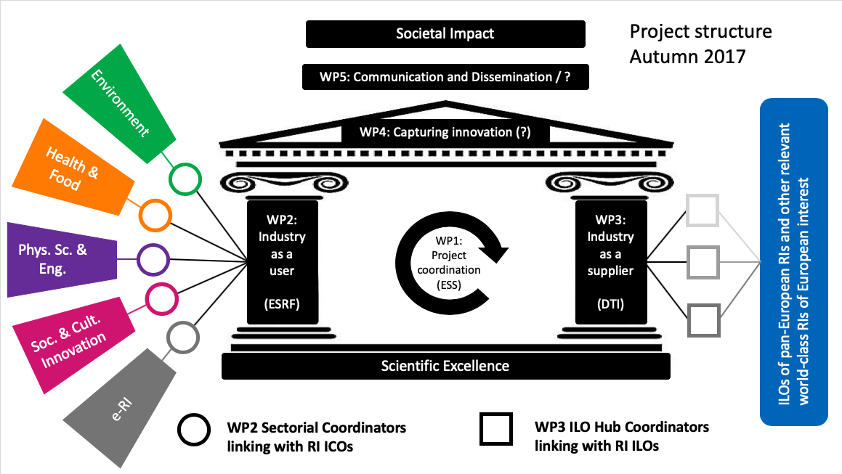
Temple

Slide 13
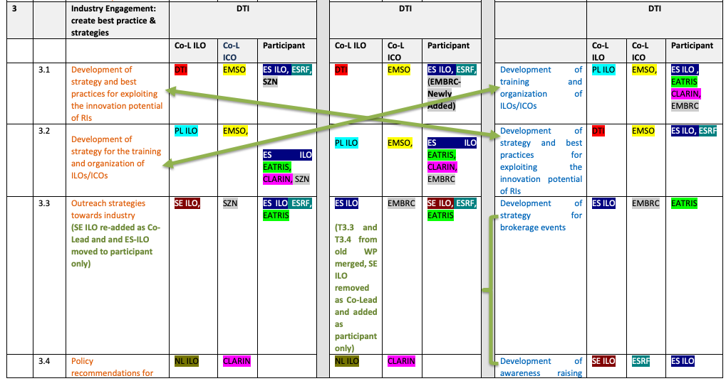
Proposal Development
Work Package Structure

Slide 14
Objectives
Mutual learning and
networking of ILOs and ICOs
Raising awareness and demonstrating impact
Enhancing RI-Industry Collaboration
Mapping of RI-Industry collaboration
Development and testing of strategies and
best practices

Slide 15
Approach
ENRIITC consortium represents 6 ESFRI Landmarks from 4 scientific domains and 5 ILOs ensuring Europe-wide coverage
Community-driven
Cross-functional
ILOs and ICOs co-lead all Tasks
All scientific domains of the ESFRI roadmap are involved + all industrial sectors are considered
Cross-sectoral
Multiplier-based
Broad basis of Associates ensure widest possible outreach

Slide 16
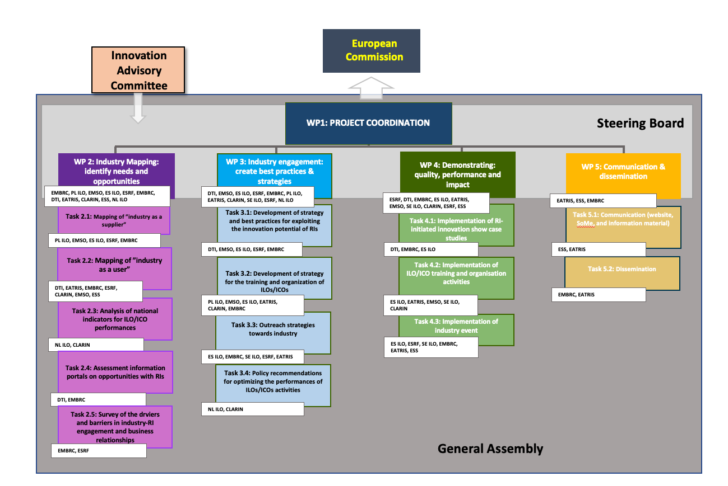
Project Management Chart

Slide 17
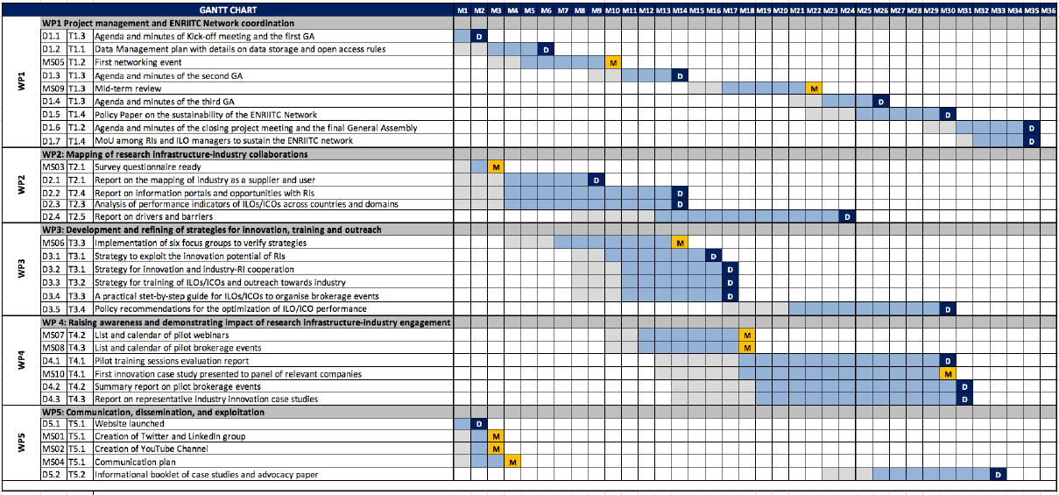
GANTT Chart

Slide 18
Concept
ENRIITC
ENRIITC
Network
Objectives
Mapping of RI-Industry Collaboration
Development and testing of strategies
Raising awareness and demonstrating impact
WP 1: Project Coordination
Associates
Associates
WP 5: Communication & Dissemination
WP2: Industry mapping: identify needs and oppontunities
WP3: Industry engagement: create best practice & strategies
WP4: Demonstrating: quality, performance and impact
Associates
Associates
Work Packages
Associates
Associates

Slide 19
The Associates
Huge interest in RI-related community to support ENRIITC
Associates are the biggest value of ENRIITC
Need to find the best possible way of making them part of it
All WPs should reflect of the role of the Associates in their WPs and how to generate mutual benefits

Slide 20
ESFRI Projects & Landmarks / 36
Associates: Research Infrastructures
Short name | Full name
ACTRIS | Aeoresols, Clouds and Trace Gases Research Infrastructure
AnaEE | Analysis and Experimentation on Ecosystems
BBMRI ERIC | Biobanking and BioMolecular Resources Research Infrastructure
CERIC ERIC | Central European Research Infrastructure Consortium
CERN | European Organization for Nuclear Research
CESSDA ERIC | Consortium of European Social Science Data Archives
CTA | Cherenkov Telescope Array Observatory GmbH
DARIAH ERIC | Digital Research Infrastructure for the Arts and Humanities
ECRIN ERIC | European Clinical Research Infrastructure Network
EHRI | European Holocaust Research Infrastructure
ELI | ELI Delivery Consortium AISBL
ELIXIR | The European Life-Science Infrastructure for Biological Information
eLTER | Long-term Ecosystem Research in Europe
EMBL | European Molecular Biology Laboratory
EMBRC ERIC | The European Marine Biological Resource Centre
EMFL | European Magnetic Field Laboratory
EMPHASIS | The European Infrastructure for Multi-scale Plant Phenomics and Simulation
EPOS | European Plate Observing System
ERINHA | European Research Infrastructure on Highly Pathogenic Agents
ESO/ELT | European Southern Observatory/Extremely Large Telescope
EU-OPENSCREEN ERIC | European Infrastructure of Open Screening Platforms for Chemical Biology
EU-SOLARIS | European Solar Research Infrastructure for Concentrated Solar Power
EURO-ARGO ERIC | European contribution to the international Argo Programme
Euro-BioImaging | European Research Infrastructure for Imaging Technologies in Biological and Biomedical Sciences
European XFEL | European X-Ray Free-Electron Laser Facility
FAIR/GSI | Facility for Antiproton and Ion Research in Europe GmbH/GSI Helmholtzzentrum für Schwerionenforschung GmbH
IAC/EST | Instituto de Astrofísica de Canarias / European Solar Telescope
IFMIF-DONES | International Fusion Materials Irradiation facility - DEMO Oriented Neutron Source
ILL | The Institut Max von Laue-Paul Langevin
INFRAFRONTIER | European Research Infrastructure for the generation, phenotyping, archiving and distribution of mouse disease models
INSTRUCT ERIC | Integrated Structural Biology Infrastructure
LifeWatch ERIC | e-Infrastructure of Biodiversity and Ecosystem Research
METROFOOD-RI | Infrastructure for Promoting Metrology in Food and Nutrition
MYRRHA | Multi-purpose hYbrid Research Reactor for High-tech Applications
SIOS | Svalbard Integrated Arctic Earth Observing System
SKA | The Square Kilometre Array
Associates: Research Infrastructures
Short name | Full name
ACTRIS | Aeoresols, Clouds and Trace Gases Research Infrastructure
AnaEE | Analysis and Experimentation on Ecosystems
BBMRI ERIC | Biobanking and BioMolecular Resources Research Infrastructure
CERIC ERIC | Central European Research Infrastructure Consortium
CERN | European Organization for Nuclear Research
CESSDA ERIC | Consortium of European Social Science Data Archives
CTA | Cherenkov Telescope Array Observatory GmbH
DARIAH ERIC | Digital Research Infrastructure for the Arts and Humanities
ECRIN ERIC | European Clinical Research Infrastructure Network
EHRI | European Holocaust Research Infrastructure
ELI | ELI Delivery Consortium AISBL
ELIXIR | The European Life-Science Infrastructure for Biological Information
eLTER | Long-term Ecosystem Research in Europe
EMBL | European Molecular Biology Laboratory
EMBRC ERIC | The European Marine Biological Resource Centre
EMFL | European Magnetic Field Laboratory
EMPHASIS | The European Infrastructure for Multi-scale Plant Phenomics and Simulation
EPOS | European Plate Observing System
ERINHA | European Research Infrastructure on Highly Pathogenic Agents
ESO/ELT | European Southern Observatory/Extremely Large Telescope
EU-OPENSCREEN ERIC | European Infrastructure of Open Screening Platforms for Chemical Biology
EU-SOLARIS | European Solar Research Infrastructure for Concentrated Solar Power
EURO-ARGO ERIC | European contribution to the international Argo Programme
Euro-BioImaging | European Research Infrastructure for Imaging Technologies in Biological and Biomedical Sciences
European XFEL | European X-Ray Free-Electron Laser Facility
FAIR/GSI | Facility for Antiproton and Ion Research in Europe GmbH/GSI Helmholtzzentrum für Schwerionenforschung GmbH
IAC/EST | Instituto de Astrofísica de Canarias / European Solar Telescope
IFMIF-DONES | International Fusion Materials Irradiation facility - DEMO Oriented Neutron Source
ILL | The Institut Max von Laue-Paul Langevin
INFRAFRONTIER | European Research Infrastructure for the generation, phenotyping, archiving and distribution of mouse disease models
INSTRUCT ERIC | Integrated Structural Biology Infrastructure
LifeWatch ERIC | e-Infrastructure of Biodiversity and Ecosystem Research
METROFOOD-RI | Infrastructure for Promoting Metrology in Food and Nutrition
MYRRHA | Multi-purpose hYbrid Research Reactor for High-tech Applications
SIOS | Svalbard Integrated Arctic Earth Observing System
SKA | The Square Kilometre Array

Slide 21
Industry Liaison Officers / 18
Associates: Industry Liaison Officers (ILOs)
Short name | Full name | Country
ANI | Agéncia Nacional de Inovacáo | PT
CEA/IRFU | CEA’s Institute for Research into the Fundamental laws of the Universe | FR
dIIF | Deutsches ITER Industrie Forum e.V. | DE
DTU | Technical University of Denmark | DK
FZJ | Forschungszentrum Jülich GmbH | DE
German CERN ILO | German Industry – CERN | DE
IJF PAN | The Henryk Niewodniczanski Institute of Nuclear Physics Polish Academy of Sciences | PL
INFN/INI | ILO Network Italia | IT
INRNE BAS | Institute for Nuclear Research and Nuclear Energy of Bulgarian Academy of Sciences | BG
NT | Norwegian Technology Group AS | NO
NWO | Ministry of Economic Affairs and Climate Policy Ministry of Education, Culture and Science | NL
PERIIA Network | Pan-European Research Infrastructure ILO Association | EU
Swiss ILO | Swiss Industry Liaison Office | CH
Technology Centre CAS | Technology Centre Czech Academy of Sciences | CZ
UKRI | United Kingdom Research & Innovation (Science & Technology Facilities Council) | UK
UT | University of Tartu | EE
VINNOVA | Sweden’s Governmental Innovation Agency | SE
Wigner | Wigner Research Centre for Physics of the Hungarian Academy of Sciences | HU

Slide 22
TechTransfer Networks + Projects / 6
Associates: Technology Transfer Networks
Short name | Full name
ASTP-PROTON | The Association of European Science and Technology Transfer Professionals - PROTON
HEPTech | High Energy Physic Technology Transfer Network
Associates: Cluster projects and initiatives
Short name | Full name
ATTRACT | breAkThrough innovaTion pRogrAmme for a pan-European Detection and Imaging eCosysTem
BrightnESS² | Bringing together a neutron ecosystem for sustainable science with ESS
CALIPSOplus | Convenient Access to Light Sources Open to Innovation, Science and to the World
LEAPS | League of European Accelerator-based Photon Sources

Slide 23
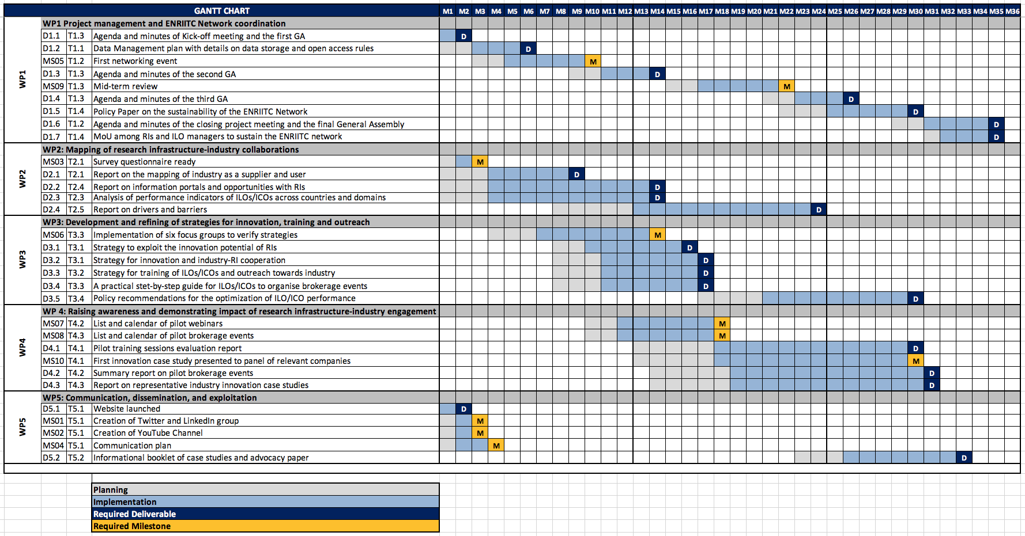
ENRIITC Network Meetings

Slide 25
The European Technology Transfer Offices Circle (TTO Circle) plenary meeting 2020 will take place in Madrid on the 4th and 5th of June.
This event is organized together with the Spanish Nation Research Council (CSIC).
The agenda and the logistics will be communicated as soon as possible

