Slide 1

Status of the Target Program
John Haines
Head of Target Division
www.europeanspallationsource.se
December 10, 2013

Slide 2
Outline
Target Station scope
Opportunities, issues, and risks
Plans
Target
Neutron instruments
Linear proton accelerator

Slide 3
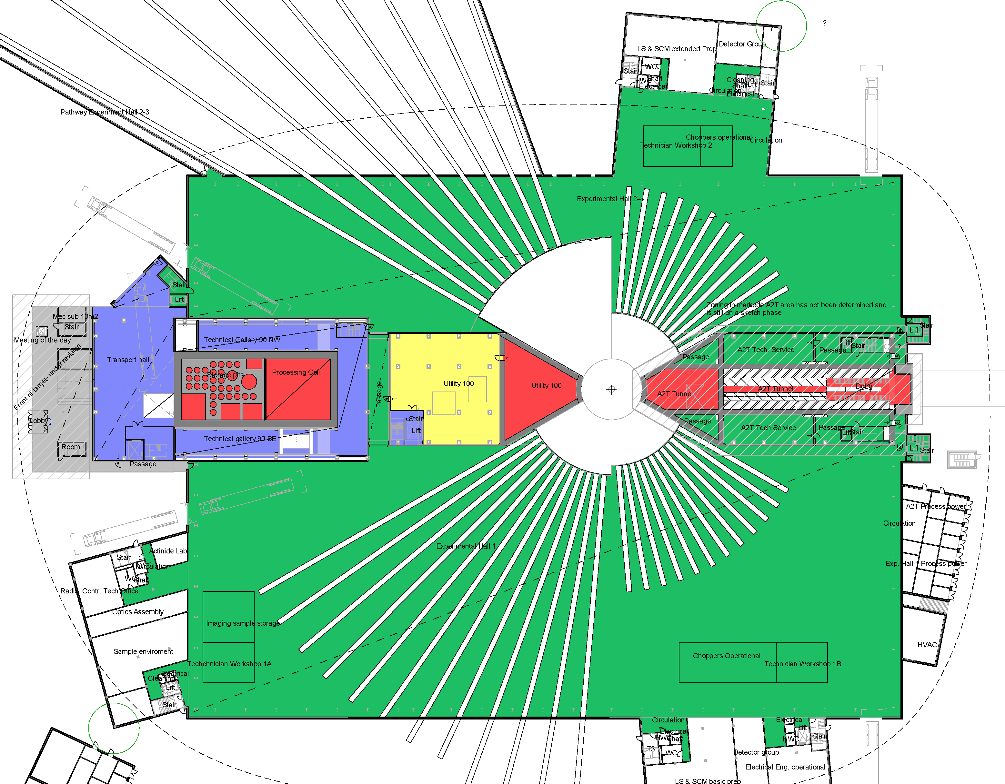
Target Station Layout
H⁺

Slide 4
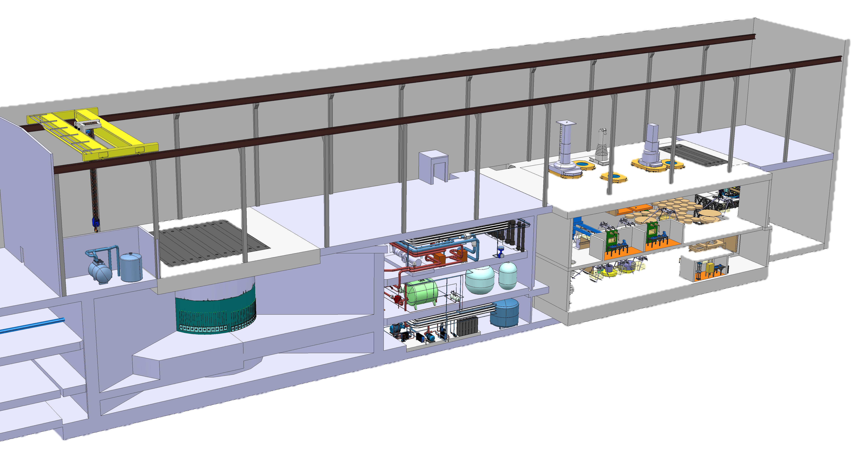
Target Station Layout
High bay
L ~ 130 m
Active cells
Utilities block
Target monolith
Accelerator – Target interface area

Slide 5
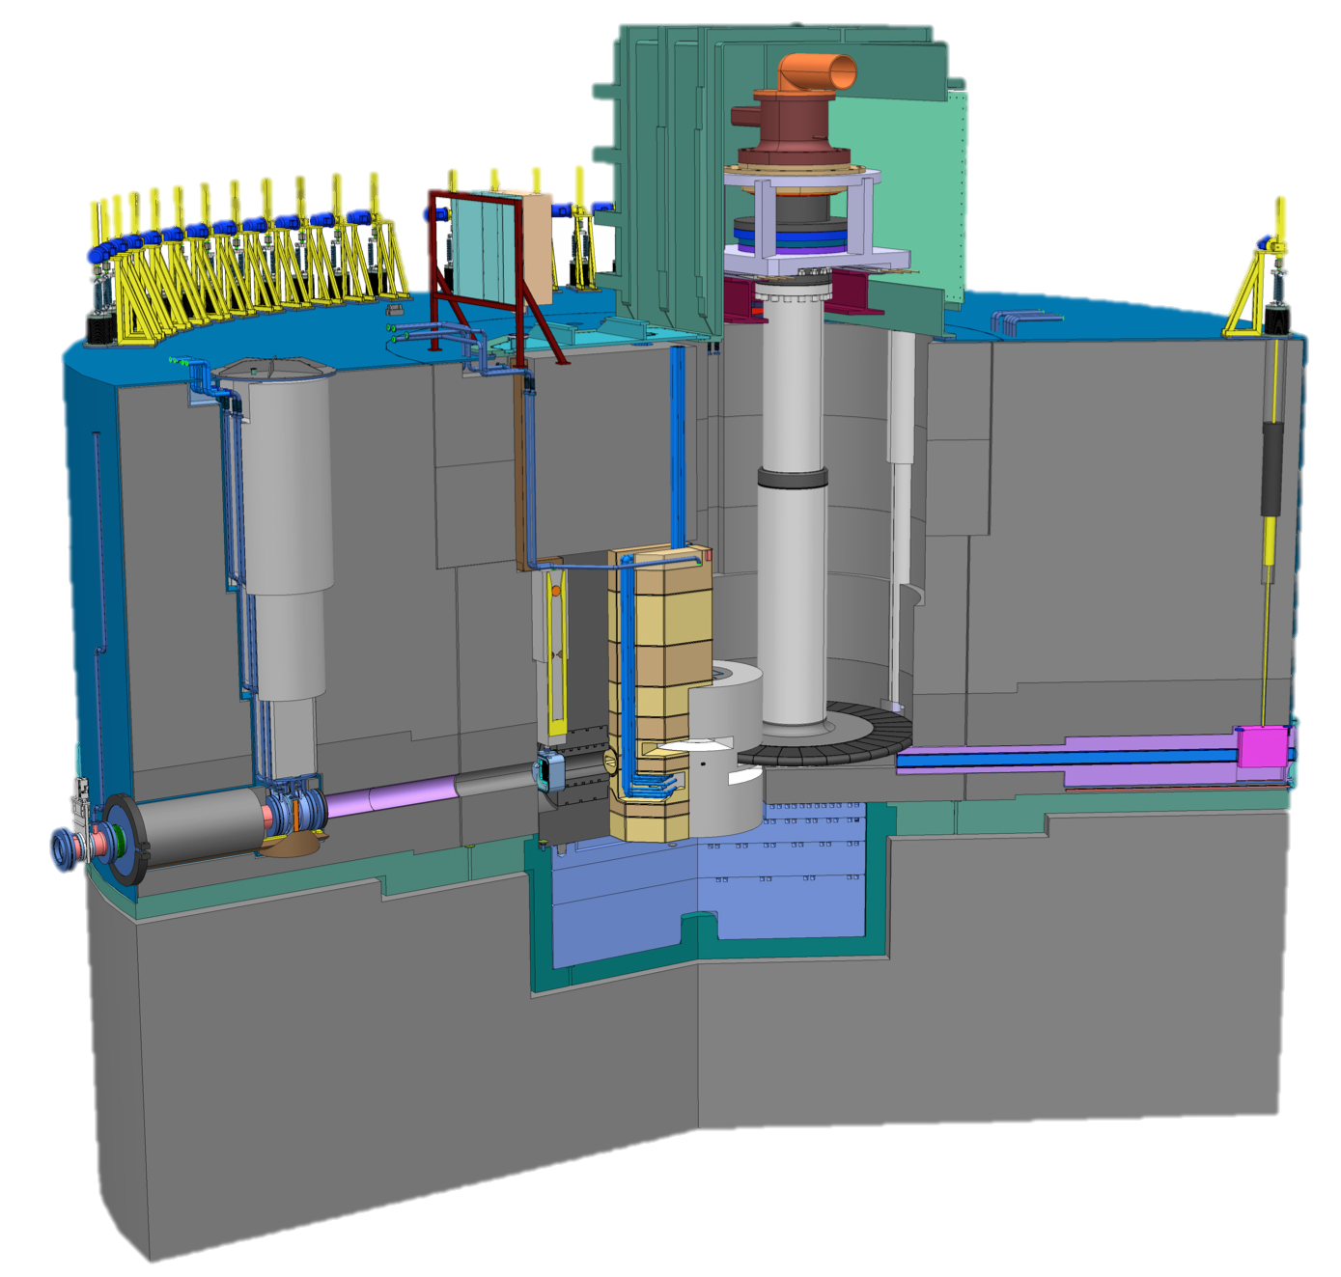
Target Station Scope – Monolith
Target drive housing
Requirements:
Convert protons to neutrons
  Peak brightness (E < 10 meV) at 5 MW: 2x10¹⁴ n/cm²/s/sr (30 x ILL)
Heat removal - 5 MW proton beam
Confinement and shielding
Unique features:
  Rotating target
  He-cooled W target
Monolith
liner
Steel
shielding
Neutron beam extraction
Proton beam window
Target wheel
Moderator and reflector plug
Neutron beam window

Slide 6
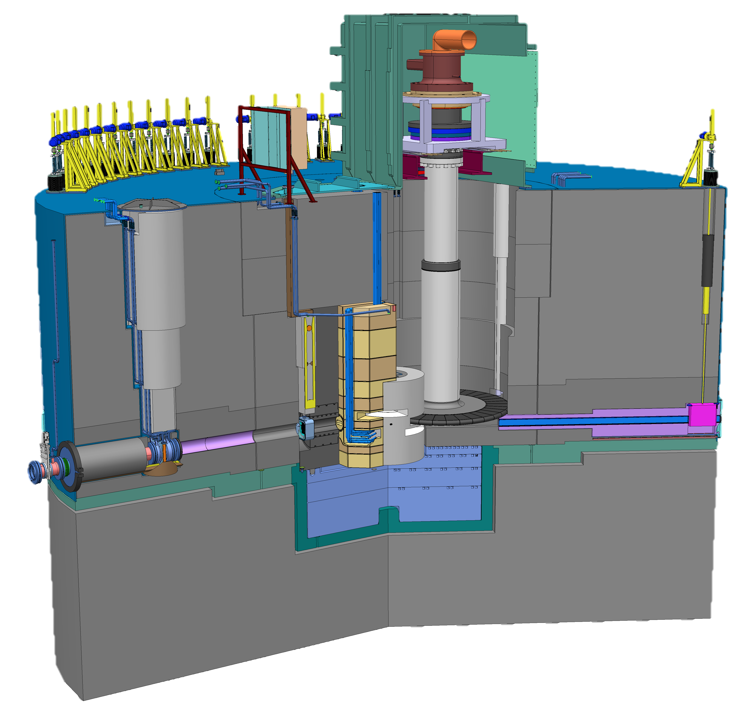
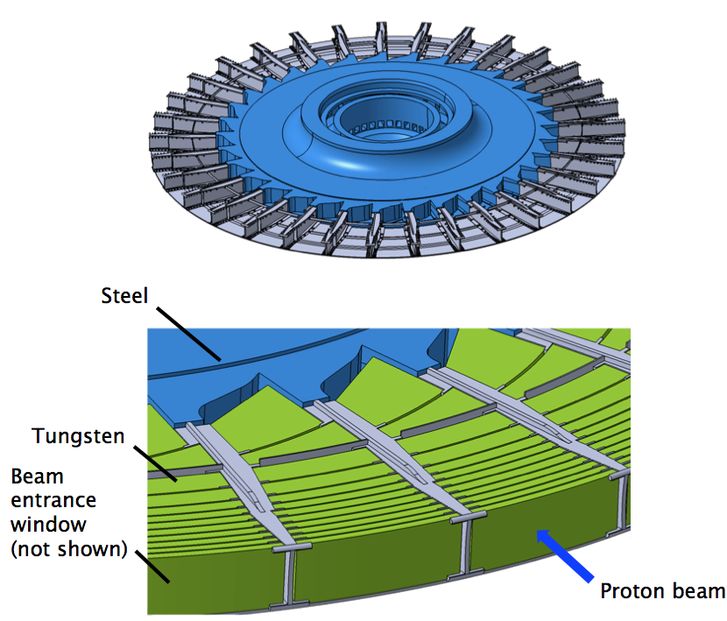
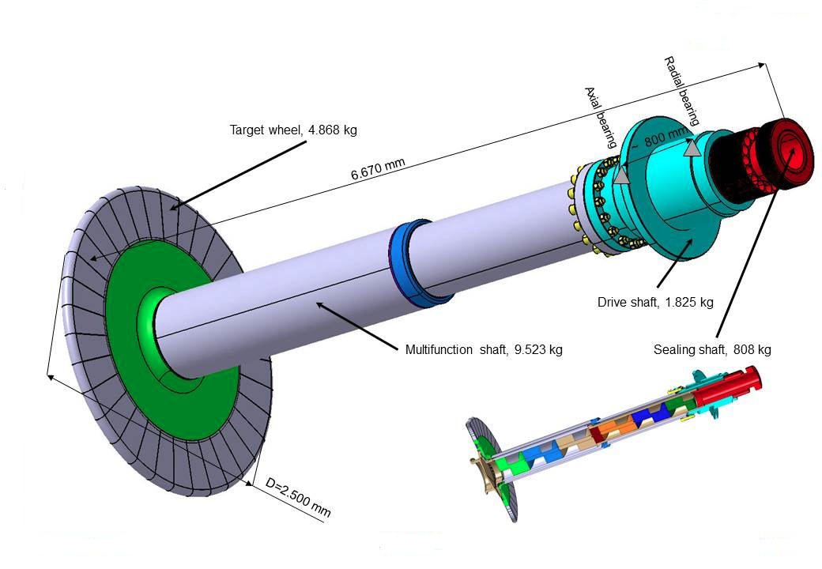
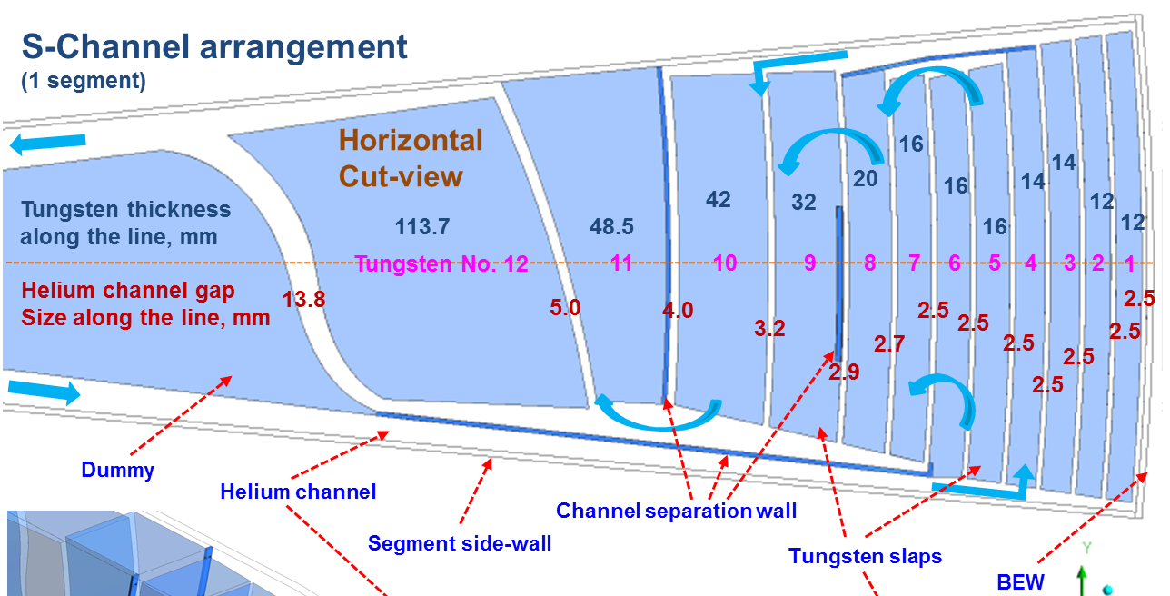
He-cooled, rotating W target has a long-lifetime and is passively safe
Tungsten slabs in 33 sectors
Helium coolant
  Mass flow 3 kg/s
  Pressure 0,3 Mpa
  Inlet/outlet temperatures: 20 °C/220 °C
Rotational speed 25,5 rpm
Wheel diameter 2,5 m
Shaft length > 5 m
Lifetime ~ 5 years (@ 5 MW)

Slide 7
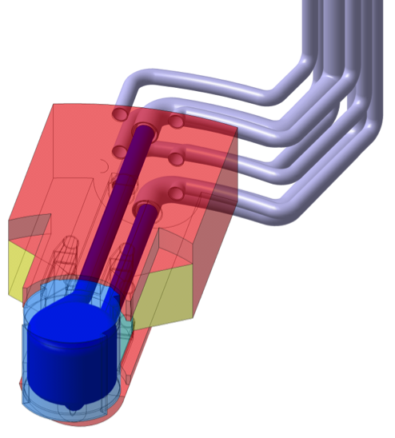
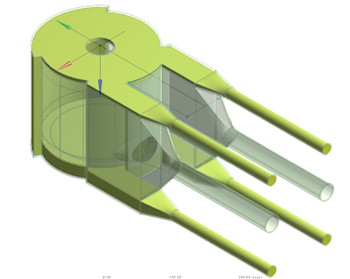
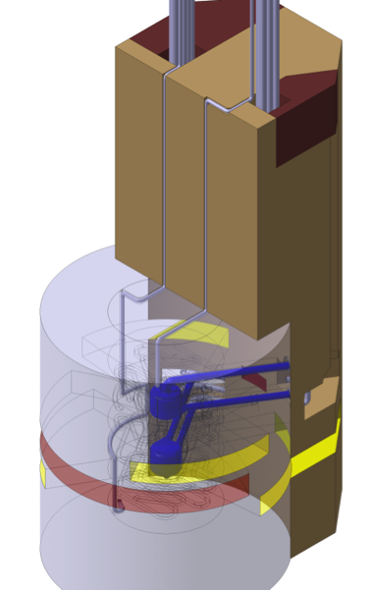
Moderator and reflector plug integrates two LH₂ moderators within a Be reflector
Inner reflector
  Beryllium
  Complex “cylindrical” aluminium vessel
  Water cooled
Outer reflector
  Steel
  Water cooled
Cold moderators
  Super-critical hydrogen at 20 K and 1.5 Mpa
  Aluminium alloy vessel
  Expected lifetime ~ 1 year @ 5 MW
  Vacuum jacket for insulation
Water moderator assemblies
  Thermal water
  Pre-moderator surrounding
  the cold moderator vessel
  Extended wings facilitate thermal or
  bi-spectral beam extraction
  Expected lifetime ~ 1 year @ 5 MW

Slide 8
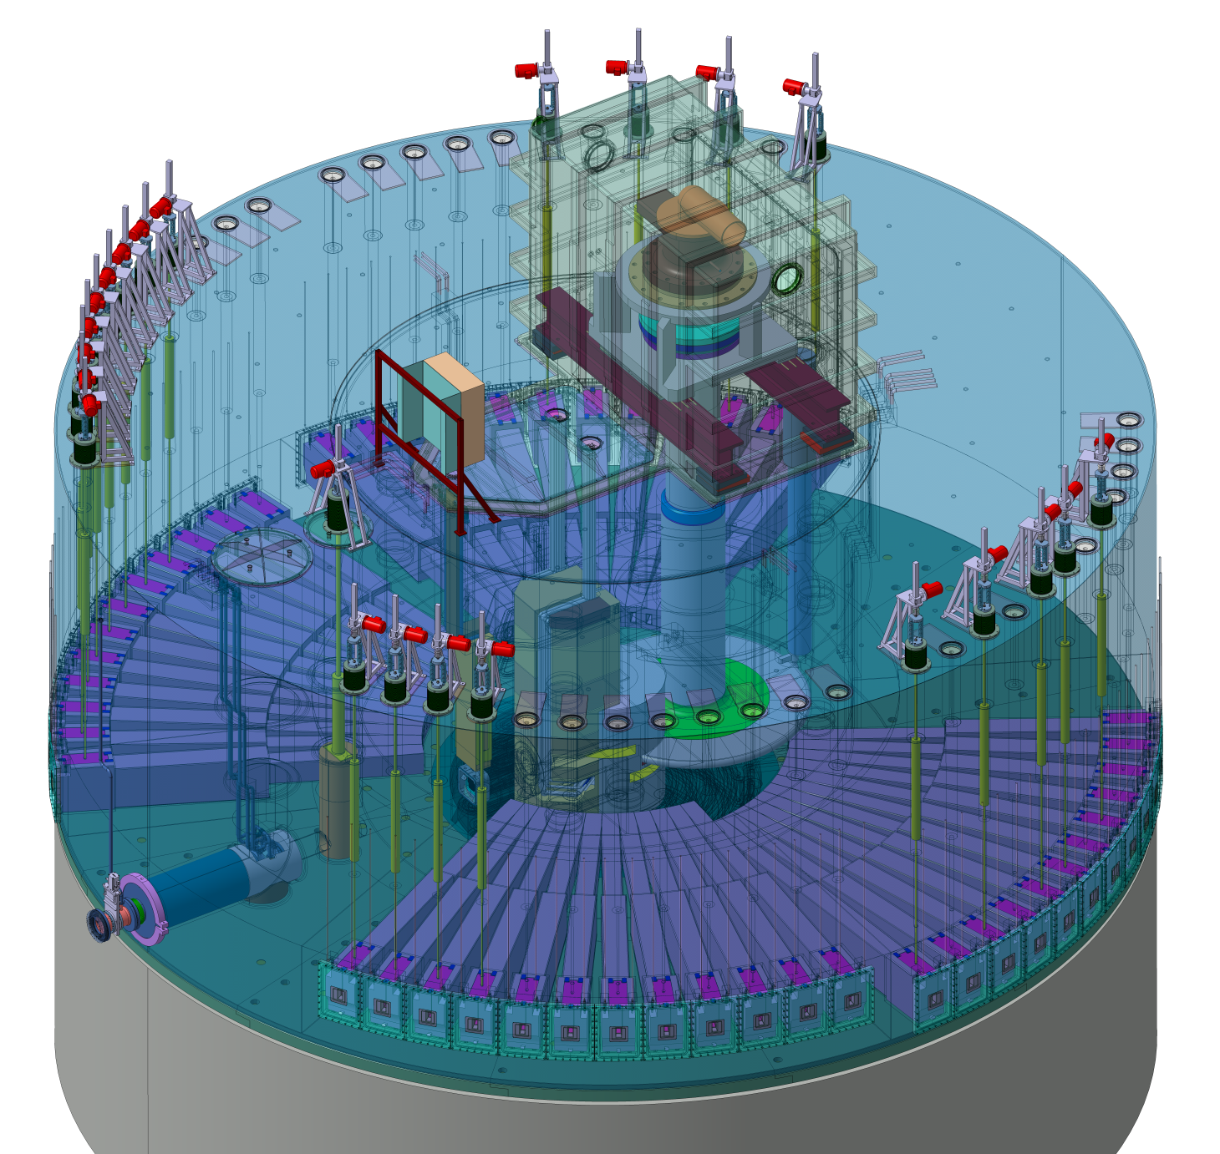
Monolith Systems serve shielding and confinement functions and facilitate neutron beam extraction
The purposes of the target monolith, i.e. the structure that houses the main target systems, are:
Provide shielding
  sufficient for personnel protection
  for reduction of background for the
  neutron science instruments
Confine radioactive inventory
  during normal situations
  in off-normal situations
Extraction of neutron beams
Dimensions
  Diameter ~ 12 m
  Height ~ 8 m
  Mass ~ 7000 tonnes (mainly steel)

Slide 9
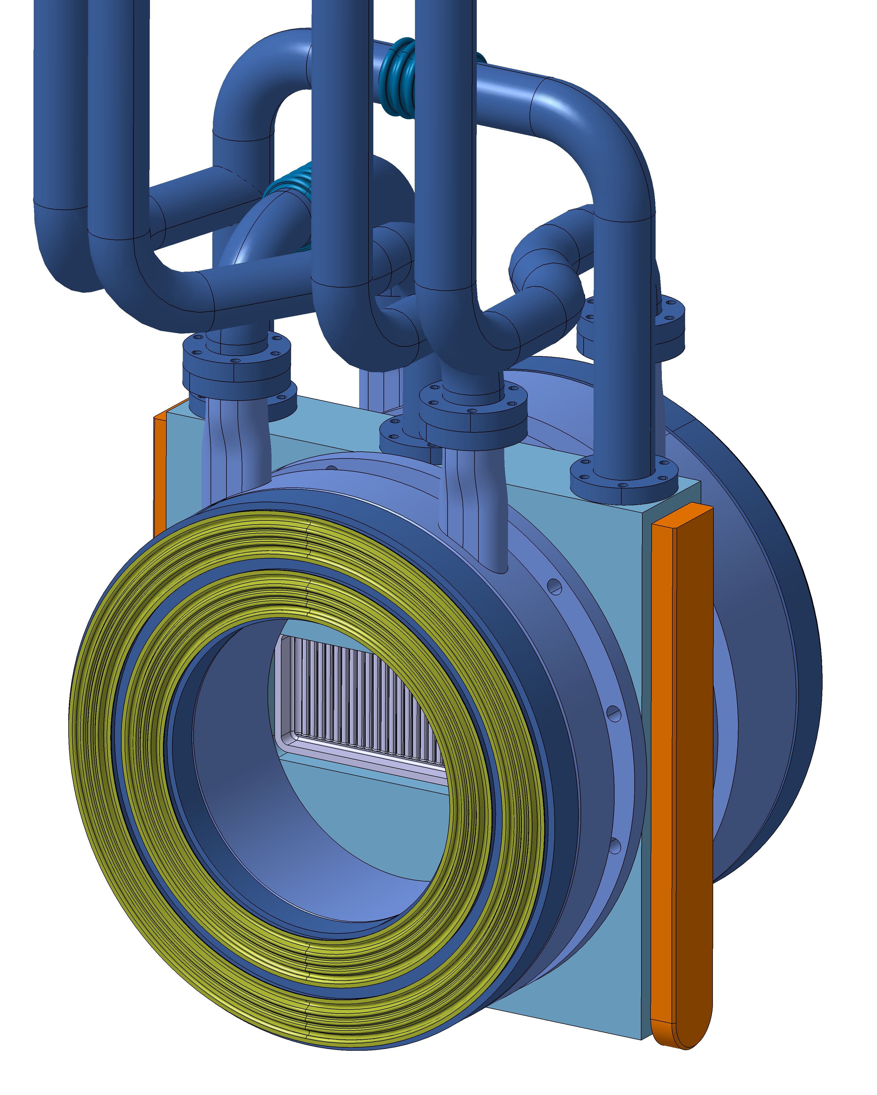
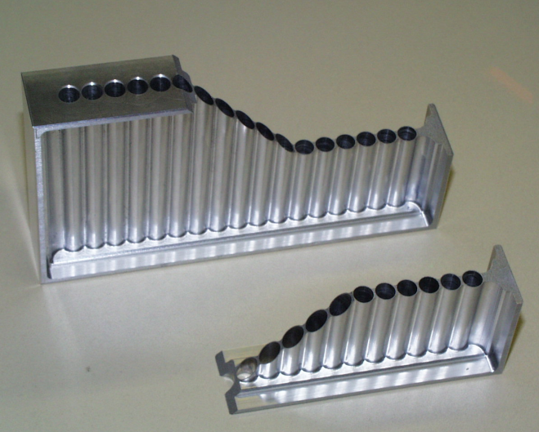
Proton beam window interfaces with accelerator systems
Separates the ultra high
vacuum of the proton beam
tube and the helium atmosphere
inside the monolith
Water cooled steel frame and flanges
Double inflatable metal seals on each side
Expected lifetime ~ ½-1 year @ 5 MW
Window uses pan flute design
  Aluminium alloy
  Helium cooled

Slide 10
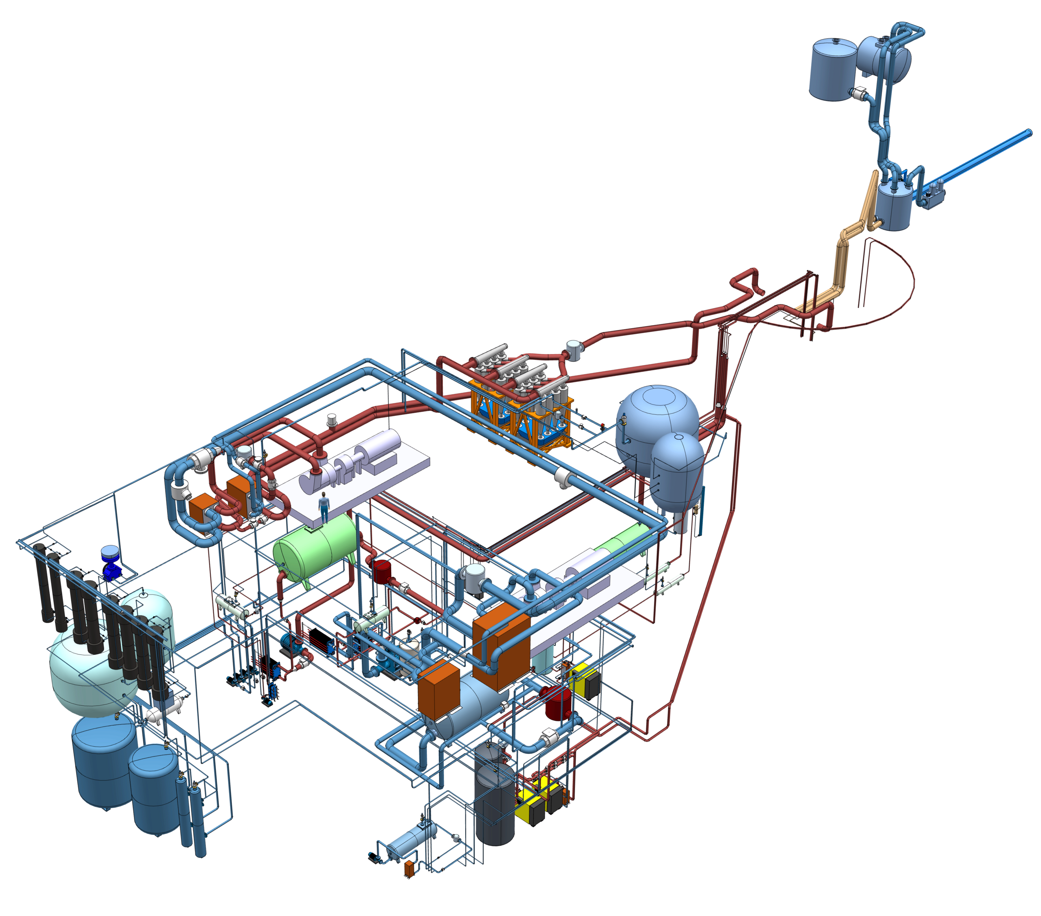
Fluid Systems provide primary and secondary cooling and process/confine radioactive fluids
Primary Water Cooling:
Water Moderators 50 kW
Reflectors 300 kW
Shielding and Plugs 1.6 MW
Intermediate Water Cooling:
for Target System 3.8 MW
for Gas Systems 90 kW
for Water Systems 2.2 MW
Rad. Gas Effluent & Confinement (RGEC):
Target Station Ventilation 110 000 m³/h
Separation Gas for Primary Water
Radioactivity Monitoring
Active storage
Water storage
Helium storage
Auxiliary Helium Systems
PBW Cooling 5 kW, 200 g/s
Target Helium Purification 3 g/s
Monolith Helium Purification 7 g/s
Vacuum, gas and water supplies

Slide 11
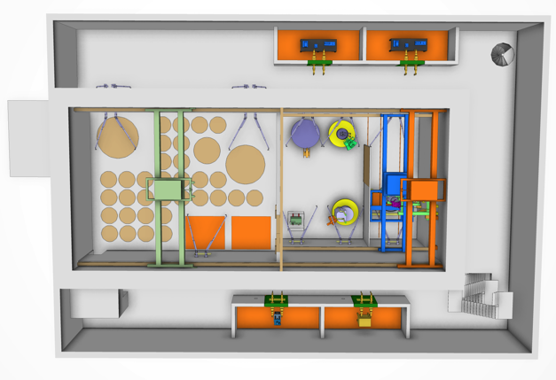
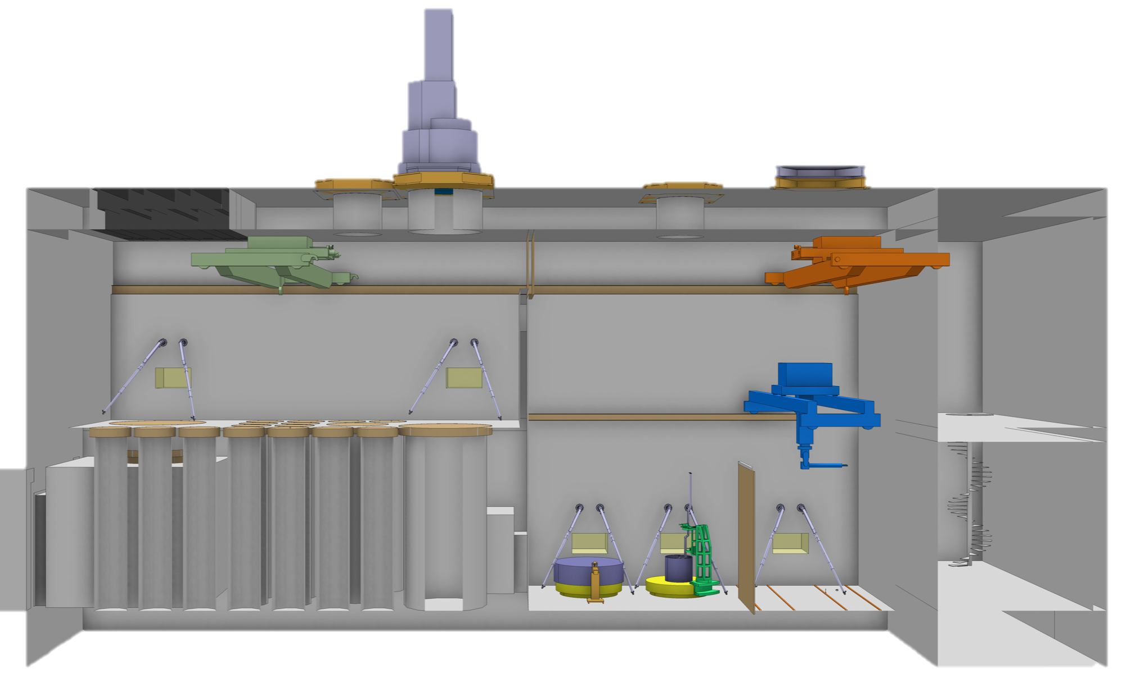
Remote Handling Systems maintain target equipment and package and process waste
Active Cells: Top View
Active Cells: Hot Cells with connected infrastructure and tooling
Internal casks and associated handling devices: Radioactive component transport between monolith and active cells
Mock-ups, test and training facility
Transfer hatch
Maintenance cell
Storage pits
Transfer zone
Internal Cask
Active Cells: Side View
Air lock
Technical galleries
Processing cell

Slide 12
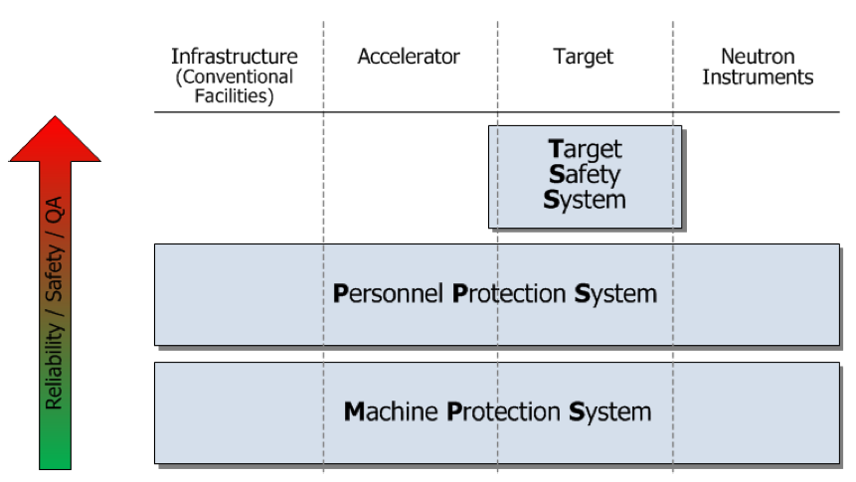
Target Safety System protects public and environment from radioactive hazard
Target Safety System
  Active controls credited with a safety function; namely
    Protect workers, public, and environment from radioactive contamination hazard
Interface/point-of-contact between other parts of TS and Integrated Control System

Slide 13
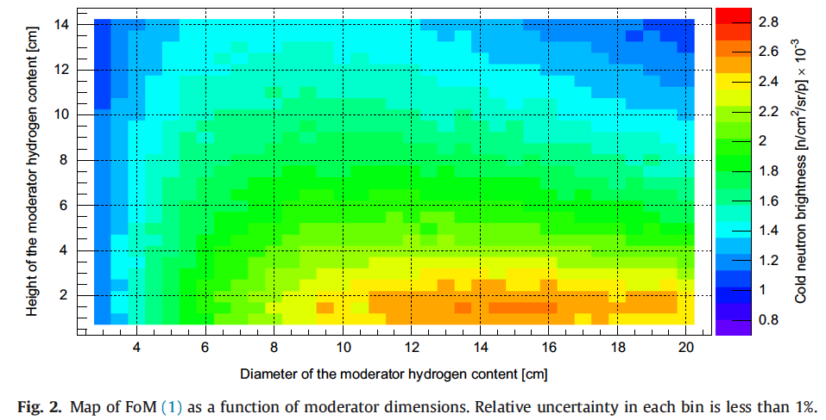
Moderator optimization studies have identified a potential opportunity for huge increase in neutron brightness
a
baseline design
K. Batkov, et al., NIM A 729 (2013) 500.

Slide 14
We are pursuing a huge increase in neutron brightness (equivalent to 15 MW accelerator for some instruments)
Opportunity: Recently discovered novel moderator concept , so-called “pancake” or flat moderator, has potential for factor of ~ three gain in neutron brightness for small samples and some classes of instruments
Facilitating Action:
Working with Science Directorate in developing path forward to realize this gain
Near term focus on understanding implications for all classes of instruments and developing strategy for implementation consistent with overall ESS schedule
ESS flat moderators
13 cm high
TDR moderator
Peak source brightness
[n/cm²/sec/sr/Å]
ESS TDR moderators
1.5 cm high
flat moderator
ILL yellow book
Neutron wavelength [Å ]

Slide 15
Concerns and issues that must be assessed for a flat moderator
The beam hole in the reflector has the same height as the hydrogen, which will require much reduced tolerances on beam hole alignment with the moderator
In order to achieve the same angular acceptance into a guide, it must start much closer to the moderator
Some instruments may prefer the greater intensity of a
13-cm-high moderator over the higher brightness of a flat moderator
Need to verify experimentally
These issues are currently being assessed within ESS Target Division and Science Directorate

Slide 16
Target Station Project Plan Shows Completion by End of 2019
2014 2015 2016 2017 2018 2019
Moderator concept finalized
Target critical path goes through Moderator-Reflector System
Moderator-Reflector Assembly – Critical Design Review
Moderator-Reflector Plug Fabrication Contract Awarded
Access to Target Building for Monolith Installation
Moderator-Reflector Assembly Delivered to ESS Site
3 months float to First Beam-on-Target commitment of Dec 2019
Target Station Ready for Beam
Target Station Construction Complete

Slide 17
Technical risks drive target development efforts
Engineering Development and Demonstration (EDD) activities focus on addressing key issues, such as rotating seal for target, He cooling, and remote handling
  EDDs must provide information for design evolution in a timely fashion
Water-cooled target with no need for emergency cooling being developed as a backup solution for early operations if there are unforeseen difficulties with He-cooling
  Need robust safety margin to facilitate licensing
  May not work at 5 MW, but backup would buy several years to develop longer term solution while accelerator power ramps up
  Decay heat removal study will be completed in May 2014 --- establishing power limit for a water-cooled target with passive removal of decay heat

Slide 18
Closing Remarks: Major Activities and Goals for 2014
Hiring, hiring, hiring
Work with Science Directorate to finalize strategy for moderator configuration
Finalize detailed requirements and key design features (He pressure in target loop, MR plug extraction scheme, monolith diameter, neutron beam extraction, …)
Complete water-cooled backup study
Engineering Development and Demonstrations (EDDs)
  Finalize plan
  Complete initial phases of EDDs on tungsten fatigue properties, helium cooling flow studies, and rotating seal tests
  Begin remote handling tests on mockups
Conduct Preliminary Design Reviews for critical components and subsystems
  Target wheel and drive systems
  Target helium cooling system
  Moderator and Reflector plug
  Neutron beam extraction system
  Target monolith shielding
Work towards establishing agreements with in-kind partners

