Slide 1
Software Core Components (ICS WP3)
Suzanne Gysin
Work Package Lead
www.europeanspallationsource.se
November 13, 2013

Slide 2
What are the "Software Core Components”?
5 Databases
15 Software Services
and
the Naming Convention

Slide 3
Control System - Software Core Compents
WBS: Project 14 Integrated Control System (ICS)
WP 3. Software Core Components
WU 3.1 Configuration Data Management
WU 3.2 Control System Services
WU 3.3 Naming Convention

Slide 4
WU 3.1 Configuration Data Management
Scope: The collection, storage, and distribution of configuration data.[9]
[9] Work Unit Description document Configuration Data Management
Controls Configuration Database (CCDB):
Static, physical attributes of the devices in the scope of the ICS
Cable Database:
Static information relevant to cables and connections
Lattice Database (BLED):
This is an import of the simulation using Tracewin and additional elements from Beam Diagnostics.
Device Configuration Database (DCDB):
The configurations files for the EPICS IOC’s, PLC integration.
Unit Conversion Database:
Standard unit conversion algorythms

Slide 5
Lattice Database (BLED)
Contains the ESS Accelerator configuration as it is simulated prior to being built.
It includes the geographical and physical information for:
All accelerating structures
Beam diagnostics
Vacuum
Stubs for RF wave guides
Status
Version 1 is deployed and operational
Import of Optimus Lattice is in progress
Requirements approved [1]
Lattice Browser is in progress [2]
Version 2 is planned to start development 1Q 2014
[1] Lattice Database Requirements Document v1.1, S.Gysin
[2] Lattice Browser Requirements Document v1.0, S.Molloy

Slide 6
Controls Configuration Database - CCDB
Scope: the physical attributes of a specific device. (barcode, location, status calibration test results, user defined attributes)
What is included: Control Boxes, MPS devices, PSS devices. Devices controlling vacuum, RF, Cryogenics, target, neutron instruments, and conventional facilities.
Status:
Requirements approved [3]
Completed a study of areas of potential collaboration with DISCS [4]
Design in progress, based on DISCS Configuration Database by V. Vuppala at FRIB
Looking for alpha users from AD:
Candidates: Rack planning, RF test results, Beam Diagnostics, Control Boxes
Timeframe:
1Q 2014 Alpha version (Proteus) available to users
1Q 2015 Operational
[3] ICS Configuration Database – Requirements v1.7, S.Gysin
[4] Evaluation of selected DISCS collaboration modules, M.Vitorovik

Slide 7
CCDB Home screen

Slide 8
Physical devices

Slide 9
Properties

Slide 10
Logical components (system)

Slide 11
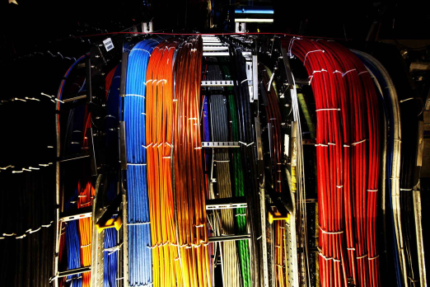
Cable Database
Scope: A database of cables and their connectors, and software tools to label the physical cables.
What is included:
ICS is responsible for data of cables to and from the Control Boxes, MPS devices, and PSS devices.
The software tools are available for use by all ESS for cable data.
Typical question the configuration database can answer are:
Which devices are connected to port A of device SSSS-BBBB:DDDD-III ?
How long is the cable connecting HBL-PBI:BPM-01a to its power supply.
Timeframe:
Requirements are written [5]
2Q 2014 Alpha version available (IRMIS – BNL)
1Q 2015 Operational
[5] Cabling Requirements, K.Rathsman

Slide 12
Device Configuration Database DCDB
Scope: Stores the configuration files for the EPICS IOC’s and PLC interface
What is included:
Version control and storage for EPICS configuration files and PLC interfaces
Verifying ESS standards in the configuration files in the EPICS files
Design and testing of files at remote sites
Integration into the central database at Factory Acceptance Testing (FAT) and Site Acceptance Testing (SAT)
Candidates:
ITER’s SDD with Cosylab’s power-user GUI
Timeframe:
Q1 2014: Proposal and cost estimate of making SDD institute agnostic and ESS customization
Q2 2014: Collaboration with ITER on SDD

Slide 13
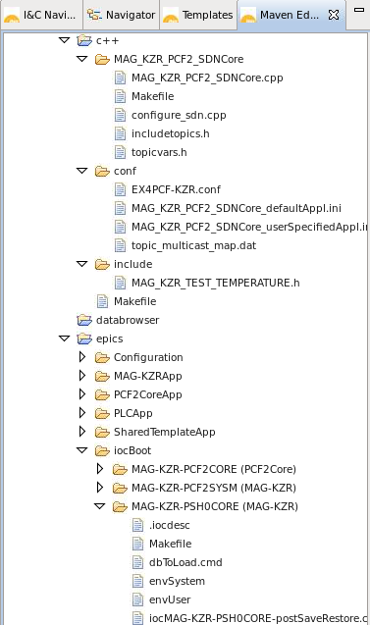
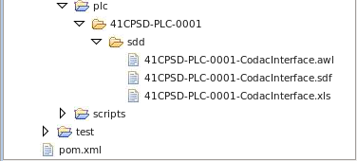
SDD Translator generates all configuration files
Generate config files
SDN C++ program
STEP-7 files
EPICS records
EPICS IOC files

Slide 14
Unit Conversion Database
Scope: magnet unit conversion, between engineering unit (Ampere), physics unit (Tesla), and model unit (K1, K2).
Candidates: DISCS unit conversion module (NSLS II)
Timeframe: Not started

Slide 15
Configuration Data Management: summary
All databases are:
Integrated, browse all database with same GUI
Adhere to ESS naming convention
Provide versioning and Role Based Access Control (RBAC)
Standard API (restful)
Web based GUI
Standard technology
Based on other accelerator lab’s software and exeprience
Collaborations:
ESS is part of DISCS, a collaboration to standardize databases for control systems. Other members are BNL, IHEP, and FRIB.
Starting a collaboration with ITER for SDD.
To successfully leverage the ESS investment in configuration data management (several FTE’s), your input is essential.

Slide 16
WU 3.2 Control System Services
Provide the common software services to the users of the control system [10]
A software service is software that benefits from having a single standard implementation. For example Role Based Access Control.
Services can be combined by other software applications to provide the complete functionality of a large software application.
The service includes the applications, application programmer interface, and repositories that provide the service.
Includes Accelerator, Target, Instruments and Conventional Facilities
[10] Work Unit Description document Control System Services

Slide 17
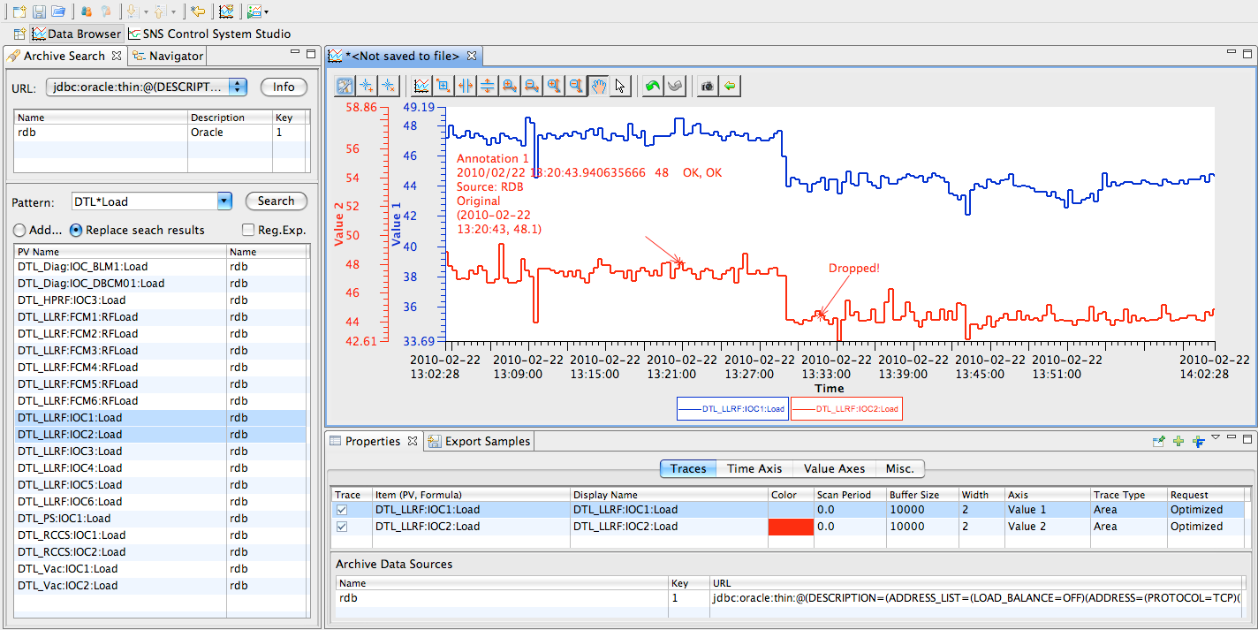
Archive, Alarms, and Logbook
ESS-CODAC package (based on ITER’s CODAC):
CS Studio (EPICS control system studio)
Operator Screen GUI builder (BOY)
Short term archive/logging (BEAUTY)
Alarms (BEAST)
Logbook (Olog)
Timeframe:
1Q 2014 : package available for test stands
1Q 2015 : alarm strategy

Slide 18
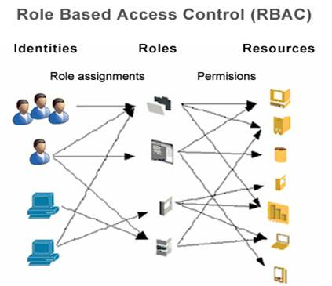
RBAC – Role Based Access Control
Role Based Access Control for EPICS IOC’s and control system applications
Extend the design of LHC RBAC to EPICS and Applications
Authentication service using LDAP
RBAC database
Authorization by roles/location/beam mode in the IOC server.
RBAC is not IT security, it is a means to prevent mistakes by a well meaning user.
DISCS collaboration: security module
Timeline:
1Q 2014 requirements and design
2Q 2014 First deliverables
Authentication service
RBAC database
1Q 2015 operational

Slide 19
The RBAC database
Roles:
Each role has a Role Manager
The Role Manager assigns the users to the role
Resources:
Each resource has an RBAC Resource Manager
The Resource Manager defines the permissions and assigns the roles to the permissions
Permissions paramters are: role, ip address, and machine state (regular expression

Slide 20
Long Term Archive
Scope: PV archive for a longer time ( 30+ years?)
Smaller set of process variables, saved less frequently
Write once, read often, optimized for fast read (data warehouse technology)
Candidates:
SLAC’s archive service
CSS with Cassandra back end
Timeframe: 2Q 2016

Slide 21
Save, Compare and Restore
Scope: Save machine settings, compare live values with saved values, restore saved values.
Features include
a golden snapshot,
grouping PV’s into snapshots,
grouping snapshots into machine configurations,
highlighting changed values and database storage of the information.
Candidates: MASAR
Timeline:
Requirements are complete [6]
Development has not started
2Q 2016 – operational
[6] Save, Compare & Restore Requirements, S.Gysin

Slide 22
Other Control System Services
Fast Data Acquisition
Data on Demand:
Archiving on a trigger from the timing system
Post Mortem Support:
Collecting the post mortem buffers and providing the tools for analysis
Diagnostic Logging Service
Centralization of the diagnostic logs of distributed systems.
Directory Service
Finds PV’s based on search criteria
Candidate – Chanel Finder
EPICS Naming Service
EPICS PV to IP address/TCP port mapping

Slide 23
Other Control System Services
Video Service
Live image stream from instrumentations
How large are the images?
Maintenance Log
log of preventive maintenance
Operations Logistics
Beam statistics, run hours, shift summaries, down time, experiment schedules, reliability statistics and analysis.
Search Service
Google like search on all ICS
On-line/Off-line Model Service
Accelerator Modeling as a service, indpenedent of simulation software
Device Oriented Access Service
Provide the ability to change an IOC/PV based on a higher level unit.

Slide 24
WU 3.3 ESS Naming Convention
Scope: provides the tools, repositories and processes to generate meaningful and consistent names for devices
Scope includes all of ESS
Name database includes 1000 items now
Definition of the naming syntax[7][8] : SSSS-BBBB:DDDD-III:TTTIIIXXX
Tools:
WEB GUI to generate a name for a device and let the user browse the names
Database to keep track of the names and convention rules
Timeline:
Naming Convention has been defined and documented
Q1 2014 Naming tools alpha release
[7]The ESS Naming Convention
[8] ESS Naming Convention, K. Rathsman

Slide 25
In Summary … next steps
Upcoming software releases looking for alpha users:
CCDB – configuration database: racks, beam diagnostics, RF, control boxes
Naming tools – request and assign names, query the database of existing names
Cable Database – planning the distribution of cables for CF
Lattice database tools v1 – export tracewin files from the Optimus lattice

Slide 26
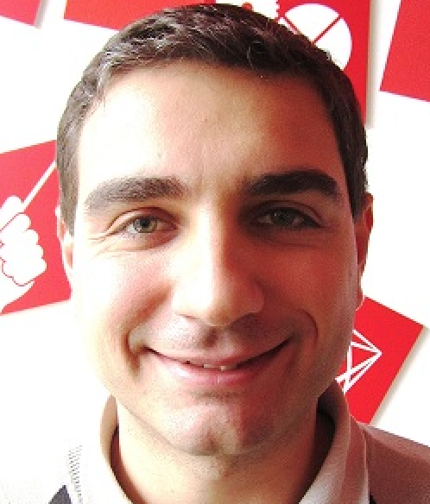
The Team
Name | Role
Suzanne Gysin (ESS) | Work Package Leader
Karin Ratsman (ESS) | Naming Convention Work Unit Leader Lattice Database Developer
Stephen Molloy (ESS – 25%) | Lattice Browser developer
Jakob Battelino (Cosylab) | Lattice Database and Naming tools developer
Jaka Bobnar (Cosylab) | RBAC lead developer
Miki Pavleski (Cosylab) | Development Environment and Cosylab’s Project Manager
Andraz Poznar (Cosylab) | Lattice Database developer
Miha Vitorovic (Cosylab) | Controls Configuration Database Lead

Slide 27
Software Core Components
DISCS
Thank you

Slide 28
References
[WP3 - 1] Lattice Database Requirements Document v1.1, S.Gysin
[WP3 - 2] Lattice Browser Requirements Document v1.0, S.Molloy
[WP3 - 3] ICS Configuration Database – Requirements v1.7, S.Gysin
[WP3 - 4] Evaluation of selected DISCS collaboration modules, M.Vitorovic
[WP3 - 5] Cabling Requirements, K.Rathsman
[WP3 - 6] Save, Compare & Restore Requirements, S.Gysin
[WP3 - 7] The ESS Naming Convention, K.Rathsman
[WP3 - 8] ESS Naming Convention, K. Rathsman
[WP3 - 9] Work Unit Description document “Configuration Data Management”
[WP3 - 10] Work Unit Description document “Control System Services”
[WP3 - 11] Work Unit Description document "Naming Convention"

Slide 29
Component types

Slide 30
Physical devices

Slide 31
Properties

Slide 32
Logical components (group)

Slide 33
Logical components (system)

Slide 34
Logical components (device) [1/2]

Slide 35
Logical components (device) [2/2]

Slide 36
Signals

Slide 37
Search with type-ahead

