Slide 1
LEDP – A Preliminary Design Study
Friederike Salveter
AD and ICS Retreat
December 11, 2013

Slide 2
Who am I?
Student of Process Engineering
  At Karlsruhe Institute of Technology (KIT), Germany
  Majors: Technical Thermodynamics & Refrigeration Material Science
At ESS since August
  Member of the Vacuum Group
  Writing my Diploma Thesis

Slide 3
Overview
Low Energy Differential Pumping System (LEDP)
Simulation
Sensitivity Analysis
Design & Layout

Slide 4
Overview
Low Energy Differential Pumping System (LEDP)
Simulation
Sensitivity Analysis
Design & Layout

Slide 5
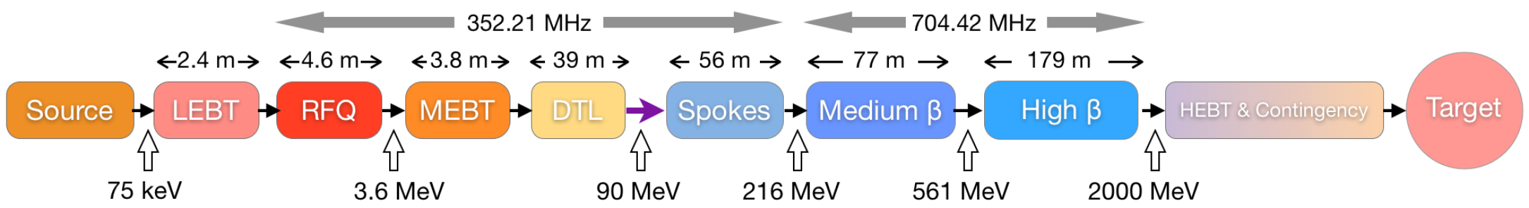
LEDP – Where?
LEDP - 1,88m

Slide 6
LEDP – Why?
Cryomodule acts as a Cryopump
Warm Linac => Higher Pressure
Particulate contamination leads to field emission -> reduce of Cavity performance
=> Protection

Slide 7
Overview
Low Energy Differential Pumping System(LEDP)
Simulation
Sensitivity Analysis
Design & Layout

Slide 8
Simulation
MolFlow
  Molecular Flow Regime
  Monte Carlo Method
  Calculation of Transmission Probability
  Calculation of Steady State Pressure

Slide 9
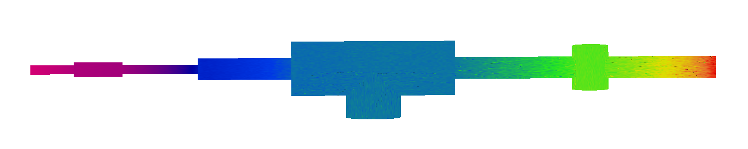

Simulation
Pressure Profile
              Texture Scaling: Pressure [mbar]

Slide 10
Overview
Low Energy Differential Pumping System (LEDP)
Simulation
Sensitivity Analysis
Design & Layout

Slide 11
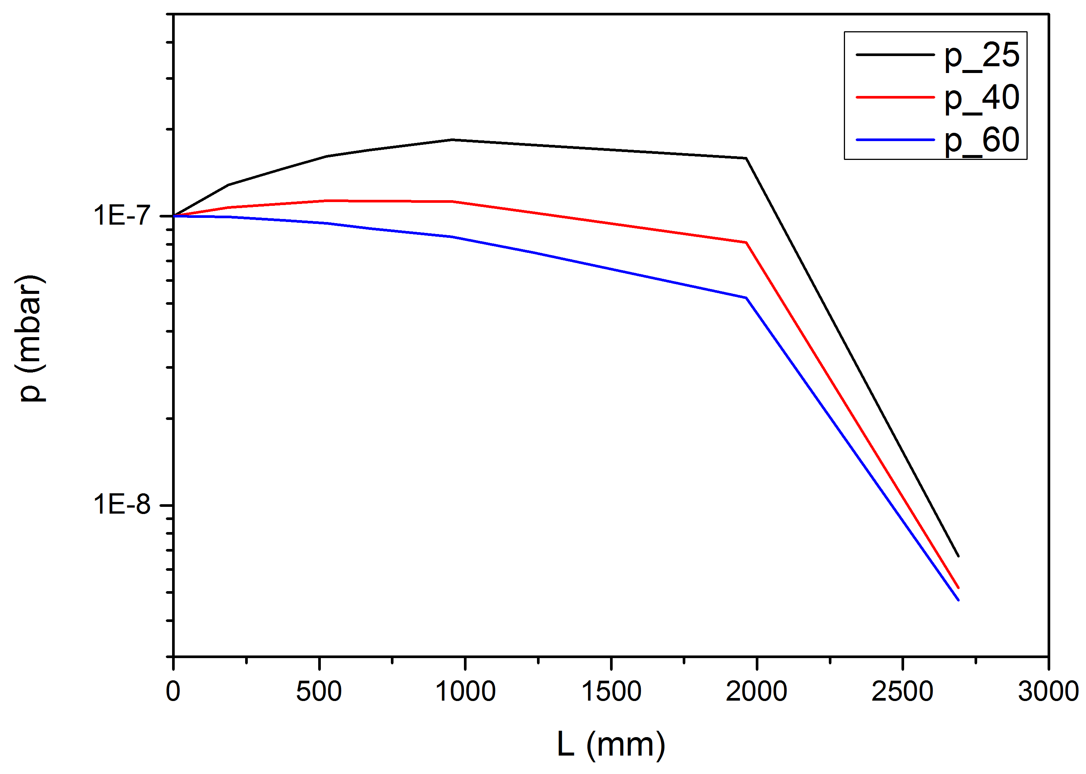
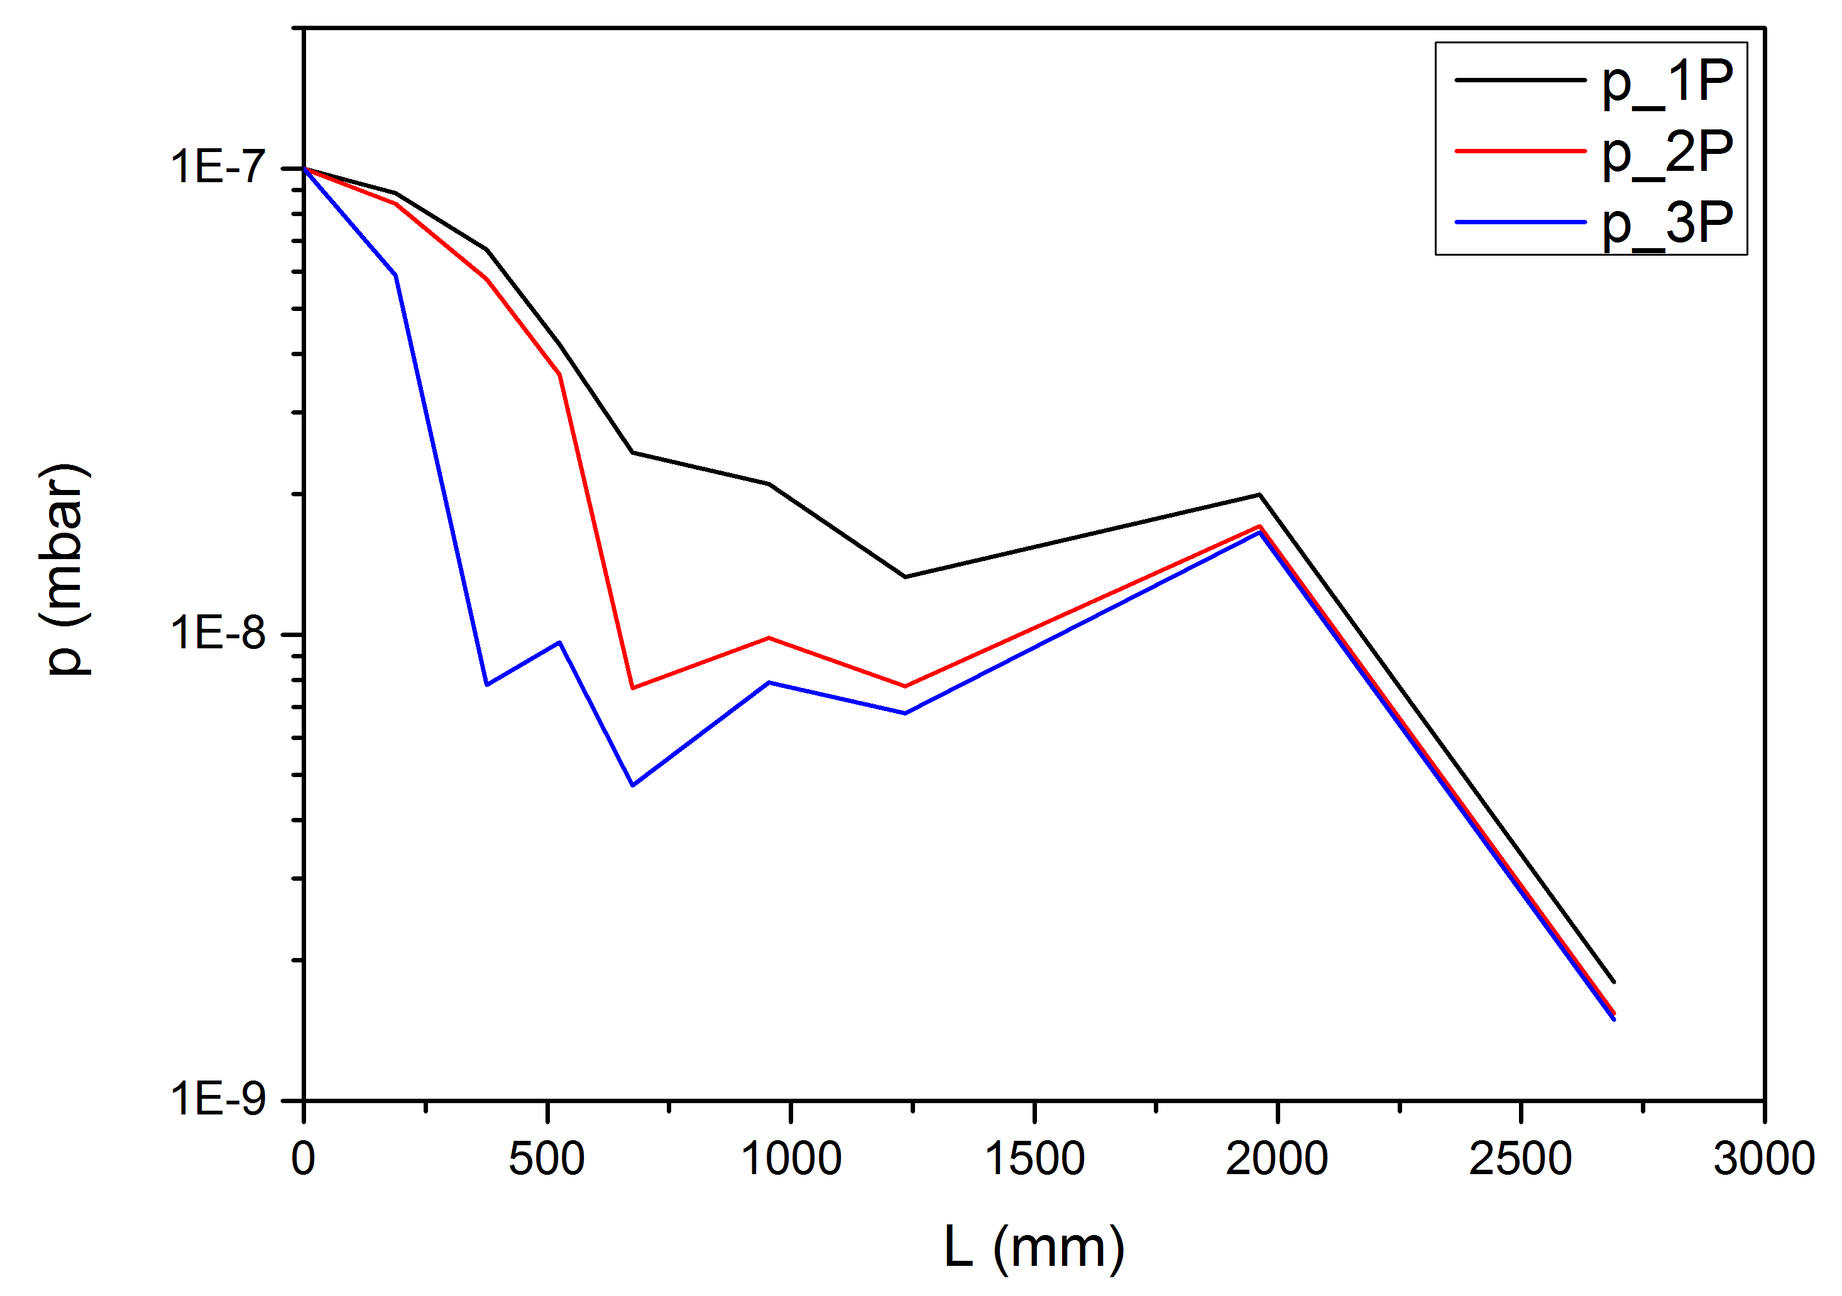
Sensitivity Analysis
Variation of Pipe Diameter
One Pump vs several Pumps

Slide 12
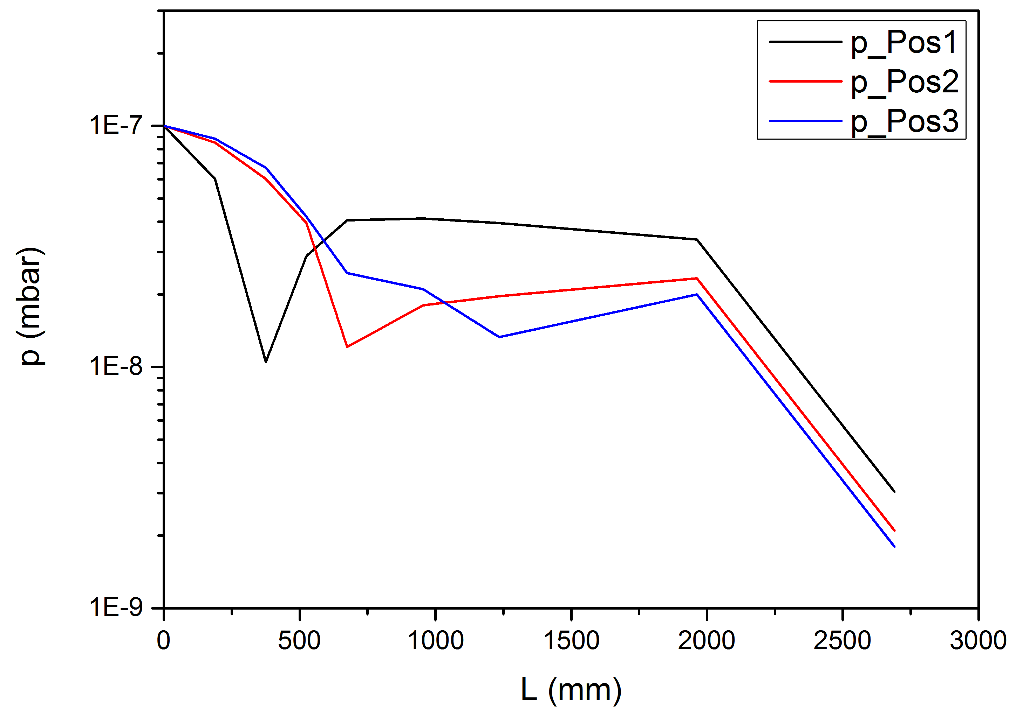
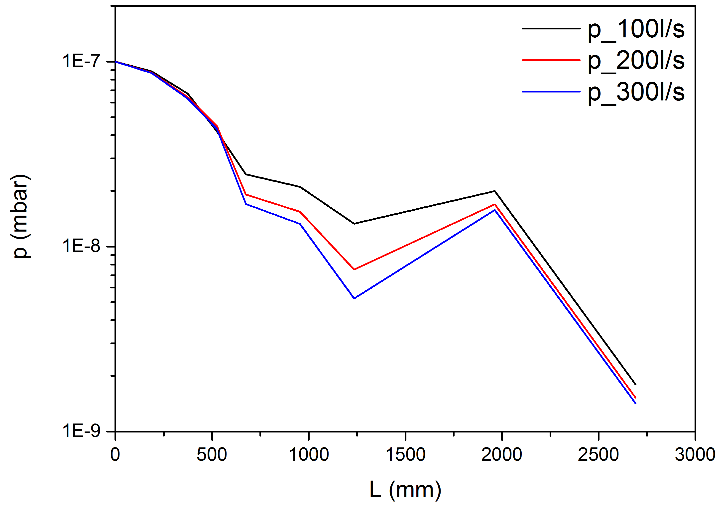
Sensitivity Analysis
Different Pumping Locations
Different Pumping Speed

Slide 13
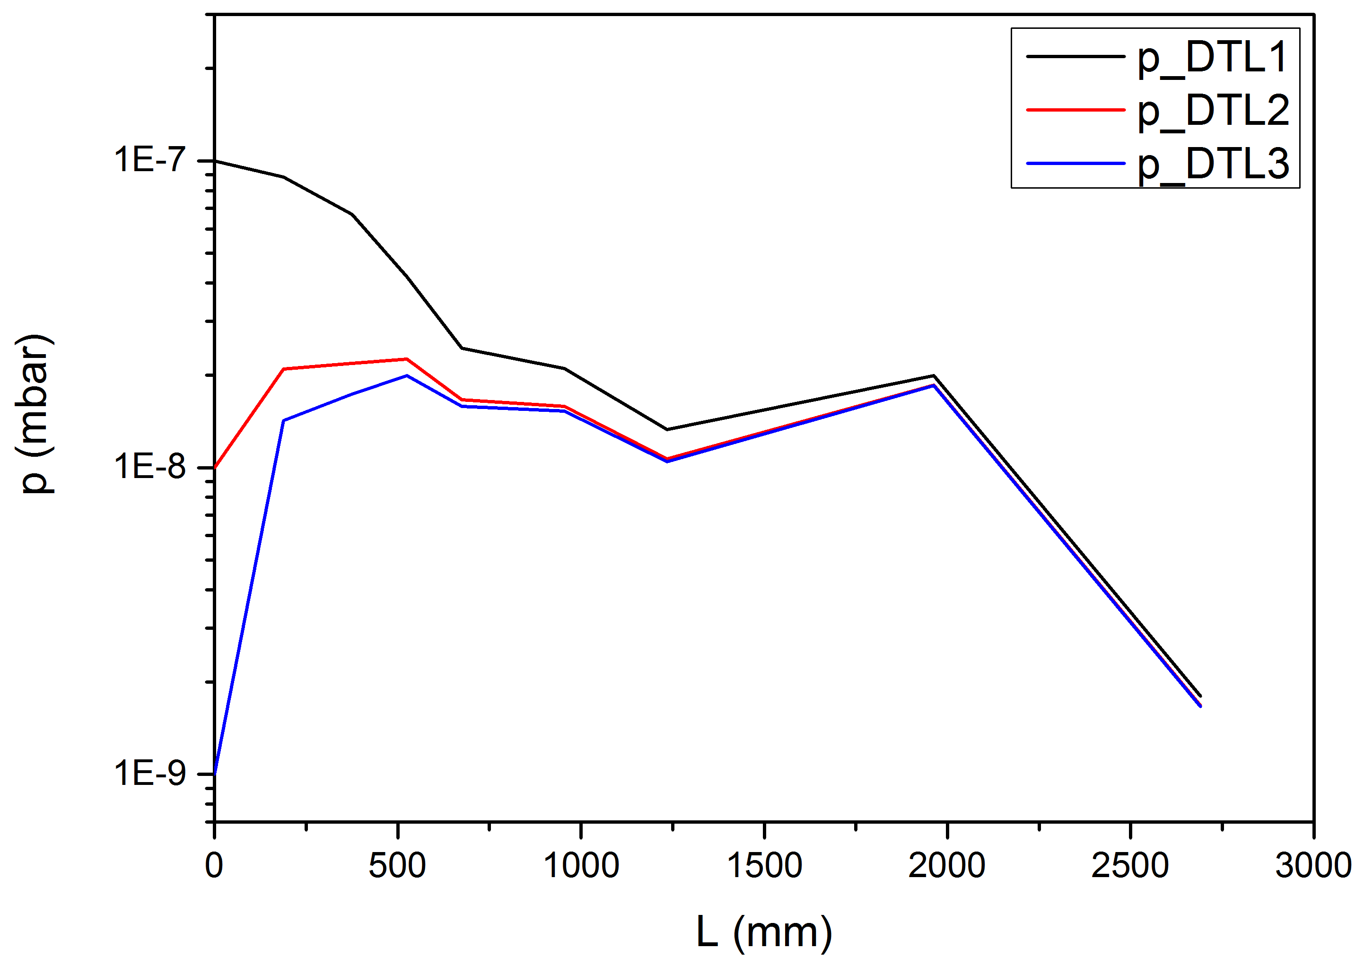
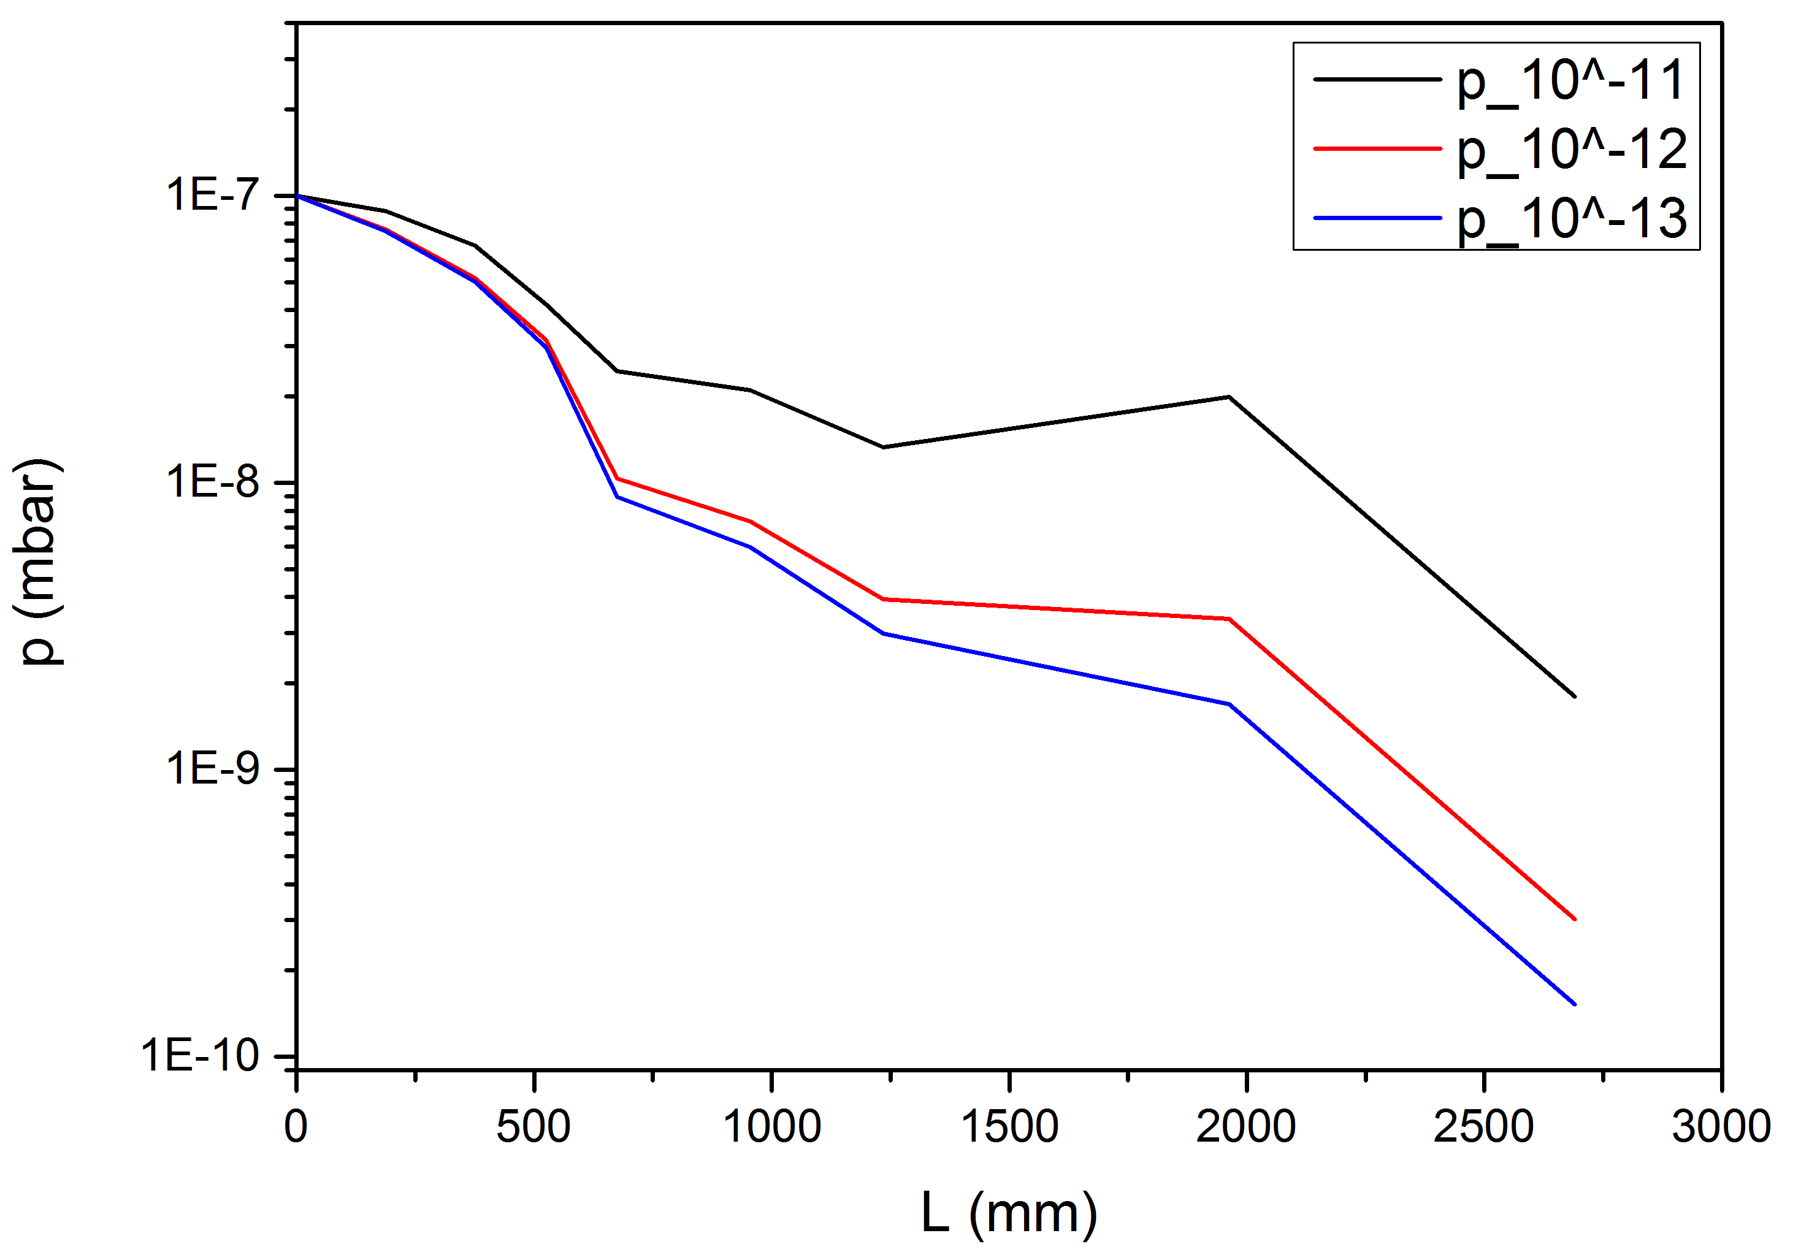
Sensitivity Analysis
Variation of DTL Pressure
Change of Outgassing Rate

Slide 14
Sensitivity Analysis
Baseline:
  2 different pipe diameters: small to large
  Pumps: two pumps sufficient, Position towards the end of the line
  Pumping Speed: 100 – 200l/s
  Outgassing rate: most important!

Slide 15
Overview
Low Energy Differential Pumping System (LEDP)
Simulation
Sensitivity Analysis
Design & Layout

Slide 16
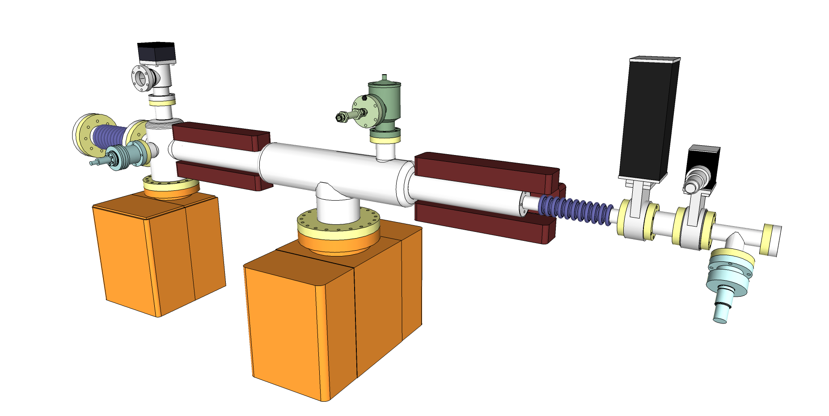
Design & Layout
Notes:
-Pumps: 300l/s & 150l/s
-FV Sensor, GV, FV, Bellow, Vent Valve + Micron Filter, Angled Valve, Inverted Magnetron Gauge

Slide 17
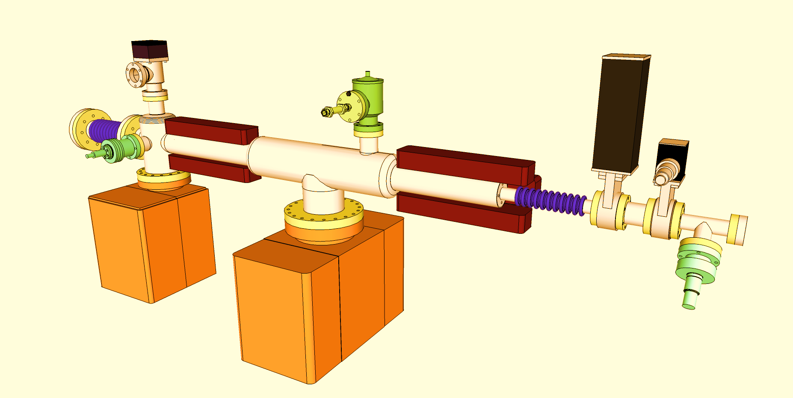

Design & Layout
Fast Valve
  Additional Protection
  Against a sudden inrush of gas
  Closure time: 11ms
Performance target
  < 7*10¹⁵ molecules enter the Cryomodule in case of an inrush of gas
  Corresponding: ~0,03% coverage of the cryomodule’s surface area in 11ms (Normal operation: ~0,003% coverage per hour)
Notes:
Inrush of gas: Leak, Operators error (opening of a valve, etc)

Slide 18
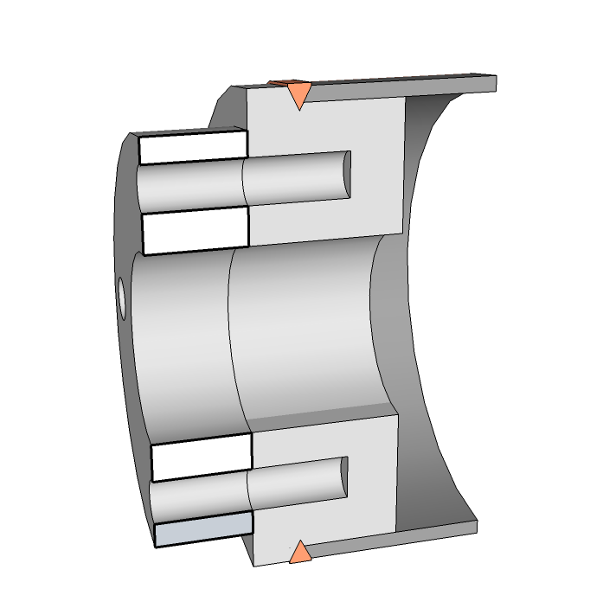
Design & Layout
Notes:
Special attention to unusual links like this weld

