Slide 1
NSS Project planning and coordination
including monthly progress reporting for instruments & Bunker construction and installation schedule
PRESENTED BY Sofie ossowski

Slide 2
Project management tools @ NSS
How do we manage 15 projects ?
Build and maintain good relationship with all our partners
NSS Master Schedule to give overview of project status & high level schedule
Change Control, Monthly Progress updates etc
Tollgate Management process (including TG-CRs)
Monthly meetings with ICCs for First 8 instruments, reviewing Internal “Critical components mapping”
ESS Monthly Integrated Project reviews, where NSS, Target etc discuss and review schedule, progress, issues
    Trying to minimise impact on Instrument plans from changes in ESS Integrated schedule
Monthly Progress updates from Instrument partners are essential !

Slide 3
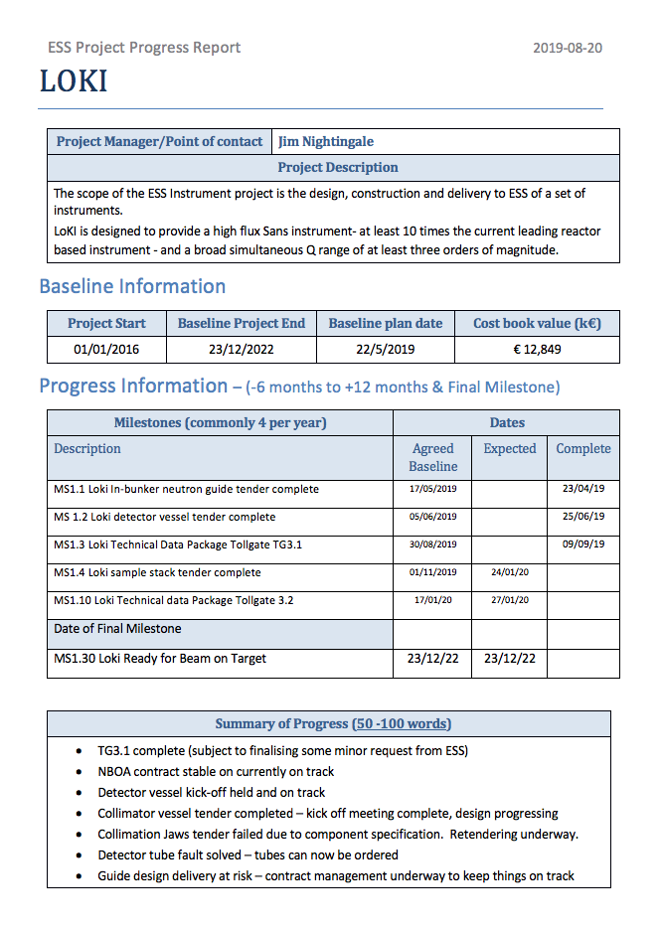
Monthly Progress reports
1) Monthly progress reports from instrument teams (lead partner) to NSS Planner & ICC
ICC play key role in ”Project management”
2) Start with Monthly progress reports from NSS inhouse projects to instrument teams
On request from instruments, we will initiate this. Aim to do it from March.
- CF/Hall access, Bunker, Common shielding, Common chopper, etc
In addition, we have the established information channels:
Monthly instrument engineering meeting (NSS Lead Engineer)
Monthly instrument scientists meetings (Group Leader Instrument Scientists)
NSS Newsletter & Confluence pages

Slide 4
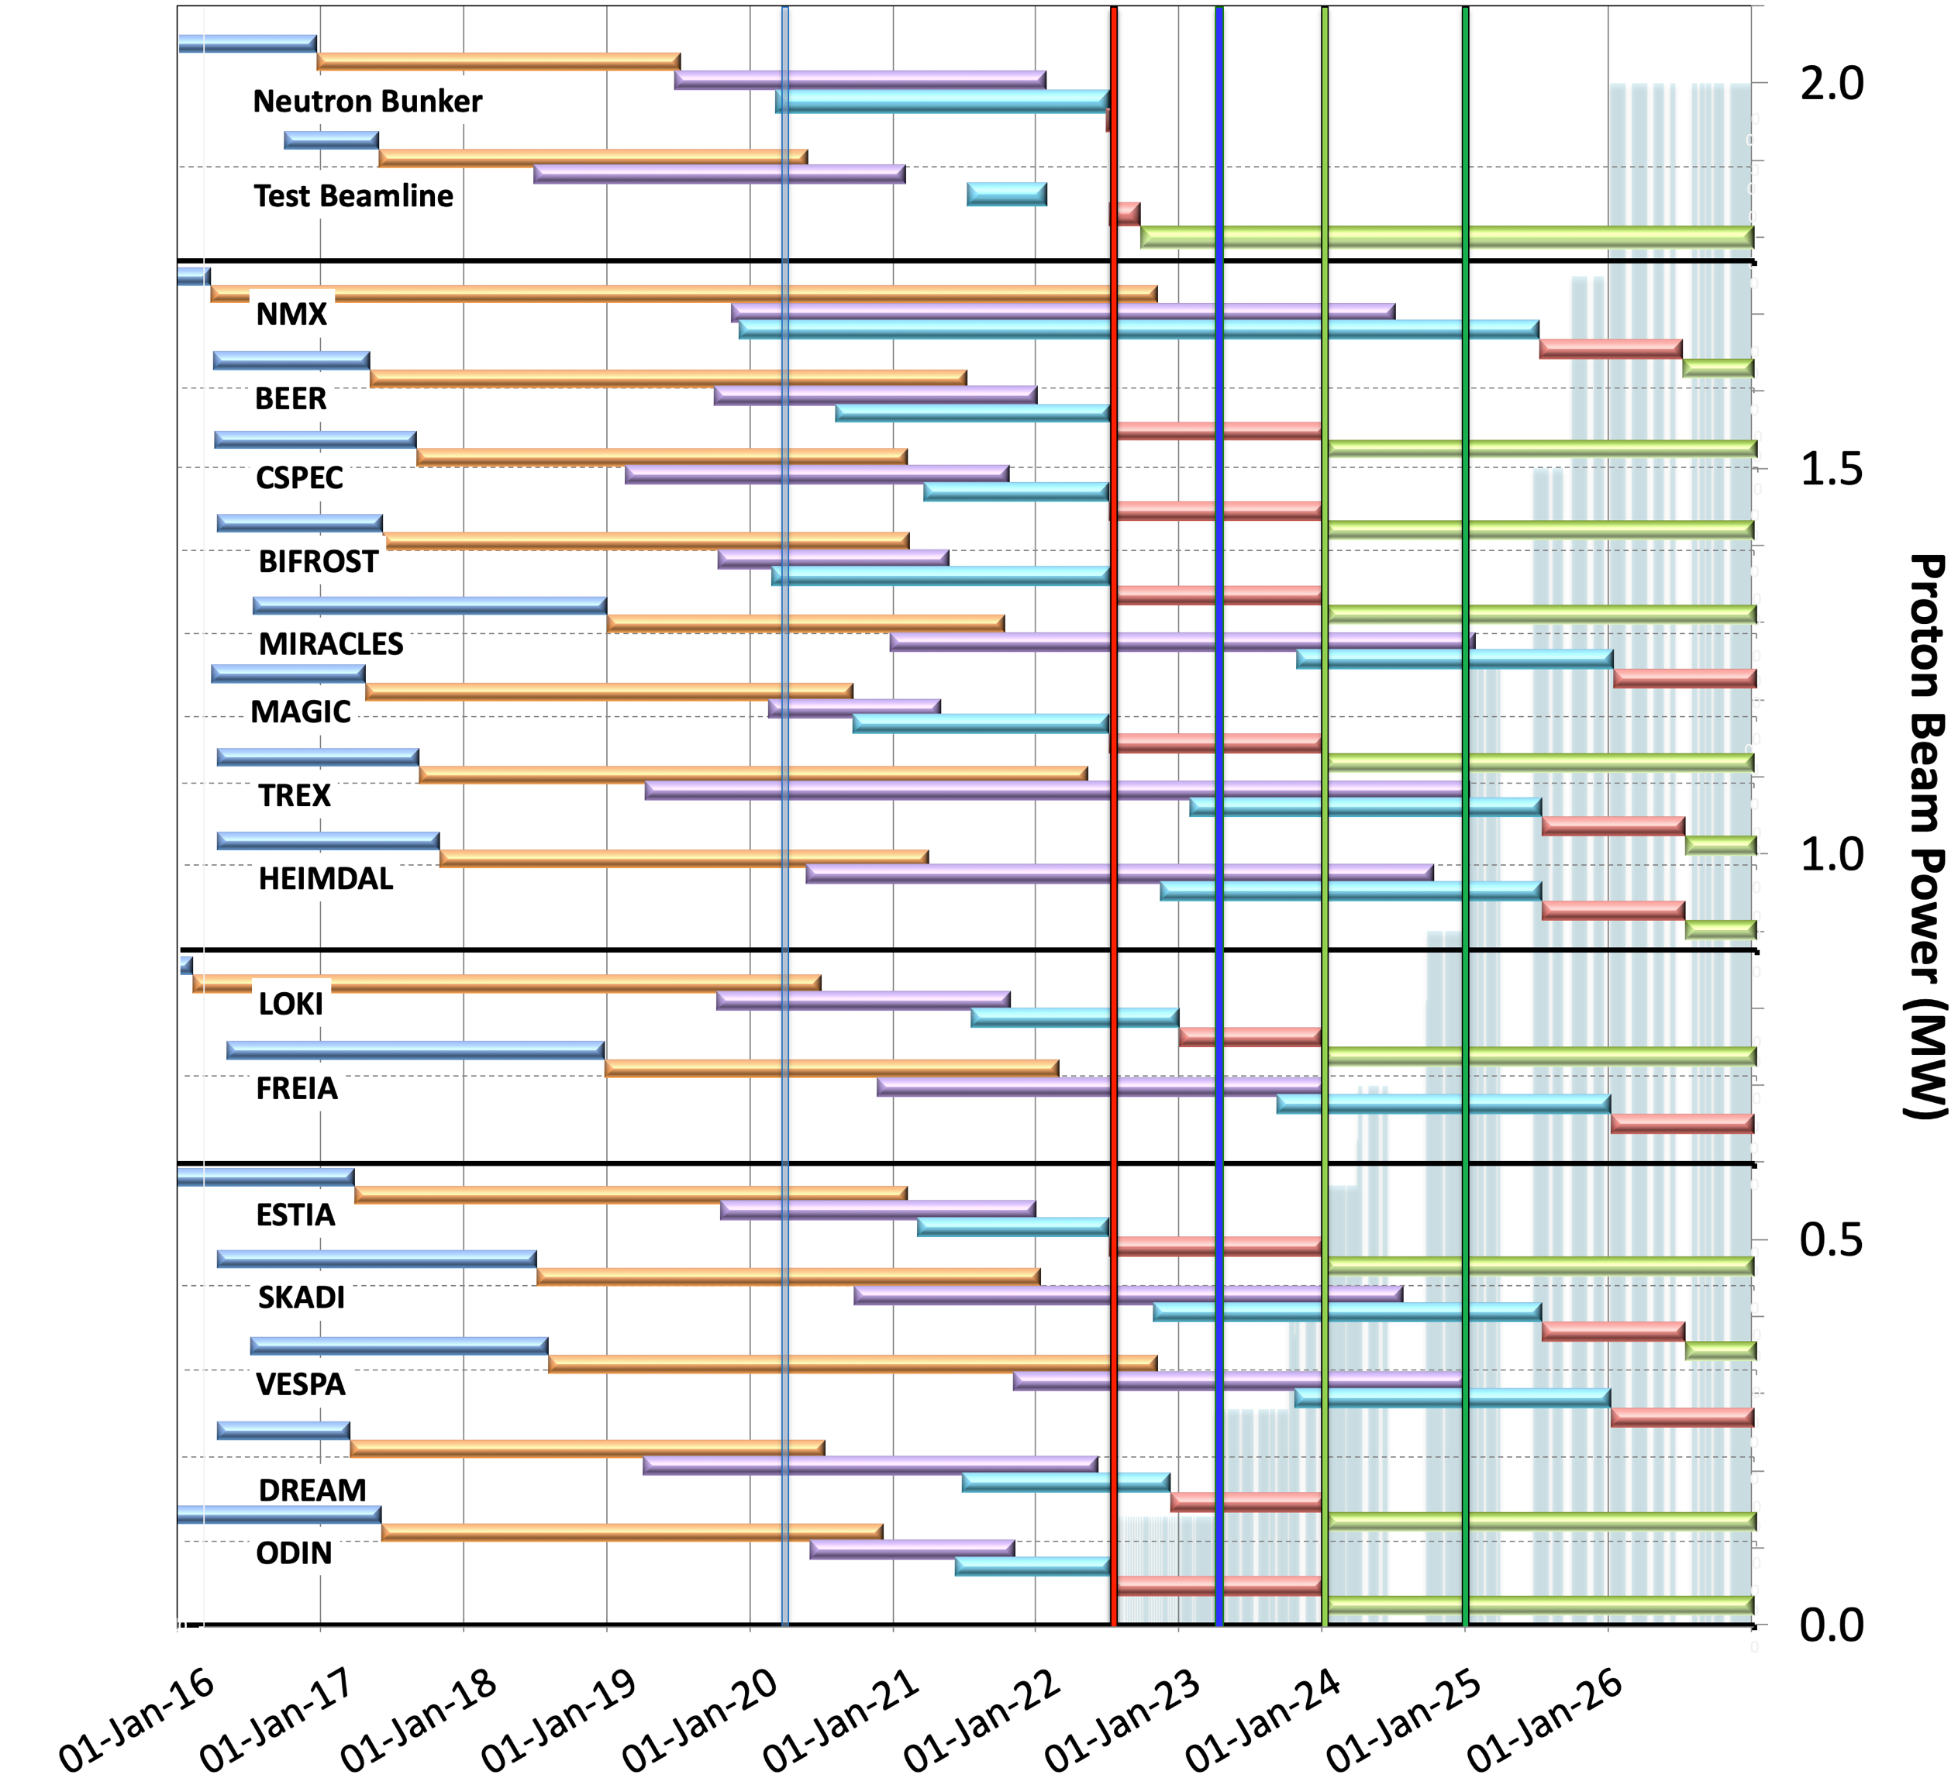

Baseline schedule for Neutron Beam Instruments
(NSS MS V4.3)
Current date
BOT
& HC
FS
SOUP
(3NBI*)
8NBI in user Program
Preliminary Design
Detailed Design
Manufacturing & Procurement
Installation & Integration
Hot Commission/Early science
Operation
ESS Major Milestones (BOT, FS, SOUP) have not changed since early 2018.
BOT currently has negative float of 8 weeks
ESS is working to reduce this as far as possible
Access to instrument areas is according to baseline.
No delays foreseen.
West sector
First 3 NBI selected for SOUP: DREAM, LOKI & ODIN (best chance for early impact, as agreed by NSS, SAC and ESS Council)
Back-up instruments: (for risk of late access to D01 & D03) BEER, CSPEC, MAGIC or BIFROST, ESTIA
North sector
March 2023:
First Science (FS) with expert teams on some of instruments above
Review progress of first 3 NBI* for SOUP, implement backup plan if needed.
East & South sectors
* NBI = Neutron Beam Instrument
February 2020

Slide 5
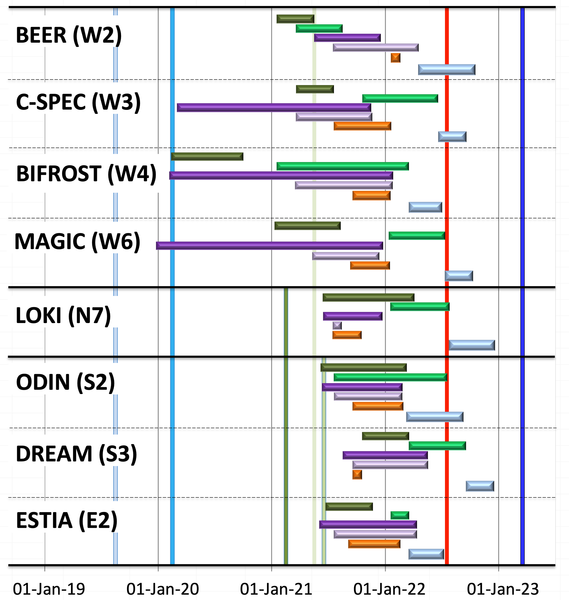
Detailed installation chart for first 8 instruments
(NSS MS V4.3)
Cave & hutch assembly
Cave & hutch fit-out
Guide shielding
Guides, choppers, shutters
In bunker installations
Integration & cold commission
E01 Access
Current date
E02/2 Access
BOT
& HC
FS
ESS Major Milestones (BOT, FS, SOUP) have not changed since early 2018.
BOT currently has negative float of 8 weeks
ESS is working to reduce this as far as possible
Access to instrument areas is according to baseline.
No delays foreseen.
West sector
North sector
D03 Access
East & South sectors
D01 Access
February 2020

Slide 6
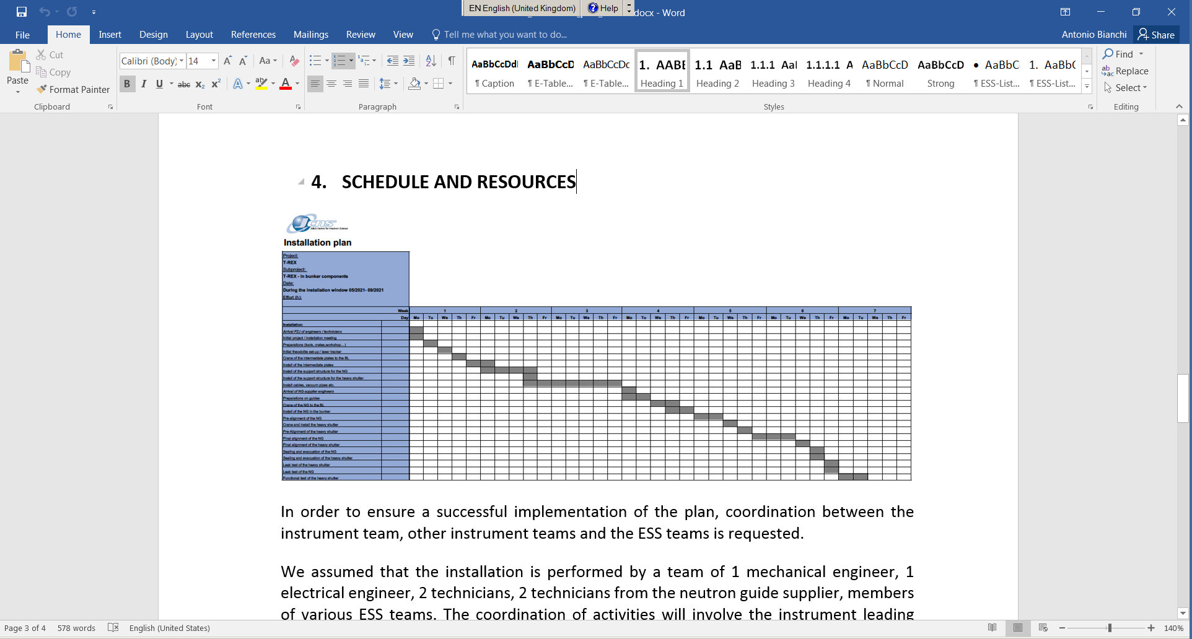
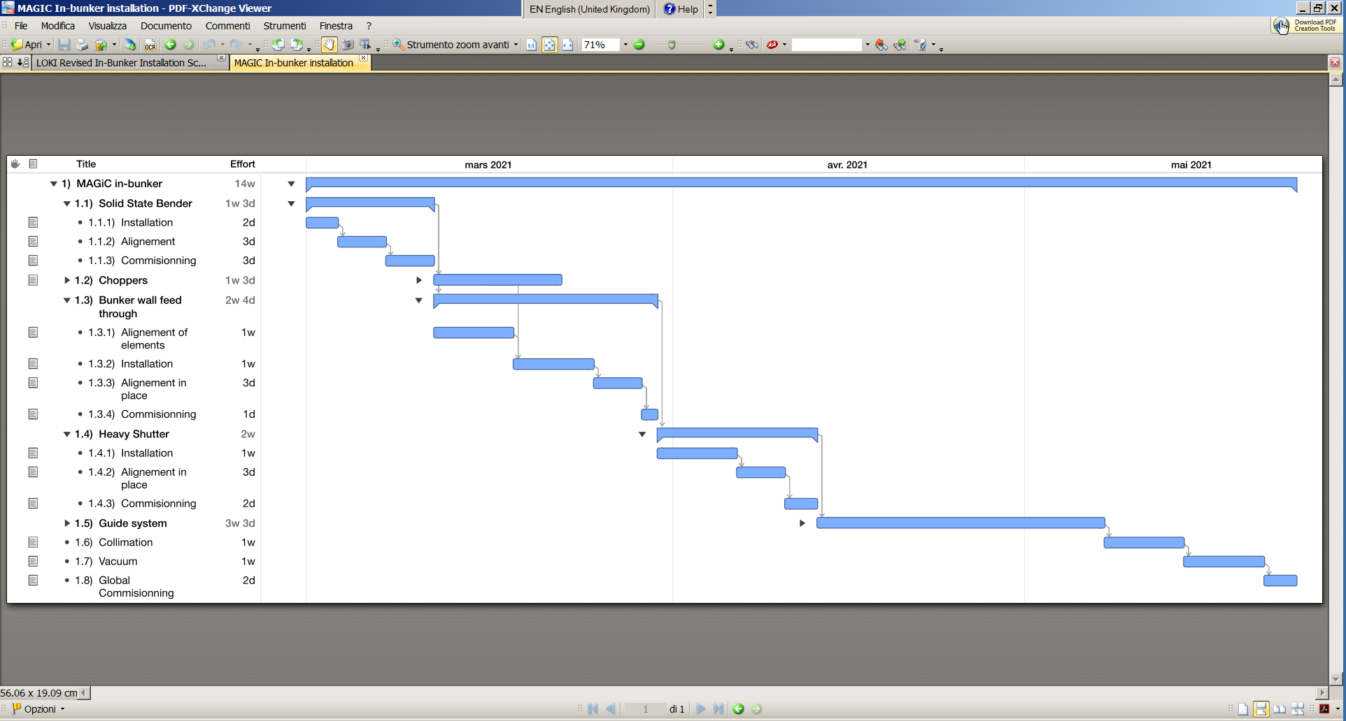
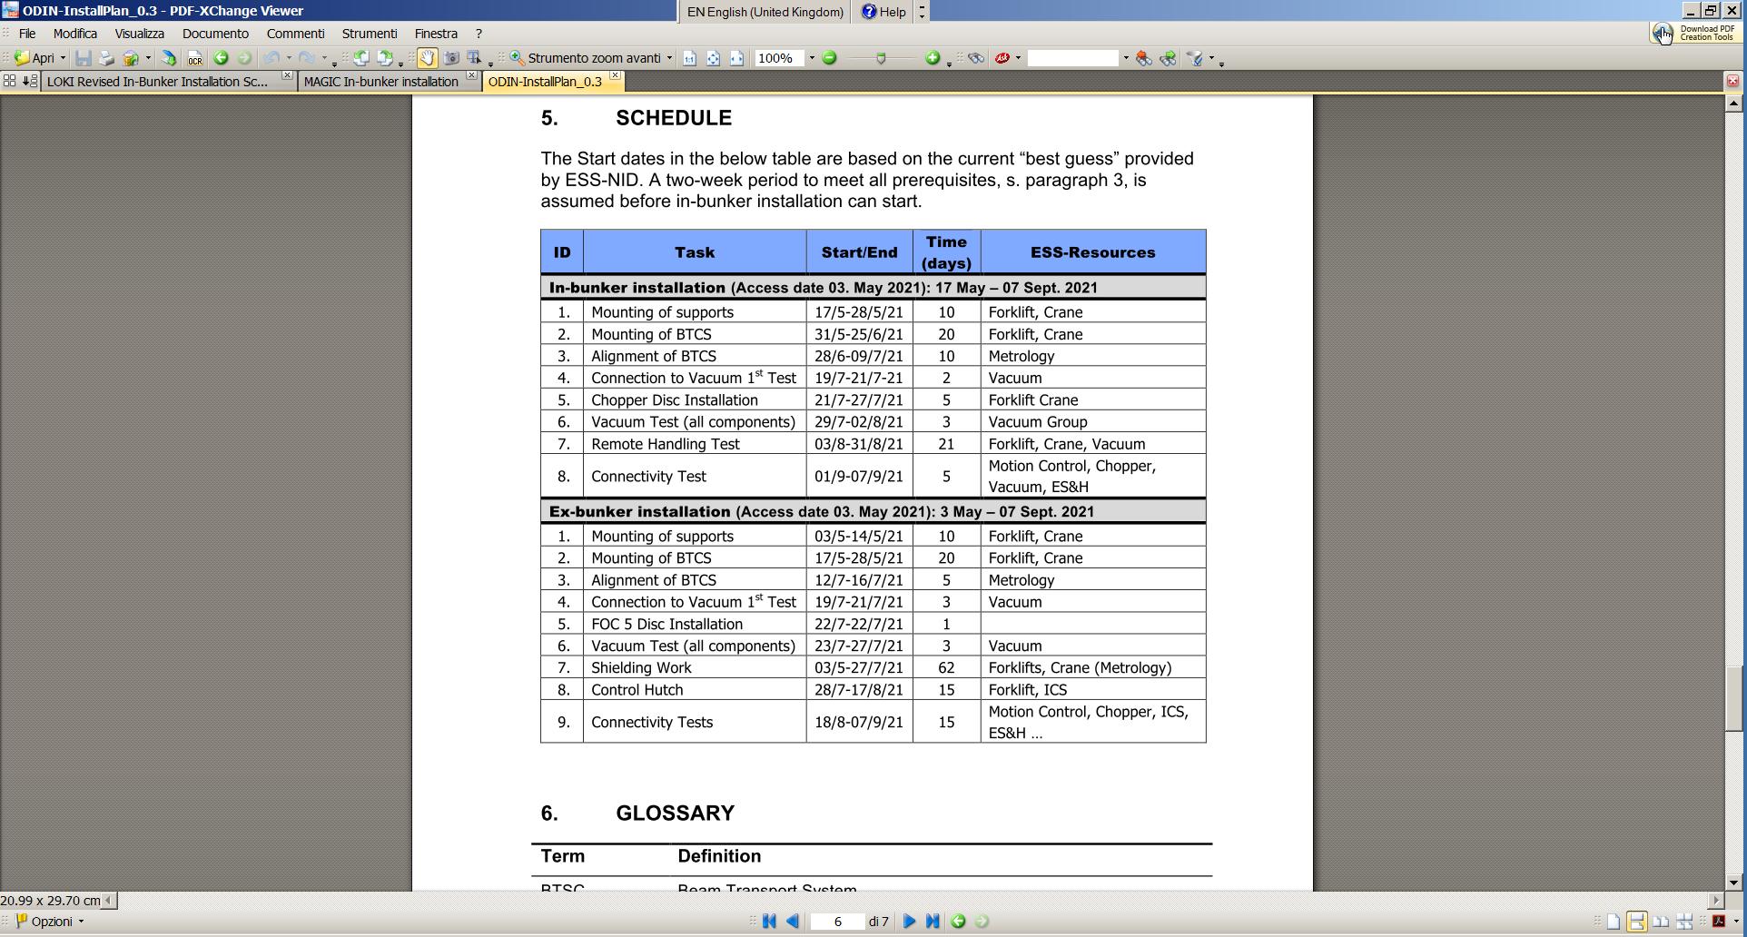
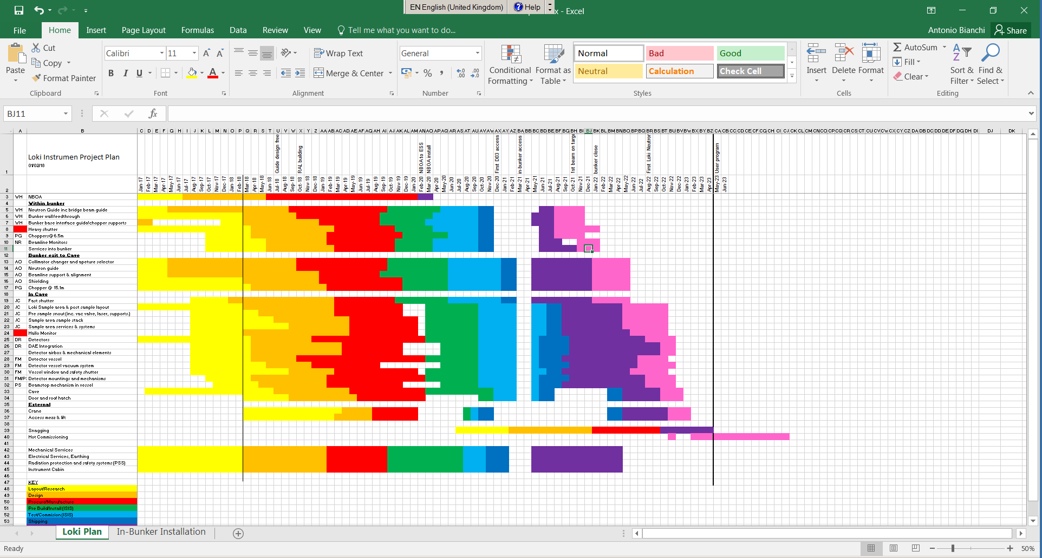
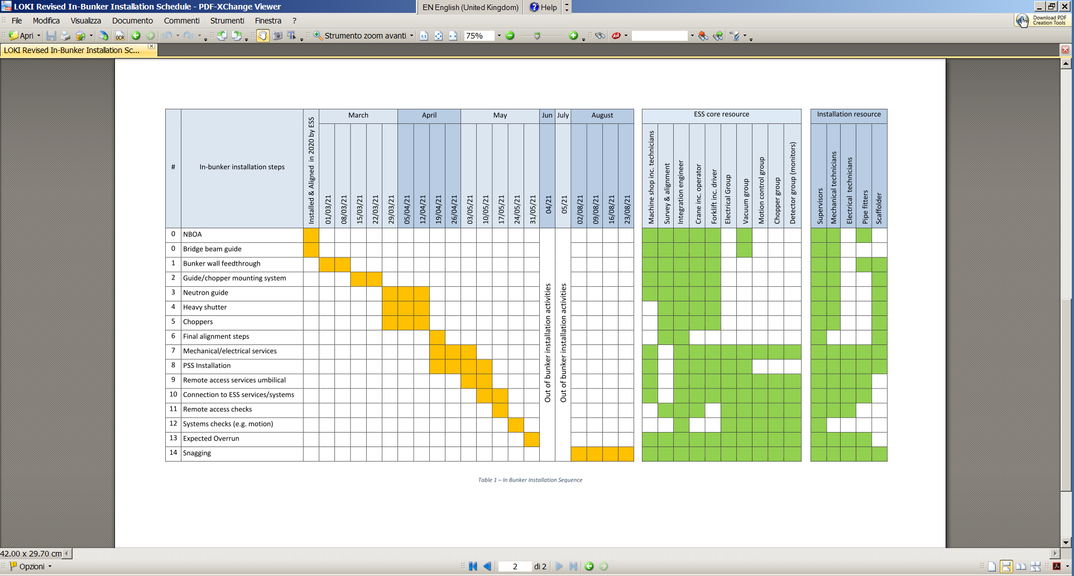
Instruments project Schedules
15 instruments – 15 ways

Slide 7
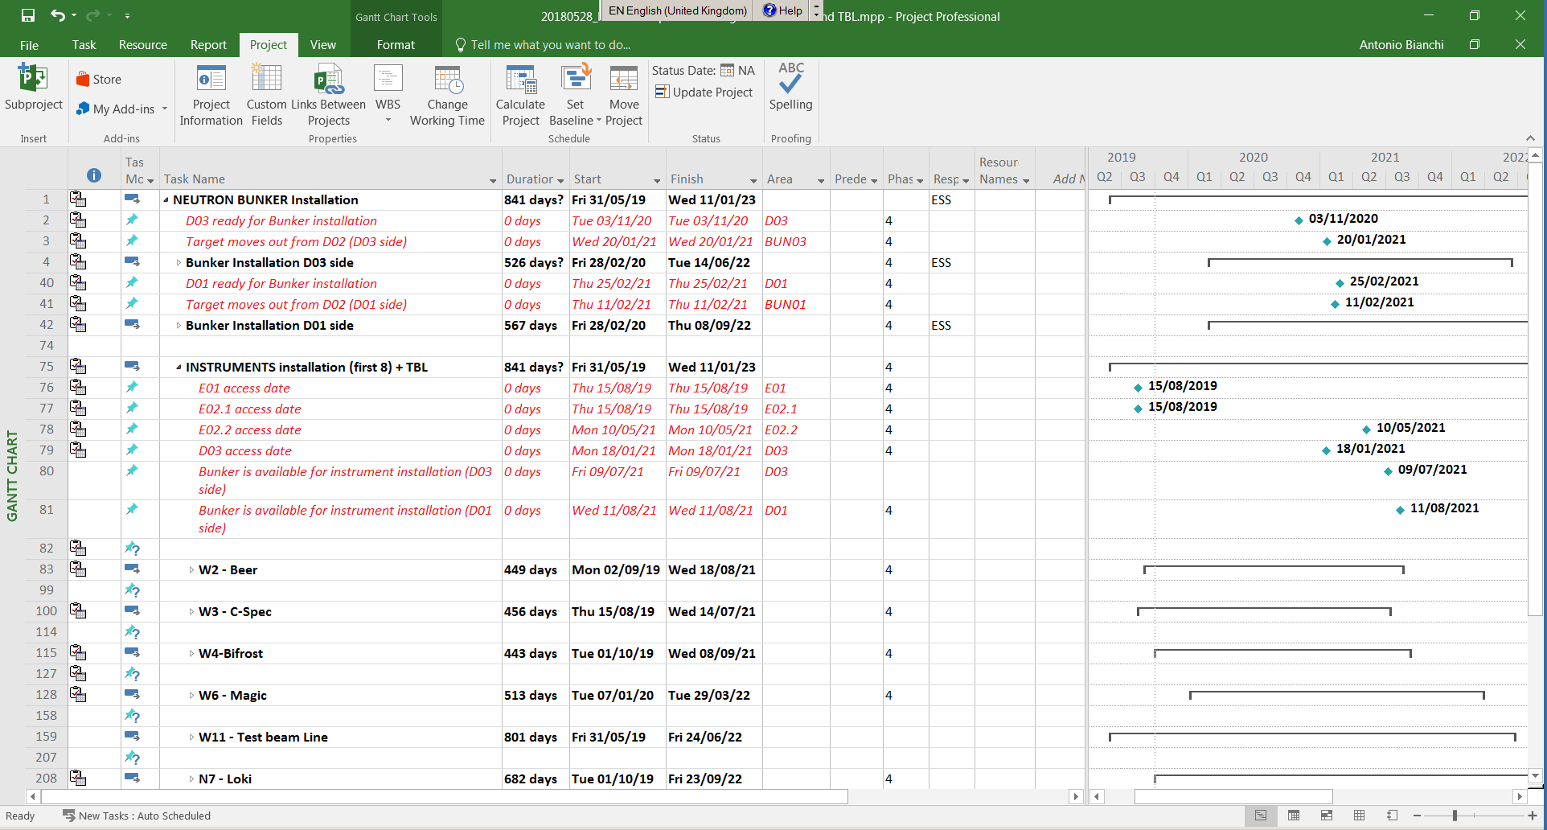
ONE Integrated Installation plan
The Integrated Installation Project
- all relevant information –
MS Project
ESS milestones, access dates etc
ESS calendar, working hours
Integrated with other ESS projects
ESS resources
Monthly updates (minimum) of subprojects plan into the integrated installation plan.
When in installation phase, this will
be required on a weekly/daily basis.
ESS
milestones
Subprojects:
Each instrument installation plan

Slide 8
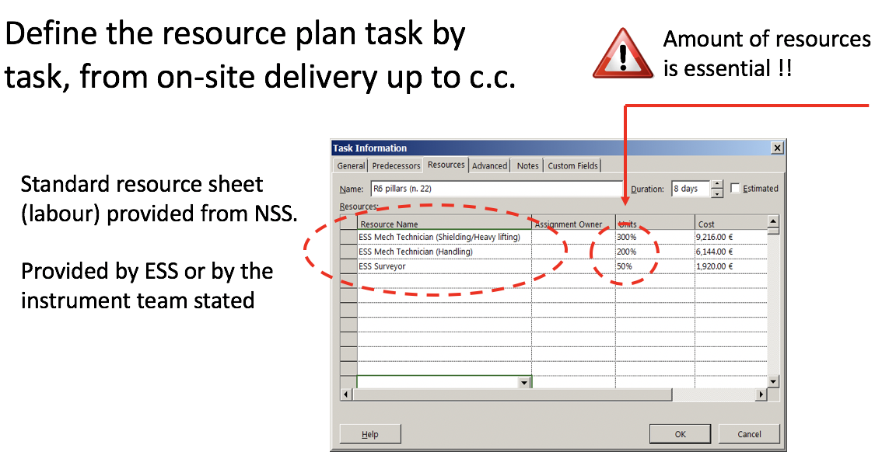
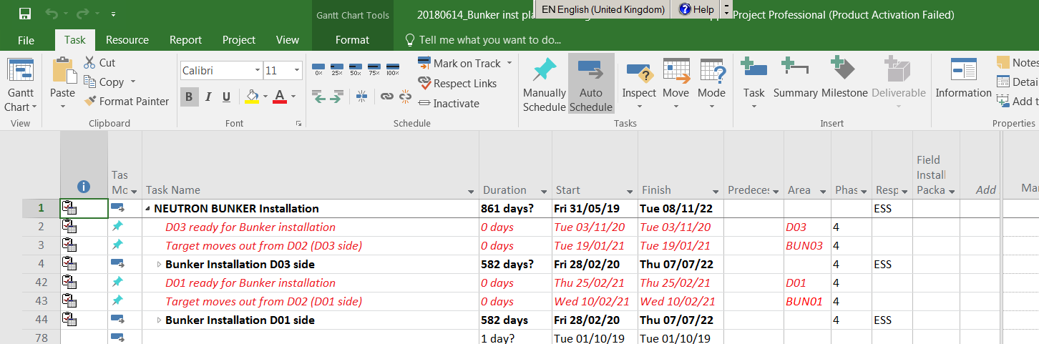
Project plan features (custom fields) - compulsory
Integration of the instruments installation plans require several custom fields
Makes it possible for us to look into specific area / time period / unique resource etc – plan and drive the Projects
Area
Project Phase
Responsible Institute (Partner) Installation package
Custom fields
Example - Hall cranes cannot be used
more than 100% in one area

Slide 9
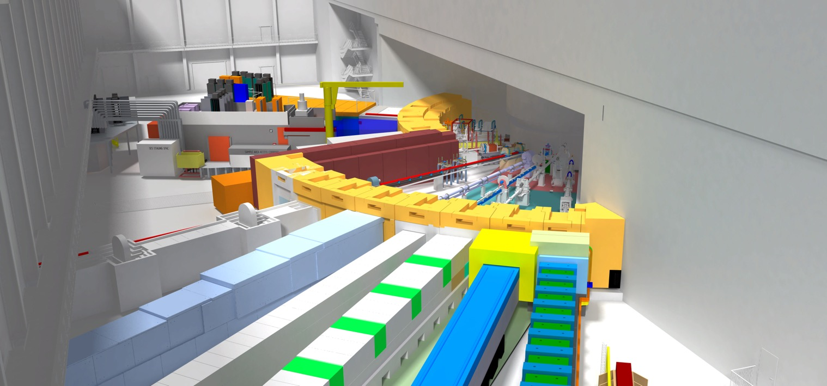
Bunker schedule

Slide 10
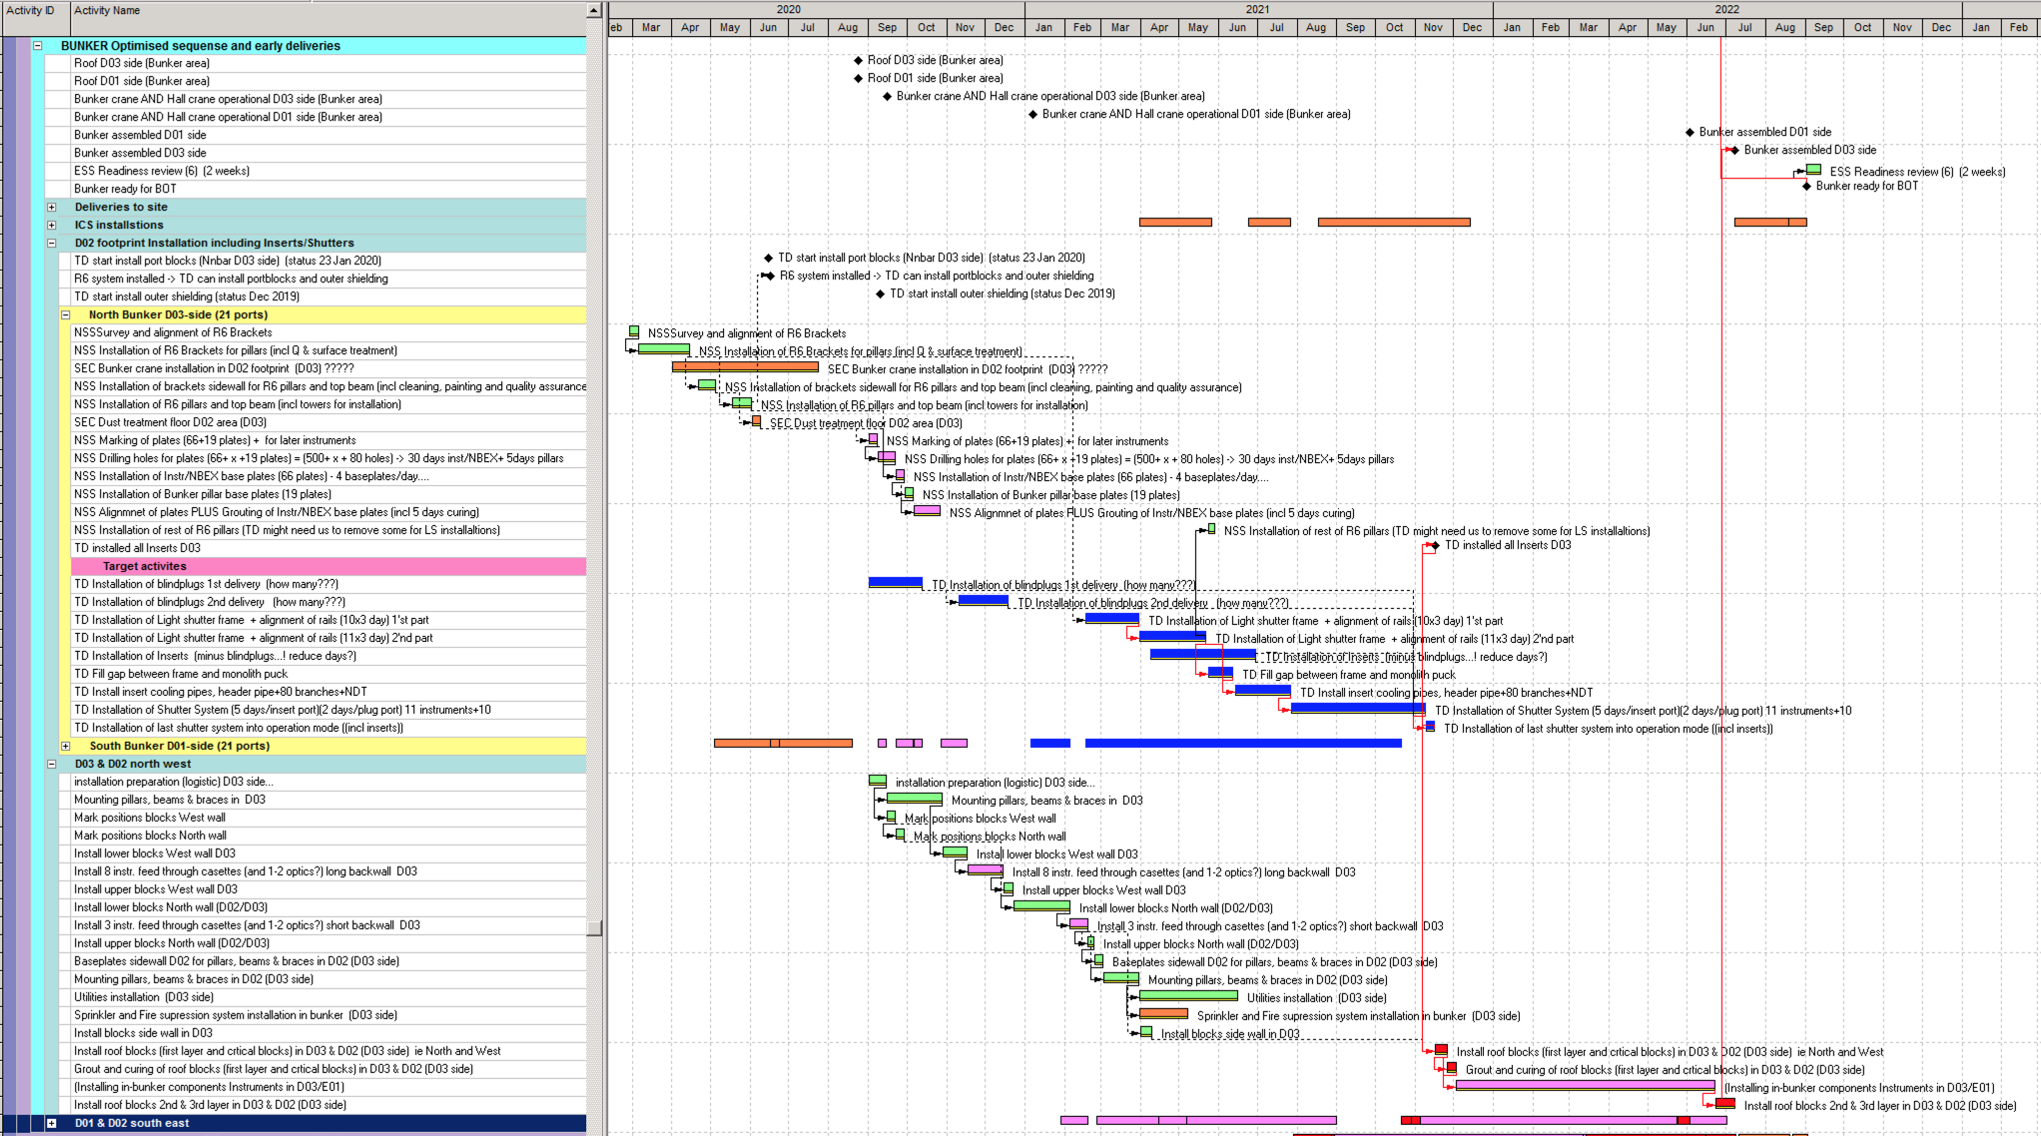
Detailed (unreadable) installation schedule

Slide 11
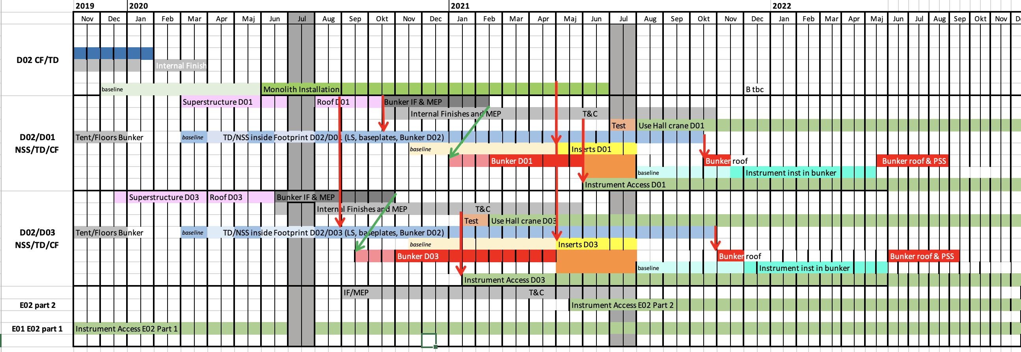
ESS integrated Bunker schedule – simplified overview

Slide 12
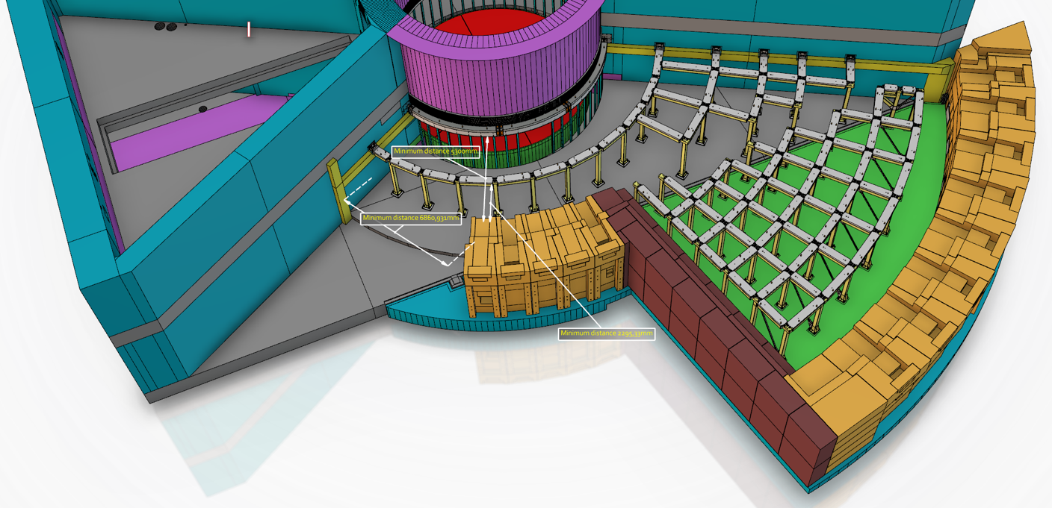
Majority of Bunker installed before Insert installation (ex D03 side)
1
5
2
4
3
6
Still room for installations
with temp. cranes if needed
Credit: Sofie Ossowski

Slide 13
Bunker Schedule – installations of interest for Instruments….
Baseplates
    Installation starts September 2020. For all 15 instruments.
BWI – should be installed with wall if possible for First 8 (see separate slide)
    Otherwise together with In-bunker installation period
    For Instruments 9-15, the Feed through steel case will be installed and plugged before BOT.
    Optics to be installed later, after ESS BOT.
6 months In-bunker instrument slot
    Target delays (portblocks/inserts, and light shutters) have impact on this period, but working on mitigations.
    Possibility of working in sections being explored
      Ex: Target done in South section -> instruments can start whilst Target continue with other section).…
    Q: Can the in-bunker period shift with 2-3 months without major impact on your schedule?
      Might help for some due to (un)foreseen delayed deliveries of in-bunker components..?
      Impact on TG5 ? Access to out of bunker area is according to baseline. No delays foreseen.

Slide 14
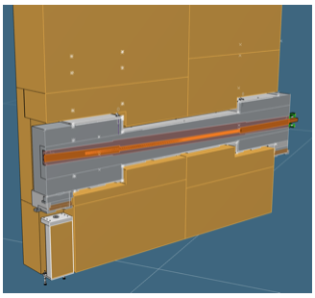
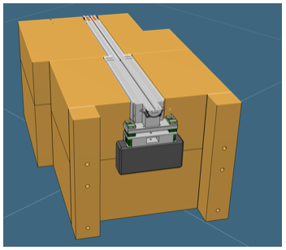
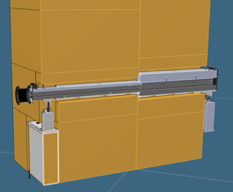
First Bunker installations & Instruments
The walls are going up first!
If possible, install Bunker wall insert with the wall for the FIRST 8, please have them Ready for Installation (ie optics aligned in wall insert):
West Wall (D03, 28m): 1 Nov 2020 BEER, BIFROST, MAGIC, C-SPEC
North Wall (D03, 15m): 15 Jan 2021 LOKi, TBL
South Wall (D01, 28m): 15 Jan 2021 ODIN, DREAM
East Wall (D01, 15m): 15 March 2021 ESTIA
Bunker Wall insert envelope frozen and confirmed by supplier 1 June 2020.
Wall feed-through cases procured and manufactured by ESS.
More info here: https://confluence.esss.lu.se/pages/viewpage.action?pageId=311642808
Credit: Sofie Ossowski

Slide 15
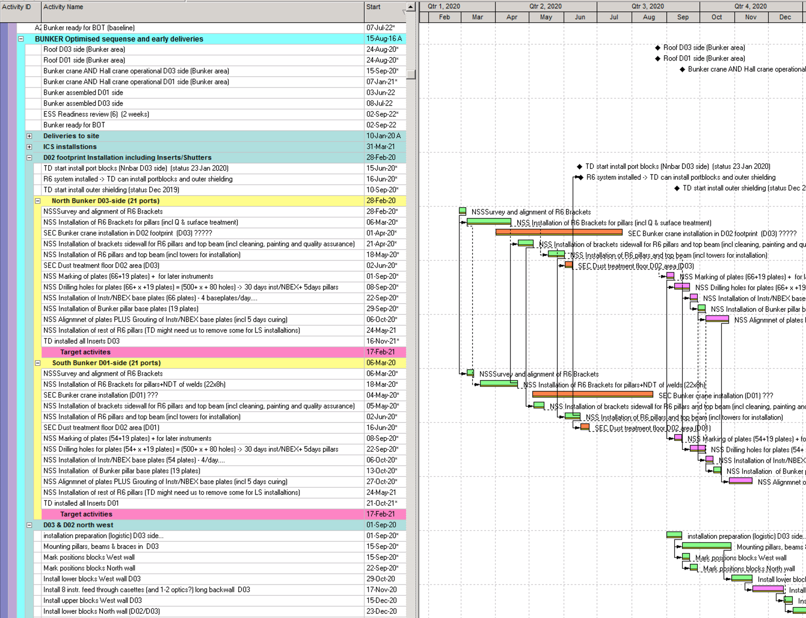
Detailed installation schedule for 2020
Installation Bunker items in 2020:
R6 brackets
R6 pillars
R6 beams
Bunker cranes (CF)
Baseplates NBEX tool
Baseplates Instruments
Customisation deadline 28/2-20
Baseplates bunker pillars in D02
Pillars West area / D03 long
Wall West area / D03 long
& Bunker wall feed throughs Nov-20

Slide 16
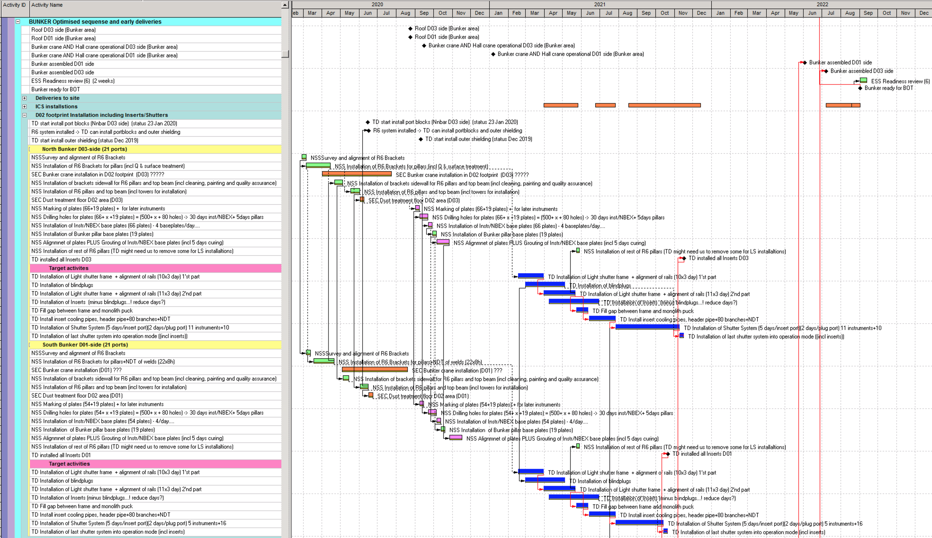
Detailed installation schedule D02 (D03 and D01 side)
NSS installations…
Target installations…

Slide 17
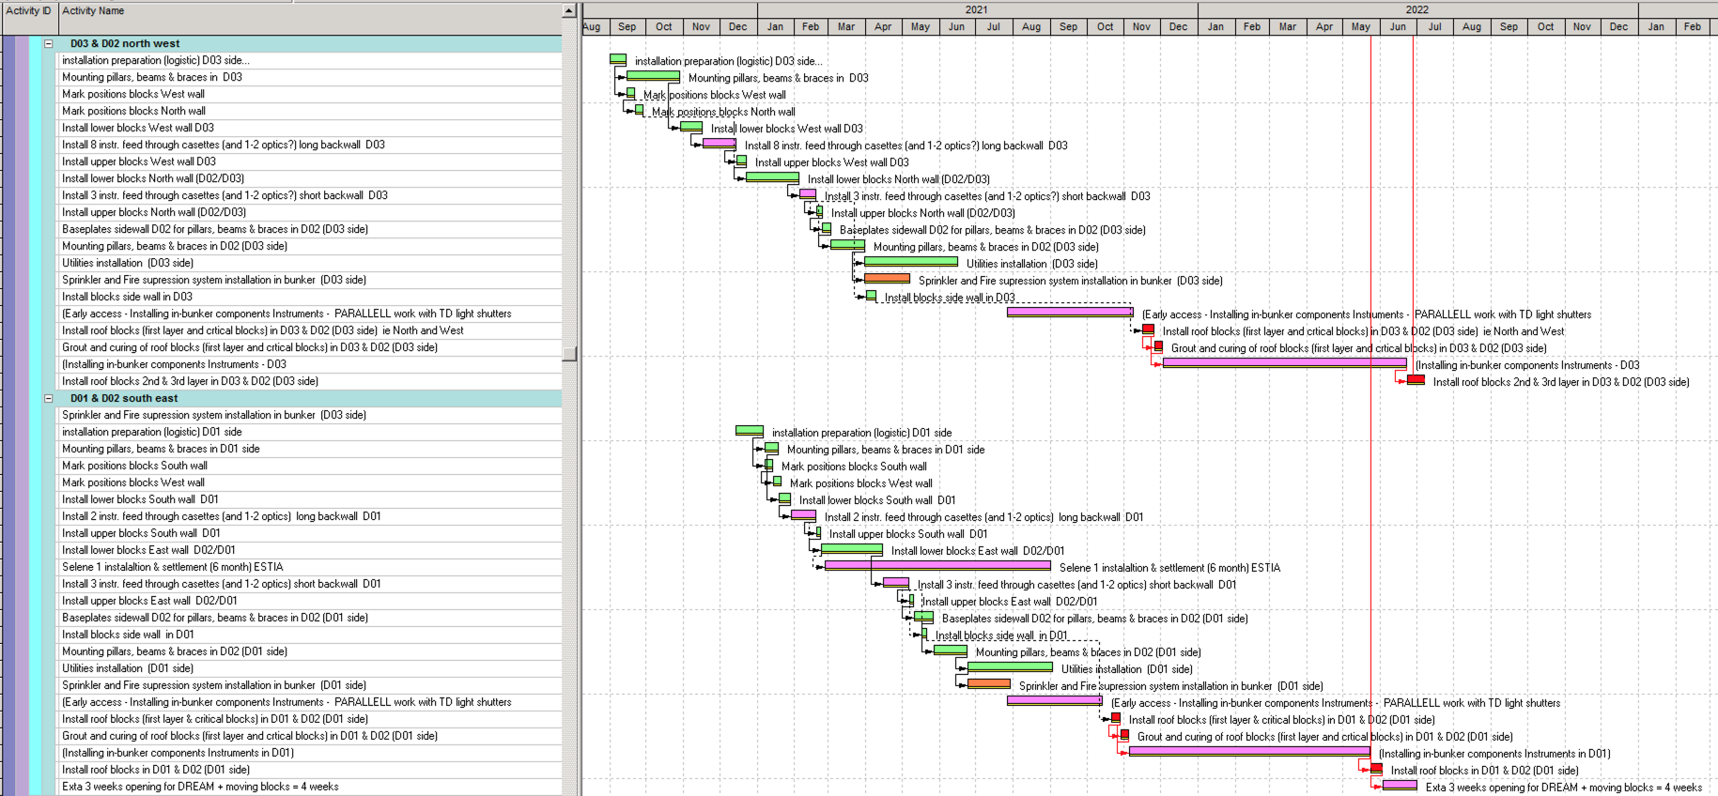
Detailed installation schedule D03/D01
Instrument Installations in PINK
BWI; CSPEC, BIFROST, BEER, MAGIC Q4-20
BWI; LOKI Q1-21
In Bunker access
BWI; ODIN, DREAM Q1-21
BWI; ESTIA Q2-21
Selene 1 - ESTIA
In Bunker access
DREAM: Chopper in Bunker (extra)

Slide 18
NBOA and
Guide coordination

Slide 19
NBOA & Guides
Inserts
    - Integration tent ready in summer 2020.
    - 12 (but hopefully all 14) NBOAs delivered to ESS by Q3 2020.
    - Target deliveries of NBPIs delayed, first deliveries planned for Q4 2020. Continuous after that.
    - Insert Installation by Target into monolith starting Q2 2021
Guides
- Coordination support from Hansdieter, please contact him!
- Overview next slide…
- Based on current progress and forecast, NSS will approve further procurements from 1st July 2020
section | NBOA | In-Bunker |  |  | Bunker wall |  |  | Out of bunker |  |  | Total % in contract
Progress MS | Contract | CTV | Tender | Contract | CTV | Tender | Contract | CTV | Tender | Contract
length | 49 m | 117 m | 79 m | 42 m | 24.5 m | 17.5 m | 10.5 m | 618 m | 471 m | 288,5 m
completion* | 100 % | 100 % | 67 % | 36 % | 100 % | 71 % | 43 % | 100 % | 76 % | 47 % | 48 %
forecast completion* by 30 June 2020 | 100 % | 100 % | 70 % | 70 % | 100 % | 71 % | 71 % | 100 % | 79 % | 79 % | 79 %
* % Completion for Instruments 1-8 + all NBOA
Notes:
A standard low speed chopper solution would reduce the schedule strain on the available commercial suppliers allowing them to focus on the complex and/or high-speed systems.
A standard low speed chopper solution would increase the commonality between systems allowing faster tuning, integration, installation and commissioning, reducing risk delays for overall ESS milestones.
A system based on well known, tested components is more easily maintained, lowering MTTR, reducing the spare part inventory and thereby increasing the instrument availability.
Increasing the number of potential suppliers would reduce the risk of schedule delays for the supply of chopper systems. Allowing orders to be shifted to suppliers with spare capacity.
ESS owned IP of chopper systems would increase the internal knowledge of the systems making system upgrades and obsolescence management easier as well as reducing the time for commissioning and maintenance.
Such a project on standard chopper systems is also cost-efficient:
A standard chopper project allows for larger scale procurements granting larger supplier discounts compared to individual instrument procurements.
Additionally, there is a labour element (often invisible) in design, selection, purchase, SAT, installation, commissioning; this labour element may be very significant.
Some institutes participating in neutron instrument construction have experience, but for most there are significant non-recurrent engineering (NRE) costs and time that will be saved through a common project.
Increased commonality leads to fewer unique spare parts required to be covered by instrument’s operational budget, lowering the overall cost of instrument maintenance costs.

Slide 20
Lengths of neutron guide for NSS Project
Instrument | In-monolith | In-Bunker |  |  | Bunker wall |  |  | Out of bunker
 | Contract | CTV | Tender | Contract | CTV | Tender | Contract | CTV | Tender | Contract
BEER | 3,3 | 19 | 0 | 0 | 3,5 | 0 | 0 | 129 | 129 | 129
CSPEC | 3,5 | 19 | 19 | 19 | 3,5 | 3,5 | 3,5 | 132 | 132 | 132
BIFROST | 3,5 | 19 | 19 | 0 | 3,5 | 3,5 | 0 | 133.5 | 133.5 | 0
MAGIC | n/a | 16 | 0 | 0 | 3,5 | 0 | 0 | 130 | 0 | 0
LOKI | 3,5 | 5 | 5 | 5 | 3,5 | 3,5 | 3,5 | 5,5 | 5,5 | 5,5
ESTIA | 3,5 | 3,5 | 0 | 0 | 0 | 0 | 0 | 17 | 0 | 0
ODIN | 3,4 | 18 | 18 | 18 | 3,5 | 3.5 | 3.5 | 22 | 22 | 22
DREAM | 3,5 | 17.5 | 17.5 | 0 | 3,5 | 3.5 | 0 | 49 | 49 | 0
NMX | 3,4 | 0 | 0 | 0 | 3,5 | 0 | 0 | 0 | 0 | 0
SKADI | 3,5 | 6 | 0 | 0 | 3,5 | 0 | 0 | 19.4 | 0 | 0
T-REX | 3,5 | 0 | 0 | 0 | 0 | 0 | 0 | 0 | 0 | 0
MIRACLES | 3,5 | 0 | 0 | 0 | 0 | 0 | 0 | 0 | 0 | 0
HEIMDAL | 3,5 | 0 | 0 | 0 | 0 | 0 | 0 | 0 | 0 | 0
FREIA | 3,5 | 0 | 0 | 0 | 0 | 0 | 0 | 0 | 0 | 0
VESPA | 3,5 | 0 | 0 | 0 | 0 | 0 | 0 | 0 | 0 | 0
SUM | 48.6 | 123 | 78.5 | 42 | 31.5 | 17,5 | 10.5 | 637.4 | 471 | 288,5
Notes:
So exactly how big

Slide 21
Next Six Months
Manufacturing progressing for First 8 Instruments*
First Installations in E01 & E02
  Intermediate Design Review
  Subsystem TG3 (intermediate)
  TG4
  STAP
  * 13/14 NBOA already in manufacturing
2019-2020 | Sep | Oct | Nov | Dec | Jan | Feb | Mar | Apr | May | Jun | Jul | Aug
LoKI
SKADI
ESTIA
FREIA
NMX
MAGIC
HEIMDAL
DREAM
BEER
ODIN
CSPEC
BIFROST
MIRACLES
T-REX
VESPA
25-26
SAC 23
SAC 24
24-25
IKRC19
SE, Samples and Users, DMSC, 27-28
ICB13
10-11
24
15-16
ICB14
7-8
IKON17
IKON18
February 2020
Notes:
More infor in talks by gabor and Inga later in the week.
Sub-TG3 received
BEER - Sub-TG3.1: - Cave; - Hutch; - Guide shielding; - Safety shutter (Reviewed. 2019-10-02)
BEER Out of Bunker guide system and Guide Exchanger
Sub-TG3 approved
DREAM (waiting for the re-start of CHESS workflow for SSDD)
ESTIA Feeder (2018-10-15)
ESTIA Selene Guide (SG1) (2019-08-06)
LoKI Chopper (6.5m and 15.1 m); Heavy shutter; Collimator selector and Detector motion me chani c s ; De t e c t o r a r r a y ; Be am s t o p (2019-11-12)
T-REX Vacuum vessel (waiting for skeleton and start of CHESS workflow)
Forecast:
LOKI ODIN DREAM completing TG3 in 2020

Slide 22
Thank you!

Slide 23
Back up slides for discussion

Slide 24
NSS-PD Org chart
Shane Kennedy
Head of NSS Division
Iain Sutton, Zsuzsa Helyes
Marie-Louise Ainalem
Technical Projects Group Leader
Stuart Birch
Markus Larsson
Gábor László
Zvonko Lazic
Fernando Moreira
Liam Whitelegg
Andrew Jackson
Acting Instrument Scientists Group Leader
Thomas Arnold
Premek Beran
Pascale Deen
Mikhail Feygenson
(start 2021)
Artur Glavic
(start 2022)
Judith Houston
Peter Kadletz
Dan Mannix
Manuel Morgano
(start 2021)
Daria Noferini
(start 2020)
Esko Oksanen
Werner Schweika
Rasmus Toft-Petersen
Robin Woracek
Sofie Ossowski
Coordination & Planning Group Leader
Nataliia Cherkashyna
Anton Khaplanov
Helena Ramsing
Hansdieter Schweiger
Peter Sångberg
Inga Tejedor
Tobias Richter
ECDC Group Leader
Torsten Börgershausen
Matt Clarke
Morten Hilker Skaaning
Morten Jagd Christensen
Afonso Mukai
Jonas Nilsson
Anders Pettersson
Richard Hall-Wilton
Detector Group Leader
Steven Alcock
Ramsey Al Jebali
Ioannis Apostolidis
Michail Ansatasopoulos
Alexander Backis
Eszter Dian
Kalliopi Kanaki
Thomas Kittelmann
Scott Kolya
Zivile Kraujalyte
Chung-Chuan Lai
Alessio Laloni
Vendula Maulerova
Dorothea Pfeiffer
Francesco Piscitelli
Linda Robinson
Nathalie de Ruette
Jerome Samarati
Irina Stefanescu
Per-Olof Svenson
Wen Xiong
Nikolaos Tsapatsaris
Chopper Group Leader
Erik Nilsson
Markus Olsson
Andrés Quintanilla
Dariusz Zielinski
Antonio & Dirk have moved to the ESS Project Office, but continue to support the NSS Project in all installation activities
Science Activities Division, DMSC & part of Instrument Technologies Division remain in Science Directorate - with no change in their contribution to NSS Project
Restructure did not change roles or responsibilities for staff in project delivery - IK partners should see no change in support
February 2020
Notes:
Experiment Control and Data Curation. Formerly known as "Data Management Group” also replaces "Beamline Controls Team/Group”
Data curation - organizing, integrating data and metadata, presenting and publishing, preserving and archiving
The Technical Projects Group is responsible for
management of engineering of the neutron beam instruments, design and
manufacturing of the neutron bunker and radiation shielding,
design support for common projects (such as choppers, detectors, beam monitors and shutter systems) and sample environment
delivery of electrical infrastructure and integration of instrument electrical systems.
The mission of the Neutron Chopper Group (NCG) is to ensure the successful, timely delivery and installation of chopper systems for instruments, while during operations ensure a high level of instrument reliability, availability and maintainability
Planning and coordination group: coordinates within a variety of areas, such as Safety & Licensing, Integrated Schedule, Systems Engineering, IK management etc.
Note that ken left. Andrew acting
Late starting dates for instrumnet scientist

Slide 25
Next six months
Priorities:
Resource loaded installation plans for first 3 instruments,
Progress with cave and hutch assembly in E01,
Progress with guide shielding in E02
Start production of CSPEC & ESTIA detectors
Start guide installation in E02
Processes:
Monthly reporting of progress with all instruments
Monthly reporting of common shielding and common chopper progress to instrument teams
Sub TG3, IRR/TG4
Progress:
Completed installation of Bunker R6 system (brackets, pillars and beams)
Pre-build of bunker west wall done (in Hungary), and shipping to Lund started.
8 (possibly 10) NBOAs delivered to ESS, and Integration tent ready
Start preinstallation of LOKI (at ISIS) & of ESTIA (at PSI)
E01 installations: NMX cave cont., BIFROST cave, CSPEC lower shielding blocks
February 2020

Slide 26
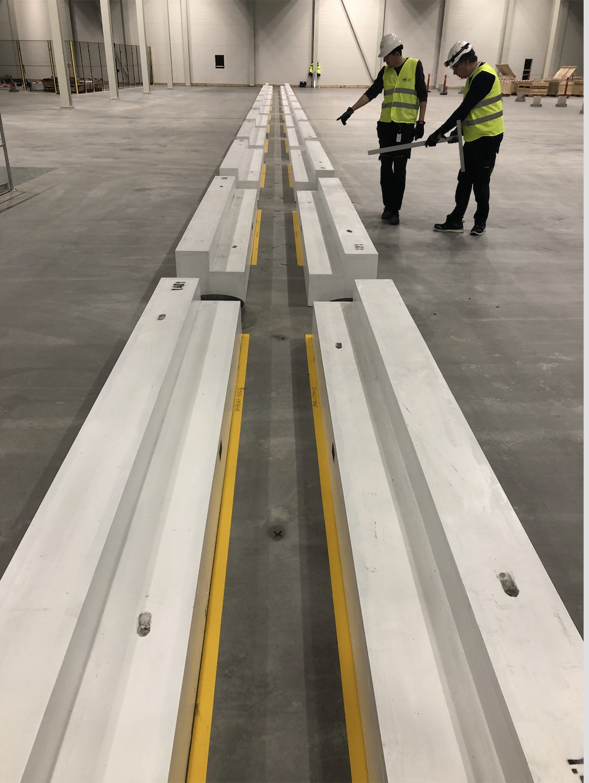
Common Shielding
schedule

Slide 27
The NSS Project Neutron Instruments
Including contribution common shielding
Common Shielding Project
Neutron Instrument | Budget (M€)
LOKI (Broad band SANS) | 12.85
SKADI (General Purpose SANS) | 11.50
ESTIA (Focusing Reflectometer) | 11.80
FREIA (Liquids Reflectometer) | 13.20
DREAM (Bispectral powder diffractometer) | 13.66
HEIMDAL (Hybrid diffractometer) | 13.55
MAGIC (magnetism single xtal diffraction) | 13.10
NMX (Macromolecular crystallography) | 11.67
BEER (Engineering diffractometer) | 14.99
ODIN (multi-purpose imaging) | 11.76
BIFROST (extreme environment spectro.) | 13.45
C-SPEC (cold chopper spectrometer) | 16.50
T-REX (bispectral chopper spectrometer) | 16.85
VESPA (vibrational spectroscopy) | 12.00
MIRACLES (backscattering spectrometer) | 13.4
 | 200.28
86.5 % of Instrument scope is in signed TAs
Confirmed
Potential or in for racks
ESS common shielding & Chopper scope:
Confirmed value = 11.8 M€
February 2020
Notes:
For the traffic lights, chopper scope only includes common chopper systems delivered by ESS
for the budget value chopper scope includes slow choppers plusracks and spindles
Common shielding:
Manufacturing contract with supplier - PACADAR signed for first 6 instruments: Kick off meeting held in Jan 2020
The production will be staged - according to area access dates & instrument guide deliveriesFirst deliveries will focus on CSPEC and BIFROST: First subTG3, for CSPEC, set for March 24
Installation schedules have to be aligned with guide delivery schedules (and access dates). Coordination with instrument teams needed.
CSPEC, BIFROST, MAGIC, BEER; ODIN and DREAM.
Common choppers
October: Successful PDR for standard low-speed chopper project, including chopper assembly and control hardware (rack and CHIC).
MAGIC chopper system kick off meeting (9th Dec)
ESTIA: buying the spindle, cables, racks and Artur wanted us to do the testing and cold commissioning of the chopper: ie all in our scope, etc almost 90 keuro. It’s a significant scope.
For cspec and brifrost I understand both of these instruments ahve reposnded with a no. Neitehr bifrost nor cspec have gone out for procurement and received delivery estimates and costs I consider them at least unofficially potential.
For beer - keeping dialogue at least for a couple of chopper
Racks: Miracles, Skadi, Trex, Loki, freia
Addiotnal Talks during wed and thu to add more details. For example niko

Slide 28
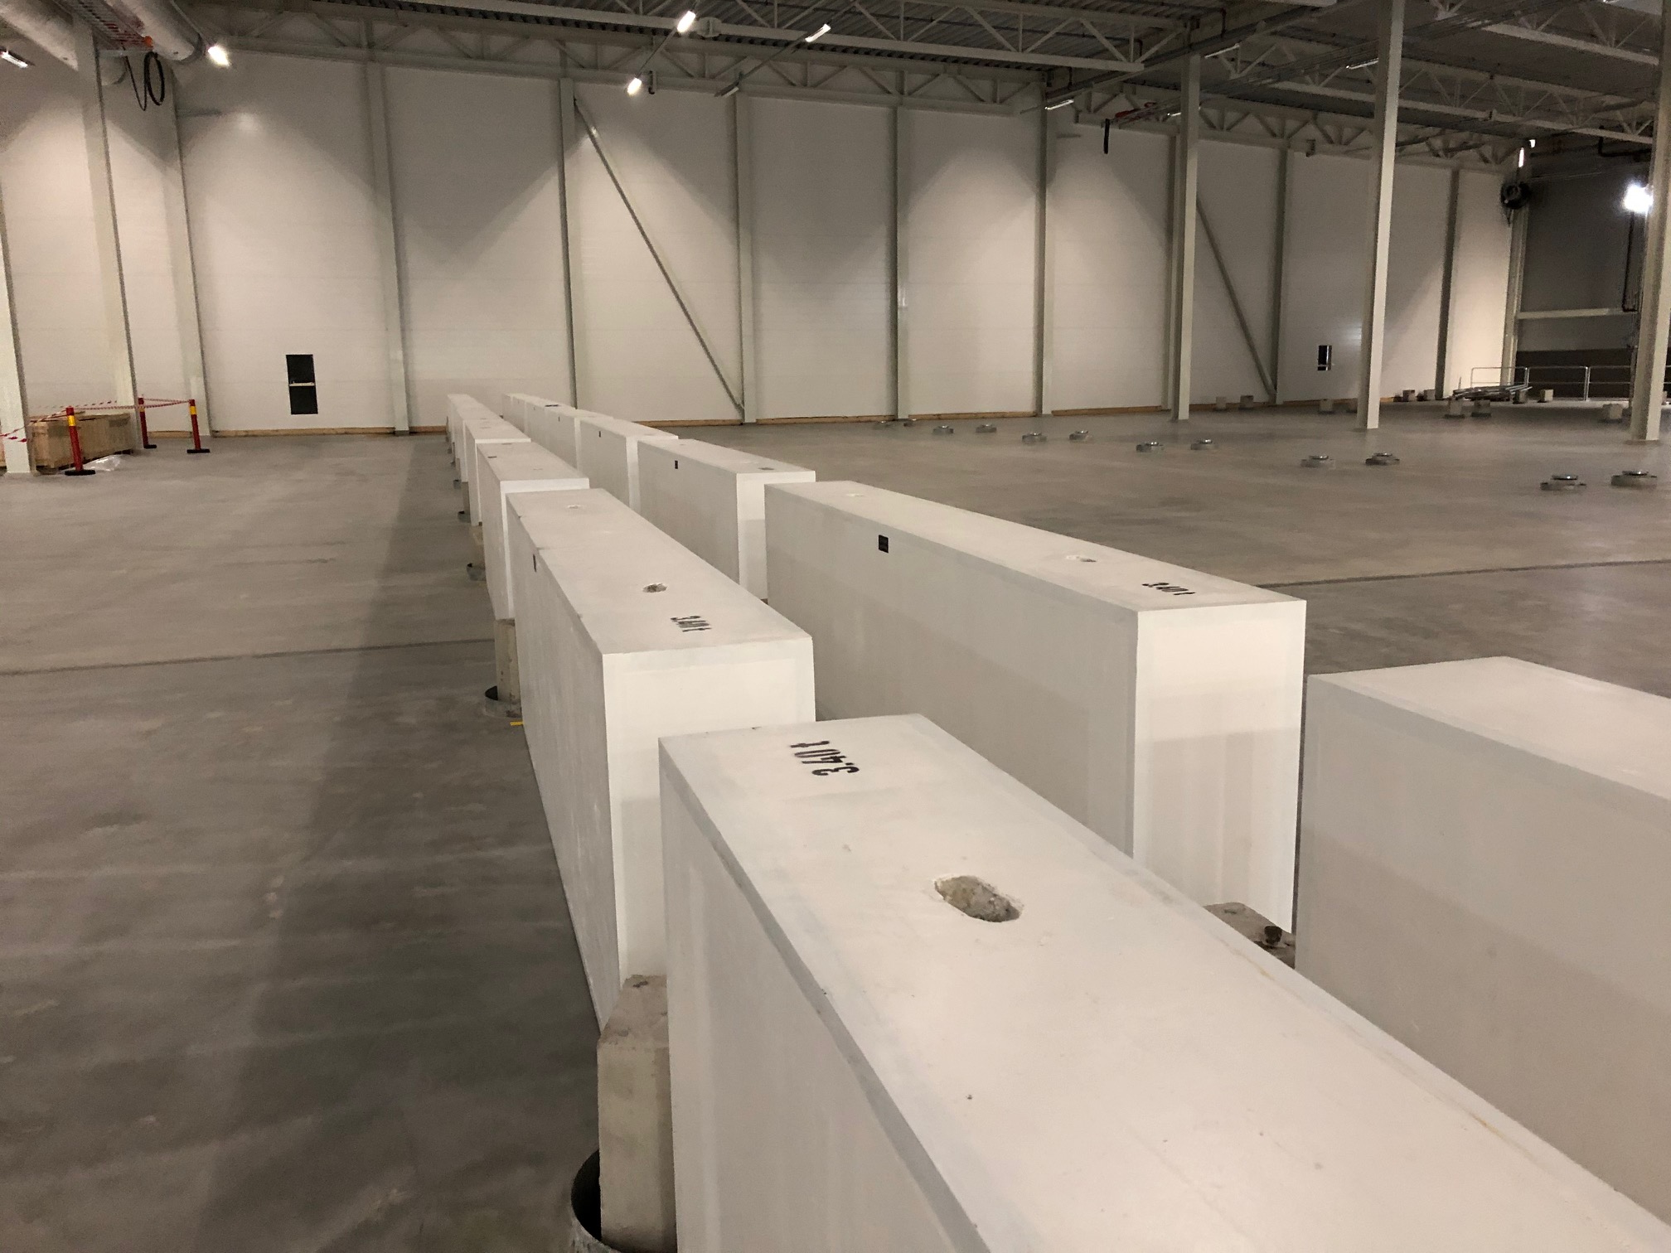
Common shielding Project Schedule – construction & manufacturing
MAGIC and BIFROST lower shielding blocks installed in Dec 2019 and Jan 2020, respectively.
CSPEC lower shielding blocks to be installed March 2020
Manufacturing contract with PACADAR signed for first 6 instruments: CSPEC, BIFROST, MAGIC, BEER; ODIN and DREAM. Kick off meeting held in Jan 2020.
First deliveries will focus on CSPEC and BIFROST: First subTG3, for CSPEC, in end of March.
    Next delivery batch needs to be agreed.
Installation schedules have to be aligned with guide delivery schedules (and access dates). Coordination with instrument teams needed.
 |  | "Blocks delivered to ESS site no later than"
 |  | Support blocks | Lower shielding blocks | Side/pile blocks | Upper blocks
C-SPEC | E01 | 19-04-2021 | 19-04-2021 | N/A | 03-08-2021
 | E02.1 | N/A | N/A | 19-04-2021 | 03-08-2021
 | E02.2 | N/A | 19-04-2021 | 19-04-2021 | 26-07-2021
 | D03 | 15-12-2020 | 01-01-2021 | N/A | 14-03-2021
BIFROST | E01 | 11-04-2021 | 11-04-2021 | N/A | 15-04-2022
 | E02.1 | N/A | N/A | 11-04-2021 | 15-03-2022
 | E02.2 | N/A | 11-04-2021 | 11-04-2021 | 15-02-2022
 | D03 | 09-01-2021 | 20-01-2021 | N/A | 08-01-2022
MAGIC lower shielding blocks
BIFROST lower shielding blocks

Slide 29
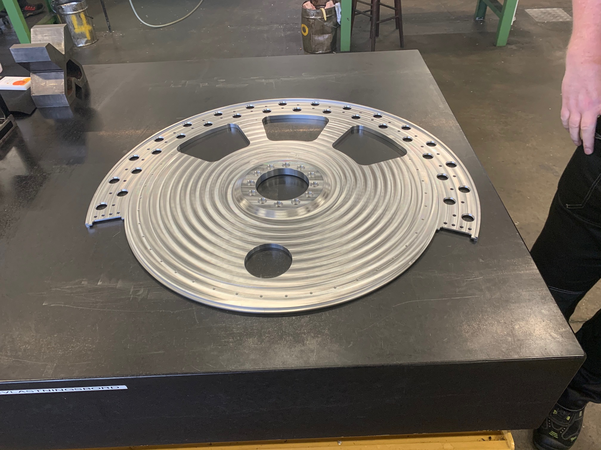
Common Chopper
schedule

Slide 30
The NSS Project Neutron Instruments
Including contribution common chopper projects
Common Chopper Project
Neutron Instrument | Budget (M€)
LOKI (Broad band SANS) | 12.85
SKADI (General Purpose SANS) | 11.50
ESTIA (Focusing Reflectometer) | 11.80
FREIA (Liquids Reflectometer) | 13.20
DREAM (Bispectral powder diffractometer) | 13.66
HEIMDAL (Hybrid diffractometer) | 13.55
MAGIC (magnetism single xtal diffraction) | 13.10
NMX (Macromolecular crystallography) | 11.67
BEER (Engineering diffractometer) | 14.99
ODIN (multi-purpose imaging) | 11.76
BIFROST (extreme environment spectro.) | 13.45
C-SPEC (cold chopper spectrometer) | 16.50
T-REX (bispectral chopper spectrometer) | 16.85
VESPA (vibrational spectroscopy) | 12.00
MIRACLES (backscattering spectrometer) | 13.4
 | 200.28
86.5 % of Instrument scope is in signed TAs
Confirmed
Potential or in for racks
ESS common Chopper scope:
Confirmed value = 1,455 M€
February 2020
Notes:
For the traffic lights, chopper scope only includes common chopper systems delivered by ESS
for the budget value chopper scope includes slow choppers plusracks and spindles
Common shielding:
Manufacturing contract with supplier - PACADAR signed for first 6 instruments: Kick off meeting held in Jan 2020
The production will be staged - according to area access dates & instrument guide deliveriesFirst deliveries will focus on CSPEC and BIFROST: First subTG3, for CSPEC, set for March 24
Installation schedules have to be aligned with guide delivery schedules (and access dates). Coordination with instrument teams needed.
CSPEC, BIFROST, MAGIC, BEER; ODIN and DREAM.
Common choppers
October: Successful PDR for standard low-speed chopper project, including chopper assembly and control hardware (rack and CHIC).
MAGIC chopper system kick off meeting (9th Dec)
ESTIA: buying the spindle, cables, racks and Artur wanted us to do the testing and cold commissioning of the chopper: ie all in our scope, etc almost 90 keuro. It’s a significant scope.
For cspec and brifrost I understand both of these instruments ahve reposnded with a no. Neitehr bifrost nor cspec have gone out for procurement and received delivery estimates and costs I consider them at least unofficially potential.
For beer - keeping dialogue at least for a couple of chopper
Racks: Miracles, Skadi, Trex, Loki, freia
Addiotnal Talks during wed and thu to add more details. For example niko

Slide 31
Common chopper Project Schedule – construction & manufacturing
Project Overview – for details please see Chopper presentation tomorrow
Instrument | Current Status | Basic scope | Kick-off | PDR | CDR | IRR | Project completion
MAGIC | Preliminary Design | Full System | 2019-12-10 | 2020-04 | 2020-08 | 2021-03 | 2021-11
LOKI | Awaiting standard system completion | Rack | 2020-01-20 | N/A* | N/A* | 2021-01 | 2021-11
FREIA | Awaiting standard system completion | Racks | 2020-01-20 | N/A* | N/A* | 2021-04 | TBD
NMX | Kick-off Meeting | Racks and Assemblies | Q1-2020 | TBD | TBD | TBD | TBD
ESTIA | Kick-off Meeting | Rack and Spindle | Q1-2020 | N/A* | N/A* | TBD | TBD
HEIMDAL | Updated proposal | Full System | Q2-2020 | TBD | TBD | TBD | TBD
DREAM | Kick-off Meeting | Racks | Q2-2020 | N/A* | N/A* | TBD | TBD
SKADI | Kick-off Meeting | Racks | Q2-2020 | N/A* | N/A* | TBD | TBD
MIRACLES | Kick-off Meeting | Racks | Q2-2020 | N/A* | N/A* | TBD | TBD
Next PDR:
- MAGIC Q1 2020
Next 2 kick off meetings:
- NMX Q1 2020
- ESTIA Q1 2020
Notes:
A standard low speed chopper solution would reduce the schedule strain on the available commercial suppliers allowing them to focus on the complex and/or high-speed systems.
A standard low speed chopper solution would increase the commonality between systems allowing faster tuning, integration, installation and commissioning, reducing risk delays for overall ESS milestones.
A system based on well known, tested components is more easily maintained, lowering MTTR, reducing the spare part inventory and thereby increasing the instrument availability.
Increasing the number of potential suppliers would reduce the risk of schedule delays for the supply of chopper systems. Allowing orders to be shifted to suppliers with spare capacity.
ESS owned IP of chopper systems would increase the internal knowledge of the systems making system upgrades and obsolescence management easier as well as reducing the time for commissioning and maintenance.
Such a project on standard chopper systems is also cost-efficient:
A standard chopper project allows for larger scale procurements granting larger supplier discounts compared to individual instrument procurements.
Additionally, there is a labour element (often invisible) in design, selection, purchase, SAT, installation, commissioning; this labour element may be very significant.
Some institutes participating in neutron instrument construction have experience, but for most there are significant non-recurrent engineering (NRE) costs and time that will be saved through a common project.
Increased commonality leads to fewer unique spare parts required to be covered by instrument’s operational budget, lowering the overall cost of instrument maintenance costs.

Slide 32
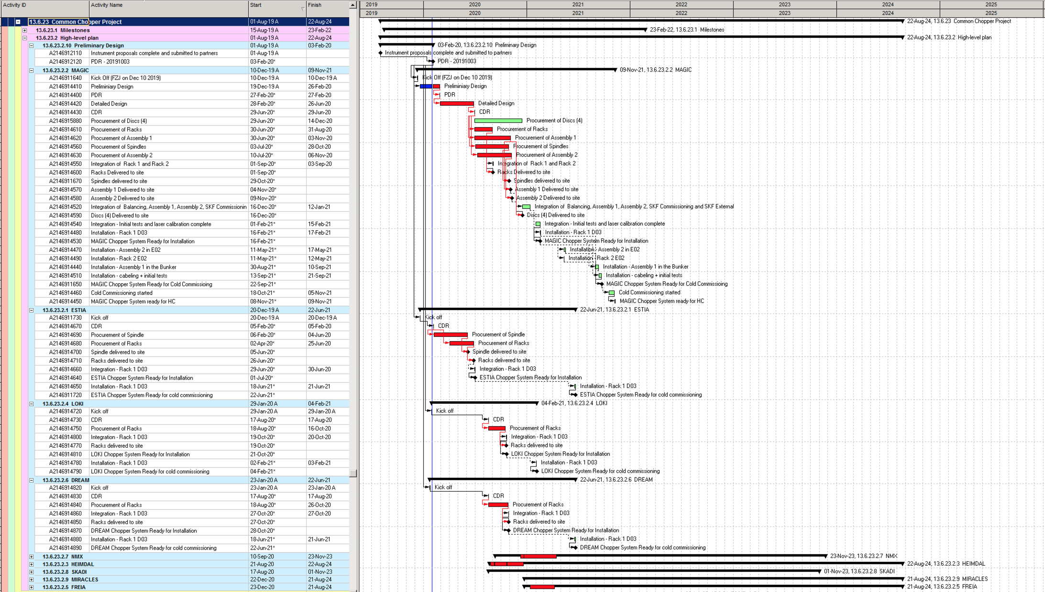
Common chopper Project Schedule – construction & manufacturing
Zooming in on / showing activities for the instruments in First 8.
Notes:
A standard low speed chopper solution would reduce the schedule strain on the available commercial suppliers allowing them to focus on the complex and/or high-speed systems.
A standard low speed chopper solution would increase the commonality between systems allowing faster tuning, integration, installation and commissioning, reducing risk delays for overall ESS milestones.
A system based on well known, tested components is more easily maintained, lowering MTTR, reducing the spare part inventory and thereby increasing the instrument availability.
Increasing the number of potential suppliers would reduce the risk of schedule delays for the supply of chopper systems. Allowing orders to be shifted to suppliers with spare capacity.
ESS owned IP of chopper systems would increase the internal knowledge of the systems making system upgrades and obsolescence management easier as well as reducing the time for commissioning and maintenance.
Such a project on standard chopper systems is also cost-efficient:
A standard chopper project allows for larger scale procurements granting larger supplier discounts compared to individual instrument procurements.
Additionally, there is a labour element (often invisible) in design, selection, purchase, SAT, installation, commissioning; this labour element may be very significant.
Some institutes participating in neutron instrument construction have experience, but for most there are significant non-recurrent engineering (NRE) costs and time that will be saved through a common project.
Increased commonality leads to fewer unique spare parts required to be covered by instrument’s operational budget, lowering the overall cost of instrument maintenance costs.

Slide 33
Progress on neutron guide manufacturing for ESS Instruments
NBOA 49 m
Bunker wall inserts 49 m
In-Bunker (incl. BBG) 220 m
Apart from in-monolith feed throughs (NBOA), manufacturing of all guides for Instruments 9-15 (707 m) is on hold until sufficient progress has been made with Instruments 1-8
14
15
15
SOURCE
Total 1515 m
D buildings 412 m
E buildings 800 m
Based on current progress and forecast. NSS will approve further procurements from
1st July 2020
15
8
SAMPLE
section | NBOA | In-Bunker |  |  | Bunker wall |  |  | Out of bunker |  |  | Total % in contract
Progress MS | Contract | CTV | Tender | Contract | CTV | Tender | Contract | CTV | Tender | Contract
length | 49 m | 117 m | 79 m | 42 m | 24.5 m | 17.5 m | 10.5 m | 618 m | 471 m | 288,5 m
completion* | 100 % | 100 % | 67 % | 36 % | 100 % | 71 % | 43 % | 100 % | 76 % | 47 % | 48 %
forecast completion* by 30 June 2020 | 100 % | 100 % | 70 % | 70 % | 100 % | 71 % | 71 % | 100 % | 79 % | 79 % | 79 %
* % Completion for Instruments 1-8 + all NBOA
February 2020
Notes:
First 8 instruments: 808 m
NBOA: all 15 is contracted
In-bunker, bunker wall and out of bunker: all 8 have gone through ctvs and about 40% have been contracted: 36%, 43% and 47%
Progress expected over the next months and forecast exceeds 70% by end of june
Last year NSS put the guide procurement of the instrument that are not int he first 8 on hold. This restriction will no longer be imposed after July 2020.
With this status …

