Slide 2
TG and documentation management
PRESENTED BY INGA TEJEDOR

Slide 3
Agenda
1 Phase 2 and TG3 – processes and meetings
2 Full TG3 Schedule
3 Tollgate Calendars
4 Status of a TG3 Review
5 TG Change Request
6 Tollgate summer plans
7 Installation Binders
8 Installation – administrative support

Slide 4
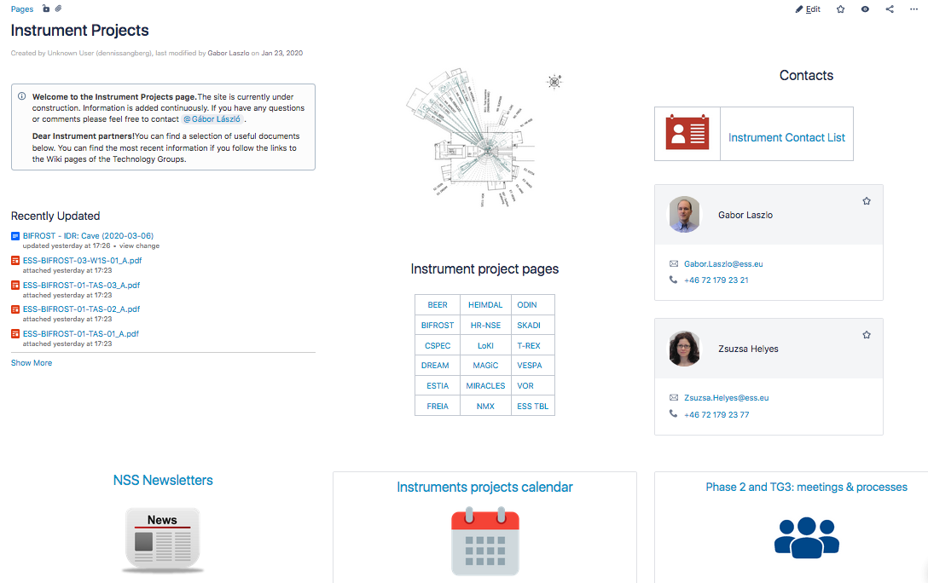
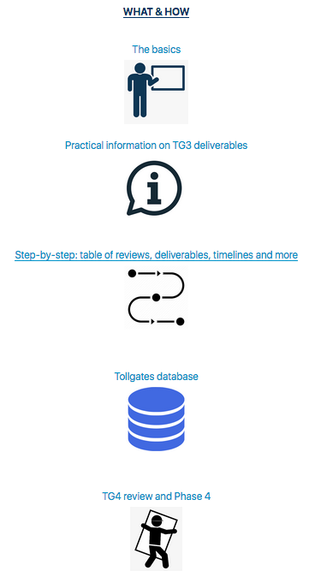
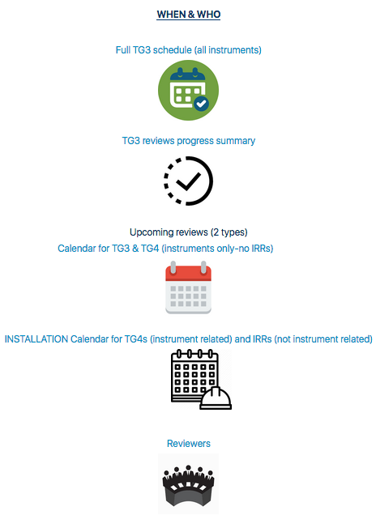
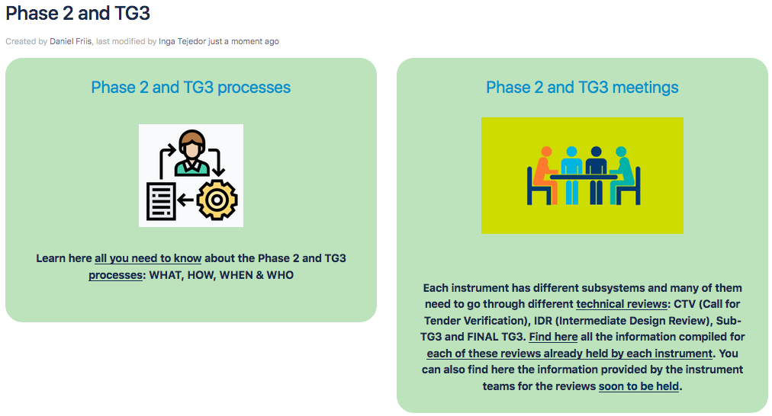
Phase 2 and TG3
Processes and meetings
Phase 2 and TG3 processes
(https://confluence.esss.lu.se/display/SPD)
Notes:
Judith did a great job compiling information and establishing a structure for the instrument’s review process. The process hasn’t changed. We still have a phase (2) to detail-design followed by a CDR or Tollgate 3 that feeds to the following phase (3) of manufacturing and procurement. To make things even more exciting we have several instruments reaching the installation phase (4), and for that purpose they need to pass the IRR.

Slide 5

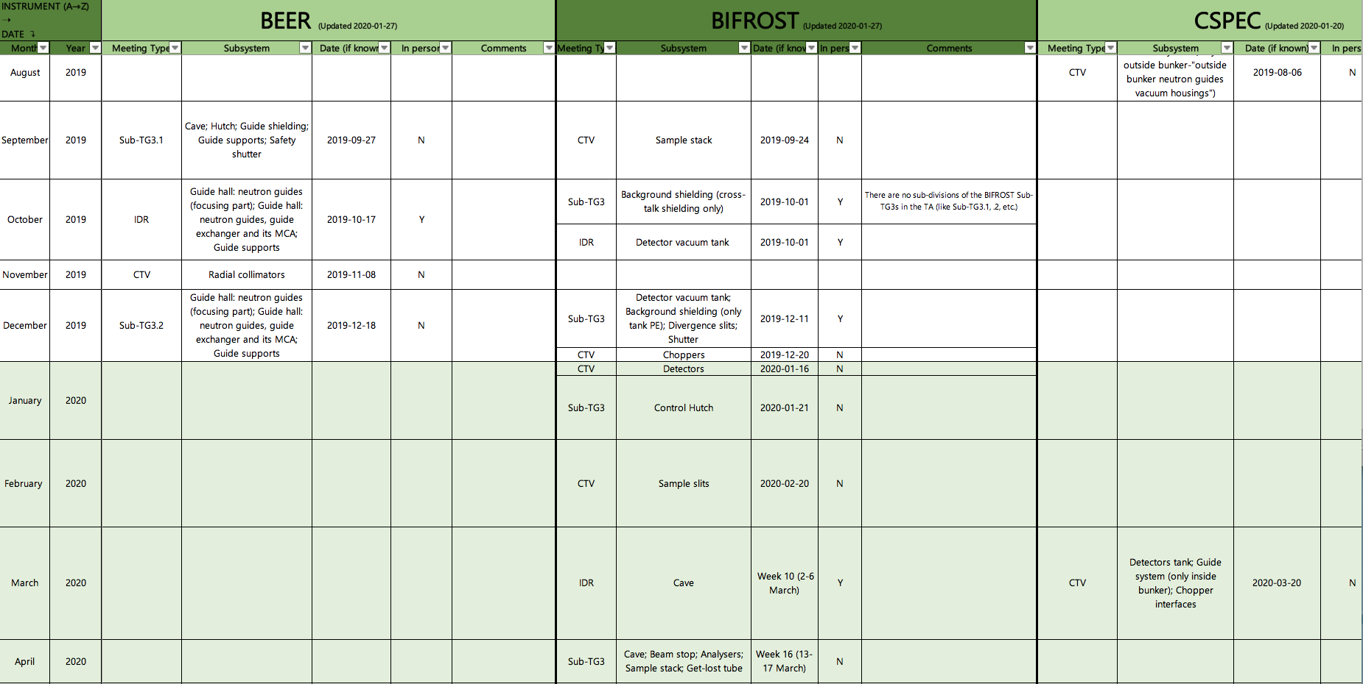
Full TG3 Schedule – New Version!
In the Phase 2 and TG3 processes page
Instruments in alphabetical order
Why the change?
  Previous set up: too much information on a single cell – difficult to stablish the format
  Frozen panels that facilitate the information view
  Possible to filter per meeting type, in person meeting (Y/N)…
  Easier to create statistics
Month/year

Slide 6


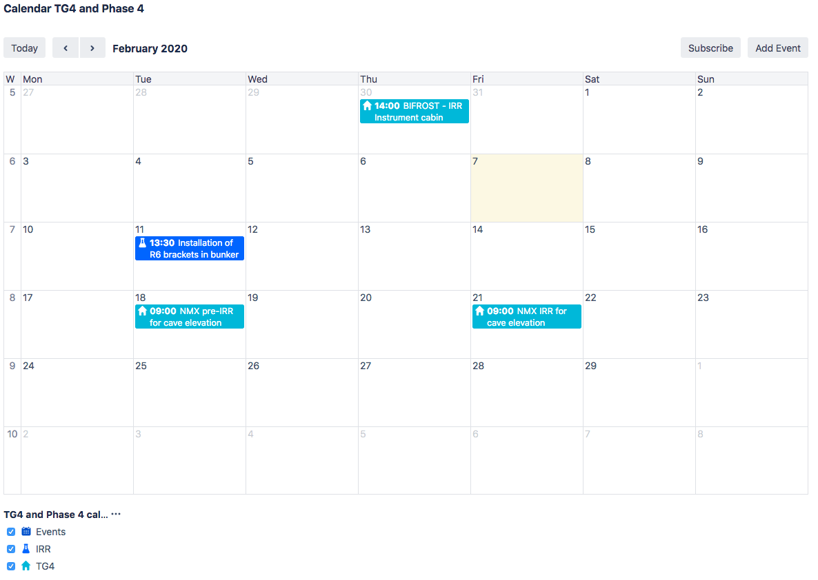
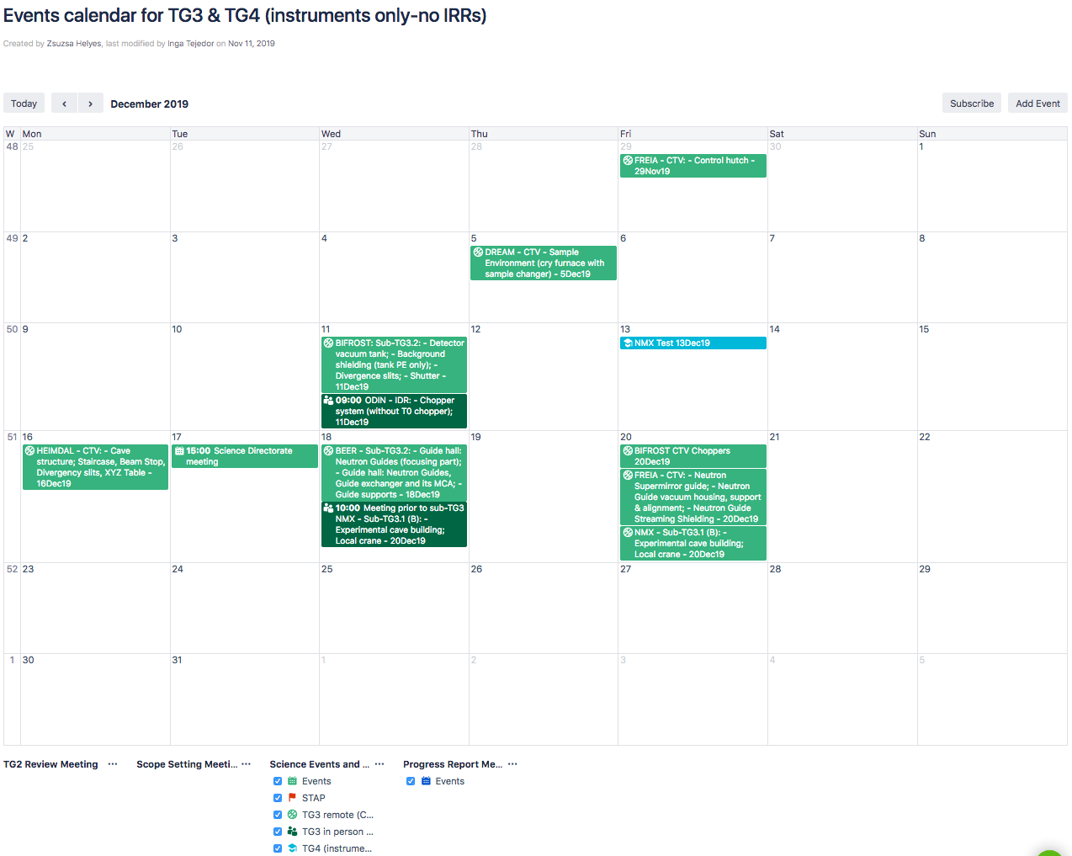
Tollgate Calendars
Which to follow?
TG3s+TG4s
(Events calendar for TG3 & TG4 (instruments only-no IRRs))
TG4s + IRRs
(Calendar TG4 and Phase 4)
TG4s = IRRs related to an instrument
TG3s in-person (IDRs)
VS
IRR = not related to an instrument (infrastructure, racks…)
TG3s remote (CTVs & Sub-TG3s)

Slide 7
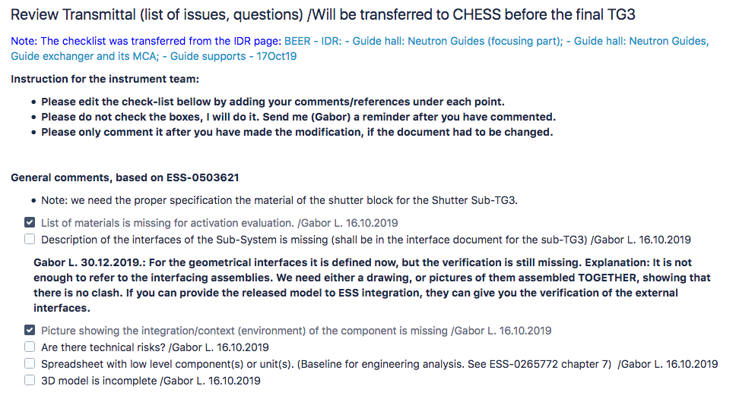
Status of a TG3 Review (1/2)
How to check the progress of a CTV/IDR/sub-TG3
  There are 3 main ways to find out:
  In the confluence page prepared for that specific tollgate. There you can see Gabor’s check list, that is filled during the review process.
    Final approval: for CTV’s or sub-TG3s only
    Review Transmittal for IDRs: reviewer’s comments compiled and copied in the sub-TG3 page for completion
ESS-0503621 - Phase 2 Check list
This is the check list that the ESS lead engineer uses to evaluate the work. DON’T MISS IT!

Slide 8

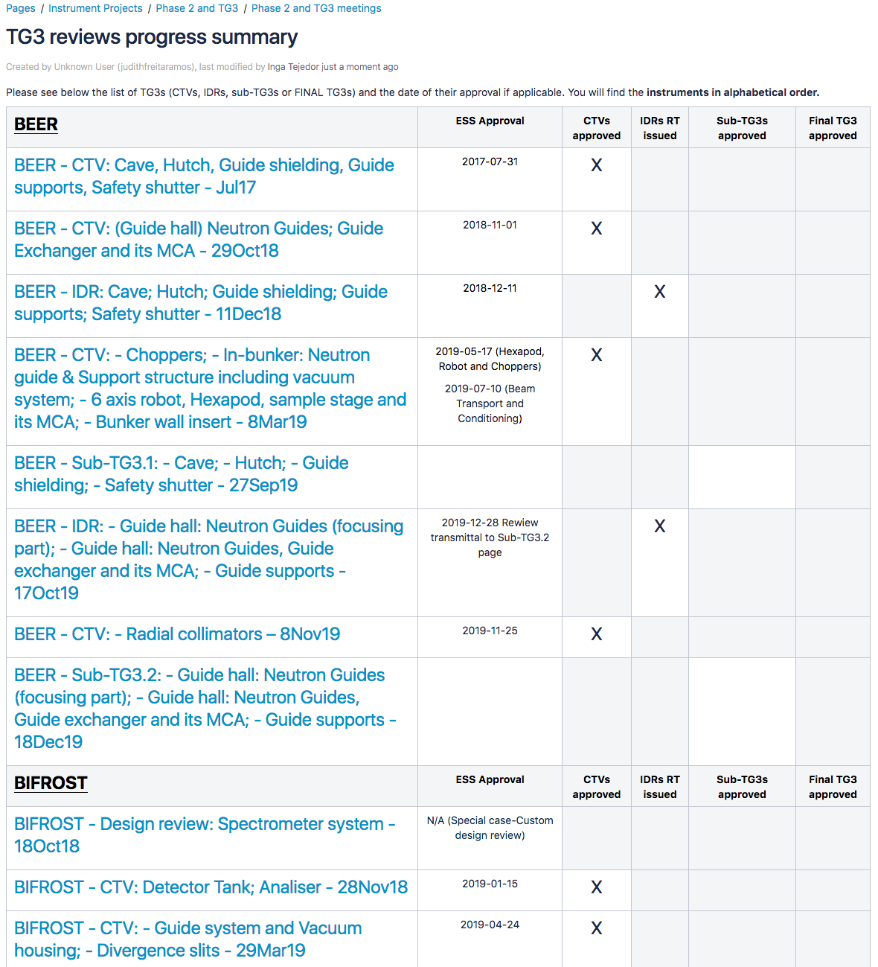
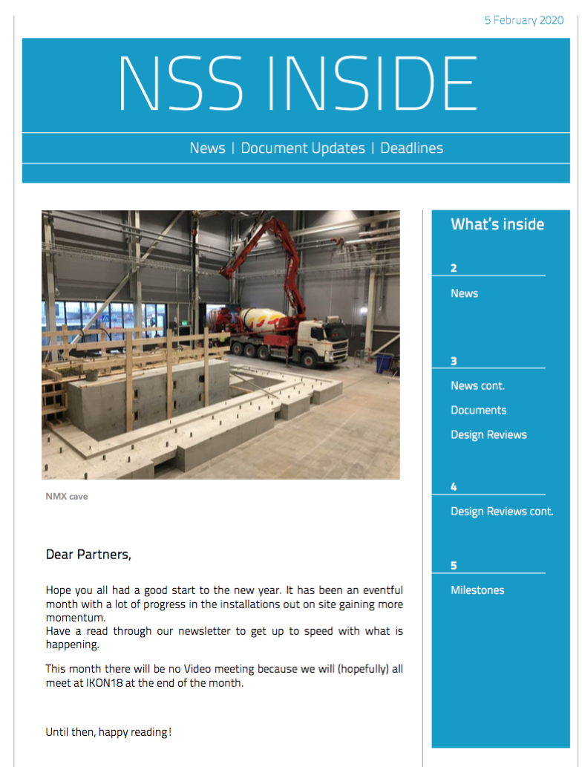
Status of a TG3 Review (2/2)
How to check the progress of a CTV/IDR/sub-TG3
In the TG3 reviews progress summary page
In the Newsletter
  CTVs:
      received to be approved
      approved
  IDRs
  Sub-TG3s:
      received
      approved
NOTE: NBOA reviews and progress in NBOA Instrument front page

Slide 9
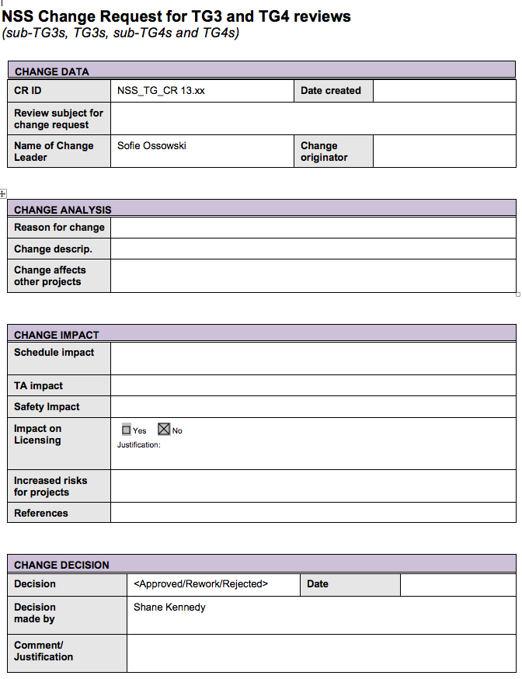
Tollgate Change Request
To keep track of significant changes to TA’s established dates
What: document that formally explains the need of a change in a Tollgate date. ONE PAGE ONLY!
Why: to formalize a significant change in a date that was originally agreed in a Technical Annex.
When: the tollgate coordinator will inform the instrument team when the Change Request is needed → COMMON SENSE APPLIES!
NOTE: It will be mandatory to mention in the ”Change Impact” field whether the change request is going to affect the planned dates of the FINAL TG3, TG4 or TG5.

Slide 10

Tollgate summer plans
Mid-June → mid-August
With the current schedule we have planned 9 Sub-TG3s, 6 IDRs and 2 CTVs → high pressure on the reviewers involved in several of them
Schedule changes for this period are accepted only until Easter, when we will freeze the possibility of adding more reviews. It will be possible to cancel or delay
Summer vacation plans affected by the schedule. If you foresee that a planned review will NOT take place in the summer, please let us know!
Discussions will be held during March with the affected instruments to confirm their plans.

Slide 11
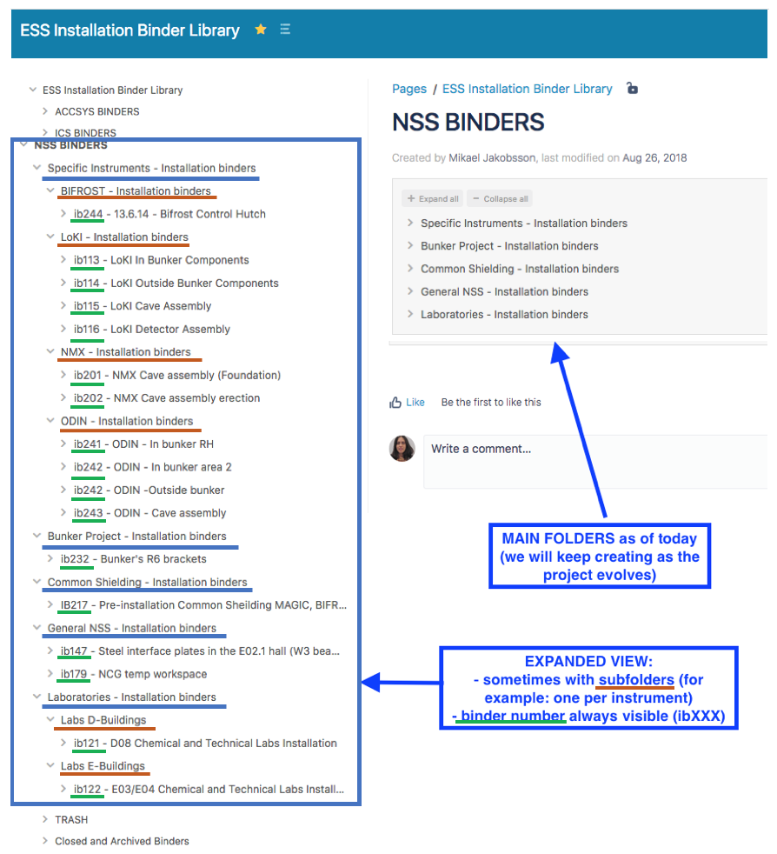
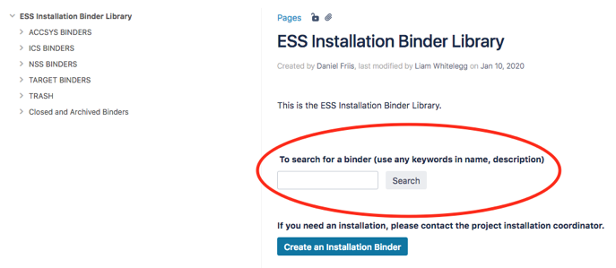
Installation Binders
Structure and support
Common structure for all ESS binders
Easy to create
NSS binders’ structure → if you need assistance on where to place your binder, please contact me (inga.tejedor@ess.eu, +46 72 179 21 87)
Notes:
The creation of an installation binder is quite straight-forward and all binders follow the same internal structure – common throughout the whole ESS

Slide 12
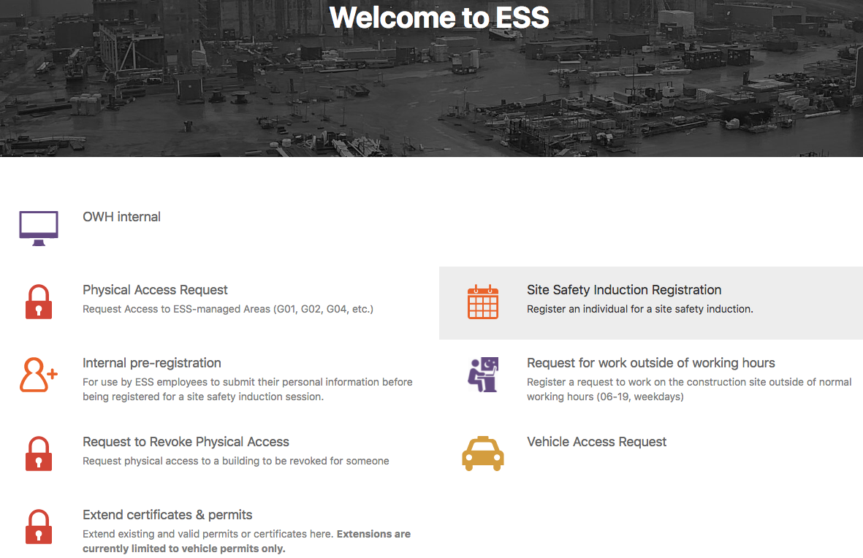
Installation - administrative support (1/2)
Prior installation mostly
Until administrative support for installation activities is centralized, the NSS installation team offers help for the IPLs to solve the several administrative tasks.
The main contact person to help with these issues is the area coordinator (Dirk Offermans – E01, E02; Monika Hartl – E03, E04), but I can also offer support if needed: inga.tejedor@ess.eu, +46 72 179 21 87
Examples of tasks:
  How to get ESS Access Cards
  How to register to Skanska’s safety induction

Slide 13
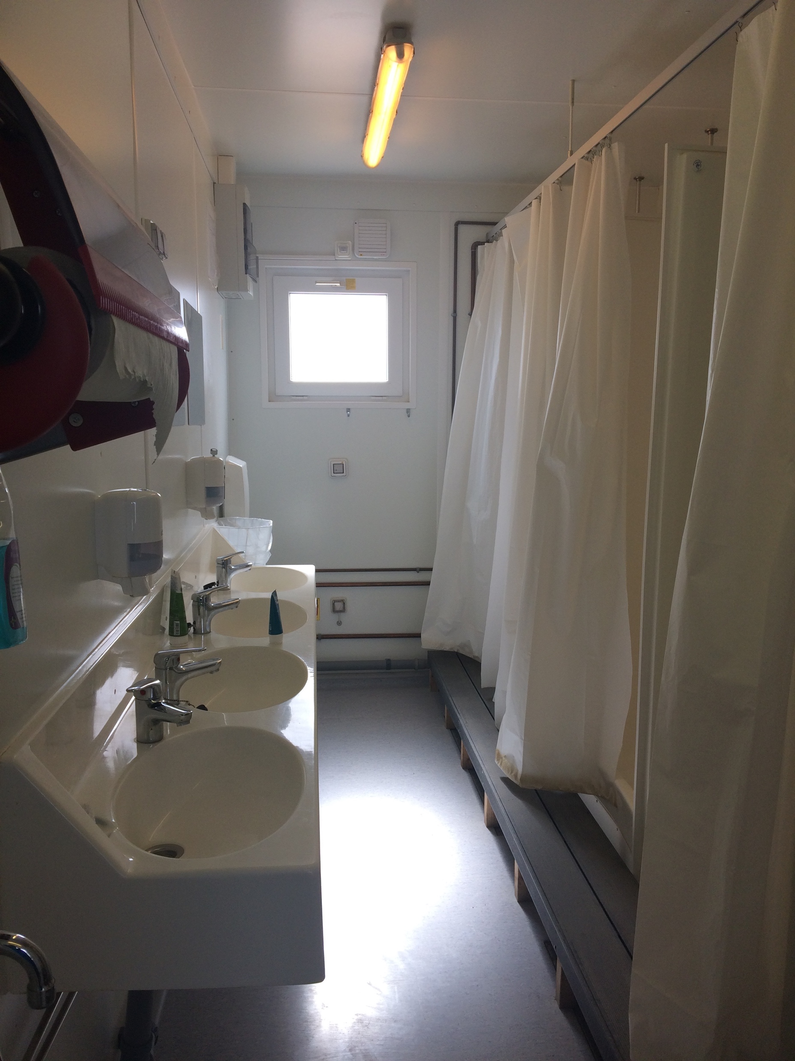
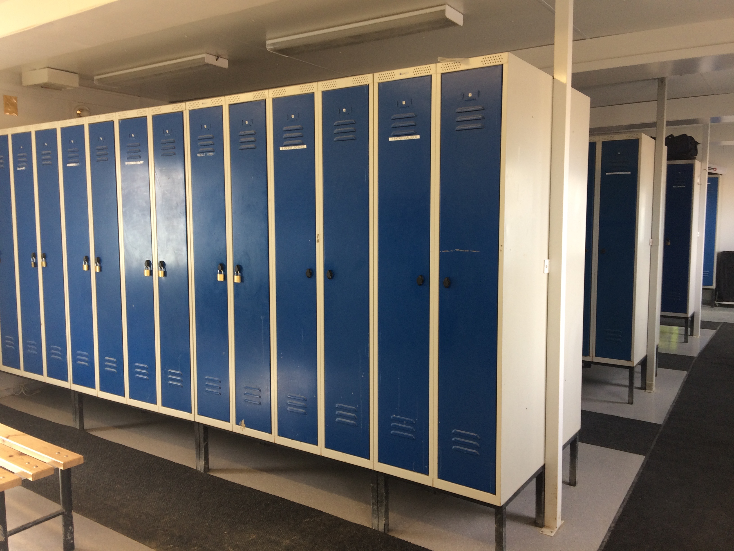
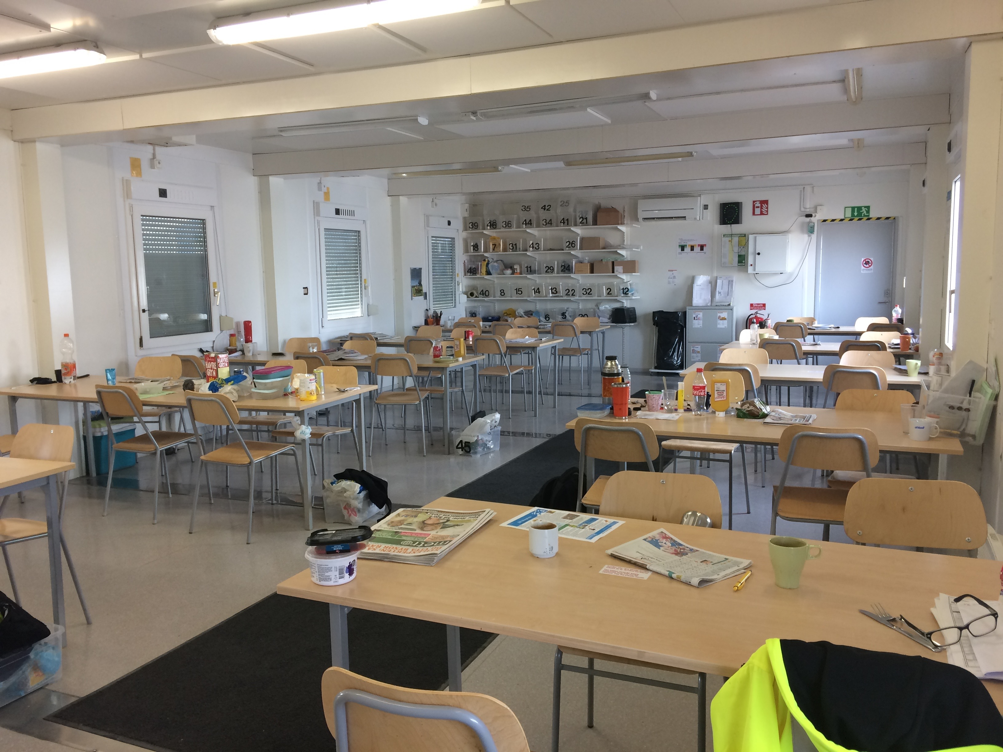
Installation - administrative support (2/2)
Prior installation mostly
  How to get a place in a worker cabin
  How to find the right person at ESS that can answer your questions (PPE, safety trainings, etc.). CONTACTS ARE ESSENTIAL!

Slide 14
Questions?

