Slide 1
Update on mechanical interfaces for sample environment
Optional subtitle
PRESENTED BY Malcolm Guthrie

Slide 2
Agenda
1 Introduction: Résumé of mount standard and terminology
2 “Floor” mount – status update
3 “Flange” mount – status update
Additional considerations: Magnetic requirements
Additional considerations: “Level-S”

Slide 3
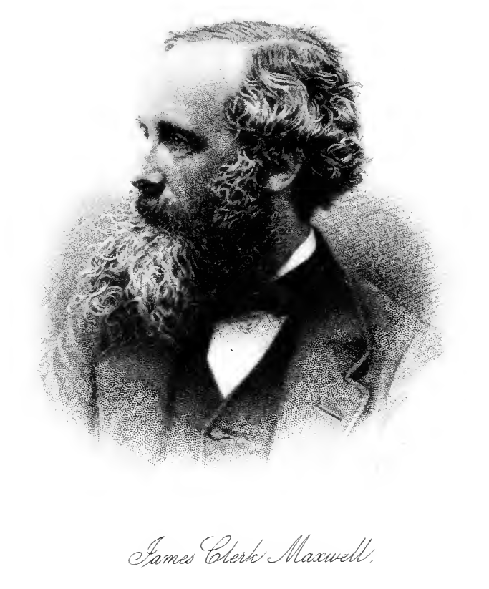
Principles of SE equipment interface
Overarching goal is enabling rapid, accurate installation of sample environment equipment.
Key elements:
  Shared coordinate system
  Based on principles of kinematic constraint
  Separate standard for floor mounted and flange mounted instruments
  Quantised mounting levels (L0,L1,L2 etc)
  Interface comprises an “instrument” part and an “equipment” part
ESS-0038078 (last release Dec 2019)

Slide 4
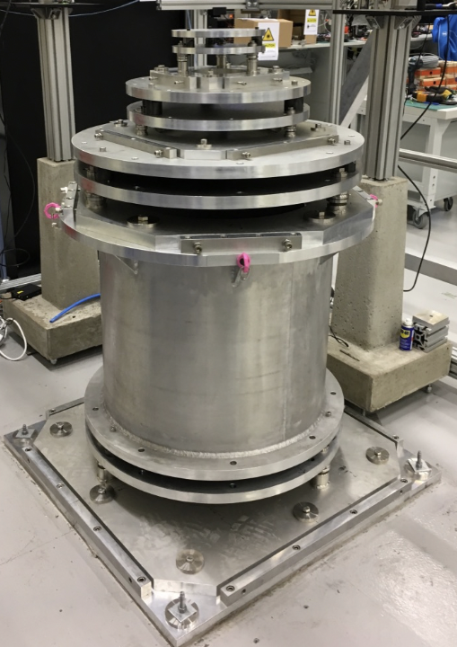
Floor mount interface - Overview
  Mass of equipment rests on the ground
  Most common interface: 73% of initial suite (15)
  4* quantised mounting levels
  Prototype in Utgård Lab (ca Jan 2019)
Level | Distance to beam (mm) | Weight max. (kg) | Interface dim. (mm)* | Positioning tolerance at sample position (mm)
0 | 1300 | 2000* | Ø 800 | ±2.500 (TBC)
1 | 500 | 1000* | Ø 800 | ±0.02 (act.)
2 | 350 | 300 | Ø 500 | ±0.02 (act.)
3 | 200 | 10 | Ø 250 | ±0.01 (TBC)
* Planned 5th SANS-specific level “Level-S” (see later)

Slide 5
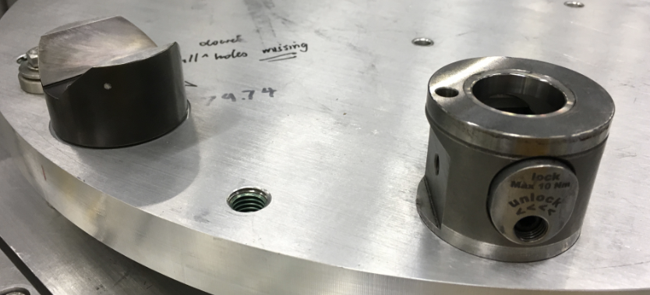
Floor mount interface - Update
Process
Timeline:
Sept 2019:
  Stakeholders notified
  Established Confluence space*
  Expt. set-up to test hardware
Nov 2019
  Conducted hardware tests with SAMS
  CDR
Dec 2019
  Design work to implement final design (A. Glavic)
Jan 2020
  Final design released in CHESS (ESS-1797666.2)
Q4/2019 underwent process to finalise L1 & L2
  Freeze dimensions of standard
  Freeze hardware
Instrument components: Baltec (left) and Kipp (right)
* https://confluence.esss.lu.se/display/SA/Process+to+Finalise+design%3A+floor-mount+interface+for+sample+environment+equipment

Slide 6
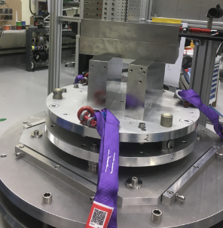
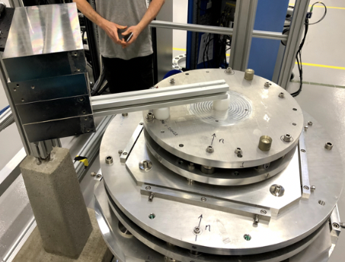
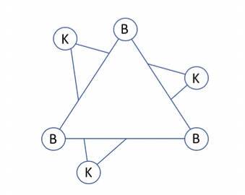
Floor mount interface - Update
Hardware tests
  Comparison of Kipp and Baltec components.
  Tested with L2 of Utgård prototype
  Single flange with both interfaces (30° separated)
  Tested: Repeated installation; “sloppy” installation; different loading scenarios
Axial loading (left) and off-centre loading (right). Data from 3 tracking points used to determine position
  Both systems demonstrated good repeatability of <0.010 mm (even with sloppy installation)
Test (mass) | Kipp (mm) | Baltec (mm)
unloaded | 0.010 | 0.010
axial load (80 kg) | 0.016 | 0.050
off centre (20 kg) | 0.02-0.08 | 0.02-0.03
off centre (80 kg) | 0.2 | 0.2

Slide 7
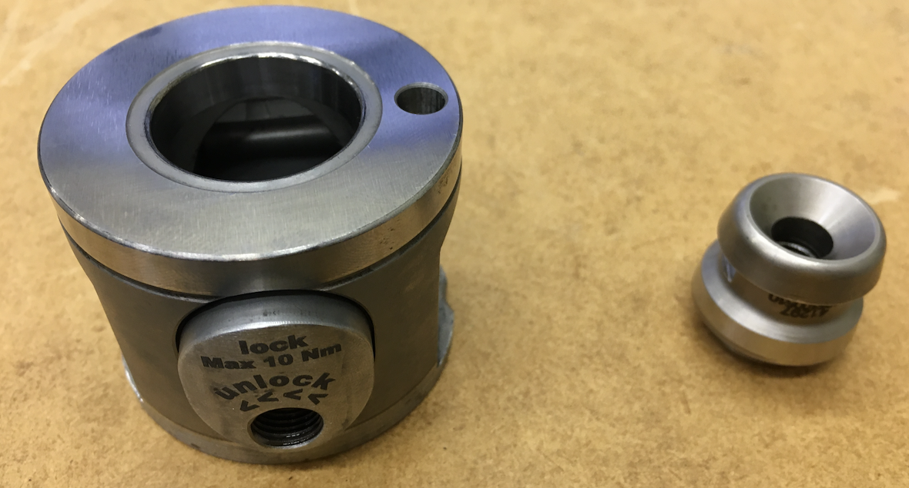
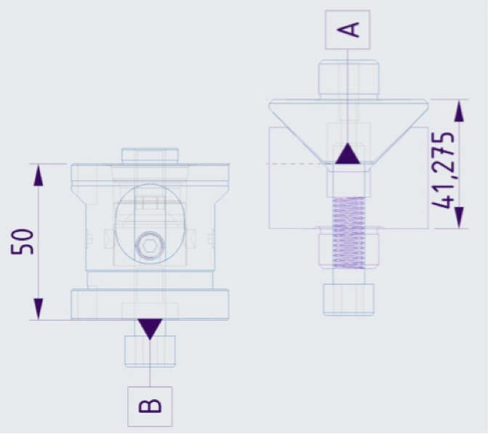
Floor mount interface - Update
Finalised design
  L1 and L2 mounting definitions are finalised (mass and location)
  Kipp hardware will be interface standard (L0,L1 & L2)
  Reference location is upper contact surface of instrument part
  Kipp component is 8.7 mm taller than baltec
Kipp components: instrument part (left) equipment part (right). Each interface consists of three pairs
15.0
  L3 interface definitions unchanged. Hardware still not finalised (prototype from Baltec)
  Ongoing: magnetic considerations (see later)
REF
Approx costs: €1250 (set of three) instrument; €93 (set of three) equip*
(* off the shelf components)
29,23

Slide 8
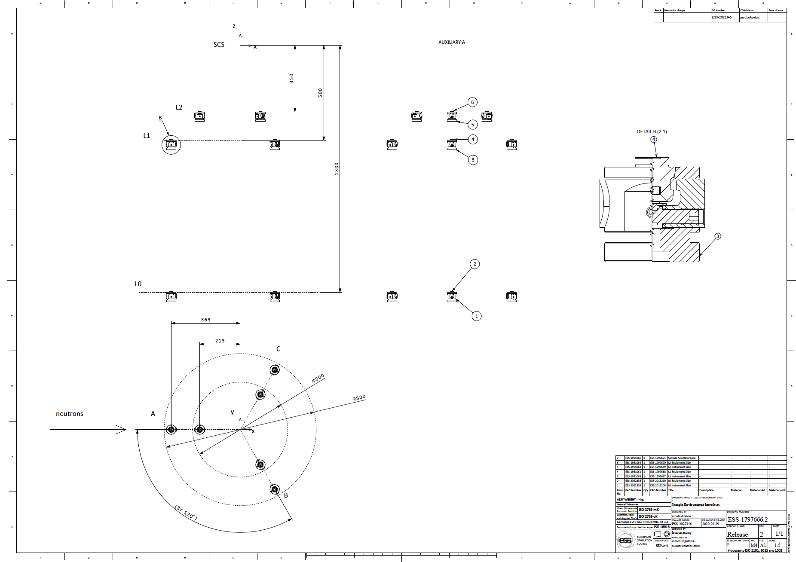
Floor mount interface - Update
Finalised design
ESS-1797666.2

Slide 9
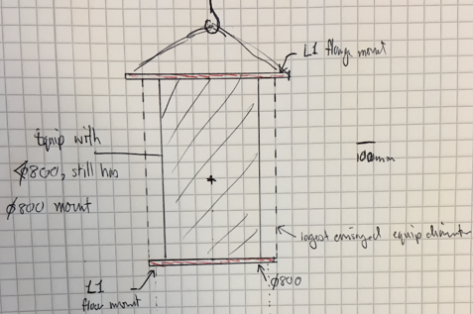
Flange mount interface - Overview
  Mass of equipment hangs from above (usually tank)
  Less common interface: 33% of initial suite (15)
  3 quantised mounting levels
Level | Distance to beam (mm) | Weight max. (kg) | Interface opening. (mm) | Positioning tolerance at sample position (mm)
1 | 600 | 1000* | Ø 805 | ±1-2 (TBC)
2 | 600 | 300 | Ø 505 | ±0.25 (TBC)
3 | 600 | 5 | Ø 255 | ±0.01 (TBC)
  Possible for equipment to simultaneously have both floor and flange mounts!
  Floor equip interface sits within diameter of 740 mm (L1), 450mm (L2)

Slide 10
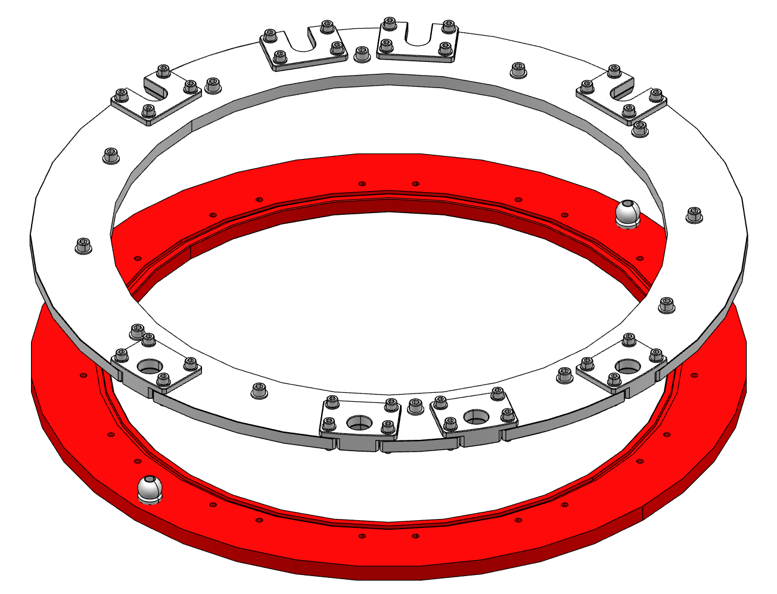
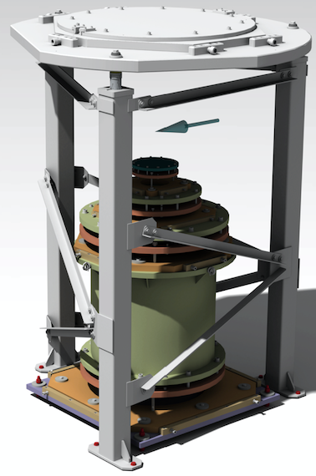
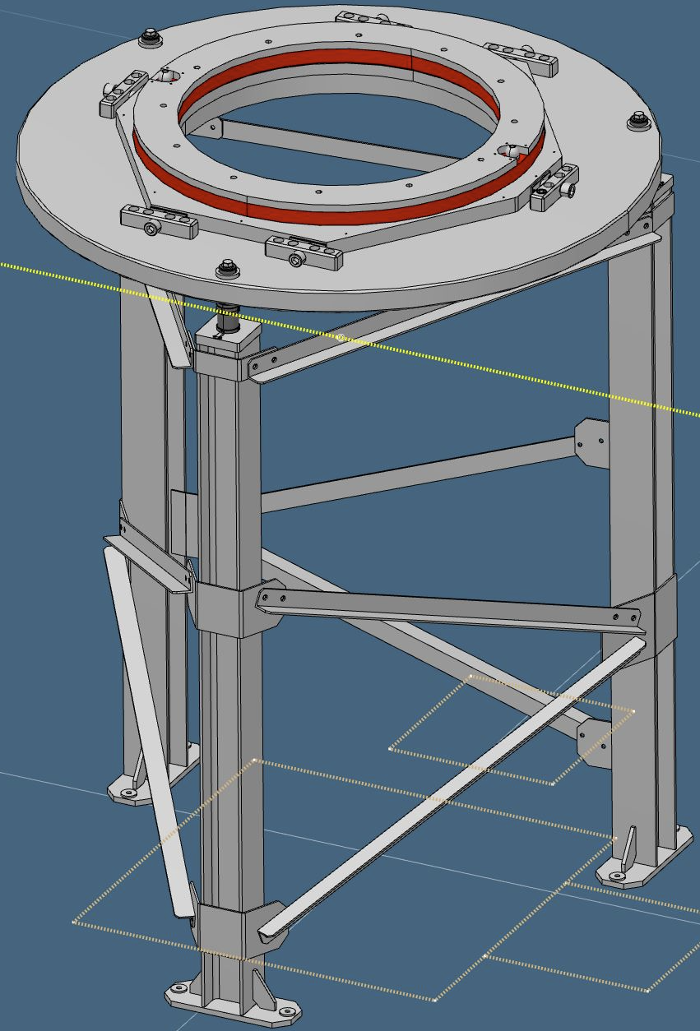
Flange mount interface - Update
Current Status
2017
  L1 Interface design complete Q4 2017
  Utgård Prototype design completed Q1 2019
  Redesign Q3-Q4 2019
  Drawings being finalised Q1 2020
  Procurement expected during Q2 2020
  Install (in E03) Q3 2020
2020
2019
  L2 preliminary design Q4/2019 (P. Luna)
L2 preliminary design Q4/2019 (P. Luna)

Slide 11
Magnetic issues - Kipp
How to define magnetic requirements?
  Stock Kipp components are hardened steel (magnetic)
  Problem for to HF magnets and He³ analysers
  Discussion with Kipp Q3 2019
  Agreement to develop NM variant based on order of 10 sets (5 instruments)
  Kipp began testing alternatives Q1 2020
  Need to define magnetic requirements...
  Preliminary consultation with CSPEC, BIFROST and MAGIC
  Please let me know what instruments are stakeholders!
Initial info from instruments:
Instrument | Max rel. μ | Notes
CSPEC | 1.01 | Distance dependence?
BIFROST | 1.1 | Distance dependence?
MAGIC | Equiv to BIFROST OK
Materials under consideration:
Material | comments | Rel. μ | Hardness* | Activation
316/L steel | Machining/heat treatment can induce magnetism. As can stray field from magnet | 1.01-1.06 | 80 HRB | 16-18% Cr
Ti |  | 1.00005 | 36 HRC | None
Al |  | 1.000022 | 60 HRB | None
Inconel 718 |  | 1.0011 | 30-40 HRC | 17-21% Cr;<1% Co

Slide 12
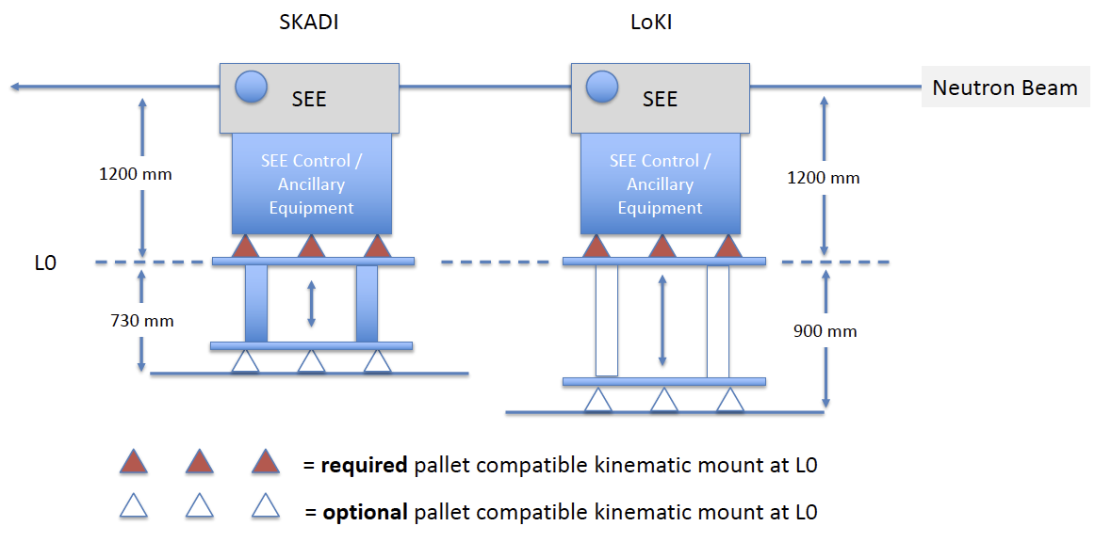
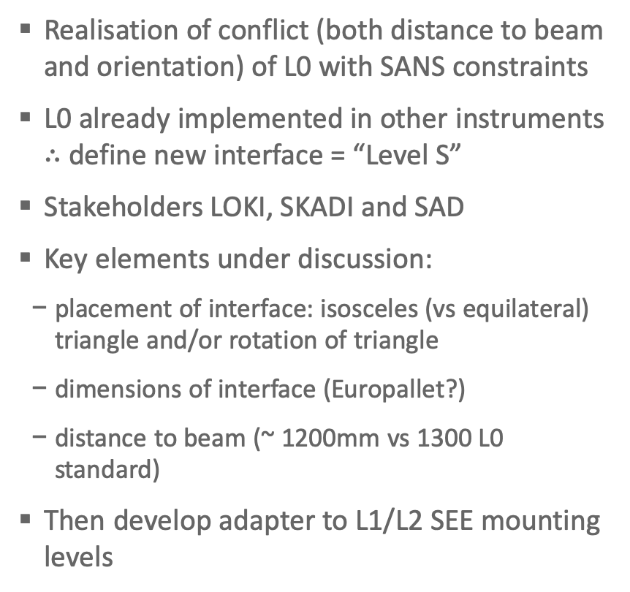
Level-S
SANS-specific interface
  Realisation of conflict (both distance to beam and orientation) of L0 with SANS constraints
  L0 already implemented in other instruments $∴$ define new interface = “Level S”
  Stakeholders LOKI, SKADI and SAD
  Key elements under discussion:
    placement of interface: isosceles (vs equilateral) triangle and/or rotation of triangle
    dimensions of interface (Europallet?)
    distance to beam (~ 1200mm vs 1300 L0 standard)
  Then develop adapter to L1/L2 SEE mounting levels
Level - “S”
Level - “S”
Level - “S”
(courtesy A. Jackson)

Slide 13
Finish presentation

