Slide 1
Updates on the beam monitor common project
Kalliopi Kanaki
Steven Alcock, Ioannis Apostolidis, Vendula Maulerová
IKON18, 25 February 2020

Slide 2
Overview of beam monitor session
Status of common project (Kalliopi Kanaki, ESS)
Status of V-monitor (Vendula Maulerova, ESS)
Mechanical interfaces and integration (Ioannis Apostolidis, ESS)
DMSC interfaces (Jonas Nilsson, ESS)
Beam monitors at ILL (Fabien Lafont, ILL/ESS)
NitroGEM beam monitor updates (Davide Raspino, ISIS)

Slide 3
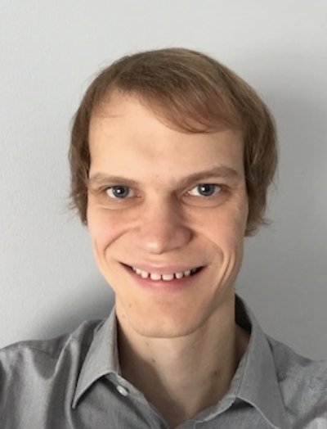
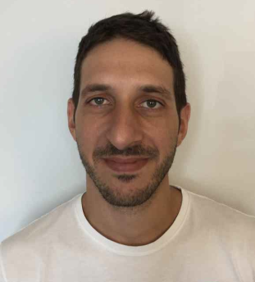
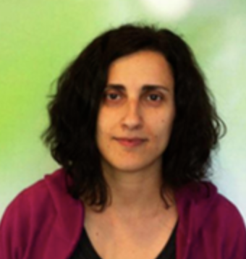
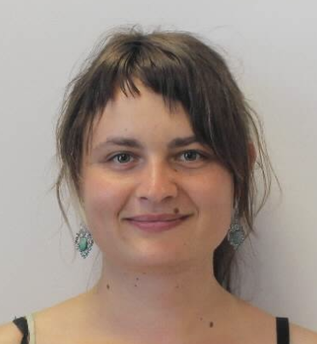
Purpose of the project
Ensure provision of monitors to enable science case of instruments and in particular early science success
Allow efficient commissioning and long term facility monitoring
Design, procurement, installation and cold commissioning of ~55 beam monitors for the ESS instruments from a few kW to 2 MW
People involved:
Steven Alcock – electronics engineer (15%-20%)
Ioannis Apostolidis – mechanical engineer (50%)
Kalliopi Kanaki – neutron scientist (50%)
Vendula Maulerová – workshop assistant (50%)
Related documents:
https://confluence.esss.lu.se/display/DG/Beam+monitors+common+project
Beam Monitors Common Project description (ESS-0502620)
Neutron Beam Monitor Use Cases for commissioning and operation of neutron instruments and processing of neutron data (ESS-0419542)
Anders left in Dec 2019.

Slide 4
Participation status
# | Instrument / BM partner | Spatial envelope status | Status of McStas/Vitess model | Indicative participation status
1 | ESTIA / PSI | Reservations in CAD | Up-to-date | Interested in utilities and services (V-monitor)
2 | ODIN / PSI | Reservations in CAD | Up-to-date | YES
3 | DREAM / FZJ | Reservations in CAD | Up-to-date | NO (CDT monitors)
4 | BEER / HZG | Reservations in CAD | Up-to-date | YES (in-bunker BMs), MWPC by HZG (pre-sample)
5 | CSPEC / TUM | Reservations in CAD | Up-to-date | Under consideration
6 | BIFROST / LLB | Reservations in CAD | Up-to-date | YES
7 | MAGIC / FZJ | Reservations in CAD | Update on the way | Undecided at the moment
8 | LoKI / ISIS | Reservations in CAD | Up-to-date | NO (NitroGEM monitors from ISIS)
9 | SKADI / JCNS | Reservations in CAD | Up-to-date | YES
10 | VESPA / CNR, ISIS | Reservations in CAD | Up-to-date | NO (B-GEM monitors from University of Milano-Bicocca)
11 | NMX / ESS | Reservations in CAD | Up-to-date | YES
12 | MIRACLES / ESS Bilbao | Reservations in CAD | Up-to-date | YES
13 | T-REX / CNR | Contact initiated | 2018-09-17 | Discussion ongoing
14 | HEIMDAL / AU | Reservations in CAD | Up-to-date | Undecided at the moment
15 | FREIA / ISIS | Reservations in CAD | Up-to-date | YES?

Slide 5
Beam monitors per location and function
Location | BM | Desired functionality
Bunker | Fission chamber (flux ✕ eff ≤ 10¹² n/cm²/s) | •Flux •Timing •Discrimination of thermal n vs. fast n vs. γ
 | Ionisation chamber (flux ✕ eff ≤ 10¹² n/cm²/s)
 | GEM (flux ✕ eff ≤ 10⁸ n/cm²/s)
Guides/choppers | Quasi-parasitic V-monitor (10⁹ n/cm²/s) | •Flux •Timing (to be investigated further for V-monitor)
 | GEM (flux ✕ eff ≤ 10⁸ n/cm²/s)
Pre- and post-sample | MWPC (flux ✕ eff ≤ 10⁵ n/cm²/s) GEM (flux ✕ eff ≤ 10⁸ n/cm²/s) | •Flux •Timing

Slide 6
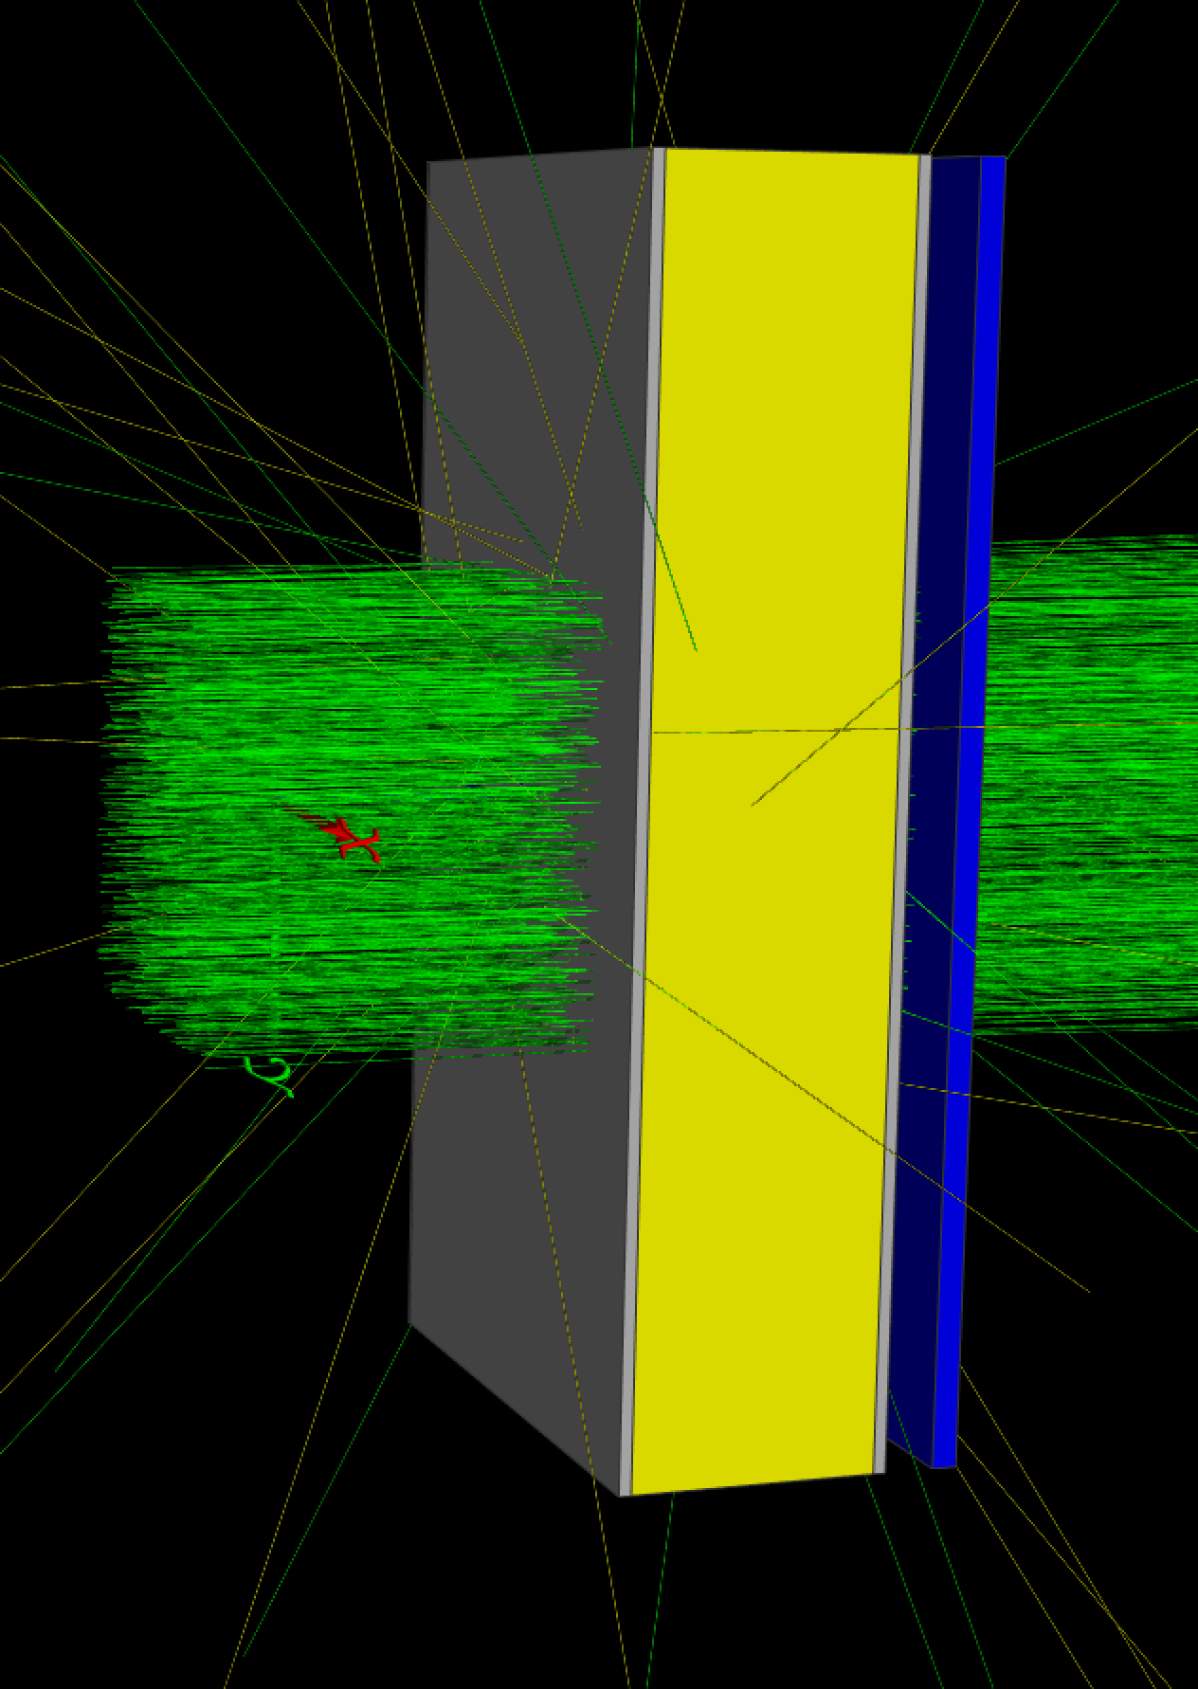
Meeting the flux challenge
Optimisation parameters for standard BMs
Choice of converter (¹⁰B₄C, ²³⁵UO₂, N₂, ³He)
Solid converter thickness
Enrichment
Gaseous converter partial pressure
Active gas depth
Optimisation parameters for V-monitor
Foil size
Foil thickness
Active detector area
Detector distance from foil
Green: neutrons
Gray: BM windows
Yellow: gas
Blue: collector volume for analysis

Slide 7
B₄C conversion efficiency
¹⁰B₄C (99% enriched)
Efficiency is primarily defined by:
Enrichment
Coating thickness
^{nat}B₄C
¹⁰B₄C (99% enriched)
^{nat}B₄C

Slide 8
UO₂ conversion efficiency
Solid line: ²³⁵UO₂ (93% enriched)
Dotted line: ± 30% effective thickness variation

Slide 9
UO₂ conversion efficiency
Solid line: ²³⁵UO₂ (93% enriched)
Dotted line: ± 30% effective thickness variation
Dashed line: ^{nat}UO₂

Slide 10
³He conversion efficiency
BM (gas) thickness = 1.3 cm

Slide 11
³He conversion efficiency
thickness = 1.3 cm
BM (gas) thickness = 1.3 cm
Dotted line: 1.0 cm < thickness < 1.6 cm

Slide 12
N₂ conversion efficiency
BM (gas) thickness = 1.3 cm

Slide 13
N₂ conversion efficiency
BM (gas) thickness = 1.3 cm
Dotted line: 1.0 cm < thickness < 1.6 cm

Slide 14
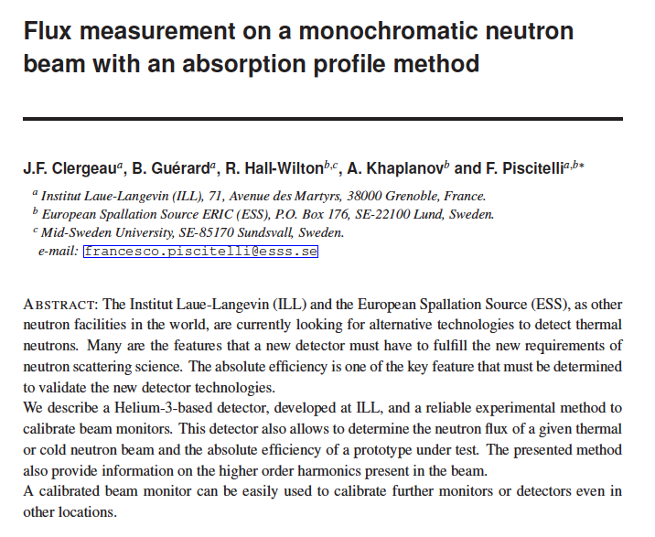
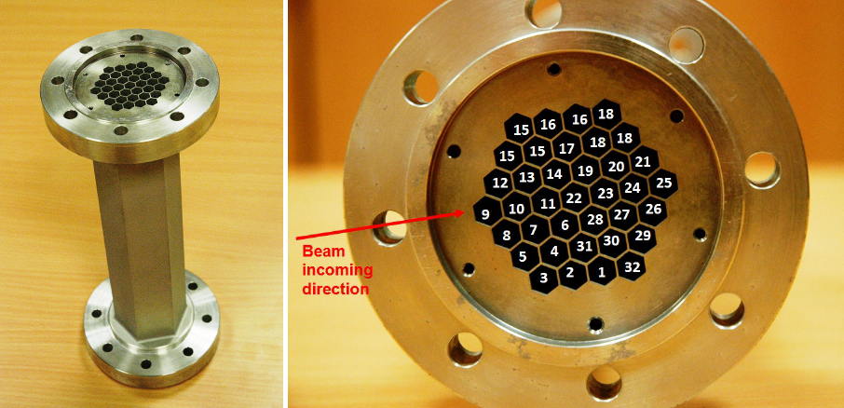
BM efficiency calibration
Honeycomb (hexacomb) detector
Allows absolute flux determination of ~ 1%!
Used for MultiGrid and MultiBlade efficiency characterisation
Draft from 2011!
30 cm

Slide 15
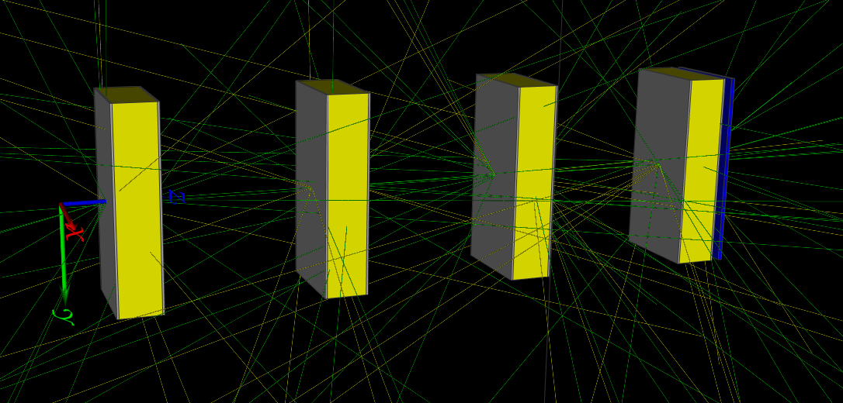
Impact of multiple BM windows
BM placed at 10 cm distance
from each other
NO converters or gas
Only windows and/or GEM foil
Monochromatic beam
neutrons

Slide 16
Impact of multiple BM windows
transmission
scattering
δθ > 0.1⚬
Need a definition for scattering that serves instrument purposes.

Slide 17
Transmission of single BM monitor
2% loss at 4 Å per 2 mm of Al
Transmission > 99% at 10 Å for thin foil BM windows (100 μm) in air placement (1 atm inner pressure)

Slide 18
Transmission studies with FREIA model
Transmission when all windows – guide (1 mm) & BM (1 mm) – are enabled.
PRELIMINARY!!!
Windows OFF
Windows ON

Slide 19
Transmission studies with FREIA model
Transmission when all windows – guide (1 mm) & BM (100 μm) – are enabled.
PRELIMINARY!!!
Windows OFF
Windows ON

Slide 20
Setup with official ESS DAQ readout
BM
Preamp
Shaping amplifier
Back-end electronics
ADC+FPGA
EFU
Event Formation Unit
Kafka
aggregator
Event-mode data
Timestamping
Pulse height spectra
Grafana live visualisation
Possibility for flux and time resolution analysis
FileWriter
(hdf5)
Timing from ICS
V. Maulerová et al., EPL 128 (2020) 52001

Slide 21
Setup with ESS DAQ readout
V20 setup
BM
Preamp
Shaping amplifier
Back-end electronics
ADC+FPGA
EFU
Event Formation Unit
Kafka
aggregator
Event-mode data
Timestamping
Pulse height spectra
Grafana live visualisation
Possibility for flux and time resolution analysis
FileWriter
(hdf5)
Timing from ICS
V. Maulerová et al., EPL 128 (2020) 52001

Slide 22
BM data acquisition in Utgård (DG, ICS, ECDC)
8 channels in 2 ADC boxes
EPICS control for HV power supply and back-end readout
Event Formation Unit (EFU)/Kafka
Grafana for EFU/BM monitoring
File writer
Software ADC scope for pulse monitoring
Tests with cosmics on-going

Slide 23
Next steps
Close out phase 1 (after IKON18)
Write Critical Design Report (March-April)
Distribute monitor technologies in each reserved location
Document summary of activities so far
Complete detailed engineering design
Initial focus on: ODIN, BIFROST, NMX, ESTIA
Write offer documents for common project participants
Write publications
Experimental tests planned (Dubna, J-PARC)

Slide 24
Check-list for the non-participants of common project
Post TG5 the BMs are delivered to ESS for operation and maintenance.
Use cases satisfaction
Documentation of BM requirements and specs (peak and average flux, timing where relevant, stability, time resolution, attenuation, scattering etc.)
Describe method for absolute flux derivation
Describe BM calibration methods before installation and regularly during operations (efficiency and TOF)
Maintain up-to-date McStas model wrt to engineering model
Shielding and insulation (radiation, electrical, mechanical)
Mechanical & electrical integration (grounding, cable routes, in-vacuum specifics, remote handling modules, etc.)
Clear definition of interfaces between instrument and DG/ICS/DMSC
Front-end electronics
Back-end electronics readout, ICS and DMSC integration (time-stamping and Mantid integration)
EPICS controls, adoption of ESS operation modes, logging parameters
Rack scheme, server characteristics
Software installation
Cost estimate (hardware, labour)
Schedule match
Spares strategy and 10-year maintenance plan

Slide 25
Backup slides

Slide 26
TOF and λ calibration
Steel cross sections and scattering angles (α-Fe)
4.03 Å
2.3 Å
2.8 Å

Slide 27
TOF and λ calibration

