Slide 1
A new neutron monitor for high flux neutron beams
F. Lafont
J-C. Buffet, S. Cuccaro, B. Guerard, R. Hall-Wilton, K. Kanaki

Slide 2
ESS Requirements for next-gen monitors
Stable over time (< 5 % variations)
High Flux
High rate
Minimal material budget and perturbations of the beam
Strong Gamma environment
Absolute flux accuracy

Slide 3
Uranium monitors
Pros
Cons
Best neutron/gamma discrimination
Efficiency specifications not reliable
Good stability over time
Bad uniformity over the active area
Fast signals / high counting rate
High beam perturbations / attenuation
Low voltage operation
One major supplier
Long delivery time
After-sales service
Radioactive sources regulations

Slide 4
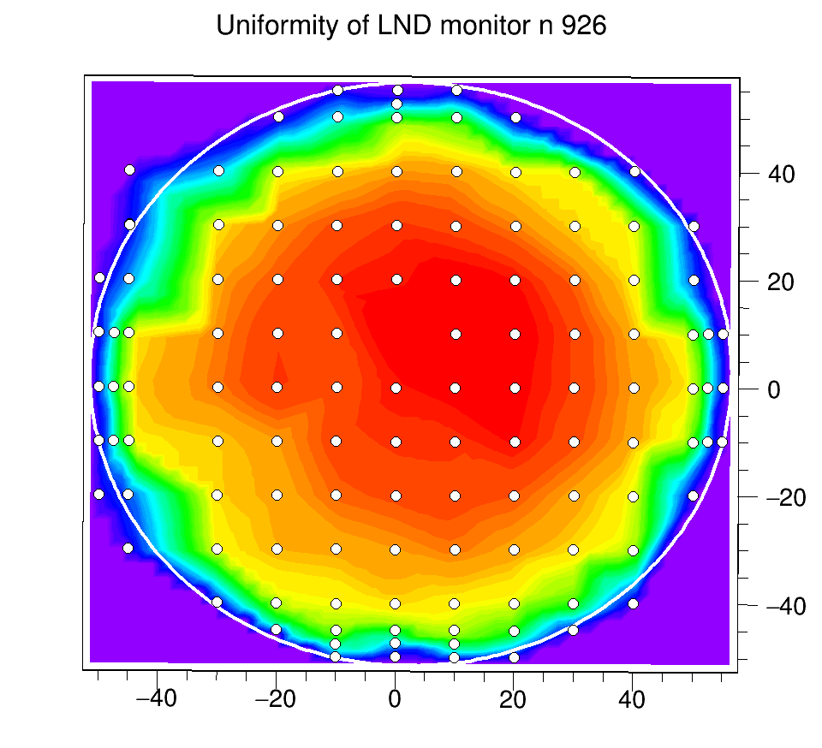
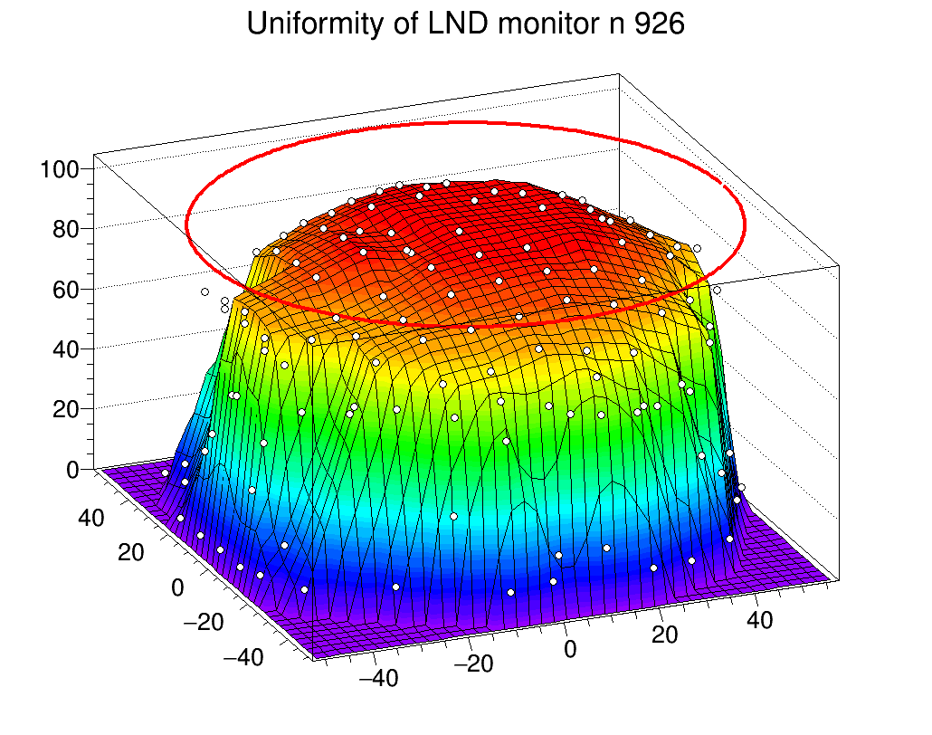
Uranium monitors
Uniformity issues
Measured with a collimated (2.5 mm ×2.5 mm) 2.5 Å- neutron beam
Distance (cm)
Distance (cm)

Slide 5

Uranium monitors
Uniformity issues
Uniformity : up to 20-25 % deviations
  Even worse with a low efficiency one ($3×{10}^{−4})$
Active area : ≈ 100 mm (108 mm in specs.)
Measured transparency : 89 - 96 %
  Average 91% (12 LND monitors tested )

Slide 6
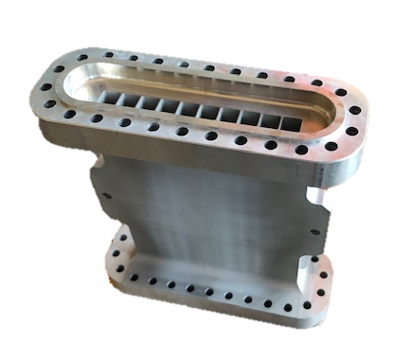
ILL proposal
A multitube gas-filled monitor
Initially designed for SHARP instrument for operation in vacuum
Additional features compared to Uranium monitors
Efficiency can be tuned
Excellent uniformity
Better transparency (0.5 mm windows / 0.4 mm inner walls)

Slide 7
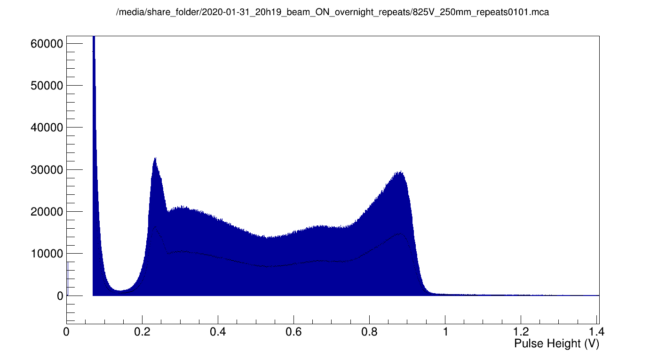
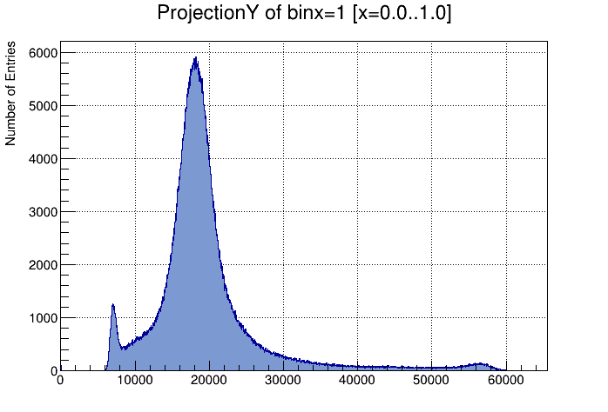
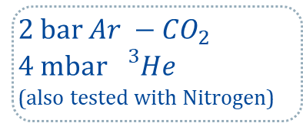
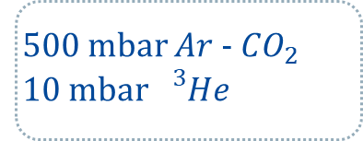
Multitube Monitor
Pulse height spectra
825 V
2 bar $Ar −{CO}_{2}$
4 mbar ${}_{}^{3}{He}$
  (also tested with Nitrogen)
500 mbar $Ar$-${CO}_{2}$
10 mbar ${}_{}^{3}{He}$
Channel

Slide 8
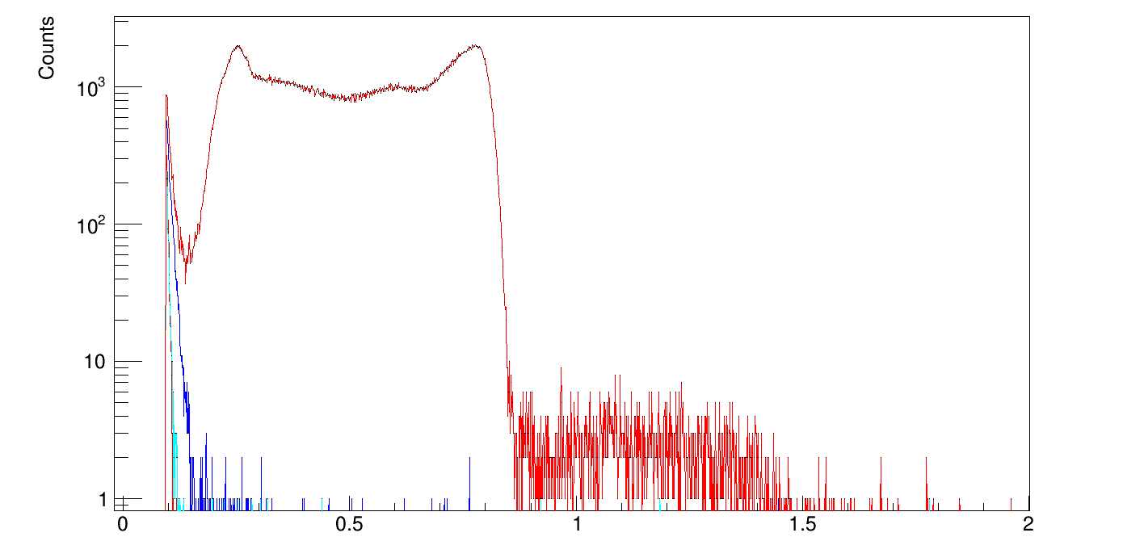
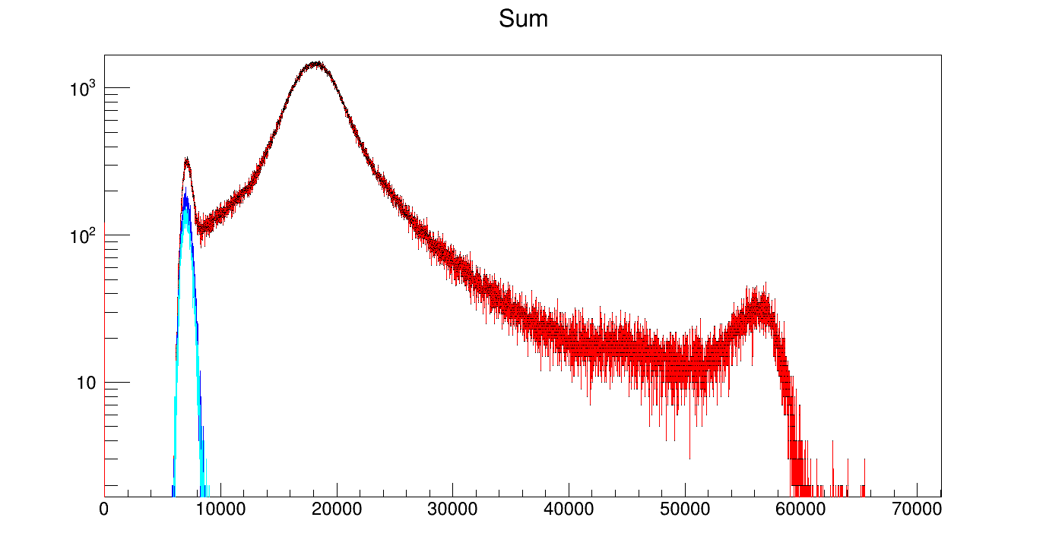
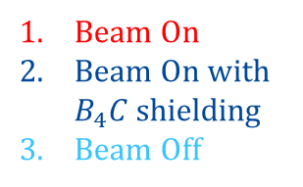
Multitube Monitor
Gamma discrimination
2 bar
500 mbar
Beam On
Beam On with $B_{4}C$ shielding
Beam Off
    Amplitude (V)
    Channel
  Excellent gamma discrimination @ 2 bar
    Even better @ 500 mbar

Slide 9
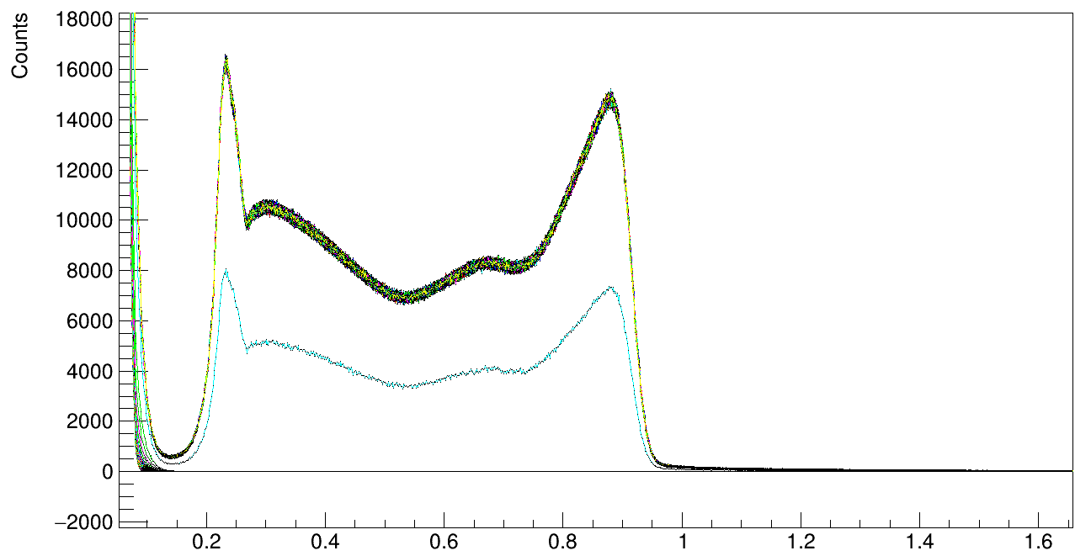

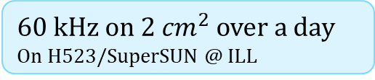
Multitube Monitor
Stability
P.H. Spectra over time
60 kHz on $2 {cm}^{2}$ over a day
On H523/SuperSUN @ ILL
One day of 100s-runs
During Shutdown
Decay
$$inc. flux : {\sim 2×10}^{7} n.{cm}^{−2}.s^{−1}$$
  Good stability – No charging effect
  No shift on PH spectra
Amplitude (V)

Slide 10
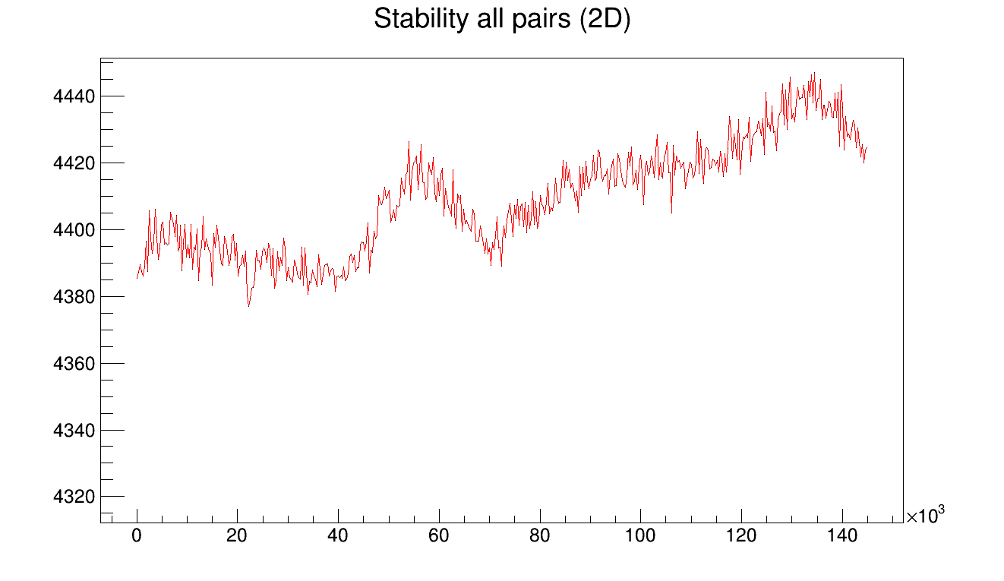
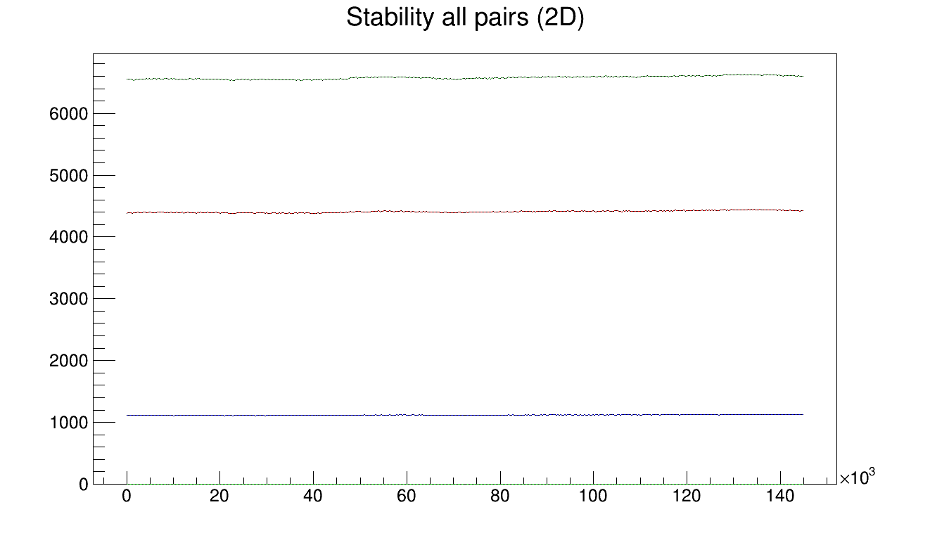
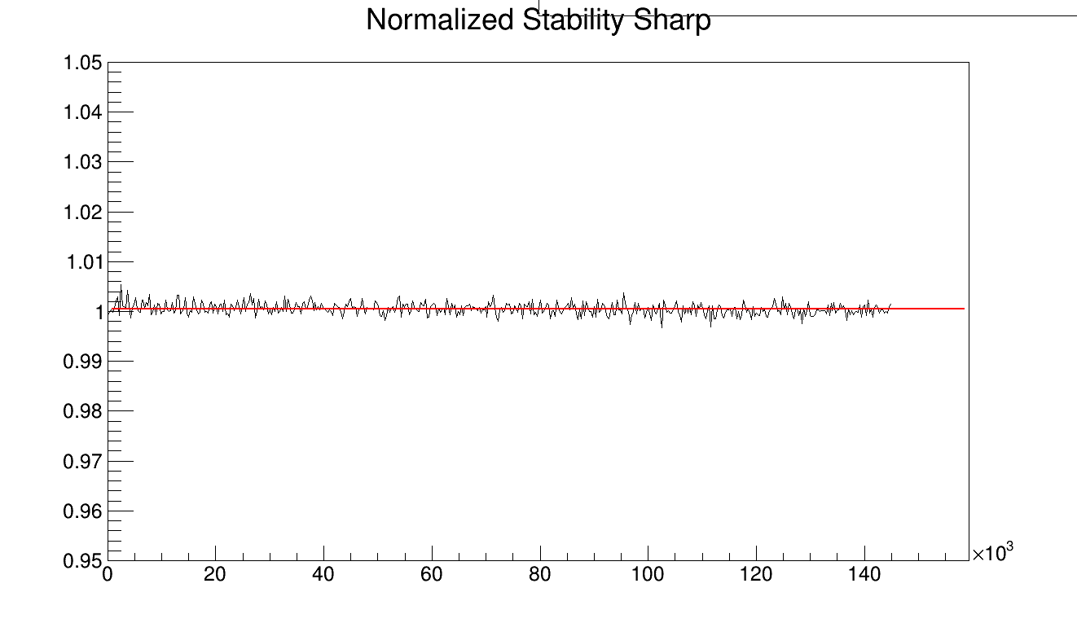
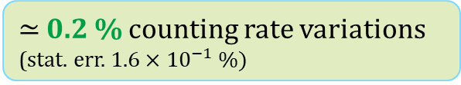
Multitube Monitor
Beam intensity variations
Stability
Rate (cps)
Two day of measurements with 3 monitors
Stability curves
U – monitor 1
Sharp_V1
U – monitor 2
Rate (cps)
Time (s)
Sharp_V1 counts normalized to Uranium monitors
a.u.
Time (s)
  ≃ 0.2 % counting rate variations (stat. err. $1.6×{10}^{−1} \%)$
Time (s)

Slide 11
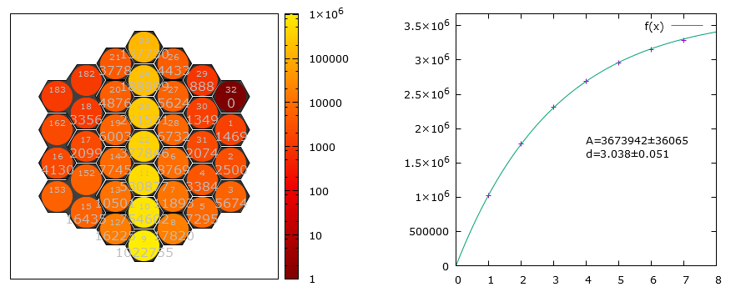
Multitube Monitor
Efficiency and Transparency
  Calibration with Hexacomb detector
    Absolute flux
    Attenuation rate by the monitor (scattered + absorbed)
  Efficiency measured to be as expected (then, used for beam flux measurement on the instrument Panther @ ILL)
  Transparency measurement : $97,6 ±0.3 \%$ (expected 97,8 %)

Slide 12
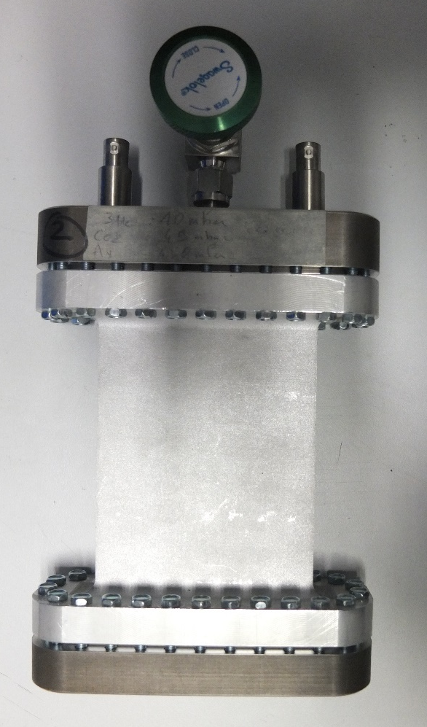
Multitube Monitor
Uniformity
Beam collimated with a slit (0.5 mm x 12 mm)
  In the normal case of use with slit apertures, uniformity is great
  (std. dev. < 0.5 % hor. / < 0.8 % vert.)

Slide 13
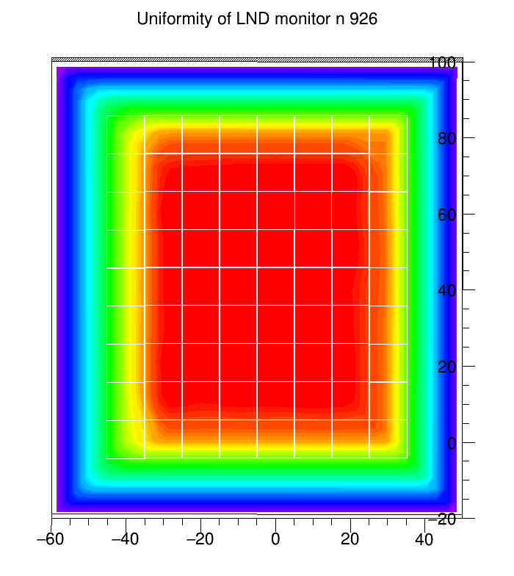
Multitube Monitor
Uniformity
Beam collimated with a mask (20 mm x 20 mm)
  Efficiency mapping within the active area shows a very uniform detector all over the surface
    Statistical uncertainty : 0.4 %
    Std deviation : 0.6 %

Slide 14
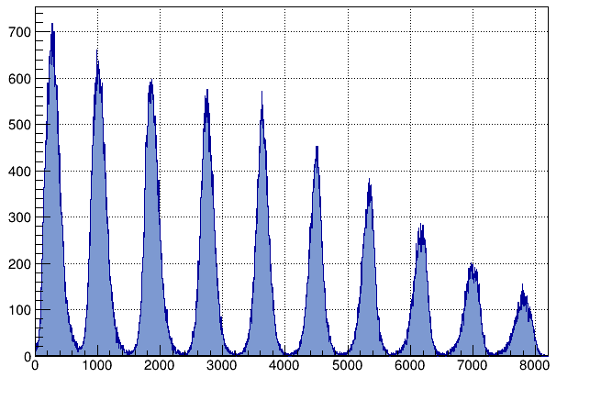
Multitube Monitor
Optional 1D or 2D localization
    This monitor could also be filled so that it allows absolute beam flux measurements (as hexacomb detector but with larger and more channels)
  More measurements still needed to evaluate the accuracy

Slide 15
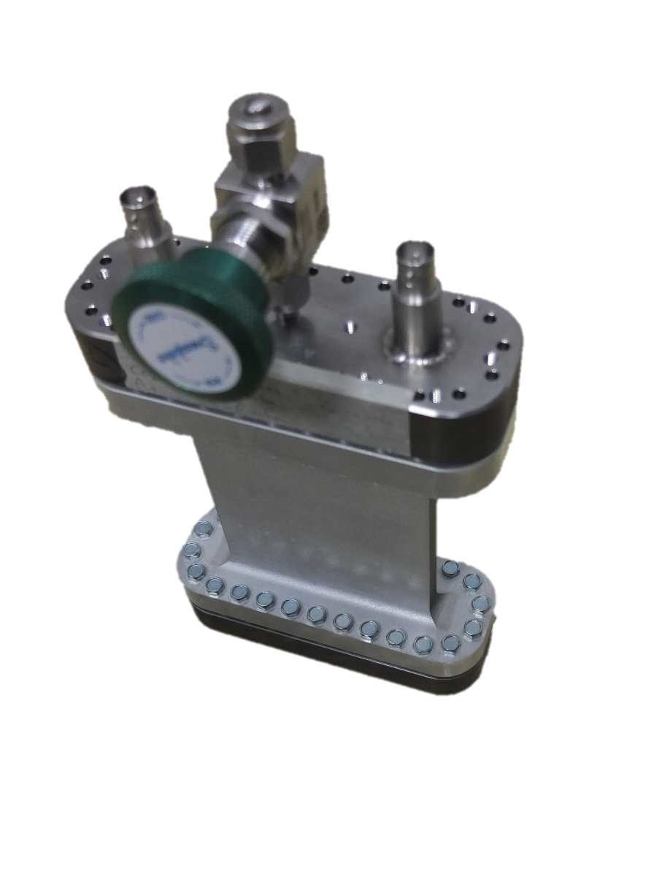

Conclusions
Good neutron/gamma discrimination
Tested on instrument with strong gamma background
Fast signals / high counting rate
Tested at 60 kHz - 300 Hz/${mm}^{2}$--- Achievable 250 kHz ?
Efficiency from ${10}^{−6} to \sim 0.9$
Excellent uniformity
Small beam perturbations / attenuation
Optional 1D-2D localization and beam absorption profile

Slide 16

Thank you for your attention

Slide 17
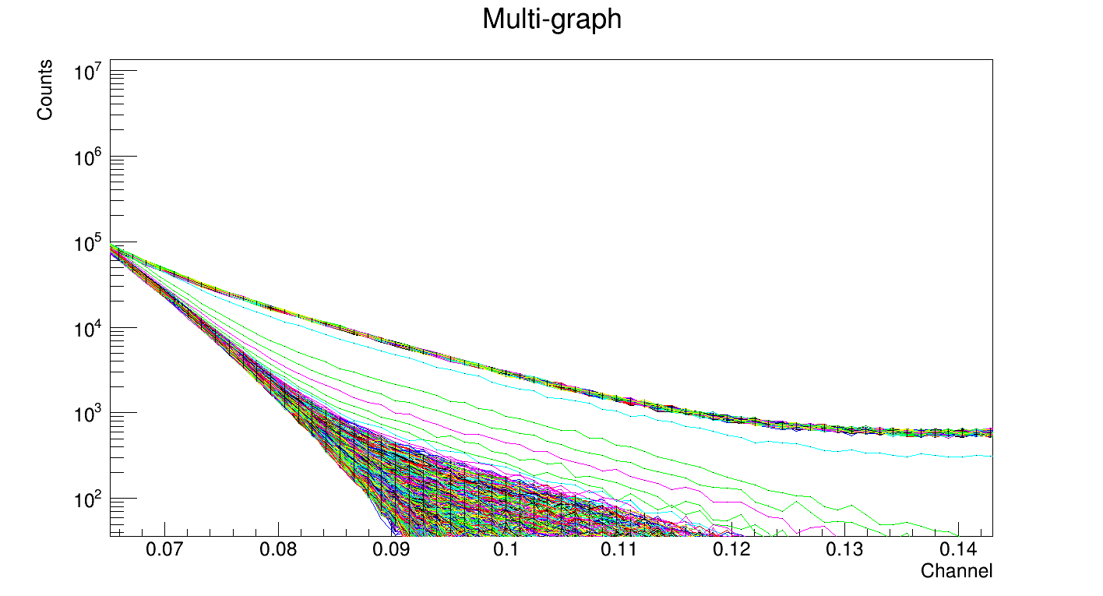
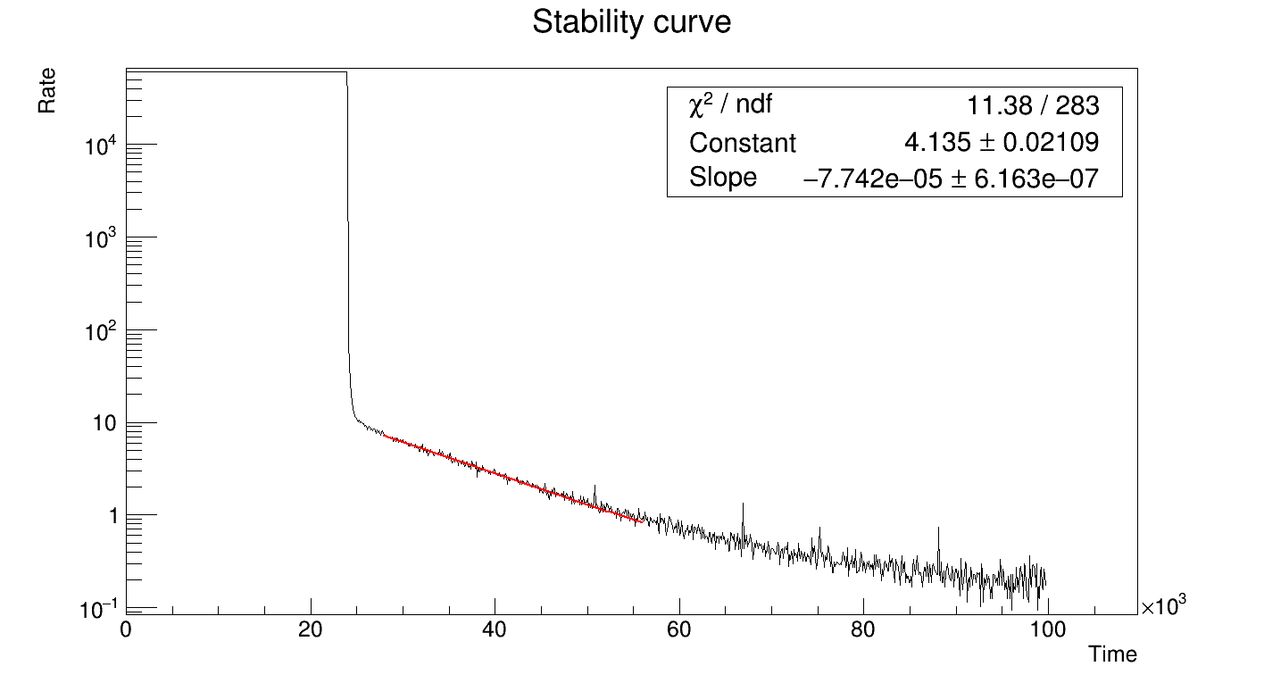
Back-up slides
Decay after shutdown
Amplitude (V)

Slide 18
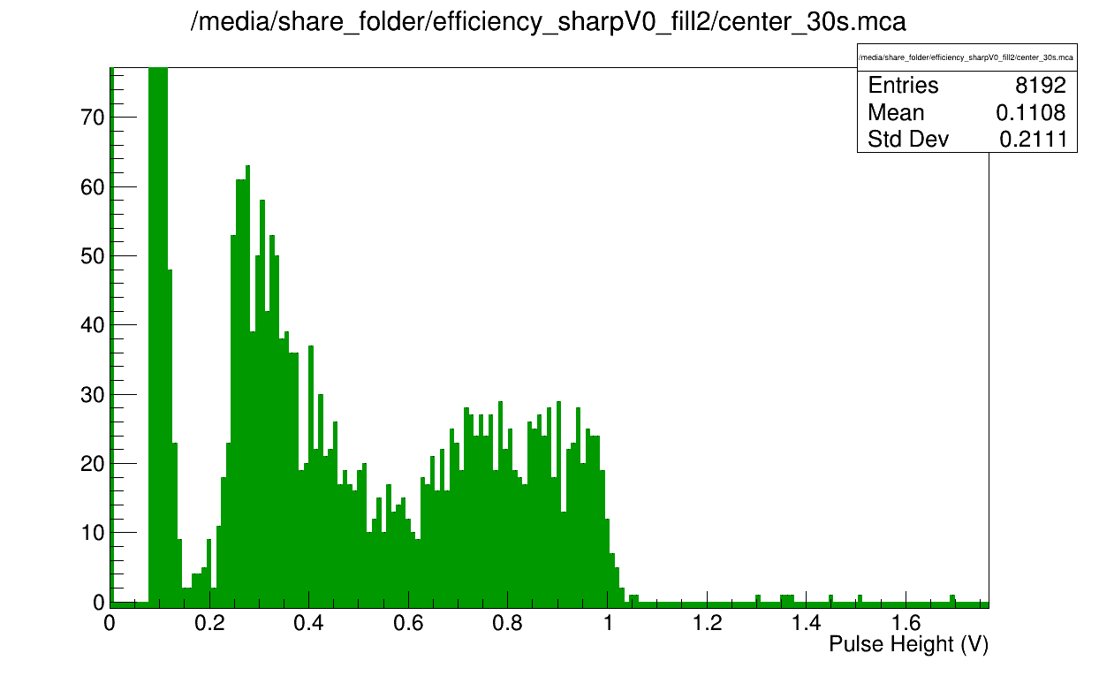
Backup slides
Pulse height spectra structure
2.5 mm slit centered on tube
2.5 mm slit centered on detector (Al wall)
2.5 mm slit perpendicular to the tubes
Structure observed in the spectrum seems to be due to the presence of Al walls

Slide 19
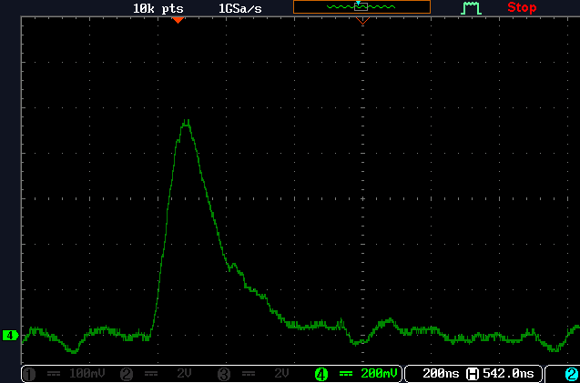
Backup slides
Signals

