Slide 1
The NitroGEM, a fast beam monitor for high intensity neutron beamlines
Davide Raspino
Jacob Young
Annabelle Brooks
Erik Schooneveld
Nigel Rhodes
IKON18

Slide 2
Outline
NitroGEM monitor layout
Performance
  Transmission
  Efficiency
  Gamma neutron discrimination
  Time resolution
What we are doing now
Conclusions and future

Slide 3
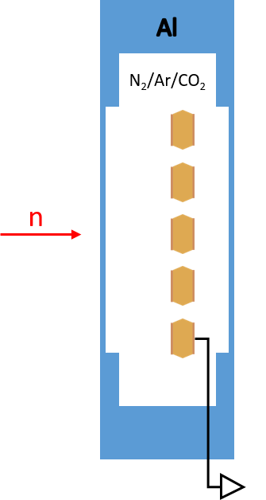
The NitroGEM monitor layout
Nitrogen:
  Low efficiency: N₂ absorption cross section 1.9 barn at 1.8 Å
  Reaction n+¹⁴N→p+¹⁴C, 620 keV proton energy
GEM:
  Low gain needed (10÷20)
  technology proven to be able to preserve its gain at high rate (~MHz/cm²)

Slide 4
The NitroGEM monitor layout
A single GEM in an aluminium vessel
Entrance and exit windows are 500μm thick
Vessel filled with a Nitrogen + Ar/CO₂
Sealed gas volume (pressure≤1 bar)

Slide 5
The NitroGEM monitor layout
Front window used as cathode
Signal picked up from the GEM electrodes
GEM electrodes biased with positive high voltage

Slide 6
Transparency
Measured on the ZOOM beamline at ISIS
Courtesy of: James Doutch (ISIS) and Judith Huston (ESS)

Slide 7
Transparency
LoKI
Measured on the ZOOM beamline at ISIS
Courtesy of James Doutch (ISIS) and Judith Houston (ESS)

Slide 8
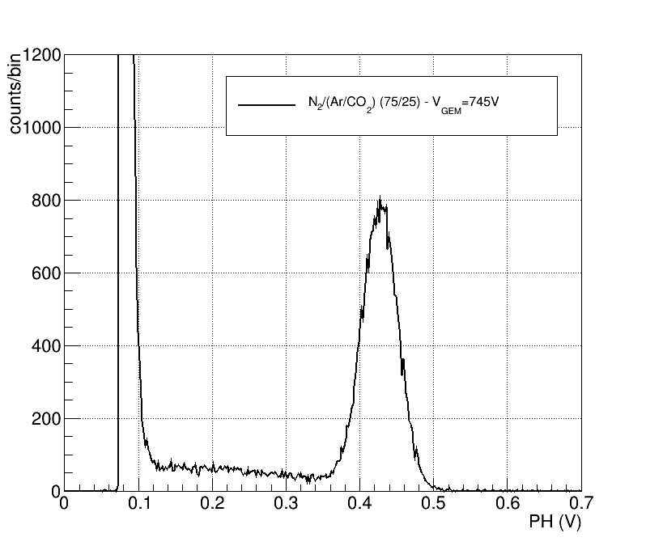
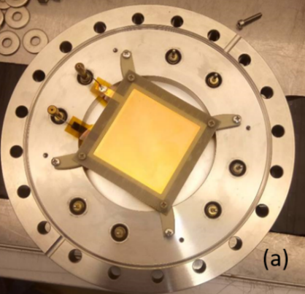
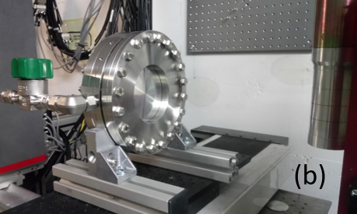
Pulse Height spectrum (1)
First Prototype
Used slow electronics (long integration time)
Signal from the bottom electrode of the GEM
75% Nitrogen

Slide 9
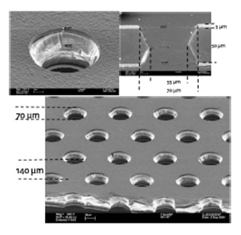
V_{gem} vs Gas Mixture
1 bar total pressure
N₂+Ar/CO₂(70/30)
Sealed vessel
Standard CERN GEMs
Bi-conical holes 50-70μm ⊘
on a 140μm pitch
50x50mm² active area
1.0 bar
0.6 bar

Slide 10
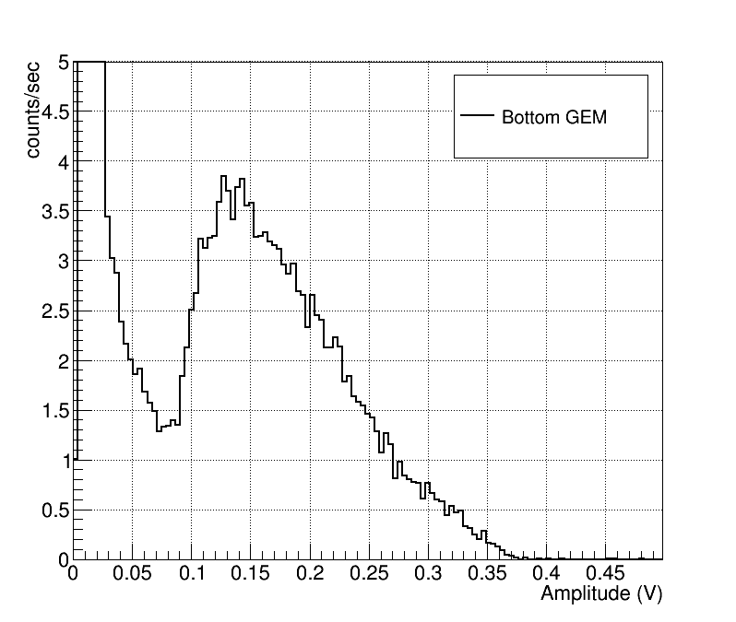
Pulse Height spectrum (2)

Slide 11
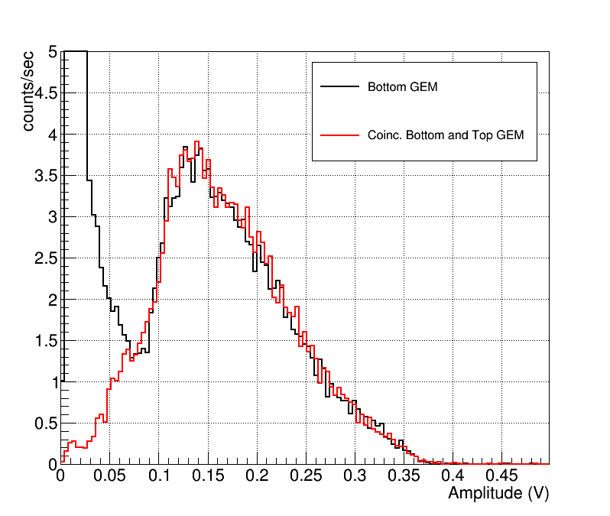
Pulse Height spectrum (2)

Slide 12
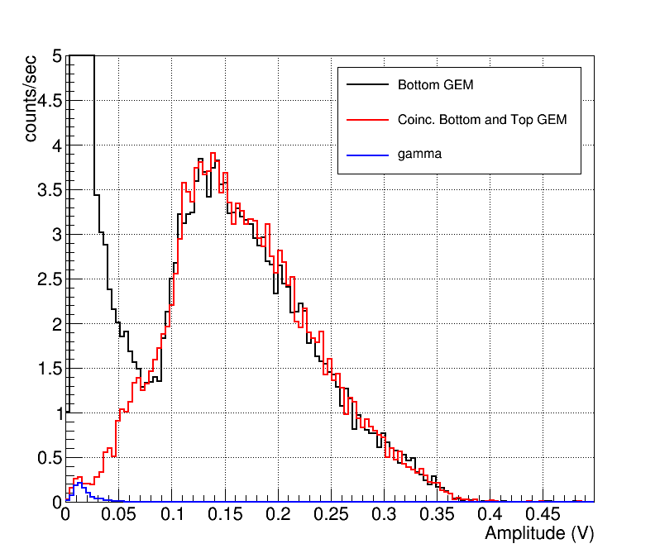
Pulse Height spectrum (2)
Cd

Slide 13
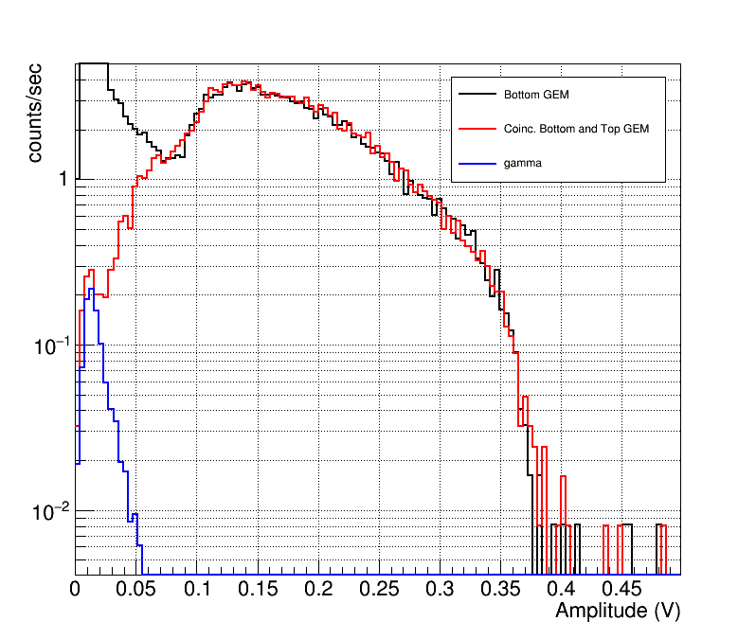
Pulse Height spectrum (2)
Cd

Slide 14
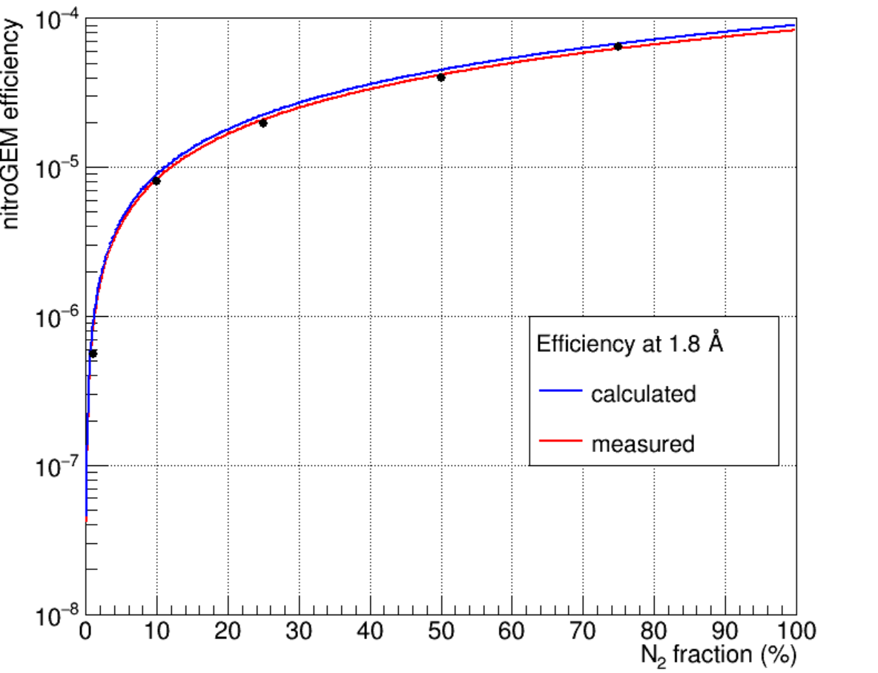
Efficiency
Measured against an ISIS monitor:
  0.25 mm thick GS1 scintillator
  35x35 mm² active area
  1.1% efficiency at 1.8 Å
20x20 mm² collimated beam
Gas mixture
  Sealed gas volume
  N₂/Ar/CO₂ mixture
  1 bar total pressure
  N₂ between 1 and 75%
  Precision 1 mbar

Slide 15
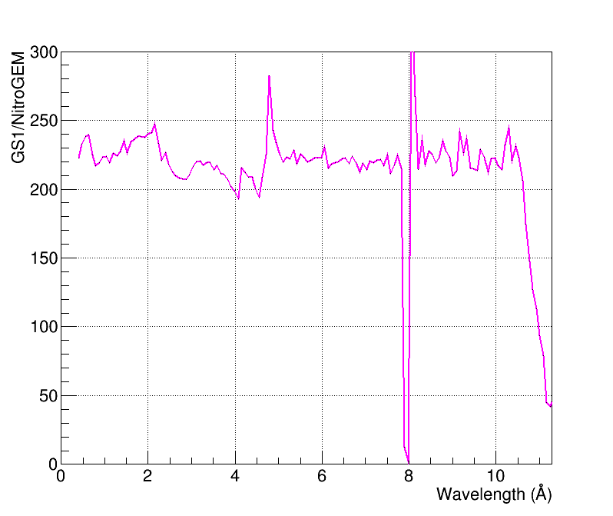
Long Wavelength Efficiency
On the CRISP beamline at ISIS
0.6 bar total pressure
N₂/(Ar/CO₂)(50/50)
V_{gem}=480 V
Sealed vessel

Slide 16
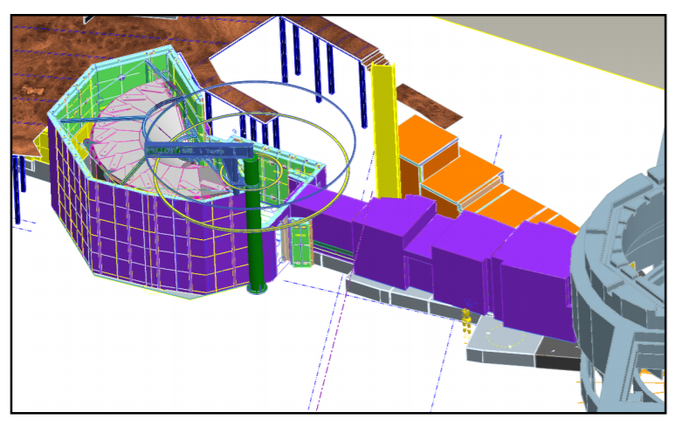
Time Resolution
LET at ISIS
Direct Geometry Time of Flight Spectrometers
R. I. Bewley et al, NIMA 637 (2011) 128-134
M. Russina, NIMA 604 (2009) 624–631

Slide 17
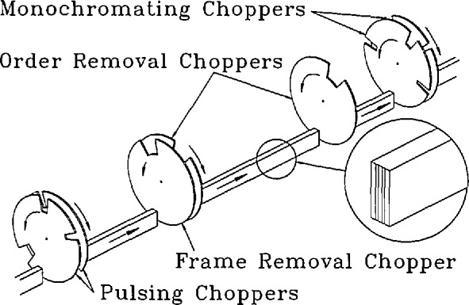
Time Resolution
LET at ISIS
Direct Geometry Time of Flight Spectrometers
Multi-chopper system: multiple E_{i} in each time frame
A monitor after each chopper
Crucial for the time phasing of the chopper system
R. I. Bewley et al, NIMA 637 (2011) 128-134
M. Russina, NIMA 604 (2009) 624–631
J.R.D. Copley et al., J Res Natl. Inst. Stand. Technol. 1993 Jan-Feb; 98(1): 71–87.

Slide 18
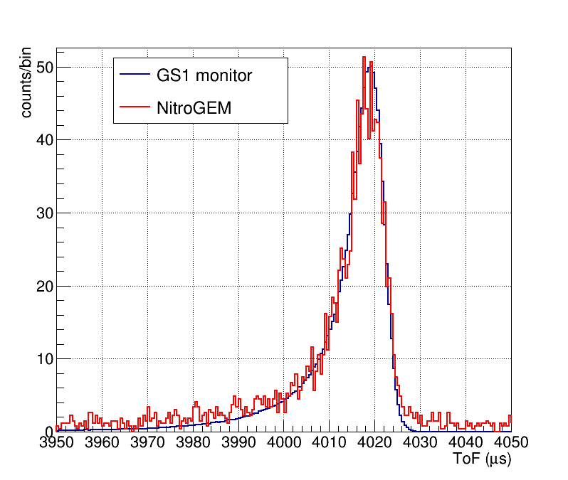
Time resolution
Fermi chopper on EMMA beam line upstream of the scintillator and NitroGEM monitor
Frequency: 400 Hz
Comparable width in ToF of the neutron pulse passing through the chopper

Slide 19
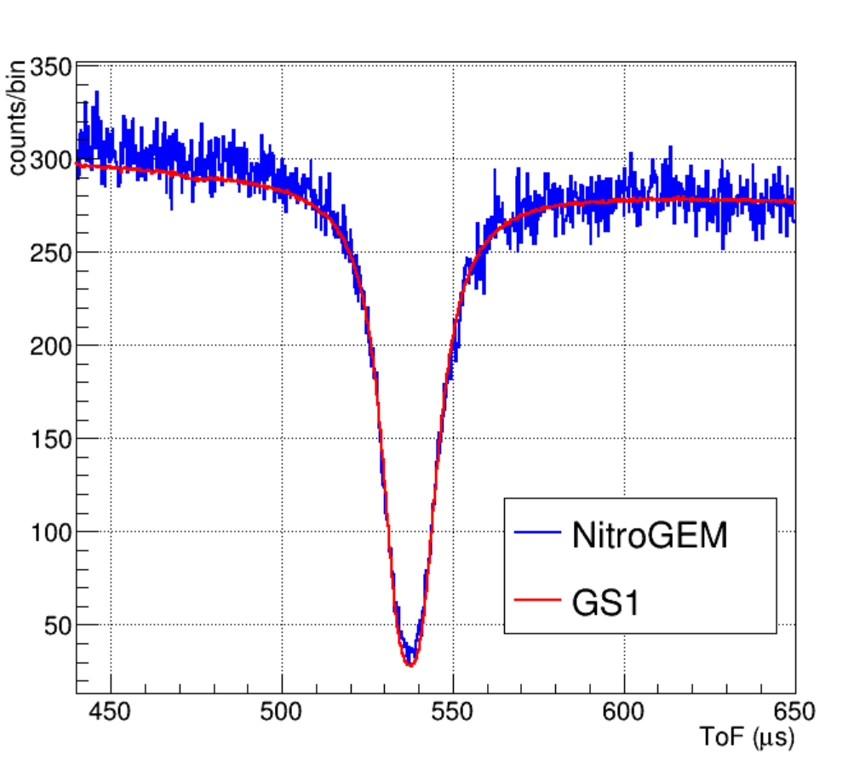
Time resolution
Neutron resonances used to compare the time resolution of the NitroGEM with the one of the ISIS scintillator monitor.
Gold foil upstream the two monitors
GS1
NitroGEM
n
4.88eV Au
Au
P. Schillebeeckx, et al, Nuclear Data Sheets 113, 3054 –3100 (2012)

Slide 20
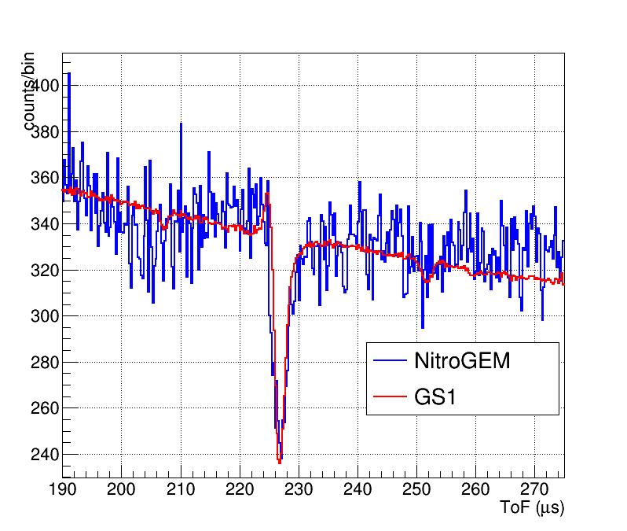
Time resolution
Neutron resonances used to compare the time resolution of the NitroGEM with the one of the ISIS scintillator monitor.
Gadolinium foil upstream the two monitors
GS1
NitroGEM
n
59.7eV Gd
4.88eV Au
Gd
P. Schillebeeckx, et al, Nuclear Data Sheets 113, 3054 –3100 (2012)

Slide 21
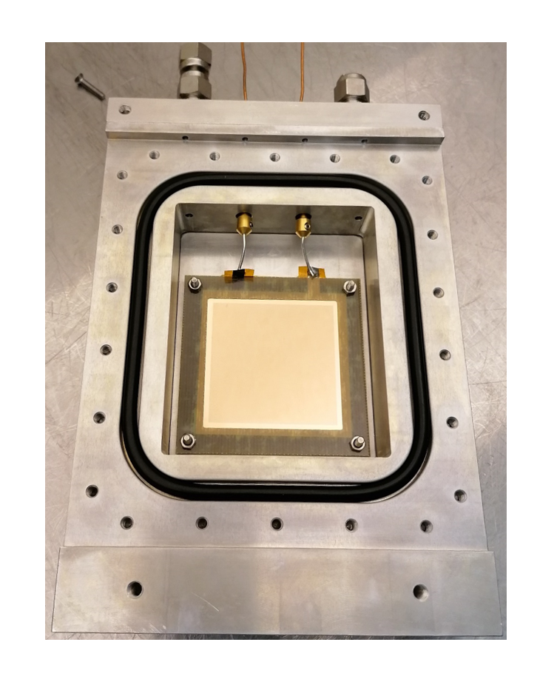
Prototypes
First results
Efficiency
Long Wavelength
Transparency
Time resolution
PH coincidence

Slide 22
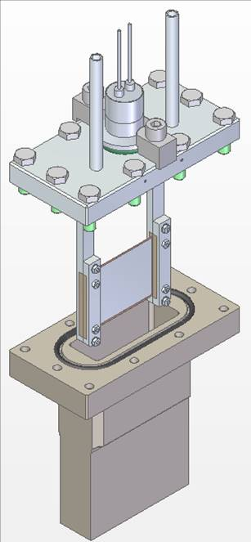
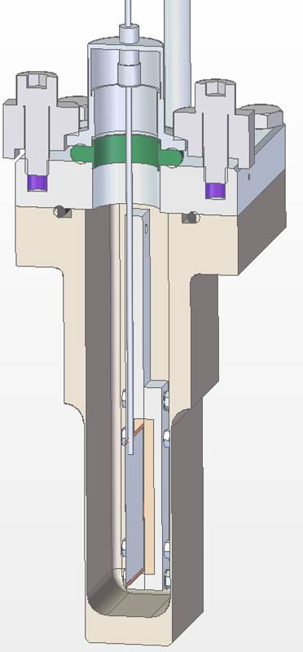
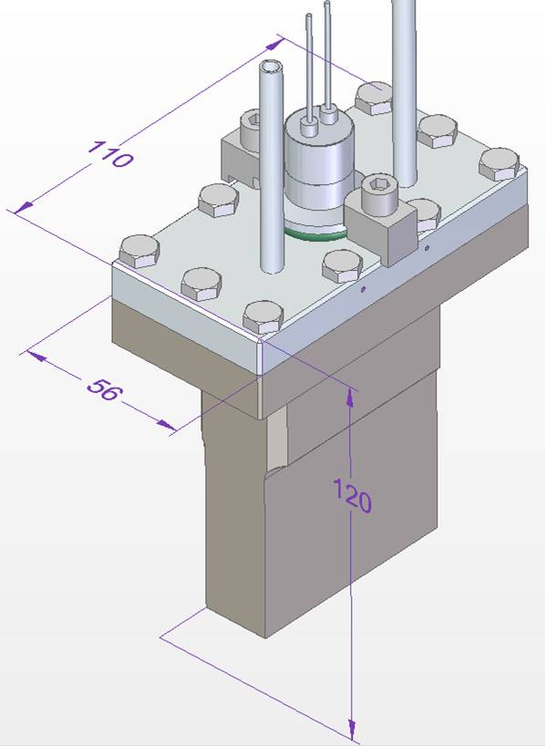
New prototype
Federico Masi (ISIS)

Slide 23
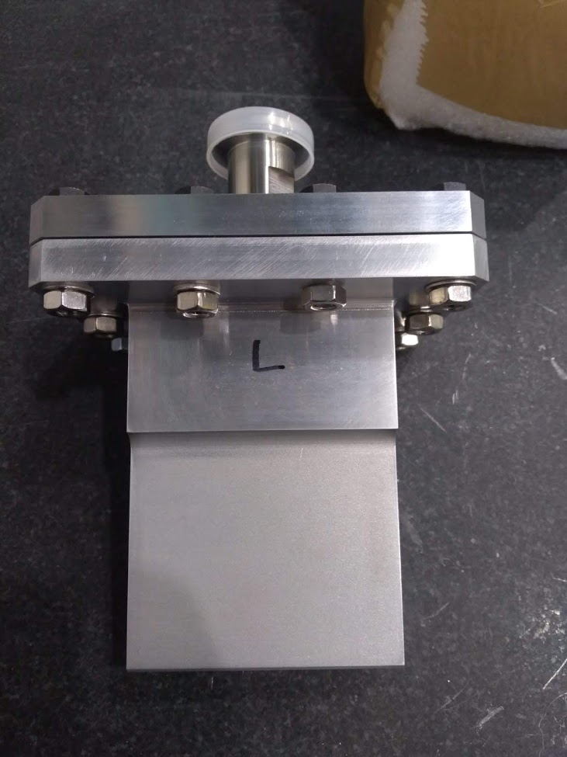
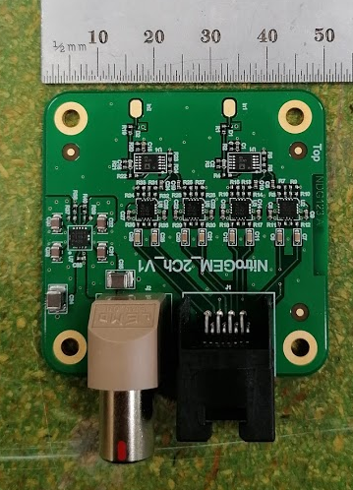
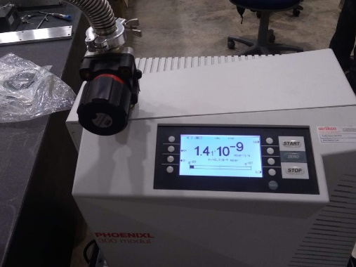
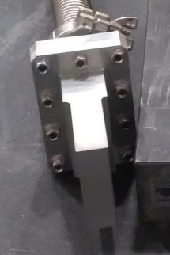
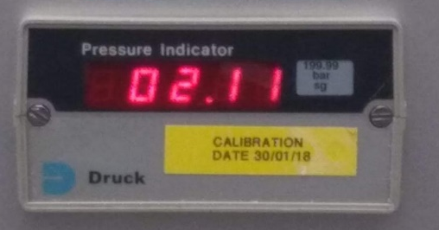
New Prototype

Slide 24
Conclusions
NitroGEM is a simple GEM detector to be use as a neutron beam monitor
Efficiency can be tuned with very high precision
Good transparency up to long wavelength
Strong method to reject electronics noise
Low gamma sensitivity
Time resolution

