Slide 1
Magnet Sample environment
Current status and timelines
PRESENTED BY Alex Holmes

Slide 2
Cryomagnets + LT
System | Instruments OPTIMISED, Suitable, Possible | Cost Book (€) | Status | Notes | Available by
8 T verti. field diffraction cryomagnet | MAGiC, DREAM, HEIMDAL, BIFROST | 1M | FR IK Draft TA/tender Waiting for IKA | Large aperture | Q1/23
15 T HZB | BIFROST, DREAM, MAGiC, HEIMDAL | 1M 200k | HZB contract signed | In-plane only | Q1/21
2.5 T Warm bore #1 | ESTIA, LOKI, MAGiC, BIFROST, SKADI, HEIMDAL, DREAM | 335k | Planned FR IK. Specs as TOFTOF |  | Q3/22
6.5 T Vertical field assymmetric | CSPEC, TREX, MAGiC, DREAM, HEIMDAL, BIFROST | 300k (see slide below) | Agreement from HZB | Needs vacuum tank integration | Q2/21
Warm bore #2,3 | General purpose | 680k | Planned
14T spectroscopy | CSPEC, TREX, MAGiC, DREAM, HEIMDAL, BIFROST | 800k | Initial ops | Low background
11T Horizontal | SKADI, ESTIA | 500k | Initial ops | Split coil
+ matching (ultra) low temperature inserts, standard wet/dry cryostats
Notes:
After consulting with instrument teams and STAPs we have come up with planned suite of cryomagnets well matched to first science needs, in particular those instruments reliant on magnetism, MAGiC BIFROST and ESTIA.
First science highlighted

Slide 3
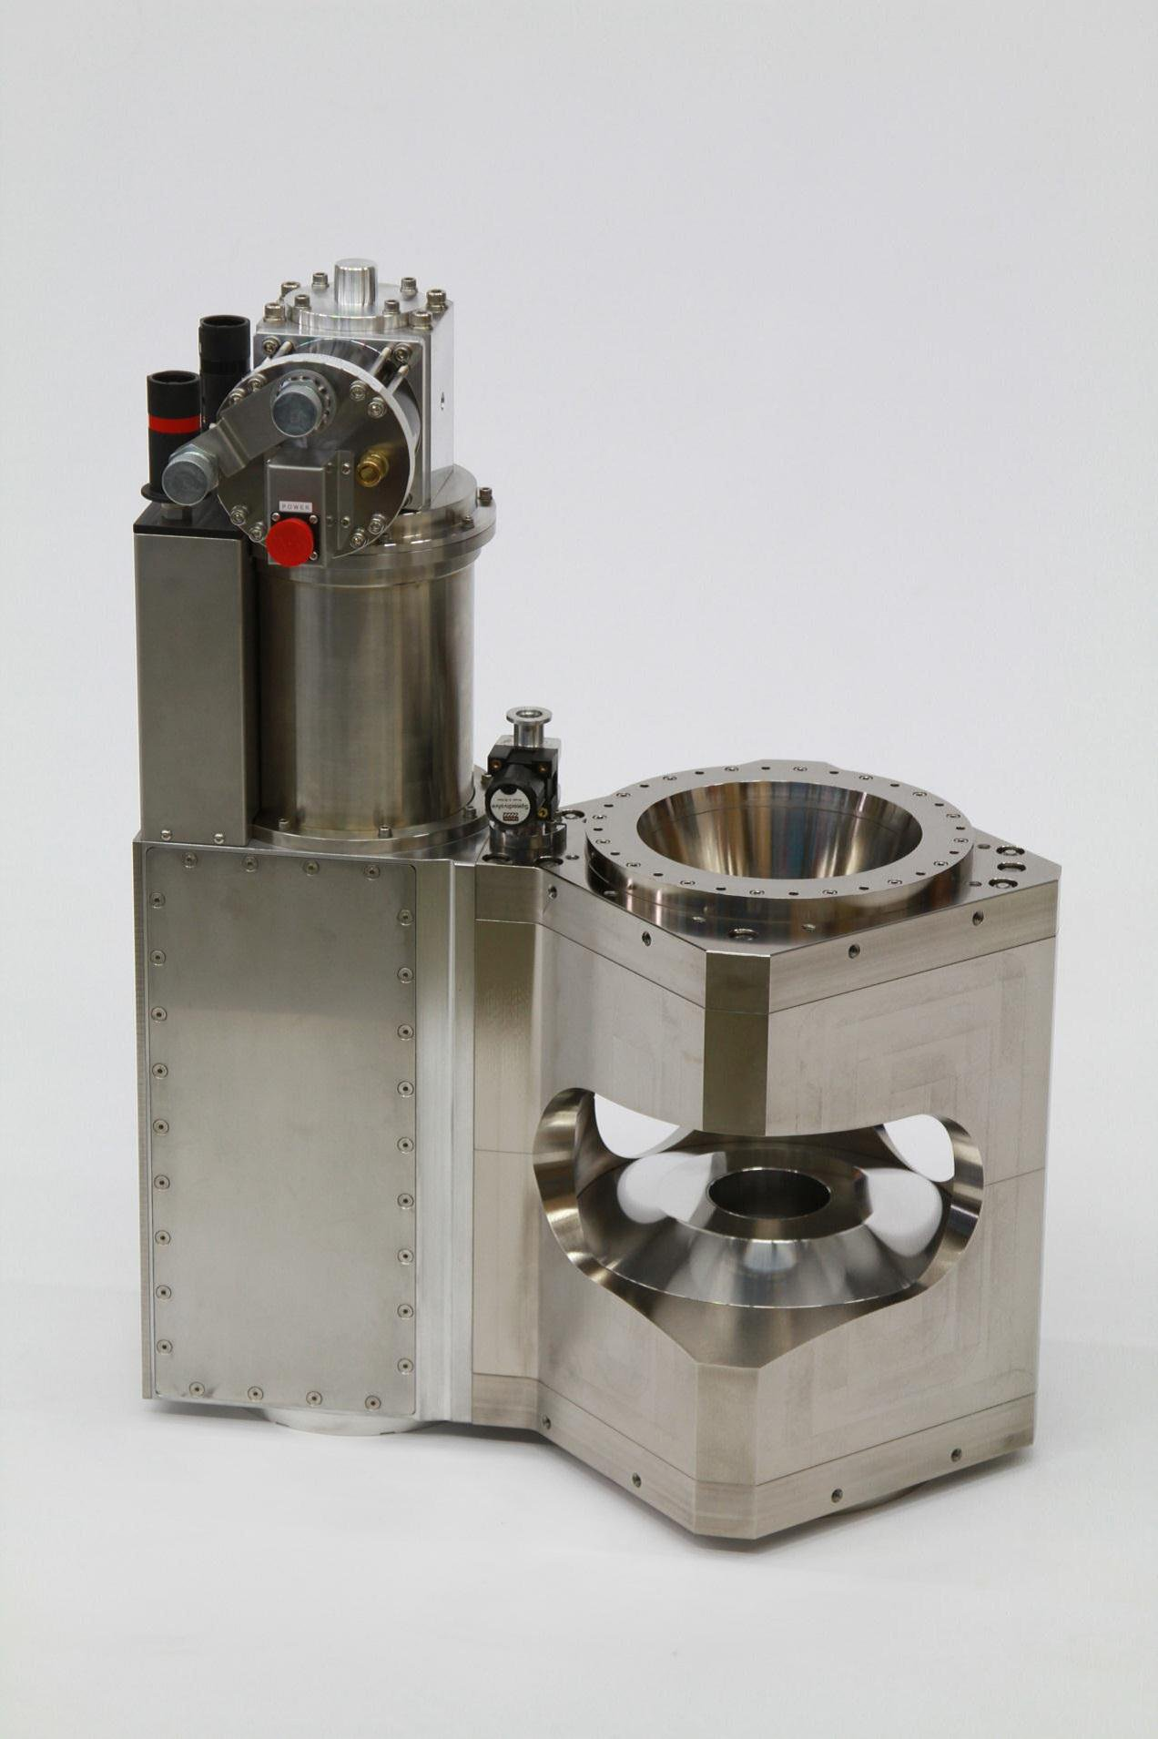
New magnets – FR in-kind
Large aperture magnet 8T – optimised for single crystal diffraction
Vertical split pair magnet, extremely wide opening angles
Matching He3/dilution inserts
Also useable on DREAM, HEIMDAL
CTV completed ✔︎
Warm bore 2.5T
Based on existing TOFTOF design
Flexible temperature inserts
Compatible across many instruments.
Principally ESTIA/LOKI
Notes:
Less detail, bigger

Slide 4
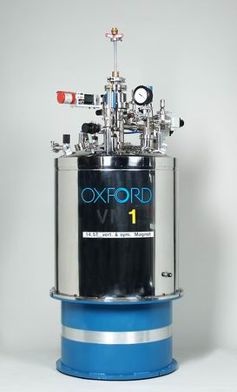
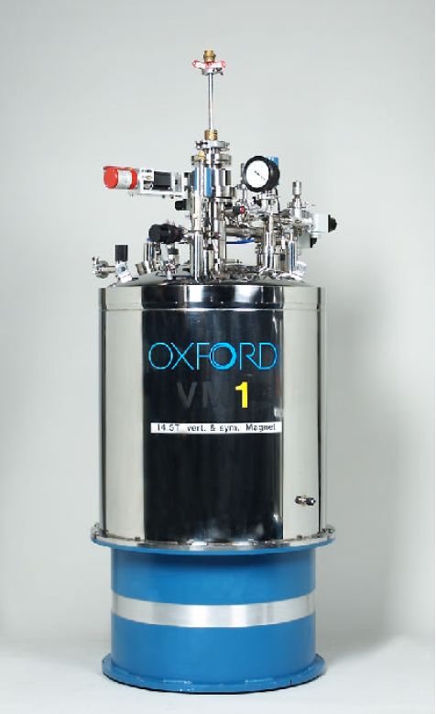
HZB second hand items
In addition:
2 Dilution inserts
1 ³He sorption insert
Total cost:
€150,000 + integration &
Refurbishment
VM-1
14.5T
VM-1B
14.8T
VM-2
6.5T asymmetric
Notes:
17 April 2019

Slide 5
Agreed timelines (TA)
 | Q1/20 | Q2/20 | Q3/20 | Q4/20 | Q1/21 | Q2/21 | Q3/21 | Q4/21 | Q1/22 | Q2/22 | Q3/22 | Q4/22 | Q1/23
8T Magnet
2.5 T Warm bore
Procurement
Design
Manufacture
Acceptance/Integration

Slide 6
Thoughts & Conclusions
New + second hand gives us good starting suite. Instruments in 1st 8 with high priority magnetic science cases (BIFROST, ESTIA, MAGIC) prioritised, with reasonable cross-compatibility for other instruments
Looked at recondensing options – Extra compressors, flexlines. Experience at other facilities shows not 100% effective with regular field changes. Wet + autofilling more reasonable option.
Clear that mixing top/bottom loading is not optimal.
Polarisation specialist with extensive magnet design experience (Hal) now joined us.
Time to revisit prioritisation for next cryomagnet:
High field spectroscopy optimised? Uncompensated?
2nd Warm bore?
Compensated mid-range workhorse?
Question – is cadmium allowed to absorb secondary scattering (not main beam)?

