Slide 1
ESS User Office
PRESENTED BY Carina Lobley,
Science Coordination and User Office

Slide 2
ESS – User Infrastructure
User Database
User Access to a large research infrastructures is a problem with many stakeholders
Similar information is needed for a range of functions: this is typically collected within User Office Software
Building the management functions for the User Office is a multi-faceted problem.
Proposals
Manage Samples
User Office
Resource Access
Publishing & Reporting
Admin & Support

Slide 3
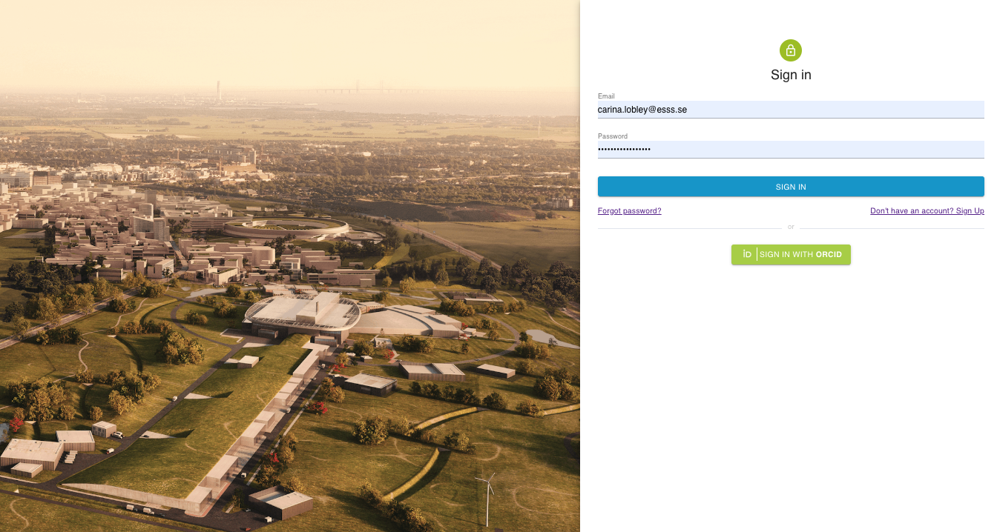
User Office Software – User Registration
Users can now register at www.useroffice.ess.eu
Privacy notice is agreed on registration
Cookie policy is agreed on registration

Slide 4
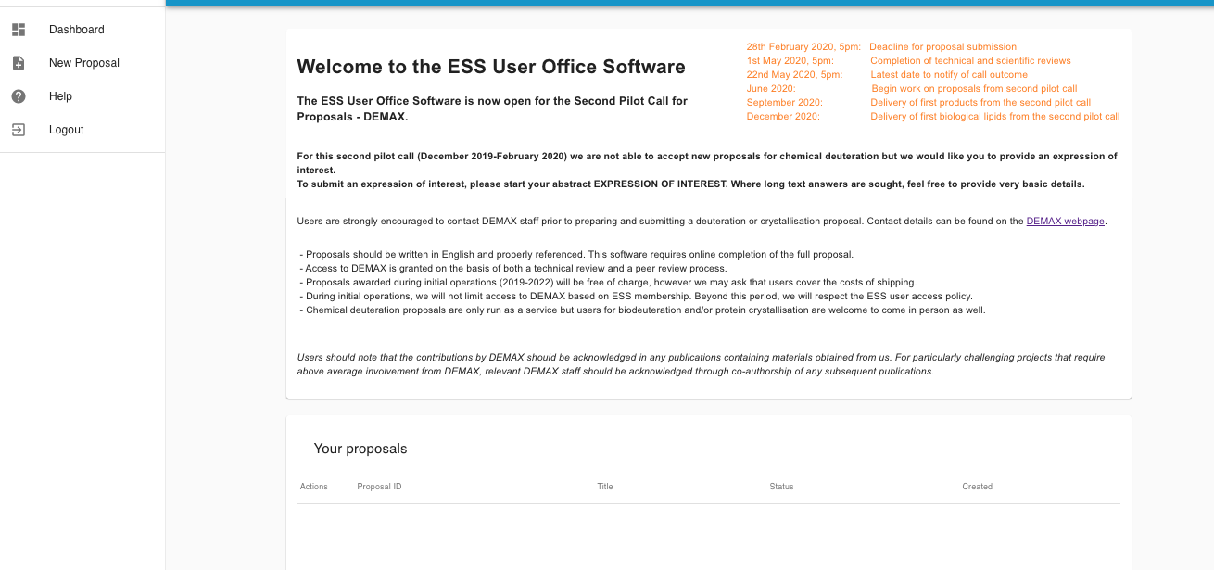
User Office Software – Proposal Submission
Key Dates
Call info
Demax 2nd pilot call for proposals closes Friday 28th February
Navigation pane
Proposal hints
List of proposals involving this user

Slide 5
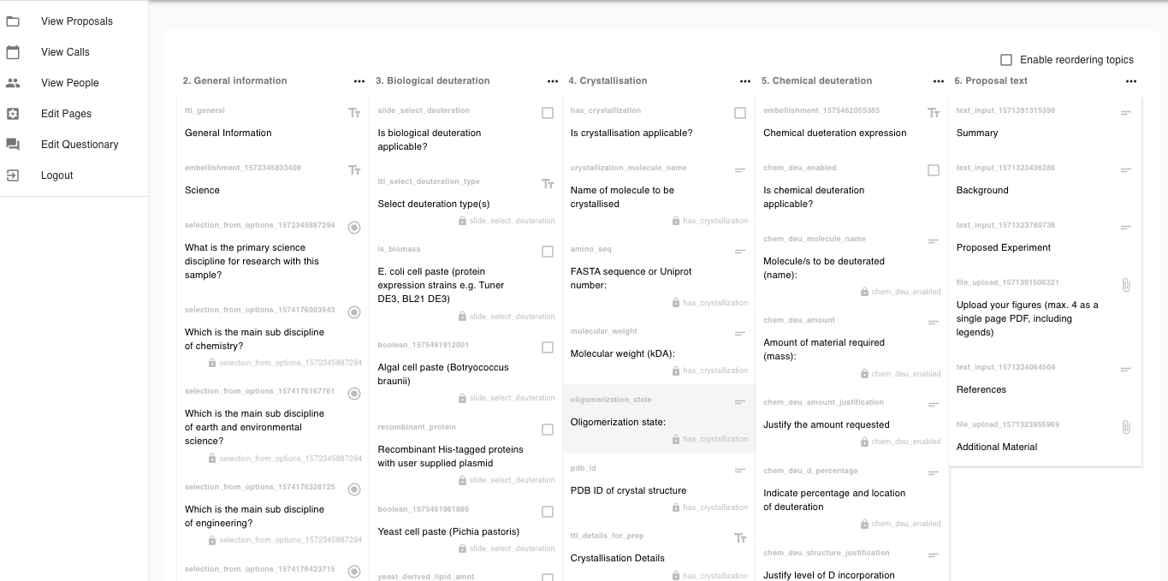
User Office Software – Flexible Proposal Design
Proposal prepared like any online form builder or survey site
Complete flexibility so no requirement for software skills in redesigning the proposal questions
Easy to make dynamic questions
Very powerful throughout the software

Slide 6
Summary
User Office is a connection between the stakeholders involved in ensuring safe, timely access to ESS resources
ESS is already a user facility, with DEMAX operating calls for proposals
User Office Software is the tool that enables this to happen in a smooth and regulated way
You can register as an ESS User at useroffice.ess.eu

Slide 7
Date: Weds 23rd – Fri 25th September 2020
Venue: Central Lund
Plenary Lectures: focussed on the societal impact of neutron science
Parallel Sessions: up to five sessions in parallel for detailed discussions ranging from fundamental physics to the life sciences
Registration opens soon!
http://www.neutrons4europe.com/

Slide 8
Any Questions?

