Slide 1
Downstream of the
Readout Master
Morten Jagd Christensen
Data Management and Software Centre
Experiment Control and Data Curation

Slide 2





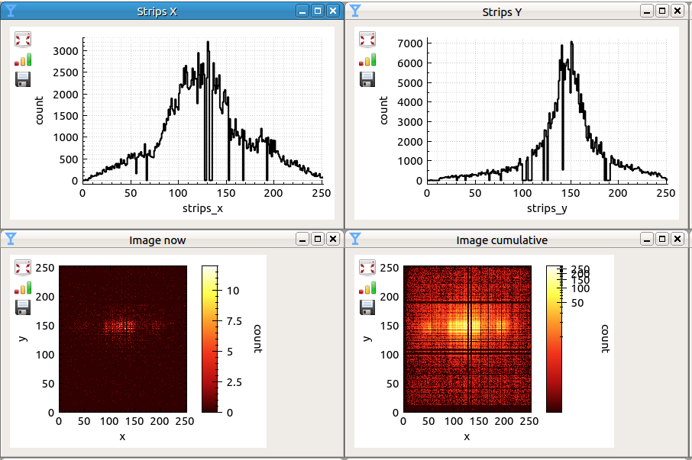
Event Formation Unit
nexus file writer
file writing
readout
event formation
Kafka
live reduction +
visualisation
DG
commisioning
visualisation
daquiri
visualisation
raw data
EFU receives readouts
EFU transmits events {t, pixelid}

Slide 3
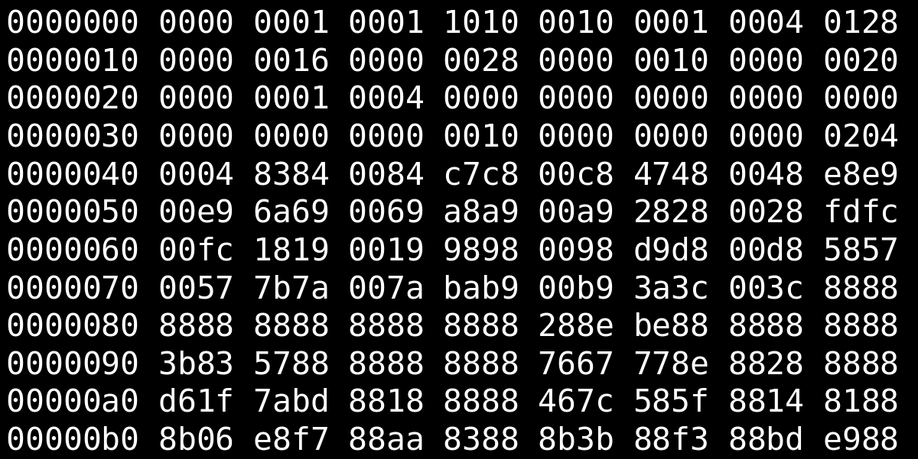
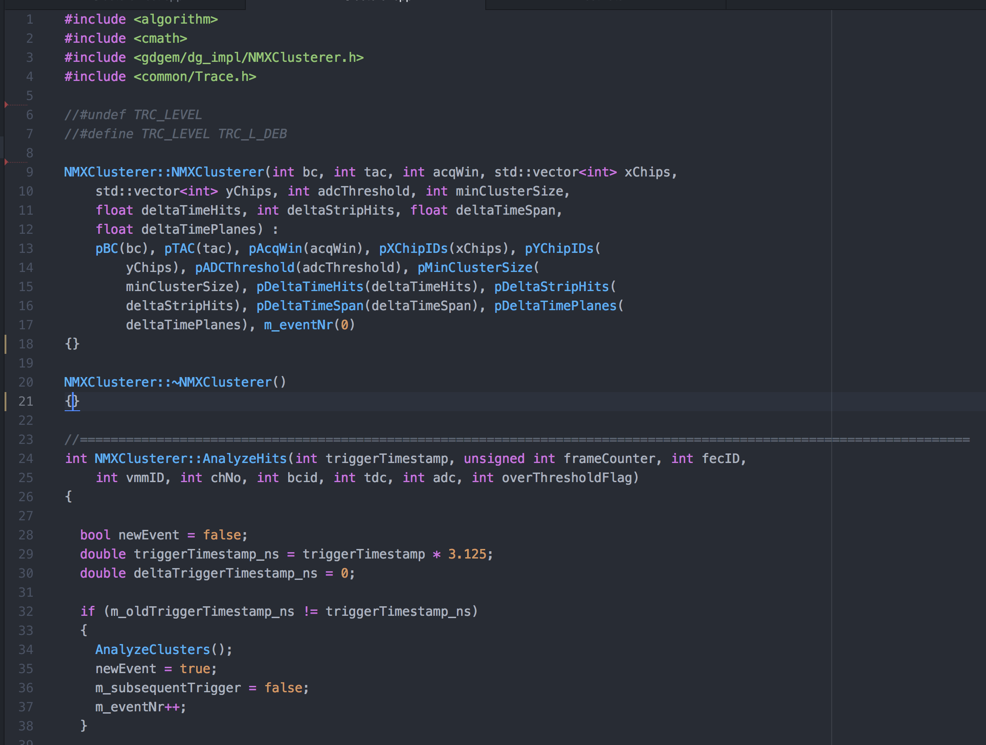
EFU Input / Output
Readout Data
+
=
Neutron Events
... {t_{n}, p_{n}}, {t_{n+1}, p_{n+1}} ...
Algorithms

Slide 4
Instrument
Mapping

Slide 5
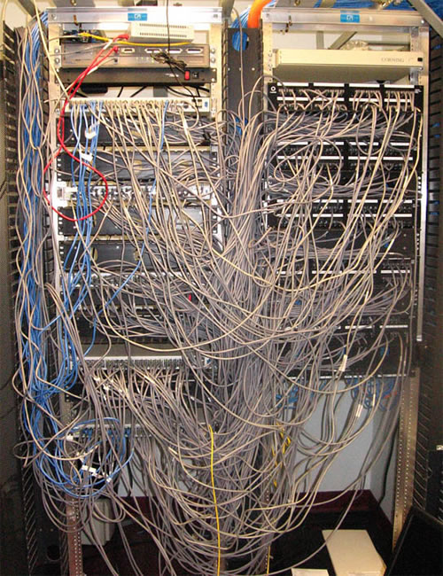
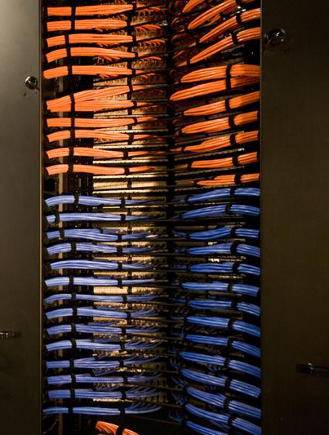

Slide 6

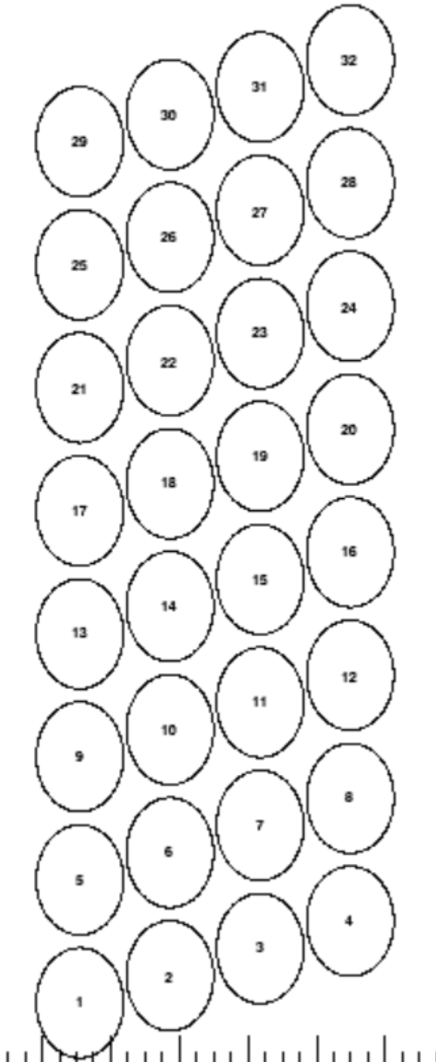
Instrument Mapping
bank 1 horiz 1200 B- 80 tubes
bank 2 horiz 500 T - 64 tubes
bank 1 vert 1200 R – 128 tubes
bank 2 vert 500 L – 48 tubes
bank 2 horiz 500 B – 64 tubes
bank 1 horiz 1200 T – 80 tubes
bank 2 vert 500 R – 48 tubes
bank 3 – 1 of 2 – 128 tubes
bank 1 vert 1200 L – 128 tubes
bank 3 – 2 of 2- 96 tubes
Suggestion
Each detector bank goes on separate rings. The biggest bank uses two rings.
For each CAEN digitizer there are
4 front end nodes each capable of processing 8 tubes
This requires 29 CAEN modules which is 2 more than the theoretical minimum requires.
R0
R1
R2
R3
R4
R5
R6
R7
R8
R9
R10
R11
Readout Backend

Slide 7
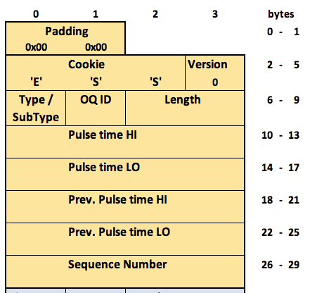
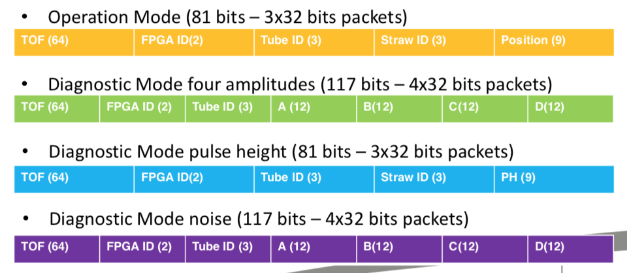
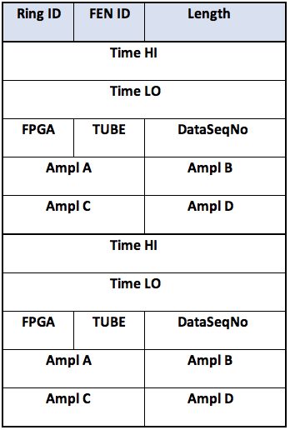
What we get
Readout data format
Also covers Diagnostic Mode noise
RingId identifies detector bank
FENId identifies sub bank (group of 32 tubes?)
FPGA identifies group of subsub bank (8 tubes?)
TUBE identifies tube within subsub bank
Amp A-D encodes straw and position along straw

Slide 8
What we get
Your detector
Common header and data headers for all detectors
Detector specific readout fields must be defined
your
detector
here
{
{

Slide 9
Reference
Data

Slide 10
”a reference dataset is a collection of digitized data from a detector readout which has a well defined interpretation”

Slide 11
”we need reference datasets in order to deliver software for event processing”

Slide 12
Algorithms
Algorithm Description
Email, paper, report, whiteboard walk-through
Prototype implementation
C/C++, Python
Analyzed reference data
Text/binary files, wireshark captures, C or C++ arrays

Slide 13
Speed Up

Slide 14
System scalability
”With high flux comes high data rates. Multiple EFUs will be needed for most instru-ments . We need to consider how to speed up processing by parallelisation”

Slide 15
Integration
Readiness
Assessment

Slide 16
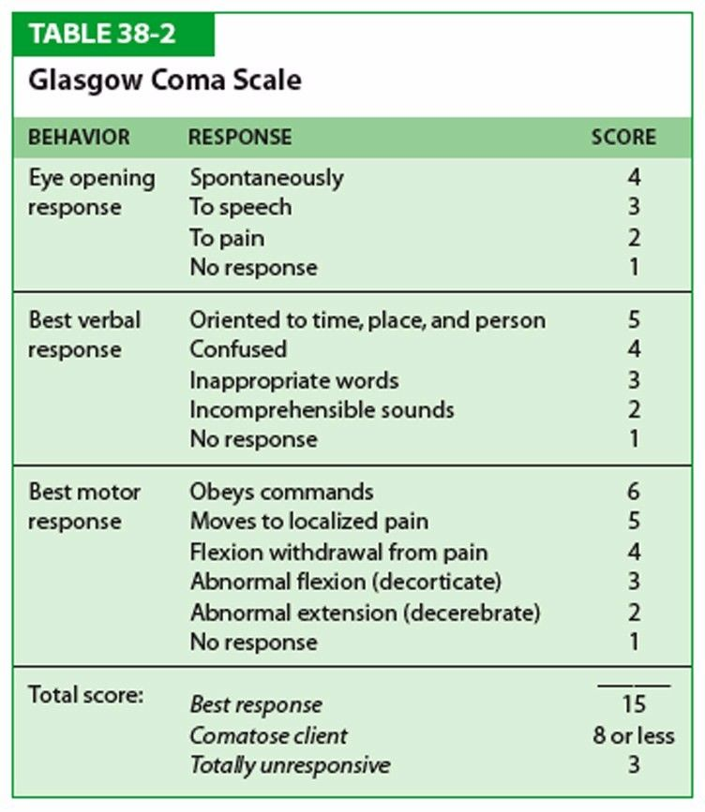
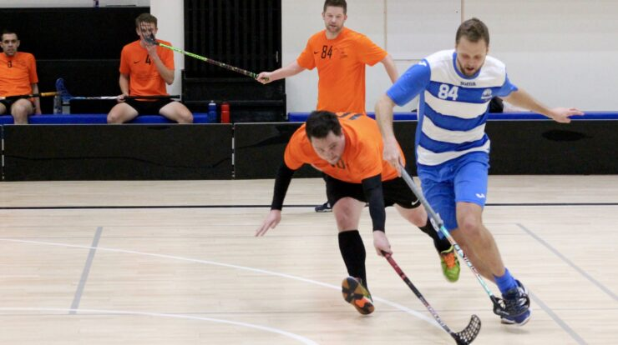
Glasgow Coma Scale
Detector Coma Scale
FEATURE STATE SCORE
Dialogue Meetings, agreed decisions 4
Initial meeting/discussion 3
Interest in meeting/discussion 2
No contact established 1
Integration Defined, understood, agreed 4
Model IM Intention stated 3
IM Undecided 2
Implicit/unspecified 1
Logical Agreed (Inst/ECDC/DRAM) 4
Geometry Under negociation 3
Acknowledged 2
Unspecified 1
Digital Documented revision control 4
Mappings Being defined 3
Aware 2
Not started 1
Total score: Best response 16
Comatose 11 or less
Totally unresponsive 4

Slide 17
Example - LoKI
Detector Coma Scale
FEATURE STATE SCORE
Dialogue Meetings, agreed decisions 4
Initial meeting/discussion 3
Interest in meeting/discussion 2
No contact established 1
Discussions among DMSC (ECDC + DRAM), Instrument Scientist, Detector Group, In-Kind partner
4
Integration Defined, understood, agreed 4
Model IM Intention stated 3
IM Undecided 2
Implicit/unspecified 1
4
Integration Model B decided
Logical Agreed (Inst/ECDC/DRAM) 4
Geometry Under negociation 3
Acknowledged 2
Unspecified 1
4
Logical geometry defined and agreed
Digital Documented revision control 4
Mappings Being defined 3
Aware 2
Not started 1
Detector Readout Data format specified
Details of detector mappings still being refined
3
Total score: Best response 16
Comatose 11 or less
Totally unresponsive 4
15
Not quite, but nearly ready for integration

Slide 18
Talk to

Slide 19

DMSC
DRAM
Experiment Control and Data Curation
Tobias Richter
Provides software for
Instrument and readout control
Readout data reception and parsing
Event Formation calculations
Fast sample environment
Data aggregation
Nexus file writing
Detector commissioning tools
Live detector statistics
Data Reduction Analysis and Modelling
Thomas Holm Rod
Provides software for
Mantid
SasView
SpinW
BornAgain
McStas
....
Detector commissioning tools

Slide 20
There is a lot of stuff to specify/do downstream the Readout Master
That stuff should go in a Interface Specification (ICD)
The ICD is the ‘contract’ that helps all parties moving forward most efficiently
Use the Detector Coma Scale to assess and progress integration readiness

Slide 21
The End
ECDC’s
HOLISTIC SOFTWARE AGENCY
The End

