Slide 1

DETECTOR BACKGROUNDS
Fast Neutron and Gamma-ray Sensitivity
of Helium-3 and Boron-10 Detectors
and Effect of Window and Cosmic Neutrons
Francesco Piscitelli
on behalf of the ESS Detector Group
IKON18
Lund
2020/02/25

Slide 2


DETECTOR BACKGROUND
Cosmic neutrons
Gamma-rays
Fast Neutrons
Scattered Neutrons
He-3 vs B-10

Slide 3
DETECTOR BACKGROUND
Detector
Cosmic neutrons
Gamma-rays
Fast Neutrons
Scattered Neutrons
He-3 vs B-10
Detector sensitive cells or voxels
Detector x-section
Detector window

Slide 4
DETECTOR BACKGROUND
LEGEND
Detector
Good events
Cosmic neutrons
Gamma-rays
Fast Neutrons
Scattered Neutrons
Unwanted events
He-3 vs B-10
Detector sensitive cells or voxels
Detector x-section
Detector window

Slide 5
COSMIC NEUTRON
BACKGROUND
August 2015

Slide 6
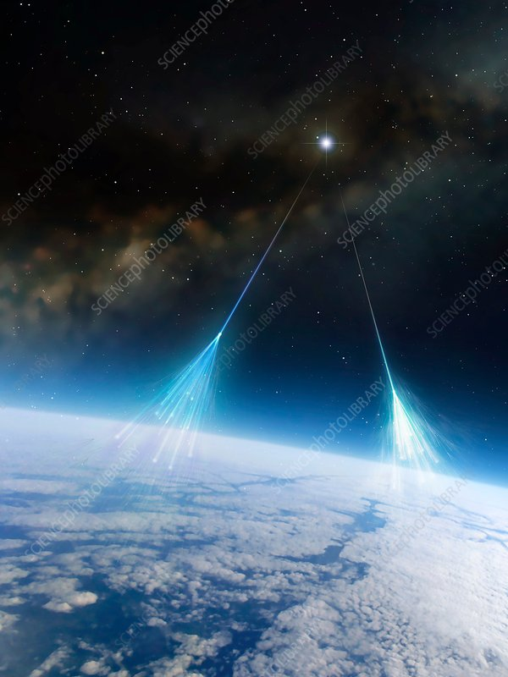
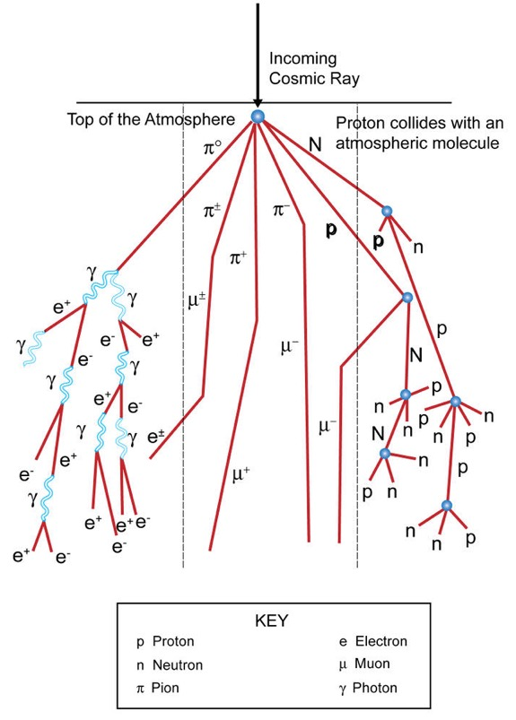
BACKGROUND: cosmic neutrons
Neutrons are created by cosmic ray spallation in the high atmosphere.
Energies from 10⁻⁹ to 10³ MeV

Slide 7
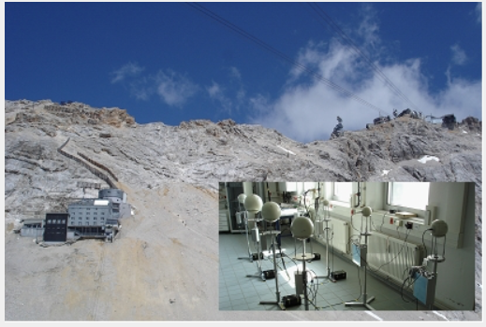
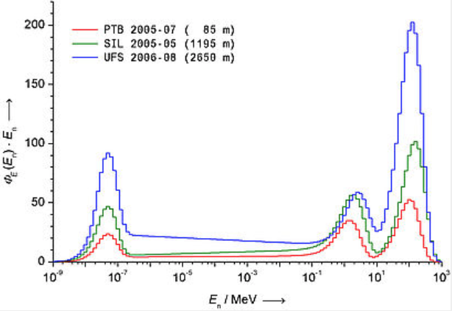
BACKGROUND: cosmic neutrons
Neutrons are created by cosmic ray spallation in the high atmosphere.
Energies from 10⁻⁹ to 10³ MeV
Neutron flux
2650m
2650m
Measured with Bonner spheres in the whole eneregy spectrum
1195m
85m
Physikalisch-Technische Bundesanstalt (PTB) - Measurements of Neutron Spectra Induced by Cosmic Radiation at Altitudes of 85m, 1195m and 2650m (2010)

Slide 8
BACKGROUND: cosmic neutrons
Neutrons are created by cosmic ray spallation in the high atmosphere.
Energies from 10⁻⁹ to 10³ MeV
FAST
Neutron flux
2650m
2650m
THERMAL
Measured with Bonner spheres in the whole eneregy spectrum
elevation
1195m
85m
25meV
1-100MeV
Physikalisch-Technische Bundesanstalt (PTB) - Measurements of Neutron Spectra Induced by Cosmic Radiation at Altitudes of 85m, 1195m and 2650m (2010)

Slide 9
BACKGROUND: cosmic neutrons
Neutrons are created by cosmic ray spallation in the high atmosphere.
Energies from 10⁻⁹ to 10³ MeV
elevation 85m ~ ESS
135 Hz/m² (10⁻⁹ to 10³ MeV) by PTB
FAST
Neutron flux
2650m
2650m
THERMAL
Measured with Bonner spheres in the whole eneregy spectrum
elevation
1195m
85m
25meV
1-100MeV
Physikalisch-Technische Bundesanstalt (PTB) - Measurements of Neutron Spectra Induced by Cosmic Radiation at Altitudes of 85m, 1195m and 2650m (2010)

Slide 10
BACKGROUND: cosmic neutrons
Neutrons are created by cosmic ray spallation in the high atmosphere.
Energies from 10⁻⁹ to 10³ MeV
elevation 85m ~ ESS
135 Hz/m² (10⁻⁹ to 10³ MeV) by PTB
FAST
Neutron flux
2650m
10⁻³ to 10⁻⁵ efficiency
2650m
THERMAL
Measured with Bonner spheres in the whole eneregy spectrum
1195m
100% efficiency
85m
25meV
1-100MeV
Physikalisch-Technische Bundesanstalt (PTB) - Measurements of Neutron Spectra Induced by Cosmic Radiation at Altitudes of 85m, 1195m and 2650m (2010)

Slide 11
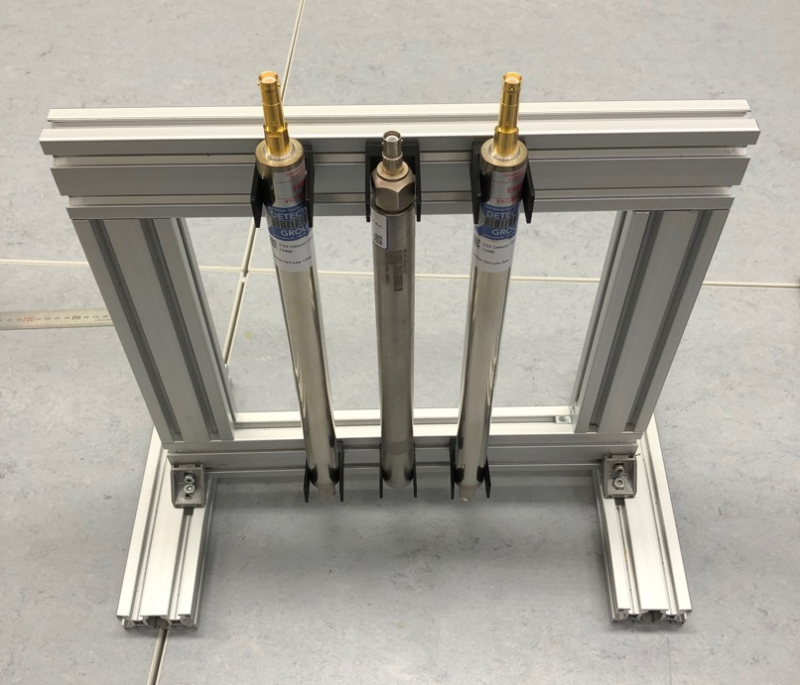
BACKGROUND: cosmic neutrons
Measurements done in Utgård
Solids + Gases
Dimensions:
2.54mm diam. x 250mm length
gas
Detector window
cosmics
He-4 5bar
He-3 10bar
He-4 10bar
He-3 and He-4 detectors
*Thanks to Toshiba/Canon Electron Tubes & Devices Co. LTD for the He-4 tubes.
F. Piscitelli et al., Verification of He-3 proportional counters fast neutron sensitivity through a comparison with He-4 detectors, sub. to EPJ Plus (2020) (arxiv: 2002.08153)

Slide 12
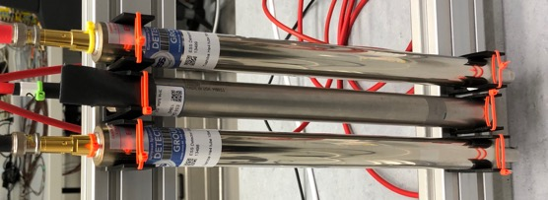
BACKGROUND: cosmic neutrons
Bare tubes
He-4 5 bar
He-3 10 bar
He-4 10 bar
Pulse-Height-Spectrum
He-3 10bar
He-4 10bar
F. Piscitelli et al., Verification of He-3 proportional counters fast neutron sensitivity through a comparison with He-4 detectors, sub. to EPJ Plus (2020) (arxiv: 2002.08153)

Slide 13
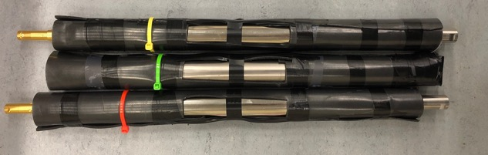
BACKGROUND: cosmic neutrons
Bare tubes
Covered with 2mm Mirrobor
He-4 5 bar
He-3 10 bar
He-4 10 bar
Pulse-Height-Spectrum
Pulse-Height-Spectrum
He-3 10bar
He-4 10bar
He-3 10bar
He-4 10bar
F. Piscitelli et al., Verification of He-3 proportional counters fast neutron sensitivity through a comparison with He-4 detectors, sub. to EPJ Plus (2020) (arxiv: 2002.08153)

Slide 14
BACKGROUND: cosmic neutrons
Bare tubes
Covered with 2mm Mirrobor
He-4 5 bar
He-3 10 bar
He-4 10 bar
Pulse-Height-Spectrum
Pulse-Height-Spectrum
He-3 10bar
Thermal n decrease
He-4 10bar
He-3 10bar
He-4 10bar
Fast n
unaltered
F. Piscitelli et al., Verification of He-3 proportional counters fast neutron sensitivity through a comparison with He-4 detectors, sub. to EPJ Plus (2020) (arxiv: 2002.08153)

Slide 15
BACKGROUND: cosmic neutrons
Bare tubes
Covered with 2mm Mirrobor
He-4 5 bar
He-3 10 bar
He-4 10 bar
Rate Hz | rate per area Hz/m² | rate per volume Hz/m³ | detector | Rate Hz | rate per area Hz/m² | rate per volume Hz/m³
0.148 0.0043 | 23 0.7 | 292 8.5 | He-3 10bar He-4 10bar | 0.007 0.005 | 1 0.8 | 14 10
0.029 Hz / (bar ⋅ litre) of He3
0.0014 Hz / (bar ⋅ litre) of He3
F. Piscitelli et al., Verification of He-3 proportional counters fast neutron sensitivity through a comparison with He-4 detectors, sub. to EPJ Plus (2020) (arxiv: 2002.08153)

Slide 16
BACKGROUND: cosmic neutrons
Bare tubes
Covered with 2mm Mirrobor
He-4 5 bar
He-3 10 bar
He-4 10 bar
Rate Hz | rate per area Hz/m² | rate per volume Hz/m³ | detector | Rate Hz | rate per area Hz/m² | rate per volume Hz/m³
0.148 0.0043 | 23 0.7 | 292 8.5 | He-3 10bar He-4 10bar | 0.007 0.005 | 1 0.8 | 14 10
0.029 Hz / (bar ⋅ litre) of He3
0.0014 Hz / (bar ⋅ litre) of He3
elevation 85m ~ ESS
135 Hz/m² (10⁻⁹ to 10³ MeV) by PTB
Agreement with rates at FRMII
K. Zeitelhack – private communication
Agreement with rates measured with MG at Utgård (See next talk from Alex)
F. Piscitelli et al., Verification of He-3 proportional counters fast neutron sensitivity through a comparison with He-4 detectors, sub. to EPJ Plus (2020) (arxiv: 2002.08153)

Slide 17
GAMMA-RAY
BACKGROUND
August 2015

Slide 18
BACKGROUND: gamma-rays
Solids + Gases
gas
Detector window

Slide 19
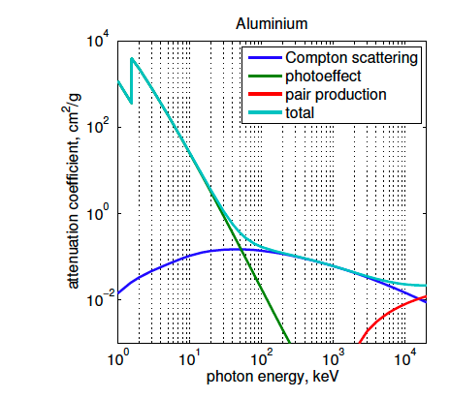
BACKGROUND: gamma-rays
Solids + Gases
gas
Detector window
50keV
electrons
gamma-rays
e⁻
photoelectric
e⁻
gamma-ray
N
Compton
Photoelectric / Compton
pair
Photoelectric interaction most probable at low energy,
Compton scattering is the majority of the background
A. Khaplanov et al., Investigation of gamma-ray sensitivity of neutron detectors based on thin converter films, JINST 8 P10025 (2013) (arxiv: 1306:6247)

Slide 20
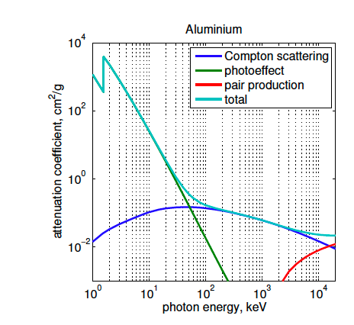
BACKGROUND: gamma-rays
solid
gas
Solids + Gases
electrons
gas
Detector window
50keV
electrons
gamma-rays
e⁻
photoelectric
e⁻
gamma-ray
Compton
Photoelectric / Compton
pair
Photoelectric interaction most probable at low energy,
Compton scattering is the majority of the background
A. Khaplanov et al., Investigation of gamma-ray sensitivity of neutron detectors based on thin converter films, JINST 8 P10025 (2013) (arxiv: 1306:6247)

Slide 21
BACKGROUND: gamma-rays
solid
gas
Solids + Gases
electrons
gas
Detector window
electrons
gamma-rays
solid
gas
gas
e⁻
e⁻
gammas in the walls can only result in a signal if the electron reaches the gas
photons interacting with the gas are guaranteed to generate a signal
Gas vs Solid
A. Khaplanov et al., Investigation of gamma-ray sensitivity of neutron detectors based on thin converter films, JINST 8 P10025 (2013) (arxiv: 1306:6247)

Slide 22
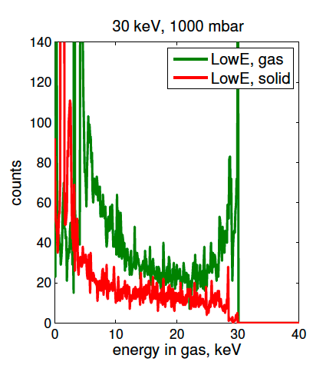
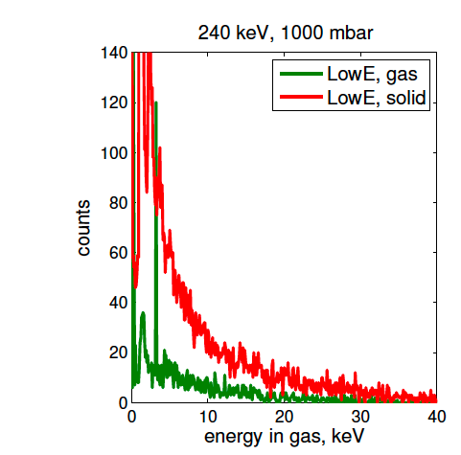
BACKGROUND: gamma-rays
(Simulations)
solid
gas
Solids + Gases
electrons
gas
Detector window
30keV
150keV
240keV
electrons
γ–ray energy
gamma-rays
Gas dominates
Solid dominates
30keV
gamma
240keV
gamma
150 keV for
1 atm of ArCO2
and Al walls
is 50/50
Gas vs Solid
A. Khaplanov et al., Investigation of gamma-ray sensitivity of neutron detectors based on thin converter films, JINST 8 P10025 (2013) (arxiv: 1306:6247)

Slide 23
BACKGROUND: gamma-rays
(Simulations)
solid
gas
Solids + Gases
electrons
gas
Detector window
30keV
150keV
240keV
electrons
γ–ray energy
gamma-rays
Gas dominates
Solid dominates
30keV
gamma
240keV
gamma
150 keV for
1 atm of ArCO2
and Al walls
is 50/50
Energy threshold generally 100-200keV
Solid dominates
Gas vs Solid
A. Khaplanov et al., Investigation of gamma-ray sensitivity of neutron detectors based on thin converter films, JINST 8 P10025 (2013) (arxiv: 1306:6247)

Slide 24
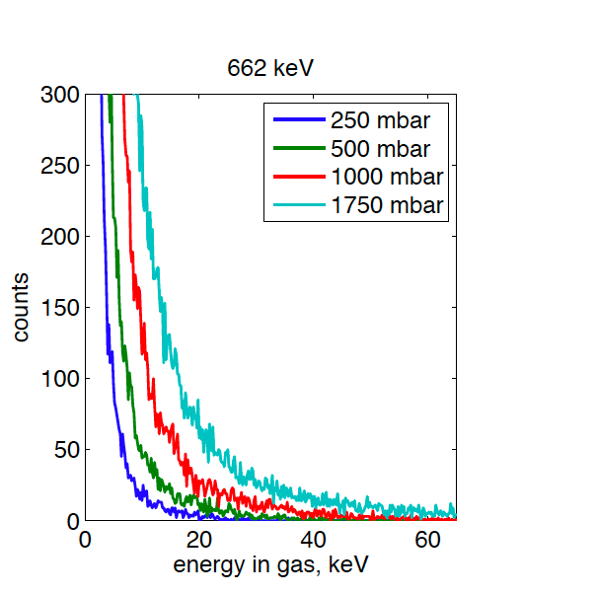
BACKGROUND: gamma-rays
Higher pressure = higher energy deposition
Solids + Gases
gas
Detector window
electrons
gamma-rays
(Simulations)
A. Khaplanov et al., Investigation of gamma-ray sensitivity of neutron detectors based on thin converter films, JINST 8 P10025 (2013) (arxiv: 1306:6247)

Slide 25
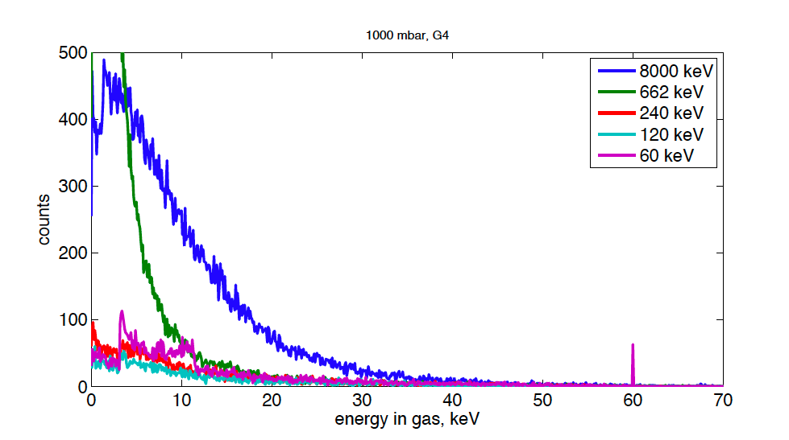
BACKGROUND: gamma-rays
Higher pressure = higher energy deposition
Solids + Gases
gas
Detector window
electrons
gamma-rays
Higher gamma energy = higher energy deposition
8MeV incoming gamma
… BUT deposited energies
rarely exceed a few tens
of keV regardless of
the primary energy
60keV incoming gamma
(Simulations)
A. Khaplanov et al., Investigation of gamma-ray sensitivity of neutron detectors based on thin converter films, JINST 8 P10025 (2013) (arxiv: 1306:6247)

Slide 26
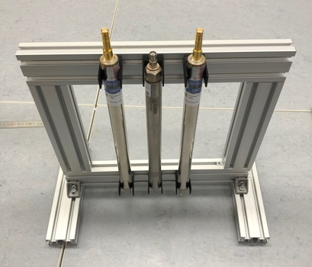
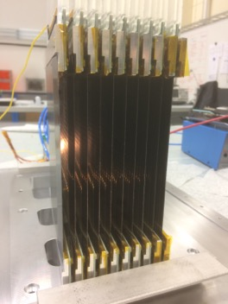
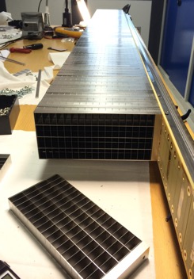
BACKGROUND: gamma-rays
Solid dominates no matter if He-3 or B-10
Solids + Gases
Measurements
gas
Detector window
electrons
gamma-rays
Multi-Grid B-10
(spectrometers)
Multi-Blade B-10
(reflectometers)
He-3/He-4 detectors

Slide 27
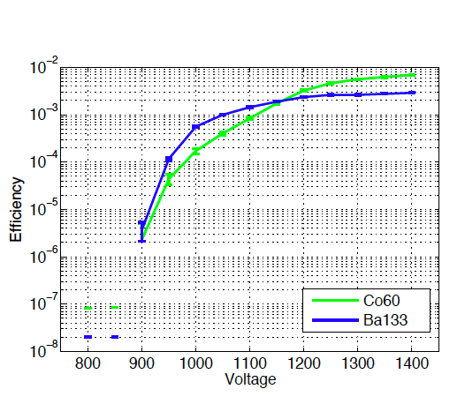
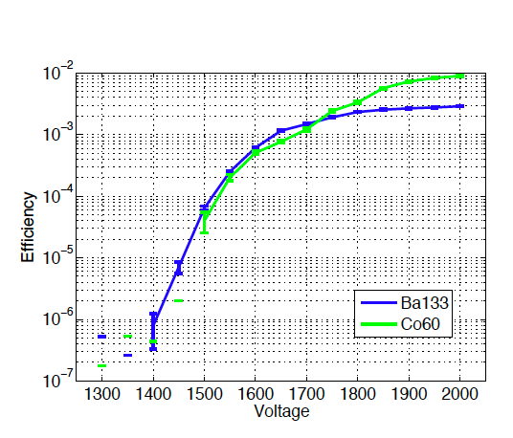
Solid dominates no matter if He-3 or B-10
Multi-Grid B-10
He-3
gammas 1.1 - 1.3MeV
gammas <400keV
August 2015
A. Khaplanov et al., Investigation of gamma-ray sensitivity of neutron detectors based on thin converter films, JINST 8 P10025 (2013) (arxiv: 1306:6247)

Slide 28
Pulse Height Spectrum - PHS
counts
Pulse Height Spectrum - PHS
Pulse Height
Sensitivity / efficiency
Sensitivity / efficiency
August 2015
Threshold

Slide 29
Pulse Height Spectrum - PHS
counts
Pulse Height
Sensitivity / efficiency
August 2015
Threshold

Slide 30
Pulse Height Spectrum - PHS
counts
Pulse Height
Sensitivity / efficiency
August 2015
Threshold

Slide 31
Pulse Height Spectrum - PHS
counts
Pulse Height
Sensitivity / efficiency
August 2015
Threshold

Slide 32
Pulse Height Spectrum - PHS
counts
Pulse Height
Sensitivity / efficiency
August 2015
Threshold

Slide 33
Pulse Height Spectrum - PHS
counts
Pulse Height
Sensitivity / efficiency
August 2015
Threshold

Slide 34
Pulse Height Spectrum - PHS
counts
Pulse Height
Sensitivity / efficiency
August 2015
Threshold

Slide 35
Pulse Height Spectrum - PHS
counts
Pulse Height
Sensitivity / efficiency
August 2015
Threshold
F. Piscitelli et al., The Multi-Blade Boron-10-based Neutron Detector for high intensity Neutron Reflectometry at ESS, JINST 12 P03013 (2017) (arxiv: 1701.07623)

Slide 36
Measured with Multi-Blade B-10
PHS
Sensitivity / Efficiency
Cold neutrons
August 2015
gammas
F. Piscitelli et al., The Multi-Blade Boron-10-based Neutron Detector for high intensity Neutron Reflectometry at ESS, JINST 12 P03013 (2017) (arxiv: 1701.07623)

Slide 37
Sensitivity / Efficiency
Cold neutrons
Gamma-ray Sensitivity
50 – 200keV
10⁻⁶
~3 orders of magnitude
10⁻⁹
August 2015
gammas
No matter if He3 or B-10
(Solid Dominates)
F. Piscitelli et al., The Multi-Blade Boron-10-based Neutron Detector for high intensity Neutron Reflectometry at ESS, JINST 12 P03013 (2017) (arxiv: 1701.07623)

Slide 38
FAST NEUTRON
BACKGROUND
August 2015

Slide 39
BACKGROUND: fast neutrons
Solids + Gases
gas
Detector window

Slide 40
BACKGROUND: fast neutrons
solid
gas
Solids + Gases
Recoil
In either
solid or gas
gas
Absorption
Detector window
fast neutrons
N

Slide 41
BACKGROUND: fast neutrons
solid
gas
Solids + Gases
Recoil
In either
solid or gas
gas
Absorption
Detector window
fast neutrons
X’
Recoil nucleus
Recoil
(elastic)
n
X
n’
(n,alpha)
N
(n,p)
n
X
Y’
Emitted particle
Absorption
n’
(n,gamma)
etc.
γ
gamma
n
X
(n,gamma)
Inelastic
(elastic)
n’

Slide 42
BACKGROUND: fast neutrons
solid
gas
Solids + Gases
Recoil
In either
solid or gas
gas
Absorption
Detector window
fast neutrons
X’
Recoil nucleus
Recoil
(elastic)
n
X
n’
(n,alpha)
N
(n,p)
n
X
Y’
Emitted particle
Absorption
n’
(n,gamma)
etc.
γ
gamma
n
X
(n,gamma)
Inelastic
(elastic)
Sensitivity <10⁻⁶
n’

Slide 43
BACKGROUND: fast neutrons
solid
gas
Solids + Gases
Recoil
In either
solid or gas
gas
Absorption
Detector window
fast neutrons
solid
gas
gas
X
X
N
particle in the walls can only result in a signal if the particle reaches the gas
particles interacting with the gas are guaranteed to generate a signal
Solid vs Gas

Slide 44
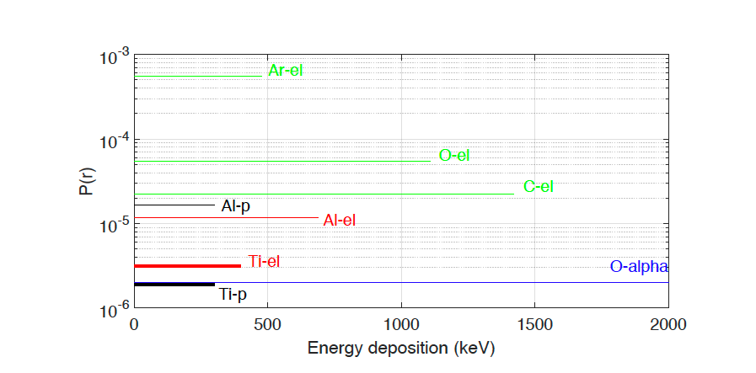
BACKGROUND: fast neutrons
solid
gas
Solids + Gases
Recoil
In either
solid or gas
gas
Absorption
Detector window
Solid vs Gas
True for both He-3 and B-10
fast neutrons
Probability to generate an event
Gas
N
Probability
Gas dominates
Gas = x100 Solid
Solids

Slide 45
BACKGROUND: fast neutrons
Gas dominates
Gas is main component, then He-3 differs from B-10 …
Recoil on He-3
Recoil on Argon
He-3 detector
B-10 detector
B-10
gas
gas
Detector window
Detector window
He-3
August 2015
Fast N
Fast N
N
N
Window+(conversion+detection)
Window+conversion+detection

Slide 46
BACKGROUND: fast neutrons
Gas dominates
Gas is main component, then He-3 differs from B-10 …
Recoil on He-3
Recoil on Argon
He-3 detector
B-10 detector
Exchange He-3 with He-4
B-10
Remove B-10
gas
gas
gas
gas
Detector window
Detector window
He-3
He-4
August 2015
Fast N
Fast N
Fast N
N
N
N
N
Window+(conversion+detection)
Window+detection
Window+conversion+detection
Window+detection

Slide 47
BACKGROUND: fast neutrons
Gas dominates
Gas is main component, then He-3 differs from B-10 …
Recoil on He-3
Recoil on Argon
He-3 detector
B-10 detector
Exchange He-3 with He-4
B-10
Remove B-10
gas
gas
gas
gas
Detector window
Detector window
He-3
He-4
August 2015
Fast N
Fast N
Fast N
N
N
N
N
Window+(conversion+detection)
Window+detection
Window+conversion+detection
Window+detection

Slide 48
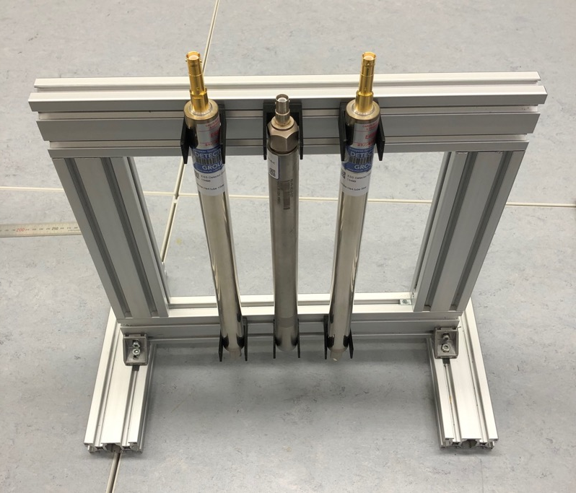
BACKGROUND: fast neutrons in He-3 detectors
*Thanks to Toshiba/Canon Electron Tubes & Devices Co. LTD for the He-4 tubes.
Recoil on He-3
He-4
10bar
He-3
10bar
He-4
5bar
He-3 detector
Exchange He-3 with He-4
gas
gas
Detector window
He-3
He-4
August 2015
Fast N
Fast N
N
N
Dimensions:
2.54mm diam. x 250mm length
Window+(conversion+detection)
Window+detection
F. Piscitelli et al., Verification of He-3 proportional counters fast neutron sensitivity through a comparison with He-4 detectors, sub. to EPJ Plus (2020) (arxiv: 2002.08153)

Slide 49
BACKGROUND: fast neutrons in He-3 detectors
Exchanging He-3 with He-4 is a good approximation to evaluate the sensitivity of He-3 to fast n
He-3
He-4
Recoil
Recoil
n
X
X’
n
X
X’
n’
n’
Absorption
n
X
Y’
n’
(n,p)
August 2015
F. Piscitelli et al., Verification of He-3 proportional counters fast neutron sensitivity through a comparison with He-4 detectors, sub. to EPJ Plus (2020) (arxiv: 2002.08153)

Slide 50
BACKGROUND: fast neutrons in He-3 detectors
Exchanging He-3 with He-4 is a good approximation to evaluate the sensitivity of He-3 to fast n
1
Similar total cross-section:
σ(He-3) ∼ σ(He-4)
He-3
He-4
Recoil
Recoil
n
X
X’
n
X
X’
n’
n’
Absorption
n
X
Y’
n’
(n,p)
August 2015
F. Piscitelli et al., Verification of He-3 proportional counters fast neutron sensitivity through a comparison with He-4 detectors, sub. to EPJ Plus (2020) (arxiv: 2002.08153)

Slide 51
BACKGROUND: fast neutrons in He-3 detectors
Exchanging He-3 with He-4 is a good approximation to evaluate the sensitivity of He-3 to fast n
1
Similar total cross-section:
σ(He-3) ∼ σ(He-4)
He-3
He-4
Recoil
Recoil
2
Almost identical energy deposition ion gas:
He-3⁺⁺ in He-3 ~ He-4⁺⁺ in He-4
n
X
X’
n
X
X’
n’
n’
Absorption
n
X
Y’
n’
(n,p)
August 2015
F. Piscitelli et al., Verification of He-3 proportional counters fast neutron sensitivity through a comparison with He-4 detectors, sub. to EPJ Plus (2020) (arxiv: 2002.08153)

Slide 52
BACKGROUND: fast neutrons in He-3 detectors
Exchanging He-3 with He-4 is a good approximation to evaluate the sensitivity of He-3 to fast n
1
Similar total cross-section:
σ(He-3) ∼ σ(He-4)
He-3
He-4
Recoil
Recoil
2
Almost identical energy deposition ion gas:
He-3⁺⁺ in He-3 ~ He-4⁺⁺ in He-4
n
X
X’
n
X
X’
n’
n’
3
Absorption
n
X
Y’
n’
(n,p)
August 2015
Different PHS
but
~ same number of events !
F. Piscitelli et al., Verification of He-3 proportional counters fast neutron sensitivity through a comparison with He-4 detectors, sub. to EPJ Plus (2020) (arxiv: 2002.08153)

Slide 53
Pulse Height Spectrum - PHS
counts
Pulse Height
Sensitivity / efficiency
August 2015
Threshold
F. Piscitelli et al., Verification of He-3 proportional counters fast neutron sensitivity through a comparison with He-4 detectors, sub. to EPJ Plus (2020) (arxiv: 2002.08153)

Slide 54
Sensitivity / Efficiency
Pulse Height Spectrum - PHS
He-3 (10bar)
Fast-N
He-4 (10bar)
Fast-N
He-4 (5bar)
gammas
August 2015
He-3 (10bar)
gammas
He-4 (10bar)
He-4 (5bar)
F. Piscitelli et al., Verification of He-3 proportional counters fast neutron sensitivity through a comparison with He-4 detectors, sub. to EPJ Plus (2020) (arxiv: 2002.08153)

Slide 55
Sensitivity / Efficiency
Fast Neutron Sensitivity
He-3
200keV
He-3 (10bar)
10⁻³
He-4 (10bar)
Fast-N
He-4 (5bar)
Difference between He3 or B-10
(Gas Dominates)
August 2015
He-3 (10bar)
gammas
He-4 (10bar)
He-4 (5bar)
F. Piscitelli et al., Verification of He-3 proportional counters fast neutron sensitivity through a comparison with He-4 detectors, sub. to EPJ Plus (2020) (arxiv: 2002.08153)

Slide 56
Sensitivity / Efficiency
100keV
200keV
Fast Neutron Sensitivity
He-3
He-3 (10bar)
10⁻³
He-4 (10bar)
Fast-N
He-4 (5bar)
Difference between He3 or B-10
(Gas Dominates)
August 2015
He-3 (10bar)
gammas
He-4 (10bar)
He-4 (5bar)
F. Piscitelli et al., Verification of He-3 proportional counters fast neutron sensitivity through a comparison with He-4 detectors, sub. to EPJ Plus (2020) (arxiv: 2002.08153)

Slide 57
Sensitivity / Efficiency
100keV
200keV
Fast Neutron Sensitivity
He-3
He-3 (10bar)
10⁻³
He-4 (10bar)
Fast-N
He-4 (5bar)
Difference between He3 or B-10
(Gas Dominates)
August 2015
He-3 (10bar)
gammas
NOTE:
high pressure He-3 detectors,
little gain in thermal n efficiency with drastic increase of fast n sensitivity!
S/B matters!
He-4 (10bar)
He-4 (5bar)
F. Piscitelli et al., Verification of He-3 proportional counters fast neutron sensitivity through a comparison with He-4 detectors, sub. to EPJ Plus (2020) (arxiv: 2002.08153)

Slide 58
BACKGROUND: fast neutrons
Gas dominates
Gas is main component, then He-3 differs from B-10 …
Recoil on He-3
Recoil on Argon
He-3 detector
B-10 detector
Exchange He-3 with He-4
B-10
Remove B-10
gas
gas
gas
gas
Detector window
Detector window
He-3
He-4
August 2015
Fast N
Fast N
Fast N
N
N
N
N
Window+(conversion+detection)
Window+detection
Window+conversion+detection
Window+detection

Slide 59
BACKGROUND: fast neutrons in B-10 detectors
Recoil on Argon
B-10 detector
B-10
Remove B-10
gas
gas
Detector window
August 2015
Fast N
N
N
Window+conversion+detection
Window+detection

Slide 60
BACKGROUND: fast neutrons in B-10 detectors
Recoil on Argon
Gas dominates
Gas = x100 Solid
B-10 detector
B-10
Remove B-10
gas
gas
Compared Titanium, Aluminum, Copper, Kapton
Detector window
August 2015
Fast N
Experimentally (+simulations) proved -> no difference!
N
N
Window+conversion+detection
Window+detection
G. Mauri et al., Fast neutron sensitivity of neutron detectors based on Boron-10 converter layers, JINST 13 P03004 (2018) (arxiv: 1712.05614)

Slide 61
Pulse Height Spectrum - PHS
counts
Pulse Height
Sensitivity / efficiency
August 2015
Threshold
G. Mauri et al., Fast neutron sensitivity of neutron detectors based on Boron-10 converter layers, JINST 13 P03004 (2018) (arxiv: 1712.05614)

Slide 62
BACKGROUND: fast neutrons in B-10 detectors
Sensitivity / Efficiency
Thermal-N
Fast-N
August 2015
gammas
G. Mauri et al., Fast neutron sensitivity of neutron detectors based on Boron-10 converter layers, JINST 13 P03004 (2018) (arxiv: 1712.05614)

Slide 63
BACKGROUND: fast neutrons in B-10 detectors
Sensitivity / Efficiency
Thermal-N
Fast Neutron Sensitivity
B-10
100keV
200keV
10⁻⁵
Fast-N
August 2015
Difference between He3 or B-10
(Gas Dominates)
gammas
G. Mauri et al., Fast neutron sensitivity of neutron detectors based on Boron-10 converter layers, JINST 13 P03004 (2018) (arxiv: 1712.05614)

Slide 64
BACKGROUND
DUE TO
SCATTERED NEUTRONS
August 2015

Slide 65
BACKGROUND: scattering
He-3 detector B-10 detector
B-10
Detector window
gas
Detector window
He-3
gas
N
N
N
N
N
N
Detector cells or voxels
August 2015
Scattering at the detector window: B10 has generally thinner windows due to lower pressure
Scattering at other parts of the detector

Slide 66
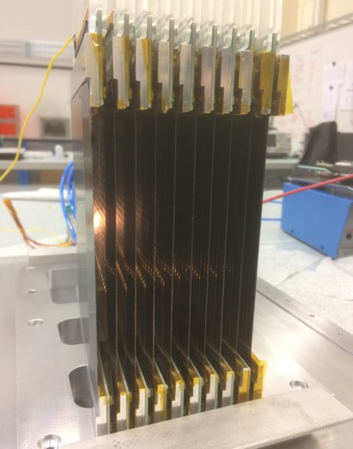
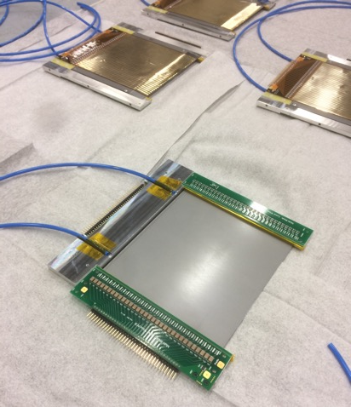
BACKGROUND: scattering
32 Wires
MWPC
130mm
¹⁰B-detector for reflectometers:
Estia and FREIA
A cassette (unit)
neutrons
100mm
neutrons
Multi-Blade
sample

Slide 67
Detector window
wires X
N
substrate
¹⁰B₄C
strips Y
G. Mauri et al., The Multi-Blade Boron-10-based neutron detector performance using a focusing reflectometer, (2020) (arxiv: 2001:02965). Accepted for publ. in JINST.

Slide 68
Multi-Blade
detector
Detector window
wires X
N
N
substrate
¹⁰B₄C
strips Y
G. Mauri et al., The Multi-Blade Boron-10-based neutron detector performance using a focusing reflectometer, (2020) (arxiv: 2001:02965). Accepted for publ. in JINST.

Slide 69
Image of the detector
Multi-Blade
detector
Detector window
Beam transmitted
wires X
N
N
substrate
¹⁰B₄C
strips Y
G. Mauri et al., The Multi-Blade Boron-10-based neutron detector performance using a focusing reflectometer, (2020) (arxiv: 2001:02965). Accepted for publ. in JINST.

Slide 70
Image of the detector
Multi-Blade
detector
Detector window
Beam transmitted
wires X
N
N
substrate
¹⁰B₄C
strips Y
1D projection
G. Mauri et al., The Multi-Blade Boron-10-based neutron detector performance using a focusing reflectometer, (2020) (arxiv: 2001:02965). Accepted for publ. in JINST.

Slide 71
Image of the detector
Multi-Blade
detector
Detector window
Beam transmitted
wires X
N
N
substrate
¹⁰B₄C
strips Y
1D projection
Beam blocked to evaluate instrument bkg
Beam blocked
Multi-Blade
detector
N
G. Mauri et al., The Multi-Blade Boron-10-based neutron detector performance using a focusing reflectometer, (2020) (arxiv: 2001:02965). Accepted for publ. in JINST.

Slide 72
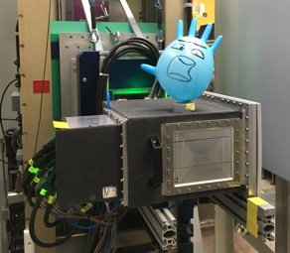
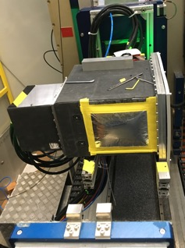
Image of the detector
Multi-Blade
detector
Detector window
Beam transmitted
wires X
N
N
substrate
¹⁰B₄C
strips Y
1D projection
DETECTOR WINDOW
1mm Aluminium
50um Aluminium foil
G. Mauri et al., The Multi-Blade Boron-10-based neutron detector performance using a focusing reflectometer, (2020) (arxiv: 2001:02965). Accepted for publ. in JINST.

Slide 73
Multi-Blade – B-10
10⁰
He-3 – AMOR detector
10⁻²
* Thanks to A. Glavic and J. Stahn
10⁻⁴
Instrument
background
10⁻⁶
G. Mauri et al., The Multi-Blade Boron-10-based neutron detector performance using a focusing reflectometer, (2020) (arxiv: 2001:02965). Accepted for publ. in JINST.

Slide 74
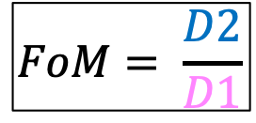
Multi-Blade – B-10
10⁰
He-3 – AMOR detector
10⁻²
* Thanks to A. Glavic and J. Stahn
10⁻⁴
Instrument
background
10⁻⁶
(normalized to same area)
Figure-of-Merit ∝ Signal-to-Background
$$FoM= \frac{D2}{D1}$$
G. Mauri et al., The Multi-Blade Boron-10-based neutron detector performance using a focusing reflectometer, (2020) (arxiv: 2001:02965). Accepted for publ. in JINST.

Slide 75
Multi-Blade – B-10
10⁰
He-3 – AMOR detector
10⁻²
* Thanks to A. Glavic and J. Stahn
10⁻⁴
Instrument
background
10⁻⁶
(normalized to same area)
Detector | FoM (2.5-15Å)
He-3 (a few mm Al window) | 4000
Multi-Blade B10 – Al 1mm window | 73000
Multi-Blade B10 – Al foil window | 211000
Figure-of-Merit ∝ Signal-to-Background
$$FoM= \frac{D2}{D1}$$
x20
x50
G. Mauri et al., The Multi-Blade Boron-10-based neutron detector performance using a focusing reflectometer, (2020) (arxiv: 2001:02965). Accepted for publ. in JINST.

Slide 76
Conclusions
August 2015

Slide 77
Conclusions
1
@ESS 23 Hz/m² cosmic thermal neutrons and 1 Hz/m² with shielding
August 2015

Slide 78
Conclusions
1
@ESS 23 Hz/m² cosmic thermal neutrons and 1 Hz/m² with shielding
2
Aluminium foil as a detector window reduces x50 the background generated by scattered neutrons
August 2015

Slide 79
Conclusions
(*results are general and applicable for any facility)
1
@ESS 23 Hz/m² cosmic thermal neutrons and 1 Hz/m² with shielding
2
Aluminium foil as a detector window reduces x50 the background generated by scattered neutrons
3
Boron-10 |  | Helium-3
0.5 – 0.8 | Thermal N Efficiency | 0.6 - 1
10⁻⁵ | Fast neutron sensitivity (gas dominates) | 10⁻³
10⁻⁶ - 10⁻⁹ | Gamma-ray sensitivity (solid dominates) | 10⁻⁶ - 10⁻⁹
August 2015
Highly affected by a small variation of the threshold

Slide 80
References
Gamma-ray sensitivity
A. Khaplanov et al., Investigation of gamma-ray sensitivity of neutron detectors based on thin converter films, JINST 8 P10025 (2013) (arxiv: 1306:6247)
F. Piscitelli et al., The Multi-Blade Boron-10-based Neutron Detector for high intensity Neutron Reflectometry at ESS, JINST 12 P03013 (2017) (arxiv: 1701.07623)
Fast neutron sensitivity
F. Piscitelli et al., Verification of He-3 proportional counters fast neutron sensitivity through a comparison with He-4 detectors, sub. to EPJ Plus (2020) (arxiv: 2002.08153)
G. Mauri et al., Fast neutron sensitivity for 3He detectors and comparison with Boron-10 based neutron detectors, EPJ TI 6, no. 1, p. 3, (2019) (arxiv: 1902:09870)
G. Mauri et al., Fast neutron sensitivity of neutron detectors based on Boron-10 converter layers, JINST 13 P03004 (2018) (arxiv: 1712.05614)
Scattered Neutron Background
G. Mauri et al., The Multi-Blade Boron-10-based neutron detector performance using a focusing reflectometer, Accepted for publ. in JINST (2020) (arxiv: 2001:02965).
F. Piscitelli et al., Characterization of the Multi-Blade 10B-based detector at the CRISP reflectometer at ISIS, JINST 13 P05009 (2018) (arxiv: 1803.09589)
G. Galgoczi et al., Investigation of neutron scattering in the Multi-Blade detector with GEANT4 simulations, JINST 13 P12031 (2018) (arxiv: 1810:06241)
E. Rossi, Master. thesis, Characterisation of the Spatial Resolution and the Gamma-ray Discrimination of Helium-3 Proportional Counters (2015) (arxiv: 1702:06501)
J. Birch et al., Investigation of background in large-area neutron detectors due to alpha emission from impurities in aluminium, JINST 10, P10019 (2015) (arxiv: 1507:00607)
J. Birch et al., In-beam test of the Boron-10 Multi-Grid neutron detector at the IN6 Time-of-Flight spectrometer at the ILL, J. Phys. Conf. Ser. 528:1, 012040 (2014)

Slide 81
BACKUP SLIDES
August 2015

Slide 82
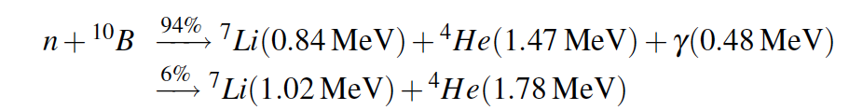
He3 detector B10 detector
Usually thicker for He3
B10
Detector window
Detector window
gas
gas
He3
Detector cells or voxels
N
N
August 2015
Window+(conversion+detection)
Window+conversion+detection

Slide 83
BACKGROUND
DUE TO
SCATTERED NEUTRONS
August 2015

Slide 84
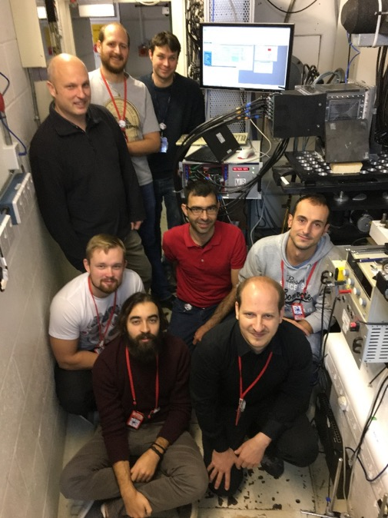
detector area
detector ToF
Multi-Blade
detector
sample
Background
Background
ToF of the
reflected intensity
reflected intensity
0.5 2 6Å
ToF (or λ)
(Log scale)
20ms (6Å)
6ms (2Å)
October 2017 - CRISP reflectometer @ ISIS

Slide 85
detector area
detector ToF
Multi-Blade
detector
sample
Background
Background
ToF of the
reflected intensity
reflected intensity
0.5 2 6Å
ToF (or λ)
(Log scale)
20ms (6Å)
Gating between 6ms and 20ms
6ms (2Å)
(Log scale)

Slide 86
detector area
detector ToF
Multi-Blade
detector
sample
Background
Background
ToF of the
reflected intensity
reflected intensity
0.5 2 6Å
Projection over Y-axis
ToF (or λ)
(Log scale)
20ms (6Å)
Gating between 6ms and 20ms
6ms (2Å)
(Log scale)

Slide 87
Multi-Blade
detector
55 neutrons get scattered @ 0.5Å
sample
100 neutrons
substrate
wires X
¹⁰B₄C
strips Y
98%
Nominal ¹⁰B₄C coating 7um
Actual ¹⁰B₄C coating 4um
90%
~4⋅10⁻³
61%
2Å
45%
0.5Å

Slide 88
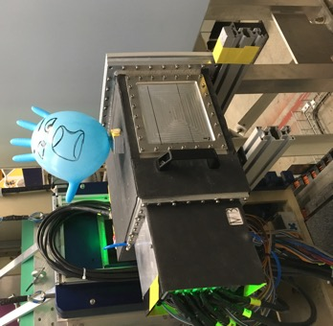
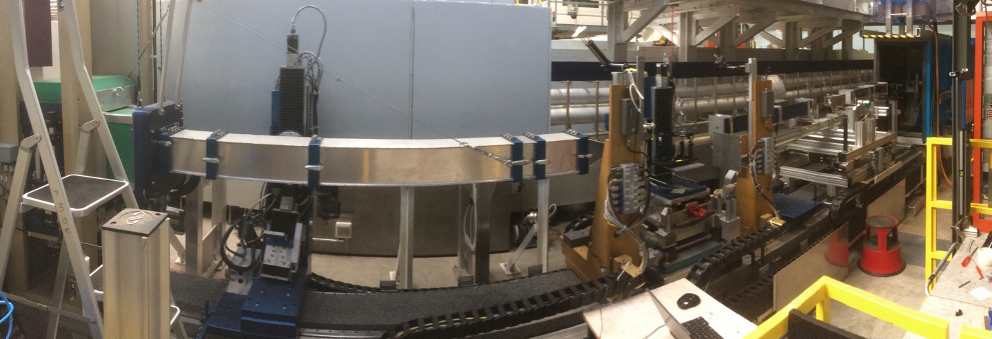
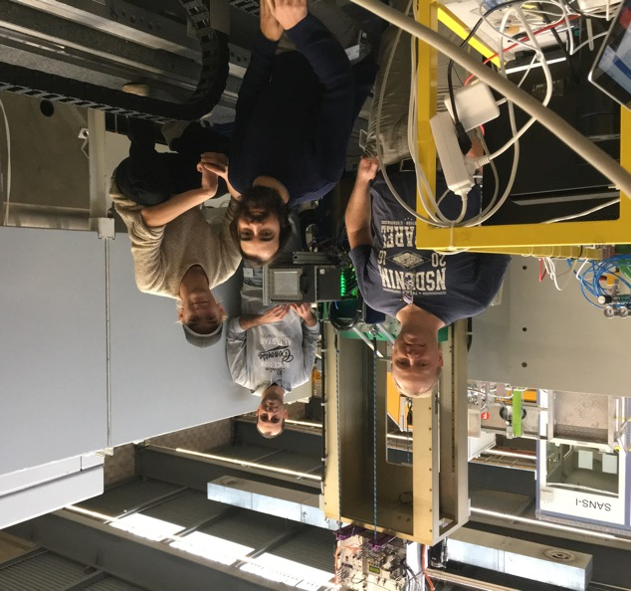
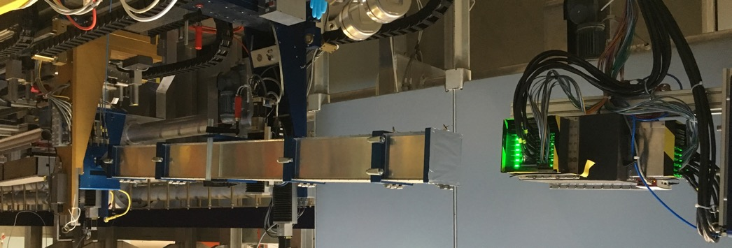
November 2018 - AMOR reflectometer @ PSI
Selene guide
detector
sample
flight tube
MB detector
neutrons
WP5 Data Acquisition software chain has been developed during BrightnESS (WP5 - i.e. DMSC/Data) and tested @ AMOR

Slide 89
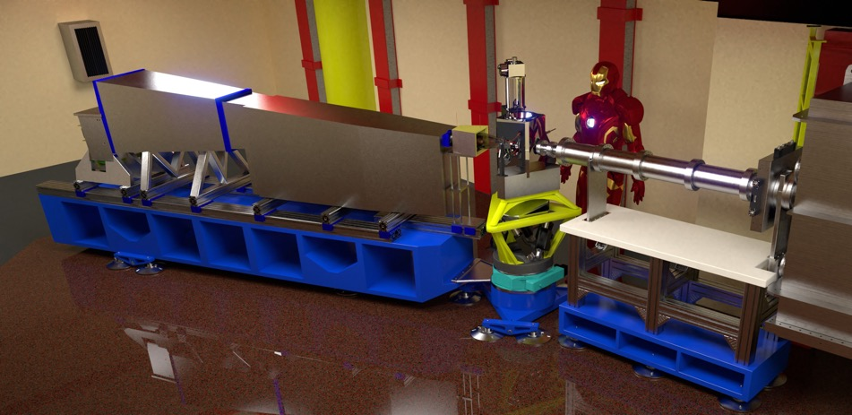
November 2018 - AMOR reflectometer @ PSI
Selene guide
detector
sample
flight tube
sample
MB detector
detector
flight tube
neutrons
ESTIA

Slide 90
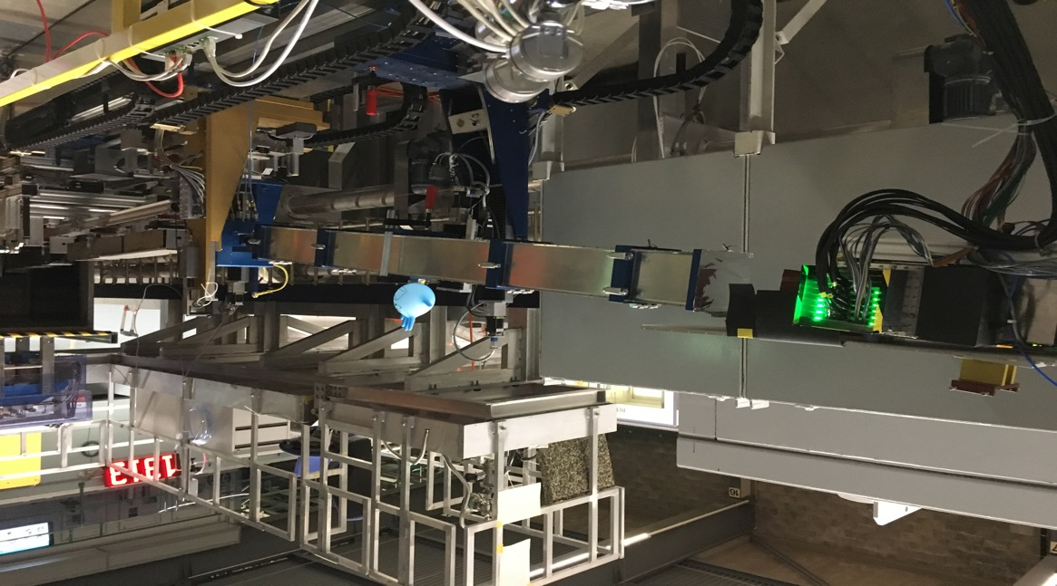
CHOPPER
SLIT 1
SELENE 1
SELENE 2
SAMPLE
SLIT 4
FRAME OVERLAP
MIRROR
MID FOCAL POINT
FOCAL POINT
MB DETECTOR
4.9 m
L ~ 3.4 m
Multi-Blade
Selene guide
flight tube
sample

Slide 91
CHOPPER
SLIT 1
SELENE 1
SELENE 2
SAMPLE
SLIT 4
FRAME OVERLAP
MIRROR
MID FOCAL POINT
MB DETECTOR
4.9 m
L ~ 3.4 m
Cd slit to block the beam far from the detector with shutter open
Beam transmitted
Beam blocked

Slide 92
Y-Projection
Beam transmitted
Beam blocked

Slide 93
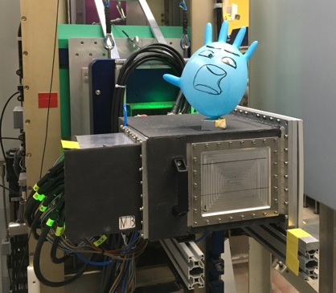
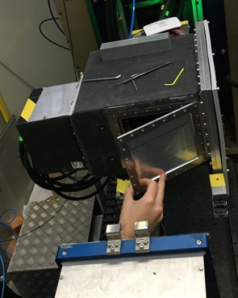

1mm Al window
50um Al foil
Y-Projection
Beam transmitted
Beam blocked

Slide 94
Y-Projection
1mm window
~ 10⁻⁴
Foil window
~ 3⋅10⁻⁵
Instrument background
~ 2⋅10⁻⁵

Slide 95
CRISP (ISIS) demonstrator
4.4um 10B4C
Y-Projection
AMOR (PSI) demonstrator
8um 10B4C
~4⋅10⁻³
~ 3⋅10⁻⁵
~ 2⋅10⁻⁵
55 neutrons get scattered @ 0.5Å
100 neutrons
Problem Solved!
substrate
wires X
¹⁰B₄C
strips Y

Slide 96
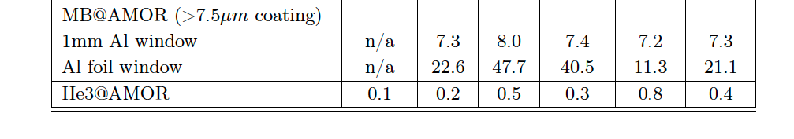
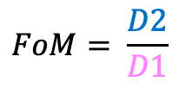
Multi-Blade - B10
10⁰
He3 – AMOR detector
10⁻²
10⁻⁴
Intrument
background
10⁻⁶
$$FoM= \frac{D2}{D1}$$
(normlized to same area)
Foil ~ x3 ~ 1mm window ~ x20 ~ He3
Foil ~ x60 ~ He3

Slide 97
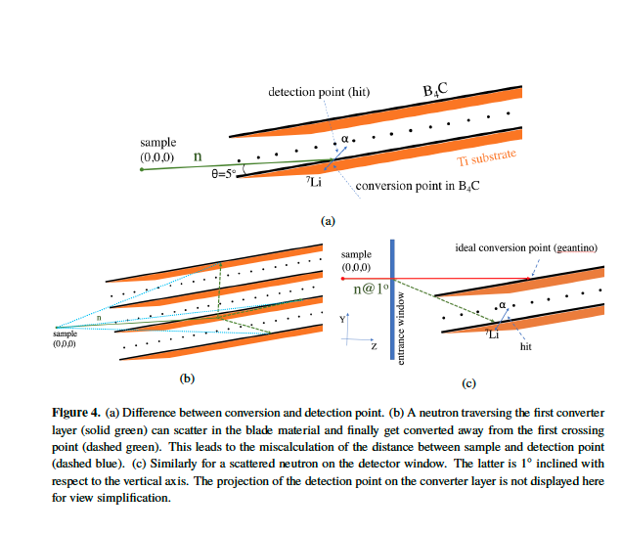
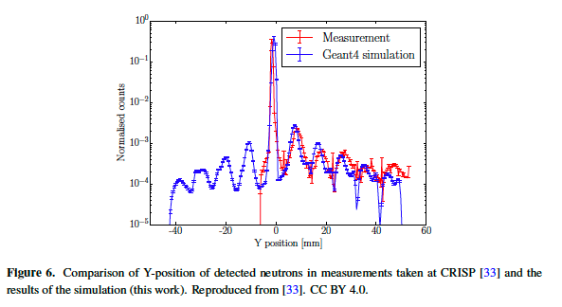
August 2015

Slide 98
FAST NEUTRON
BACKGROUND
August 2015

Slide 99
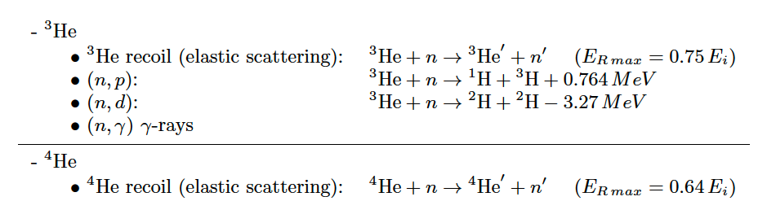
THEORY
Cross-sections
Similar probability:
to happen recoil in He4
as recoil+(n,p) in He3!
August 2015
We can consider only recoil and (n,p)

Slide 100
THEORY
Same number density for He3 and He4 -> n = 2.43e19 1/cm³ @ 1 bar
Macro corss-sect
And Probability
Mass density: He4 0.00016 g/cm3 and He3 0.00012 g/cm3 @ 1bar
for 2.54cm
(tube diam.)
August 2015

Slide 101
August 2015

Slide 102
Set-up and Methodology. Background Measurements @ CRISP reflectometer
25Hz
Spectrum sketch scenarios:
O: chopper in phase with the proton pulse. Beam passes through the chopper
C: chopper not in phase with the proton pulse. Neutron beam hits the chopper
TS2: 1 every 5 pulse is sent to Target Station 2
2. Indirect Calculation

Slide 103
Measurements & Calculation. Background Measurements @ CRISP reflectometer
Spectrum region of interest:
(T): 𝚽 total flux integrated in the full spectrum t = 0-200 ms
(O): 𝚽_{tn} thermal flux integrated in t = 120-160 ms
(C): 𝚽_{p} background flux integrated in t = 100-105 ms
2. Indirect Calculation

Slide 104
Measurements & Calculation. Background Measurements @ CRISP reflectometer
Spectrum region of interest:
(T): 𝚽 total flux integrated in the full spectrum t = 0-200 ms
(O): 𝚽_{tn} thermal flux integrated in t = 120-160 ms
(C): 𝚽_{p} background flux integrated in t = 100-105 ms
2. Indirect Calculation

Slide 105
Measurements & Calculation. Background Measurements @ CRISP reflectometer
Spectrum region of interest:
(T): 𝚽 total flux integrated in the full spectrum t = 0-200 ms
(O): 𝚽_{tn} thermal flux integrated in t = 120-160 ms
(C): 𝚽_{p} background flux integrated in t = 100-105 ms
2. Indirect Calculation

Slide 106
Measurements & Calculation. Background Measurements @ CRISP reflectometer
Indirect calculation
$$Φ_{i}^{MB}: ε_{i}^{MB}=Φ_{i}^{He}: ε_{i}^{He}$$
$$ε_{i}^{He}=\frac{{Φ_{i}^{He}∗ε}_{i}^{MB}}{Φ_{i}^{MB}}$$
Calculated fast neutron flux
$$Φ_{fn}=\frac{Φ−(4∗Φ_{tn})}{4} \sim { Φ}_{p}$$
2. Indirect Calculation

Slide 107
Measurements & Calculation. Background Measurements @ CRISP reflectometer
(T)
(O)
(C)
 | 𝚽 | 𝚽_{tn} | 𝚽_{p} | 𝚽_{fn}
MB | 6.6∙10⁴ ± 250 | 1.56∙10⁴ ± 120 | 870 ± 30 | 900 ± 140
³He | 3.95∙10⁵ ± 600 | 2.45∙10⁴ ± 150 | 7.38∙10⁴ ± 300 | 7.4∙10⁴ ± 200
$$ε_{tn}^{He}=0.94 ±0.09$$
$$ε_{fn}^{He}=1.2∙ {10}^{−3}±6∙ {10}^{−4}$$
2. Indirect Calculation

Slide 108
GAMMA-RAY
BACKGROUND
August 2015

Slide 109
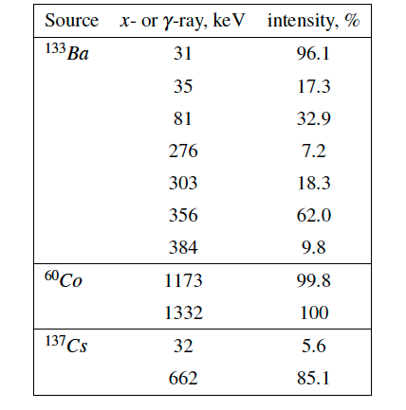
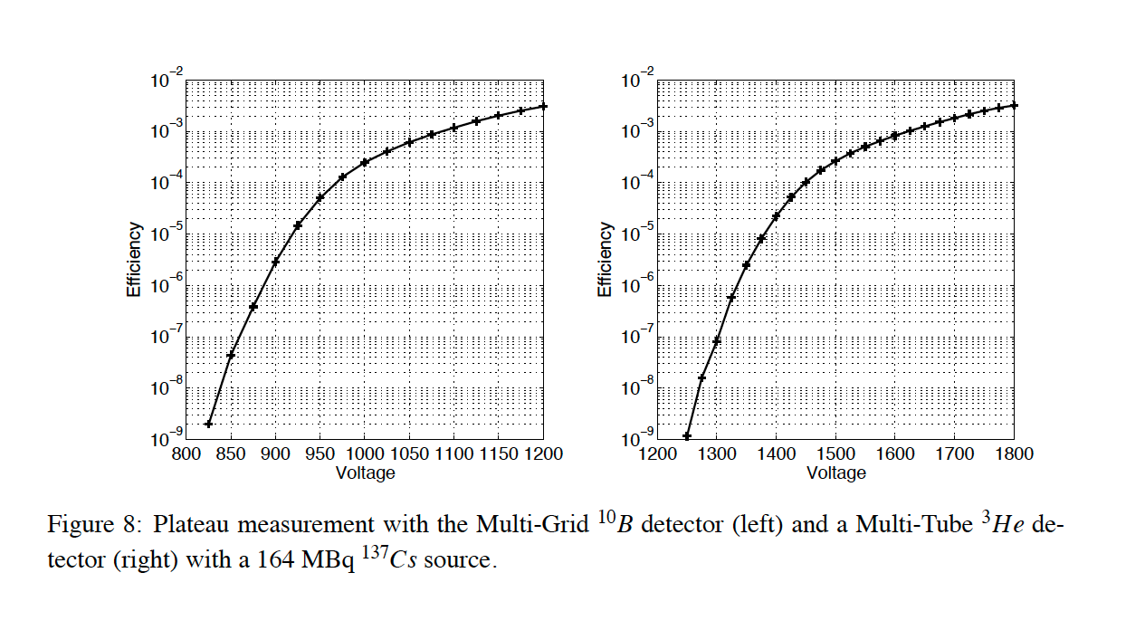
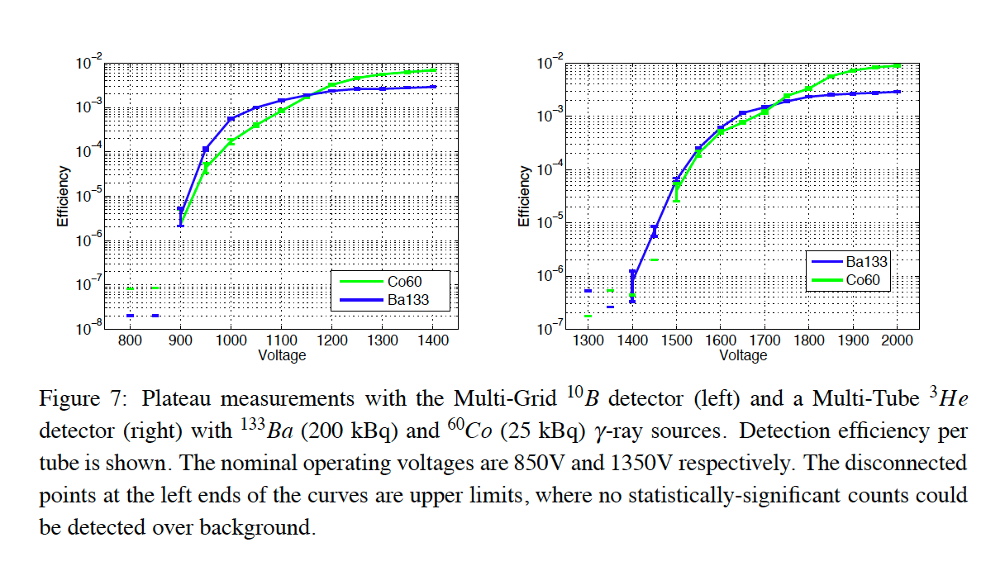
August 2015
A. Khaplanov et al., Investigation of gamma-ray sensitivity of neutron detectors based on thin converter films, JINST 8 P10025 (2013) (arxiv: 1306:6247)

Slide 110
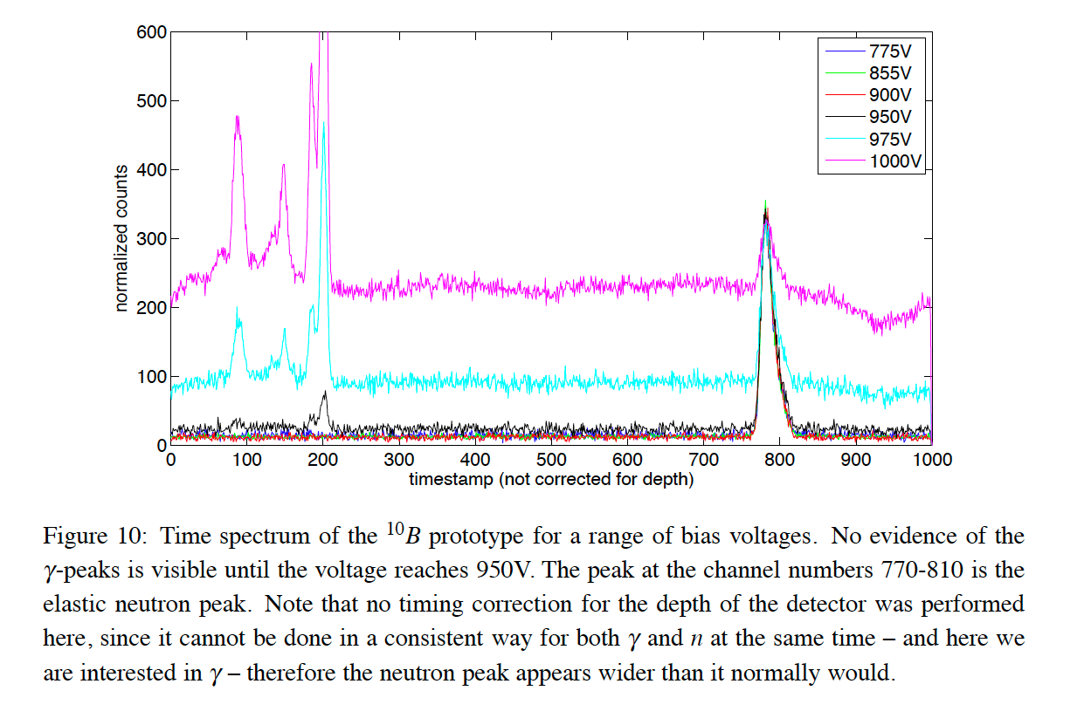
August 2015

Slide 111
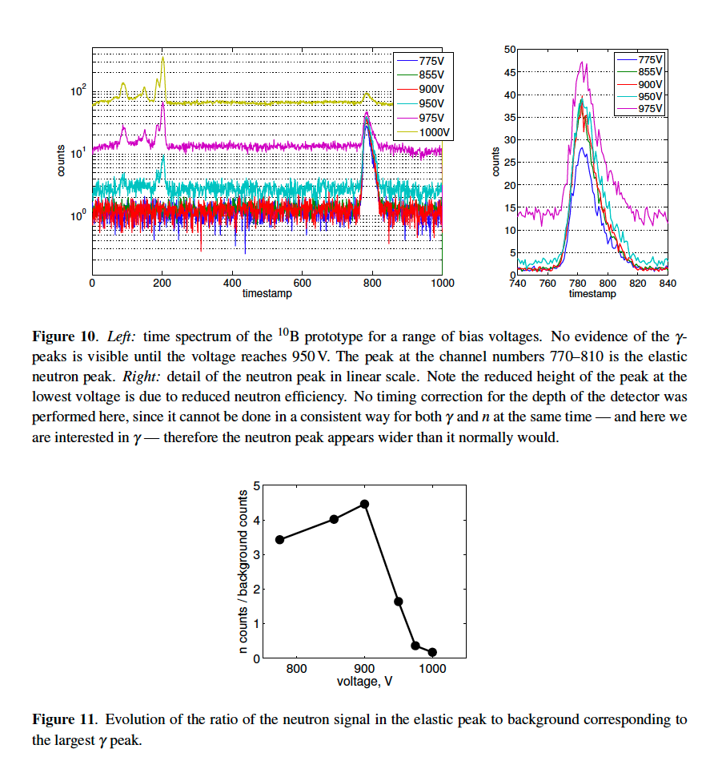
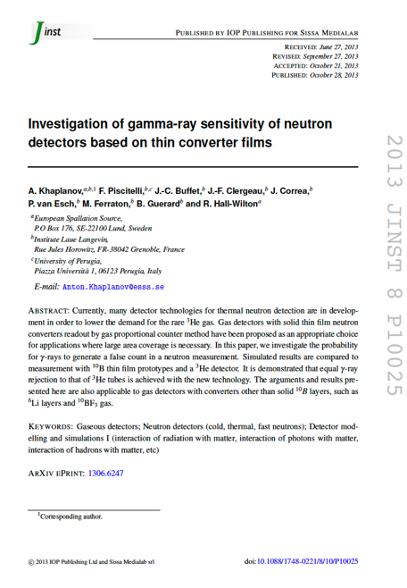
August 2015

Slide 112
August 2015

