Slide 1
PROPOSAL: Instrument Electrical integration
Clara Lopez
Senior engineer- Integration engineer
European Spallation Source ERIC
Date

Slide 2
NSS - Technical Projects Group High Level Scope of Work
NSS Electrical Integration
Electrical Integration
NSS - Technical Projects Group
Finalise NSS Grounding/Earthing Strategy
Load list
Cable list
Cable containments
E3D
Cabinet location
Grounding
Agree NSS Grounding/Earthing Zones
Finalise Grounding/Earthing Documentation
NSS Instrument Mains Power Design. E buildings
NSS Instrument Mains Power Design. D buildings
NSS Instrument Mains Power Design. Bunker areas
Electrical Design
in E-Plan
NSS Instrument Mains Power Containment Aveva 3d.
NSS Instrument Mains Power Installation and commissioning.
NSS Instrument Mains Power design Eplan
Rack distribution
P&ID
Power needs
(lights, cave,
crane, hutch,
HVAC, etc)
Electrical installation
needs in bunker
Cross Division
NSS Instrument Mains Power Documentation.
CF
Fire systems
Security systems
HVAC
ESH & Q
Electrical Safety
CE Marking
EIS
Drawing standardisation
HW standardisation

Slide 3
Electrical engineering on Instruments projects
Organisational structure & Interfaces (Electrical design phase),
Technical Groups
Electrical contact in TG
Instrument team
Load list
Cable list
Cable containments
E3D
Cabinet location
Grounding
Contact person/ Instrument
Lead Instrument Engineer
Grounding Zones
Motion Control
Design
MCA
Thomas Gahl
Support
Motion Control
Design
Lead Instrument Engineer
Motion Control
Design
NSS Electrical
Engineer
Chopper Control
Design
Electrical Design
in E-Plan
Chopper Control
Design
Support
Chopper Control
Design
CHOPPERS
Markus Olsson
Detector Control
Design
Detector Control
Design
Support
Detector control
Design
DETECTORS
TBD- Richard Hall-Wilton
Integrated strategy for electrical design package
Support
Sample environment
Control Design
Sample environment
Control Design
Sample environment
Control Design
SAMPLE ENV.
Harald Schneider
ELECTRICAL INTEGRATION
Vacuum group
Vacuum group
E-Plan
Package
VACUUM
Hilko Spoelstra
PSS
Load
Amount of cabinets
Cabling
Electrical Design
E-plan
PSS
Morteza Mansouri
Rack distribution
P&ID
Power needs
(lights, cave,
crane, hutch,
HVAC, etc)
Electrical installation
needs in bunker
PSS
… etc.
… etc.
Support
…etc.
NSS
INSTRUMENTS

Slide 4
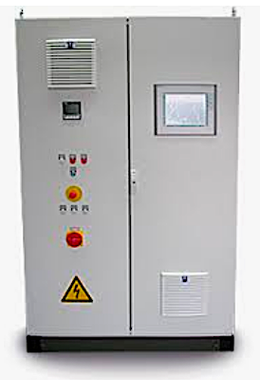
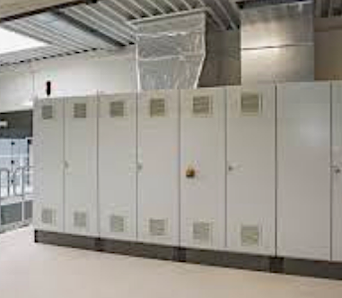
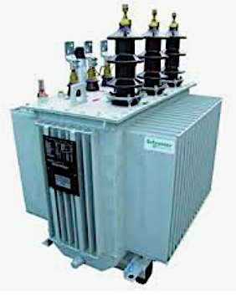
Electrical engineering on Instruments projects
Organisational structure & Interfaces (Electrical design phase),
Instruments power distribution panels
Instruments control racks
Detectors and
Beam monitors
Substation, Main Switch Gear
Components
Motion Control
Electrical Design
Procurement
Installation
Commissioning
Chopper
Assemblies
Vacuum
Equipment
CF
NSS
Instruments teams
PSS
Review process
etc

Slide 5
Electrical engineering on Instruments projects
Organisational structure & Interfaces (Electrical design phase),

