Slide 1
Summary of MCA Instruments Workshop #5
Paul Barron
Motion Control and Automation Group
February 2020

Slide 2
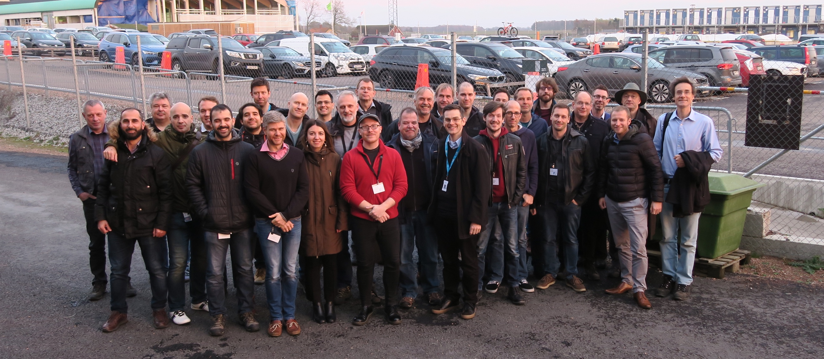
Workshop Summary
Workshop #5: November 12th – 14th 2019
~30 participants coming from In-kind partners, ESS MCA, ICS and a four person TAP.

Slide 3
Aims of the workshop
Create a coherent and high quality and well integrated suite of instruments at ESS with regards to MCA.
Inform partners and give updates on the ESS project and motion control standards.
Share challenges faced on neutron instruments and and experiences from other institutes.
Obtain feedback on what MCAG should prioritise; especially from the TAP.
Build and foster the motion control community within neutron scattering.

Slide 4
Participants
Attendees from
ANSTO, PSI, Diamond, MaxIV | Technical Advisory Panel (TAP)
FZJ Juelich, Germany | DREAM, SKADI, T-REX, MAGIC
HZG Geesthacht, Germany | BEER
ISIS, UK | LOKI, FREIA, VESPA
AU, Denmark | HEIMDAL
ICS | ESS
ESS Bilbao, Spain | MIRACLES
PSI, Switzerland | ESTIA, ODIN, BIFROST, HEIMDAL
MCAG | NMX, BIFROST
No representitives
LLB Saclay, France | MAGIC, SKADI, BIFROST
CNR-ISC, Italy | VESPA
CNR, Italy | T-REX
Wigner Institute, Hungary | NMX, BIFROST
TUM, Munich, Germany | ODIN
DTU, KU, Denmark | BIFROST

Slide 5
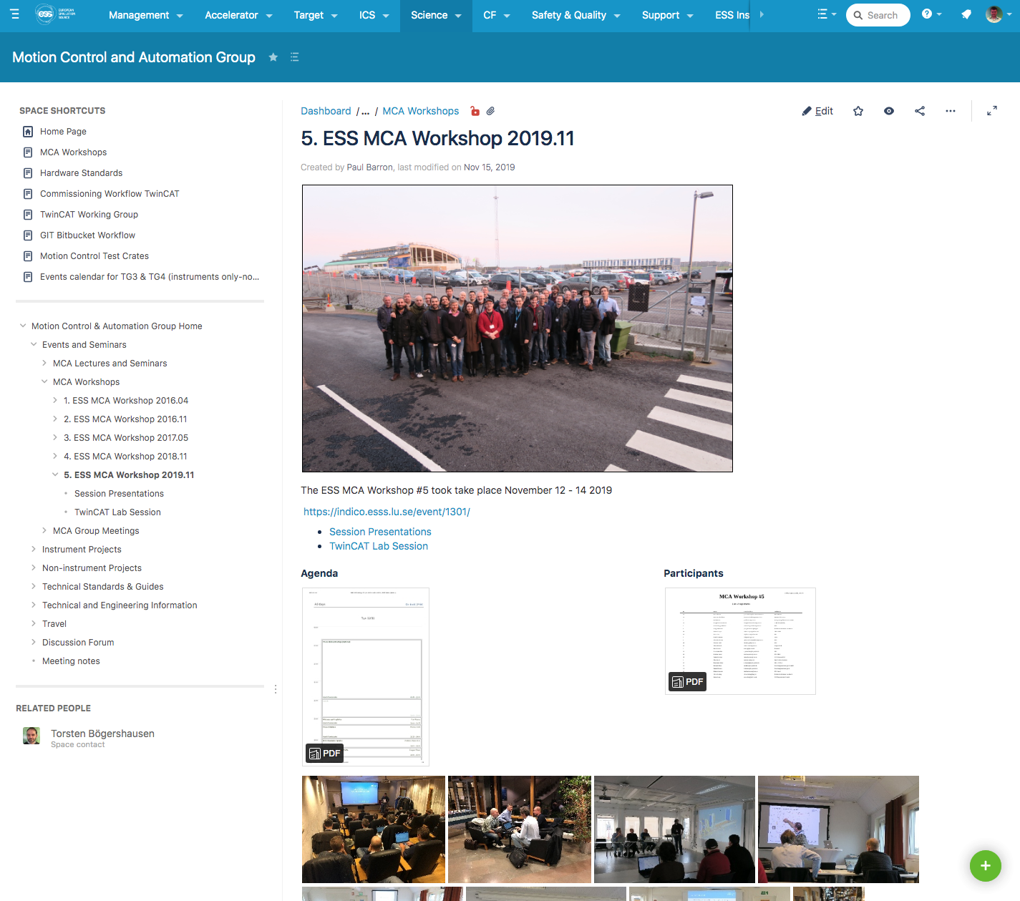
Presentations and Reports on Confluence
https://confluence.esss.lu.se/display/MCAG/MCA+Workshops

Slide 6
Pre-workshop Workshops
Beckhoff TwinCAT Collaboration
  Participants from ISIS, Jülich and ESS.
  Standardise TwinCAT Software for motion.
  ISIS will use Beckhoff TwinCAT as their next generation motion controller and JCNS have a lot of experience with motion in Neutron Facilities.
Eplan Working Group
  Participants from MAX IV, Jülich and ESS.
  Discuss important considerations for Instrument Eplan drawings.
Open source EtherCAT motion control Training/Workshop
  Accelerator will use Open Source EtherCAT for motion because of the simple and repetitive applications but also most of the work will be done in house at ESS.

Slide 7
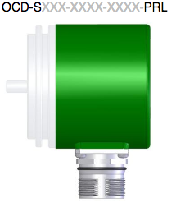
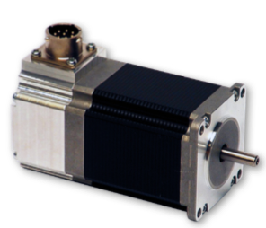
Schedule – Day 1
ESS MCA Standards
  Beckhoff Terminal Standards ESS-0365855 given by Federico Rojas: Includes CPUs, motor drive modules, encoder modules, digital I/O modules etc.
  Motion Control Hardware standards ESS-0439471 given by Kristina Jurisic: includes motors, encoders, limit switches, cables and connectors.

Slide 8
ESS-0439471 Components Standard Status
Requirements and preliminary choices presented at last years workshop
Received feedback from the participants and TAP
Selected 90% of the components for normal environment, vacuum and radiation
Defined cabling concept and selected cables and connectors
Started buying selected components to test

Slide 9
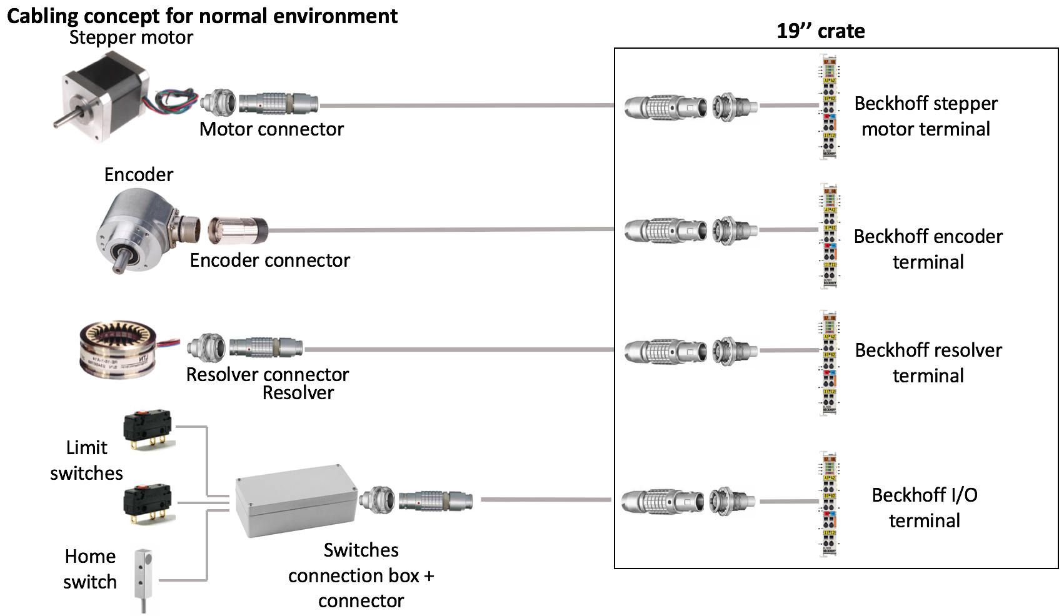
Cabling Concept

Slide 10
Components
Normal Environment
Component | Level 1 Component | Other options
Stepper motors | Mclennan 23HT18C330 L1 | Phytron NEMA size <23 Mclennan and Stögra NEMA 34 and 42
Servo motors | Beckhoff AM81x1 series Beckhoff AM80xx series | N/A
Rotary absolute encoder SSI | Posital OCD-S101G-1416-S060-PRL | N/A
Linear absolute encoder BiSS C | AMO LMKA20106 scanning head with LMTA scale | Numerik Jena LAK with Singleflex scale tape
Standard Limit switch | Crouzet 83 160 786 | N/A
Industrial end switch | Euchner NZ1HS-538-M | Crouzet 83 871 306
High precision switch | Metrol P085DB-A | N/A

Slide 11
MCA Standards
Rule: Use the MCA Components Standard to choose the components, if not possible speak with you MCA Point of Contact and put forward suggestions.
Possible exceptions:
  Cannot fulfil requirements with MCA standard component, lack of space etc.
  Special motion control component (example: piezo slits)
  Instrument will buy spare parts for the components that are not according to standard (example: Bifrost)

Slide 12
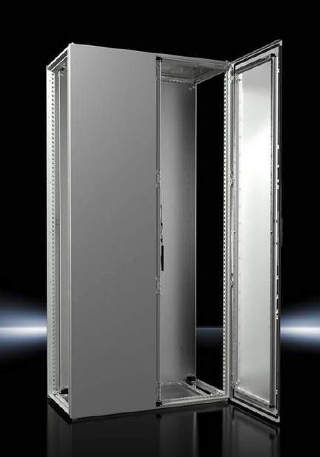
16Ax. Prototype Cabinet Project (In-Kind from Jülich)
Housing
  Steel cabinet, RITTAL VX25 series
  H 2000 (+200) x W 800 x D 400
  2 front doors
  200mm plinth
  6 or 7 DIN rails, 600mm long
  Input and output cables top or bottom
  Cooling system: TBD

Slide 13
16Ax. Prototype cabinet
Specifications
DIN rail 1
  Power Distribution, socket, filter, RCCB
  24V power supplies (redundant)
  48V power supply
DIN rail 2
  8Ch 24V breakers + 0V distribution
  CPU, Internal I/Os
  Fast 5V input
DIN rail 3
  8 SSI + 4 BiSS-C encoder inputs
  4 Resolver inputs
  4 INC encoder inputs

Slide 14
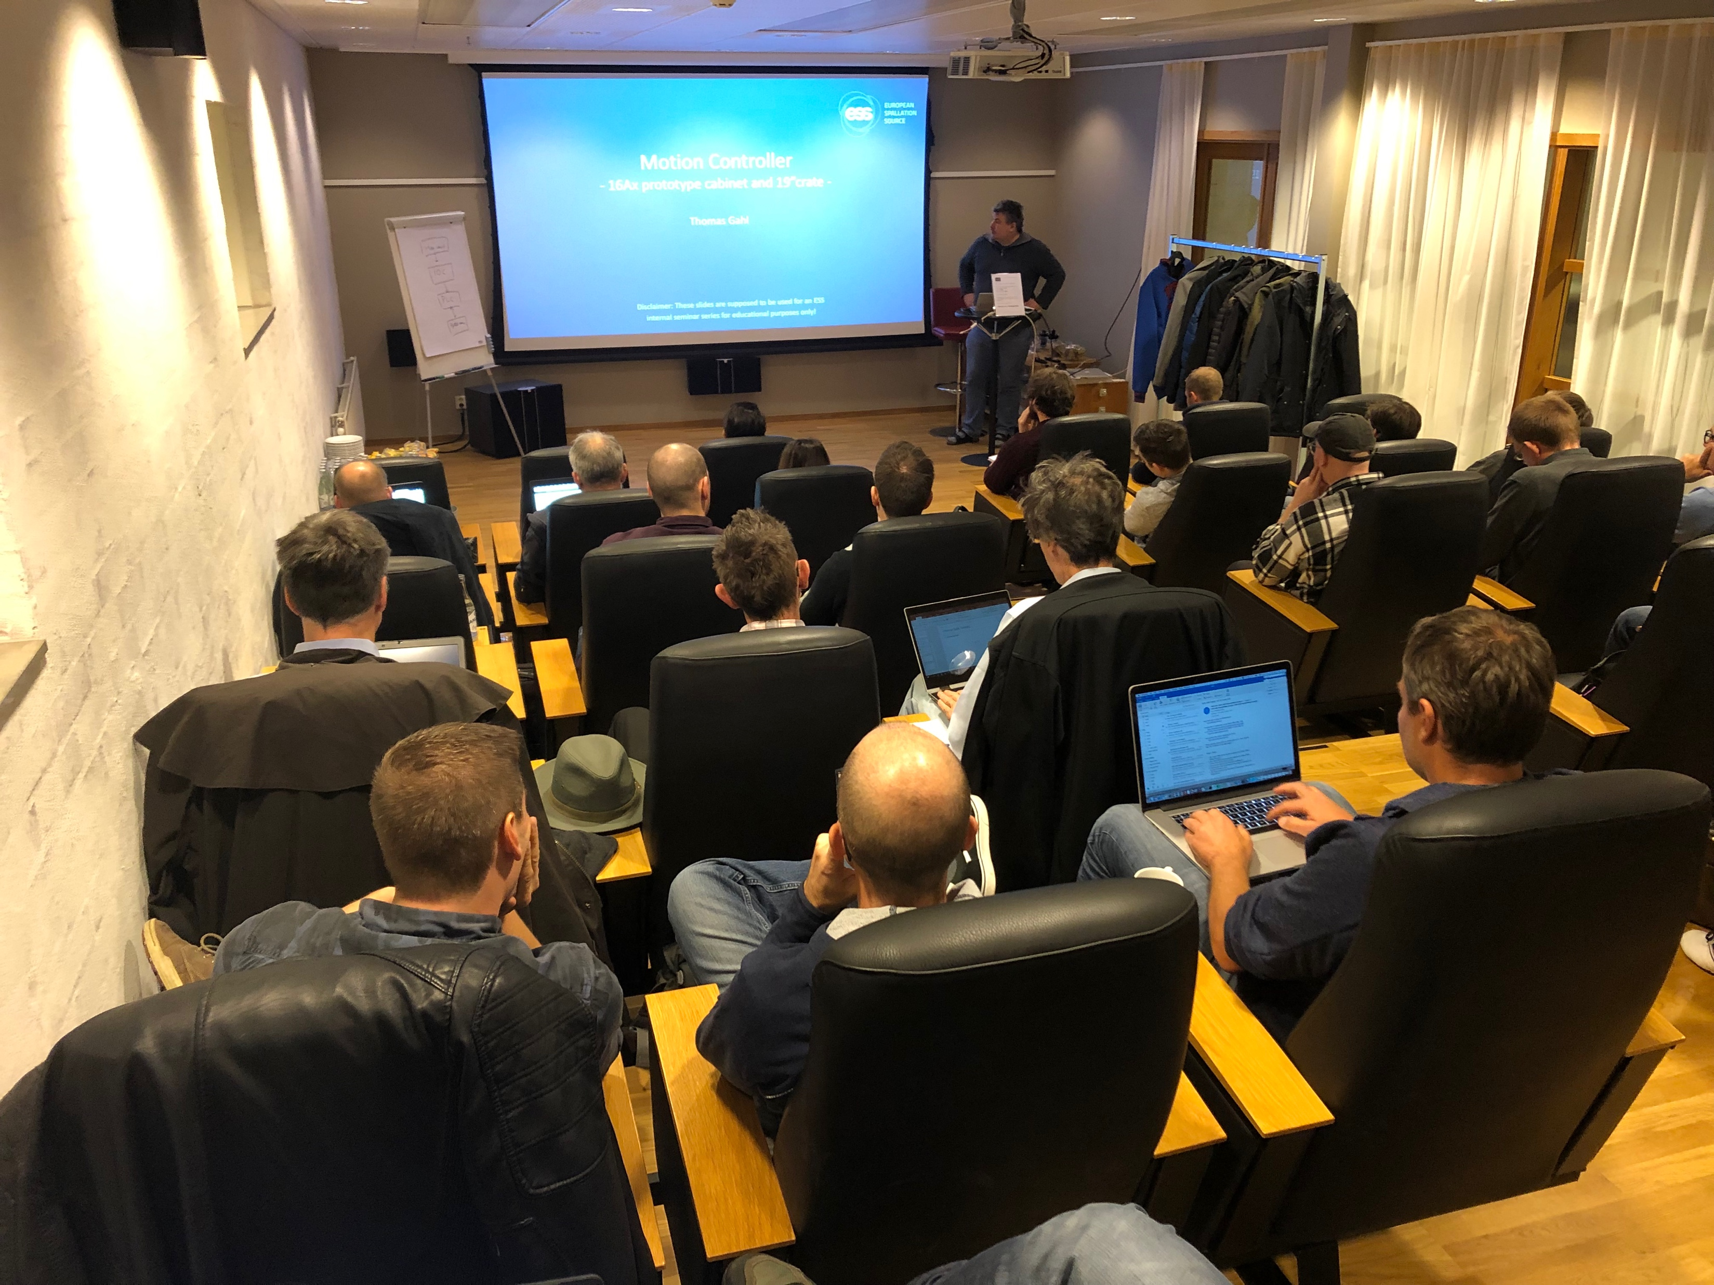
Schedule – Day 2
Instrument Use Cases
Morning
Experiences with Tollgate Reviews
User cases:
  ESTIA Robot
  BIFROST Detector Tank
  LOKI Beamstop
  Slit Systems
Afternoon
Motion Safety Case Study
EMC and Cabling
Implementation of TwinCAT Activity

Slide 15
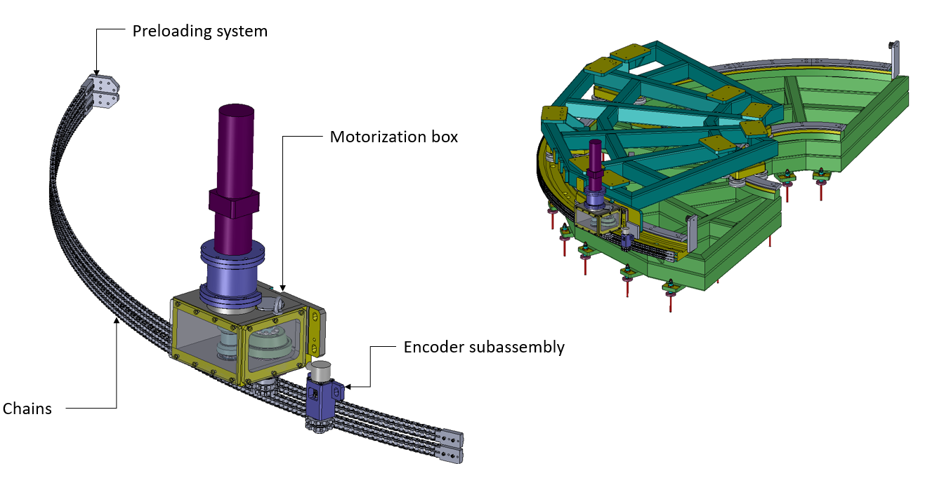
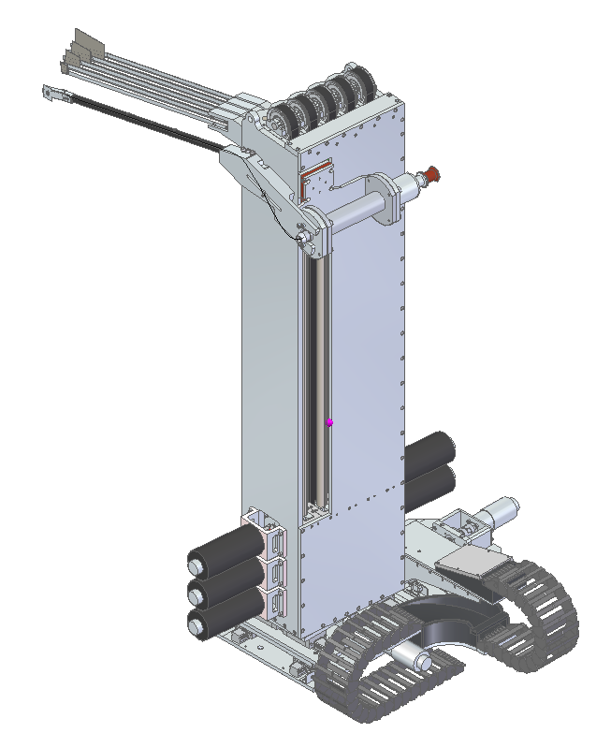
Instrument Use Cases
BIRFROST, LOKI, ESTIA

Slide 16
Schedule – Day 3
MCA In-Kind Project Updates
Linear Actuator Project – JCNS – Michael Klein
  Extended to include rotary actuators
Mobile Sample Robotics Project – JCNS – Sven Janaschke
  Managed in conjunction with MESSI group in SAD

Slide 17
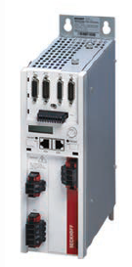
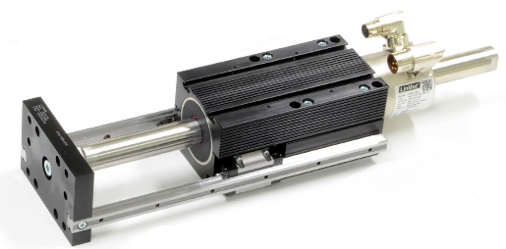
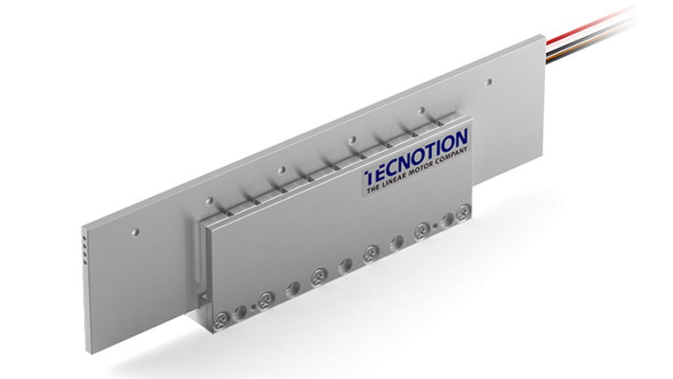
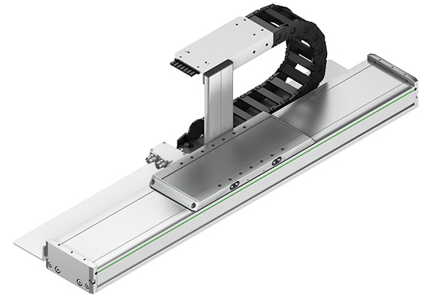
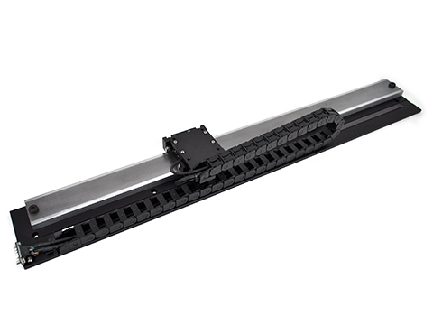
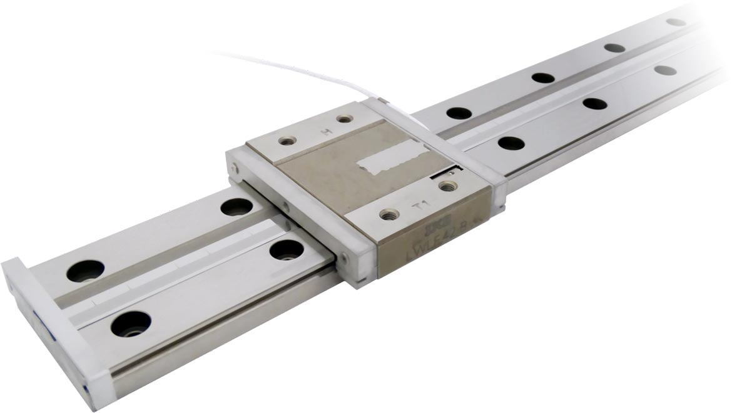
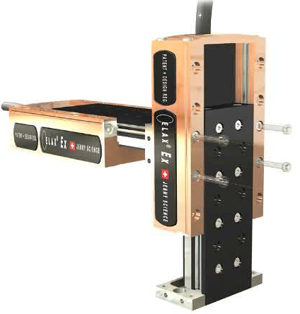
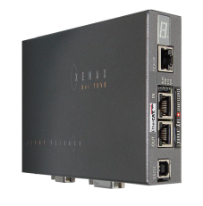
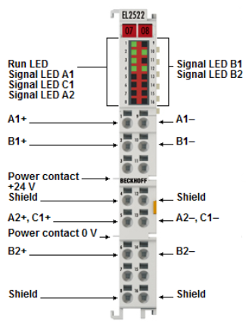
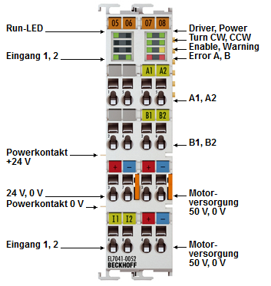

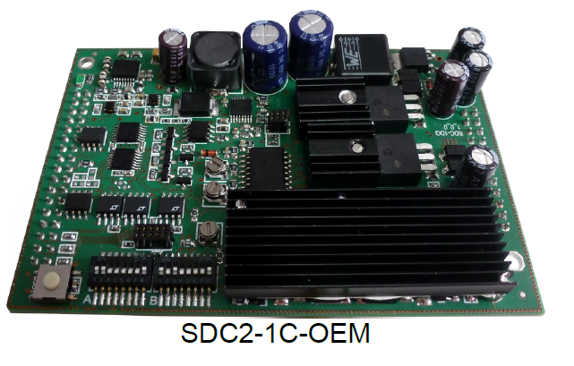
Schedule – Day 3
Linear Actuator Project
Beckhoff AX5106 / AX5206
LinMot PS10-70x80U;
Tecnotion UVM12, S-Winding;
HIWIN HT150-L;
SmarAct SLLV42-600-S-HV
H2W LSS-016-04-006-01A-ME
Jenny Science ELAX EX110F20
Beckhoff EL2522
Beckhoff EL7041-0052
SmarAct SDC2
Jenny Science XENAX Xvi 75V8

Slide 18
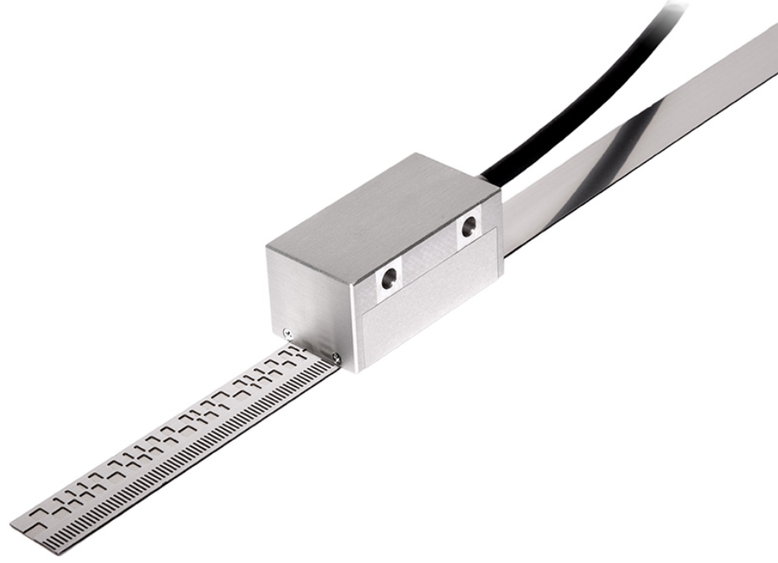
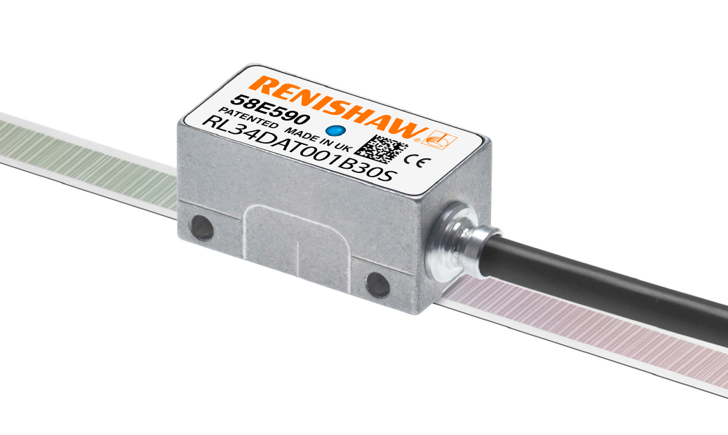
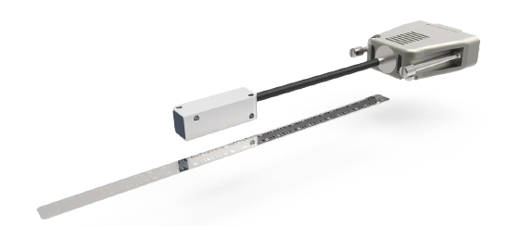

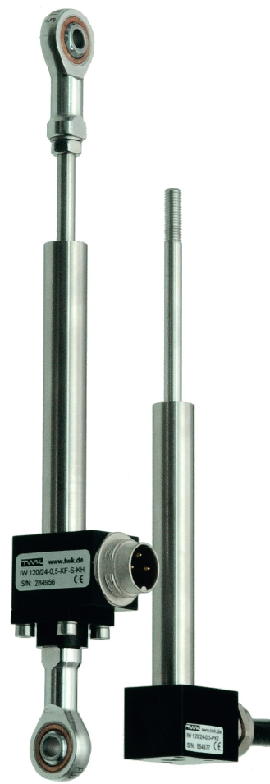

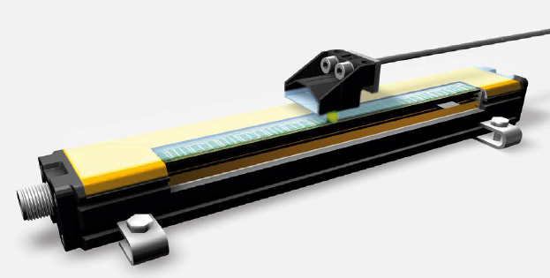
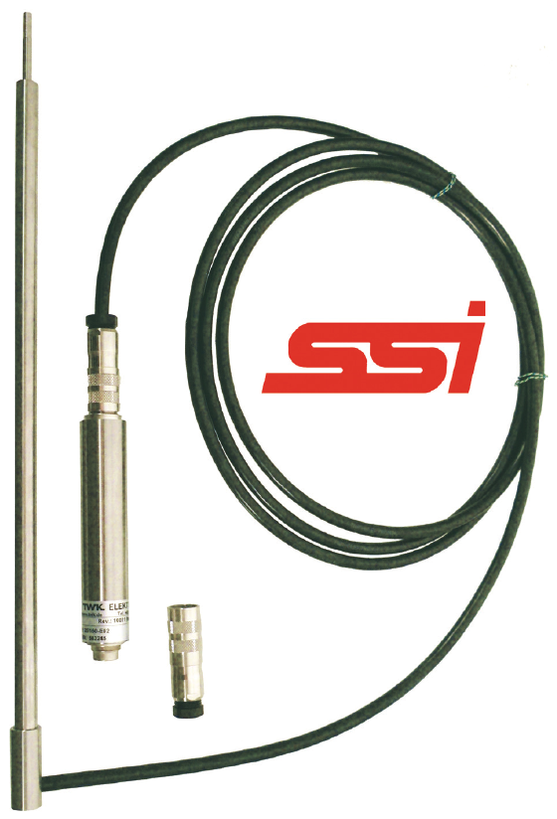
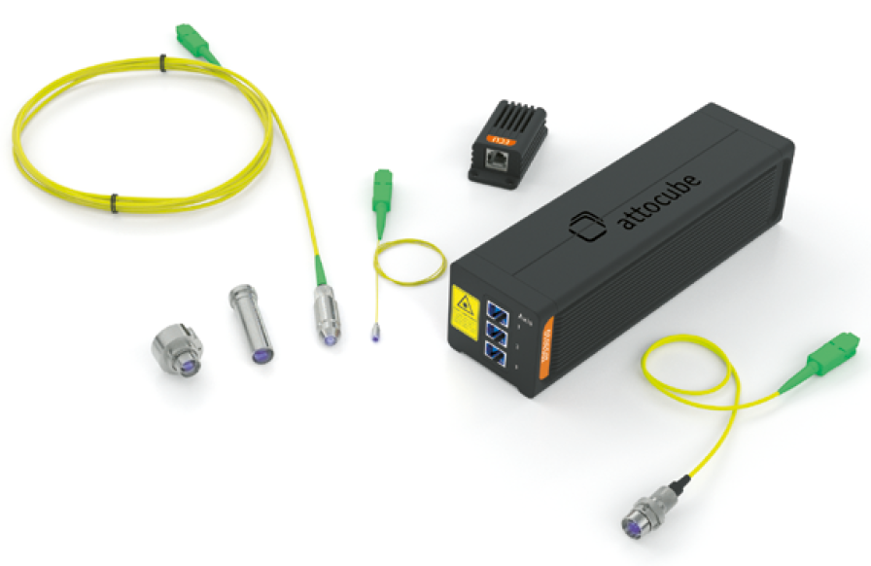


Schedule – Day 3
Linear Actuator Project
AMO LMKA-2010S + LMTA-4010C scale;
Renishaw Resolute UHV + RSLA scale;
Numerik Jena LAK + Quick Guide scale;
Turck Li700P0-Q25L
TWK Elektronik IW120/150
+ IE25/150 Electronic module
  Test Items – Reference System
$${Max. distance with highest resolution⇒ 10}^{−12}∗2^{32}=4,3 mm$$
Attocube IDS3010 BiSS-C 32 Bits, up to 1 pm sensor resolution;
3 different sensor heads:
long-range up to 5 m; (M12/C7.6)
Standard for broad variety of applications; (M12/F40)
Small sensor head for limited space; (D4/F17)
Compatible environments:
Radiation up to 10 MGy;
$$⇒ \frac{5 m}{2^{32}}=1,16 nm$$

Slide 19
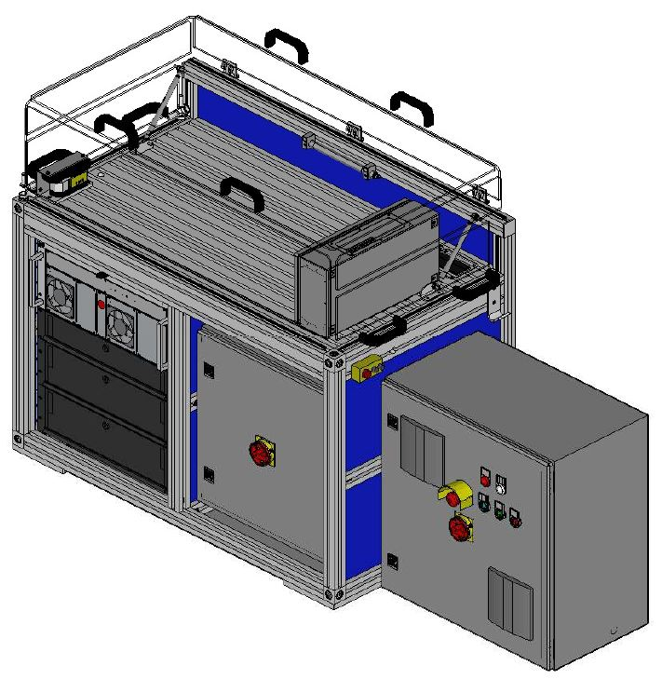
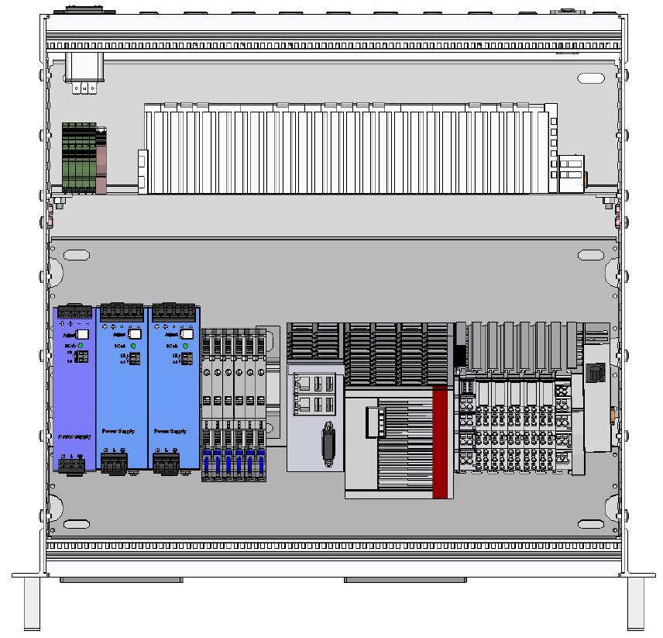
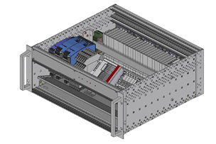
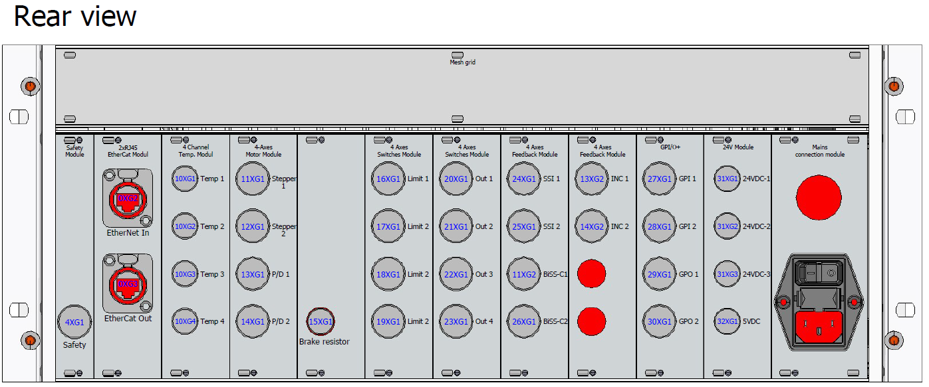
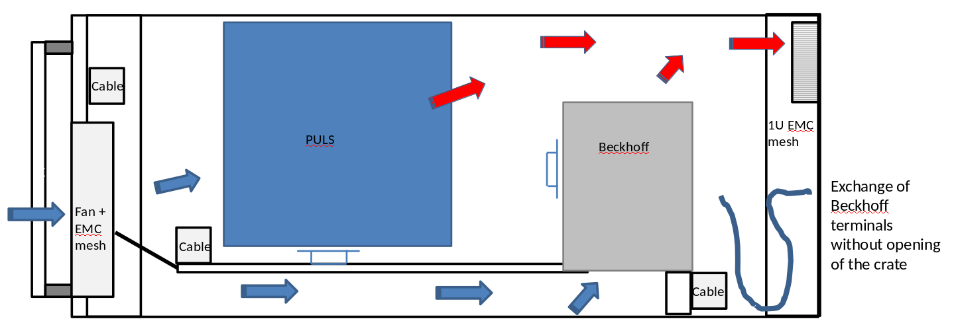
Schedule – Day 3
Linear Actuator Project
SmarAct Box UC2
  New Design:
  1 x 19“ rack, 2 x electrical cabinets, 1 x SmarAct Box;
  UC1: Through bend in the front airflow from top to bottom (2 levels);
  UC1: Connectors and PIN assignment according to ESS Standards;
  UC1: EL-terminals that communicate to the outside are completely
  mounted on the rear DIN rail;
Rack UC1: 3+1U
Integrated Cabinet UH2
Mobile Cabinet UH1

Slide 20
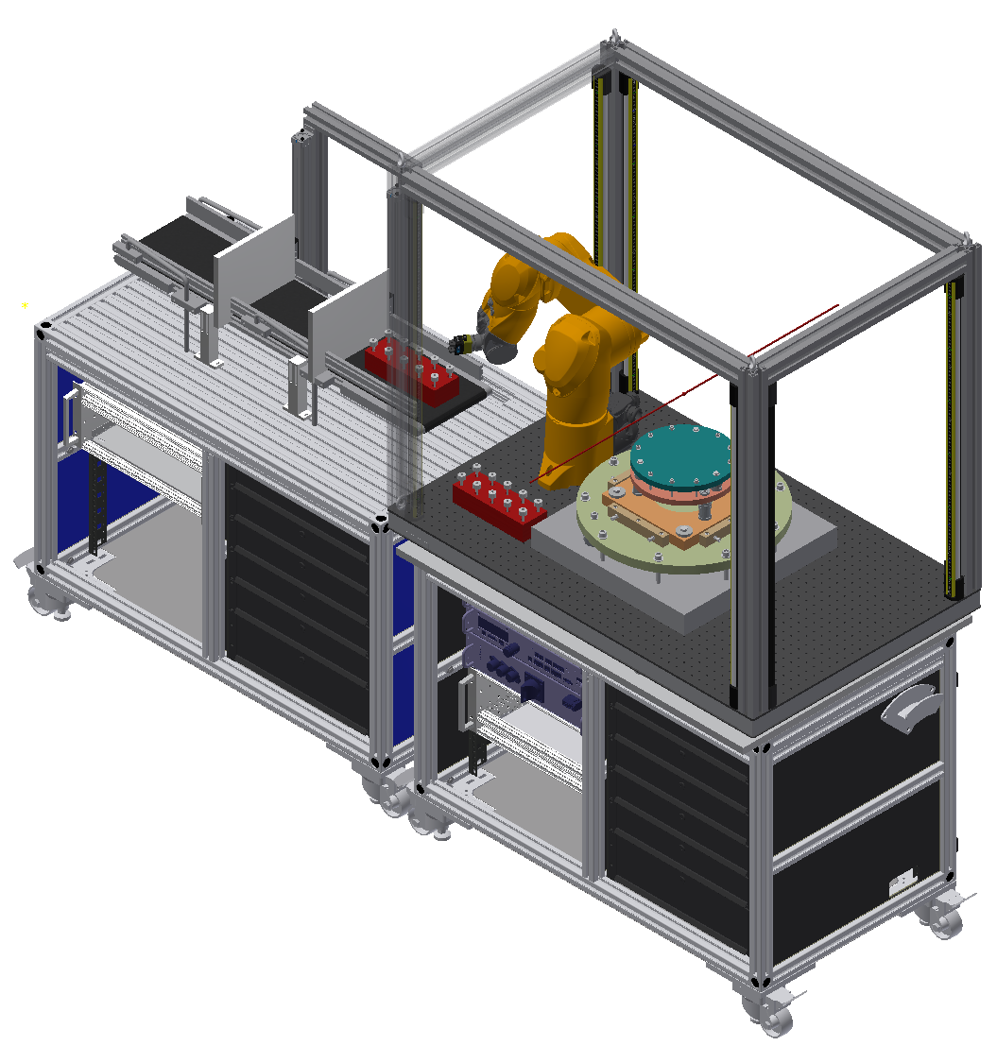
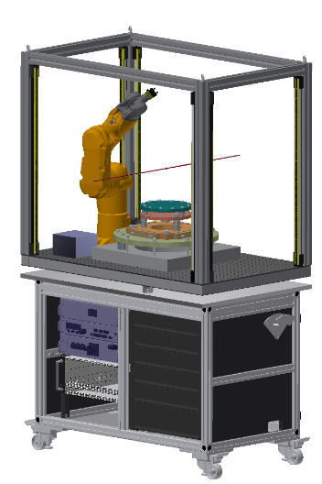

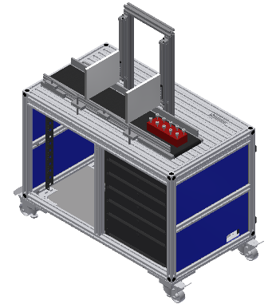
Schedule – Day 3
Mobile Robotics Project
Mobile conveyor unit
Used only for demonstration of infinite sample flow
Mobile transport trolley + robotics platform
Push/roll it to the instrument
Crane platform to final position inside the cave
Mechanical docking system

Slide 21
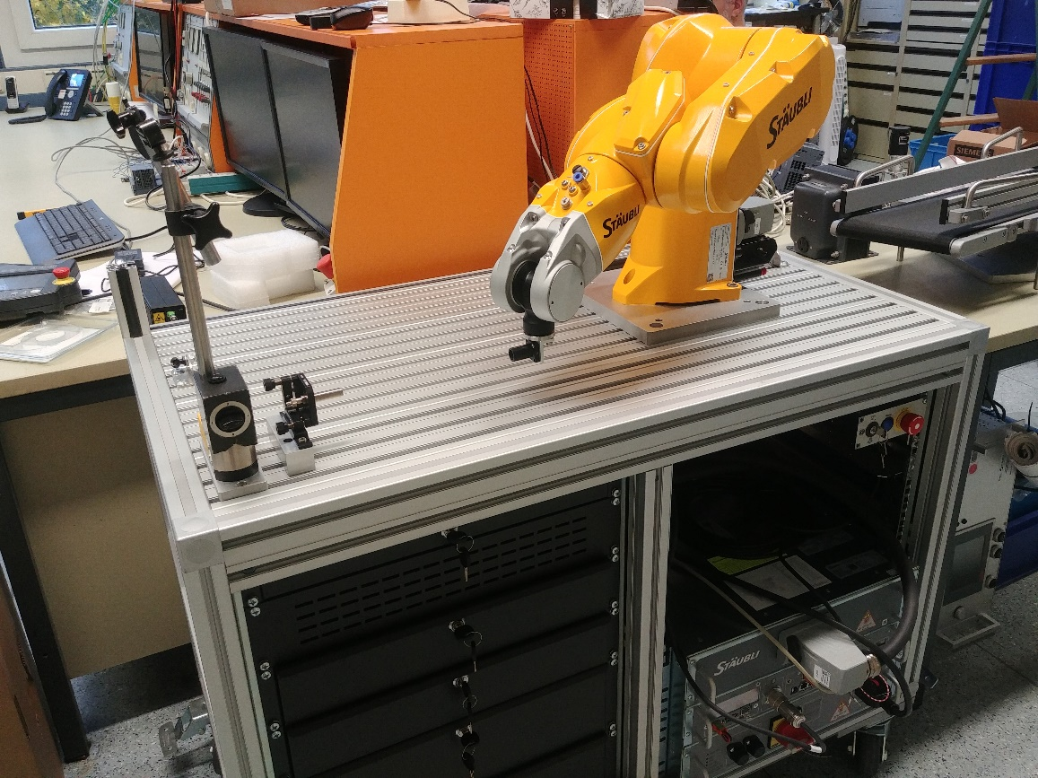
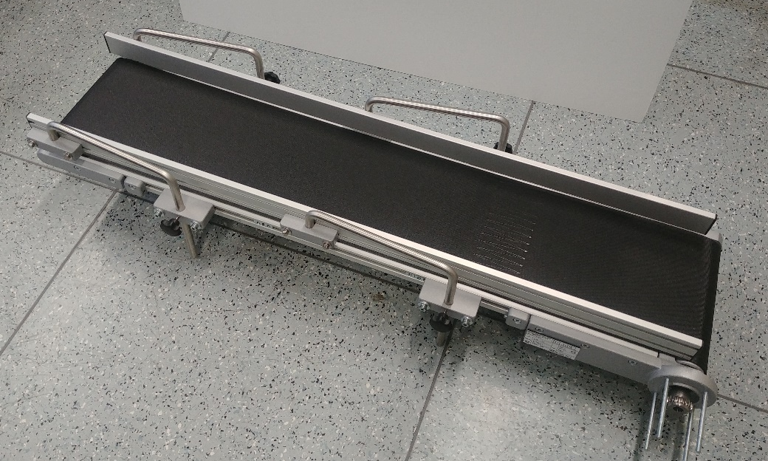
Schedule – Day 3
Mobile Robotics Project Status
Passed the preliminary design review (PDR) last September
Robot and controller have been mounted to a test bench
Performed first functional tests
Performed first repeatability tests (1D) to verify the manufacturers specification

Slide 22
Conclusions and Outcomes
“Getting everyone together in this format is a great start” – support for the workshop to continue.
Eplan drafting probably behind where it needs to be.
Standard FAT/SAT plans for generic components e.g. slits should be written now.
Commissioning plans should be presented at the next workshop.
Control of safety shutter, motion safety and interaction with PSS needs to be clarified.

Slide 23
Open Questions
Decide on limit for what is a vacuum i.e. at level are vacuum meters actually required. Brian has tested a lot of components at low level and found out they are fine.
Will there be two types of Emergency stops on the beam lines; one for motion and one for beam off?
How does motion safety integrate/interact with PSS? Are PSS responsible in any way for motion safety?
Decide whether motion will be allowed while there is access to the cave.
Who will build the racks/cabinets? Is it responsibility of the instruments? Can it be done locally and managed by ESS.

Slide 24
MCA Work Package Offers
Soon to publish document ESS-2070580 MCA Work Package Definition.
CSPEC and ODIN: offers being formed for with figures based on the number of axes.
BIFROST: agreed in principle.
NMX: planned to be done in house from the beginning.
If any other instruments are interested in contracting the group to do motion please let us know.

