Slide 1

Accelerator systems (ACCSYS)
Mats Lindroos
Head of Accelerators
www.europeanspallationsource.se
November 19, 2013

Slide 2
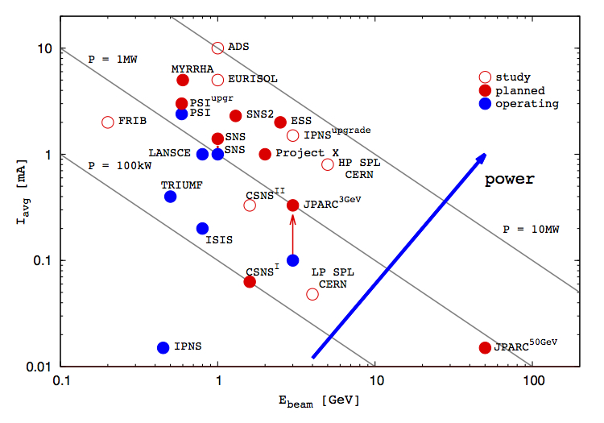
ESS accelerator
Design Drivers:
High Average Beam Power
5 MW
High Peak Beam Power
125 MW
High Availability
> 95%
Key parameters:
-2.86 ms pulses
-2 GeV
-62.5 mA
-14 Hz
-Protons (H+)
-Low losses
-Attention is paid to cryoplant turn down capabilities to minimize use of electrical heaters at low temperatures and proper cryogenic design techniques to minimize static heat leaks
-Flexible design for
future upgrades

Slide 3
ESS Linac
352.21 MHz
704.42 MHz
2.4 m
4.5 m
3.6 m
40 m
54 m
75 m
174 m
Target
Source
LEBT
RFQ
MEBT
DTL
Spokes
Medium β
High β
HEBT & Contingency
75 keV
3.6 MeV
90 MeV
220 MeV
570 MeV
2000 MeV
 | Energy (MeV) | No. of Modules | No. of Cavities | βg | Temp (K) | Cryo Length (m)
Source | 0.075 | 1 | 0 | – | ~300 | –
LEBT | 0.075 | – | 0 | – | ~300 | –
RFQ | 3.6 | 1 | 1 | – | ~300 | –
MEBT | 3.6 | – | 3 | – | ~300 | –
DTL | 90 | 5 | 5 | – | ~300 | –
Spoke | 220 | 13 | 2 (2S) × 13 | 0.5 βopt | ~2 | 4.14
Medium β | 570 | 9 | 4 (6C) × 9 | 0.67 | ~2 | 8.28
High β | 2000 | 21 | 4 (5C) × 21 | 0.86 | ~2 | 8.28
HEBT | 2000 | – | 0 | – | ~300 | –

Slide 4
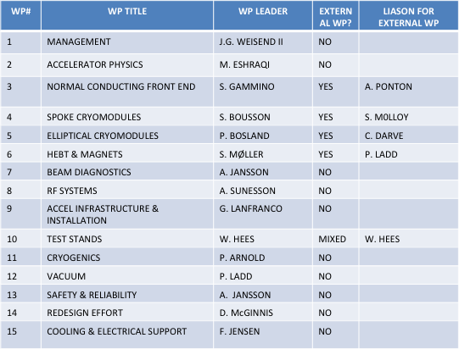
Organization and Work package leaders
Head of Accelerators
Mats Lindroos
Deputy division
Håkan Danared
Deputy project
John Weisend II
Chief engineer
David McGinnis
Safety & Availability
Andreas Jansson
Planning manager (PMO)
Mikael Klein Velderman
Division and project aligned at high level
“WP as a group” would make for too big fragmentation
Four WPs have external leaders
Weekly or bi-weekly meetings at ESS Accelerator Division
Management board of project and division
WP leaders
Lead engineers
Safety
Regular meetings for ACCSYS project
Technical board (all WP leaders and reps of labs/uni. with contract) as governance and CCB on project level (6 meetings per year)
Collaboration board with reps of director of of labs/uni. with contracts as oversight committee
Audits yearly of every WP
Reviews (Conceptual, design, ready to build) as required mostly co-organized with audits
Beam Physics
Håkan Danared
RF systems
Anders Sunesson
Beam Instrumentation
Andreas Jansson
Specialized Technical services
John Weisend II
Lead engineers: Aurelien Ponton, Benjamin Cheymol, Stephen Molloy, Christine Darve, Peter Ladd, Tom Shea

Slide 5
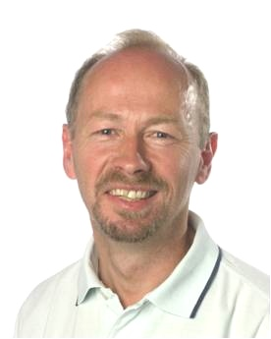
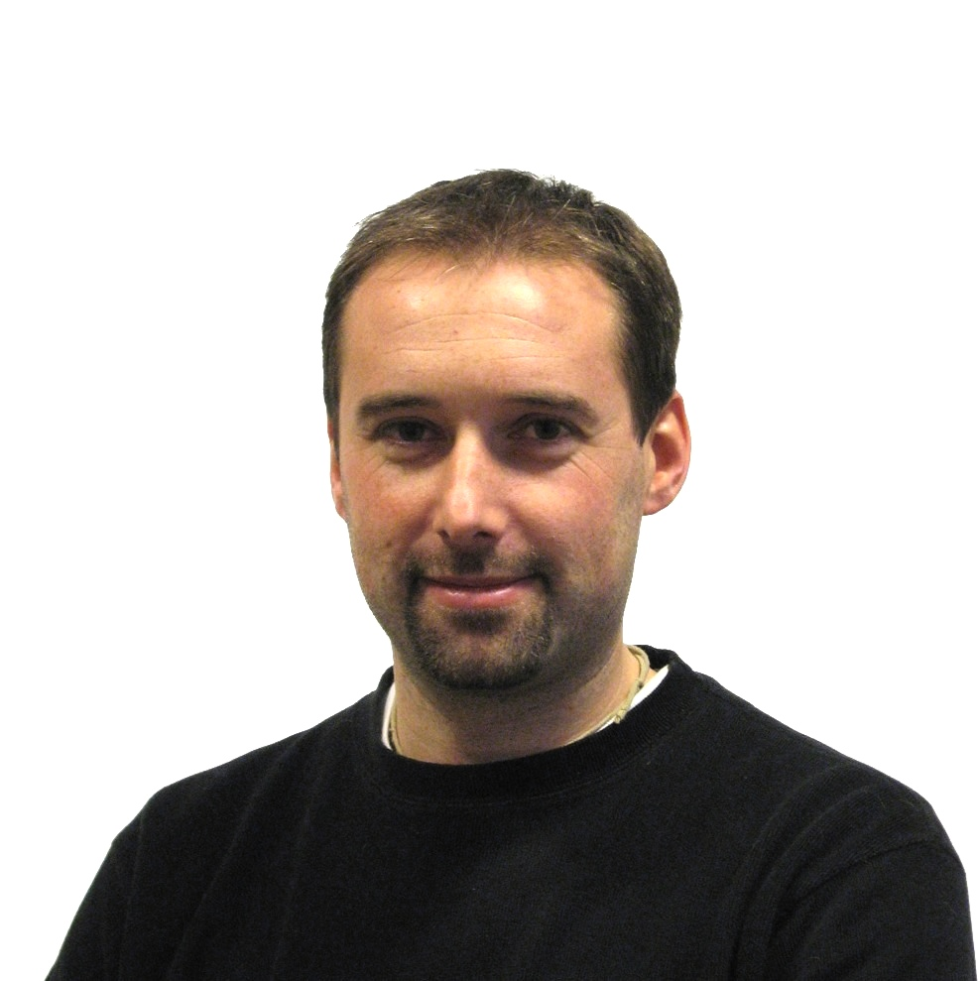


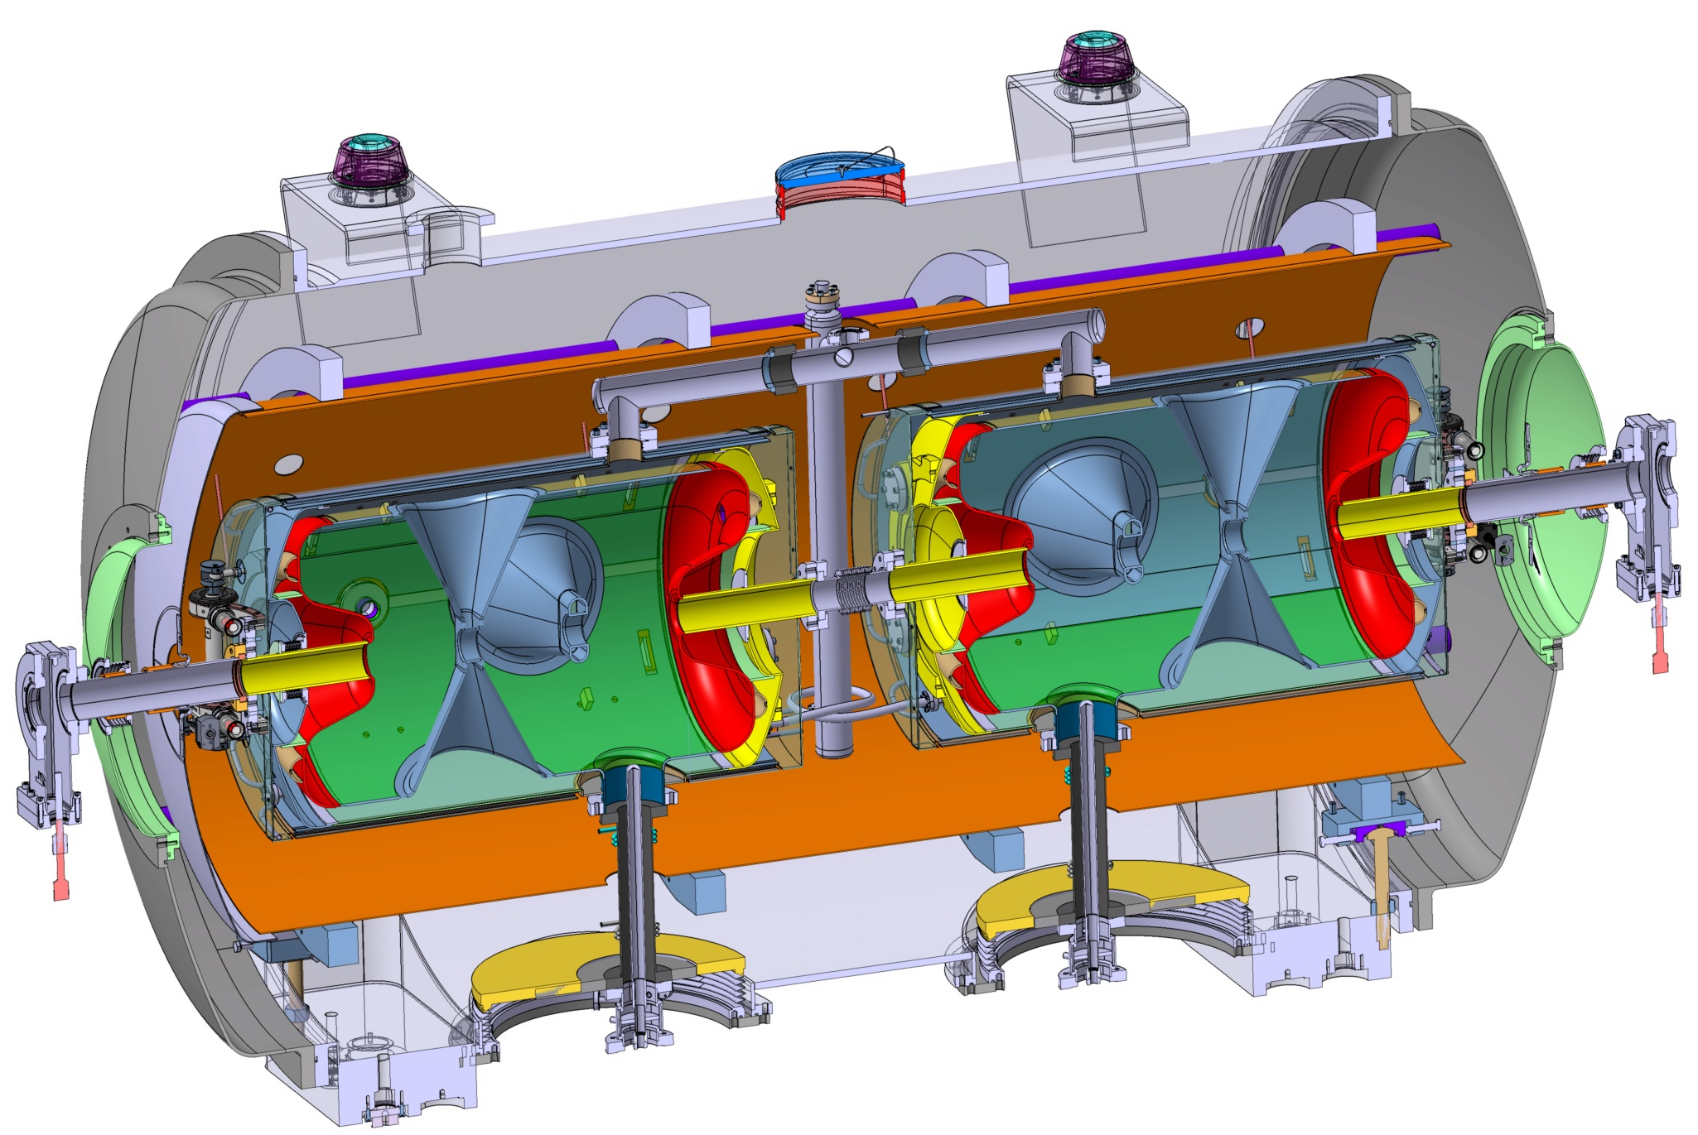
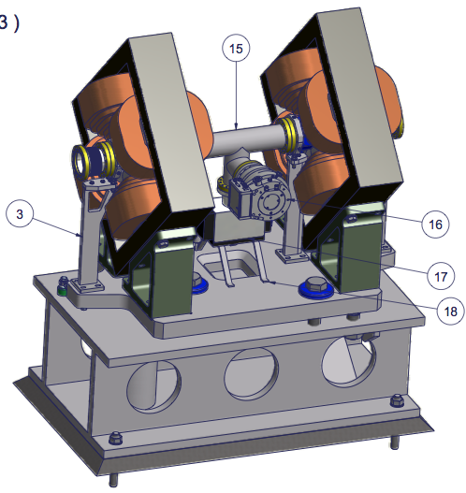

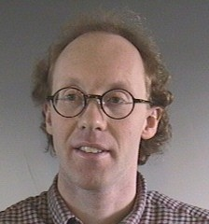


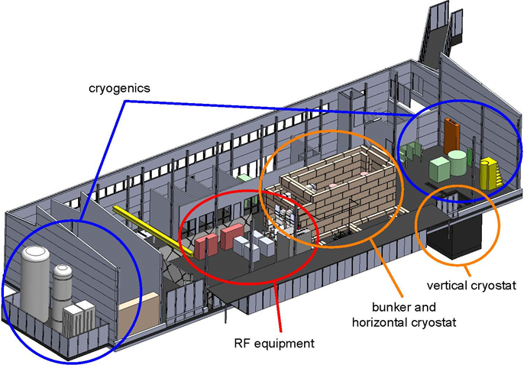
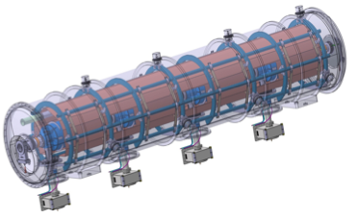

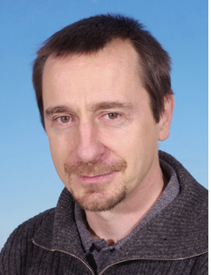
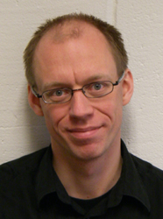
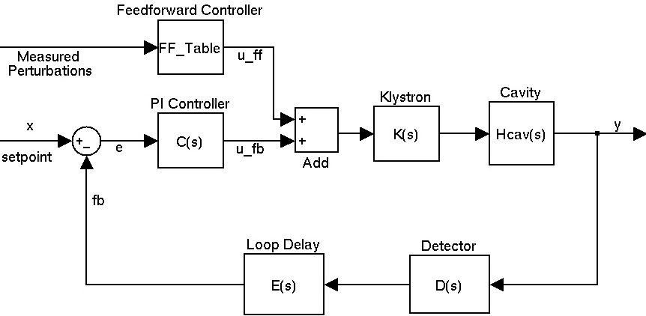

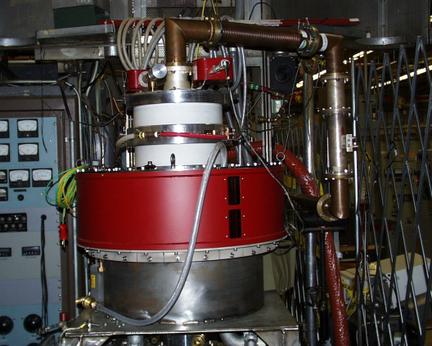


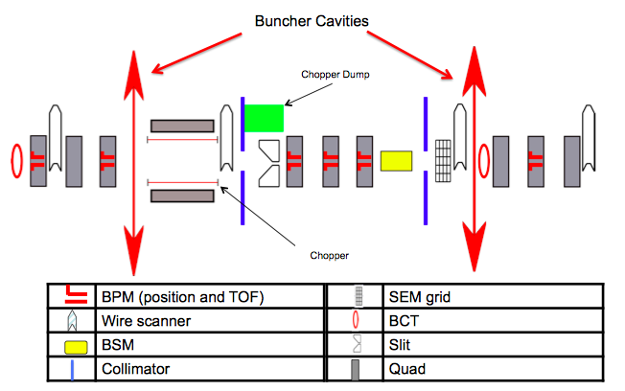
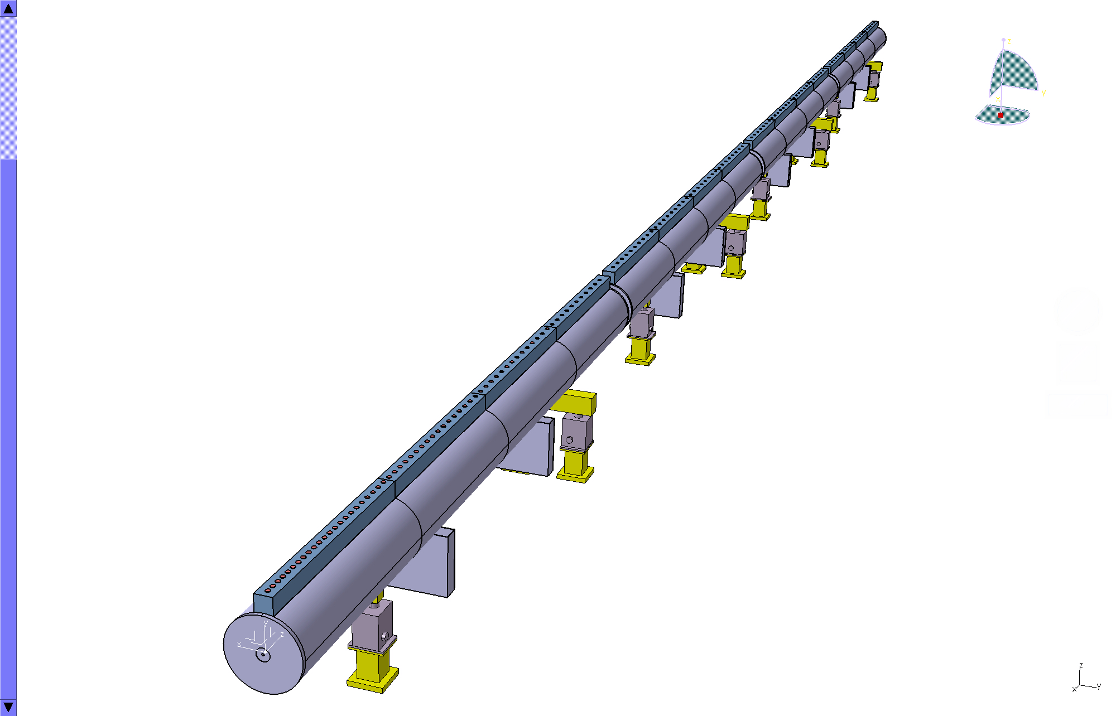
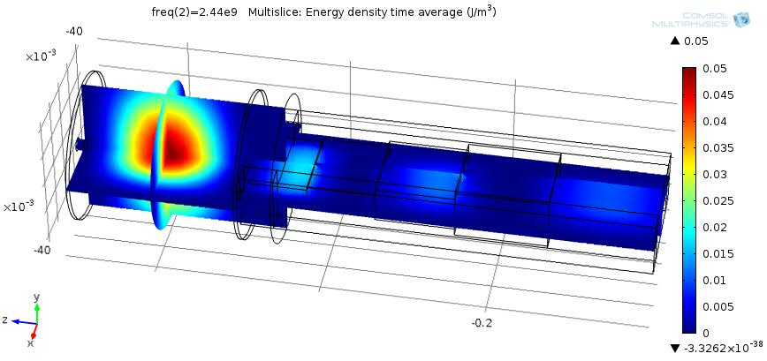
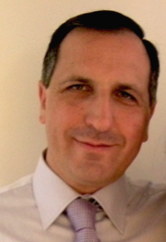


Prototyping the ESS accelerator
Søren Pape Møller
Sebastien Bousson
Roger Ruber
Pierre Bosland
Anders J Johansson
CERN
The National Center for Nuclear Research, Swierk
Roger Barlow
Ibon Bustinduy
Santo Gammino

Slide 6
Cost ACCSYS: Total 510 M€

Slide 7
Scope contingency for 5 MW accelerator
We plan for delivering a 5 MW accelerator
The scope contingency for the accelerator is beam power. The purchasing of power supplies and RF sources necessary to go from 2.5 to 5 MW will be scheduled discretely. These purchases will be authorized after the financial requirements for delivering 2.5 MW of beam power are secure.
Each 7 M€ reduction decrease energy by 70 MeV (=175 kW at 62.5 mA)
Scope contingency
100 M€
CM and RF sources
352.21 MHz
704.42 MHz
2.4 m
4.5 m
3.6 m
40 m
54 m
75 m
174 m
Target
Source
LEBT
RFQ
MEBT
DTL
Spokes
Medium β
High β
HEBT & Contingency
75 keV
3.6 MeV
90 MeV
220 MeV
570 MeV
2000 MeV

Slide 8
Very high level Schedule
2010
11
12
13
14
15
16
17
18
19
20
21
22
23
ESS ADU starts
Redesign approved
Conceptual Design
First SC cavity ordered
CM prototypes launched
Spoke CM prototype available
Ellip CM productionlaunched
Decision on
Scope
SC linac 570 MeV ready
SC RF
NC and FE IK contracts
Injector test at Saclay
NC linac ready
NC linac
Klystrons and IOTs ordered
Prototype IOT tubes delivered
Decision IOT or klystrons
RF for medium beta ready
RF for High beta ready
RF
Cryo dist. line ordered
Acc cryoplant ordered
Early access cryo and test buildings
Cryoplant ready
Cryogenics
Early access to tunnel
First protons to target
1370 MeV protons available
2 GeV protons available
Services, installation and com.

Slide 9
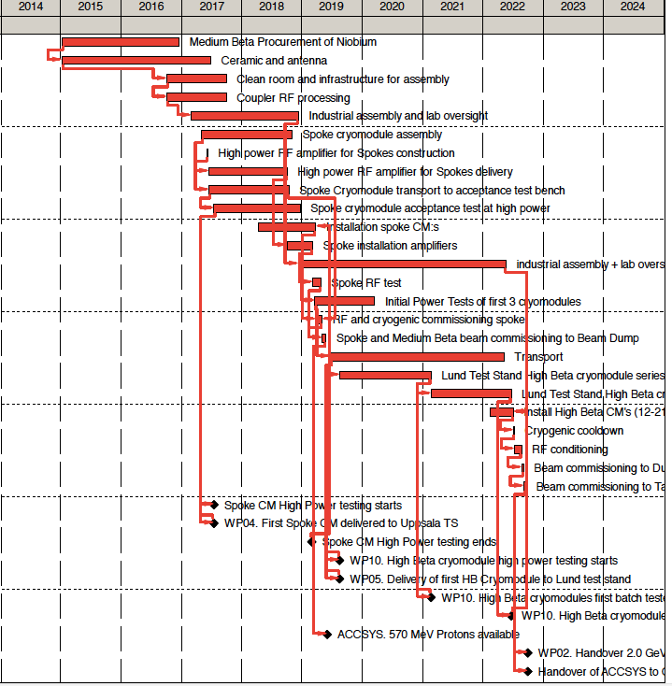
Schedule Critical Path
For first protons to target:
CP is mainly set by cryomodule production
For final milestone for 2 GeV:
CP is mainly set by elliptical cryomodule production
Interplay between activities at different labs critical:
Transport
“on the same schedule”

Slide 10
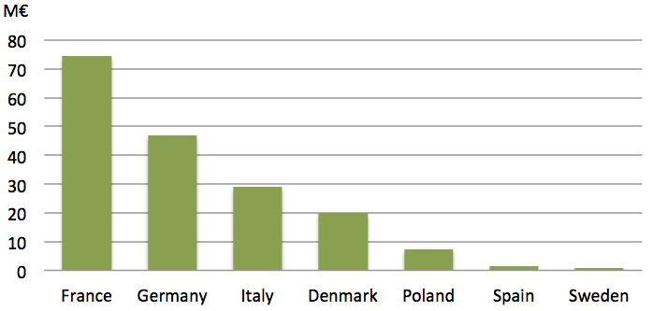
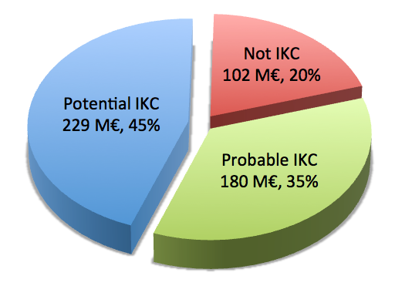
In-Kind Potential and Partners
Probable in-kind contributions where contacts are established with partners amount to 35% of ACCSYS budget.
Another 45% are mainly commercial items which are potential in-kind contributions, but where no partners that could provide funding have been identified.
Seven countries are giving contributions to the ACCSYS pre-construction phase, and all are expected to participate also as in-kind partners for construction.

Slide 11
Realistic In-Kind by WP/WU
WP/WU | Title | Institute | Primavera value (k€) | % in kind | In-kind value (k€) | Comment
3.2 | Proton source and LEBT | INFN | 5 048 | 100 | 5 048 | In total
3.3 | RFQ | CEA | 8 298 | 94 | 7 838 | Except contract
3.4 | MEBT | ESS-Bilbao | 1 594 | 100 | 1 594 | In total
3.5 | DTL | INFN | 16 227 | 100 | 16 227 | In total
4 | Spoke cavities and cryomodules | CNRS | 16 582 | 91 | 15 119 | Except contract
5.2.3 | Medium beta cavity fabrication | INFN or DESY | 7 702 | 100 | 7 702 | Except vertical tests
5.2.3 | Medium beta vertical tests | DESY | 2 377 | 100 | 2 377 | Vertical tests only
5.2.4 | Medium beta cavity follow-up | DESY | 1 221 | 100 | 1 221 | In total
5.2.5 | Medium beta power coupler | CEA | 5 812 | 100 | 5 812 | In total
5.2.6 | Medium beta cold tuning system | CEA | 687 | 100 | 687 | In total
5.2.7 | Medium beta cryomodule | CEA | 6 075 | 100 | 6 075 | In total
5.2.8 | Medium beta infrastructure | CEA | 5 494 | 100 | 5 494 | In total
5.3.3 | High beta cavity fabrication | DESY or INFN | 17 972 | 100 | 17 972 | Except vertical tests
5.3.3 | High beta vertical tests | DESY | 5 545 | 100 | 5 545 | Vertical tests only
5.3.4 | High beta cavity follow-up | DESY | 2 231 | 100 | 2 231 | In total
5.3.5 | High beta power coupler | CEA | 10 854 | 100 | 10 854 | In total
5.3.6 | High beta cold tuning system | CEA | 1 604 | 100 | 1 604 | In total
5.3.7 | High beta cryomodule | CEA | 10 664 | 100 | 10 664 | In total
5.3.8 | High beta infrastructure | CEA | 10 264 | 100 | 10 264 | In total
6 | HEBT, warm magnets, collimators | Aarhus Univ | 19 867 | 100 | 19 867 | In total
7 | Beam diagnostics | DESY | 22 751 | 12 | 2 800 | Part of BPMs, BCMs, BLMs
8.2 | LLRF | DESY | 14 379 | 96 | 13 756 | Non-labour except prototyping
8.3 | Master oscillator | DESY | 1 201 | 60 | 717 | Non-labour except prototyping
9.5 | Installation phase 1 | IFJ PAN | 1 544 | 48 | 745 | Half of labour cost
9.6 | Installation phase 2 | IFJ PAN | 677 | 49 | 329 | Half of labour cost
10.4 | Uppsala test stand | UU | 4 614 | 16 | 726 | Except contract
11.2 | Accelerator cryoplant | DESY | 34 987 | 1 | 250 | 3 FTEs
11.5 | Cryogenic distribution | WUT | 12 608 | 50 | 6 304 | Estimated capacity
 | Sum |  |  |  | 179 821

Slide 12
Staff plan and in-kind
Leveling required: i) move non critical activities, ii) temporary staff movements within division and iii) look for in-kind partners who can contribute with staff on site
110 in operation
Probable in-kind ->

Slide 13
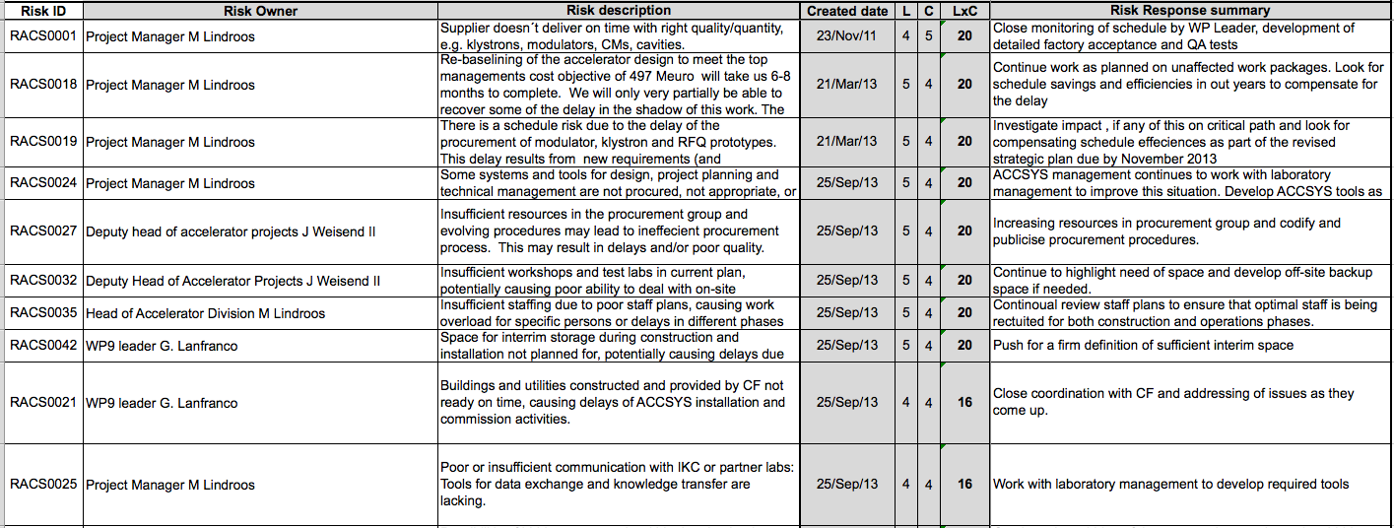
Risks and Mitigating Actions
60 Project risks (re-)evaluated in the last risk workshop
Risk management is an on-going task… The ESS successive planning exercise was an eye opener for me!
10 top risks:

Slide 14
Risk management – keeps me awake!
Recruitment of experienced staff and retaining staff
Mitigation: Work wit ESS management on competitive salaries, relocation issues, integration issues and enforce sufficient amount of leave
Compressed schedule for installation in tunnel
Mitigation: Pursue detailed planning
Staff leveling and persons available for installation and testing (including availability in holiday periods)
Mitigation: Move non-critical activities, propose staff mobility measures at ESS and Investigate possibility to have installation team as in-kind from partners to increase staff numbers
Phase 2 for instrumentation, spares and installation costs pushed to pre-ops and early operation
Mitigation: Pursue detailed planning of pre-ops and operation
Complex and slow negotiations with potential in-kind partners
Mitigation: Dedicate one person to in-kind negotiations at the project (Håkan Danared) and help establish well working processes at ESS for in-kind

Slide 15
Beam instrumentation
ESS beam instrumentation work package was planned to be in-house with all development and off-line testing done on site
Recent decision to open all aspects of the work package for in-kind partners and to phase installation
Phase 1 installation installed for first protons
Phase 2 installation installed in shutdowns during early operation for which experience from early operation can be useful
Full scope for the work package is well documented but details for the phasing and to adapt the work package for in-kind must still be implemented in planning

Slide 16
Next Six Months
Contracting prototypes for modulators, MB-IOT high power tubes, klystrons and modulators
Agreement and contracts for (early) in-kind for ion-source, MEBT, RFQ, DTL and cryomodules
Recruitment at ESS accelerator division according to staff plan
Finalizing Level 3 and 4 requirements following CCB process at ESS
Continued project work including audits, reviews and governing meetings of the existing accelerator collaboration

Slide 17
Summary
The ACCSYS project has a scope, schedule and cost coherent with set objectives
Medium technical risk and high schedule and cost risk
Detailed planning of transfer in 2019 to operation of some staff cost and costs for phase 2 instrumentation and spares in operation
Success oriented planning
Many near critical paths which all must be monitored
A new baseline for the Accelerator has been set with requirements to level four.
The requirements have been reviewed by ESS TAC
Recruitment and keeping experienced staff remains key factors for success
Timely agreement on in-kind will be crucial for keeping schedule and cost
If budget, agreements and contingencies are in place we can deliver to plan

