Slide 1

ESS Overview and Status
ESS Accelerator Collaboration Meeting
Uppsala
Jim Yeck
www.europeanspallationsource.se
November 19, 2013

Slide 2
Outline
Introduction and Organization
Status
Conclusions
Review Results

Slide 3
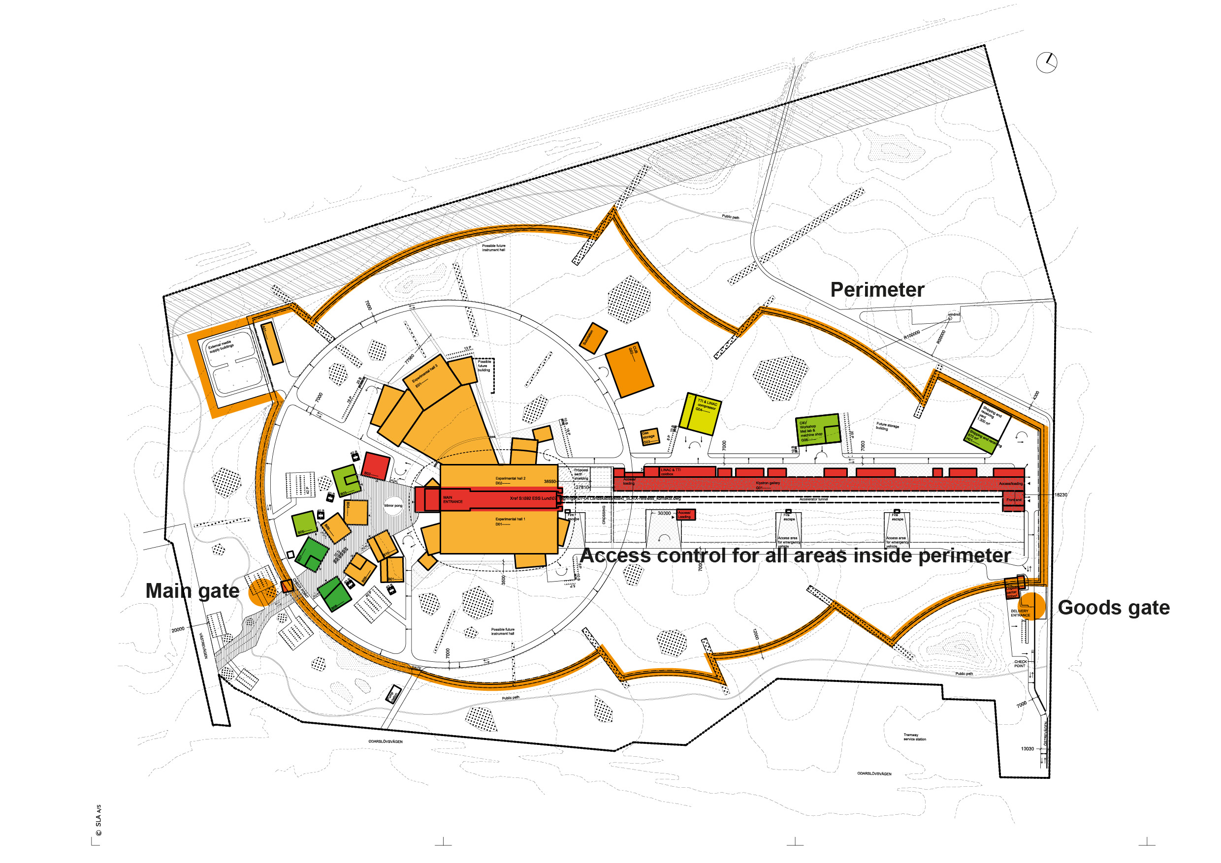
Site Plan

Slide 4
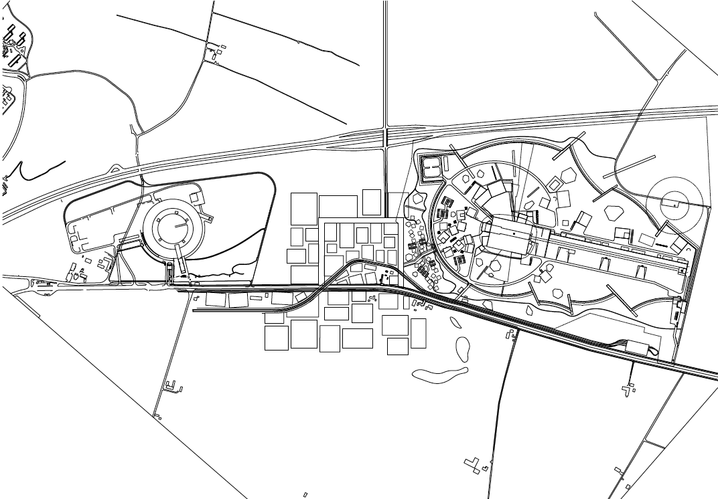
Site Plan

Slide 5
ESS organization

Slide 6
ESS organization

Slide 7
2013 status
Key Steering Committee project approvals
Technical Design Report, Construction Cost, and Annual Operations Cost Target
ESS organization clarified for project delivery
Strengthened ESS support for Member LoI decisions
Cost Book, Call for Expressions of Interest, Partner Days, ILOs
Maturing In-kind plans
Regular meeting of the advisory committees (AFC, IKRC, SAC, TAC, CFAC)
Prepared for the 1st Annual Review!
Focus shift towards project and project execution plans

Slide 8

Preparing the Project Performance Baseline
Deliver on TDR performance and STC commitments
5 MW accelerator capability
Construction cost of 1,843 B€
Operations cost target of 140 M€
22 “public” instruments
Start w/ unconstrained resources (technically limited schedule)
Develop credible project execution plans
Secure funding and resources
Align schedules with the available resources
Establish performance measurement baseline

Slide 9
Project delivery strategies
Schedule Priority – Facility construction complete at the end of 2022 with 5 MW capability installed;
Operations Linked to Construction Progress – Initial operations in 2019 (production of 1st neutrons) and facility operations in 2023 (instruments available for the user program);
Scope Contingency - Explicit scope contingency integrated into the accelerator plans (scope that can be delayed if necessary);
Instrument Program – Technically limited schedule, leverage construction investment, plan for additional investment; and
Conventional facilities costs above the cost report value covered outside the cap by the host countries or new partners.

Slide 10
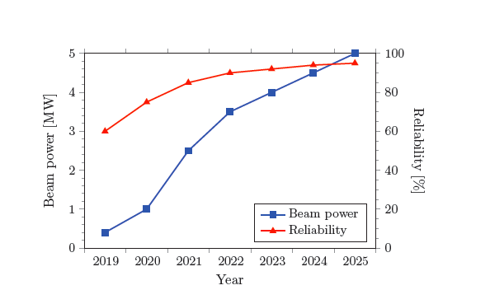
Planned ramp up of beam power and reliability (TDR ref. reminder)

Slide 11
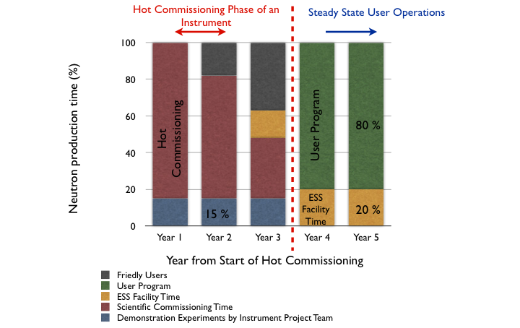
Example of hot commissioning schedule for an instrument (ref.)

Slide 12
Transition from construction to operations
ESS Operations can be divided into three distinct phases:
Initial Operations Phase (2019 – 2022, 4 years) – Includes one year of activities to produce first neutrons (2019) and three years of activities to improve accelerator performance and to commission instruments (experiments by friendly users);
Initial User Program Operations (2023 – 2025, 3 years) – Includes support necessary for reliable operations with public users and provides the basis for future cost sharing; and,
User Program Operations (Beginning in 2026 – ) – Routine operations including the completion and commissioning of the final 22 public instruments.

Slide 13
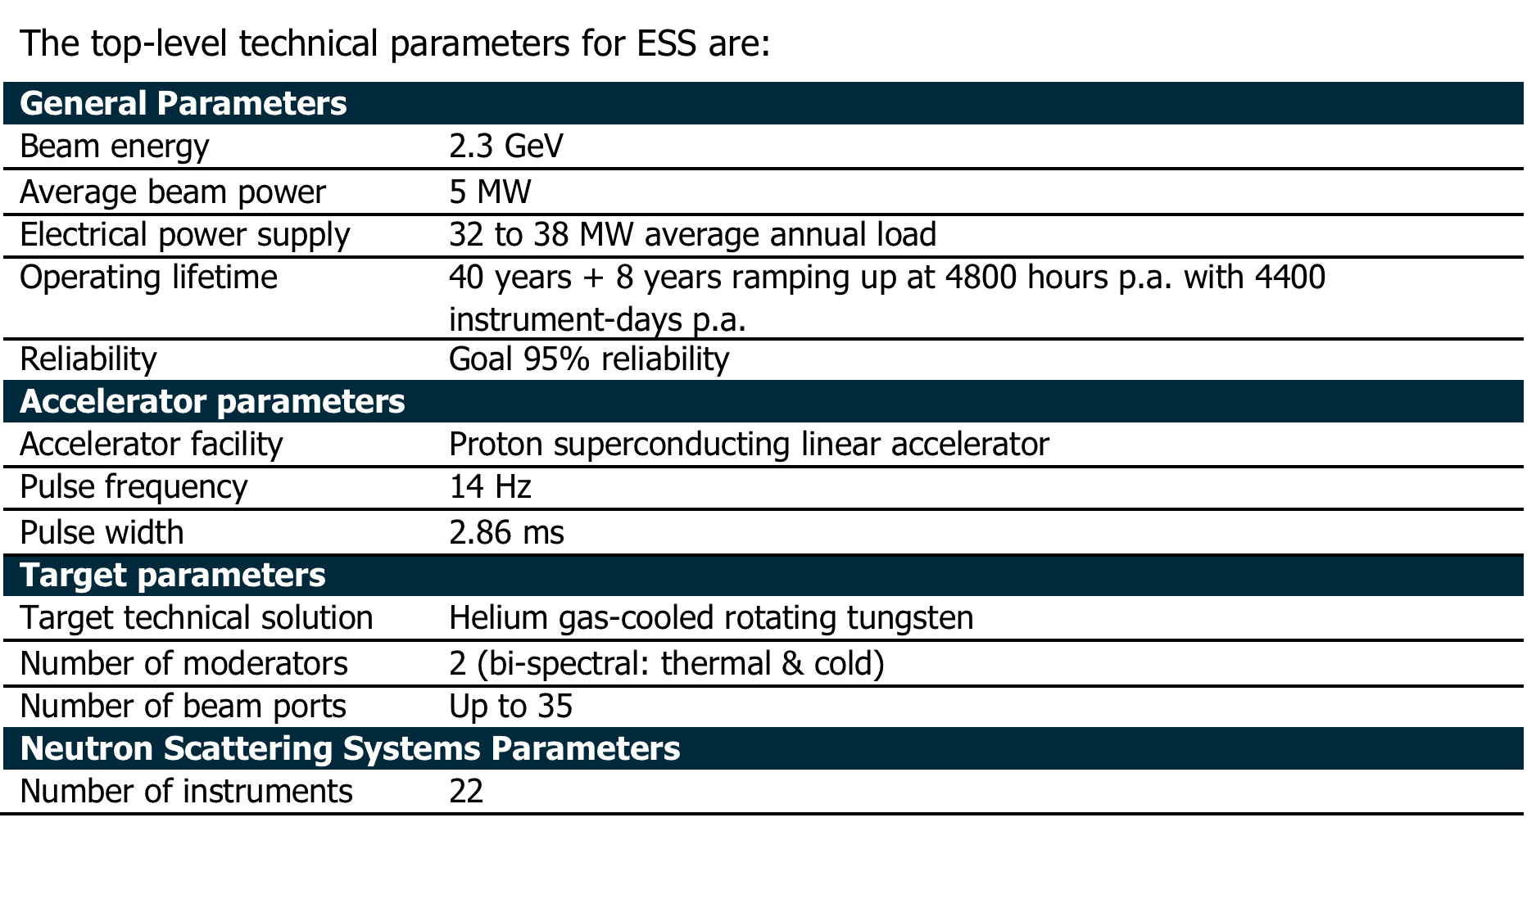
Technical Baseline

Slide 14
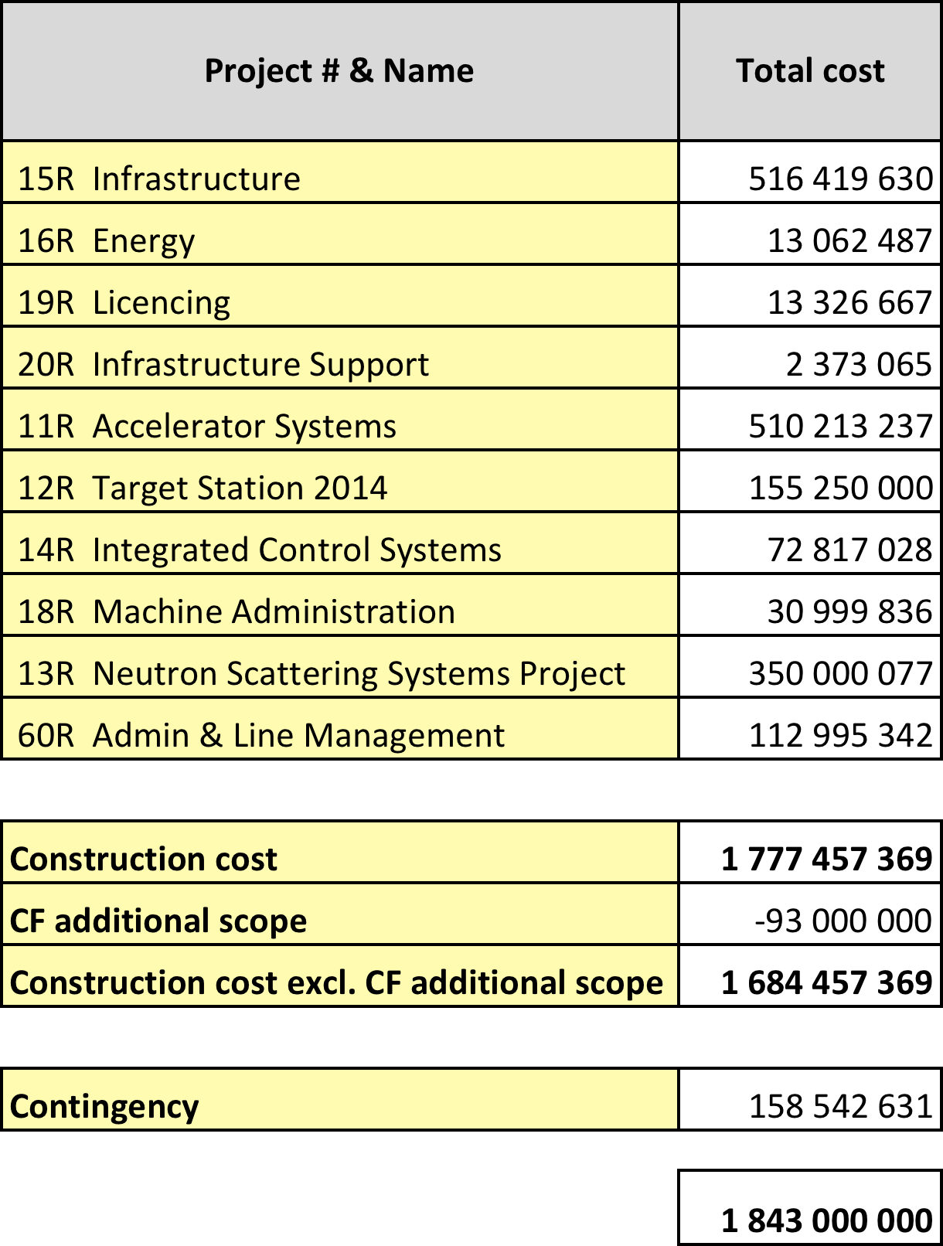
Cost Baseline
Construction cost is 1843 M€
Contingency budget is 158,5 M€
January 2013 pricing
Initial operations in 2019
Construction complete in 2025

Slide 15
Critical Path
Licencing
Accelerator Buildings
Licensing
ConvF
Spoke & Medium Beta CM
(Prod&Inst&Comm)
AccSys
NSS
High Beta CM
(Prod&Inst&Comm)
Instrument Construction
Ground break
First installations on-site (ACCSYS)
First Beam on Target (570 MeV)
Machine installed
for 2.0 GeV
Last of Instr Const
Instr HO to Op

Slide 16
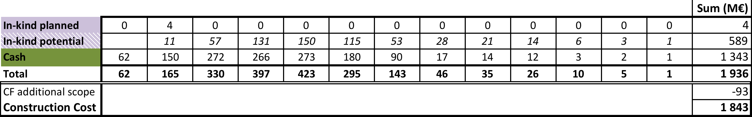
Cash vs. In-kind

Slide 17
Host and Member Funding Plans
Annual funding requirements derived from the project schedules – Technically limited schedule with limited float
Hosts providing funding in 2013
Hosts will provide funding for 2014, assuming funding agreements with members are formalized – Initial in-kind deliverables planned in 2014 with large increase in 2015
Two major issues to be resolved: securing 100% funding and cash flow – Expect financial commitment at the 80-85% level in 2014 – Cash requirements high in early years to enable efficient construction
European Investment Bank loan would address both the temporary gap and the cash flow issue

Slide 18
Next 6 months
1st Annual Review and resulting action plans
Letters of Intent or Agreements with Member countries
Demonstrate accelerator and target station technology readiness – key CF, Machine, and NSS interfaces resolved for a civil construction start
Continue engagement of the scientific user community and select initial instruments for engineering development – first three instruments in 2013, additional instruments in 2014
Select conventional facilities partner company/start final design in Feb 2014
Secure license and permits for facility construction and establish Project Performance Measurement Baseline by May 2014
Start facility construction!

Slide 19
Conclusions: 1) time for funding commitments 2) construction ready by mid-2014
ESS is transitioning into a construction project
Organization and management
Commitment to strategies for delivering TDR performance and cost target
Additional clarity on In-kind expectations
Performance baseline, budget accountability, and rigor of regular reviews
Operations plans are maturing
Commitment to operations cost target
Developing and improved understanding of construction to ops transition
Community driven instrument selection process underway
Conventional construction ground breaking in June 2014

Slide 20
1st Annual Project Review
The first ESS annual review took place at LUND the 12th-14th November 2013
Present : ESS project team, 33 members of the review team organized in 7 subcommittees and 7 observers (see next slide for details)
First impressions:
The review committee congratulates the ESS team and its management for the quality of the material and presentations submitted to the reviewers
The ESS is now a real project from all points of view, well shaped and well organized. ESS is now managing to the established baseline.
A big effort was made in the last 10 months to build up an organization structure with names and clear responsibilities attached to it
The management of the project is strong, well determined, motivated and success oriented. The ESS overall schedule foresees first protons on target in December 2019. The cost cap has been fixed to 1.843 Beuro (year 2013).
ESS will start real construction work in June 2014 (ground break)

Slide 22
TOP 10 worries
Integration and technical overview of the entire project is vital and must be strengthened, in particular areas around interfaces, reviews, configuration control, installation, commissioning and anticipating unforeseen problems. There is a missing key figure in the organization.
The staffing plans are very demanding. Too many positions to be filled in short periods. To be clarified first is the ratio of staff in the various activities. Obtain clarity of rules and taxes when bringing staff from the partner institutions to ESS. Today staffing figures do not mix ESS staff and in-kind staff in a clear way.
Accelerator: basic assumption of 1 W/m used as Level 1 requirement with major implications inter alia on licencing, shielding and operation; needs to be confirmed by realistic end-to-end beam simulations including errors, showing sufficient margin. Normal operation envelope should include beam loss scenarios.
Timely execution of the EDD activities for the target (cooling, …) will address most of the identified technical risks. Implications on cost and schedule might become a important issue
Planning of the remote-handling schemes for target & moderator-reflector replacement needs to be completed. The two-dimensional move of the MRP should be avoided

Slide 23
TOP 10 worries
ICS mandate need some clarification. ICS must be available in time while components are qualified. Be more proactive in defining interfaces and in communication with other systems. All safety aspects including interlocks need to have a common approach across the organization. It would be advantageous to incorporate ICS into IKCs.
NSS needs a workable breakdown of the budget to deliver an acceptable number and quality of instruments, including essential support systems.
CF construction is starting in mid-2014. The project must establish internal milestones for freezing interface requirements between CF and other systems.
423 to 516 M€ for CF, need to understand how this is handled.
Management and integration of in-kind contributions and procurements needs strengthening. Timeline for in-kind and industrial contracts might be too aggressive. Having the right staff and procedures at the right moment is an issue.

Slide 24
TOP 10 recommendations
Appoint a technical manager of the entire project, as a direct report to the CEO/DG (deputy DG?).
Develop a plan to maximize the in-kind contributions to NSS
Establish a clear process for freezing and enforcing controls to changes to interface requirements to contain cost and schedule impacts. CF is particularly urgent.
Reassess the entire staffing procedure and schedule. Come up with a realistic plan.
Put in place the necessary manpower and procedures for the procurements planned in 2014.
Solve the HR contract problems related to short, long time visitors and in-kind manpower.
Relook at the assumption of beam line losses of 1W/m and establish consequences if different.
Prepare a project plan for the ICS personnel safety system by April 2014.
Get the LOI process for in-kind ready before April 2014.
Confirm the exact responsibility of the host countries on CF procurements and contracts. Ensure that the process for selecting the contractor is robust to limit the possibility of challenges that might cause unnecessary delays.

Slide 25
1 – Accelerator Subcommittee Carlo Bocchetta, Mikael Eriksson, Francis Perez, Philippe Lebrun, Maurizio Vretenar
Brief description of the mandate and of the subjects to be reviewed
Review the readiness of the ESS accelerator project for construction start in 2014
Baseline design and requirements
Accelerator systems and RF
Beam instrumentation
Safety
Reliability
Specialized technical services
Accelerator-to-target interface

Slide 26
1 – Accelerator Subcommittee Carlo Bocchetta, Mikael Eriksson, Francis Perez, Philippe Lebrun, Maurizio Vretenar
Status up to the review and brief description of the present achievements
Accelerator has been re-baselined towards cost containment; in doing so it has gained in coherence, modularity and contingency management
Accelerator division (54 staff) organized towards ACCSYS project construction, with focused groups, WP leaders, lead engineers and operational management and communication structure
Development and prototyping of different WPs conducted in collaboration with national institutes in Europe, has generated a collaborative culture with some of the potential candidates for IKC
Scope contingency created through staged beam power
Spending and personnel profiles established for construction phase
General construction schedule established
Aiming at large fraction (50 %) of IKC, probable (35 %) and potential IKCs identified

Slide 27
1 – Accelerator Subcommittee Carlo Bocchetta, Mikael Eriksson, Francis Perez, Philippe Lebrun, Maurizio Vretenar
Risks, critical items and possible showstoppers [1/2]
44 MV/m surface field on elliptical RF cavities: achievable in principle, moderate performance risk in industrial production, mitigation by lower beam energy or additional cryomodules
Spoke cavities: never used before, moderate risk once prototypes fully tested, economical interest over conventional solutions still to be demonstrated
IOTs as alternative to klystrons: outcome of R&D uncertain, risk mitigated by strategy of integration in project
High-power RF couplers: capacity demonstrated in excess of nominal power, moderate performance risk in series production
Halo beam loss: basic assumption of 1 W/m used as Level 1 requirement with major implications inter alia on licencing, shielding and operation; needs to be confirmed by realistic end-to-end beam simulations including errors, showing sufficient margin

Slide 28
1 – Accelerator Subcommittee Carlo Bocchetta, Mikael Eriksson, Francis Perez, Philippe Lebrun, Maurizio Vretenar
Risks, critical items and possible showstoppers [2/2]
Accidental beam loss: need to establish “worst case” scenarios based on risk analysis and to conduct simulations to determine appropriate shielding (interface with CF) and system interlocks for personnel protection
IKC negotiation: ambitious objective (50%), critical to the success of the project
IKC execution: effort on structuring, WP definition and documentation should be complemented by thorough follow-up (QA, performance, cost, schedule)
Announced staff ramp-up (54 to 79 FTE from 2013 to 2014) incommensurable with on-going recruitment effort, casts doubt on credibility of staff plan
Definition of interfaces with conventional facilities for single CF contract: potential cost and schedule risk to CF

Slide 29
1 – Accelerator Subcommittee Carlo Bocchetta, Mikael Eriksson, Francis Perez, Philippe Lebrun, Maurizio Vretenar
General assessment (implementation readiness, project organization) [1/2]
Accelerator design judged basically sound
Knowledgeable and experienced staff recruited in Accelerator Division
Extra length (170 m) of tunnel, although an expensive over-investment, serves both as scope contingency for the 5 MW objective, and as reserve for possible future upgrades: it is therefore supported by the Committee
Rationale not clearly established for proposal to “initially reduce” beam instrumentation
Staffing requirements appear relatively high and showing large variability: scrutiny and levelling required by top-down managerial approach complementary to bottom-up collection of requirements; advantage should be taken of potential IKC and developments at other laboratories to limit in-house staff numbers
Accelerator Systems group is to be commended on technical choices, use of previous experience, and involvement of contributing labs for warm RF systems
Committee was pleased to hear that success-oriented schedule for R&D and construction of accelerating structures are endorsed by representatives of contributing institutes present at review

Slide 30
1 – Accelerator Subcommittee Carlo Bocchetta, Mikael Eriksson, Francis Perez, Philippe Lebrun, Maurizio Vretenar
General assessment (implementation readiness, project organization) [2/2]
Committee supports the approach of developing IKC for beam instrumentation
Committee acknowledges the choice of uTCA for beam instrumentation
Committee acknowledges the integrated approach of a single group providing front-end specialized technical services to whole project, and appreciates that this group also takes care of complete integration using 3-D CAD, integrating 3-D models developed by IK contributors
Several technical services are not yet clearly allocated and need to be specified (e.g. emergency and no-break power systems, gas systems)
Committee notes that the necessary input for sizing cryoplants will be available in due time, though only based on estimations (no experimental data): an adequate margin on specified power therefore needs to be defined
Committee welcomes the improved high-level definitions of one hour reliability and availability
Committee acknowledges the sound design of A to T and raster concept

Slide 31
1 – Accelerator Subcommittee Carlo Bocchetta, Mikael Eriksson, Francis Perez, Philippe Lebrun, Maurizio Vretenar
Proposed list of recommendations
Reassess beam instrumentation based on effective strategy of commissioning and needs of operation
Recommend push for faster prototyping of all accelerating structures and raster magnet system
Establish criteria for success and formalize decision process in advance for decision of IOTs (end 2017)
Analyse and develop IKC potential for beam instrumentation
Be aware of the critical importance and manage properly the communication of radiation-protection issues to the public
Translate high-level requirements for reliability and availability into performance figures for elementary components and systems, identify discrepancies with state-of-the-art and implement corrective / mitigating actions (overcapacity, redundancy, reparability, “hot” spares, etc.)
Integrate utilities into reliability/availability studies

Slide 32
Review Charge
∗ A Performance Measurement Baseline (PMB) is an integrated work plan made up of a sequence of activities which cover the complete scope, cost and schedule of a project. Once the PMB established and approved, the PMB can be used to evaluate actual cost and schedule performance to determine whether the project is meeting its planned scope, cost and schedule objectives.

Slide 33
Review Charge
1
2
3
4
5
6
7
1. Is the technical design sound and likely to meet the performance expectations
identified in the ESS Technical Design Report?
In general yes, but a few technical issues remain to be clarified
- accelerator : IOTs, Beam losses, beam instrumentation, accidental beam losses scenarios
- target : cooling, remote handling, moderators, design basis accident scenarios
- neutron scattering : shielding, interfaces with other systems, selection of instruments

Slide 34
Review Charge
1
2
3
4
5
6
7
2. Are the technical specifications sufficiently advanced and under adequate
configuration control to support the project baseline?
Yes, but interfaces between the various project components need to be better defined and integrated inside the project.
As an example is the C101 contract which will start soon, but the technical specifications of the interfaces will define later the exact construction layout. Engineering changes at a later stage will produces additional delays and complexity.
In addition, the plan to communicate requirements to the broader in-kind community is not well developed across ESS. Note, the recommendation to strengthen the central organization with a TC and more robust in-kind procedures.

Slide 35
Review Charge
1
2
3
4
5
6
7
3. Are the costs, schedule, and risk estimates complete, reasonable, and adequately
understood to serve as the performance baseline for the construction project? Does
the project baseline provide flexibility to address typical project risks, e.g., schedule
float, budgetary contingency, technical performance margin, etc.?
A lot of information was presented. Cost, schedule and risks are quite detailed. Estimation are based on the experience gained in similar facilities, some information comes from vendor first estimations, engineering cost estimated by hours.
Schedule is aggressive. Some of the decision will be done later in the project (IOT,..) and might affect the overall schedule if problems are found. Some internal float is included against key milestones to allow some flexibility but should be validated.
Once the LOIs are in place, CF financial responsibilities resolved, and substantial In-Kind delivery responsibilities negotiated, the adequacy of the contingency necessary to deliver the facility should be reassessed.
Budget has an index for inflation changes. The project assumes currency exchange risk.

Slide 36
Review Charge
1
2
3
4
5
6
7
4. Are the Safety, Health and Environment and Quality Assurance aspects being
properly addressed given the project’s current stage of development?
Yes, but
No progress on the personnel safety system has occurred.
Licencing is still a key issue which might impact the overall project. But the project is active in finding solutions and guiding the process.

Slide 37
Review Charge
1
2
3
4
5
6
7
5. Are the plans for managing the regulatory permitting adequate for this stage of the Project?
Very critical issue, but difficult to have an opinion, being the process fully internal to Sweden.
Avoid showstoppers by mixing this activity to nuclear plan facilities. Dose figures for personnel and site emission, should be carefully handled. In some cases, ALARA principle should be demonstrated.

Slide 38
Review Charge
1
2
3
4
5
6
7
6. Are all the prerequisite activities and documents necessary to support a project
performance baseline complete?
Many excellent documents and activities are in place, however based upon the
recommendations of this report documents and activities will need to be updated,
particularly in the areas of procurement, in-kind, configuration and change control.
These should be completed and approved prior to starting the construction phase.
There needs to be clear agreement between various ESS sub-projects on scope
boundaries and those agreements should include financial responsibilities. This should
be formally documented.
Prior to start of construction, a bottoms-up contingency assessment should be
performed and compared to available cost and scope contingency.

Slide 39
Review Charge
1
2
3
4
5
6
7
7. Are the plans for host laboratory support functions (HR, IT, Legal, Finance, etc.)
adequate to support the construction project?
No, the new ERIC framework might solve some of the problems. HR contracts for visitors and in-kind personnel need particular attention.
Procurement office and procurement procedures might require more attention. Already in 2014 ~160M will be going to procurement. An internal audit organization is necessary

Slide 40
Review Charge
1
2
3
4
5
6
7
8. Are the plans for managing procurements, including staffing the procurement
function, appropriate?
No. It will be very difficult to hire all the require staff in an effective way. Further, there does not appear to be a plan to hire adequate number of staff.
Other solutions (in-kind, services outsourcing, …) need to be further investigated.
See 7.

Slide 41
Review Charge
1
2
3
4
5
6
7
9. Are the plans for managing In-Kind contributions appropriate?
Plenty of work on-going, but this remains a very critical item, until the LOI process is completed.
The approach is very similar for firms and institutes, which is questionable.
The in-kind manpower which could become available for installation and/or commissioning should be spelled out.
Key opportunities for partnerships have been identified for the instrument’s construction, but negotiation will be on-going for some time.
Some confusion on the level of responsibility of the in-kind deliverables and on the financial follow up.

Slide 42
Review Charge
1
2
3
4
5
6
7
10. Is the management team organized and adequately staffed to successfully execute the project?
An overall technical coordinator responsible for construction and integration work is needed to provide integration of all technical aspects and overview is necessary.
Some key management positions are vacant and must be filled quickly, and others should be realigned (e.g., MRP WP Manager, CF Planner, ES&H).

Slide 43
Review Charge
1
2
3
4
5
6
7
11. Will ESS be ready to establish the project performance baseline∗ in early 2014 and start conventional construction in mid-2014?
Yes, if environmental permits and regulatory licence are available, the possible interfaces with the various systems is mastered and the mitigation of possible late changes is taken into account in the CF contract.
In addition, CF funding and overall 85% of commitments to the project secured.

