Slide 1
State of the Unit Address
Tobias Richter
Joint WP3^2 Workshop of PaNOSC and ExPaNDS
Lund, Sweden
February 2020
This project has received funding from the European Union’s Horizon 2020 research and innovation programme under grant agreement No. 823852

Slide 3
Why Units?

Slide 4
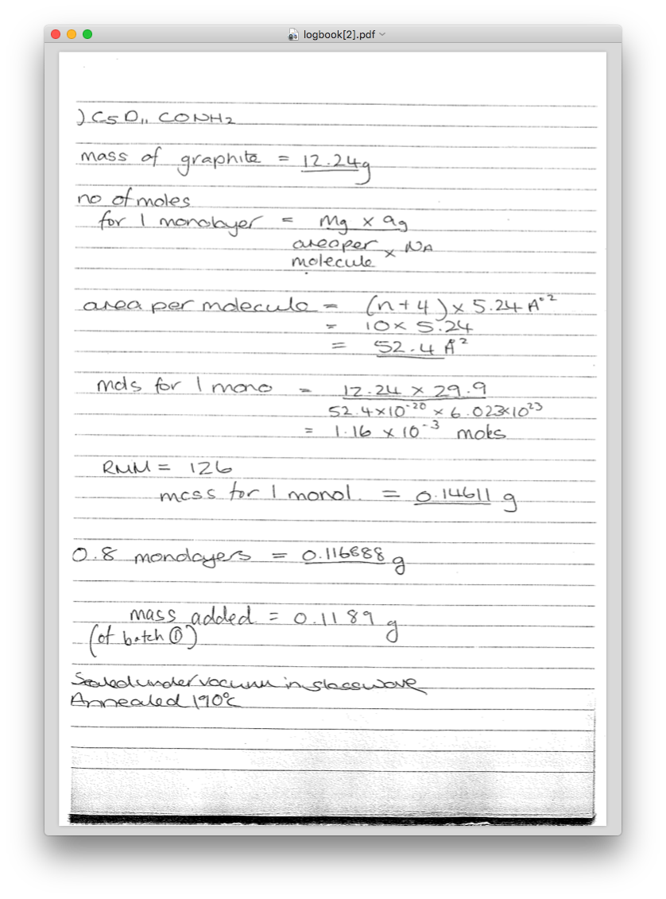
Because Science!
Scientists will use whatever units are appropriate for their particular domain or problem.
For the same experiment they may record metadata in:
min counting time
s⁻¹ count rate
m detector – sample distance
keV photon energy
K temperature of optics
ºC sample temperature
g sample mass
mm sample size
rad detector angle

Slide 5
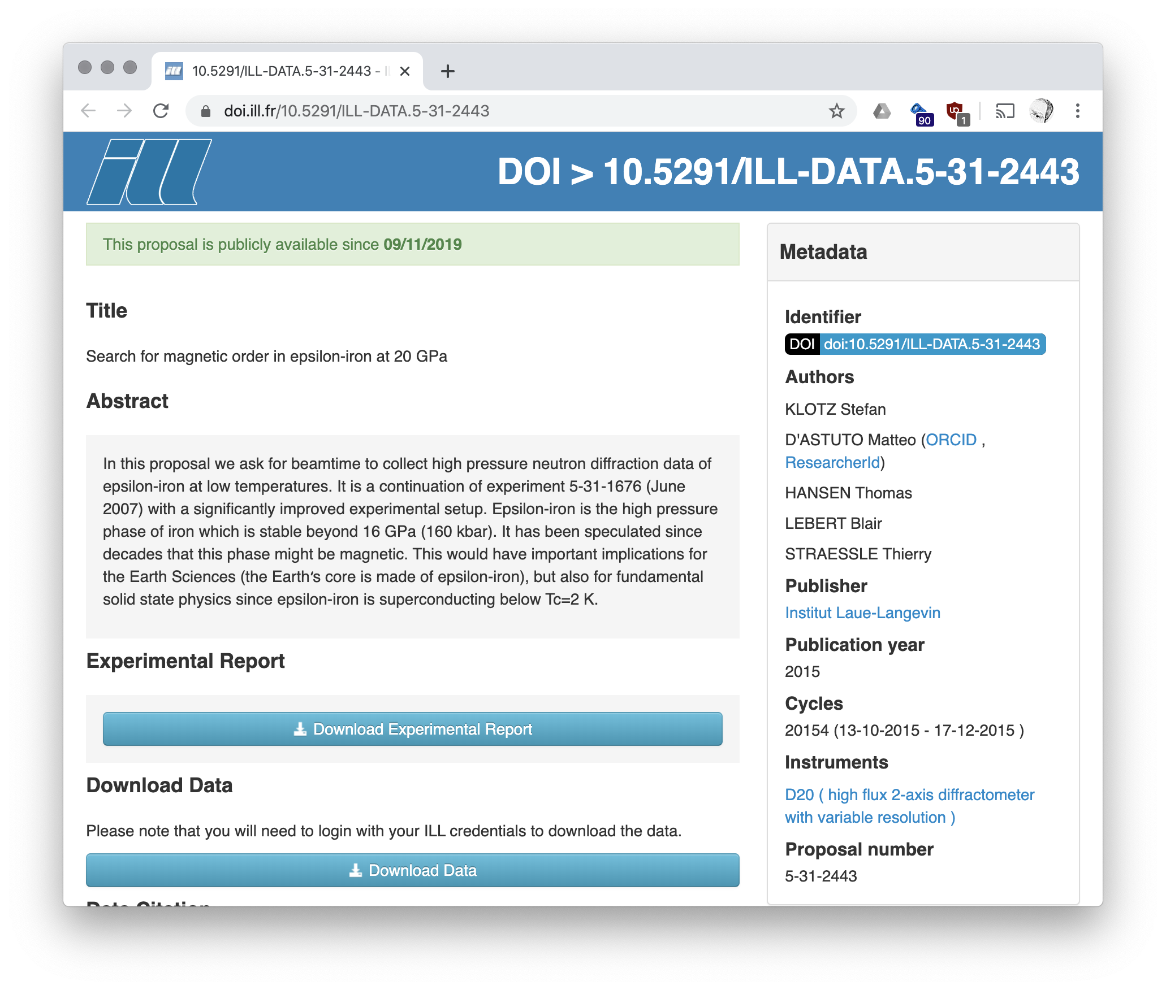
Why is this a problem?
x
The PI expects the units to be represented back to them as originally provided.
The open data user has a reasonable expectation for their search to work.
Example:
The proposal on the right should come up when looking for data on:
Iron
below -100 ºC
above 500 MPa
Storing what was provided verbatim gives the data on the right.
Matching that to the search is very inefficient.

Slide 6
Why can’t we all agree to…
…use SI base units?
No. Have a look at what our users currently use.
We are not going to change how science is done.
…use SI and only allow decade prefixes (atto, femto, nano, micro, …)?
No. That does not work well for time, temperature, photon energy, etc.
…store SI internally?
Maybe.

Slide 7
How we store stuff internally cannot matter
Most of us have made choices, or have had the choices made for us by beamline scientists, users, controls staff, etc.
Changing what is currently in the data catalogues is prohibitively complex.
How we record data in the future, will still be a choice made locally.

Slide 8
Proposal
By default units are being displayed as intended by the original user group.
For a search the user trying to filter data can use the units familiar to them.
The search results should come back with the quantities in the requested units.
Then the user can easily check the filter has been correctly applied and can sort the results from different datasets and facilities.

Slide 9
How we plan to implement this in SciCat
Store both the
original value + unit
and
SI representation + unit
Searches/filters use the SI units through database functions.
Storing the (redundant) original value in additions speeds up the default display and avoids rounding problems.

Slide 10
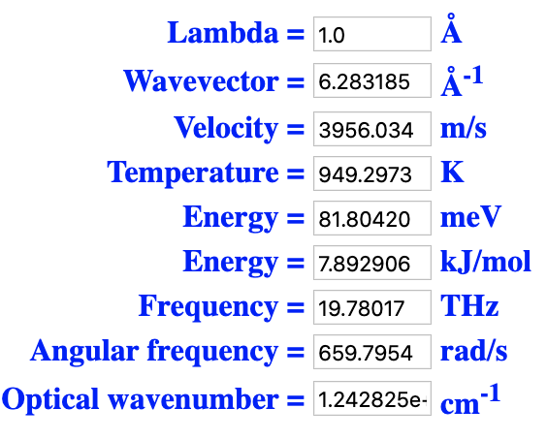
All easy, we can just use conversion libraries!
Yes, there are libraries.
https://pint.readthedocs.io/en/0.10.1/
http://gentooboontoo.github.io/js-quantities/
https://mathjs.org/docs/datatypes/units.html
http://jscience.org/
https://units.readthedocs.io/en/latest/
Some conversions are easy.
Nothing works for all unit systems, though.
Converting to and from wavelengths between photon and neutron experiments, means trouble.
See the boxes.
x
Photon
x
Neutron

Slide 11
Do not despair!
To cover a high percentage of the likely use cases, we only need to curate the conversions of a limited set of search terms (key words).
Most of them are
simple prefix conversions (kg or ug to g)
time (s, min, hours)
temperatures (even ignoring Fahrenheit)
For the special cases we need to customise the conversion and comparison.
Finding out what these most frequently used keywords are and how to convert between the difference quantities is a main topic in the PANOSC ontology task.

Slide 12
Final question: What if we don’t recognise the units?
This should be allowed. We want to be permissive and extensible. We cannot curate everything immediately.
But no automatic conversion occurs.
Good news: This is the status quo everywhere today. (Correct if wrong.)
The original user will still see verbatim what they recorded.
Someone searching can still find exact matches and potentially use comparison operations.
Later curation may change the situation.

