Slide 1

Introduction to python at ESS
training
Data Reduction, Modeling and Analysis group
DMSC, European Spallation Source ERIC
27.02.2020

Slide 2
Agenda
13:00 – 13:30 Introduction to Python, Jupyter notebooks and usage at ESS
13:30 – 13: 45 Group set up
13:45 – 17:00 Exercises
17:00 – 17:30 Closing remarks, solutions to exercises, etc.

Slide 3
What is Python?

Slide 4

About Python
General purpose high-level programming language
Interactive scripting language supporting object oriented programming
Developed by Guido van Rossum and first released 1991
Free Open Source Software (FOSS)
Is today maintained by the Python Software Foundation (PSF)
The logo contains pythons (snakes) but name is derived from

Slide 5
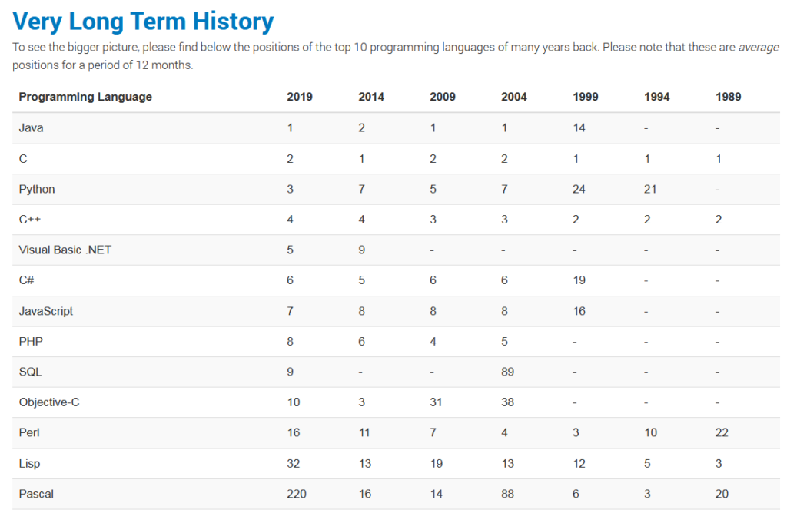
Popularity of Python
Has constantly increased
Ben Putano, August 30 2019
@ stackify.com”
A Look At 5 of the Most Popular
Programming Languages of 2019”
https://stackify.com/popular-programming-languages-2018/

Slide 6
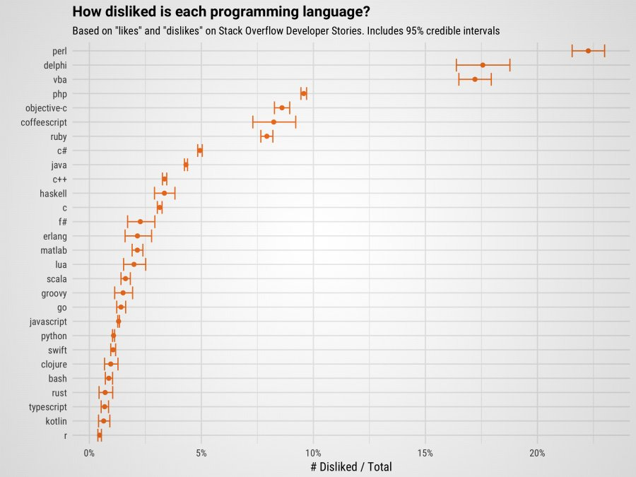
It is not particularly disliked

Slide 7
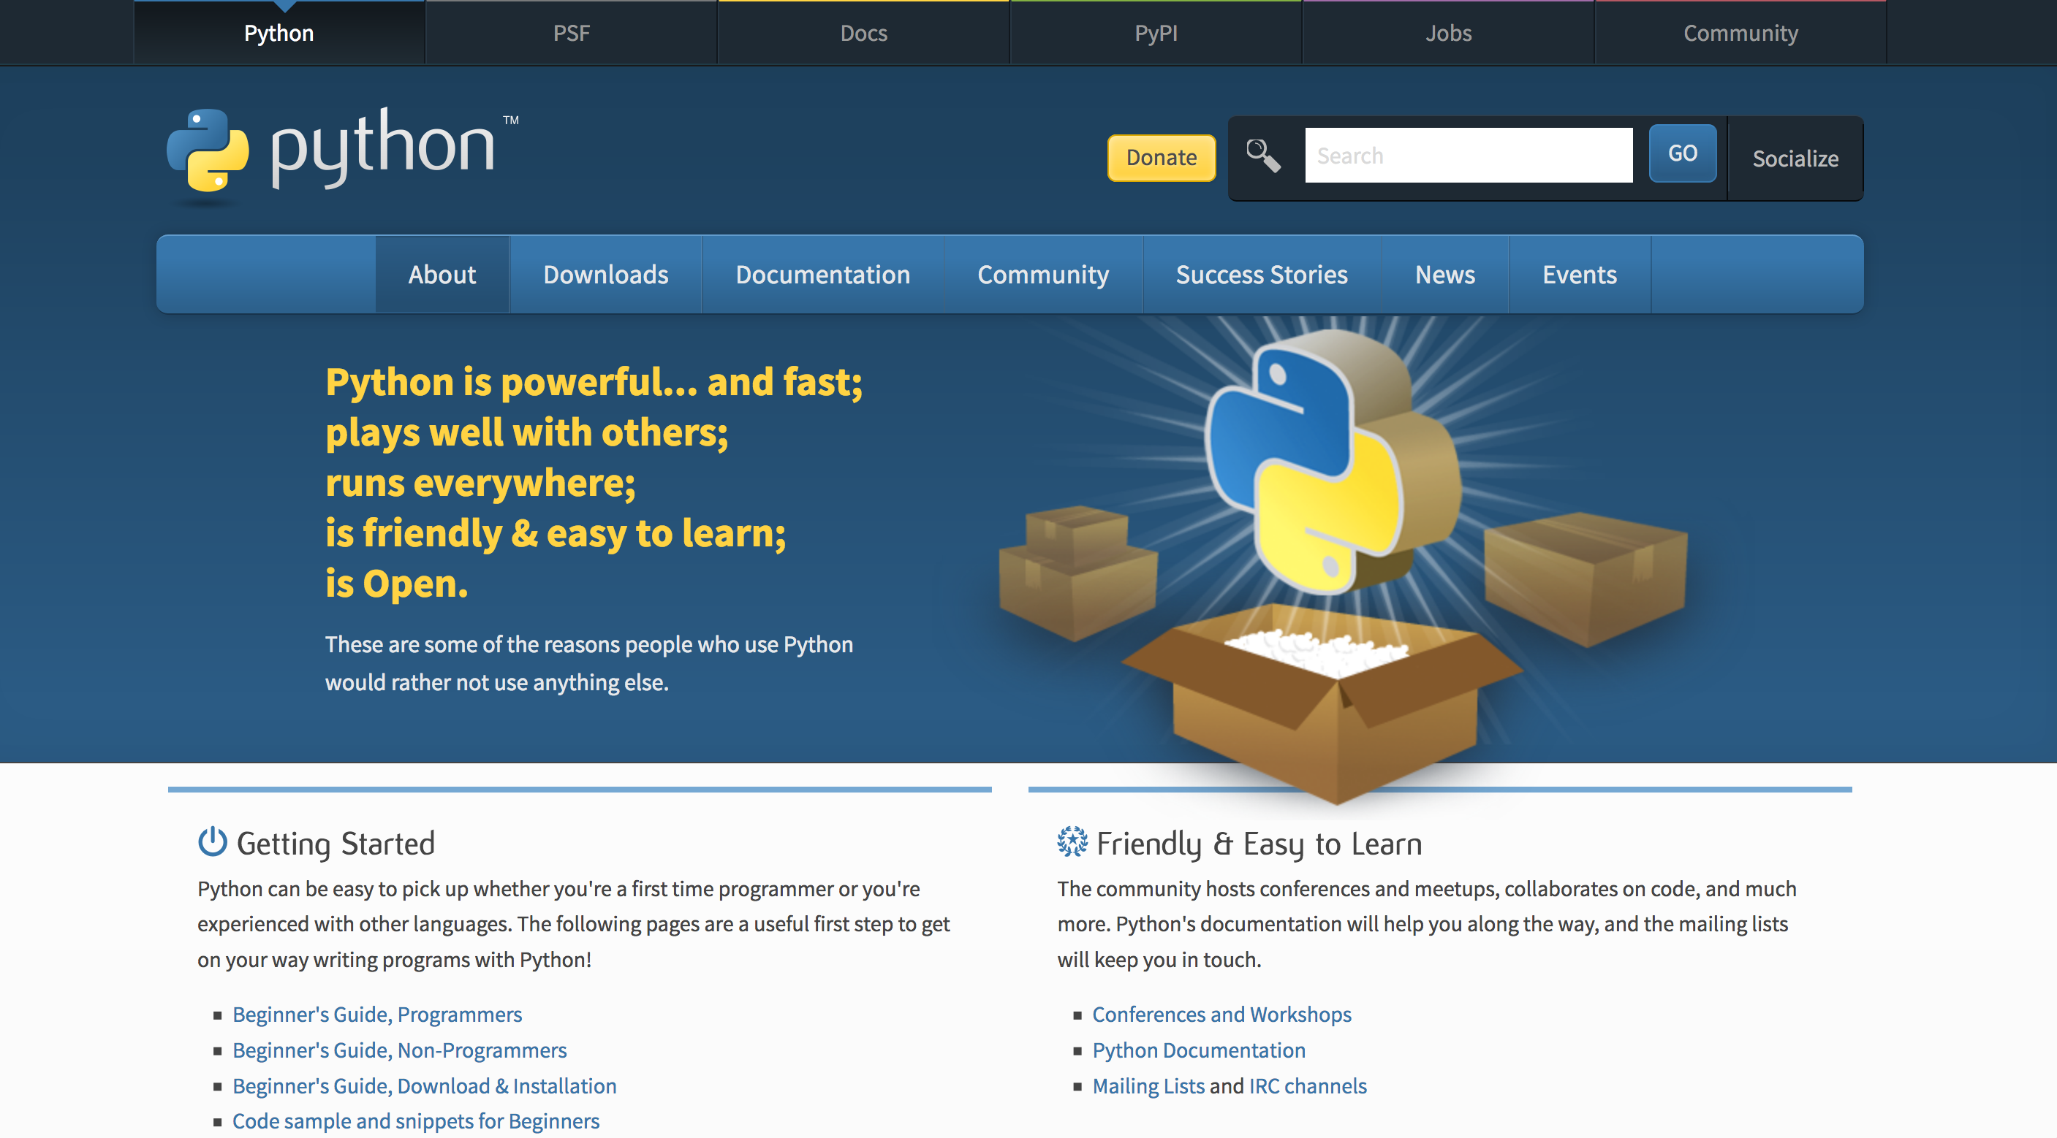
Top 20 ML & AI Python open source projects

Slide 8
Motivation

Slide 9
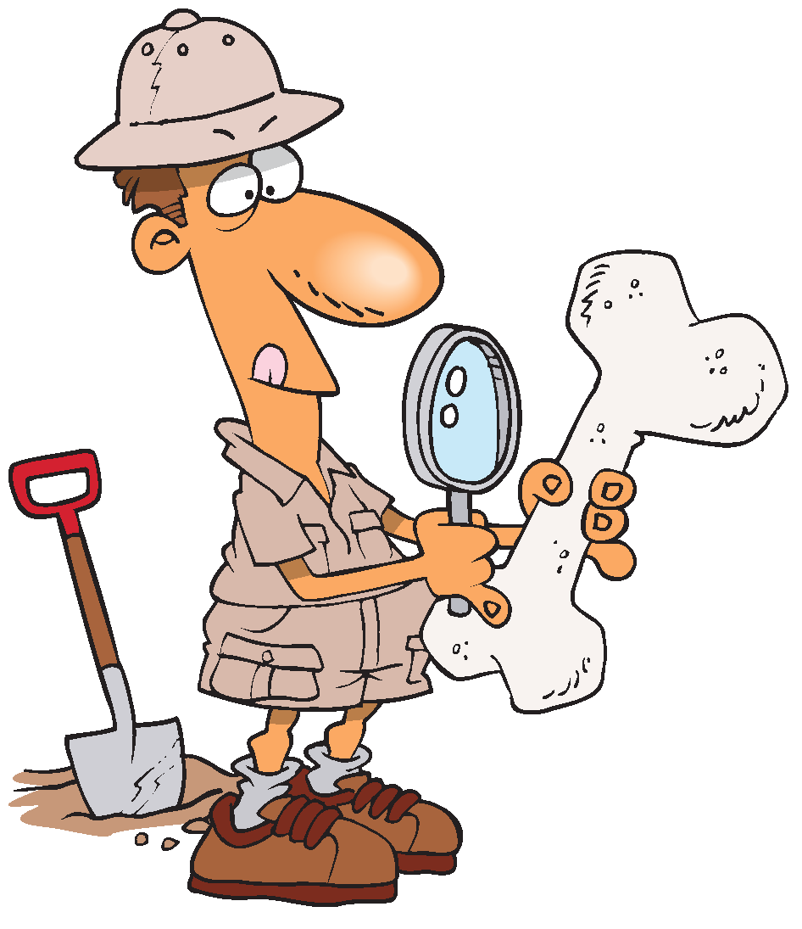



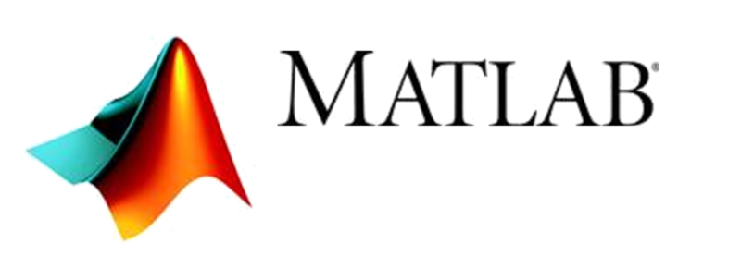
Our motivation
User community is diverse
Non-expert and occasional user (few days/year)
Experienced (daily) or geeky user
Graphical User Interface
The Niels Bohr Institute
9
Command Line Interface

Slide 10
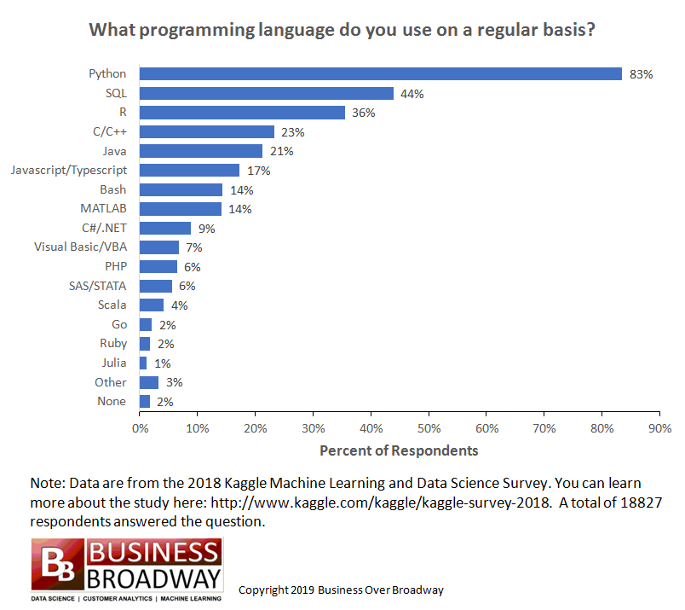
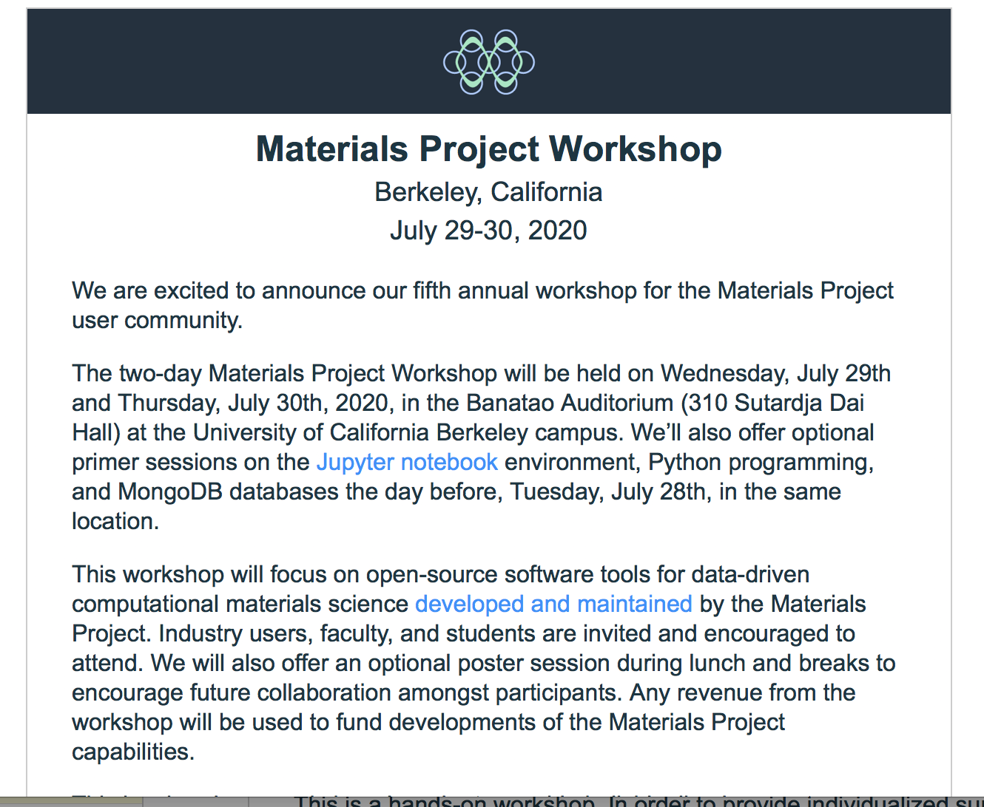
Most popular choice among (data) scientists

Slide 11
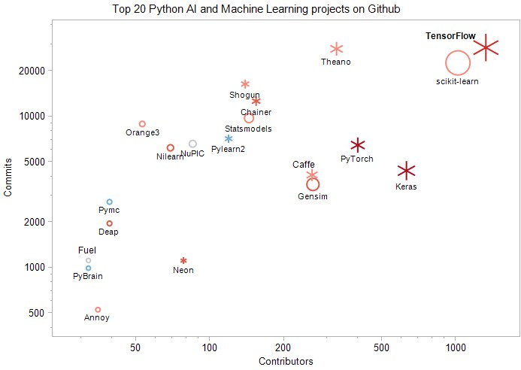
Development is supported by some big players
Top 20 ML & AI Python open source projects
Univ, Montreal
Google
Facebook
Facebook
Google
Kdnuggets.com (2018)
https://www.kdnuggets.com/2018/02/top-20-python-ai-machine-learning-open-source-projects.html

Slide 12
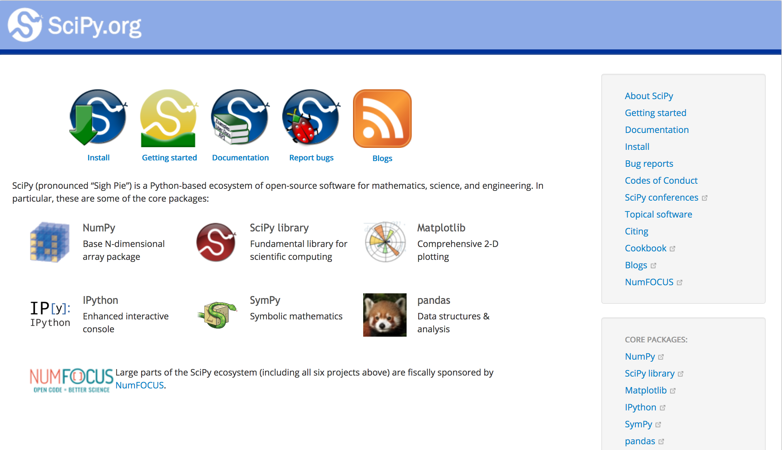

Slide 13
How we use it

Slide 14
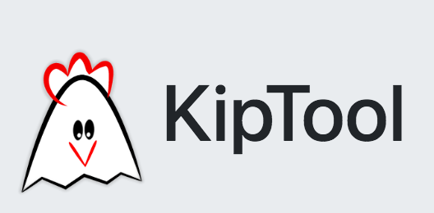






You can use Python for your entire data pipeline
and GUI – in most cases - if you really want to
Data aquisition
Data reduction
Data analysis
Data management
NICOS

Slide 15
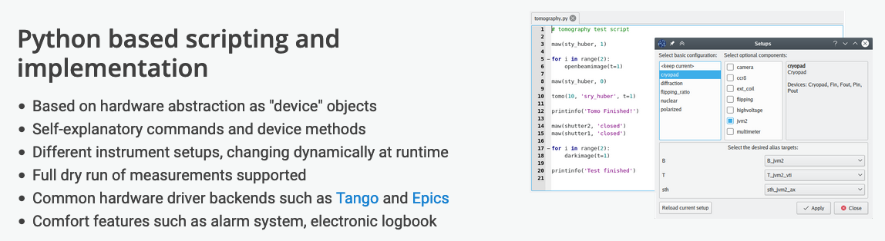
Experiment control
NICOS
https://nicos-controls.org/

Slide 16
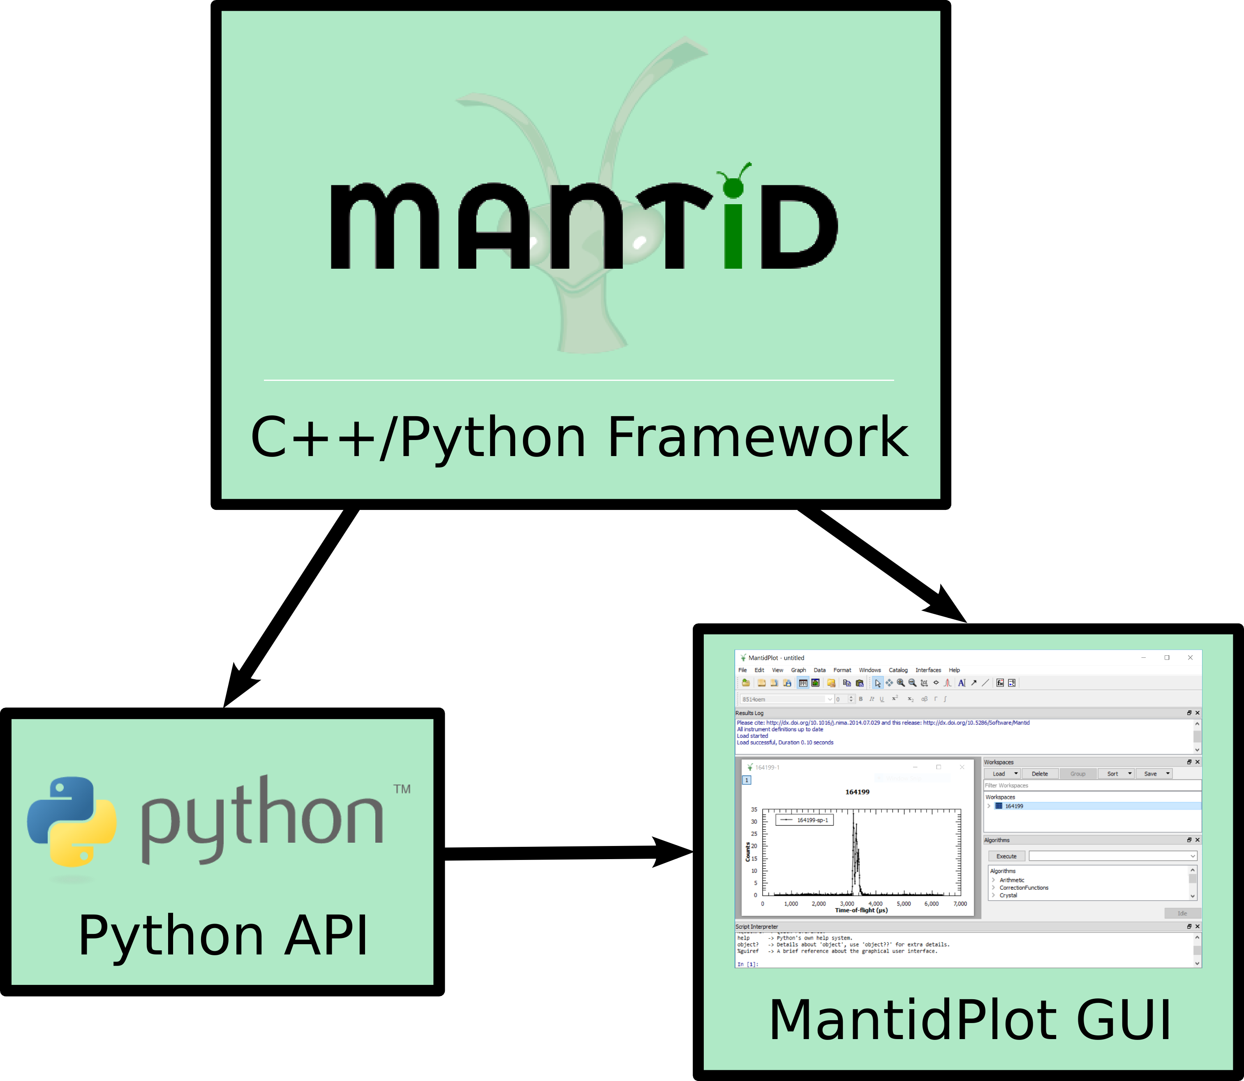
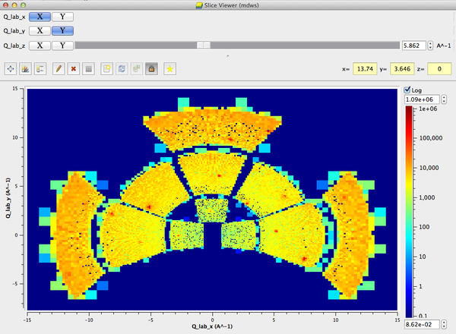
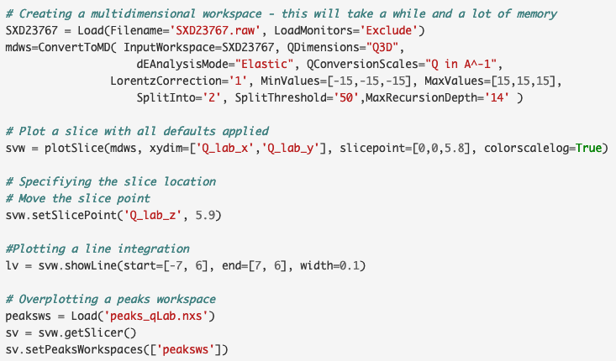
Data reduction
SliceViewer Python Interface

Slide 17
Data reduction
C++ core
Python interface
Multi-dimensional arrays with labeled dimensions

Slide 18
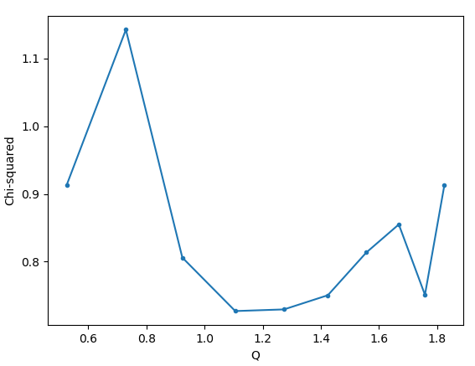
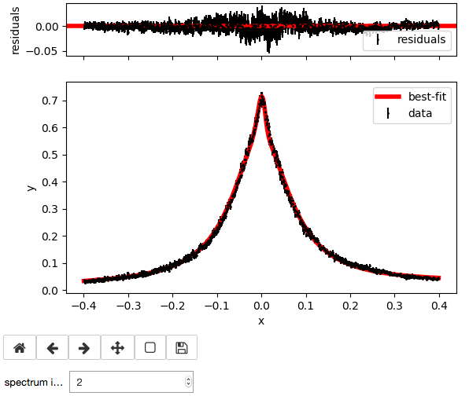
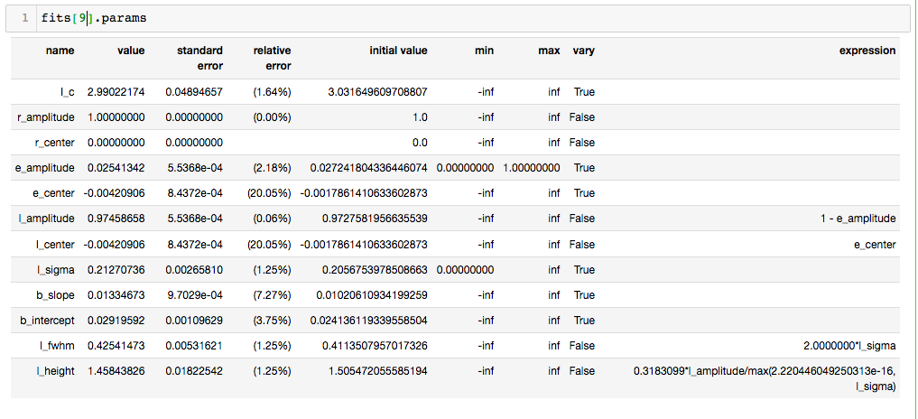
Data Analysis
QENS
Examples run in Jupyter notebooks
Sequential fitting using lmfit
- Download, load display data
- Plot loaded data
- Fit data:
  define model
  initial guesses
  choice of minimizers
- Sequential fits
References: qef, QENSmodels
Data: Mantid Sample Data from IRIS at ISIS
𝜒² for each spectrum
Plot of fitted model for each spectrum using ipywidgets
Display refined parameters for selected spectrum

Slide 19
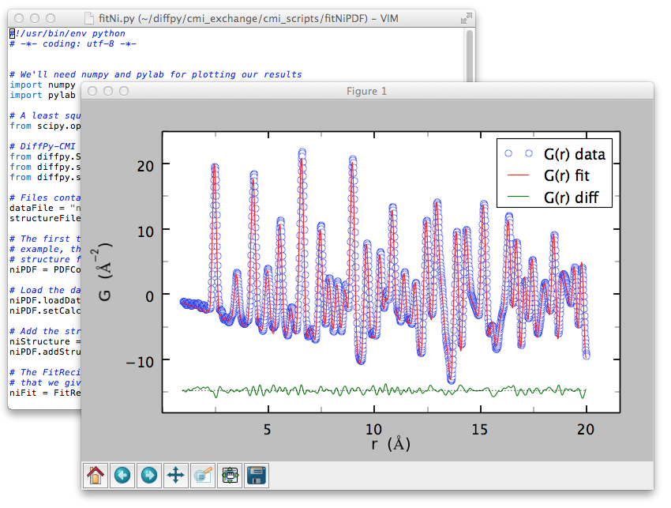
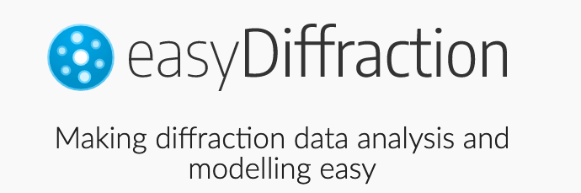
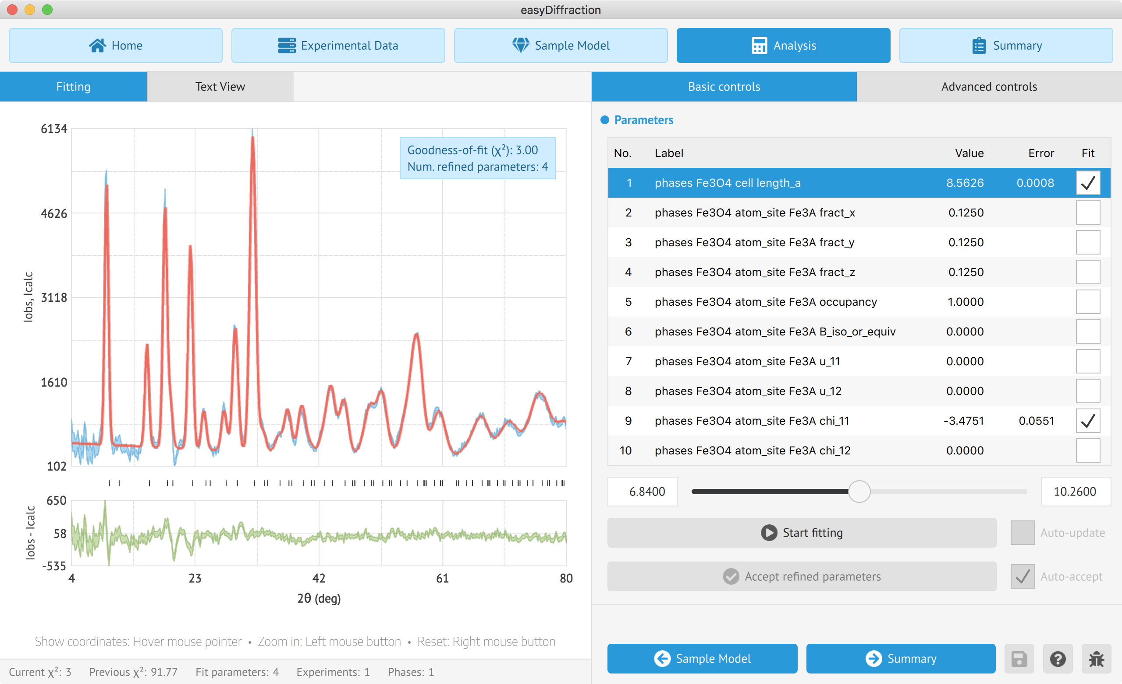
Data Analysis
Diffraction
PDF analysis with DiffPy
https://www.diffpy.org/products/diffpycmi/index.html
Python interface to come (EasyInterface or CoDe based)

Slide 20
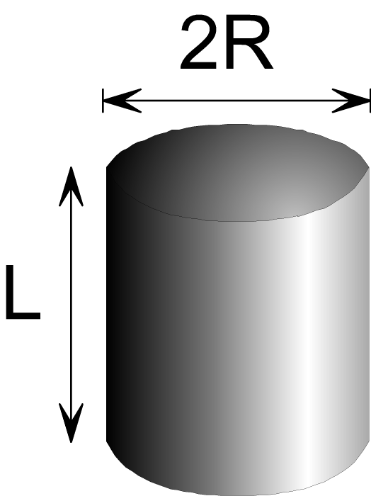
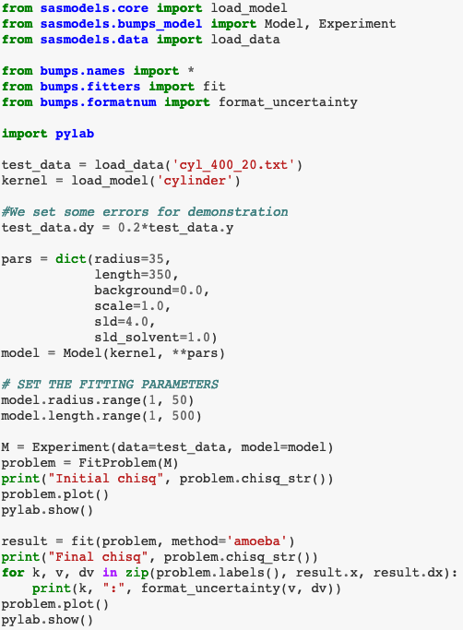
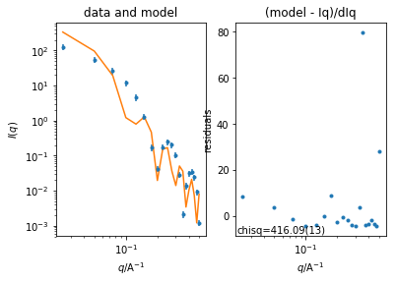
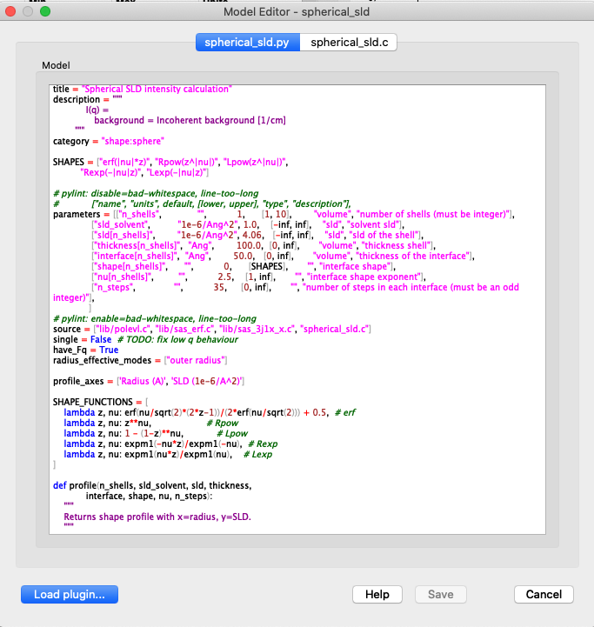
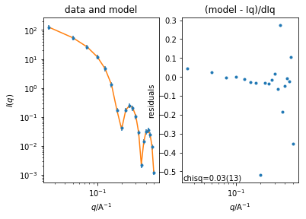
Data Analysis
SANS
Stand-alone script
Iniitial fit
Built-in model editor
Fitted
https://github.com/SasView/documents/blob/master/Notebooks/SasView%2BCLI%2Boverview.ipynb

Slide 21
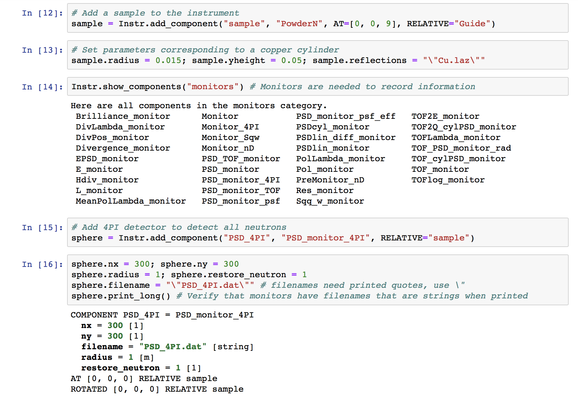
McStasScript
McStas from python scripting
Part of jupyter demonstration
Adding a sample
Help to find a monitor
Adding such a monitor
Verify the entered data

Slide 22
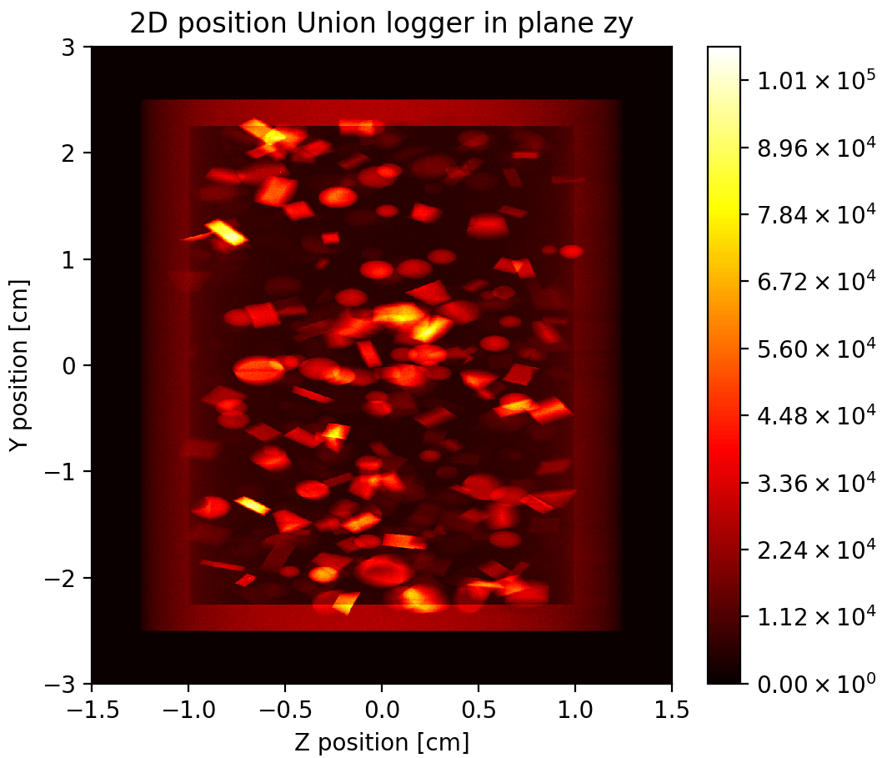
McStasScript
Python API for McStas
  Build instrument
  Run simulation
  Access data as numpy arrays
  Plot data
Can generate python script from .instr
Shown example
  Powder simulated as many single crystals
  for-loop over crystals in python
  Plotted with matplotlib from API

Slide 23
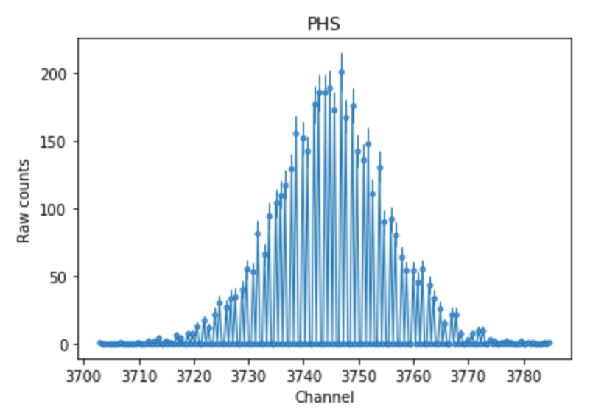
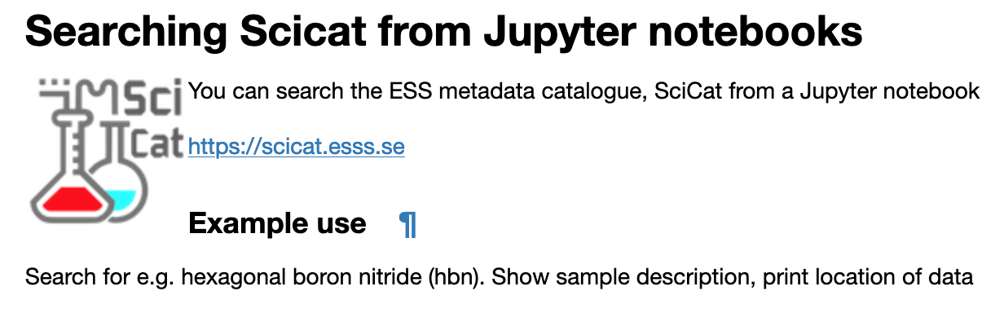
Data management
https://github.com/garethcmurphy/searchScicat/blob/master/Search%20SciCat-Plot.ipynb

Slide 24
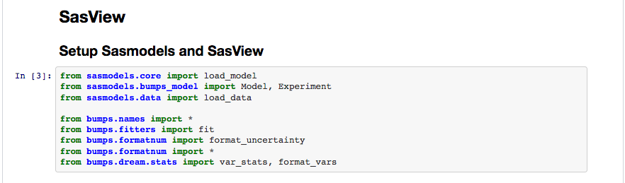
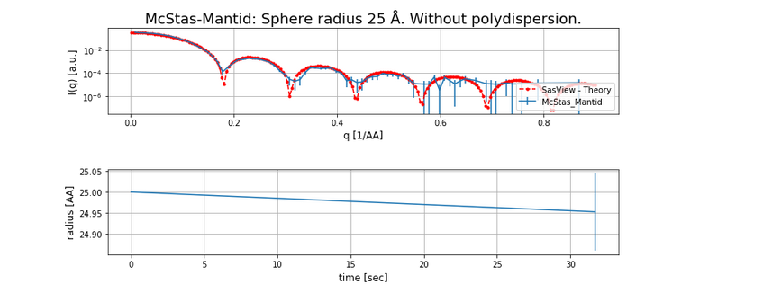
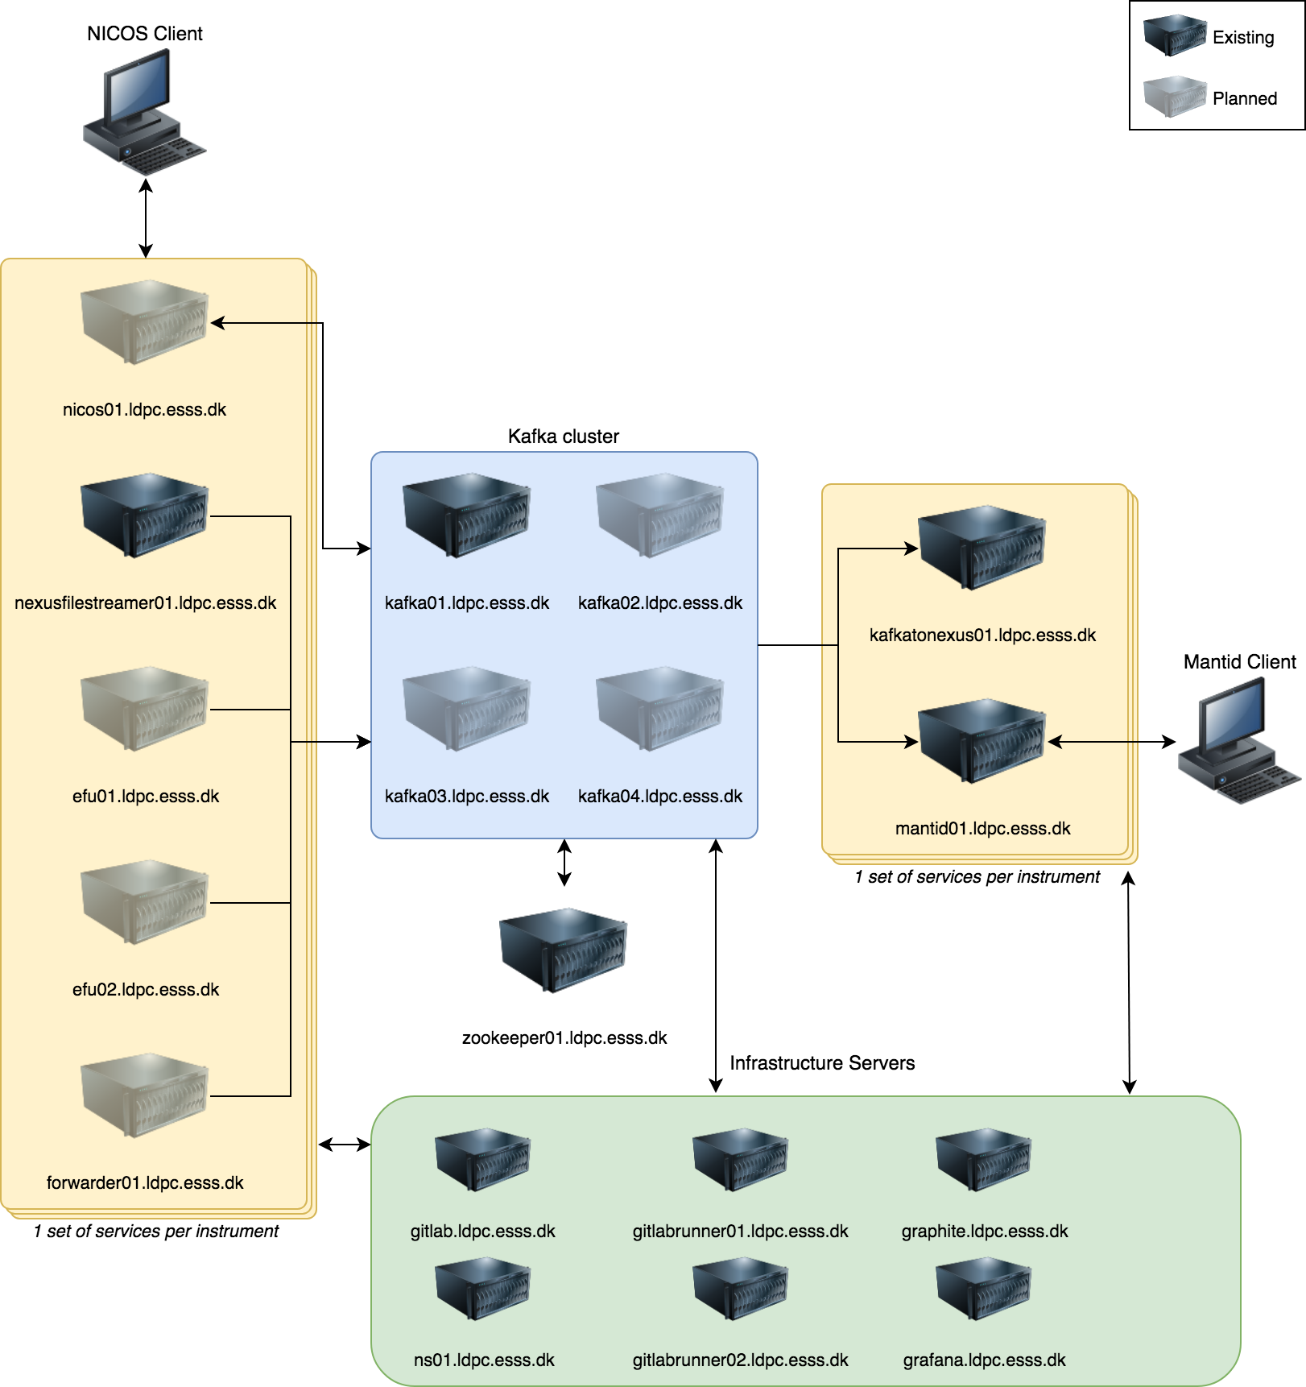
No neutrons – no problem
Simulated pipeline
A virtual data pipe line
Can be used to stream event data
A Mantid client will grab the event data
the detector intensity build up can be monitored.
Subsequently event data may be reduced
and analysed using and e.g.

Slide 25
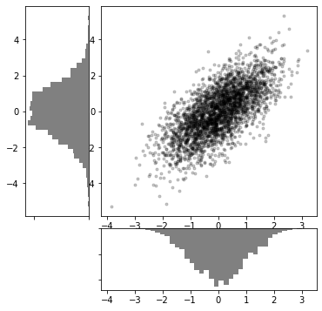
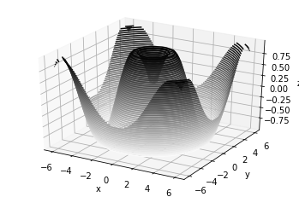
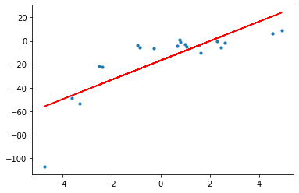
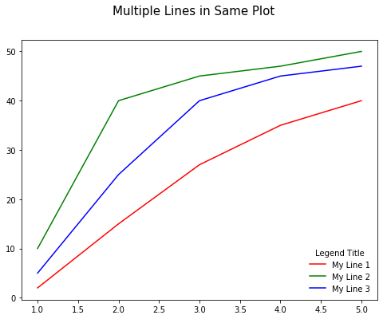
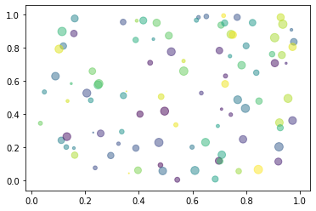
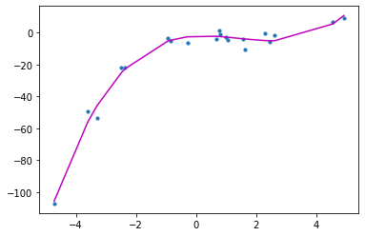
Not convinced yet?
Plotting and fitting is general

Slide 26
Today

Slide 27
Today
Introduction to Python and Scientific Python
13:00 – 13:30 Introduction to Python, Jupyter notebooks and usage at ESS
13:30 – 13: 45 Group set up
13:45 – 17:00 Exercises
17:00 – 17:30 Closing remarks, solutions to exercises, etc.

Slide 28
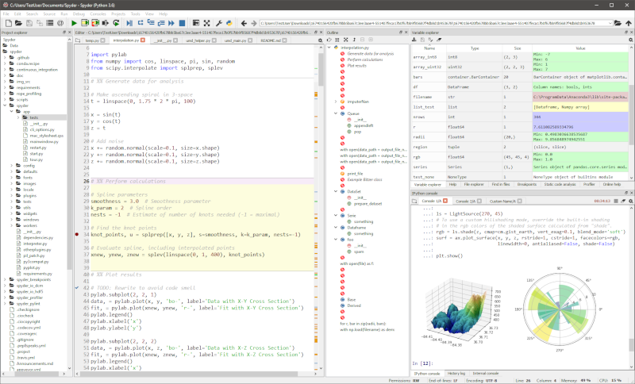
Many ways to run python
text editor + built-in machinery (terminal)
spyder (Matlab like environment)
Jupyter-notebook (we will use it today)
$ python my_script.py

Slide 29
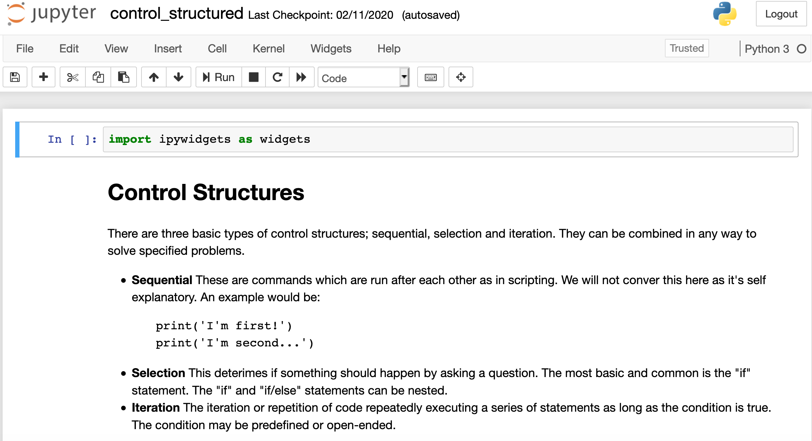
Jupyter notebook
Different cell types (_code_, _markdown_)
Run cell: shift+enter
Run all cells
Saving; exporting
https://jhubworkshop.esss.dk/

Slide 30
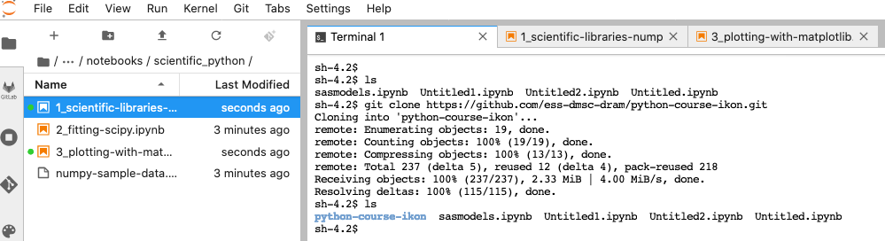
Ways to continue
Guests accounts at https://jhubworkshop.esss.dk/ available this week and from ESS network
https://jupyterhub.esss.lu.se (most of contetnt works)
Anaconda Navigator (both jupyterhub and spyder)
  https://www.anaconda.com/distribution/#download-section
  Windows:
    https://docs.anaconda.com/anaconda/install/windows/
  Mac:
    https://docs.anaconda.com/anaconda/install/mac-os/
Github:
  https://github.com/ess-dmsc-dram/python-course-ikon

Slide 31
Feedback/requests
Pandas
Testing (Pytest)
Use cases are welcomed
Python different versions/enviroments
Feedback form will be sent out

Slide 32
Groups/modules
Beginner (Celine, Torben, SimonW, Wojtek) | Intermediate (Mads, SimonH, Neil) | Intermediate (Andrew, Piotr, Thomas)
Jupyter basics jupyter-notebook-intro Python basics 1_basic_language_principles 2_sequence-data-types 3_control_structures 4_working-with-functions 5_using_modules 6_input-and-output 7_python2vs3 | External libraries 1_scientific-libraries-numpy 2_plotting-with-matplotlib 3_ipywidgets 4_fitting-scipy | Molecular visualization 1_Visualization_Tutorial 2_Atomistic_Simulation_Enviroment GUI developement
Extras (repetion): 1_disclose_enemy_weakness

Slide 33
Questions

Slide 34
Python is a winner among data scientists
Python is becoming the de facto standard scripting language for data science incl. in our commumity.
By choosing Python as scripting interface we:
Foster collaboration and inter-operability
Lower the entry barrier for many scientists
Foster develpment of new applications through integrations of existing applications

