Slide 1
SRF Cryomodules
November 2013 Meeting
Christine Darve
Lead Engineer – SRF Linac (704 MHz)
www.europeanspallationsource.se
November 21, 2013

Slide 2
Agenda
10:30-10:45: Goals of workshop – CD
10:45-11:45: ESS cryo-operating modes – JF
11:45-12:45: ESS infrastructures (CTL, valve box) – JF, PA, CD
  Cryogenic infrastructures
  Cryomodule handling, alignment, interfacing (to the ground, with RF distribution...) in the tunnel
13:00-14:00: Lunch
14:00-14:30: Cryomodule cryogenic design – CEA, IPNO
  Cryogenic distribution
  Valves and Instrumentation
  Interface valve box / jumper
14:30-17:00: Discussion – Open topics (among others):
  Positions of heat exchanger, cryogenic valves, vacuum barrier ;
  Temperatures, pressures and distribution lines of the CTL;
  MAWP pressure.
See the WP4/WP5 Audit Indico page at: https://indico.in2p3.fr/conferenceDisplay.py?confId=9118
Password: essaudit

Slide 3
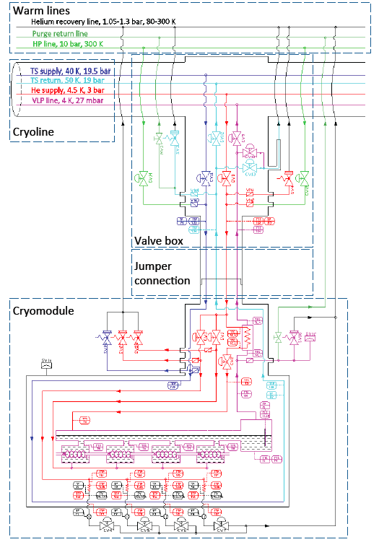
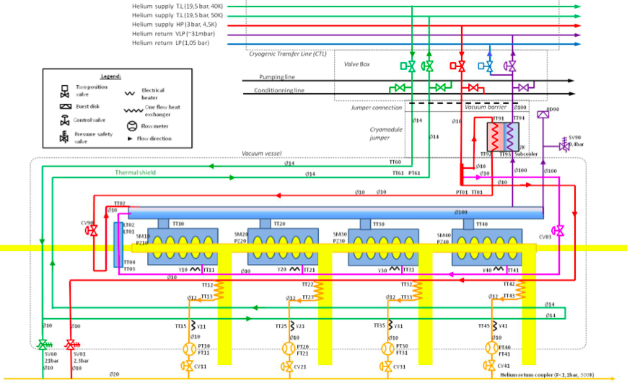
Objectives of the workshop
Define interfaces between Cryomodules and Cryogenic Transfer Line (CTL):
1) Temperature 4) Cryo-distribution sizing
2) Pressure 5) Control (instrumentation, PLC)
3) Mass-flow
The Process and Instrumentation Diagram (P&ID) shall:
Comply with the Electro-Magnetic Resonator requirements
Results from the ESS cryo-operating modes

Slide 4
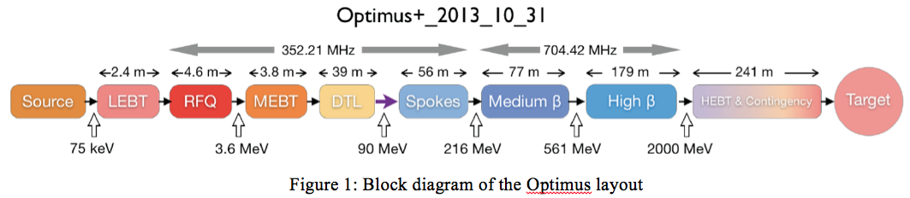
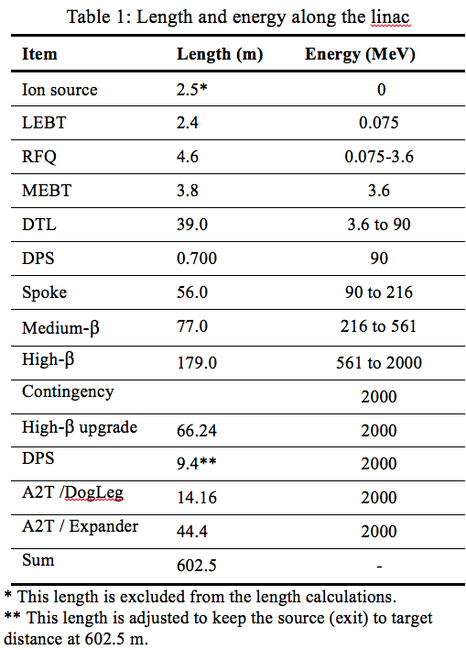
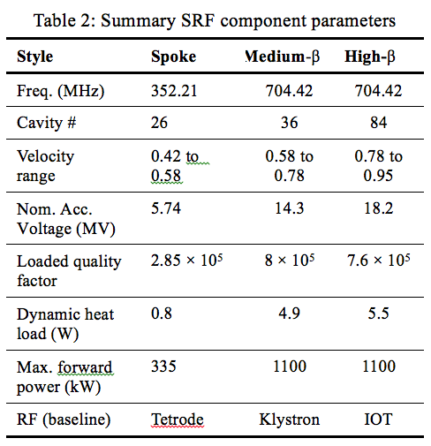
Context : ESS Layout

Slide 5
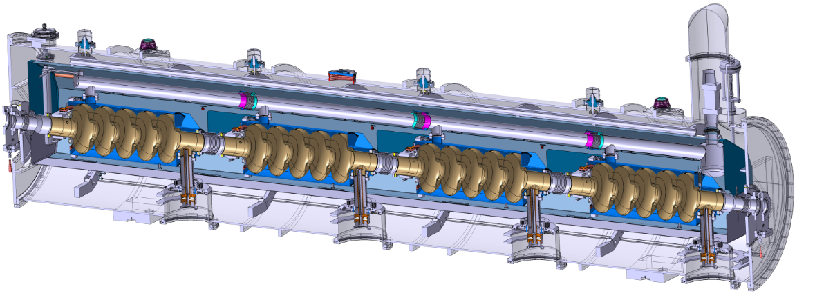



Context: Elliptical Cavity Technology Demonstrator (ECCTD)
Use the ECCTD and the Spoke Technology Demonstrator to validate the equipment and operating mode to be implemented in the ESS tunnel.
What ESS Hardware is prototyped ?
EMR: 4x SRF resonators in an equipped cryomodules (cryo, vacuum, RF)
Valve box: to interface with the cryogenic supply.
Control system (control box, instrumentation, process variables, EPICS, etc)
Other components:
Magnetic and Thermal Shields
Supporting system
Etc..
Helium tank
Cold tuning System
5-cell elliptical cavity
Power coupler
Space frame

Slide 6
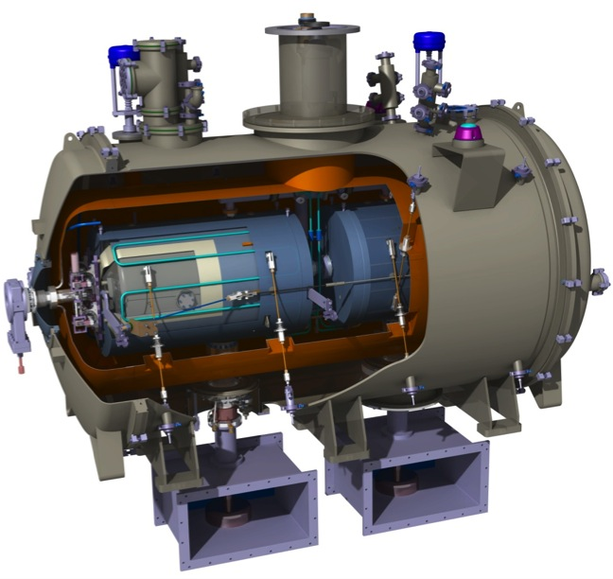
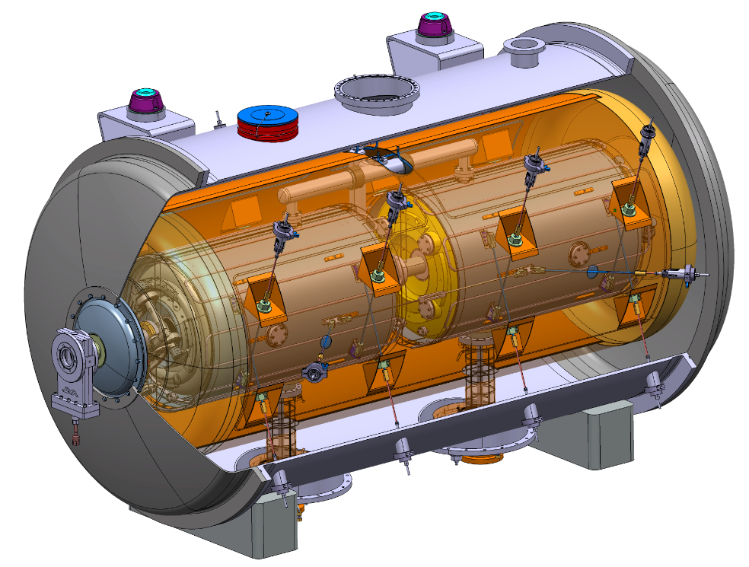
Goal of Cryomodules Technology Demonstrators
Validate the life-cycles of the cryomodule fabrication, assembly and operation
Validate interfaces of the cryomodule with the Stakholders
Validate the performance of the ECCTD at low RF power and cryogenic condition, before initiating series fabrication
Identify possible issues and transfer knowledge to industry for series fabrication
Notes:
Accelerateur principe avec proton
Technologie de pointe supraconductice
Spoke – insatalle

Slide 7
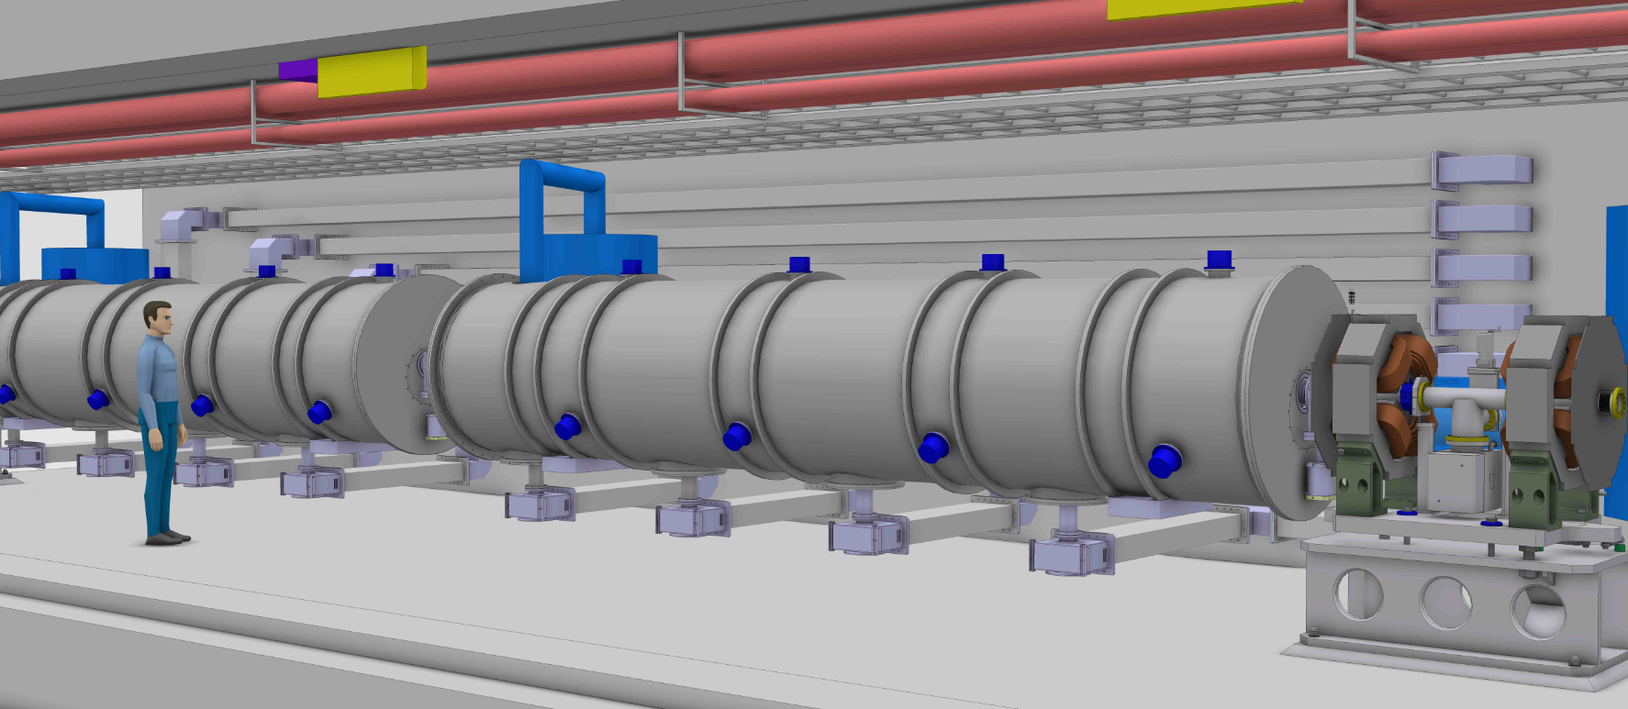
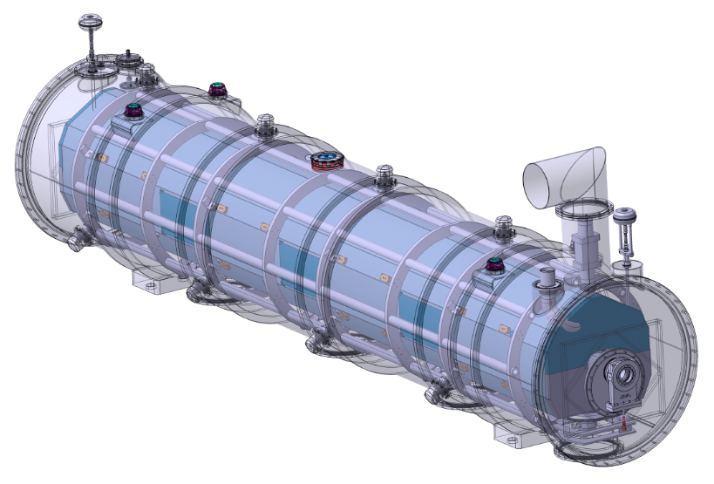
Cryomodule Interfaces
ESS lead engineers and WPs leaders
Cryomodule designers
Cavity package designers
Control command (Control Box, PLC, LLRF, MPS)
Instrumentation teams
Safety team
RF team
Component assembly teams
ESS system engineer, QA
Survey experts
Test stand service
Toolings
Transport
Conv. Fac.
Cryogenic distridution
Cryogenic distribution
Control system
Beam Diagnostic
Beam Optics
Beam Vacuum
Radio-frequency

Slide 8
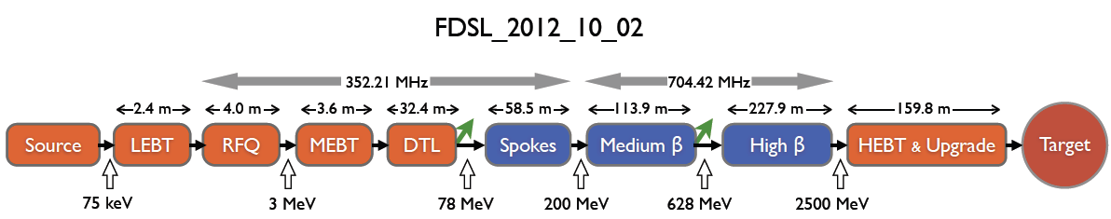
Accelerator Systems way of working
- Accelerator deliverables ‘x’ from ‘suppliers’ (WPs) to ‘customers’ (PBS)
 | ‘suppliers’ |  | ‘customers’ Product Breakdown Structure (PBS)
 |  |  | 1.1.01 | 1.1.02 | 1.1.03 | 1.1.04 | 1.1.05 | 1.1.06 | 1.1.07 | 1.1.08 | 1.1.09
 | acc physics | WP 2 | x | x | x | x | x | x | x | x | x
Accelerator Support | NCFE | WP 3 | x | x | x | x | x
 | Spoke etc.. | WP 4 |  |  |  |  |  | x
 | Elliptical SRF etc.. | WP 5 |  |  |  |  |  |  | x | x
 | HEBT and magnets | WP 6 |  |  |  | ? |  | x | x | x | x
 | beam diagnostics | WP 7 | ? | x | x | x | x | x | x | x | x
 | RF | WP 8 |  |  | x | x | x | x | x | x
 | Installation | WP 99 | x | x | x | x | x | x | x | x | x
 | test stands | WP 10 |  |  |  | x | x | x | x | x
 | cryogenics | WP 11 |  |  |  |  |  | x | x | x
 | vacuum | WP 12 | x | x | x | x | x | x | x | x | x
 | Safety etc.. | WP 13 | x | x | x | x | x | x | x | x | x
 | Lead Engineer | WP 14 | x | x | x | x | x | x | x | x | x
 | Cooling and electrical | WP15 | x | x | x | x | x | x | x | x | x

Slide 9
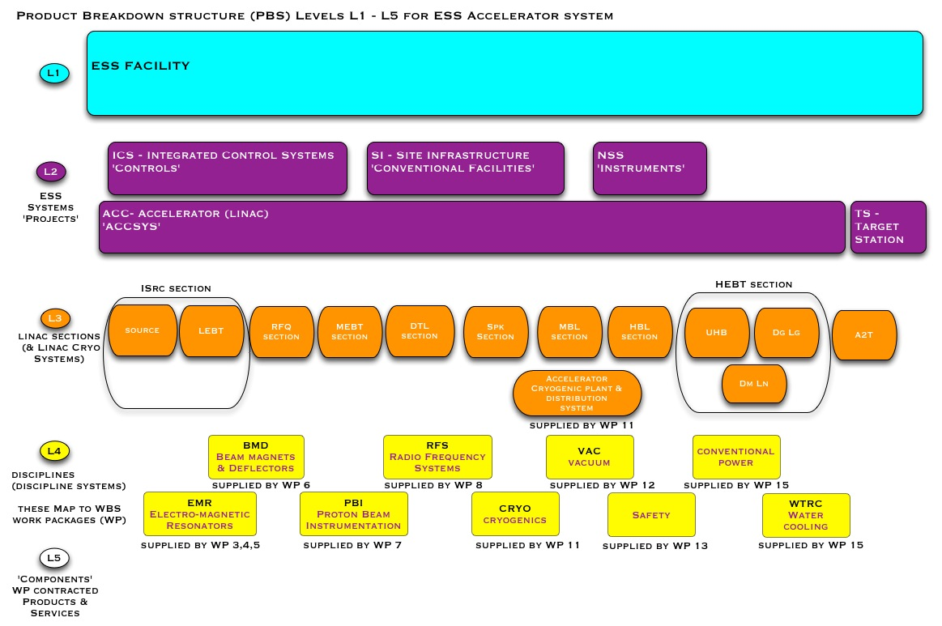
What is the framework for our requirements?
This drawing is not yet approved

Slide 10
Open issues
  Define common set of assumptions (HX, cool-down time, operating parameters..)
  Towards one unique flow schematic: operating modes
  Interface cryomodule/valve box via jumper
  Interface cryomodule / waveguides
  Positions of heat exchanger, cryogenic valves, vacuum barrier
  Pressure drops estimation for all operating modes
  CEA test area extrapolation to ESS tunnel: constraints and boundaries conditions
  Failure scenarios and what-if analysis, FMEA
  Maximal Credible Incident
  Maintenance modes and Risk analysis
  Instrumentation and fail-safe modes
  Valves and Instrumentation standardized
  Analyse, justify and communicate solutions
  Consistent and coherent !

Slide 11
Slides for discussion

Slide 12
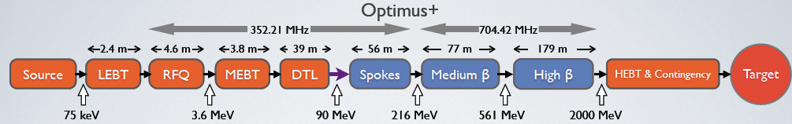
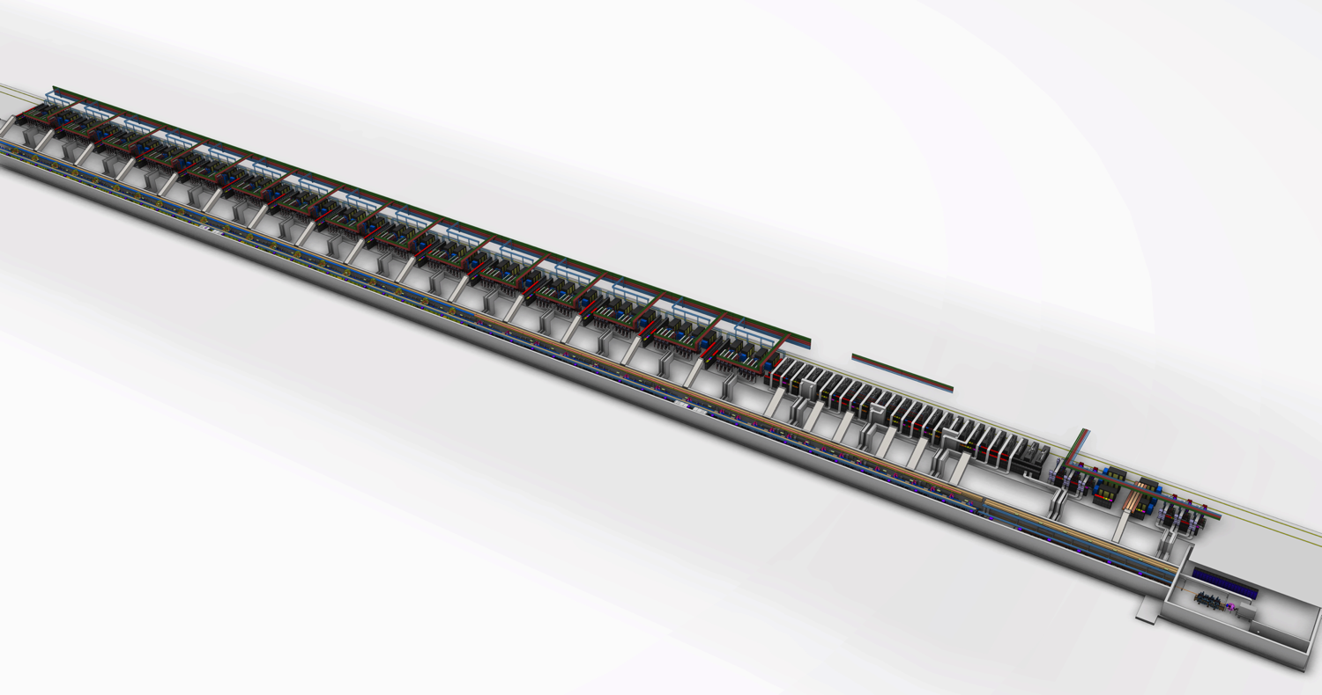
ESS Linac Layout
High beta RF
DTL RF
Medium beta RF
Low Energy Front end
Spoke RF
High beta cryomodules
Medium beta cryomodules
Spoke cryo-modules
DTL tanks

Slide 13
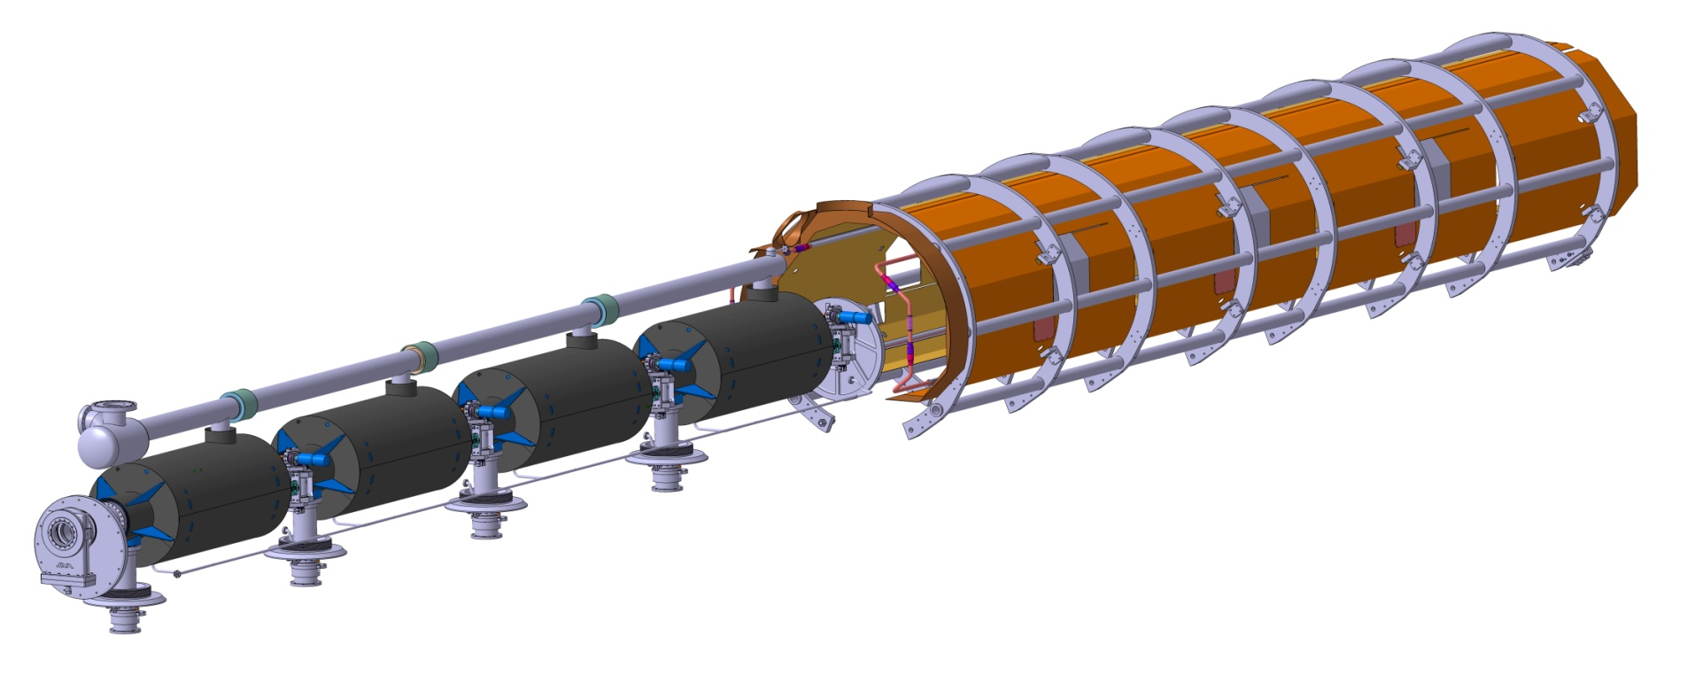
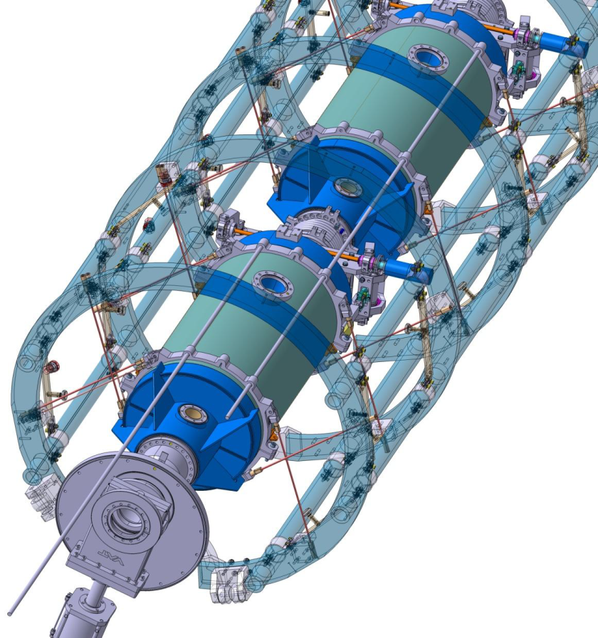

Cryomodule life-cycle
High pressure rinsing
In clean room (ISO5 or ISO4)
Cavity fabrication
Chemical treatment
Validation test of the cavity in vertical cryostat
Transport
Cryomodule components fabrication
Cryomodule reception and storage
Qualified cavity storage
Cavity string assembling in clean room
Cryomodule assembling
Validation test of the cryomodule
Processed couplers storage
Tools fabrication
Cryomodule storage
Coupler RF processing
Space frame
Tuning system
Assembling in clean room
Magnetic shield
Cryomodule on beam line
TA6V rods in X pattern to keep the beam axis at the same position during cool down
Power coupler fabrication
Beam valves and extremity flange
Courtesy of Pierre Bosland CEA/IRFU
Notes:
QA control

Slide 16
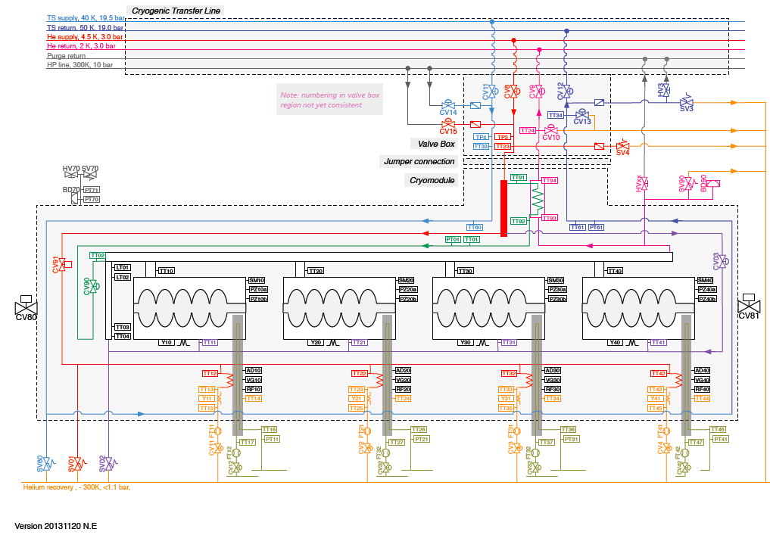

Slide 17
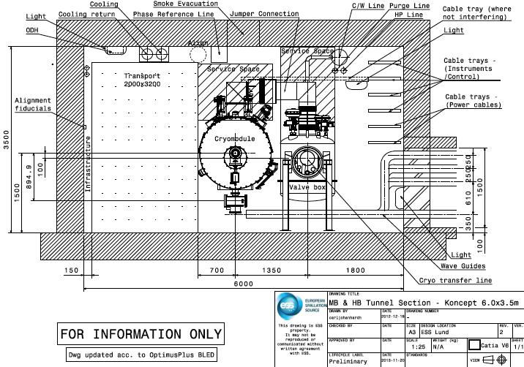
Tunnel cross-section

Slide 18
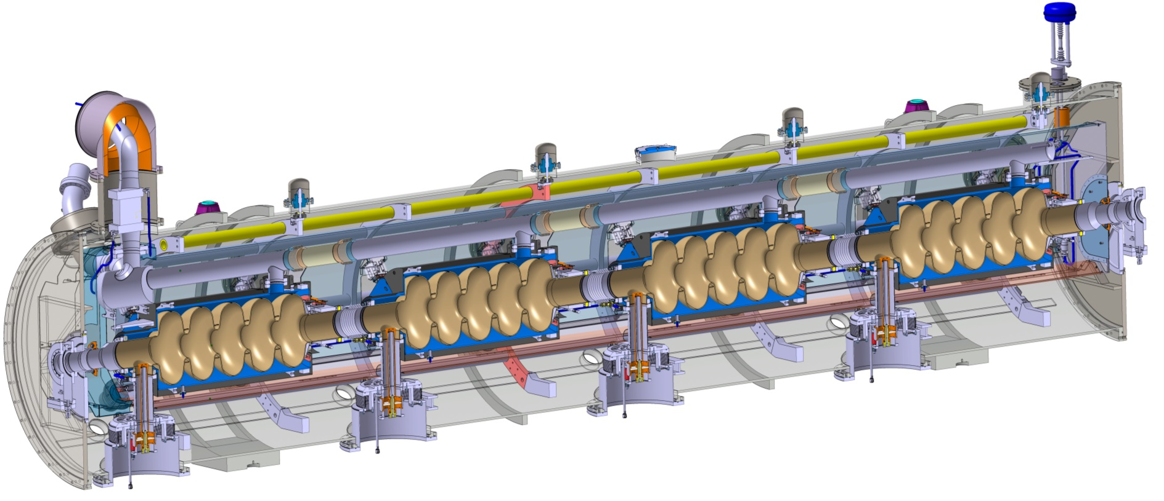
ECCTD Cryomodule - Generic
Engineering studies by G. Olivier & F. Leseigneur (IPNO)
High beta ECCTD
Same vacuum vessel for medium and high-beta cavity cryomodules
Only minor differences:
    Length of the inter-cavity bellows
    Tuner piezo frames
    Penetration of the antenna for Q_{ext} adjustment

Slide 19
Standards and ESS Safety Culture
Engineering standards
CEN, European Committee for standardization
SIS, Swedish Standard Institute
ISO, International Organization for standardization
  → e.g. European Directive 97/23/EC; EN ISO 4126, PED
  ESS guidelines for pressure vessel modeled after FNAL, European and CERN expertise
Radio-Protection and Rad-hard equipment
As low as reasonable achievable (ALARA)
Passive and active safety measures (safety barrier)
Personnel Protection System, Machine Protection System (IEC61508)
  Risk analysis and reliability study
  Safety reviews
  Quality Assurance

Slide 20
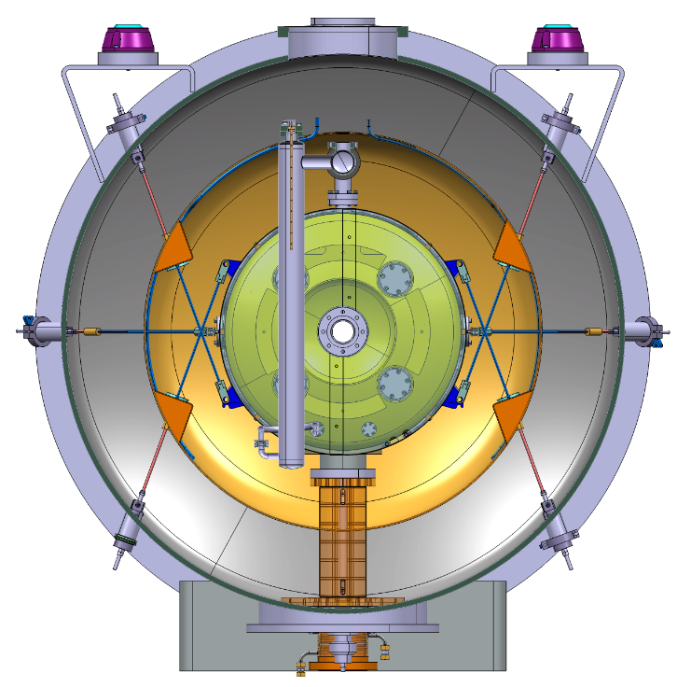
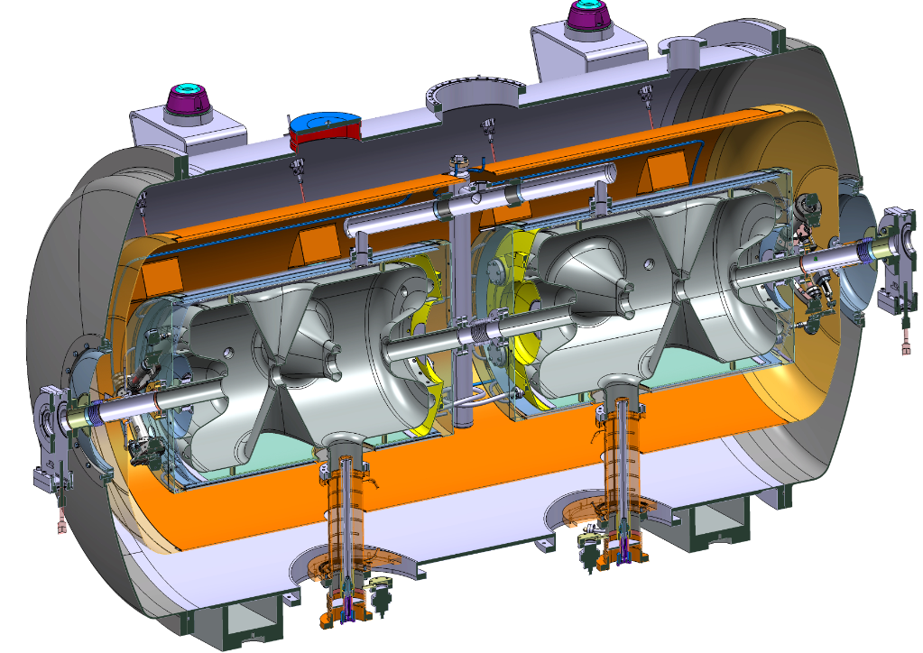
Spoke cavity string and cryomodule package

Slide 21


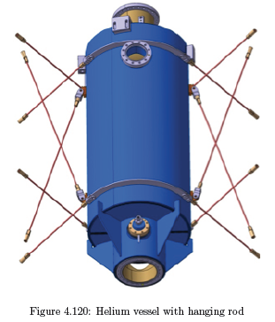
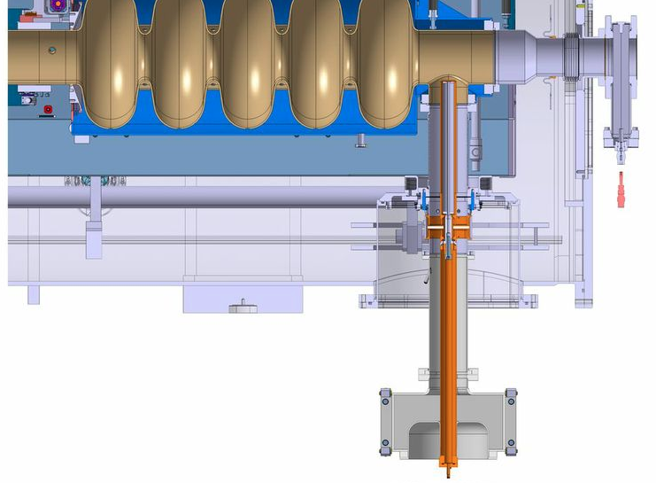
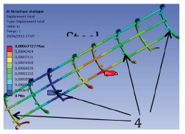
Elliptical Cryomodule Components
Helium tank
Cold tuning System
5-cell elliptical cavity
Power coupler
Space frame

Slide 22
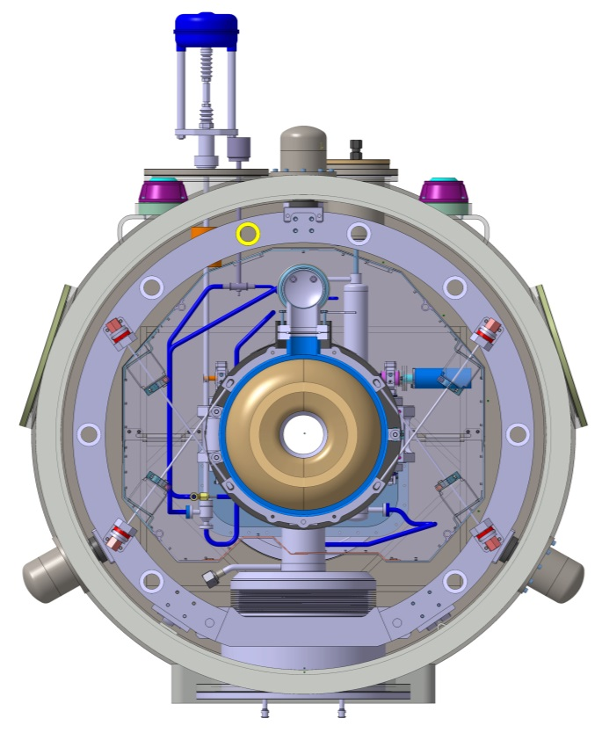
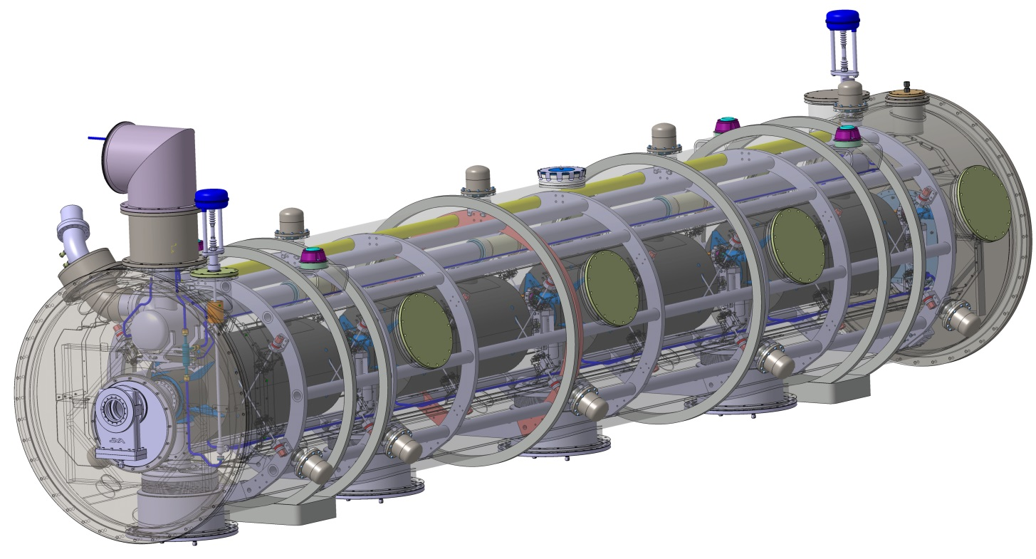
1,2 m
Space frame
Cavity supports: TA6V rods
Thermal shield inside the space frame
Access traps to the tuners
Magnetic shield close to the cavity
Cryogenic line interface
Helium safety valve

Slide 23
Elliptical Cryomodule Components
  Four elliptical cavity helium tanks equipped
  with their power couplers and cold tuning systems
  The supporting and mechanical systems
  The vacuum vessel, thermal and magnetic shieldings
  to insulate the cavity packages from the ambient condition
  The cryogenic distribution (hydraulic circuits, jumper connection)
  to interface the cavity packages with the cryogenic valve box (incl. CTL, cryoplant)
  The instrumentation, control equipment and the safety devices
Integrated hazards due to operating environment:
  Cryogenic temperature: 2 K (Helium II), cryogenic vessel, pressure vessel
  Sub atmospheric condition 31 mbar saturated, leak-tightness
  Magnetic environment (14 mGauss)
  Radiation environment (high intensity proton beam)
Notes:
The supporting and mechanical systems : interface cavity packages in the test area than in the tunnel

Slide 24

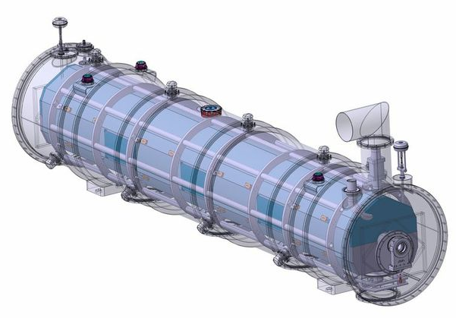
Cavity Cryomodule Technology Demonstrator
One full scale cell of 704 MHz high- and medium-beta cavity cryomodule
A staged approach towards the ESS Linac tunnel installation
Validate designs (incl. SRF cavities, coupler, CTS)
Prepare the industrialization process by validating
component life-cycles (incl. assembling process, QA)
Validate performances (incl. RF, mechanical, thermal)
Develop ESS 704 MHz SRF linac operating procedures
Validate control command strategy (Control box, PLC, EPICS, LLRF)
Test the ESS integration and interface with cryogenics, vacuum systems
Train people and build collaboration
Develop expertise in SRF technology
→ Similar process for the spoke cryomodules

Slide 25

WP 4: Spoke Cryomodule design
Two cavities per cryomodule
Contains:
    Cavities
    He vessel
    Cooling systems
    Magnetic shield
    Insulation shield
    Support rods
    He system
    Cold tuning systems
    Power couplers
Design of the Cryomodule Spoke 10/2013

Slide 26
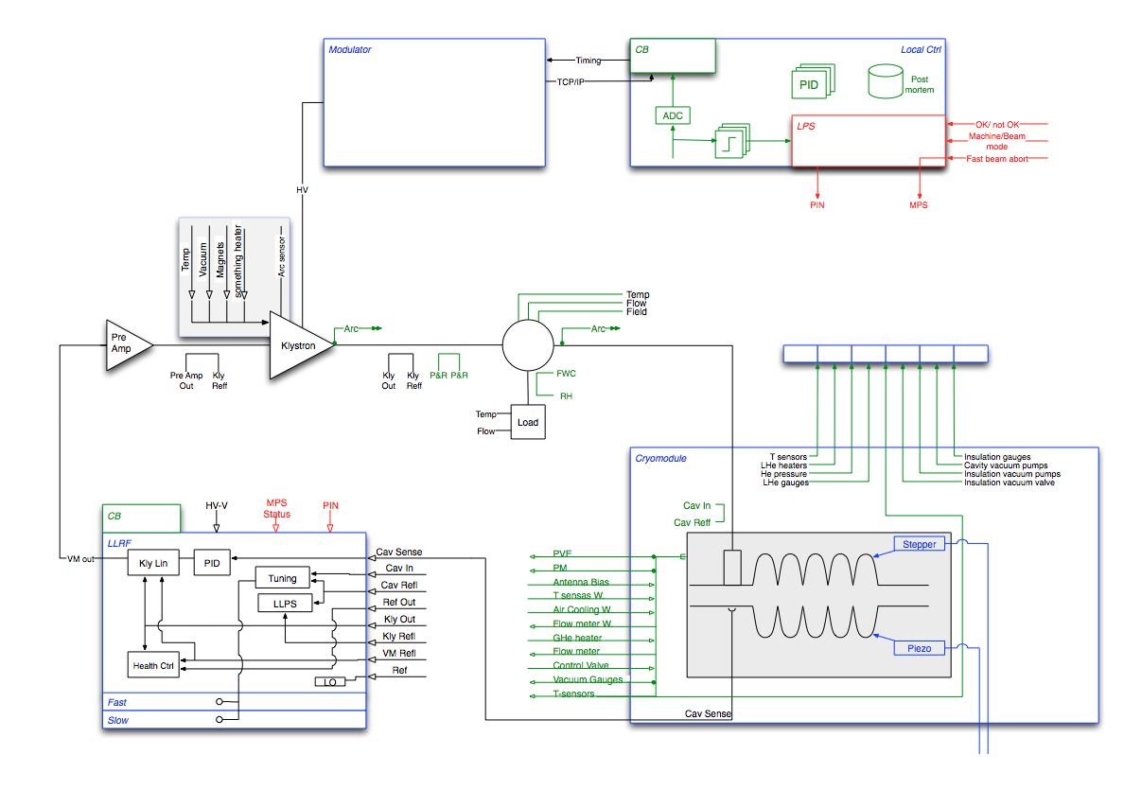
WP 8: LLRF and control schematic
RF cell control
LLRF system
Cavity with subsystems

Slide 27
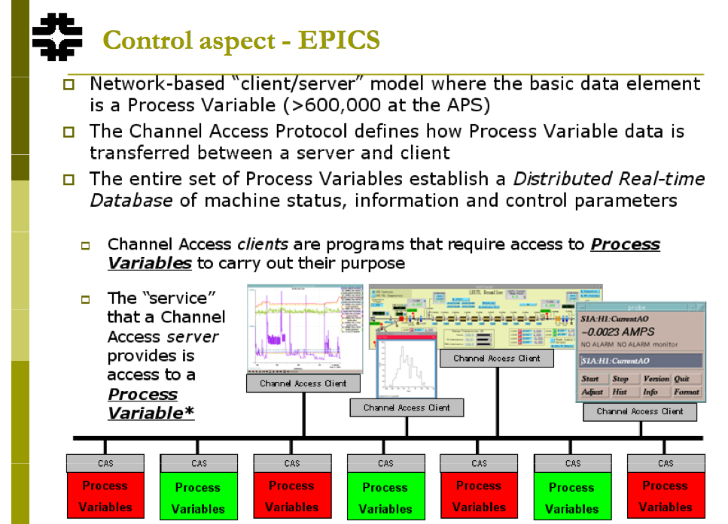
Example of FNAL - design

Slide 28
Cryomodule project flow
Assess:
Mitigate:
Identify:
Linac Layout, Flow Scheme, Breakdown Structures
Feasibility of different Technologies and Assemblies
Risks and Manage Interfaces
Components and tooling Requirements (Technology Demonstrator and series)
Extrapolation to Production, industrialization
Quality Assurance using lessons learned from PX, X-FEL, SNS, J-PARC
Life Cycles and infrastructures using. clean room, assembly hall, RF, cryogenics
Risks (Project Risk and Technical Risk)
Develop DAQ and Control,
Cost Estimate
Operating Modes and WPs interfaces

Slide 29
ESS SRF integration
Coordination of requirements and interfaces between WP4, WP5, WP10, WP11 and WP99.
Planning and oversight of the following engineering activities:
design
selection, construction, manufacture, assembly, installation and other integration
verification of requirements, including through analysis, inspection, demonstration and testing
validation, including through commissioning for operations
Managing product architecture and configuration information including:
models, simulations, calculation and analysis results, parameters, test and other verification and validation results
specifications and statements-of-work for agreements with external suppliers including ESS collaboration partners, In-Kind Contributors (IKC) and suppliers from industry

