Slide 1




ESS Spoke Cryomodule
Cryogenic distribution
CNRS/IN2P3/ IPNO – Paris-Sud University

Slide 2
Contents
  Process and Instrumentation Diagrams
  Mechanical aspects
  Cold box

Slide 3
Cryodistribution: Spoke PID
Helium supply T.L (19.5 bar, 40K)
Helium return T.L (19.0 bar, 50K)
Helium supply HP (3 bar, 4.5K)
Helium Return VLP (~31 mbar)
Helium Return LP (1.05 bar)
Cryogenic Transfer Line (CTL)
Valve Box
Pumping line
He conditionning line - (1.5bar, 300K)
jumper
Spoke cryomodule
TT
808
PT
808
TT
808
TT
808
PT
808
TT
808
LT
TT
808
TT
808
RFT
808
RFT
808
TT
808
TT
808
TT
808
TT
808
TT
808
TT
808
TT
808
TT
808
TT
808
TT
808
TT
808
PT
808
TT
808
TT
808
TT
808
PT
808
TT
808
ADT
808
ADT
808
23/10/2013
TT
808
TT
808
TT
808
TT
808
TT
808
TT
808
Helium Return Coupleur (1.05bar, 300K)

Slide 4
Cryodistribution
    Why placing the heat exchanger and the cryogenic valves in the cryomodule ?

Slide 5
Cryodistribution: Spoke PID 2
Helium supply T.L (19.5 bar, 40K)
Helium return T.L (19.0 bar, 50K)
Helium supply HP (3 bar, 4.5K)
Helium Return VLP (~31 mbar)
Helium Return LP (1.05 bar)
Cryogenic Transfer Line (CTL)
Cold Box
TT
808
TT
808
Pumping line
TT
808
TT
808
He conditionning line - (1.5bar, 300K)
jumper
TT
808
PT
808
TT
808
PT
808
Spoke cryomodule
PT
808
TT
808
LT
TT
808
TT
808
RFT
808
RFT
808
TT
808
TT
808
TT
808
TT
808
TT
808
TT
808
TT
808
TT
808
TT
808
TT
808
TT
808
PT
808
TT
808
TT
808
TT
808
PT
808
TT
808
05/04/2013
(updated 19/11/2013)
ADT
808
ADT
808
TT
808
TT
808
TT
808
TT
808
TT
808
TT
808
Helium Return Coupleur (1.05bar, 300K)

Slide 6
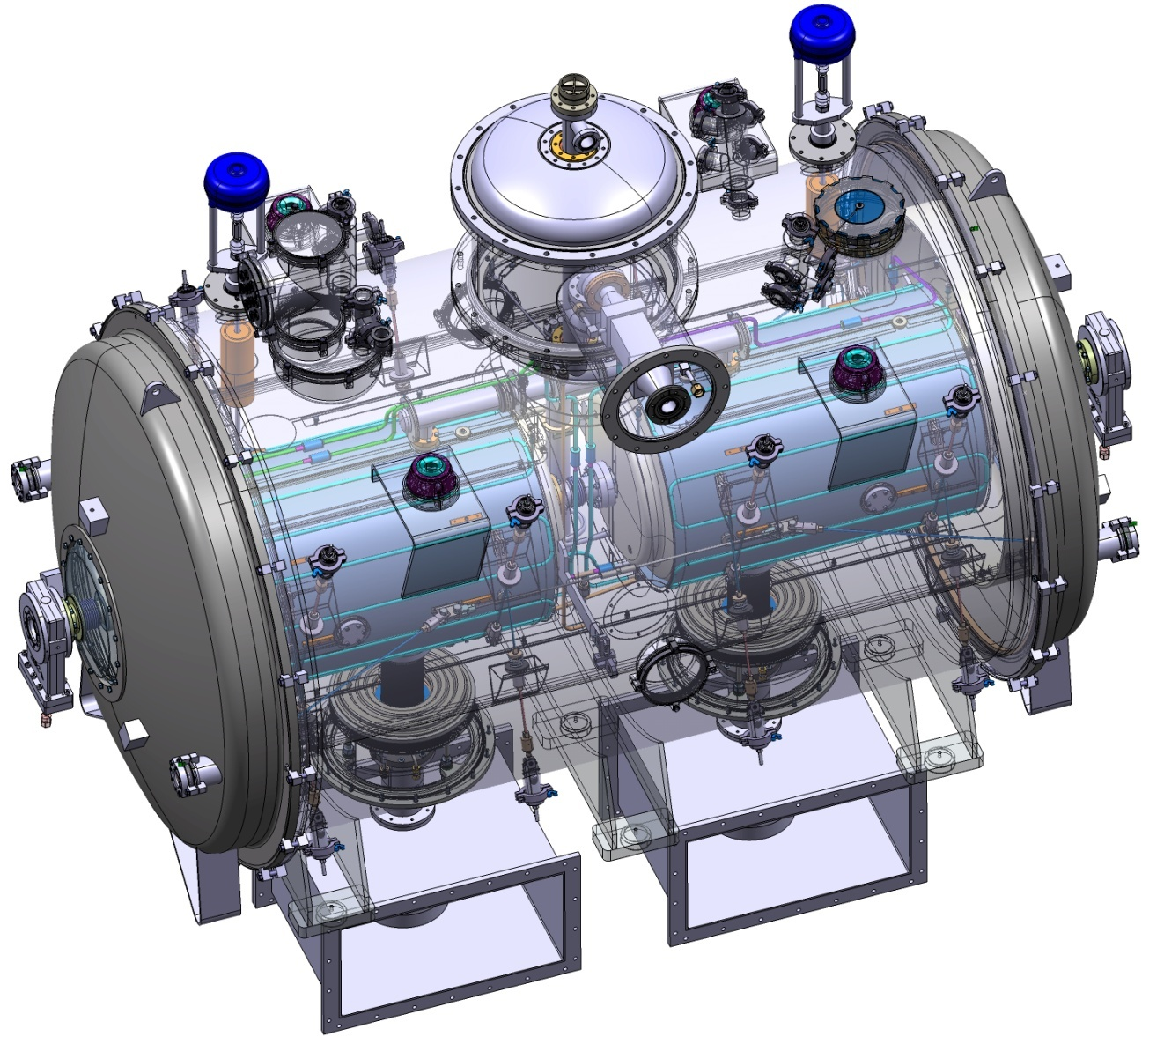
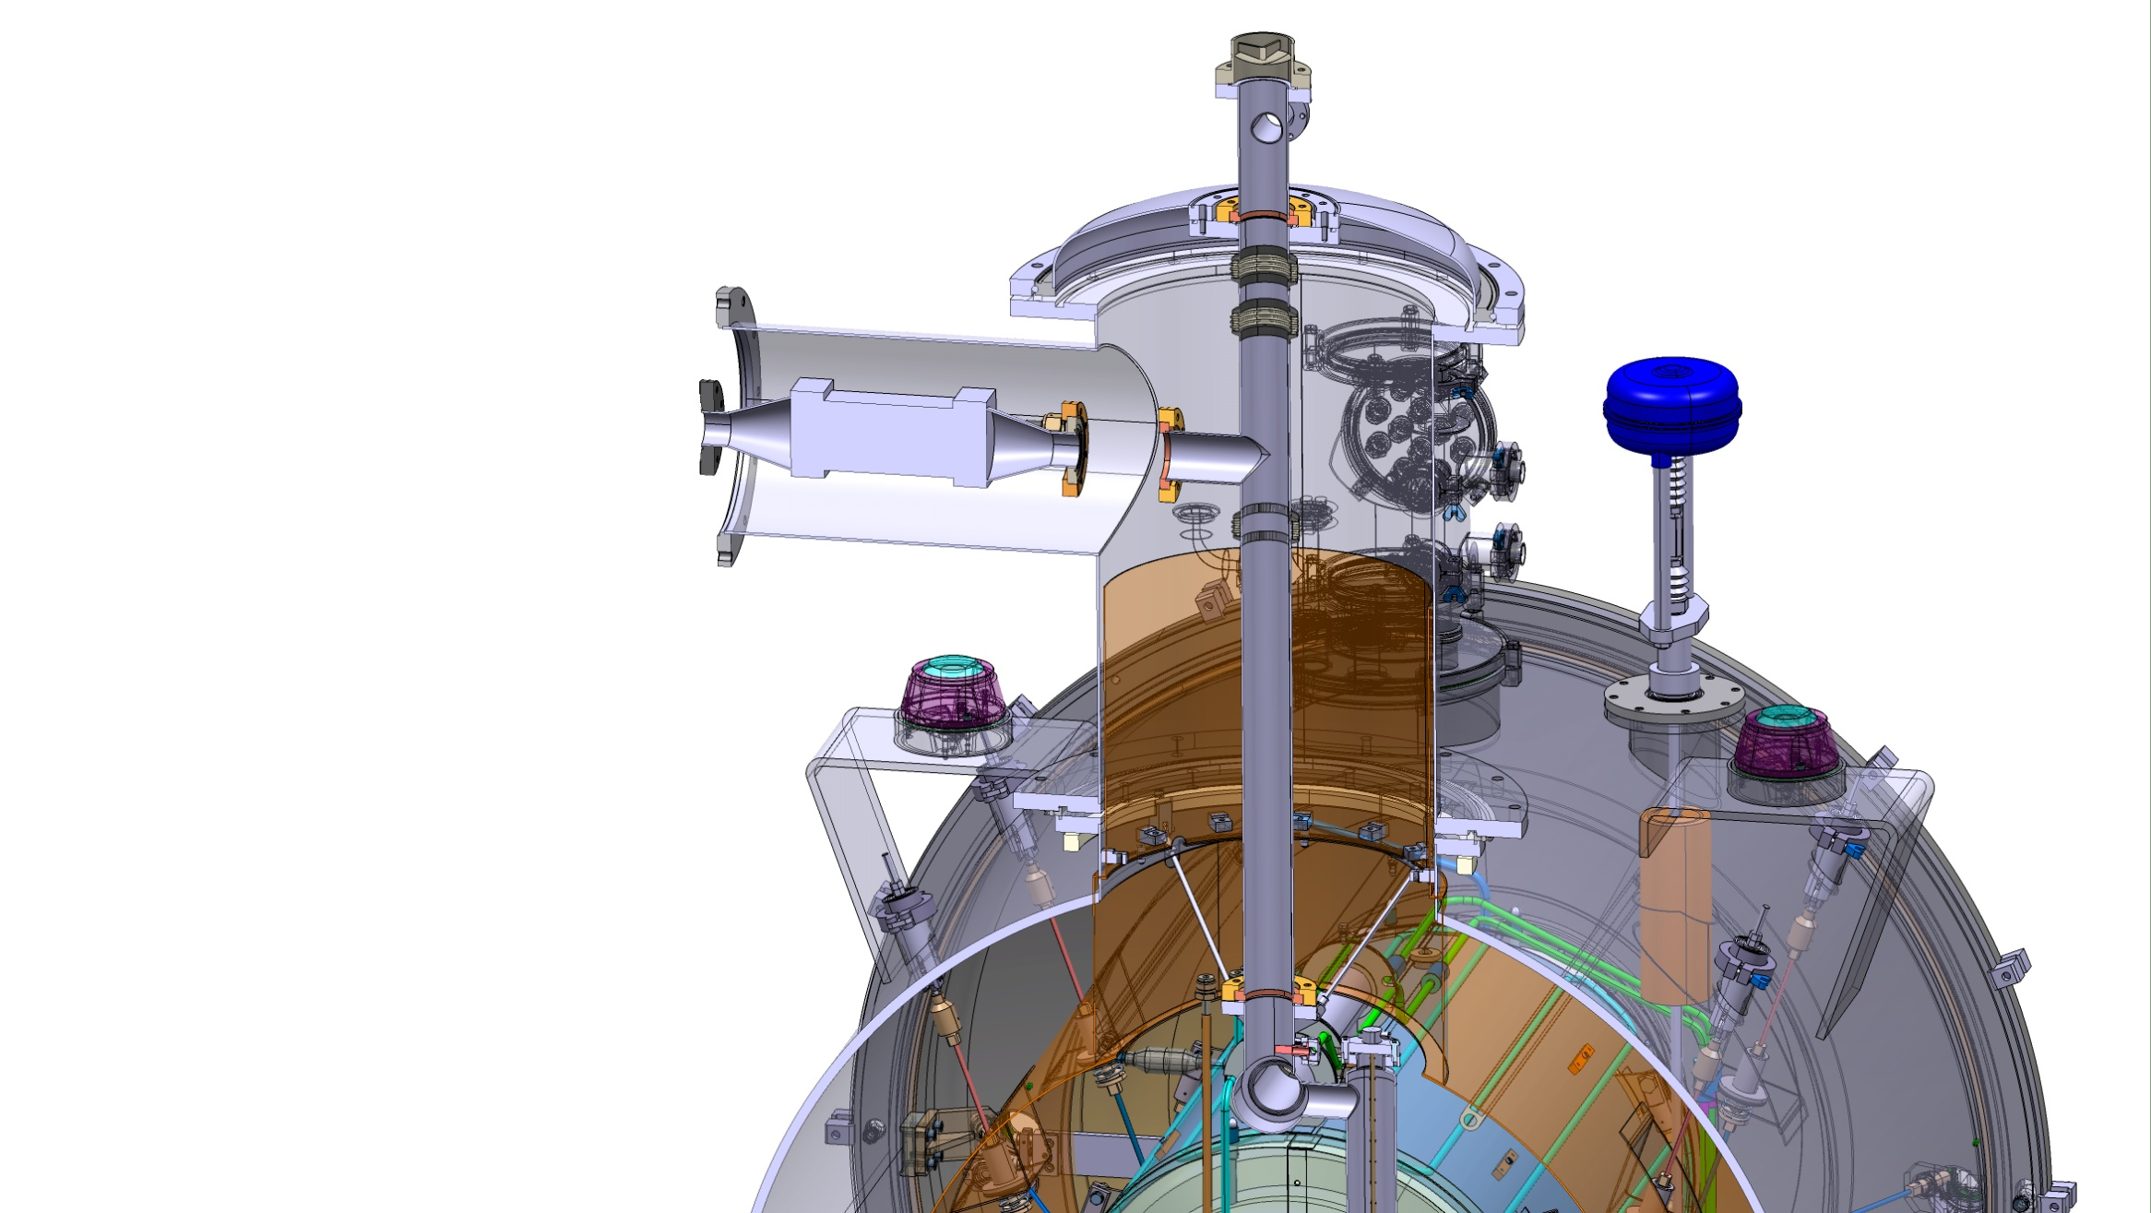
Cryodistribution

Slide 7
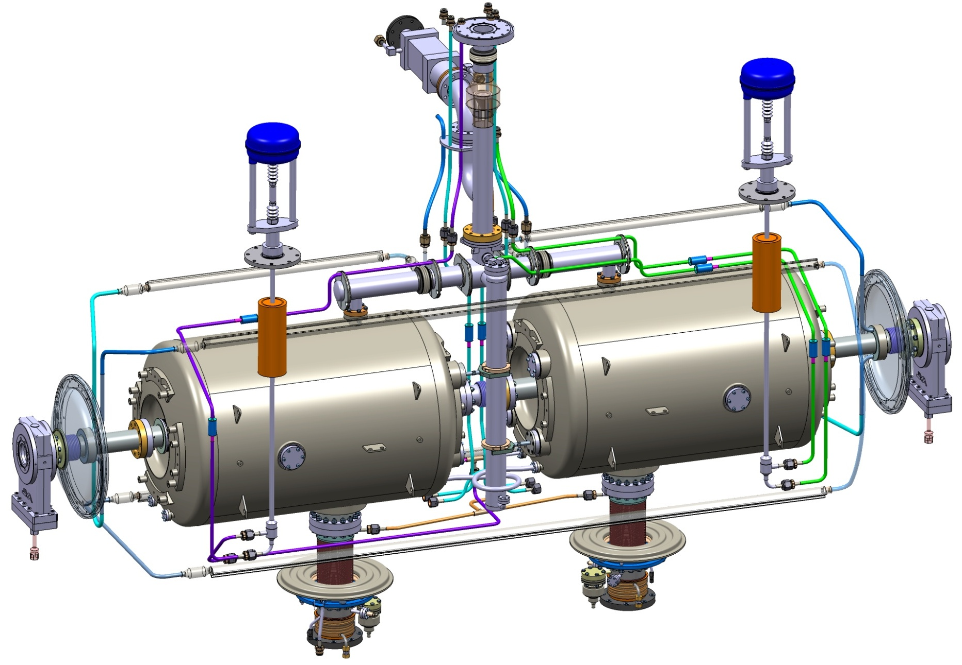
Cryodistribution: cryo valves
Jumper connection
Cool-down valve
JT valve
Valves are mounted after
the cryostating step
Valves are placed at the cryomodule extremities to get access, allowing:
to connect the cryolines (by welding or via fittings);
to achieve leak test.

Slide 8
Cryodistribution
Heat exchanger (in the jumper)
JT valve
Distance from this plane
(heat exchanger flange)
L=2.565 m
Cool-down valve
L= 1.678 m
L= 2.545 m
JT

Slide 9
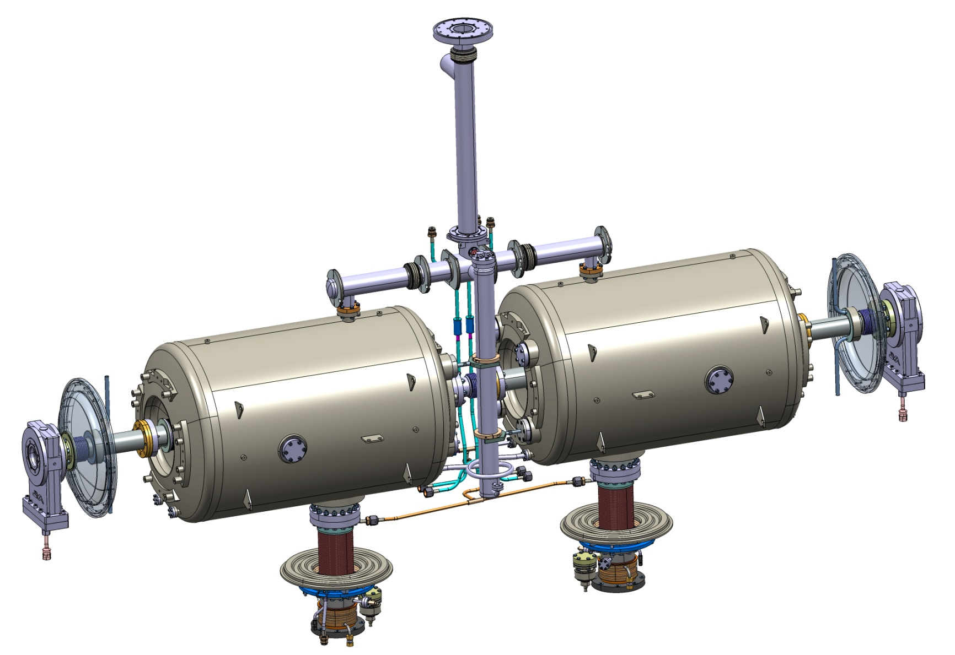
Cryodistribution
Fill-in line (from JT valve) – L= 2.620 mm
Cool down line – L= 2.480 mm
Heat exchanger and valves placed in the valve box

Slide 10
Pipe lengths
Helium supply T.L (19.5 bar, 40K)
Helium return T.L (19.0 bar, 50K)
Helium supply HP (3 bar, 4.5K)
Helium Return VLP (~31 mbar)
Helium Return LP (1.05 bar)
Cryogenic Transfer Line (CTL)
Valve Box
L = 1889 mm
Pumping line
L = 5205 mm
He conditionning line - (1.5bar, 300K)
L = 2620 mm
L = 1291 mm
jumper
Spoke cryomodule
TT
808
PT
808
TT
808
TT
808
PT
808
TT
808
LT
TT
808
L = 910 mm
TT
808
RFT
808
RFT
808
TT
808
TT
808
TT
808
TT
808
TT
808
TT
808
TT
808
TT
808
TT
808
L = 2565 mm
TT
808
TT
808
PT
808
TT
808
TT
808
TT
808
PT
808
TT
808
ADT
808
ADT
808
L = 1678 mm
TT
808
TT
808
TT
808
TT
808
TT
808
TT
808
Helium Return Coupleur (1.05bar, 300K)

Slide 11
Pipe lengths
Helium supply T.L (19.5 bar, 40K)
Helium return T.L (19.0 bar, 50K)
Helium supply HP (3 bar, 4.5K)
Helium Return VLP (~31 mbar)
L = 200 mm ?
L = 200 mm ?
Helium Return LP (1.05 bar)
Cryogenic Transfer Line (CTL)
Cold Box
L = 200 mm ?
TT
808
TT
808
Pumping line
TT
808
TT
808
L = 800 mm ?
L = 4340 mm
He conditionning line - (1.5bar, 300K)
jumper
TT
808
PT
808
TT
808
PT
808
Spoke cryomodule
PT
808
L = 2680 mm
TT
808
LT
TT
808
TT
808
RFT
808
RFT
808
TT
808
TT
808
TT
808
TT
808
TT
808
TT
808
TT
808
TT
808
TT
808
TT
808
TT
808
PT
808
TT
808
TT
808
TT
808
PT
808
TT
808
ADT
808
ADT
808
L = 2620 mm
TT
808
TT
808
TT
808
TT
808
TT
808
TT
808
Helium Return Coupleur (1.05bar, 300K)

Slide 12
Pipe lengths sum-up
Placing the cryogenic valves and the heat exchanger in the valve box would:
Position of the cryogenic valves and the heat exchanger: |  | in the cryomodule | in the valve box
 |  | Lengths (mm) | Lengths (mm)
Fill-in line | From CTL to HEx | 2620 | 200 ?
 | From HEx to JT valve | 2565 | 800?
 | From JT valve to bi-phase pipe | 1678 | 2620
 | Total | 6863 | 3620
Pumping line | From bi-phase pipe to HEx | 910 | 2680
 | From Hex to CTL GRP | 1889 | 200 ?
 | Total | 2799 | 2880
Cool-down line | From CTL to cryo valve | 5205 | 200 ?
 | From Cryo valve to cavities | 1291 | 4340
 | Total | 6496 | 4540

Slide 13
Conclusion
Placing the cryogenic valves and the heat exchanger in the valve box would:
    simplify the cryogenic distribution (number of interfaces, number of valves, piping lengths) (and not only within the cryomodule);
    reduce the jumper diameter;
    allow to (leak) test all the cryogenic distribution before cryostating ⇒ the jumper interface would be the only element to be tested after cryostating;
    ease the cryomodule assembly.

Slide 14
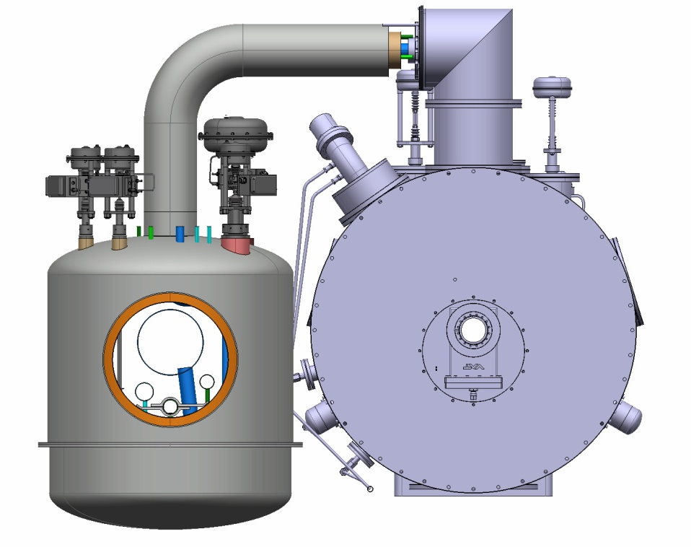
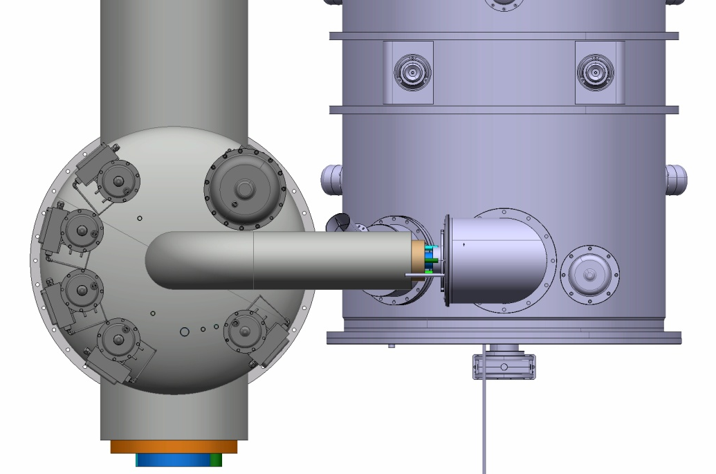
Valve box
Interaction with the wave guides
Lack of space between valve box and cryomodule

Slide 15
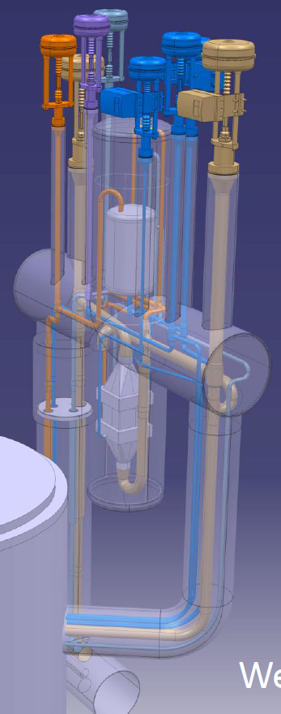
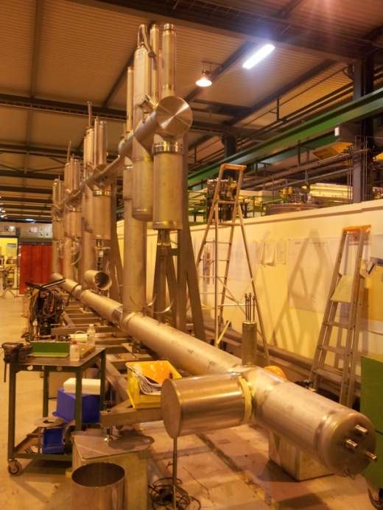
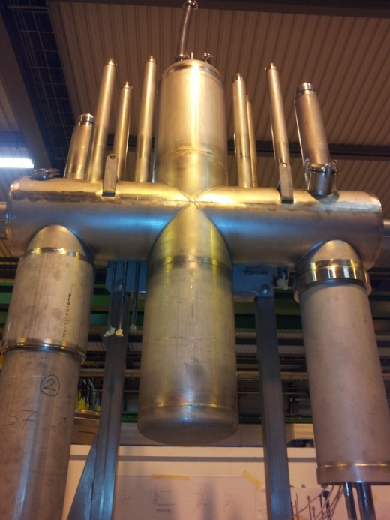
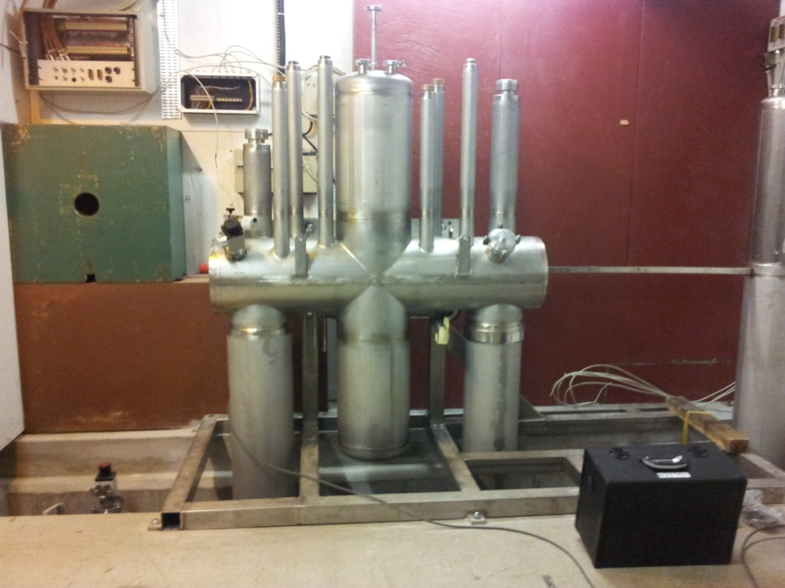
Upgrade of SM18 Infrastructure at CERN
P. Maesen Dec 2012

Slide 16
  Thank you for your attention

