Slide 1
Progress Update
HZG

Slide 2
Progress Update
Contracts
Work on TA on going
Negotiations end of March ‘20
One remaining issue concerning installation and integration has to be solved
Delays in procurement and delivery of components
Necessary changes in schedule has been accepted by ESS

Slide 3
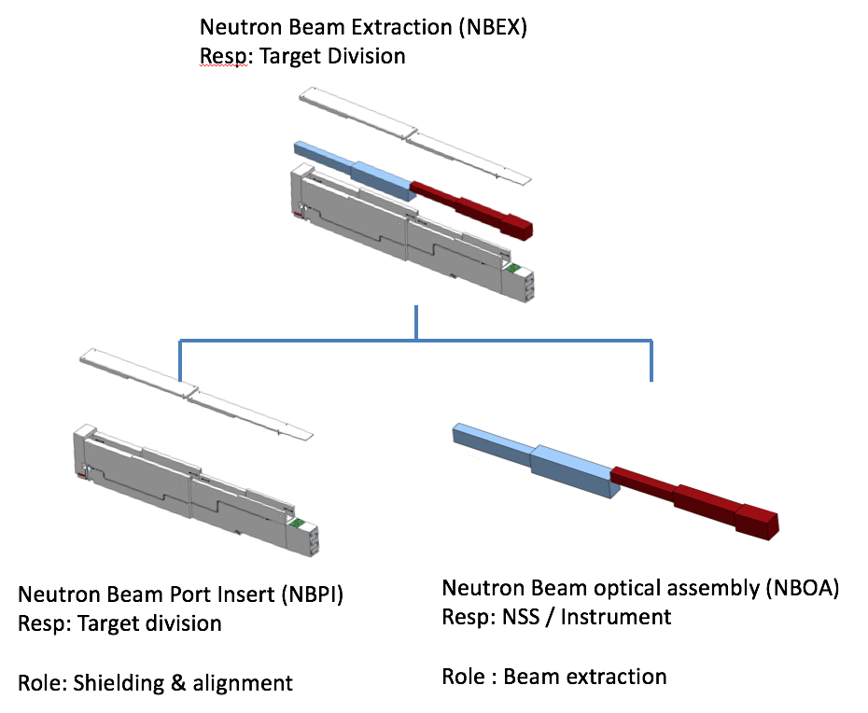
Progress Update
Work Packages
NBOA taken over by ESS:
Kick-off meeting in January ‘20
Check of interfaces:
Bunker Wall insert
NPI Shutter
80m Chopper
Guide Exchanger
Pre-Design Work on:
Detector support
alignment features of Radial Collimators
In-bunker support of Chopper and Neutron Guides including cables and pipes
Beam monitors:
In-bunker we will join ESS common monitor project
In front of sample provided by HZG

Slide 4
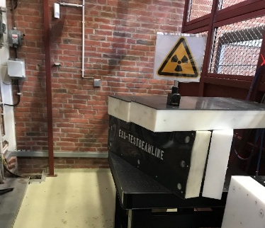
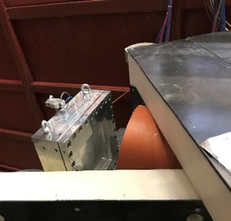
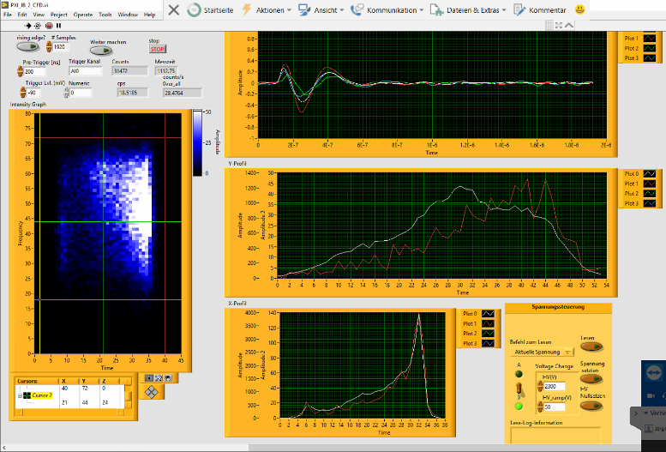
BEER Detector
Status
Detector test area equipped with ²⁴¹Am/Be source and certified:
basis functional tests of the detector at HZG possible
Am/Be-source:
-58.3 mg ²⁴¹Am= activity: 7.4 GBq
-flux: 4x10⁵ n/s in 4π
-n-energy: 2-6 MeV
-ᵧ-energy: 59 keV
-11 m² floor space
-Access from roof by crane
-variable shielding in place
Lab-View software for n/ᵧ-pulse discrimination based on
machine learning algorithms*
First “images” recorded with 2 wire grids set-up and developed read-out:
Cd-mask
Detector housing arrived last week=> leak test will follow!
Discussion/Exchange regarding data-protocol for read-out started
Practical activity on detector development since March 2020 dramatically reduced by CoVID-19 situation
*„Klassifizierung der Neutronendetektor-Signale mit Hilfe von maschinellem Lernen auf FPGAs“-Master Thesis E. Romanenkov (November 2019)

Slide 5
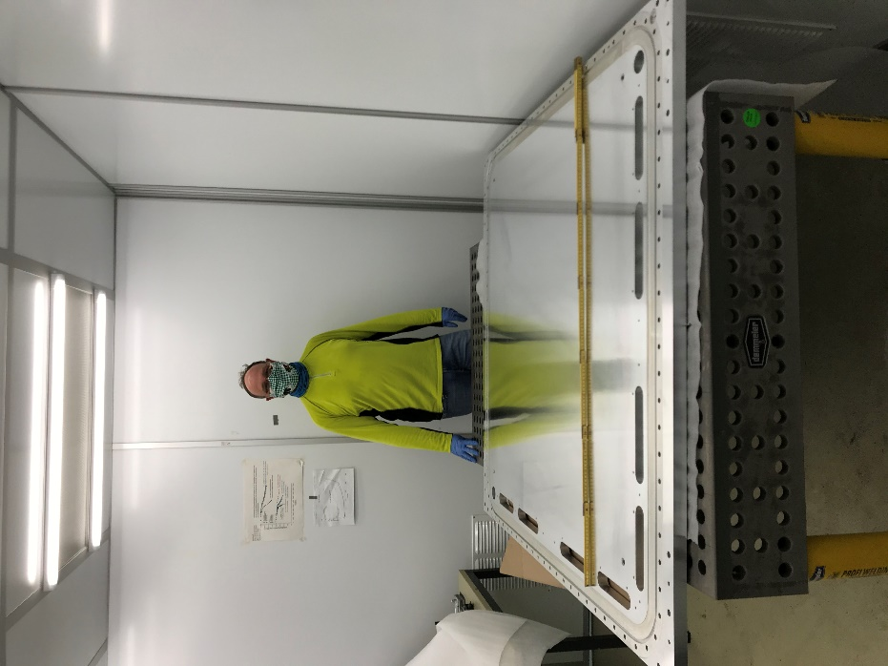
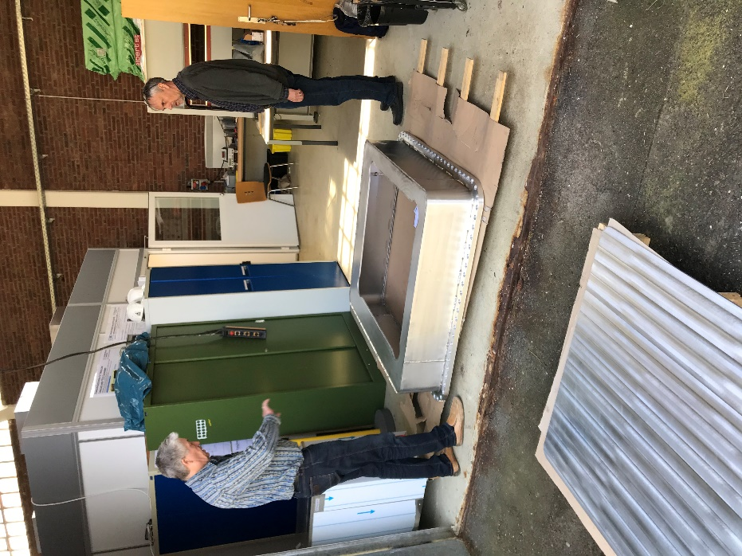
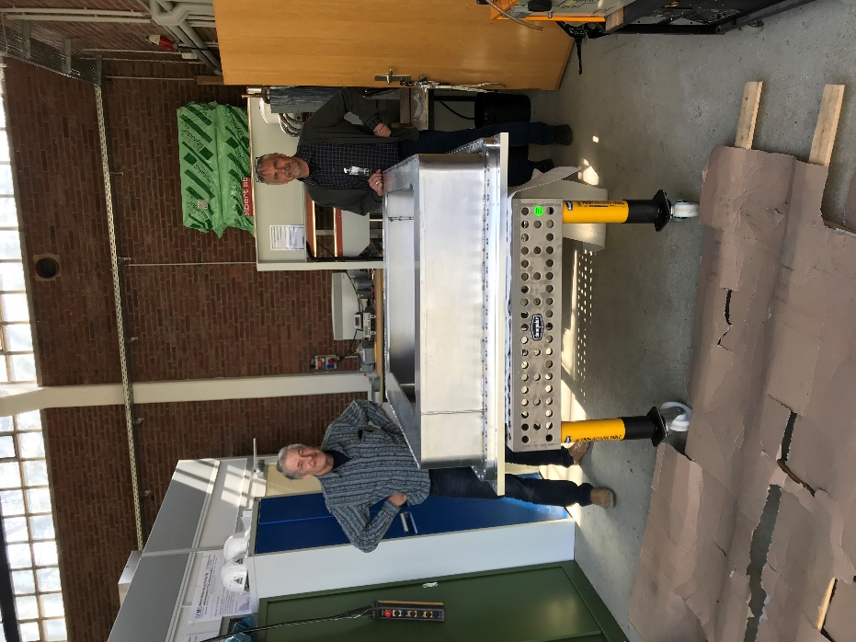
BEER Detector
Detector housing arrived
back-plate
housing
housing on back-plate
entrance window

Slide 6
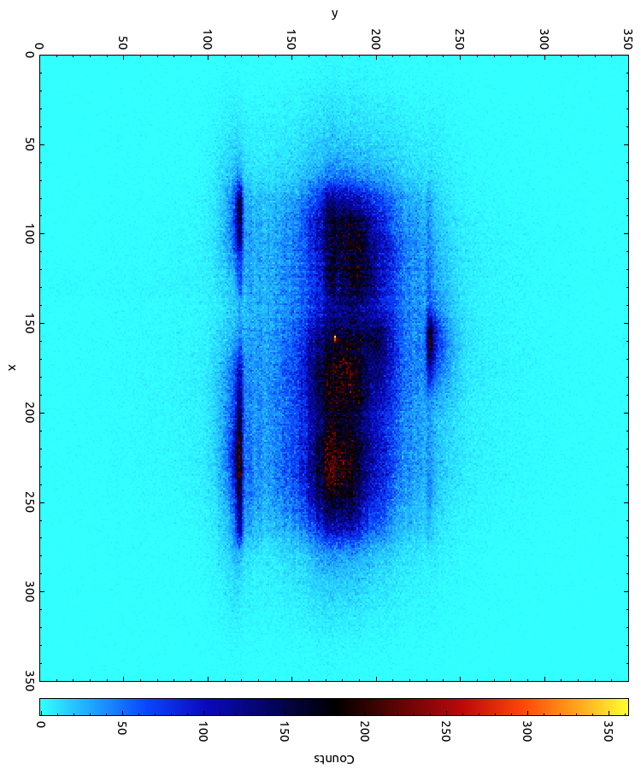
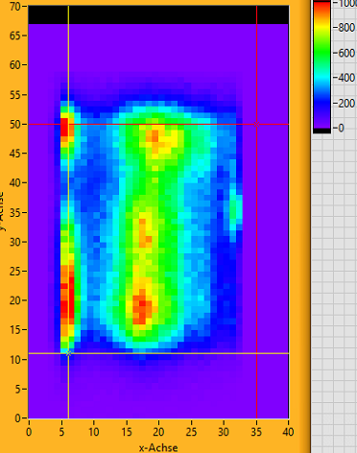
BEER Detector
Position Resolution: Mater of time resolution
200 ps time resolution on DL (HZG-read-out):
1 ns time resolution on DL (NI-read-out):

Slide 7
Progress Update
NPI

Slide 8
Progress Update
Update from last STAP
TA and funding issue
  2020-2022 funding not approved as planned by MEYS (ES funds)
  Instead, MEYS, NPI and ESS negotiate a new funding scheme (similar to German IKC)
  Drafts of new IKCA and TA schedule have been written (now under evaluation)
  The new schedule is very challenging as for the nearest milestones:
    New procurement of cave, hutch, shutter and cave utilities is necessary (delayed by ~ 1 year)
    Optics installation requires TA signed well in advance. Guide supports still to be procured ...
Guide early manufacturing (hall E02-1)
  Progressing well, small delay due to the Corona can be expected
  Delivery is expected in Nov/20 and the first installation in E02-1 is scheduled for Jan/21
Sub-TG3s
  Sub-TG3 for cave, hutch, shutter and neutron guide were submitted before Christmas
  Update of documentation and 3D model is under good progress – finalized by April
  The evaluation process too long (no engineer, long communication with sub-contractors, long feed-back from ESS)
Lack of engineer
  ESS offered to hire the lead engineer, paid by CZ contribution
  The hiring process should start by the next week

Slide 9
Progress Update
Update from last STAP
Sample environment
  NPI took the initiative in the project to provide the deformation rig for BEER
  There are plan for 3 rigs in total, budget sits with SAD (340 kEUR)
  RIG1 based on prototype build in NPI (60 kN) with vacuum furnace (tension/compression)
  RIG2 new rig with rotation/torsion capacity based on Robin’s design
  RIG3 small portable rig
  Preliminary design of an interface for RIG1 and hexapod is under consideration

Slide 10
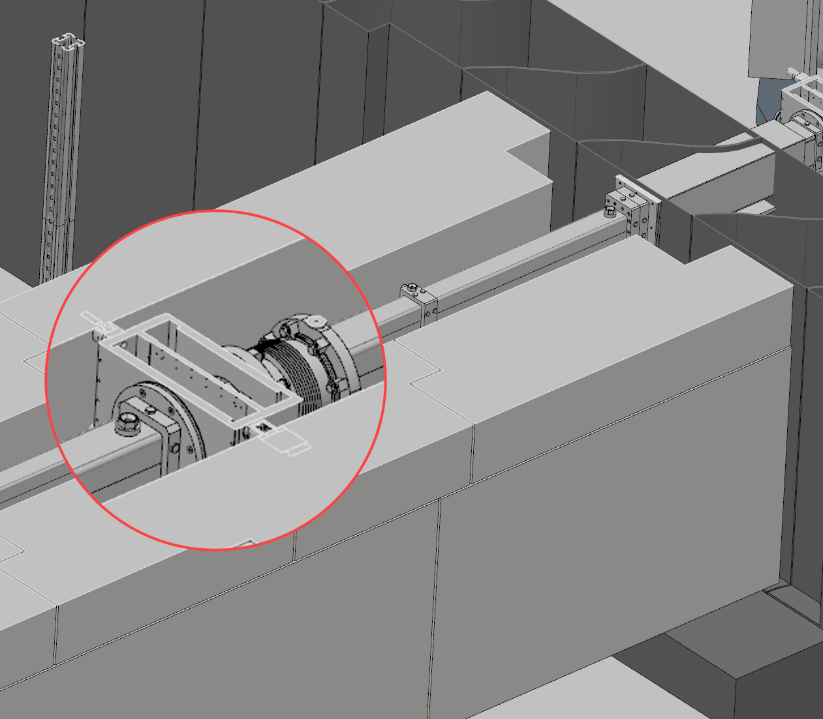
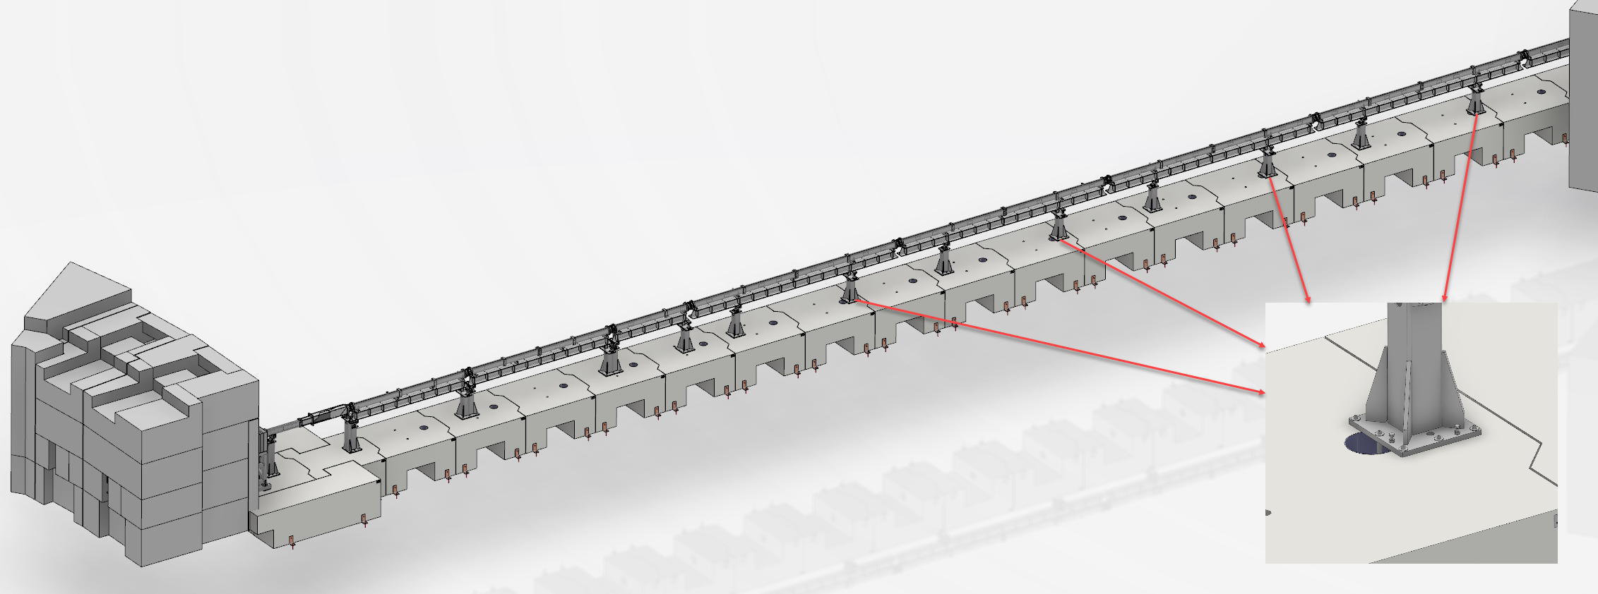
Progress Update
Update from last STAP
Common shielding
  New shielding calculation started – Miguel Magan from Bilbao took over
  Provided all necessary information and inputs
  Preliminary information should be available soon
  Integration of the neutron guide system into the shielding tunnel
    Redesign of the vacuum ports on the housing – done
    Redesign of support blocks in D03 – done
    Redesign of the slits cave – under progress

