Slide 1
ESS Cryomodule operating modes
Nuno Elias
Design Engineer Cryogenics
SLHIPP-4, 16th May 2014

Slide 2
Summary
ESS Operating modes
Cryomodules overview
Cryomodules sub-systems
Instrumentation overview
Cryomodule operating modes
Process abstract
Final remarks

Slide 3
ESS operational modes
Machine modes #6: beam destination
Beam modes: beam parameters
Pulse length,
Energy,
Current,
Rep rate,
Probe Beam Mode
Setup Beam Modes
Production Beam Modes
dump
Faraday Cups

Slide 4
Cryomodules
 | SPOKES | MEDIUM-β | HIGH-β
β | 0.5 | 0.67 | 0.86
# CM | 13 | 9 | 21
Cav. /CM | 2 | 4 | 4
# Cav. | 26 | 36 | 84
CM L [m] | 2.88 | 6.584 | 6.584
Sector L [m] | 56 | 77 | 179

Slide 5
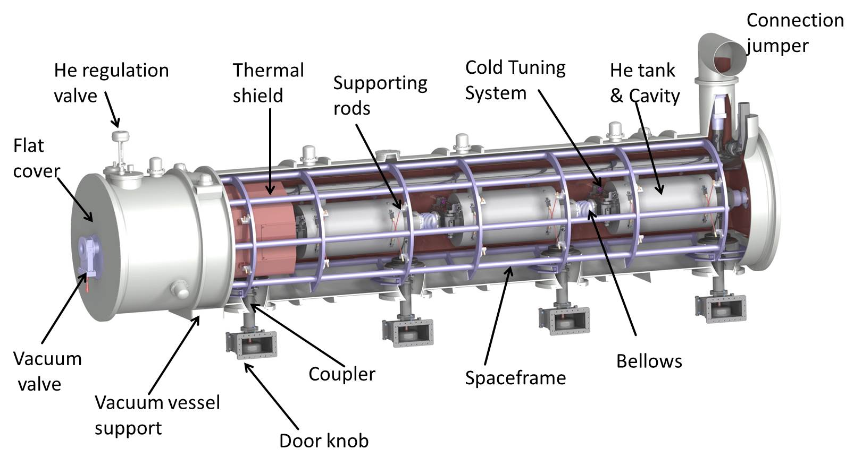
Cryomodule subsystems
Interface stake holders ESS:
Accelerator Cryoplant
Cryogenics Transfer Line
Vacuum system
LLRF
Integrated control Systems
Machine protection system
Test stands
In-kind Collaborators
IPNO
CEA-IRFU
Definition of OM, early in the project:
Define needed process variables with stake holders
Improve functions and act on design
Prepare diagnostic tools
Test and optimise control systems
Ready to accept change

Slide 6
Cryogenics Distribution System layout
Courtesy: J. Fydrych

Slide 7
PID –Elliptical skeleton

Slide 8
PID- Vacuum Equipment

Slide 9
PID- RF instrumentation

Slide 10
PID- Helium to cavities

Slide 11
PID – Helium to cavities (filling)

Slide 12
PID – Helium to cavities (VLP)

Slide 13
PID- Thermal shield cooling

Slide 14
PID- He guard

Slide 15
PID – Power Coupler (Double wall Cooling)

Slide 16
PID – Power Coupler (Antenna Cooling)

Slide 17
PID – Spokes cryomodule

Slide 18
Instrumentation overview
Instrumentation List:
Instrument type/ quantity
Signal type
Cable type/ allocation
Interfaces
Rack space allocation

Slide 19
Operating modes (normal)
Other modes:
-Pressure Test; Leak tightness test; Commissioning (heat load measurements);
-Loss of insulation vacuum (Air/He); Loss of beam vacuum (Air/He)
-Cavity quench

Slide 20
Op. Mode: Cool-down from 300K to 4.5K [2]
Cold compressors OFF
VLP > 1bara

Slide 21
Op. Mode: Cool-down from 300K to 4.5K [2]
Cold compressors OFF
VLP > 1bara

Slide 22
Op. Mode: Steady 2K [5]
Cold compressors ON
VLP = 27 mbara

Slide 23
Op. Mode: Steady 2K [5]
Cold compressors ON
VLP = 27 mbara

Slide 24
Process Abstract: position for each phase

Slide 25
Process Abstract: position for instrument

Slide 26
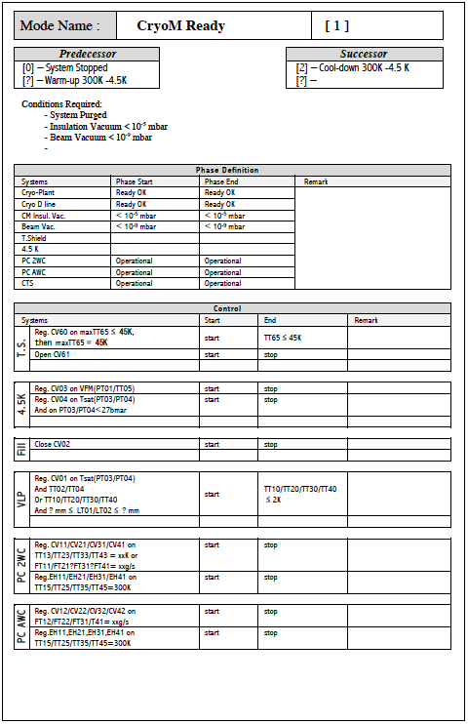
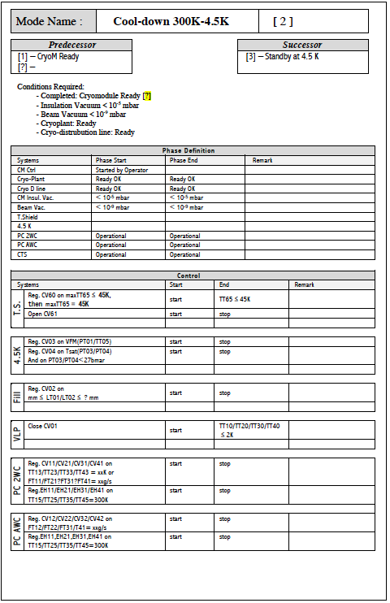
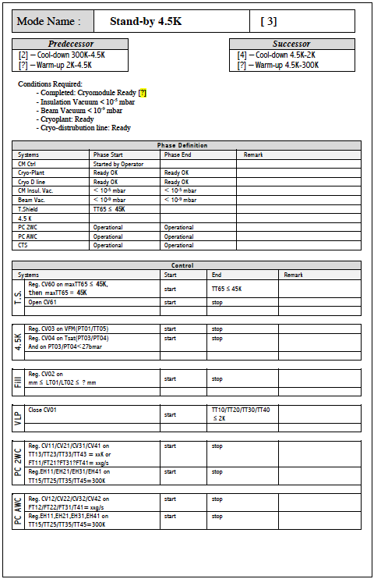
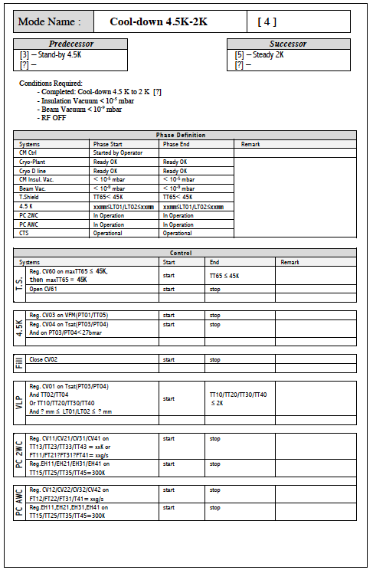
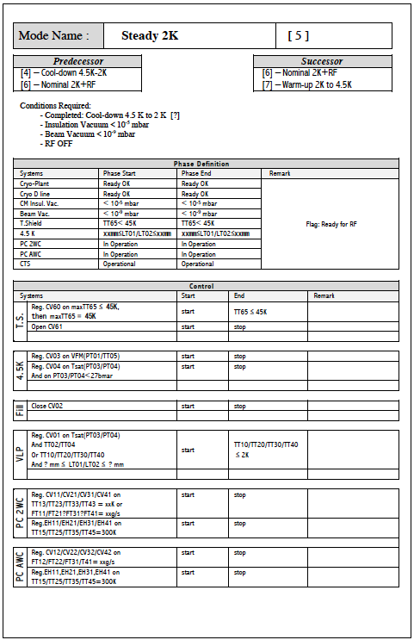
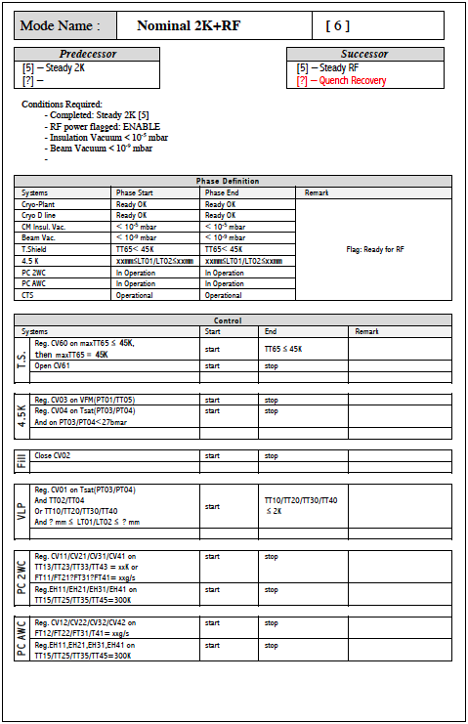
Operating mode – Process Definition
Based on: “The process of the cryogenic system for the LHC functional analysis”; Engineering specification

Slide 27
On the line…
Sequencer definitions for each mode:
Regulation routines/ sequencers
Warnings definition
Operator messages used by the supervision system to alert of a possible malfunction of a component or deviation of system from expected values within a defined phase (alarm H or L).
Alarms definition
Operator messages used by the supervision system to alert of a malfunction of a component or deviation of system from the range of safe or acceptable values (alarm HH or LL).
Interlock Definition
Software mechanisms that prevent the process in both automatic or manual mode to perform actions that would take the system out of its safe operating range and would therefore generate an alarm.
Abnormal States
Modes or sequences to respond to an abnormal event (quench, leaks, equipment failure) in order to bring the system into a safe state minimizing downtime.

Slide 28
Acknowledgements:
C. Darve, D. Piso, P. Arnold, J. Fydrych, A. Nordt,
P. Duthil, G. Olivier, P. Bosland, S. Bousson
SLHIPP-4, 16 May 2014; Nuno ELIAS

Slide 29
PID with dimensions

