Slide 1
ESS control integration for SRF cryomodule
D. Piso
Integrated Control System Division
ESS
www.europeanspallationsource.se
May 16, 2014

Slide 2
Summary
Some words about the ICS project
Some words about EPICS controls systems
Basic control components for commissioning of a Linac Section available
Integration cost of the cold Linac
Draft architecture for the control of a cryomodule
Controls functional analysis and state diagram for the operation of a cryomodule

Slide 3
The ICS Project
WP1 Management & Administration
WP2 Applications
WP3 Software Core Components
WP4 Hardware Core Components
WP5 Protection Core Components
WP6 Equipment
WP7 Control System Infrastructure
WP8 Physics
WP9 Project Milestones
WP10 Accelerator integration support
WP11 Target integration support
WP12 Instruments integration support
WP13 Conventional Facilities integrations support
WP14 Test stands integration support
WP20 Installation

Slide 4
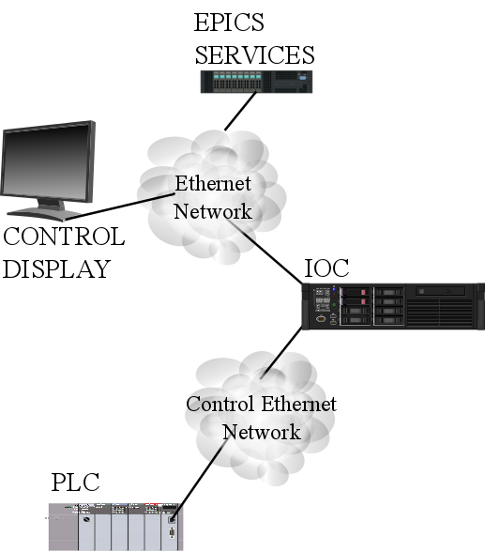
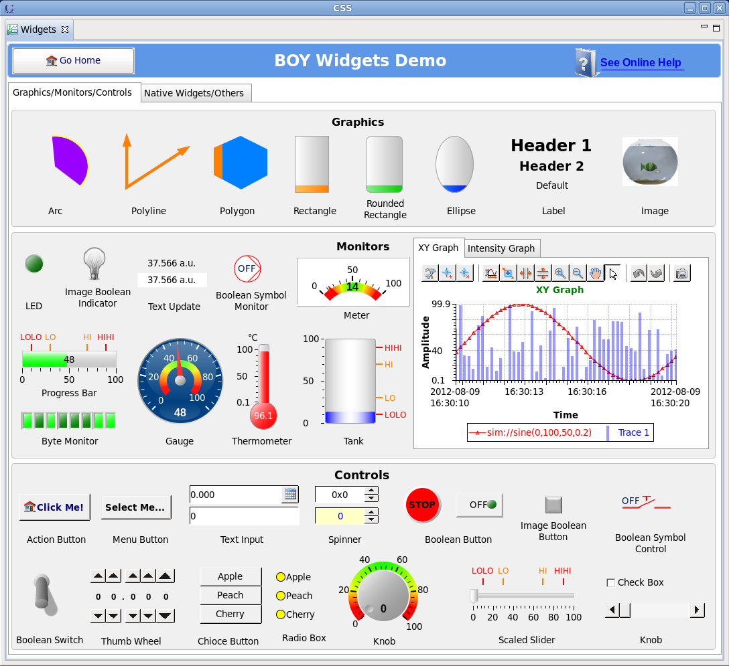
EPICS

Slide 5
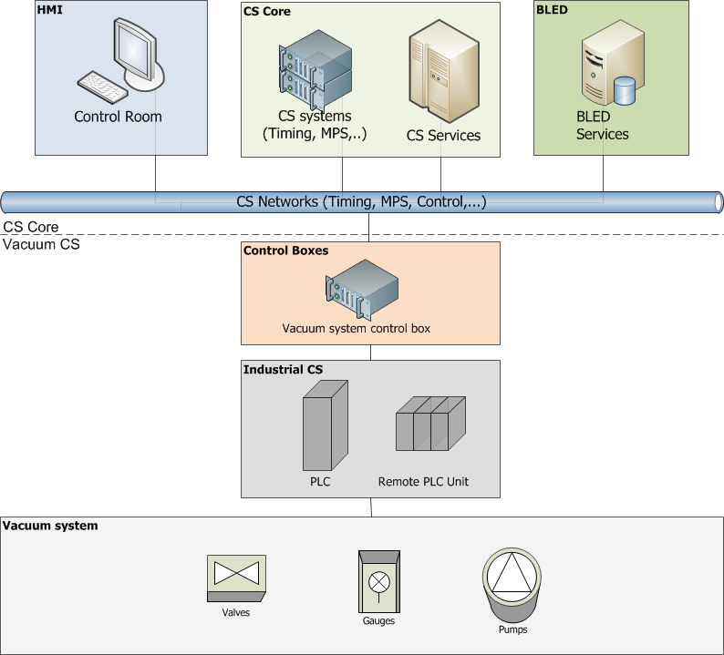
EPICS DESIGN CONTROLS ARCHITECTURE (I)
EPICS Domain

Slide 6
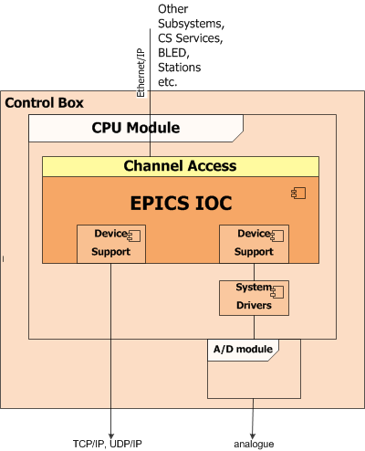
EPICS DESIGN CONTROLS ARCHITECTURE (II)
EPICS IOC runs on Control boxes
Control Box provides the interface to equipment
1
2

Slide 7
CONTROLS INTEGRATION BASIC TOOLKIT
(for commissioning)
IOC
  CPU (running EPICs IOC)
  Timing Receiver (providing synchronization)
  Supported I/O (acquisition)
SERVICES
  Alarms (BEAST)
  Short Term Archiving (BEAUTY)
  Save and Restore
Applications
  HMIs
Support from ICS (PLC programming, EPICS integration, equipment controls interfaces and cabling, advise with procurement, etc.)

Slide 8
How much does it take from the total Linac Effort?
TOTAL INTEGRATION EFFORT SPOKES (FTE) |  | 10
TOTAL INTEGRATION EFFORT MEDIUM BETA (FTE) |  | 12
TOTAL INTEGRATION HIGH BETA (FTE) |  | 11
EFFORT TOTAL FOR LINAC INTEGRATION (FTE) |  | 70
14%
17%
16%

Slide 9
How much does it take from the Linac controls hardware? (II)
SPOKES | HARDWARE TYPE | NUMBER OF UNITS
 | PLC | 42
 | MOTION CONTROLLER | 28
 | CPCI CONTROL BOX | 34
 | MTCA CONTROL BOX | 31
 | STRUCK DAQ | 45
 | COST (KEUROS) | 2500
MEDIUM BETA | HARDWARE TYPE | NUMBER OF UNITS
 | PLC | 45
 | MOTION CONTROLLER | 38
 | CPCI CONTROL BOX | 43
 | MTCA CONTROL BOX | 39
 | FAST cPCI DAQ | 3
 | CPCI DIO | 1
 | STRUCK DAQ | 50
 | COST (KEUROS) | 3000
 | HARDWARE TYPE | NUMBER OF UNITS
HIGH BETA | PLC | 105
 | MOTION CONTROLLER | 85
 | CPCI CONTROL BOX | 96
 | MTCA CONTROL BOX | 91
 | FAST cPCI DAQ | 1
 | CPCI DIO | 0
 | STRUCK DAQ | 113
 | TOTALS (KEUROS) | 7000
HARDWARE TOTAL FOR THE LINAC (KEUROS) |  | 14000
18%
21%
48%

Slide 10
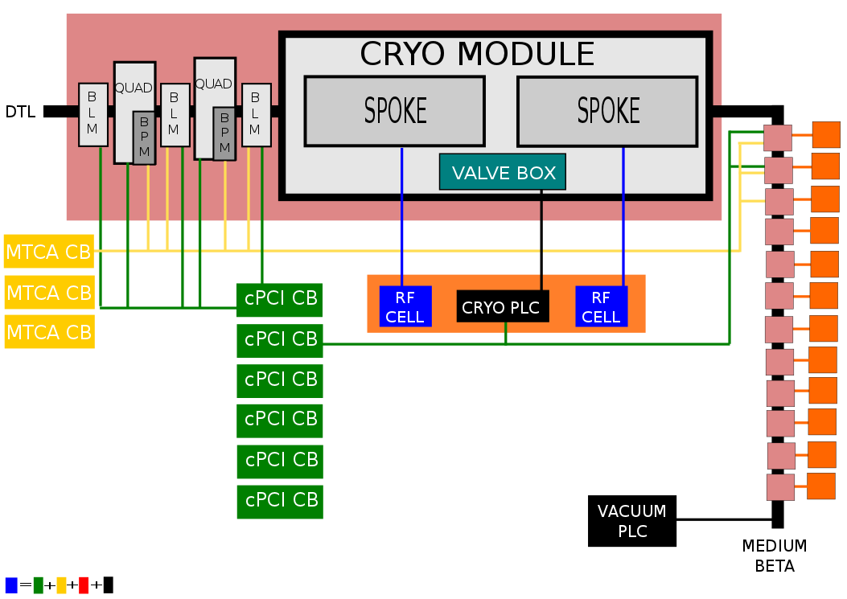
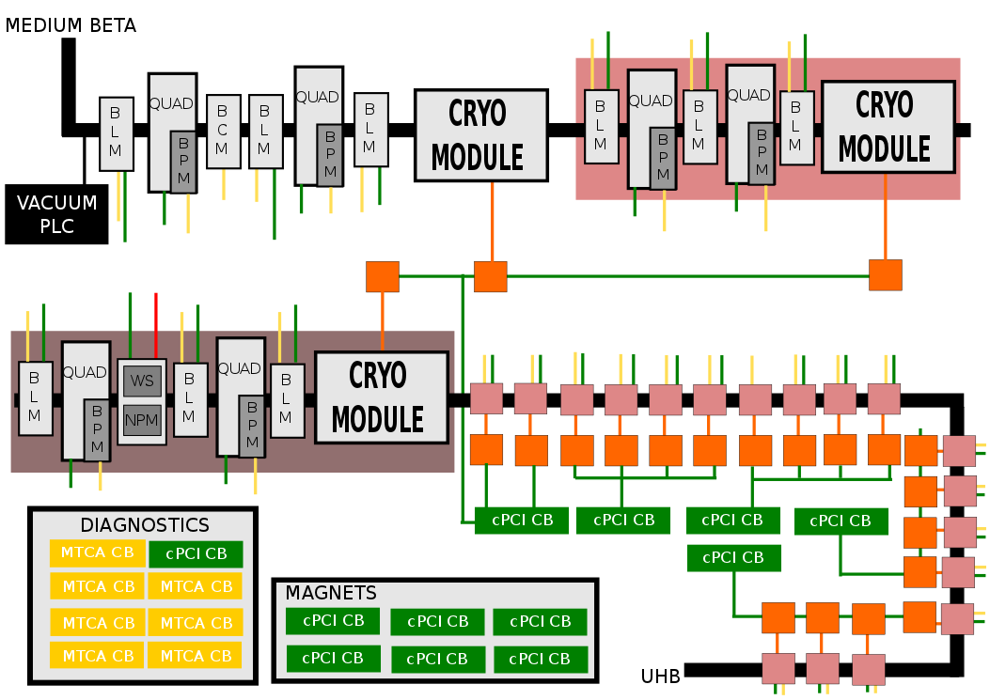
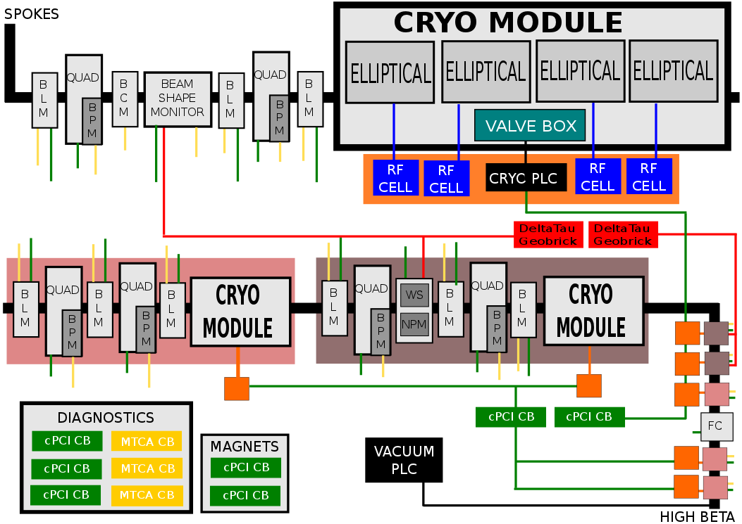
CONTROLS ARCHITECTURE (I)
SPOKES
HIGH
MEDIUM

Slide 11
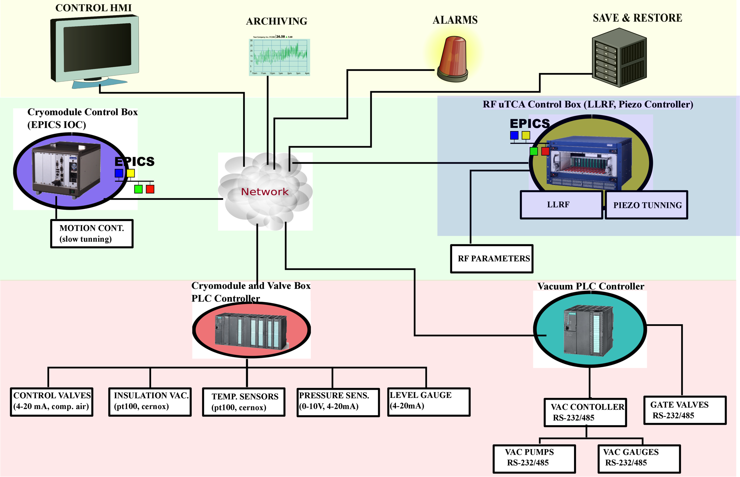
CONTROLS ARCHITECTURE (II)

Slide 12
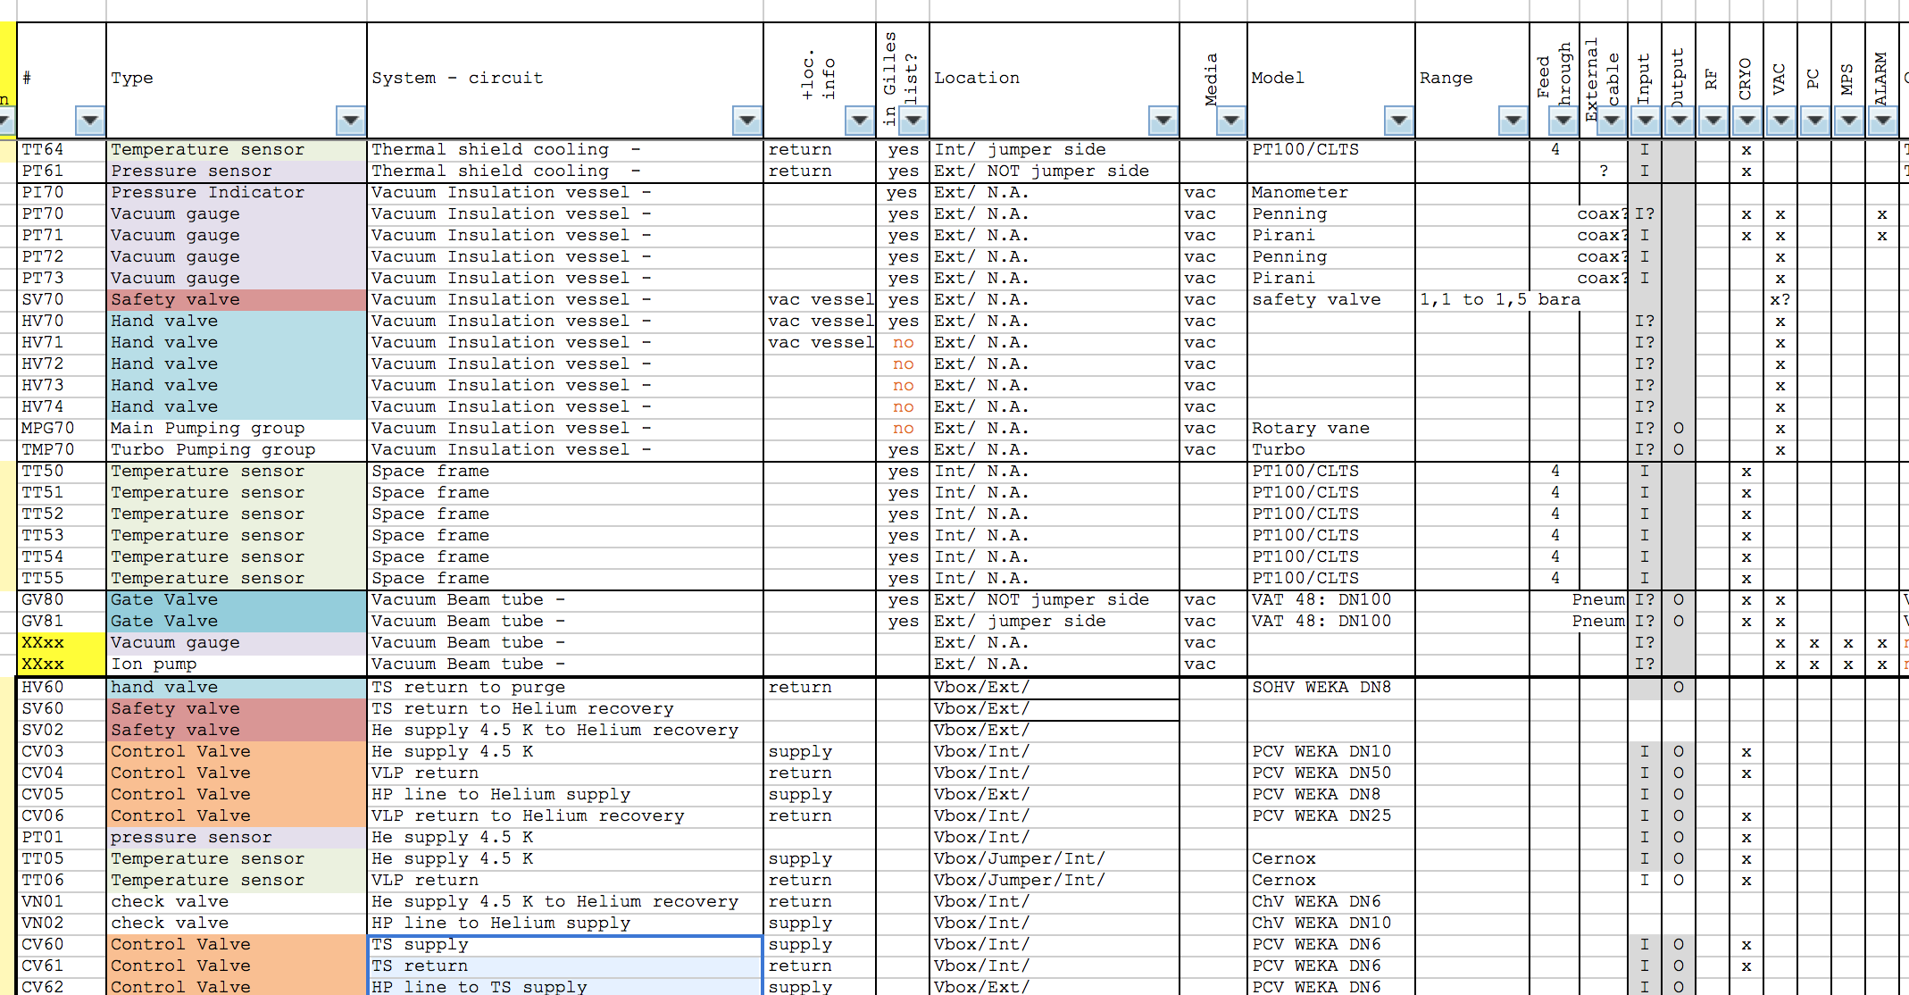
The starting point for the controls
Process Operation Modes
+
Instrumentation & Signals List

Slide 13
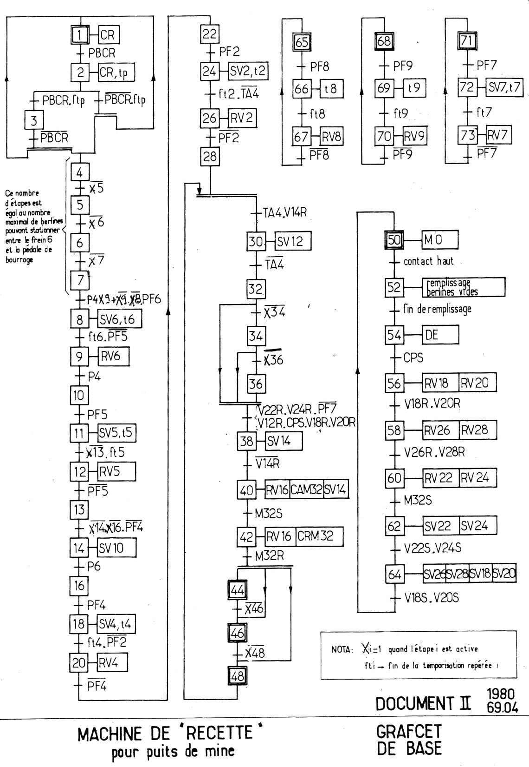
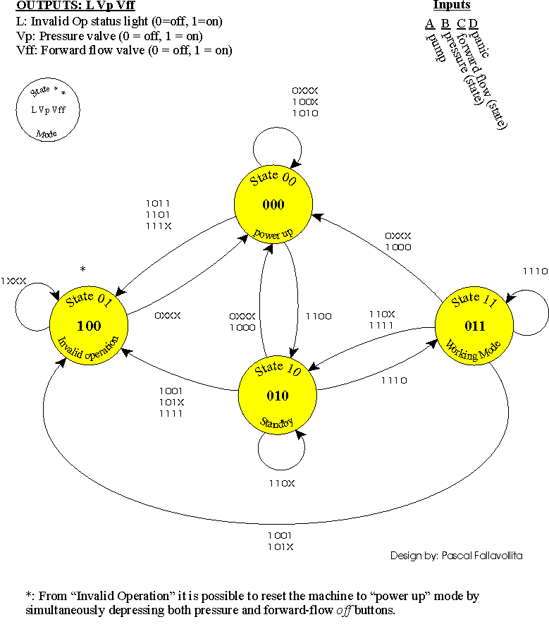
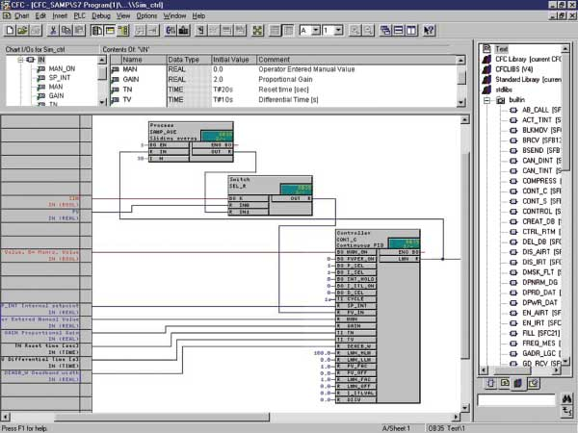
How to get the controls
Process
GRAFCET
+
States Diagram
PLC Code
Instrumentation & Signals

Slide 14
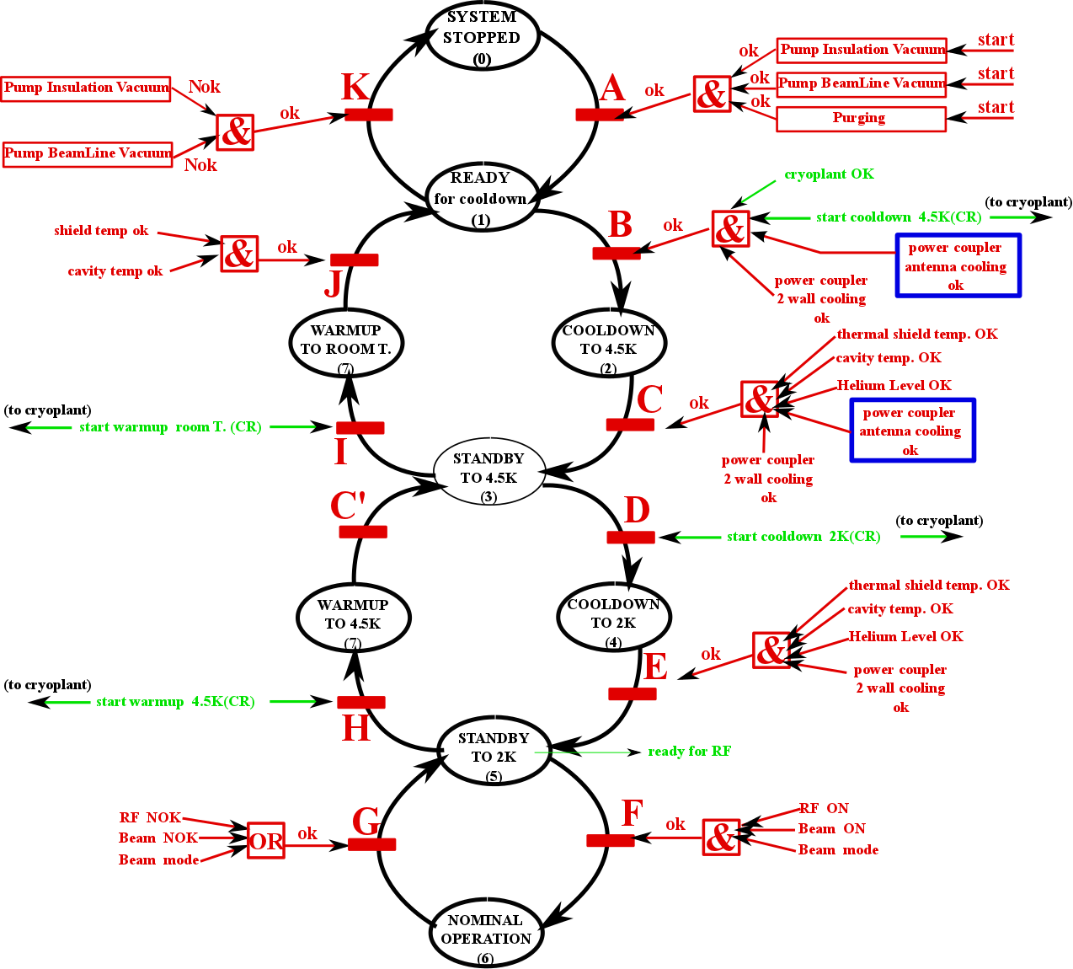
Preliminary operation states diagram
(2) Cooldown to 4.5K- state variables (controller outputs)
Valve Box
  CV03, CV04 % open (4-20mA analog)
  CV05, CV06 close (4-20mA analog)
  PT01 < 3 bar (signal)
Thermal shielding in valve box
  CV60, CV61 % open (4-20 mA analog)
  CV62, CV63 close (4-20mA analog)
  PT60 < 19.5 bar (4-20mA or 0-10V analog)
Cryomodule
  CV02 % open (4-20mA)
  CV01 close (4-20mA)
  EH10, EH20, EH30, EH40 OFF (heaters- Power Supply with LAN Interface)
  PT02 < 3 bar, PT03<1.4 bar (4-20mA or 0-10V analog)
  LT01 < ? mm, LT02 < ? mm (4-20mA analog)
Power Couple double wall cooling
  FT11, FT21, FT31, FT41 %open (MFC 0-10V analog)
  CV11, CV21,CV31,CV41 %open (4-20mA)
  EH11, EH21, EH31, EH41 ON (heaters- Power Supply with LAN Interface)
Power coupling antenna cooling
  FT12, FT22, F32, FT42 open (MFC- 0-10V analog)
  CV12, CV22, CV32, CV42 open (signal)
  EH13, EH21, EH31, EH41 ON (heaters- Power Supply with LAN Interface)
  PT11, PT21, PT31, PT41 < x bar (4-20mA or 0-10V analog)
Vacuum cryomodule
  PT70, PT71, PT72, PT73 < 0.0001 mbar (4-20mA or 0-10V analog)

Slide 15
Preliminary operation states diagram (II) what it is to be done
Include failures and abnormal modes in the state diagram ( leaks, loss of vacuum, cavity quench.)
Progress in the definition of signals and thresholds (for alarms and interlocks).
Complete the tables for all the states
Implement all the regulation needed
Do the GRAFCET representation of the controls
Controls Implementation
Vertical Integration

Slide 16
Thank you

