Slide 1
High power IOTs
Anders Sunesson/Morten Jensen
Accelerator Division RF group leader
www.europeanspallationsource.se
May 16 2014

Slide 2
Overview
ESS Linac and the driving parameters
IOT function
Examples of IOT
IOT possibility for high beta section?
ESS IOT parameters

Slide 3
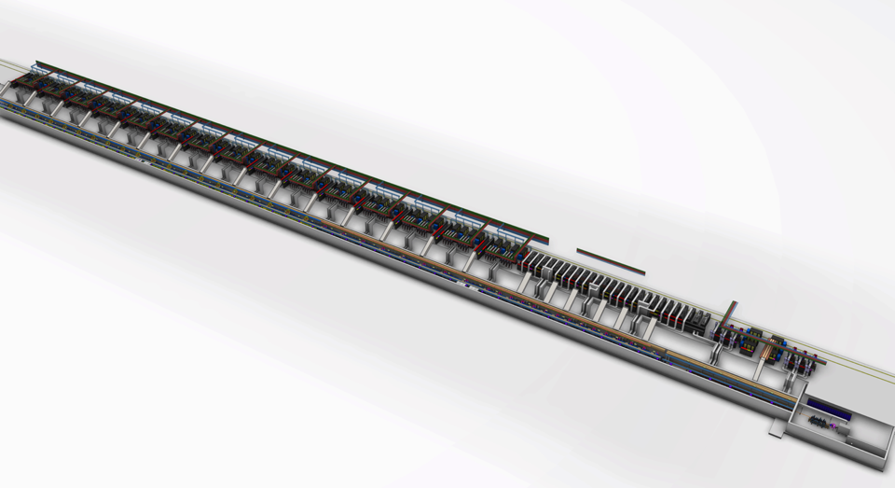
ESS Linac Layout
High beta RF
DTL RF
Medium beta RF
Low Energy Front end
Spoke RF
High beta cryomodules
Medium beta cryomodules
Spoke cryo-modules
DTL tanks

Slide 4
ESS accelerator
Design Drivers:
High Average Beam Power
5 MW
High Peak Beam Power
125 MW
High Availability
> 95%
Staged installation
i) 570 MeV
ii) 2000 MeV
Key parameters:
-2.86 ms pulses
-2 GeV
-62.5 mA
-14 Hz
-Protons (H+)
-Energy efficient

Slide 5
ESS Linac
352.21 MHz
704.42 MHz
2.4 m
4.5 m
3.6 m
40 m
54 m
75 m
174 m
Target
Source
LEBT
RFQ
MEBT
DTL
Spokes
Medium β
High β
HEBT & Contingency
75 keV
3.6 MeV
90 MeV
220 MeV
570 MeV
2000 MeV
 | Energy (MeV) | Frequency /MHz | No. of Cavities | βg | Temp / K | RF power /kW
Source | 0.075 | - | 0 | – | ~300 | –
LEBT | 0.075 | - | 0 | – | ~300 | –
RFQ | 3.6 | 352.21 | 1 | – | ~300 | 1600
MEBT | 3.6 | 352.21 | 3 | – | ~300 | 15
DTL | 90 | 352.21 | 5 | – | ~300 | 2200
Spoke | 220 | 352.21 | 26 (2/CM) | 0.5 βopt | ~2 | 330
Medium β | 570 | 704.42 | 36 (4/CM) | 0.67 | ~2 | 870
High β | 2000 | 704.42 | 84 (4/CM) | 0.86 | ~2 | 1100
HEBT | 2000 | – | 0 | – | ~300 | –

Slide 6
RF Systems
RF powers all cavities of the linac
Meets the requirements for each part of the linac
Section | Power /kW | Solution
RFQ | 1600 | Klystron
MEBT | 15 | Solid state
DTL | 2200 | Klystron
Spoke | 330 | Tetrode
Med β | 870 | Klystron
Hi β | 1100 | IOT

Slide 7
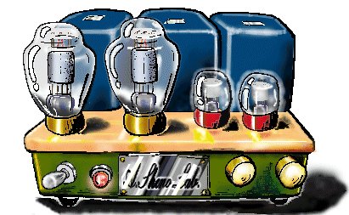
IOT = Inductive Output Tube
Invented in 1938 by Andrew V. Haeff as a source for radar
To overcome limitation of output power by grid interception
Pass beam trough a resonant cavity
Achieved: 100 W at 450 MHz, 35% efficiency
Used first in 1939 to transmit television images from the Empire State Building to the New York World Fair
IOTs then lay dormant until the 80’s
Intense competition with velocity modulated tubes - klystron had just been invented by the Varian Brothers
Difficult to manufacture
The IOT is often described as a cross between a klystron and a triode hence Eimac’s trade name ‘Klystrode’

Slide 8
How does it work?
Deceleration = RF Output
Source
Control
Beam
Acceleration
IOT
(Density modulated)
Magnetic field
Reduced velocity spread compared to klystrons
Higher efficiency
Lower gain
No pulsed high voltage
Cheaper modulator
No current without drive
RF input
Biased
Control Grid
RF output

Slide 9
Klystron (Velocity Modulated)
RF input
RF output
Cathode
(DC Beam)
Collector
Class A amplifier – needs pulsed HV
Bunching of electrons via cavities
Longer than IOT
Higher gain (40-50 dB)
High power (several MW)

Slide 10
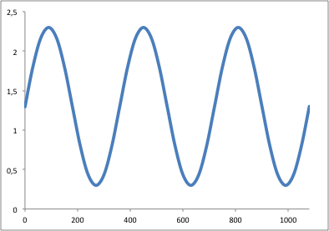
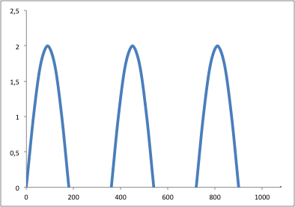
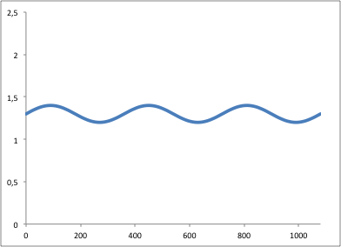
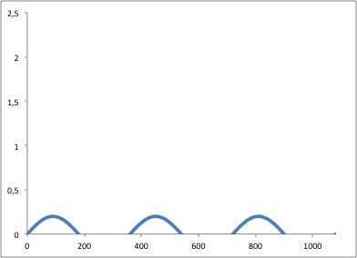
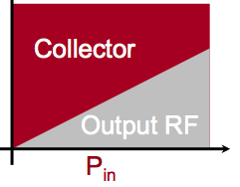
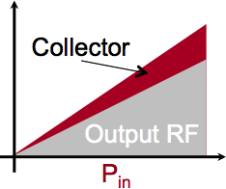
Klystrons
IOTs
Power delivered to beam
Cartoon!
Power delivered to beam
High Beam Current
Electrical Power Consumed
Low
Beam Current

Slide 11
Power transfer IOT vs klystron
IOT’s don’t saturate.
Built-in headroom for feedback.
IOT
MB-IOT
Klystron/MBK
Back-off for feedback
Unstable region
+6 dB
Short-pulse
excursions possible
η_{sat} ~ 65-68%
Operating
Power Level
Long-pulse
excursions possible
~ 52-55%
ESS estimate <45%
P_{out}
~ 70%
High gain
Low Gain
Courtesy of CPI
P_{in}
*** Klystrons: Back-off for feedback costs 30% ***
*** IOTs: Operate close to max efficiency***

Slide 12
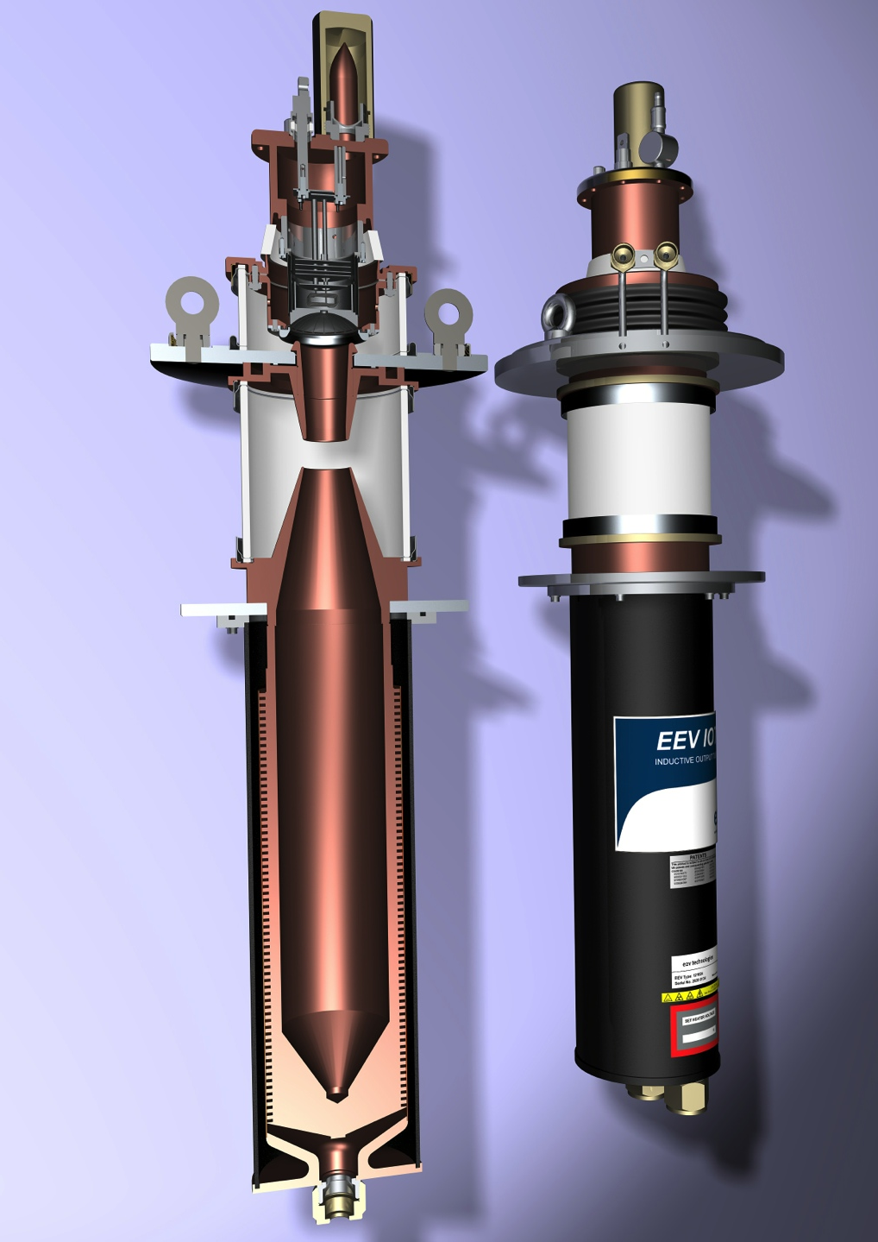
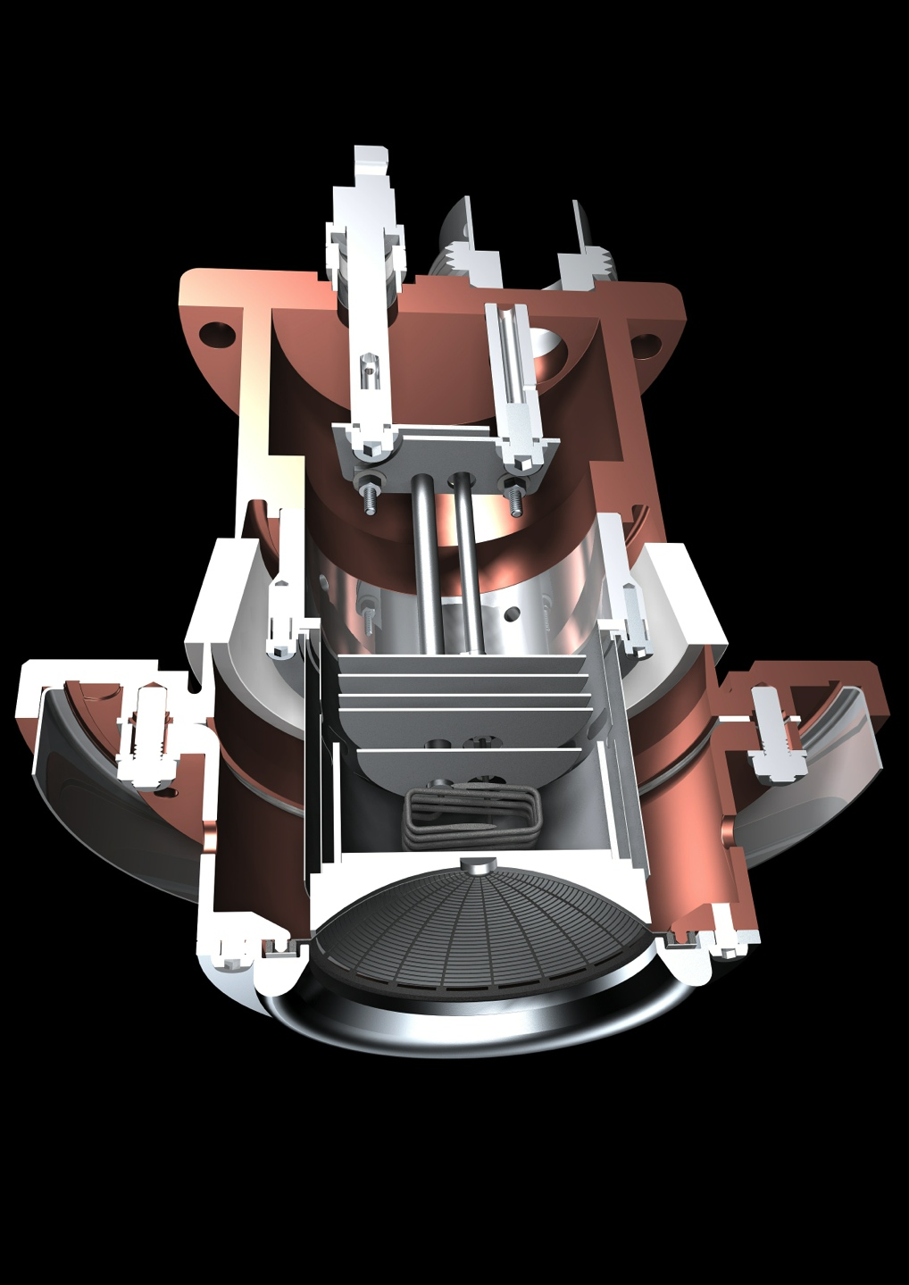
Typical Broadcast IOT
Courtesy of e2v

Slide 13
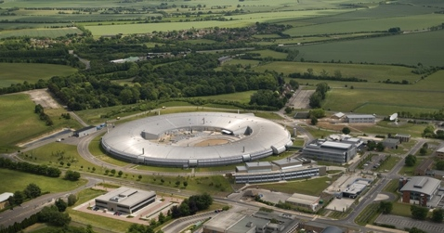
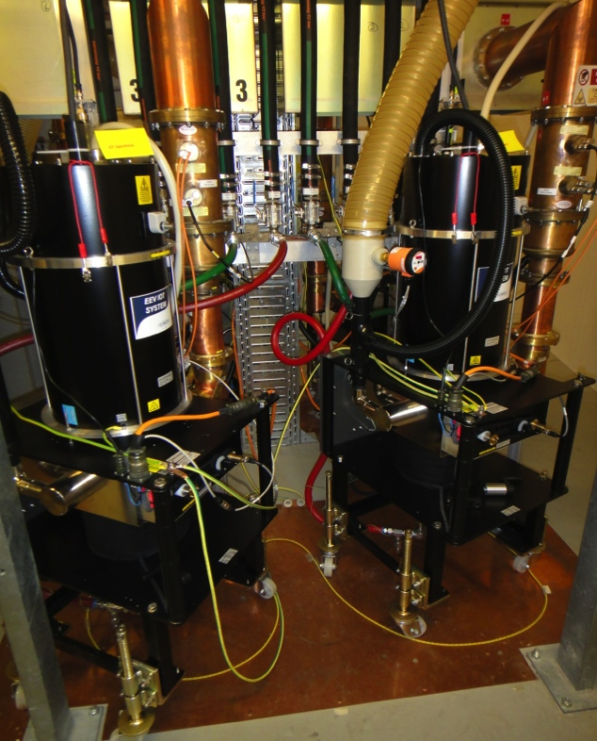
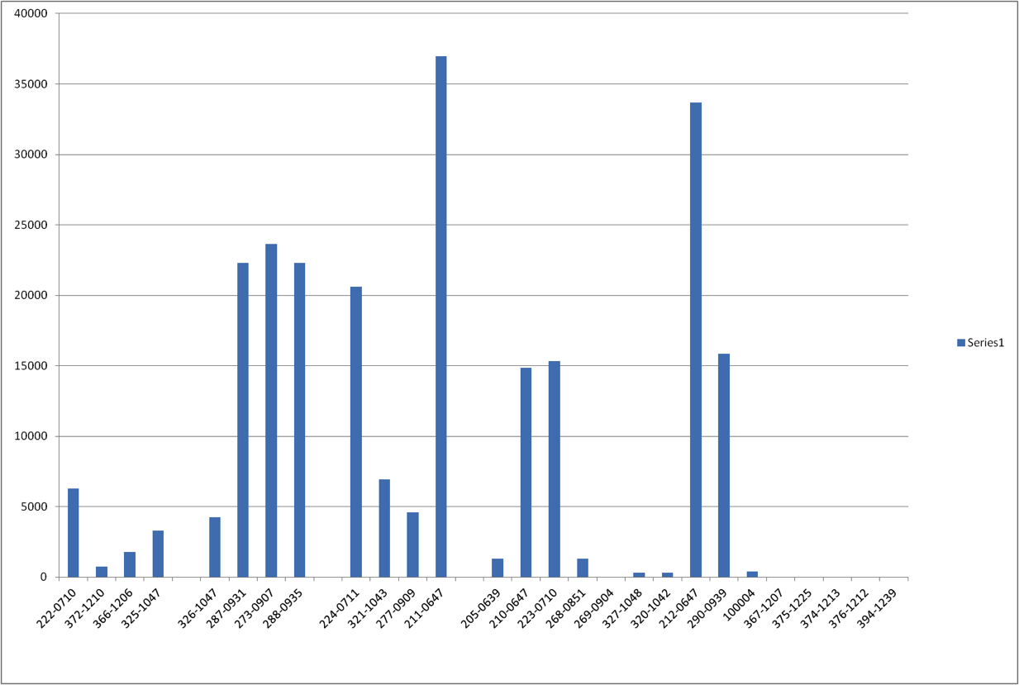
3rd Generation Light Source
Storage Ring
Three 500 MHz 300 kW amplifier for SR
- 4 x 80 kW IOT combined
One 80 kW for the Booster
Operational Hours at Diamond
30000
20000
Filament Hours
10000
Test system
Serial Number
In Operation
Peter Martin, Diamond

Slide 14
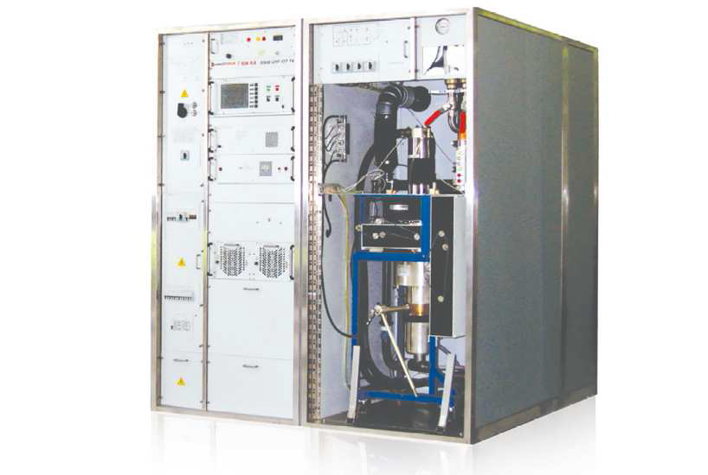
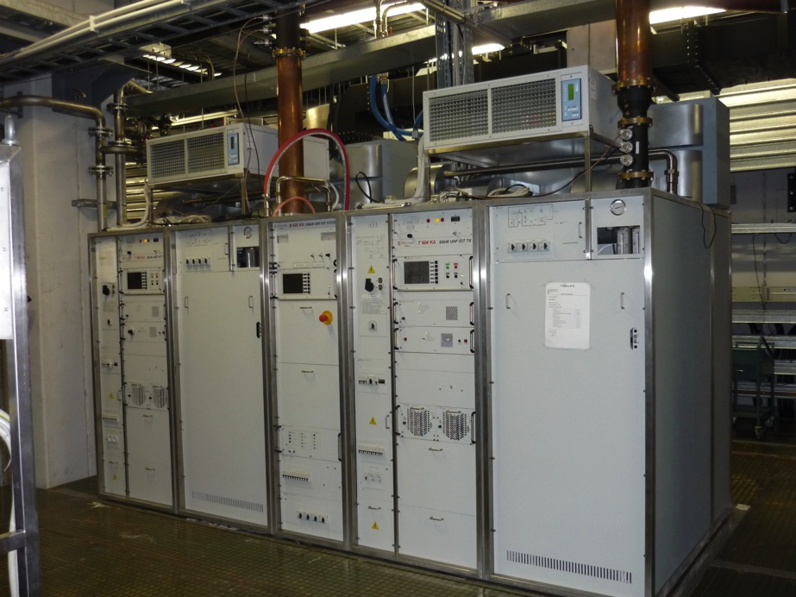
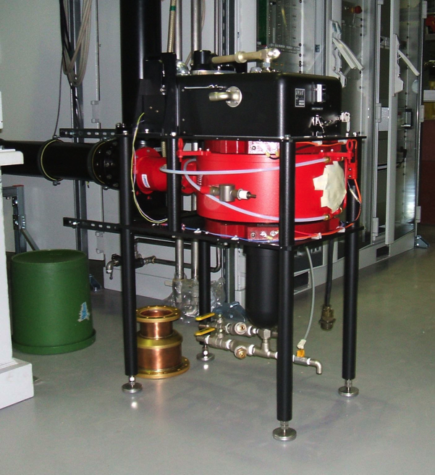
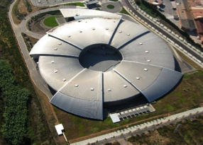
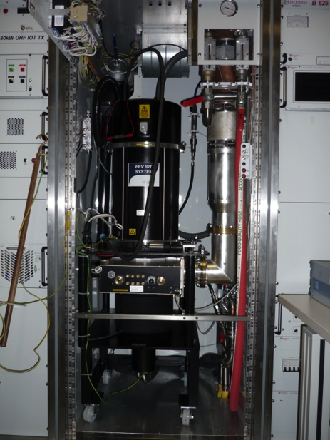
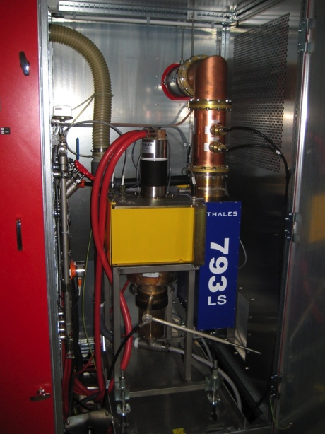
Other Facilities using IOTs
CERN
800 MHz
60 kW
Metrology Light Source
(Willy Wien Laboratory)
CPI 90 kW IOT (K5H90W1)
> 33 000 operating hours
Elettra
500 MHz
150 kW IOT based amplifier for Combination of 2x80 kW
12 IOTs

Slide 15
Easy? Use IOTs instead of klystron?
Klystrons are the standard choice for high power accelerators
They exist at the power levels needed for ESS
They are really pretty good, reliable and quite efficient
IOTs at ESS parameters don’t exist
Typical power 80-100 kW
Lower gain (20-25 dB)
They may be more complicated
They need to be developed
More risk

Slide 16
But: Schedule opportunity
2010
11
12
13
14
15
16
17
18
19
20
21
22
23
ESS ADU starts
Redesign approved
Conceptual Design
First SC cavity ordered
CM prototypes launched
Spoke CM prototype available
Ellip CM productionlaunched
Decision on
Scope
SC linac 570 MeV ready
SC RF
NC and FE IK contracts
Injector test at Saclay
NC linac ready
NC linac
Klystrons and IOTs ordered
Prototype klystrons delivered
Prototype IOTs delivered CERN
Decision IOT or klystrons
RF for medium beta ready
RF for High beta ready
RF
Cryo dist. line ordered
Acc cryoplant ordered
Early access cryo and test buildings
Cryoplant ready
IOT delivery
Cryogenics
Test stand Lund University
Test stand on site
Early access to tunnel
First protons to target
1370 MeV protons available
2 GeV protons available
Services, installation and com.

Slide 17
High beta: Superpower IOT
Superpower IOT – a multi-beam IOT aimed at powering the high beta section. The target peak power is 1.2 MW
Advantages: higher efficiency than klystrons, smaller footprint
Lower voltage, operation at nominal power
Disadvantage: device does not exist, must be developed
Collaboration with CERN:
ESS to tender and buy prototype tubes (delivery 2016)
CERN to test (test stand in preparation)
Decision IOT/klystron end 2017
If the IOTs fail, go klystron (the medium beta klystron prototyped has the right specification)

Slide 18
How to reach the power needed?
Power requirement 500 kW – 1.5 MW
Single beam – Large cathode
High voltage
High cathode loading
Oil in the modulator and gun
Multi beam - Several smaller cathodes
Higher total perveance
Lower voltage
Lower cathode loading
Scalable for higher power levels (100-140 kW per cathode)

Slide 19
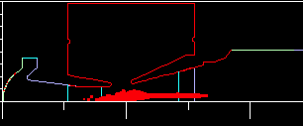
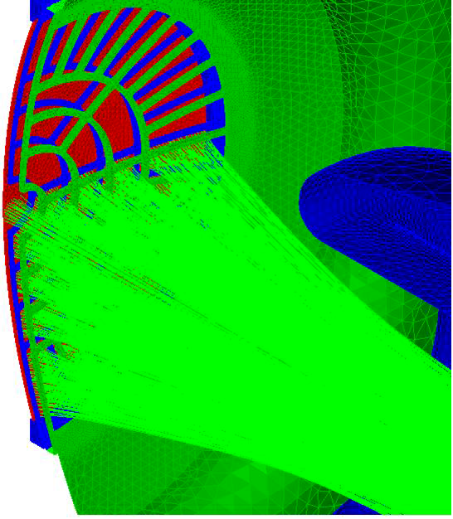
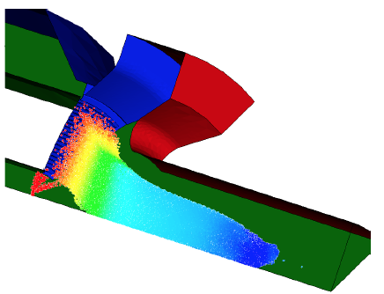
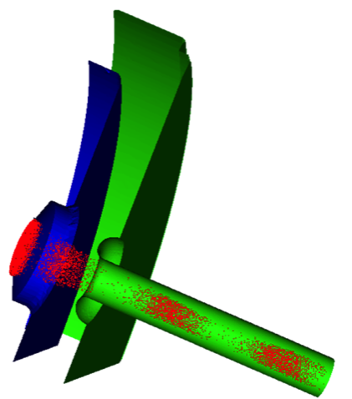
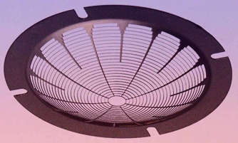
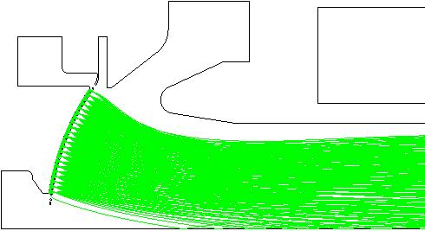
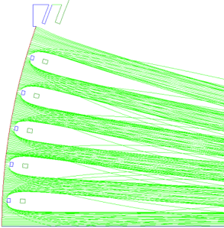
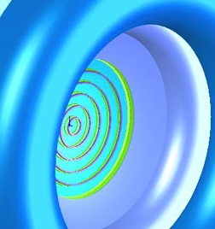
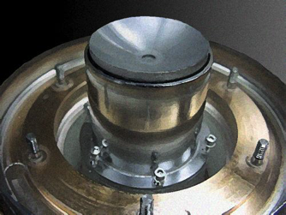
Design and Simulation
Analytical and Numerical codes available
Commercial codes well developed in addition to manufacturers own
Increased computing power allows improved simulation of grid structures, trajectory and PIC modeling
Gun simulation
TED
CPI
IVEC 2009
CPI

Slide 20
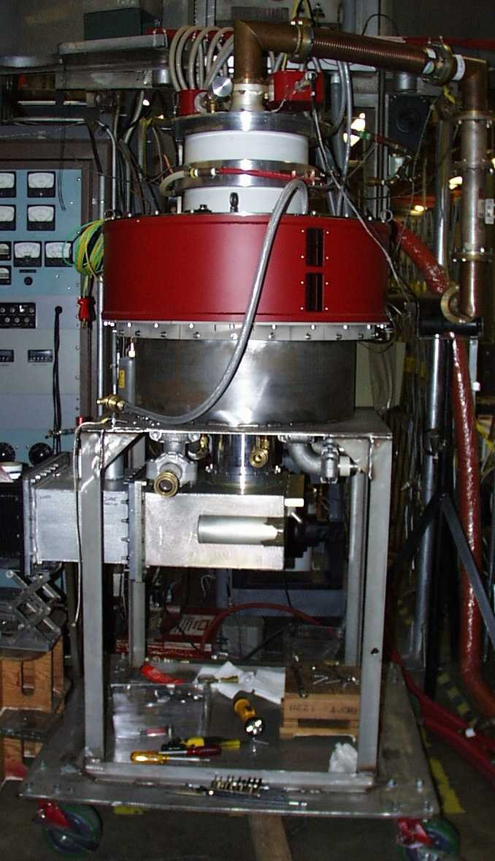
700 MHz HOM IOT experience CPI
VHP-8330A IOT
RF Input
Design Parameters value units
Power Output 1000 kW (min)
Beam Voltage 45 kV (max)
Beam Current 31 A (max)
Frequency 700 MHz
1dB Bandwidth ± 0.7 MHz (min)
Gain 23 dB (min)
Efficiency 71 % (min)
Diameter 30/76 in/cm
Height 51/130 in/cm
Weight 1000/450 lbs./kg
Collector Coolant Flow 220 gpm
Body Coolant Flow 10 gpm
O/P Window Cooling (Air) 35 cfm
Gun
Solenoid,
O/P Cavity
@ 31kV
RF Output
Collector
Test Results (pulsed)

Slide 21
Some IOT publications by Labs
Applications of High Power Induction Output Tubes in High Intensity Superconducting Proton Linacs
Testing of Inductive Output Tube based RF amplifier for 650 MHz SRF Cavities, A. Mandal et al, PCaPAC2012
90 kW CW IOT development at L3 Communications Electron Devices, M Boyle et al, CWRF Workshop, 2012
Development of a 402.5 MHz 140 kW IOT, M Read et al, PAC2011
The first continuous wave and long pulse operation, DESY, 2011
Simple Model of an Inductive Output Tube, R. Carter, IEEonED 2010
CPI’s 1.3 GHz, 90 kW Pulsed IOT Amplifier, M. Marks et al, IPAC2010
Modelling and Design of High-Power Inductive Output Tubes, E. Wright et al, PAC2009.
Highly stable IOT based 1.3 GHz/16kW RF Power Source for CW operated SC Linacs, SRF2009
The ALBA RF Amplifier System based on IOTs, P. Sanchez et al, EPAC2008
Installation and Commissioning of the new 150 kW plant for the Elettra RF System Upgrade, A Fabris et al, PAC07
Grid less IOT for Accelerator Applications, C. Wilson et al, PAC2007
IOT testing at the ERLP, J Orrett at al, EPAC2006
First Results of the IOT Based 300 kW 500 MHz Amplifier for the Diamond Light Source, M. Jensen et al, EPAC05
IOT RF Power Sources for Pulsed and CW Linacs, H. Bohlen et al, Lunac2004
Comparison of Klystron and Inductive Output Tubes Vacuum-Electron Devices for Amplifier service in Free-Electron Laser, EPAC04

Slide 22
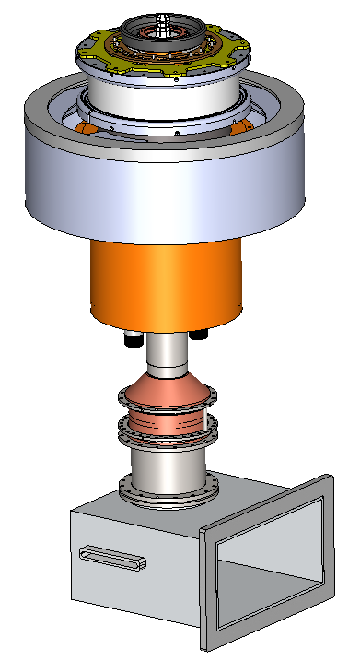
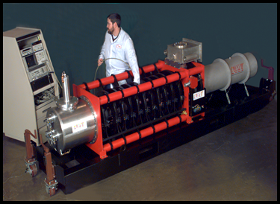
A 700 MHz Comparison
 | Single Beam Klystron | MB IOT
Peak output Power | 1 | 1 | MW
Cathode Voltage | 95 | 50 | kV
Beam Current | 21 | 31 | A
Efficiency at saturation | 65 | 65 (min) | %
Est. efficiency for operation | <45 | >60 | %
Gain | 48 | 23 | dB
0.6 m
1.3 m

Slide 23
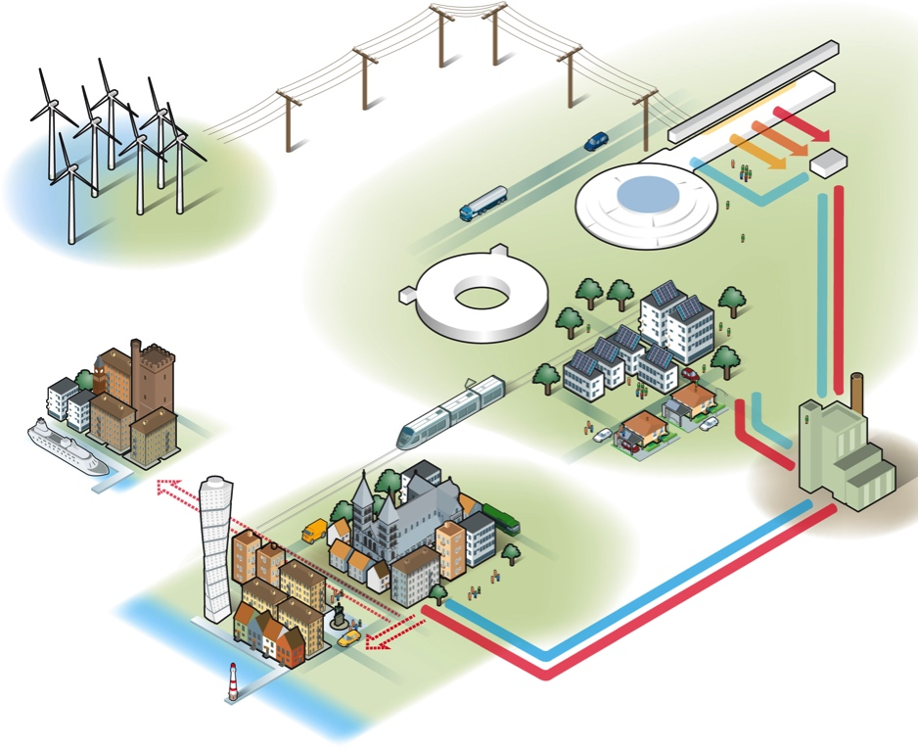
Where next?
ESS requirements
Carbon Neutral
Innovative
Green
Accelerating Structure | Freq. (MHz) | Quantity | Max Power (kW)
RFQ, DTL | 352 | 5 | 2200**
Spoke | 352 | 26 | 330**
Elliptical Medium Beta | 704 | 36 | 860**
Elliptical High Beta | 704 | 84 | 1100**
Power saving from high beta about 20 GWh per year
** Plus overhead for control

Slide 24
IOT tender
Parameter |  | Comment
Frequency | 704.42 MHz | Bandwidth > +/- 0.5 MHz
Maximum Power | 1.2 MW | Average power during the pulse
RF Pulse length | Up to 3.5 ms | Beam pulse 2.86 ms
Duty factor | Up to 5% | Pulse rep. frequency fixed to 14 Hz
Efficiency | Target > 65%
High Voltage | Low | Expected < 50 kV
Design Lifetime | > 50,000 hrs
Target: Approval for ESS series production in 2017/18
Work is being carried out in collaboration with CERN
ESS to procure prototypes
CERN to make space and utilities available for testing

Slide 25
Conclusion
The IOT is an alternative as RF source for accelerators
It can offer high efficiency
It does not require pulsed HV
To develop an IOT at ESS specification, going multibeam offers the possibility of HV low enough to avoid oil
The use of IOTs in the high beta section is proposed
The staged installation provides schedule opportunity
ESS has tendered for a 1.2 MW IOT according to ESS parameters
The development is done in collaboration with CERN

Slide 26
Thank you

