Slide 1
SM18 Klystron Modulator
Sven Pütz
Project Description
System Parameters
Electrical Schematic & Layout
Pulse Waveforms
Resistive Dummy Load
Project Schedule

Slide 2
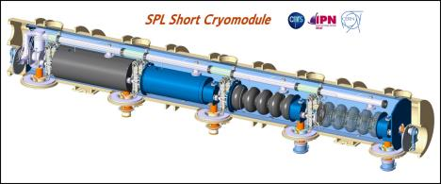
Project Description
In 2011, a modulator requirement identified for a high power 704MHz teststand at CERN
Deliver 2.8MW electrical pulsed power to a klystron
Flexible enough to adapt to several specifications, including ESS and SPL parameters
Modulator supplied by ESS through superconducting cavity collaboration
Contract prepared and managed by ESS with some CERN input
Selection of best offer which was based on simple LR bouncer topology
Contract placed in 2011

Slide 3
System Parameters
Parameter | SM18 / ESS | SPL | LINAC4
U_{k} | -115 | -110 | -110 | kV
I_{k} | 25 | 25 | 50 | A
P_{pulse} | 2.88 | 2.6 | 5.5 | MW
P_{avg} | 161 |  | 20 | kW
PRR | 20 | 50 | 2 | Hz
Z_{k} | 4.6 | 4.4 | 2.2 | kΩ
τ_{pulse} / τ_{flat-top} | 2.8 / 2.5 | 1.0 / 0.8 | 1.8 / 1.5 | ms
droop | 3 | 1 | 1 | %
droop compensation type | LR |  | LC
Design / Production | AMPEGON PPT GmbH |  | CERN / JEMA sa
Z_{k}
$$P_{k,avg}=U_{k}∙I_{k}∙τ_{p}∙PRR≤161kW$$
$$Z_{k}<14 kΩ$$

Slide 4
System Parameters
Parameter | SM18 / ESS | SPL | LINAC4
U_{k} | -115 | -110 | -110 | kV
I_{k} | 25 | 25 | 50 | A
P_{pulse} | 2.88 | 2.6 | 5.5 | MW
P_{avg} | 161 |  | 20 | kW
PRR | 20 | 50 | 2 | Hz
Z_{k} | 4.6 | 4.4 | 2.2 | kΩ
τ_{pulse} / τ_{flat-top} | 2.8 / 2.5 | 1.0 / 0.8 | 1.8 / 1.5 | ms
droop | 3 | 1 | 1 | %
droop compensation type | LR |  | LC
Design / Production | AMPEGON PPT GmbH |  | CERN / JEMA sa
Z_{k}
$$P_{k,avg}=U_{k}∙I_{k}∙τ_{p}∙PRR≤161kW$$
$$Z_{k}<14 kΩ$$

Slide 5
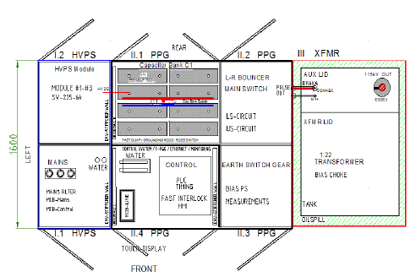
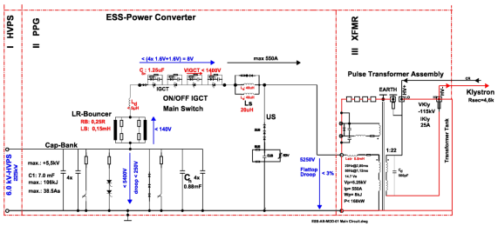
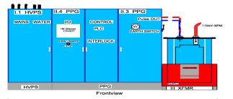
Electrical Schematic & Layout

Slide 6
Electrical Schematic & Layout

Slide 7
Electrical Schematic & Layout

Slide 8
Electrical Schematic & Layout

Slide 9
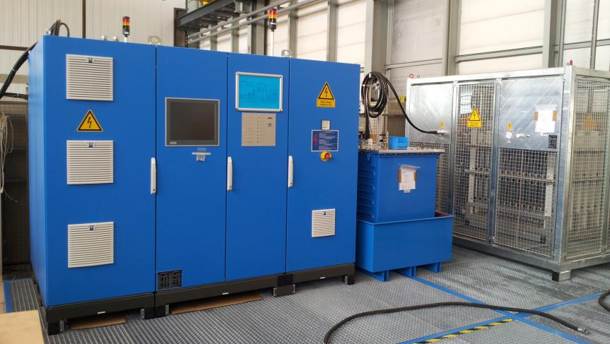
Test Site Assembly

Slide 10
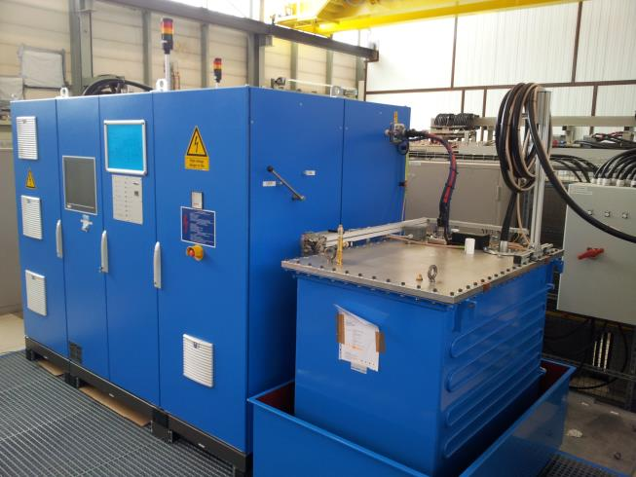
Test Site Assembly

Slide 11
Pulse Waveforms
Mar 2014: reception test in Dortmund (PPT)
P_{avg} limited to 25%
burst tests with full pulse voltage/current
operation with resistive dummy load
arc protection validated
CH1 Uk 114kV (droop: 3%)
CH2 Ik 29A (droop: 3%)
CH3 main pulse cmd
CH4 Ip 633A

Slide 12
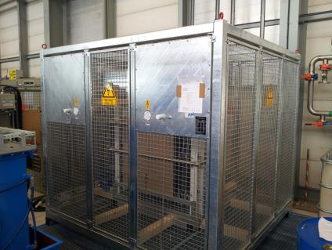
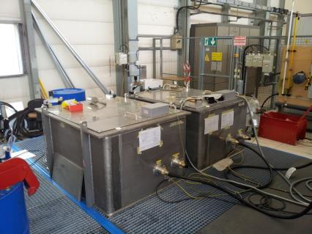
Resistive Dummy Load
SM18/ESS
LINAC4
2400
2300
2000
1500
1300
1.6 m³ / 1 m²
800
11 m³ / 6 m²
air insulated
water cooled
P_{avg} 161 kW
oil insulated
forced convection
P_{avg} 10 kW (per tank)

Slide 13
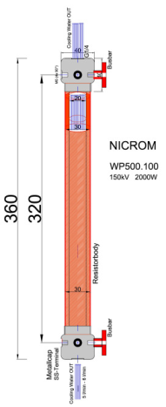
Resistive Dummy Load
NICROM WP500.100
U_{nom} | 150 | kV | tested @115 kV operated @58 kV
P_{rms,nom} | 2 | kW | tested @2 kW operated @0.8 kW_{rms}/15 kW_{pk}
R | 220 | kΩ | ±10 % ±100 ppm/K
E_{pulse,10ms} | 2.2 | kJ | singe pulse, 10 ms
E_{pulse,1ms} | 0.44 | kJ | singe pulse, 1 ms operated @42 J / 20 Hz
Q | 6 | l/min | per element

Slide 14
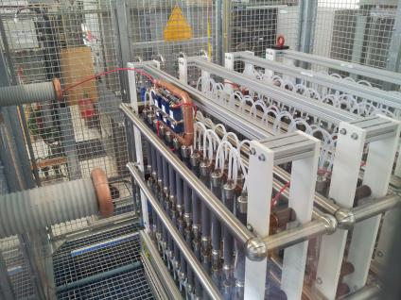
Resistive Dummy Load
NICROM WP500.100
U_{nom} | 150 | kV | tested @115 kV operated @58 kV
P_{rms,nom} | 2 | kW | tested @2 kW operated @0.8 kW_{rms}/15 kW_{pk}
R | 220 | kΩ | ±10 % ±100 ppm/K
E_{pulse,10ms} | 2.2 | kJ | singe pulse, 10 ms
E_{pulse,1ms} | 0.44 | kJ | singe pulse, 1 ms operated @42 J / 20 Hz
Q | 6 | l/min | per element
192 Resistors / 4 Modules
diode to simulate reverse blocking
2nd HV outlet to connect spark gap

Slide 15
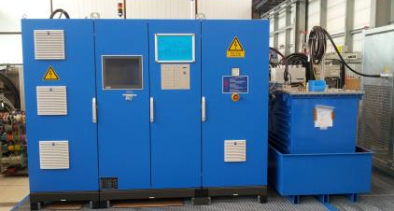
Project Schedule
2012
2013
2014
2011
07 - call for tender
09 - TDR presentation
10 - dummy load revised TDR
03 - reception @25% (PPT)
05 - reception @100% (CERN)
09 - commissioning SM18
12 - contract start
10 - TDR approval (except dummy load)
10 - approval of dummy load TDR

Slide 16
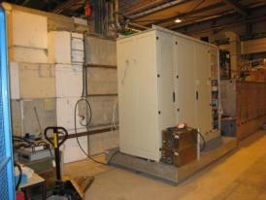
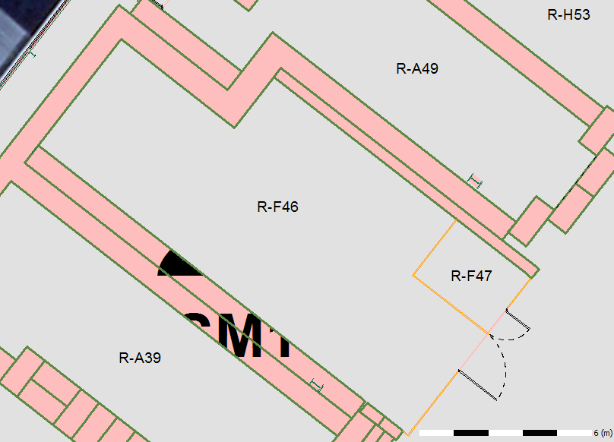
ToDo
Reception Test @100%
Fast Interlocks (e.g. arc detection)
Output Performance
Remote Control
EMC & Efficiency
Heat-Run
Gain Operational Experience
Commissioning with Klystron in SM18
Electrical Power and Cooling
Signal Interfaces
Filament Heater
Anode Control
LEP Klystron

Slide 17
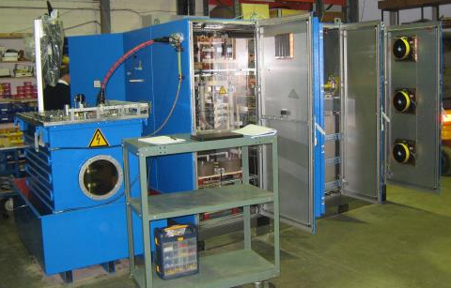
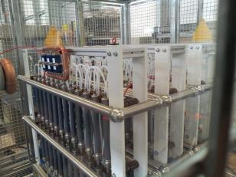
Thank you for your attention!

