Slide 1

ESS Beam Diagnostics:
Challenges and perspectives
SLHIPP 2014
Cyrille Thomas

Slide 2
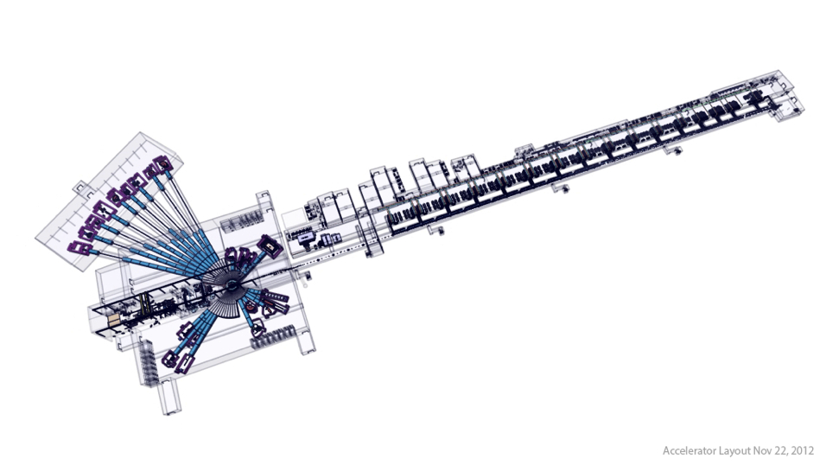
EUROPEAN SPALLATION SOURCE
An European multi-disiplinary research centre based on the world’s most powerful neutron source
Accelerator | LINAC
Particle | Proton
Max Energy | 2 GeV
Power | 5 MW
Current | 62.2mA
Pulse length | 2.86 ms
Pulse frequency | 14 Hz
Hosted by Sweden (source facility) and Denmark (data management facility)
Notes:
ESS 1.60E15 flux
SNS 0.10E15 flux
ESS will provide around 30 times brighter neuutron beams than existing facilities today.
The difference between the current neutron sources and ESS is something like the difference between taking a picture in the glow of a candle, or doing it under flash lighting.

Slide 3
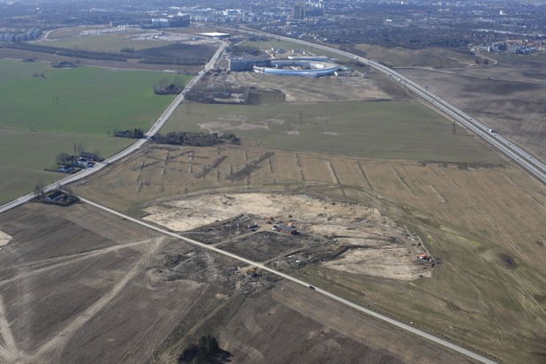
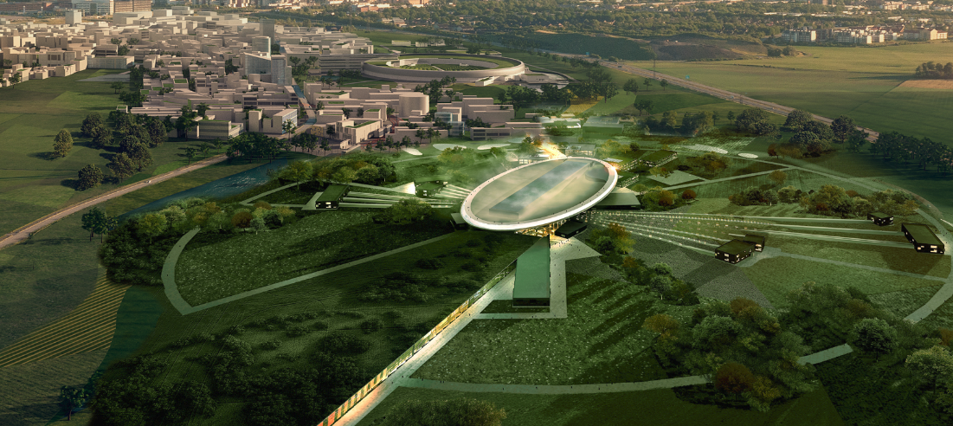
SITE
Start construction in September!

Slide 4
ESS Proton Beam
High quality, High power beam transported towards Tungsten Target:
  2 GeV proton beam
  Transverse Normlised Emittance: 0.7 mm.mrad both planes, r.m.s beam size: 2mm
  Longitudinal Normalised Emittance: 1.2 mm.mrad, r.m.s bunch length 1mm or 3ps
Macro-Pulse characteristics:
  10⁶ bunches every 2.86nm: 2.86ms
  Total Charge: 178.75 μC or current: 62.5mA
  Peak power: 125MW, average power, 5MW
  Repetition rate: 14Hz
Beam Loss average rate for machine component lifetime:
  Less than 1W/m: Charge: 0.2 fC/bunch, 60 fC/μs or 200pC/macro-pulse
Linac length: 600m
Beam current density: 500x10³ μA/cm² (σ_{x,y} = 2 mm)
Beam on Target:
  Straight beam on target
  Machine Protection imposes beam average current density must be less than: 100μA/cm²

Slide 5
ESS Linac Diagnostics layout
Measure 6-D phase-space of the proton beam during commissioning: transverse emittance, bunch length and energy spread
Current along macro-pulse: BCM
Emittance: Allison scanner and slit and grid
Beam position: BPM
Bunch Longitudinal profile: BSM
Beam losses: BLM
Beam transverse profiles: WS, and BIF and IPM
352.21 MHz
704.42 MHz
2.4 m
4.6 m
3.8 m
39 m
56 m
77 m
179 m
Target
Source
LEBT
RFQ
MEBT
DTL
Spokes
Medium β
High β
HEBT & Contingency
75 keV
3.6 MeV
90 MeV
216 MeV
571 MeV
2000 MeV
Warm linac
Cold linac
HEBT and A2T

Slide 6
Beam modes: Commissioning and Operation
5 μs
100 μs
6 - 62.5 mA
6-62.5 mA
Commissioning
Commissioning
<14 Hz
<1 Hz
2.86 ms
2.86 ms
6-62.5 mA
6-62.5 mA
Commissioning
Operation
<0.034 Hz
14 Hz
Peak Current as adjustment variable
  For tuning RF (minimise beam loading)
  For Operation (control power while meeting neutron instruments requirements)

Slide 7
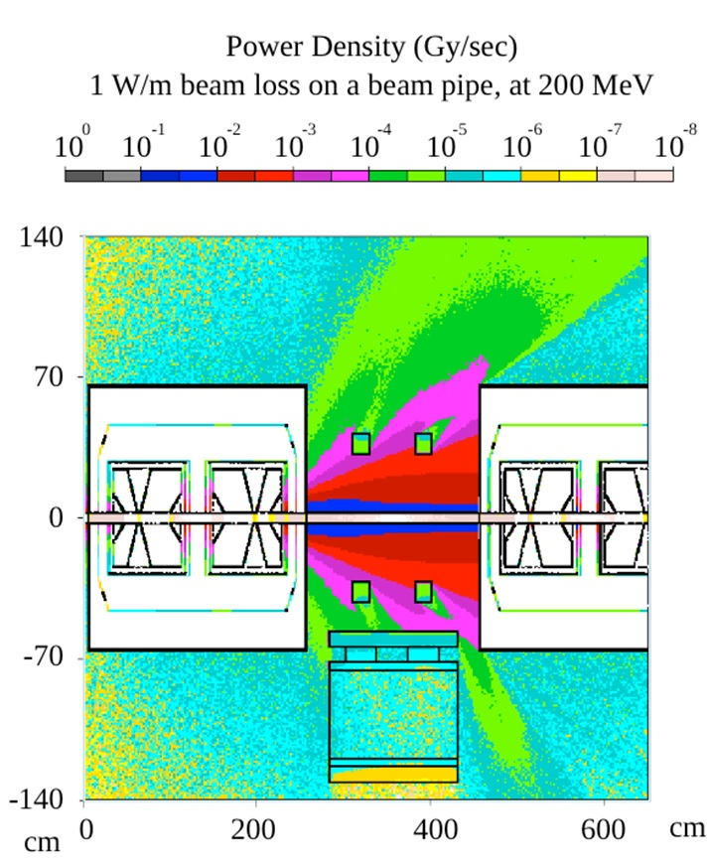
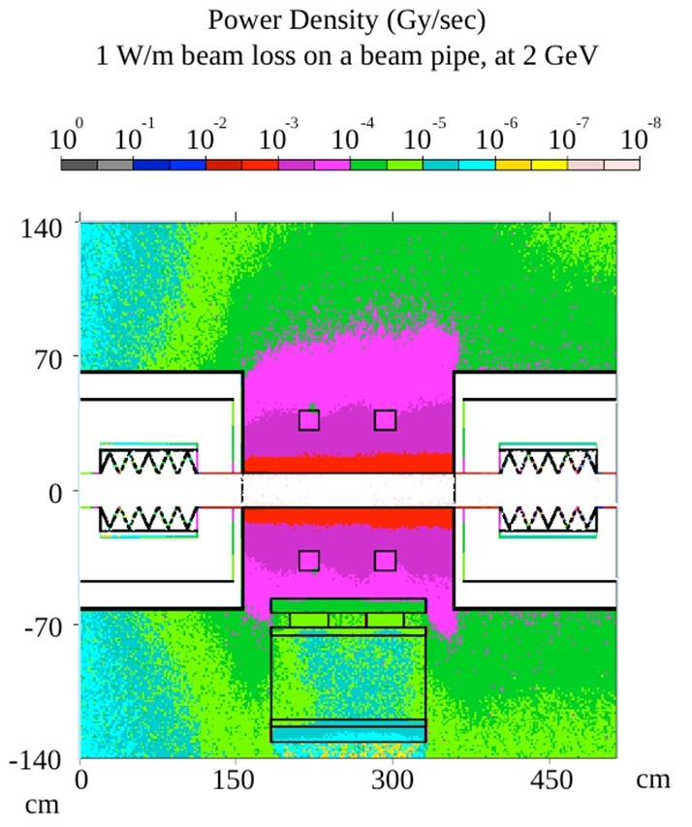
BLM
Main detector: LHC Ion Chamber (CERN collaboration, along with last batch production)
  Detect 0.01W/m up to 10⁴ W/m of primary beam loss
Electronics requirements:
  Charge sensitivity: 10mW/m (2pC at 2GeV), produces 1.5mGy/sec, and 0.81nA
  Dynamic range: 6 orders of magnitude
  response time < 2μs imposed by Machine Protection System (total 10μs)
Additional detectors: scintillators and neutron detectors in the warm Linac
Simulation of beam loss patterns defining positions of BLMs
  Performed using Monte-Carlo simulation (MARS), which in general has poor if not at all any direct correlation with current models of beam dynamics
  Next level of analysis: produces a loss map from beam dynamics to feed new MARS simulation
Lali Tchelidze, system leader
Michal Jarosz, oPac student, MARS simulation
Hooman Hassanzadegan, Acquisition Electronics
Hinko Kocevar, EPICS integration
Maurizio Donna, FPGA programmer

Slide 8
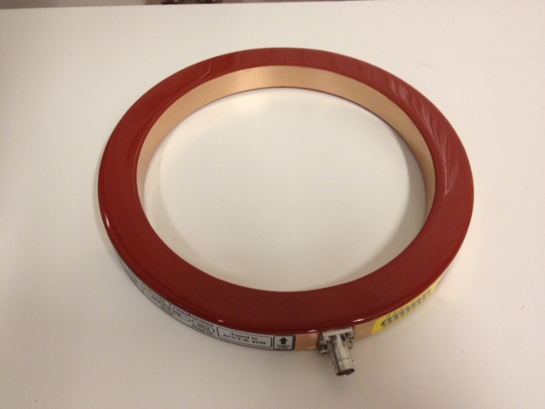
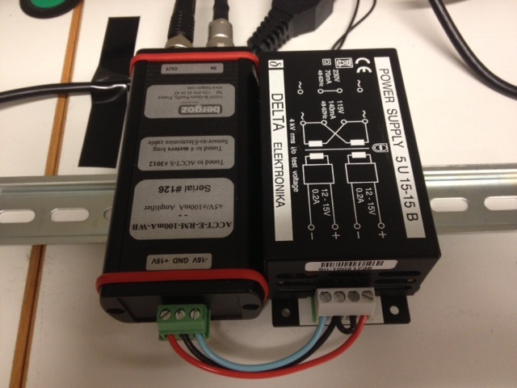
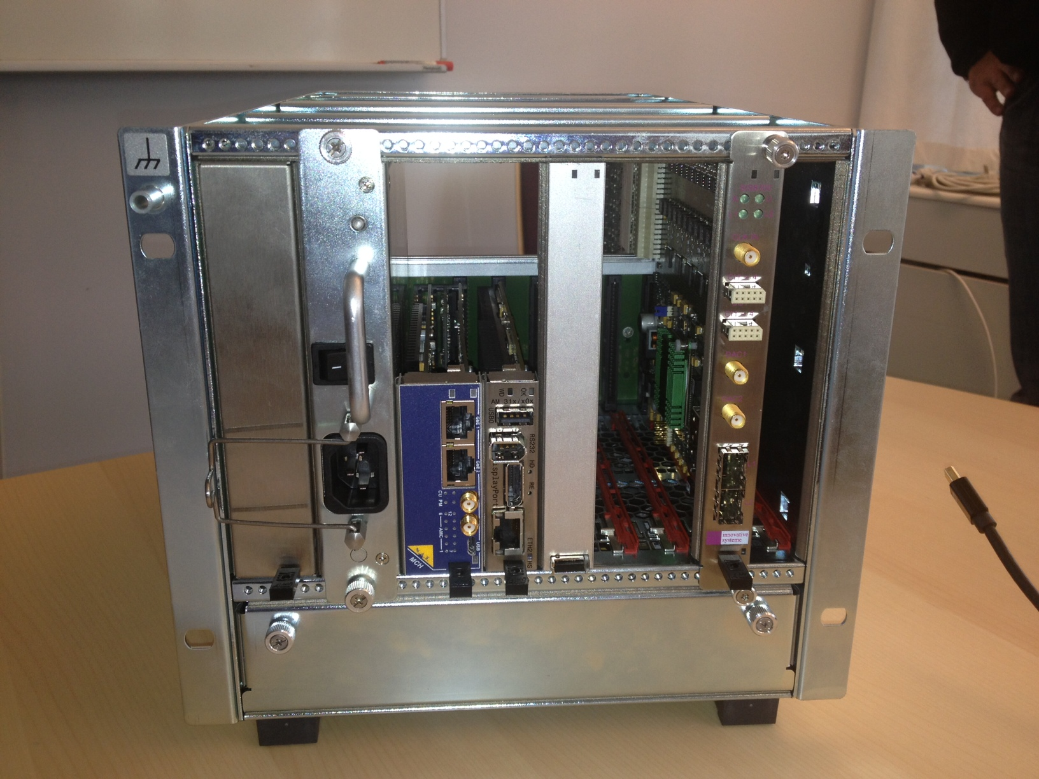
BCM
2.86 ms
62.5 mA
Nominal pulse
Nominal pulse:
Accuracy (20 mA – 60 mA): ±1%
Resolution: 0.1%
Response time (coil + elect.): < 1 μs
Sample rate: > 1 MSPS
Refresh rate (end user): 14 Hz
14 Hz
Hardware: ACCT tested prototype
MTCA.4 crate hosting:
  RTM (frontend analog electronic)
  Struck digitizer card (FPGA processing)
  Timing
Make sure beam pattern is as intended
Make sure beam is transmitted
Account for Beam on target accumulated charge
I1 - I2
Differential measurement:
I1
I2
Absolute measurement:
MPS
Hooman Hassanzadegan, system leader
Collaboration with DESY and Cosylab
MPS
BCM1
BCM2

Slide 9
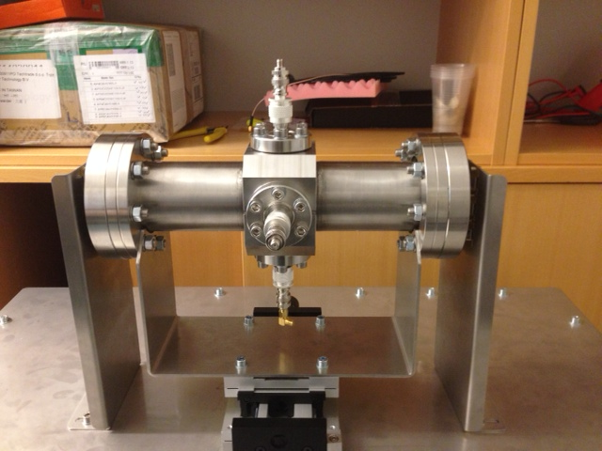
BPMs
BPM buttons prototype on test bench
Beam position:
Accuracy:0.1mm
Precision: 20 μm
Phase Stability: 0.2 degrees (1.5ps @ 2GeV)
Phase Precision: 0.2 degrees
Phase Accuracy: 1 degree
MTCA.4 crate hosting:
DWC-10 frontend electronics
FPGA card
Timing
Hooman Hassanzadegan, system leader
Collaboration with DESY and Cosylab

Slide 10
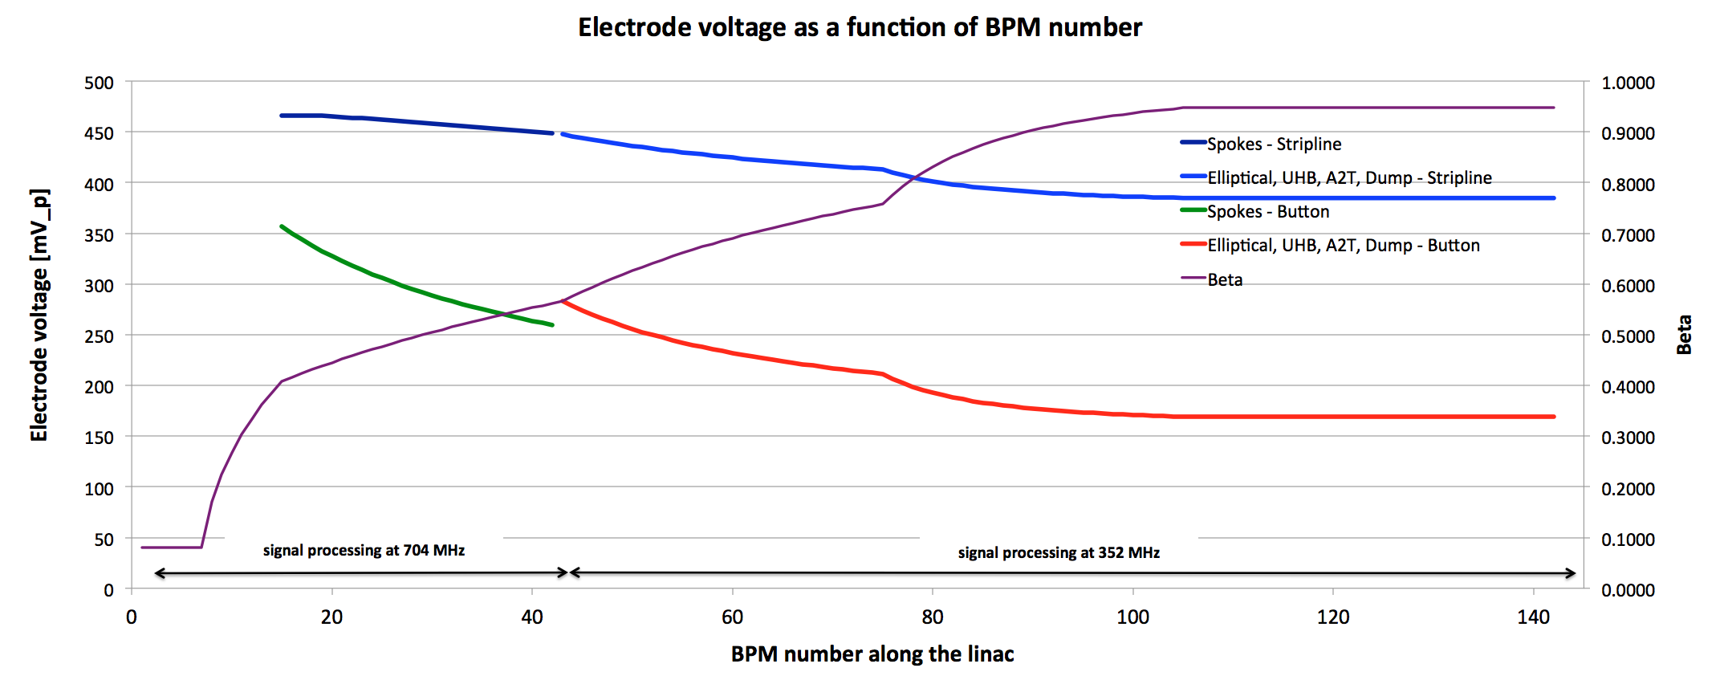

Slide 11
BPM signal detection methods
1) Sampling in IF:
f = f_{RF} +/- f_{IF}
IQ (under-) sampling
Demux + sign correction
Ref.
f = f_{IF} , T_{sampling} = n T_{RF} + T_{RF} /4
+Q
+Q
I
f = f_{RF}
+I
+Q
+I
+I
-I
-Q
-I
-Q
Input
Mixer
Q
2) Sampling in RF:
f = f_{RF}
IQ (under-) sampling
Demux + sign correction
+I
+Q
+Q
+I
I
Input
Q
-I
-Q
-I
-Q

Slide 12
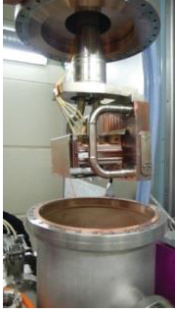
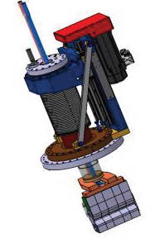
Emittance
Early in-kind from Saclay on LEBT Allison Scanner (similar to IFMIF).
Conceptual design ongoing on MEBT slit/grid system. Discussing on in-kind for mechanical design with Bilbao.
Operational with 12kW beam power
Emittance measurement uncertainty: 10%
ε = σ . σ’
Position scan
Charge detector
±V
Slit
Slit
LIPAC Allison emittance scanner
Benjamin Cheymol: system leader
Collaboration with CEA Salclay and CNRS

Slide 13
Beam Profile
Position scan
Wire scanners / Halo
Warm Linac:
  Carbon Wire, SE signal readout
  Single actuator at 45 degrees
  Thermal load limit @62mA pulse:
    50μs in MEBT
    100μs in DTL at 1Hz rep rate.
Cold linac:
  Tungsten Wire, SE signal readout in spokes, Scintillator downstream of spokes
  Dual actuators, shorter travel
  Thermal load limits to 62mA pulse:
    100μs at 1Hz
HEBT & A2T
  Fast wire scanners based on CERN design
  Capable of full beam operation
wire
Diagnostic for Commissioning
Cross-reference for non invasive profile monitors

Slide 14
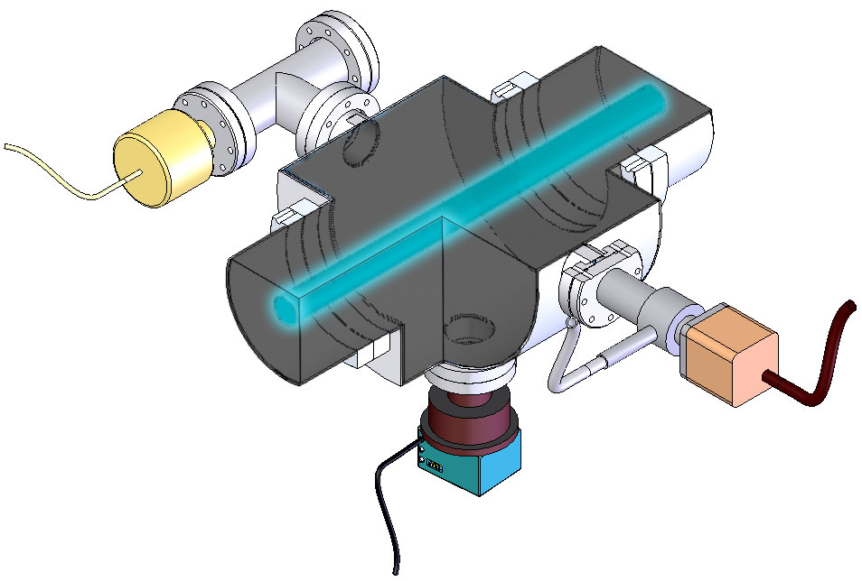
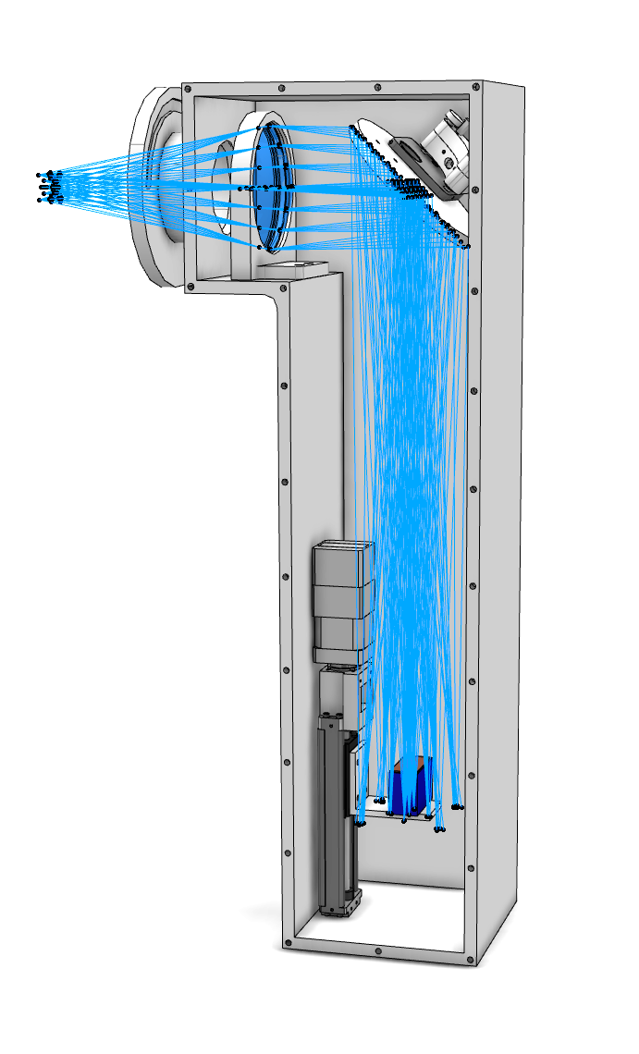
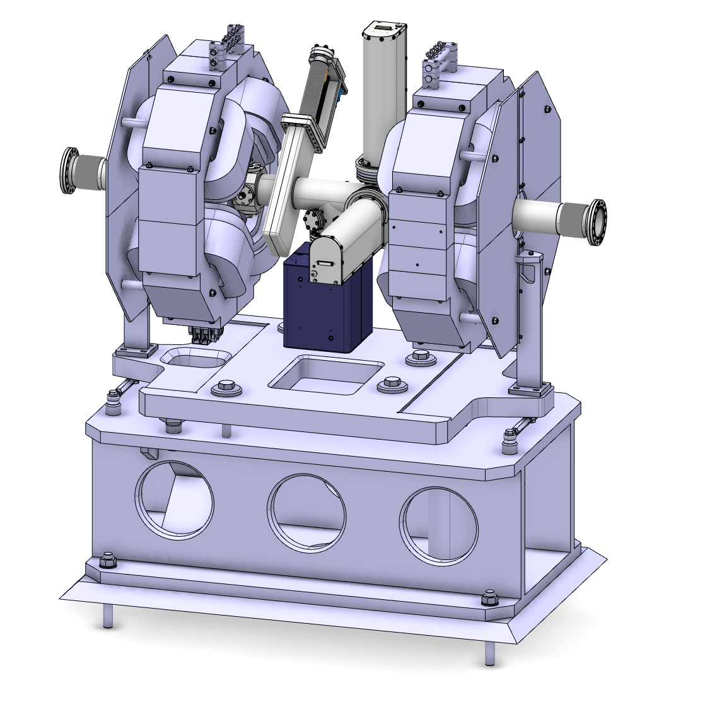
Beam Profile
Beam Induced Fluorescence:
Warm Linac and HEBT
Beam size HxV: 2x2 mm²
Single shot profile
Dynamic range: 100-10³
Resolution: <1mm
Ion beam
Viewport
WS
BIF
BPMs
Diagnostic for Commissioning and Operation

Slide 15
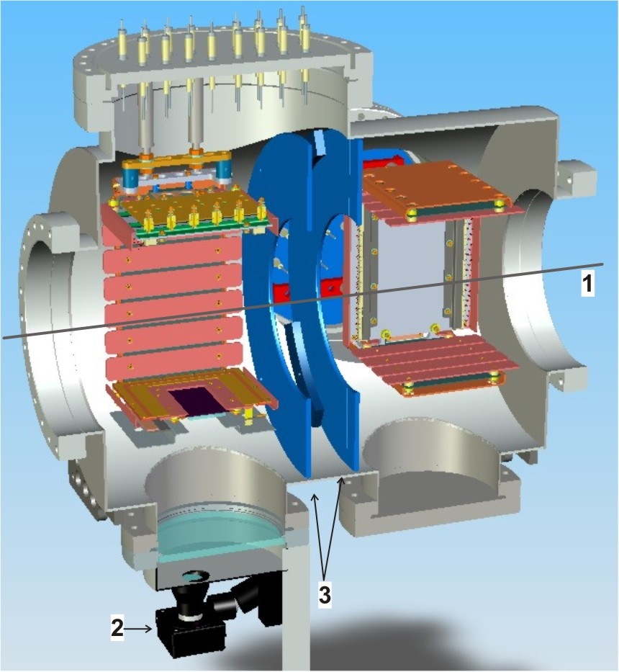
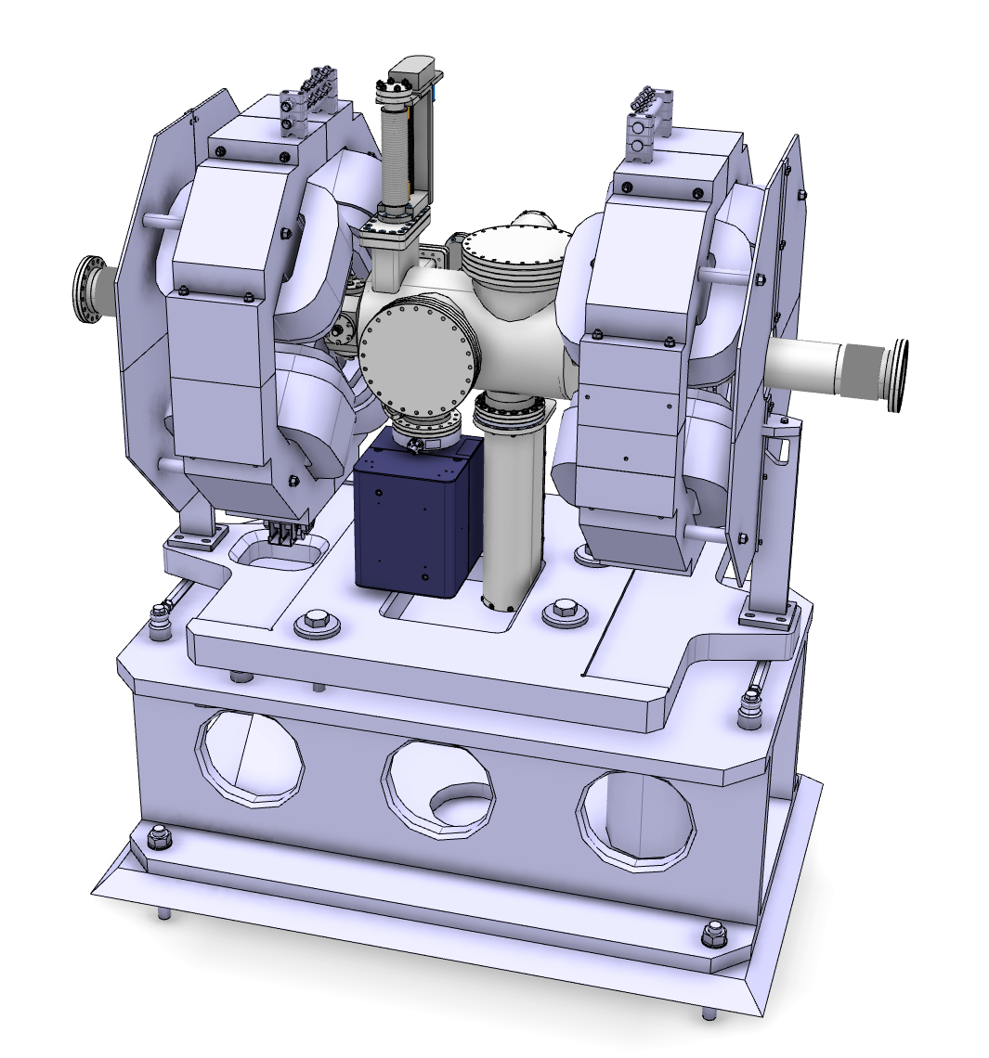
Beam Profile
Ionisation Profile Monitors:
Cold Linac
Beam size HxV: 2x2 mm²
Single shot profile
Dynamic range: 100-10³
Resolution: <1mm
60kV
Proton beam
WS
IPM port
BPMs
Scintillator screen
Optical imaging system
Diagnostic for Commissioning and Operation

Slide 16
Summary Linac Diagnostics
Suite of Diagnostics for tuning of the linac to deliver a high quality (0.7mm.rad) high power (5MeV) proton beam to the target, with less loss than 1 part in a million.
Current in all sections of the linac
Position along the trajectory
Emittance at low energy
Beam size along the linac
Bunch length at critical points for cavities tuning
Beam loss along the linac
Challenges to come: develop prototype diagnostics early enough in the project to adjust to the performance required for each and every diagnostic to be installed in the machine for commissioning and for operation
Additional challenges: Diagnostics in the Target monolith area

Slide 17
Beam on Target
High Quality Beam, (0.7 mm.rad)² x 1.2 mm.rad
High Power, 5MW
  High Power density, High current density > 500mA/cm²
Maximum current density on Proton Beam Window and Target Window:
  100 mA/cm²
What strategy to dilute the current density by 10⁴?
Defocus the beam: Not enough due to too small emittance
Defocus and raster: Good enough, but require very good control of raster for MPS and for neutron science

Slide 18
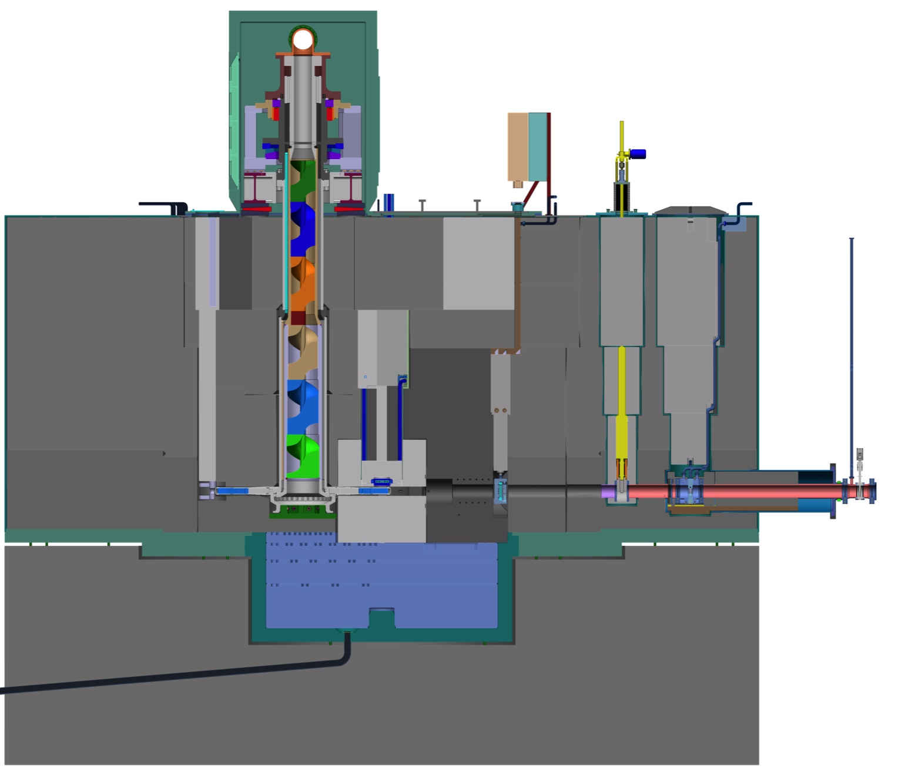
Beam transport line within the target monolith
target wheel
gate valve
beam diagnostics
proton beam window
4.4 m

Slide 19
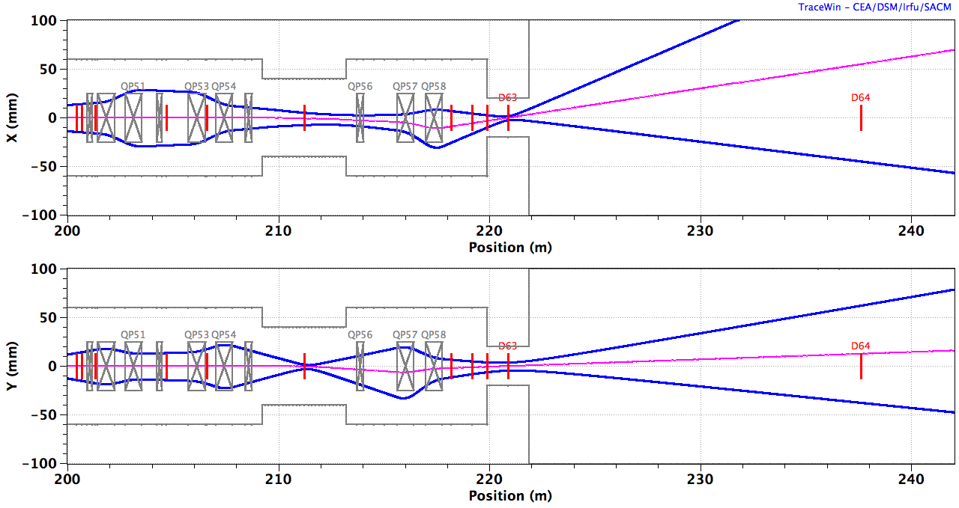
‘Raster25’
Centroid
10 x RMS beamlet
BEW
QP1-4
RMs
QP5,6
PBW
B_{y} B_{y} B_{x} B_{x} | B_{x} B_{x} B_{y} B_{y}
ACH
A2T
AP
CO
2.0 GeV: B_{x} = ±1.96 mT.m, B_{y} = ±2.28 mT.m, ±5 mT.m
Notes:
NSW
location of fixed collimator

Slide 20
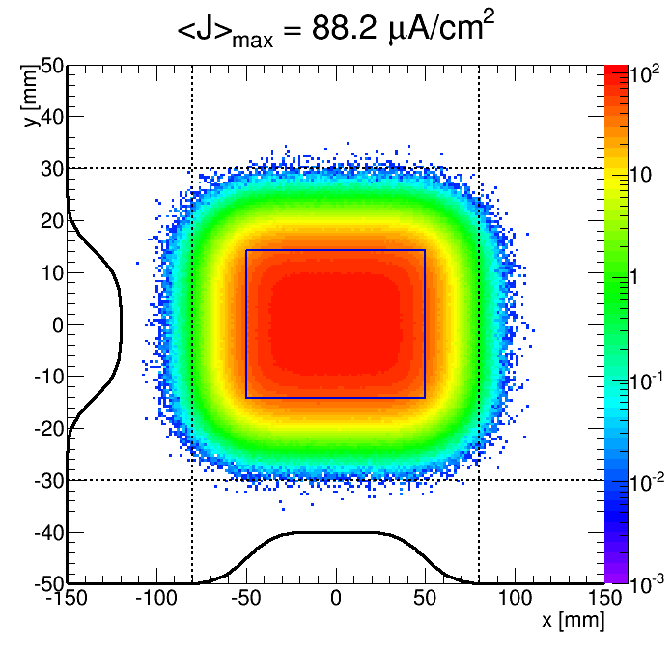
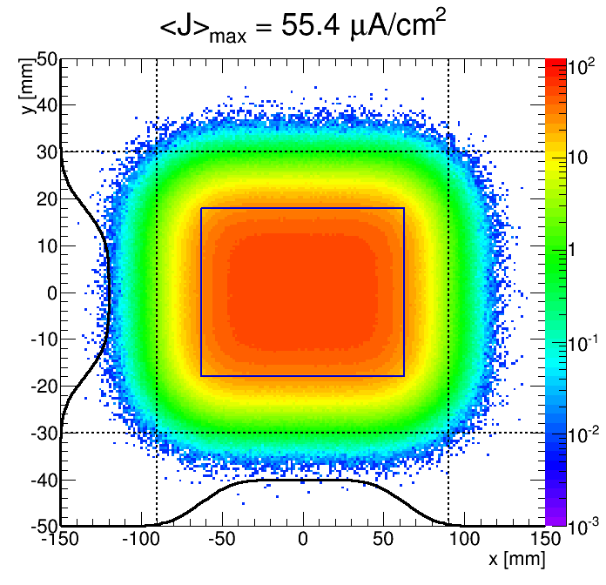
Integrated beam current density on PWB and on TW

Slide 21
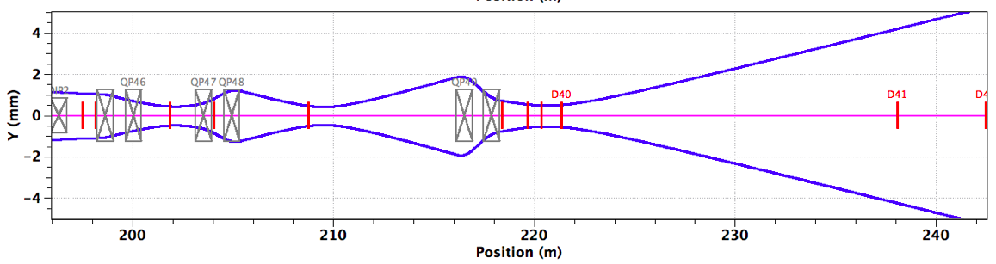
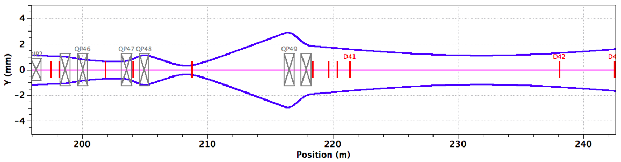
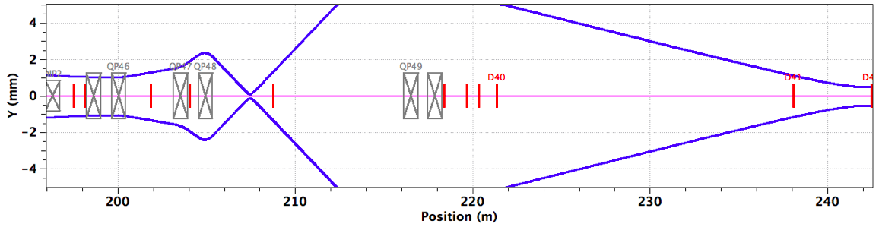
Unrastered Beamlet Focused on Target
Instrumented movable collimator in shield wall as part of MPS
Survive one pulse
Maybe not
Definitely not

Slide 22
Proton Beam Diagnostics for Target Monolith Area
Measure beamlet size on PWB and TW
Measure raster motion speed and amplitude
Measure Power density – current density profile of each macro-pulse
BPMs: at the pivot point, at the Proton Beam Window Plug, and at the Beam Instrumentation Plug: beamlet position and angle
SEM grid: beam profile
Halo: machine protect
optical system: imaging the proton beam density profile at PBW and TW
All Diagnostics in this area are to be operated in high radiation environment
  Subject to short lifetime (0.5 - 1 year), remote handling and waste management requirements, thermo-mechanical stress and fatigue and additional noise from radiation

Slide 23
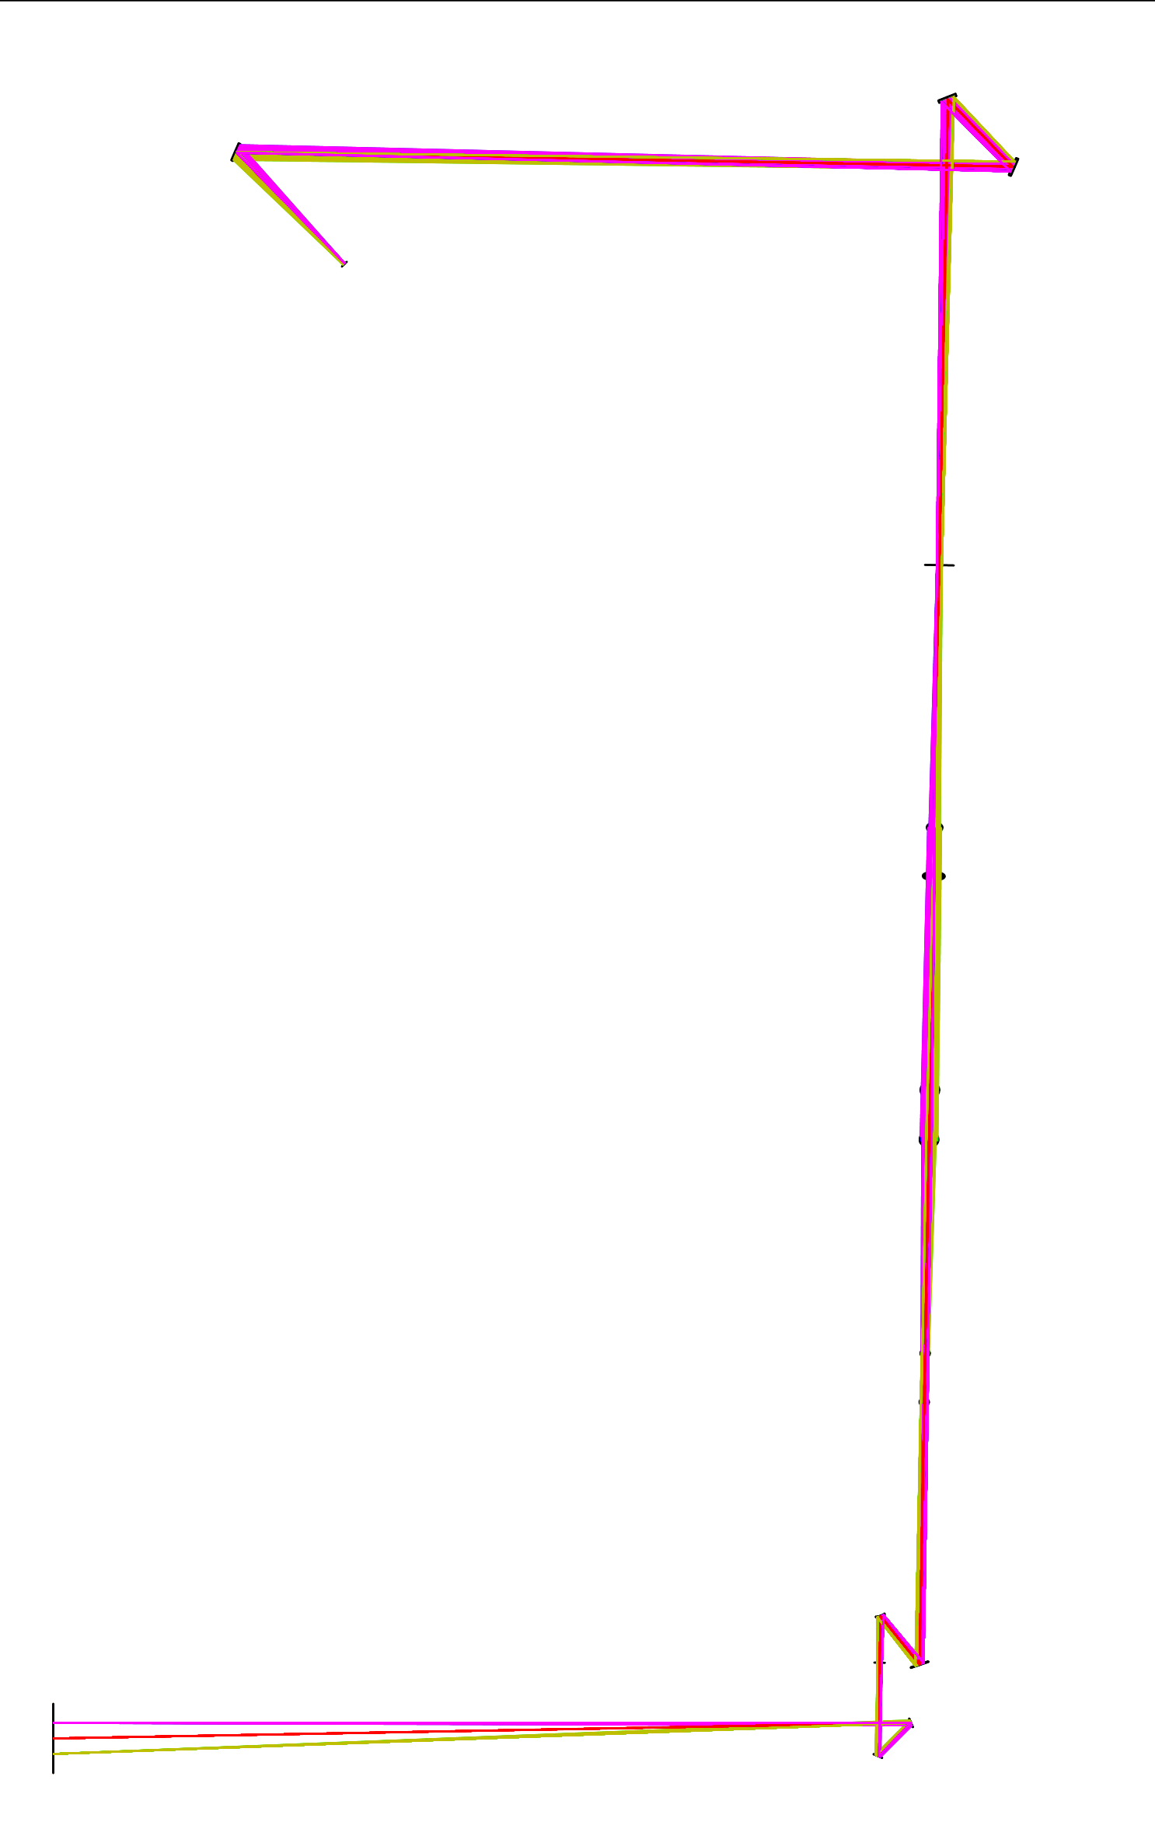
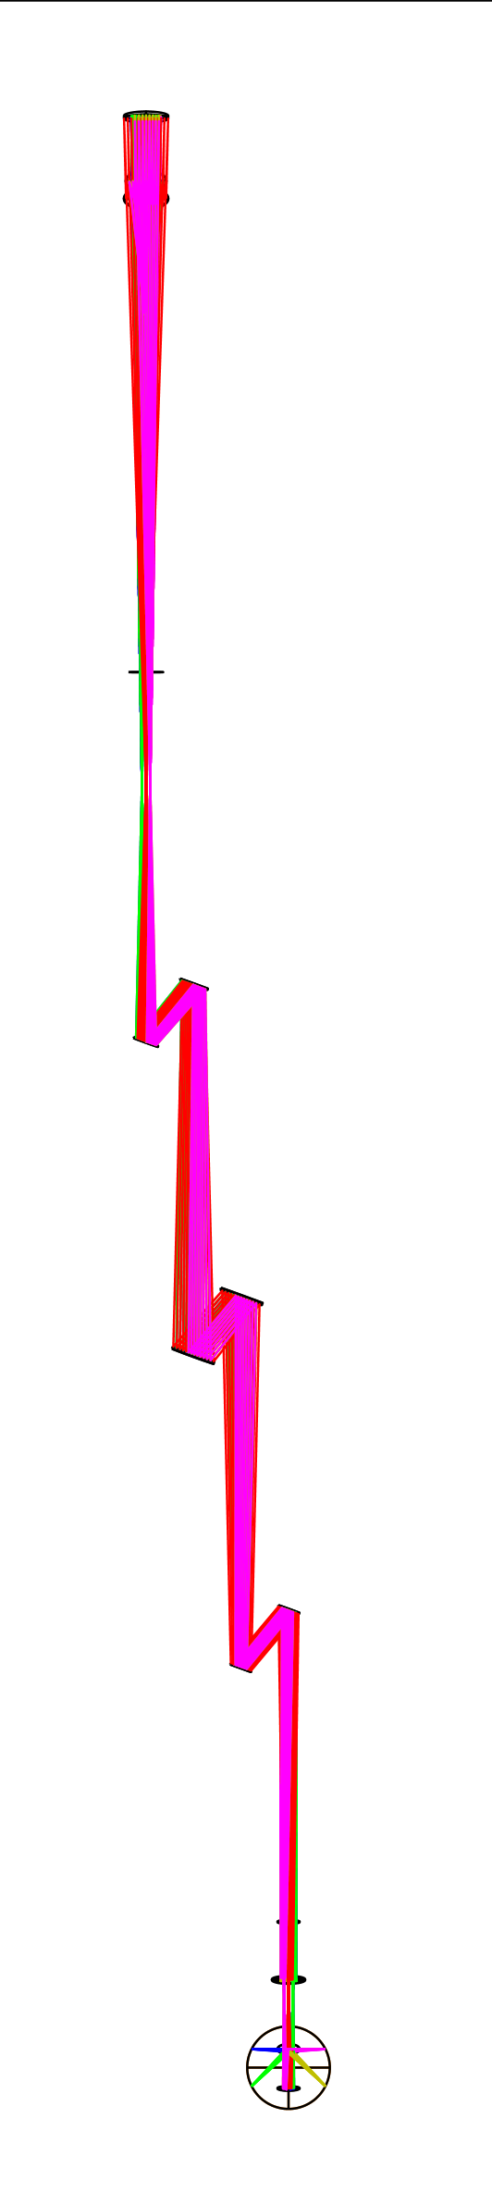
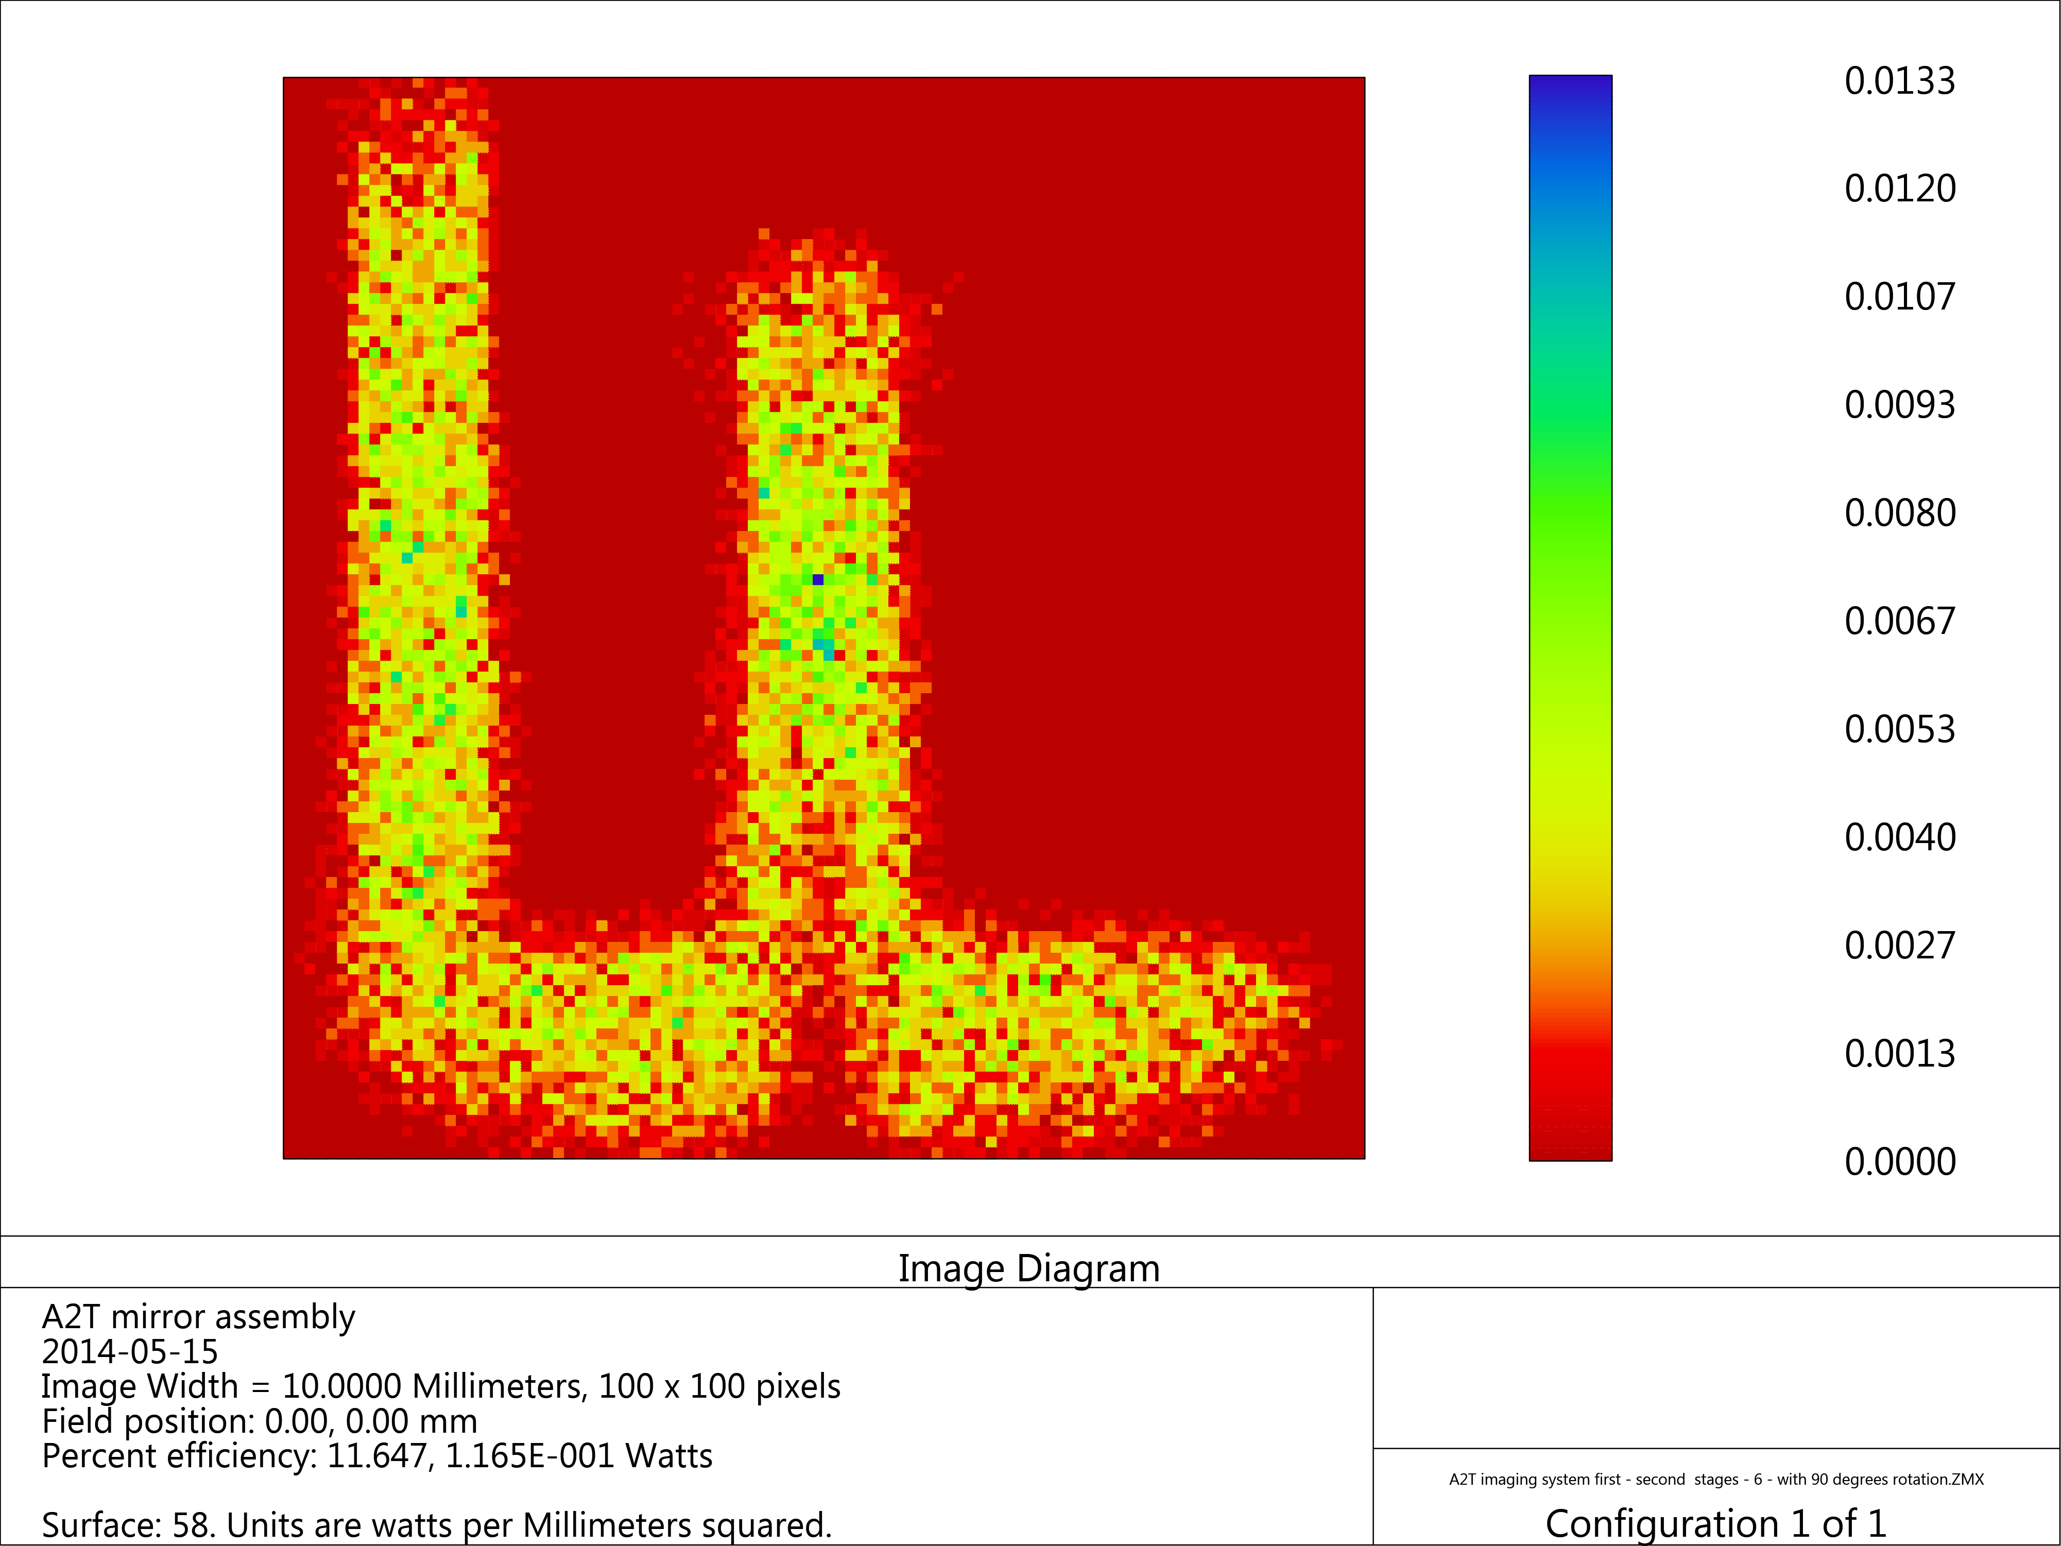
Example: Optical system
Power transmission: 11%
Resolution: ~ 1.5mm (beamlet size 15x5 mm²)
PBW size: 250x100mm²
First 4 mirrors exposed to radiation
Thermo-mechanical stress
Radiation hard materials
No motion controlled allowed
Removed by remote handling
Waste management
5m
Halo
SEM
BMP
Object: 250x250 mm²
beam
PWB
Instrumentation Plug
2.7m

Slide 24
Summary
Suite of Diagnostics defined and started to be designed for the proton beam quality control and machine protect.
  Mainly these diagnostics are well established and will benefit from the experience of many years development and operation on running machines around the world. However, most will have to have stretched performance to satisfy machine protect requirements but also the dynamic range imposed by commissioning and operation
Suite of diagnostics dedicated to the Target Monolith Area, in the design phase, not very different from conventional diagnostics but issues to be addressed, for signal acquisition and dynamic range, noise from radiation background, thermo-mechanical stress, lifetime and waste management

