Slide 1
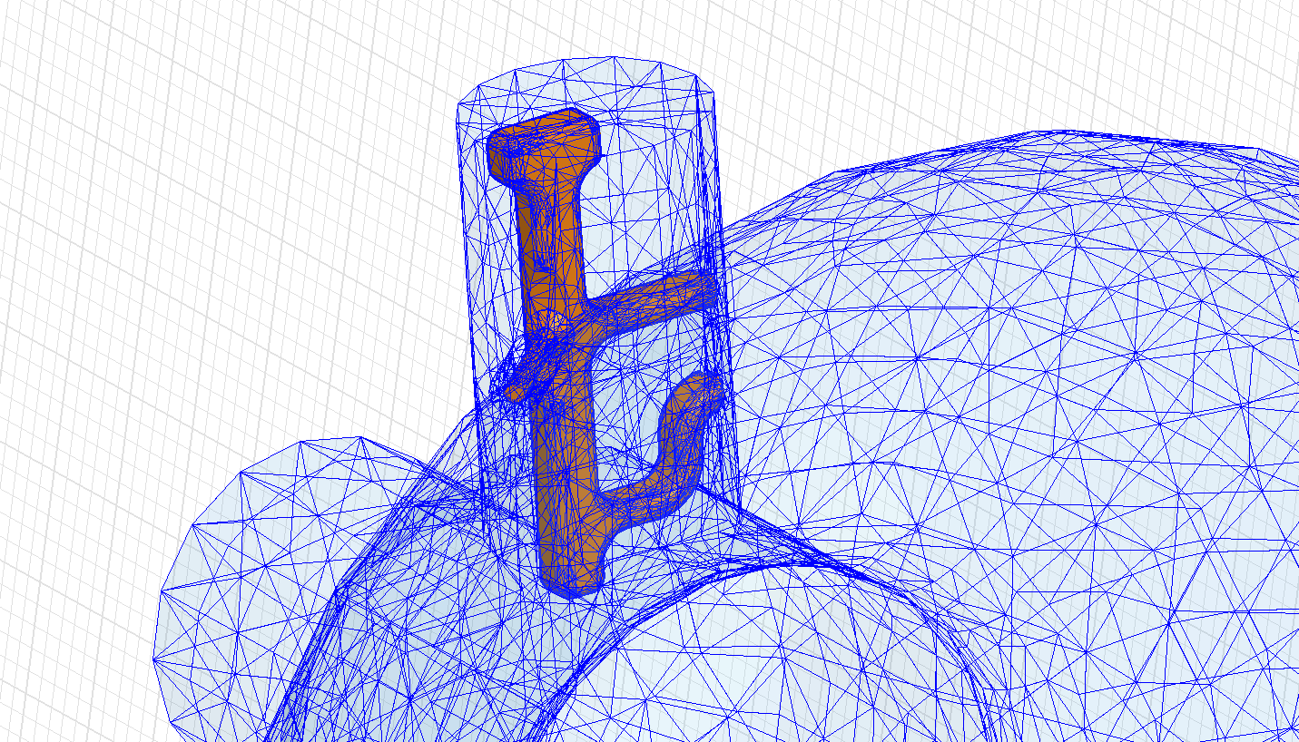
HOM Couplers for CERN SPL Cavities
Kai Papke
Work supported by the Wolfgang-Gentner-Programme of the Bundesministerium für Bildung und Forschung (BMBF)

Slide 2
Outline
Overview
RF Characteristics
Mechanical Design
Heat Loss Investigation
Outlook

Slide 3
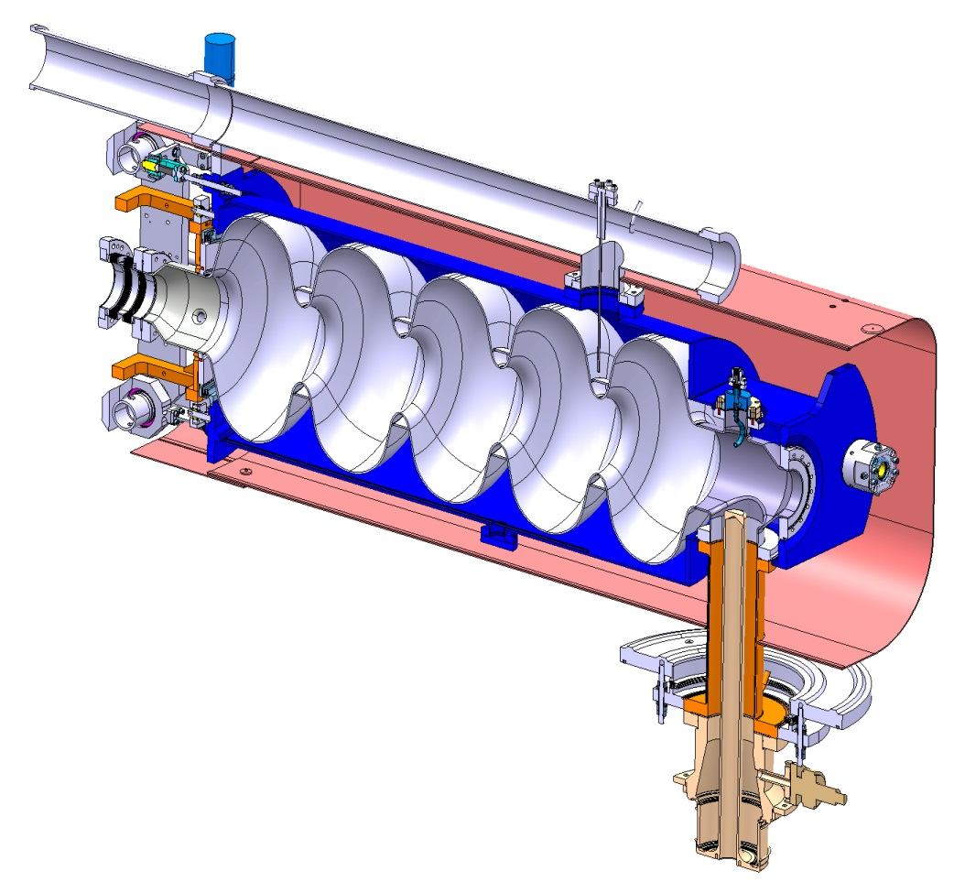
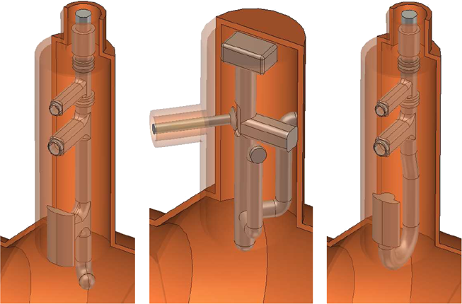
Overview
Design goal of HOM filter: block the transmission of the accelerating mode, while transmitting HOMs, which have significant (R/Q) values
Bulk Niobium 5 Cells SPL cavity
Approaches for HOM coupler
probe
coupler
modified TESLA
design
hook
coupler
O. Capatina, SPL Seminar 2012

Slide 4
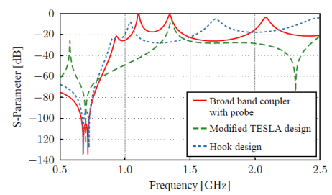
Overview
Number of factors such as RF transmission behaviour, power dissipation, multipacting sensitivity, field emission, heat loss, mechanical restrictions
RF characteristics
Heat loss
Design approaches for HOM coupler
Mechanical issues
Multipacting
probe
coupler
modified TESLA
design
hook
coupler

Slide 5
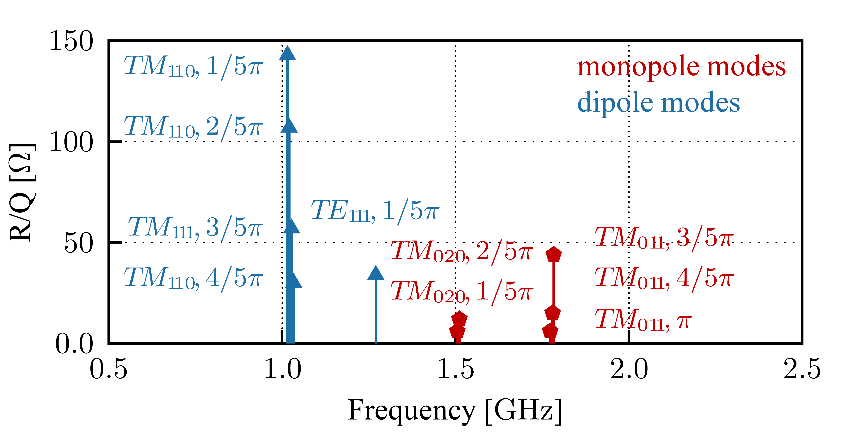
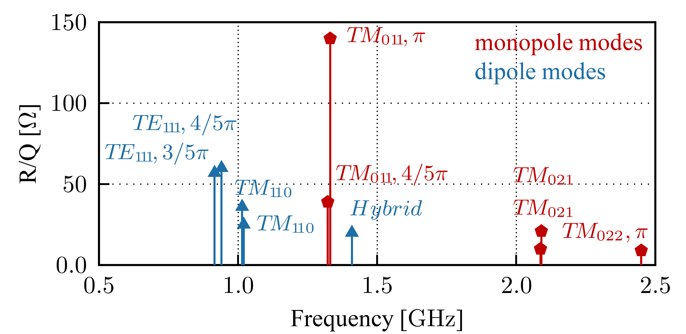
RF Characteristics - Requirements
3 MeV
50 MeV
102 MeV
160 MeV
750 MeV
4/5 GeV
H⁻ source
RFQ
chopper
DTL
CCDTL
PIMS
β=0.65
β=1.0
Schematic layout of the linac
(Conceptual design of the SPL II)
352.2 MHz
704.4 MHz
For SPL dipole HOMs are considered less problematic
In case of recirculators or synchrotrons should be also considered
HOM spectra for the medium and high beta Cavities:
Medium beta cavity (beta = 0.65)
High beta cavity (beta = 1)
M.Schuh, F. Gerigk. “Influence of higher order modes on the beam stability in the high power superconducting proton linac“, Phys. Rev. ST Accel. Beams, 2011

Slide 6
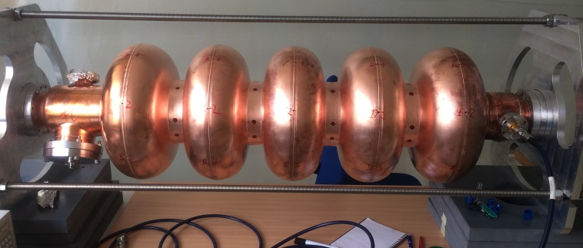
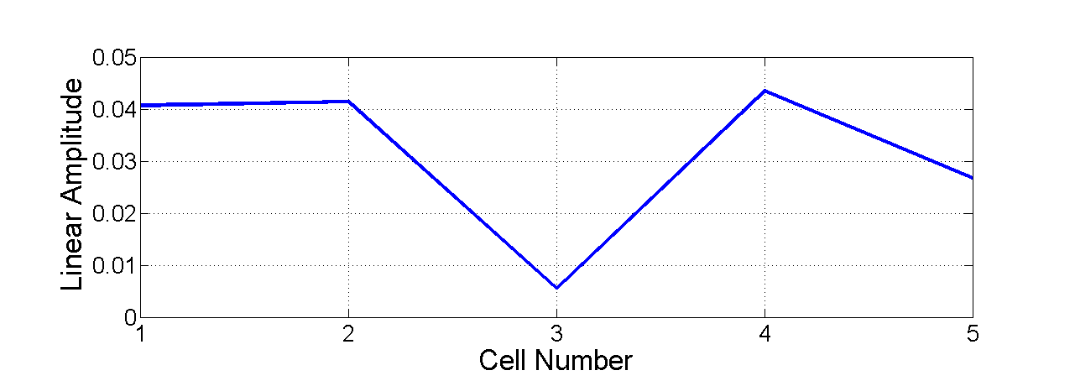
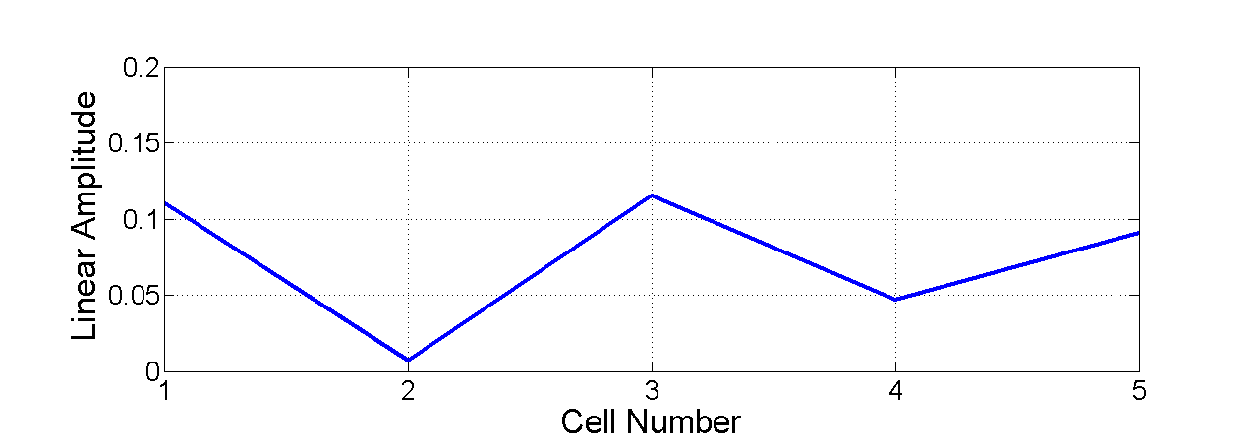
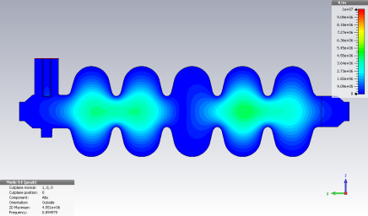
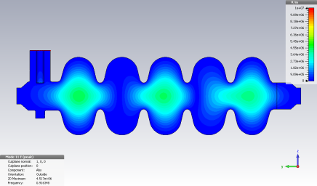
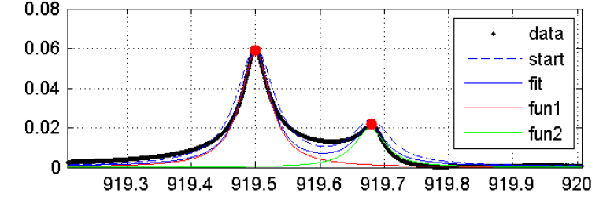
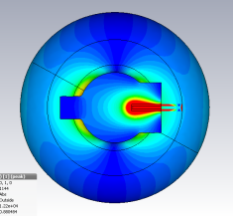
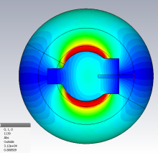
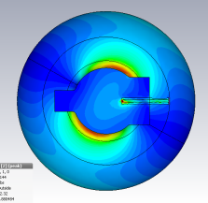
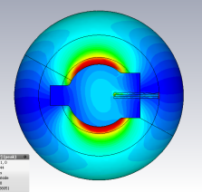
RF Measurements - Field Distribution
Field distribution and polarization measured via probe antenna around the equators of each cell for a copper SPL Cavity
Positions for the probe antenna
TE₁₁ 2/5 π– Mode (989 MHz)
TE₁₁ 3/5 π– Mode (920 MHz)
Input Coupler
Pick-Up
Fitting of the data to extract Q values,
field distribution and polarization
Polarization of TE₁₁ 3/5 π– Mode (920MHz)
Excitation by Input Coupler*
Excitation by Pick-Up*
|S21| (linear)
Frequency [MHz]
*Each coloured ring represents the field distribution around the equator of a cell. Depending on the excitation of the mode and its polarization the error of the angle measurements ranges from ±2 deg to ±20 deg (see second polarization excited by the input coupler)

Slide 7
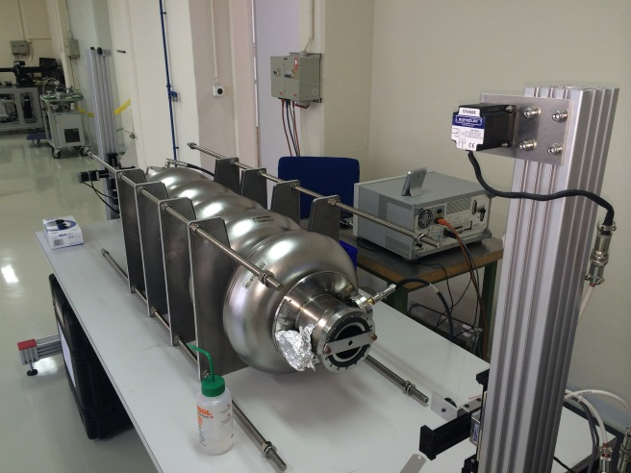
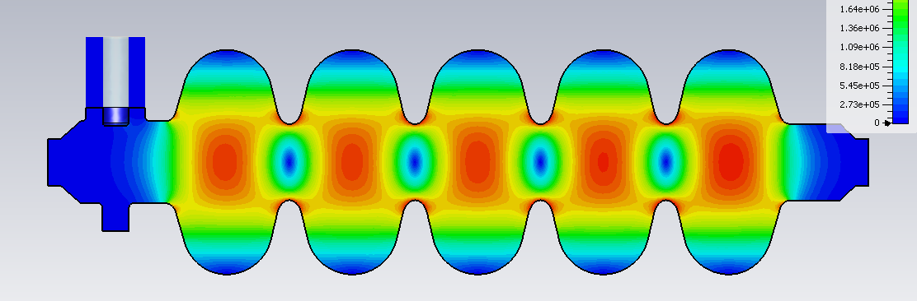
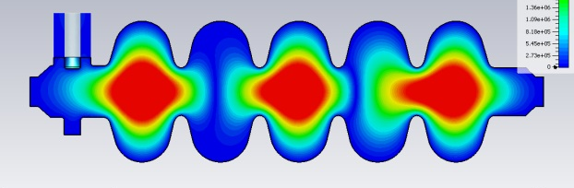
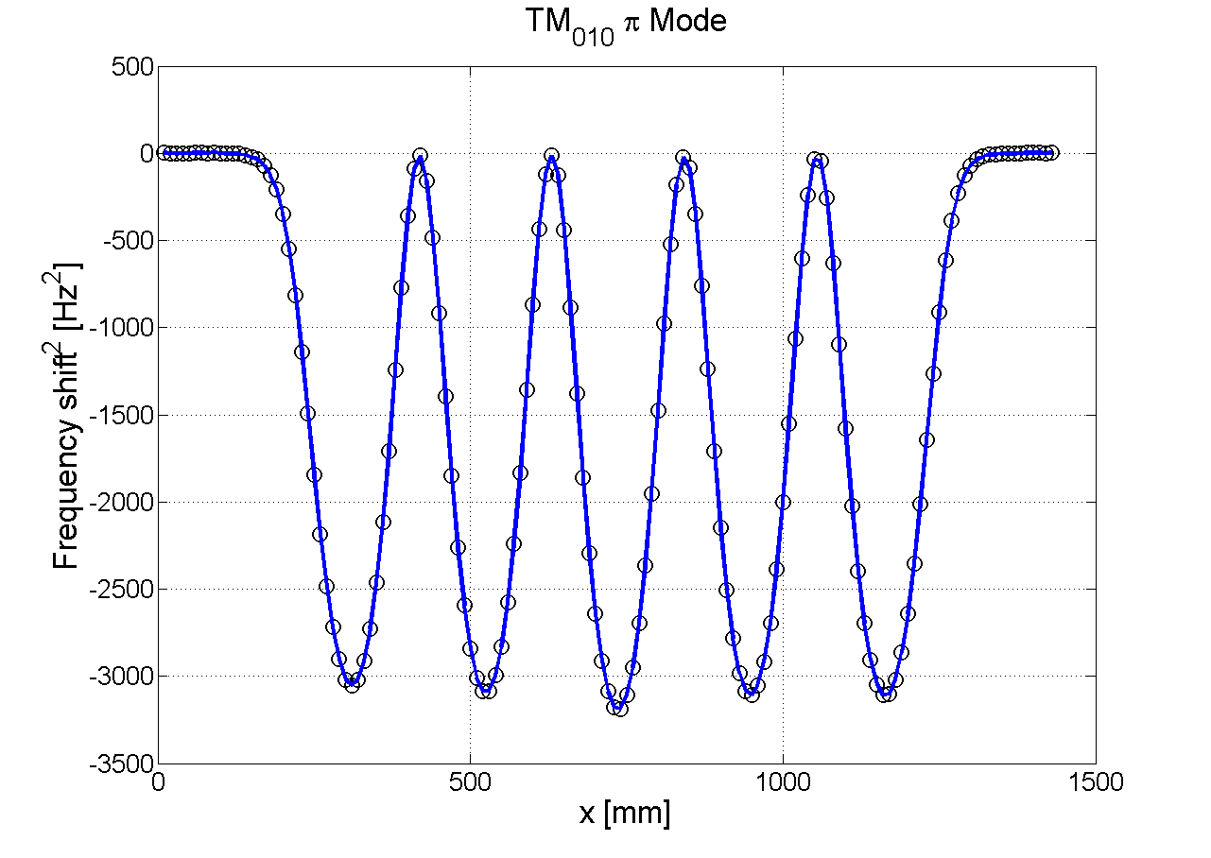
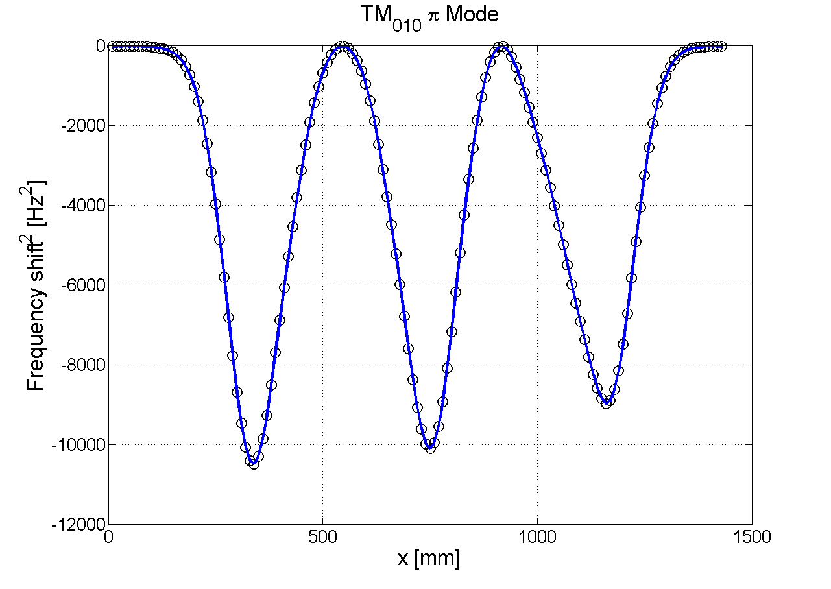
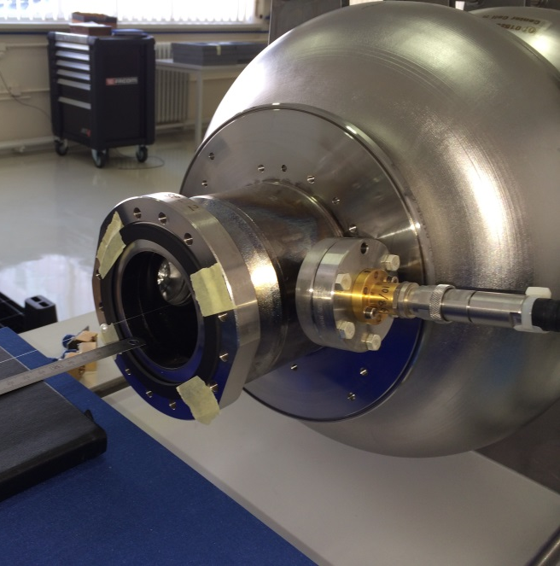
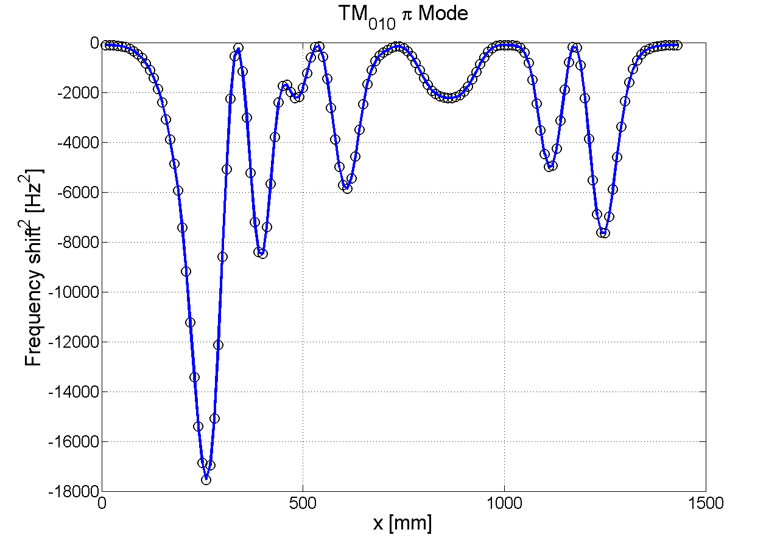
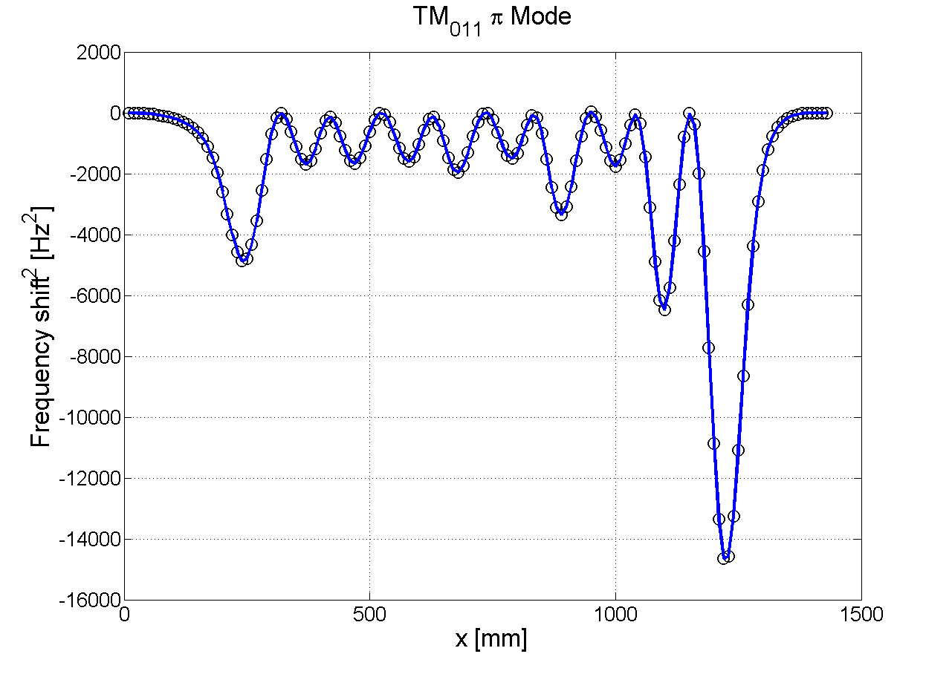
RF Measurements - Field Distribution
Bead-pull measurements in comparison with simulations to identify modes and their field distribution at the center axis
Magnitude of E-field vs. Frequency shift due to bead
TM₀₁₀ π – Mode (704 MHz)
TE₁₁₁ 3/5 π– Mode (920 MHz)
TM₁₁₀ 4/5π – Mode (1330 MHz)
TM₁₁₀ π – Mode (1333 MHz)

Slide 8
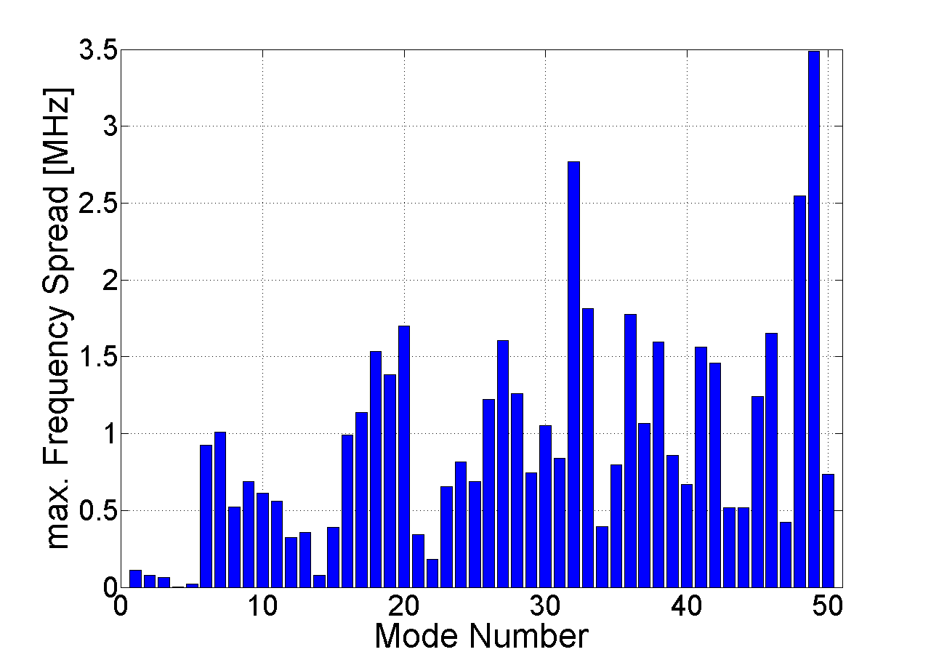
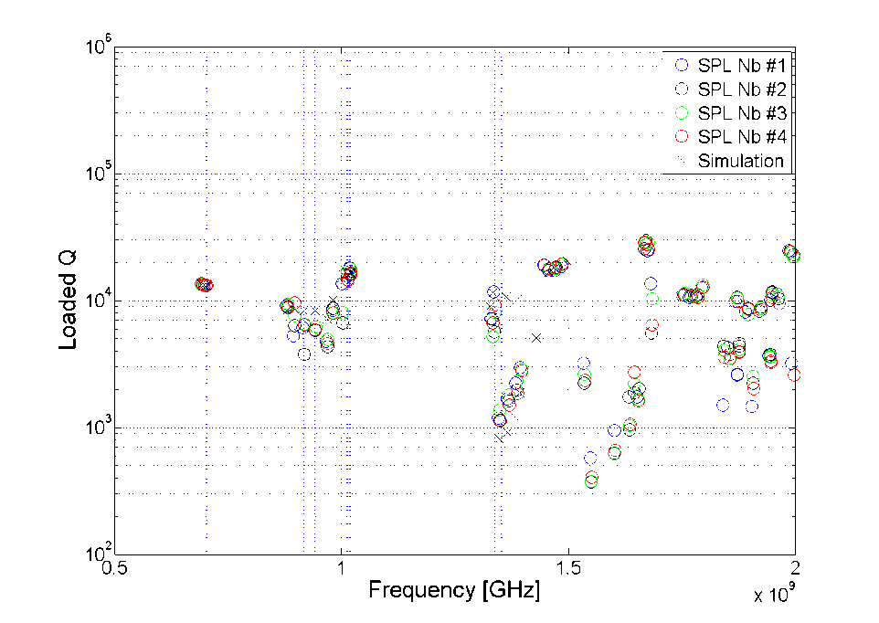
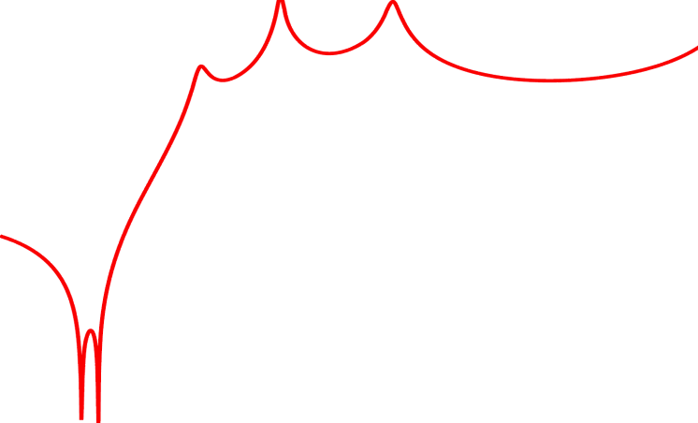
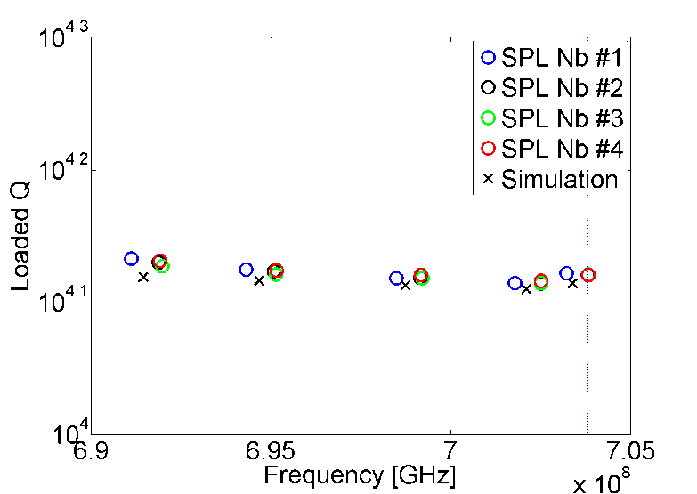
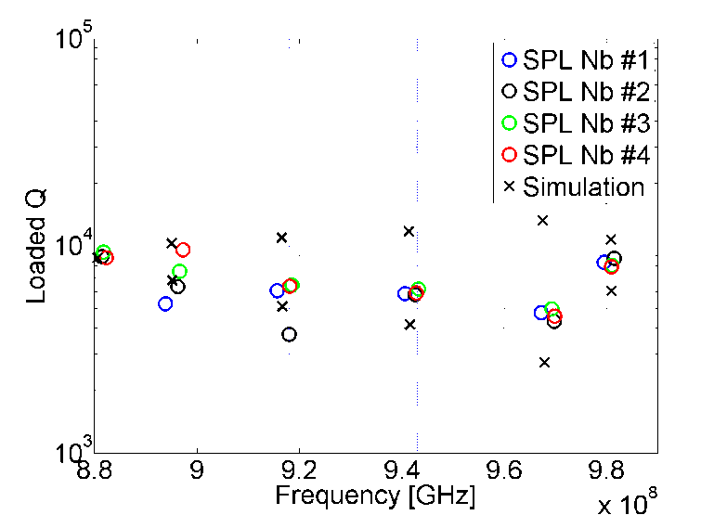
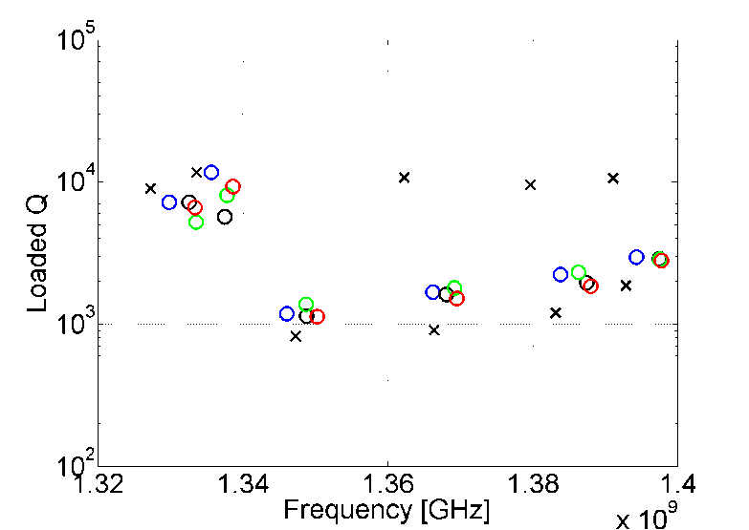
RF Measurements – Cavity Statistics
Frequency and Q measurements for the first 4 niobium cavities (warm tests)
HOM Coupler Transmission
TM₀₁₁ 1330MHz
TM₀₁₀ π 704 MHz
TE₁₁₁ 920 MHz
[Hz]
[Hz]

Slide 9
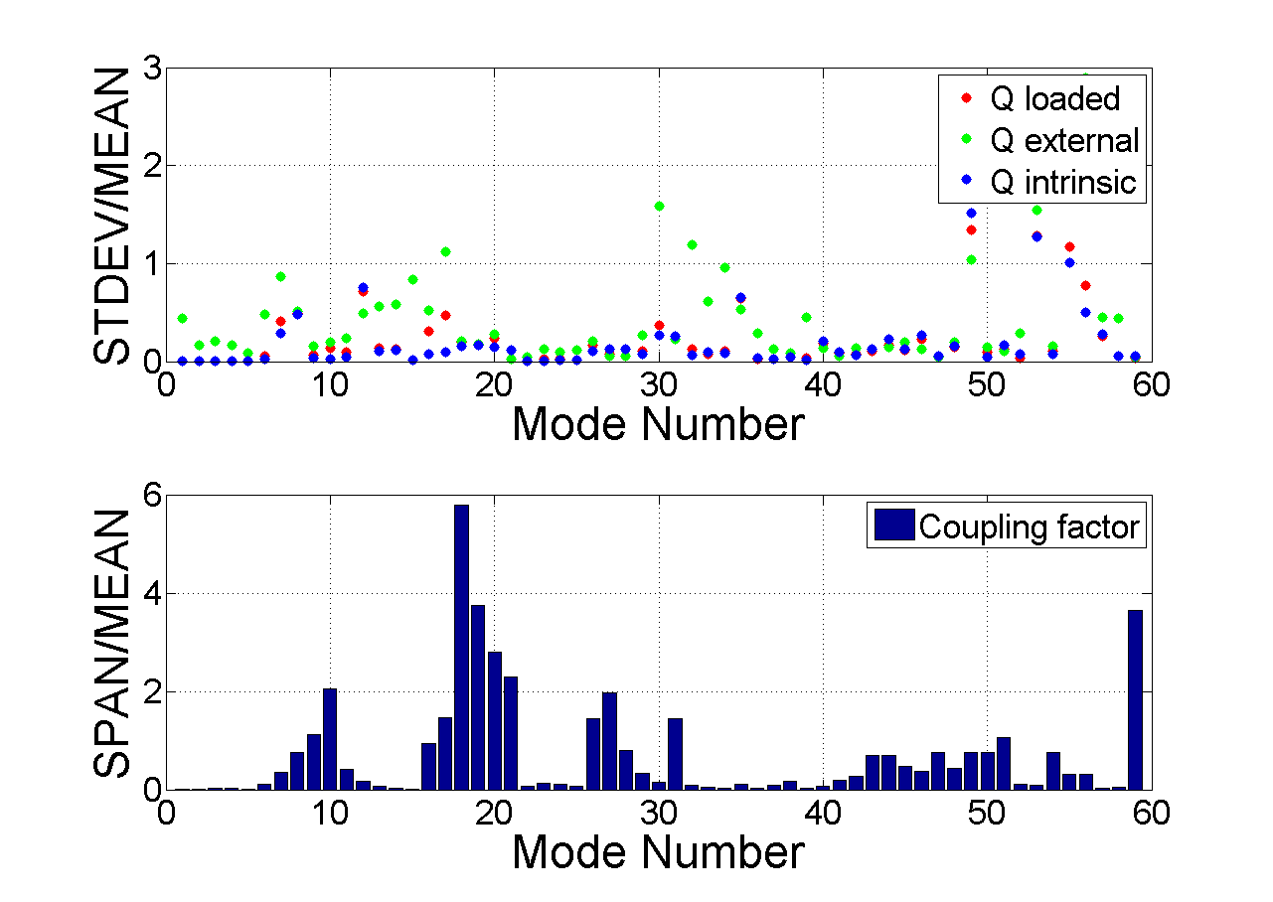
RF Measurements - Summary
Direct method by using probe antennas around the cavity surface results in a very coarse resolution however polarization could be proofed as well as the field distributions up to the 1st dipole band
Bead-Pull measurements provide information about the field distribution along the center axis in more detail (also applicable for the Nb cavities)
Bead-Pull measurements extendable by using different beads and also off axis
Measured frequencies for the interesting modes differ < 1MHz for the 4 niobium cavities
Measured Q values for the interesting modes differ < 100%
Q and coupling factor measurements have been carried out by reflection and reaction type methods*
*D. KAJFEZ: REFLECTION-TYPE Q FACTOR MEASUREMENT OF TRANSMISSION-TYPE CAVITIES

Slide 10
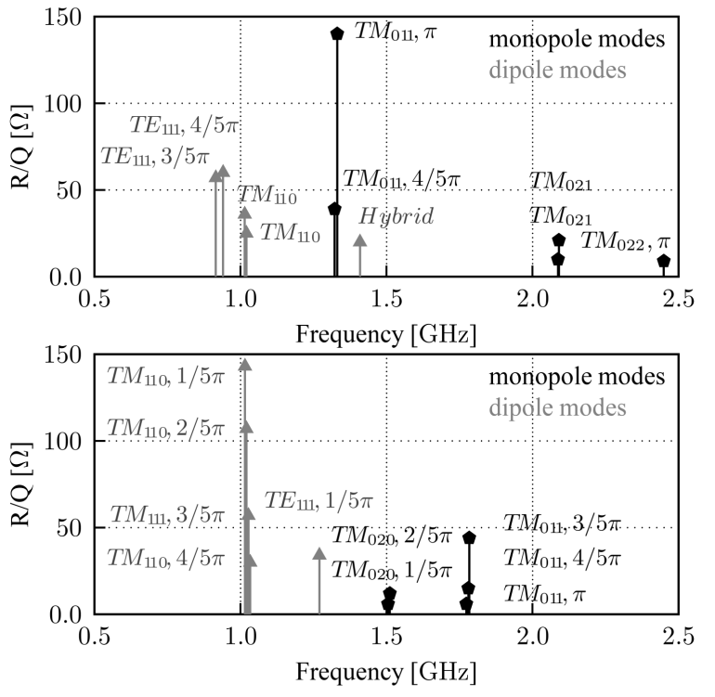
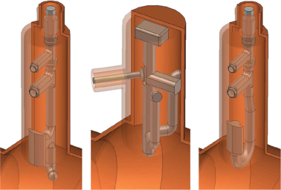
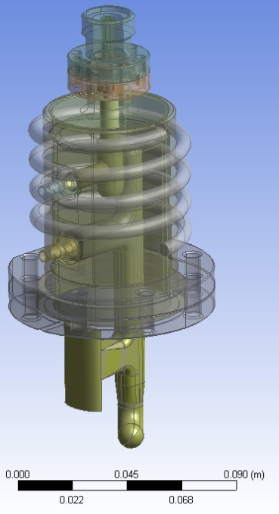
Mechanical Design
For the 1st Prototype the Probe Coupler with 3 stages have been selected (red transmission curve)
High beta cavity (beta = 1)
Mechanical Design
by T. Renaglia
Probe
TESLA
Hook
TM₀₁ – TEM
10

Slide 11
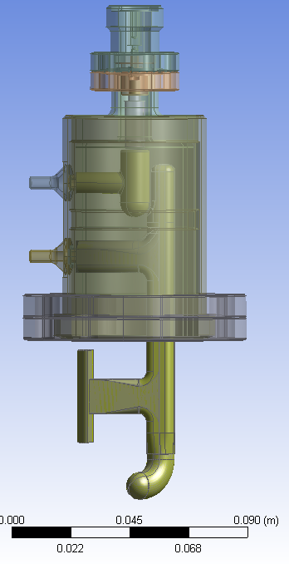
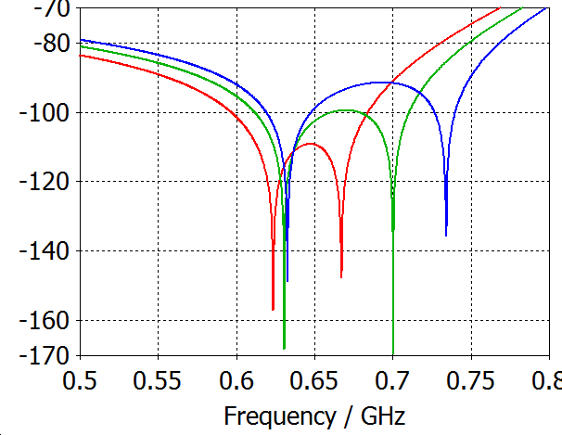
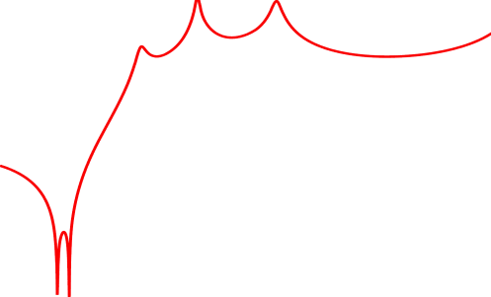
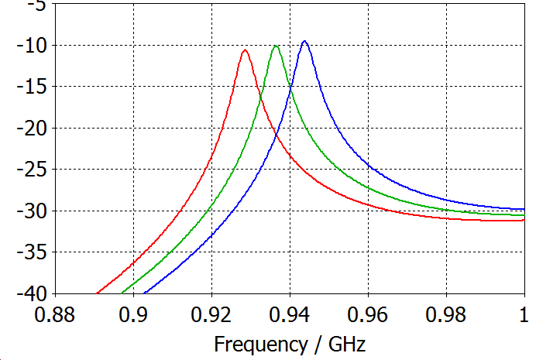
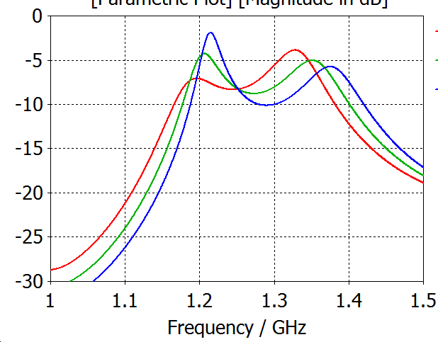
Mechanical Design
Tolerances ≥ ±0.1 mm including the sensitive tuning parts
The tuning will be done in 3 steps according to the 3 capacitances (red)
3.
1.
2.
2.
1.
Sensitivity:
1: 35 MHz/0.1 mm
2: 5 MHz/0.1 mm
3: 25 MHz/0.1 mm
3.
+ 0.1 mm
0 mm
-0.1 mm
11

Slide 12
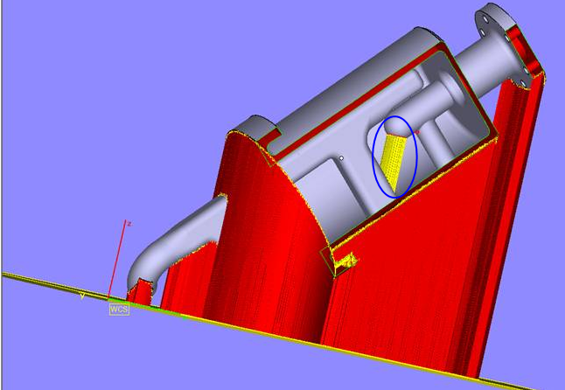
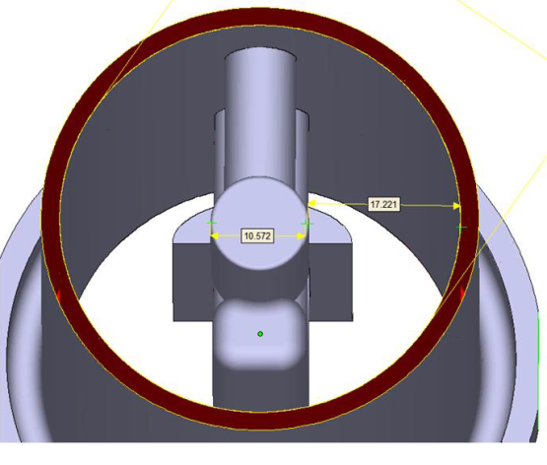
Mechanical Design
The first prototype is a 3D print made of plastic and then copper coated in a galvanic process
The surface roughness at the notch capacitance might be a problem for the tuning
A rapid prototype made of bulk copper is in the fabrication process more problematic (additional support are necessary)
Coupler will be tested on the available copper and niobium cavities after its assemble
Additional support for the metal 3D print (yellow, red)
Open top required to remove supports afterwards
Plastic prototype coated with copper
12

Slide 13
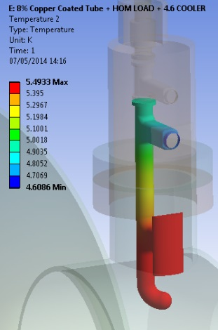
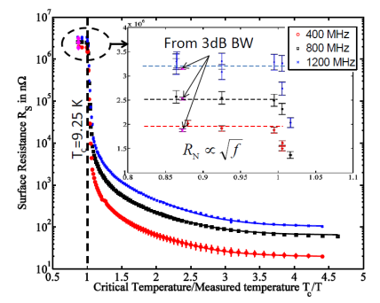
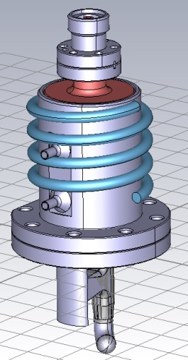
Heat Loss Investigation
Coupled Simulation performed by HFSS (EM Field calculation) and ANSYS (steady state thermal analysis)
$$Ploss=\frac{1}{2}RS∯{HH^{∗}}ds$$
Surface loss density
Design | P_{loss} [mW] | T_{max} [K]
Probe | 40.5 | 5.49
TESLA | 51.3 | 3.97
Hook | 40.1 | 5.69
Tube (Cu) | 27.5 | 16.5
exponential dependent on T
T. Junginger, CERN-ATS-2011-037, 2011
Values for 8% duty cycle
worst case study/ Iterative scheme
Cooling requirements are moderate (a heat flow of 60mW at the outer tube surface is sufficient to keep the coupler superconductive)
A cooling loop as shown on the right side could be an option

Slide 14
Review of the Designs
Hook Design
Best dipole coupling (especially for the 1st dipole band)
Due to moderate cooling requirements no active cooling is necessary
Robust notch filter (with additional inductive stub)
Monopole coupling TM₀₁ - TEM
TESLA Design
Very appropriate for cooling (but not necessary)
Notch filter easy to adjust
Higher damping in the pass band
Dipole coupling TE₁₁ - TEM
Probe Design
Best transmission behavior for monopole HOMs
Due to moderate cooling requirements no active cooling is necessary
Robust notch filter (with additional inductive stub)

Slide 15
Outlook
1st prototype coupler will be tested on the available copper and niobium cavities after its assemble
Tuning procedure will be investigated
Frequency and Q factor sensitivity of selected HOMs will be investigated for a copper SPL high beta cavity using a tuning machine
Investigation of Multipacting barriers
Mechanical design and fabrication of a real coupler (maybe also a second rapid prototype made of bulk copper)
Thank you for your attention
15

