Slide 1

ESS
Accelerator and target
Mats Lindroos on behalf of the ESS
CERN SLHiPP / May 2014

Slide 2




A European research center

Slide 3

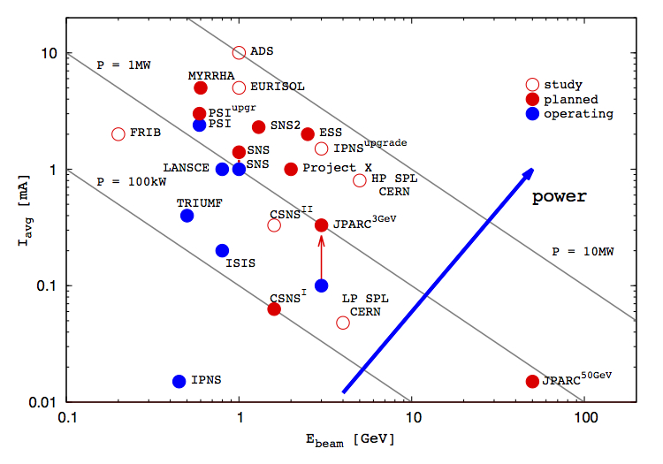
ESS - Bridging the neutron gap
10²⁰
J-PARC
ESS
SNS
MTR
NRU
HFIR
ILL
ISIS
10¹⁵
NRX
HFBR
ZINP-P/
IPNS
WNR
KENS
FRM-II
X-10
SINQ
Effective thermal neutron flux n/cm²-s
10¹⁰
CP-2
ZINP-P
CP-1
10⁵
Berkeley 37-inch cyclotron
350 mCi Ra-Be source
Steady State Sources
Pulsed Sources
1
Chadwick
1930
1940
1950
1960
1970
1980
1990
2000
2010
2020
(Updated from Neutron Scattering, K. Skold and D. L. Price, eds., Academic Press, 1986)
Notes:
Many of the reactor based neutron sources are being phased out = decline in the availability of neutrons = decline in competence and competitiveness
The vast majority of users will profit from a pulsed structure
A large fraction of users are fully satisfied by a long pulse source
Existing short pulse sources (ISIS, JPARC and SNS) can supply the present and imminent future need of short pulse users
Long pulse for physics flexibility (cold and thermal neutrons available)
++. Keep competency in communities – countries balance in science knowledge

Slide 4












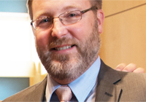






17 nations committed to build ESS
Cash contributions
from Sweden, Denmark and Norway
50% of construction and
15-20% of operations costs
In-kind contributions
from the other
14 nations
Construction cost: 1843 M€
Operation cost: 140 M€
Decommissioning cost: 177 M€
ESS AB 2014, ca 250 personer, 32 nationaliteter

Slide 5
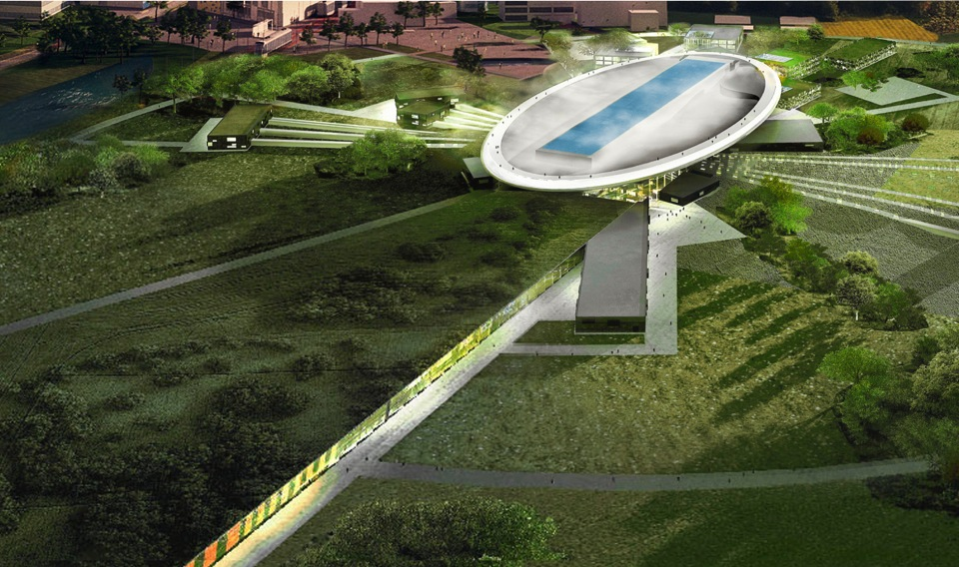
Road to realizing the world’s leading facility for research using neutrons
2025
ESS construction complete
2014
Construction work starts on the site
2023
ESS starts
user program
2009
Decision: ESS will be built in Lund
2019
First neutrons on instruments
2012
ESS Design Update phase complete
2003
First European design effort of ESS completed

Slide 6
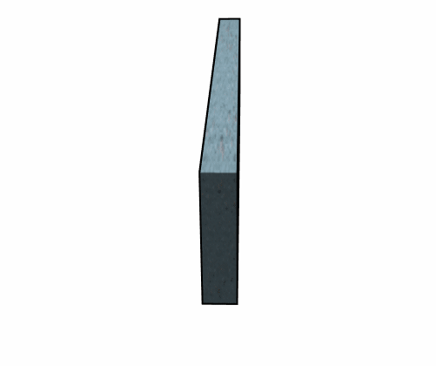
Spallation
“Spallation is a process in which fragments of material (spall) are ejected from a body due to impact or stress”
Source Wikipedia

Slide 7
Helicopter view of ESS
Protons
Moderator
Target
NEUTRONS

Slide 8
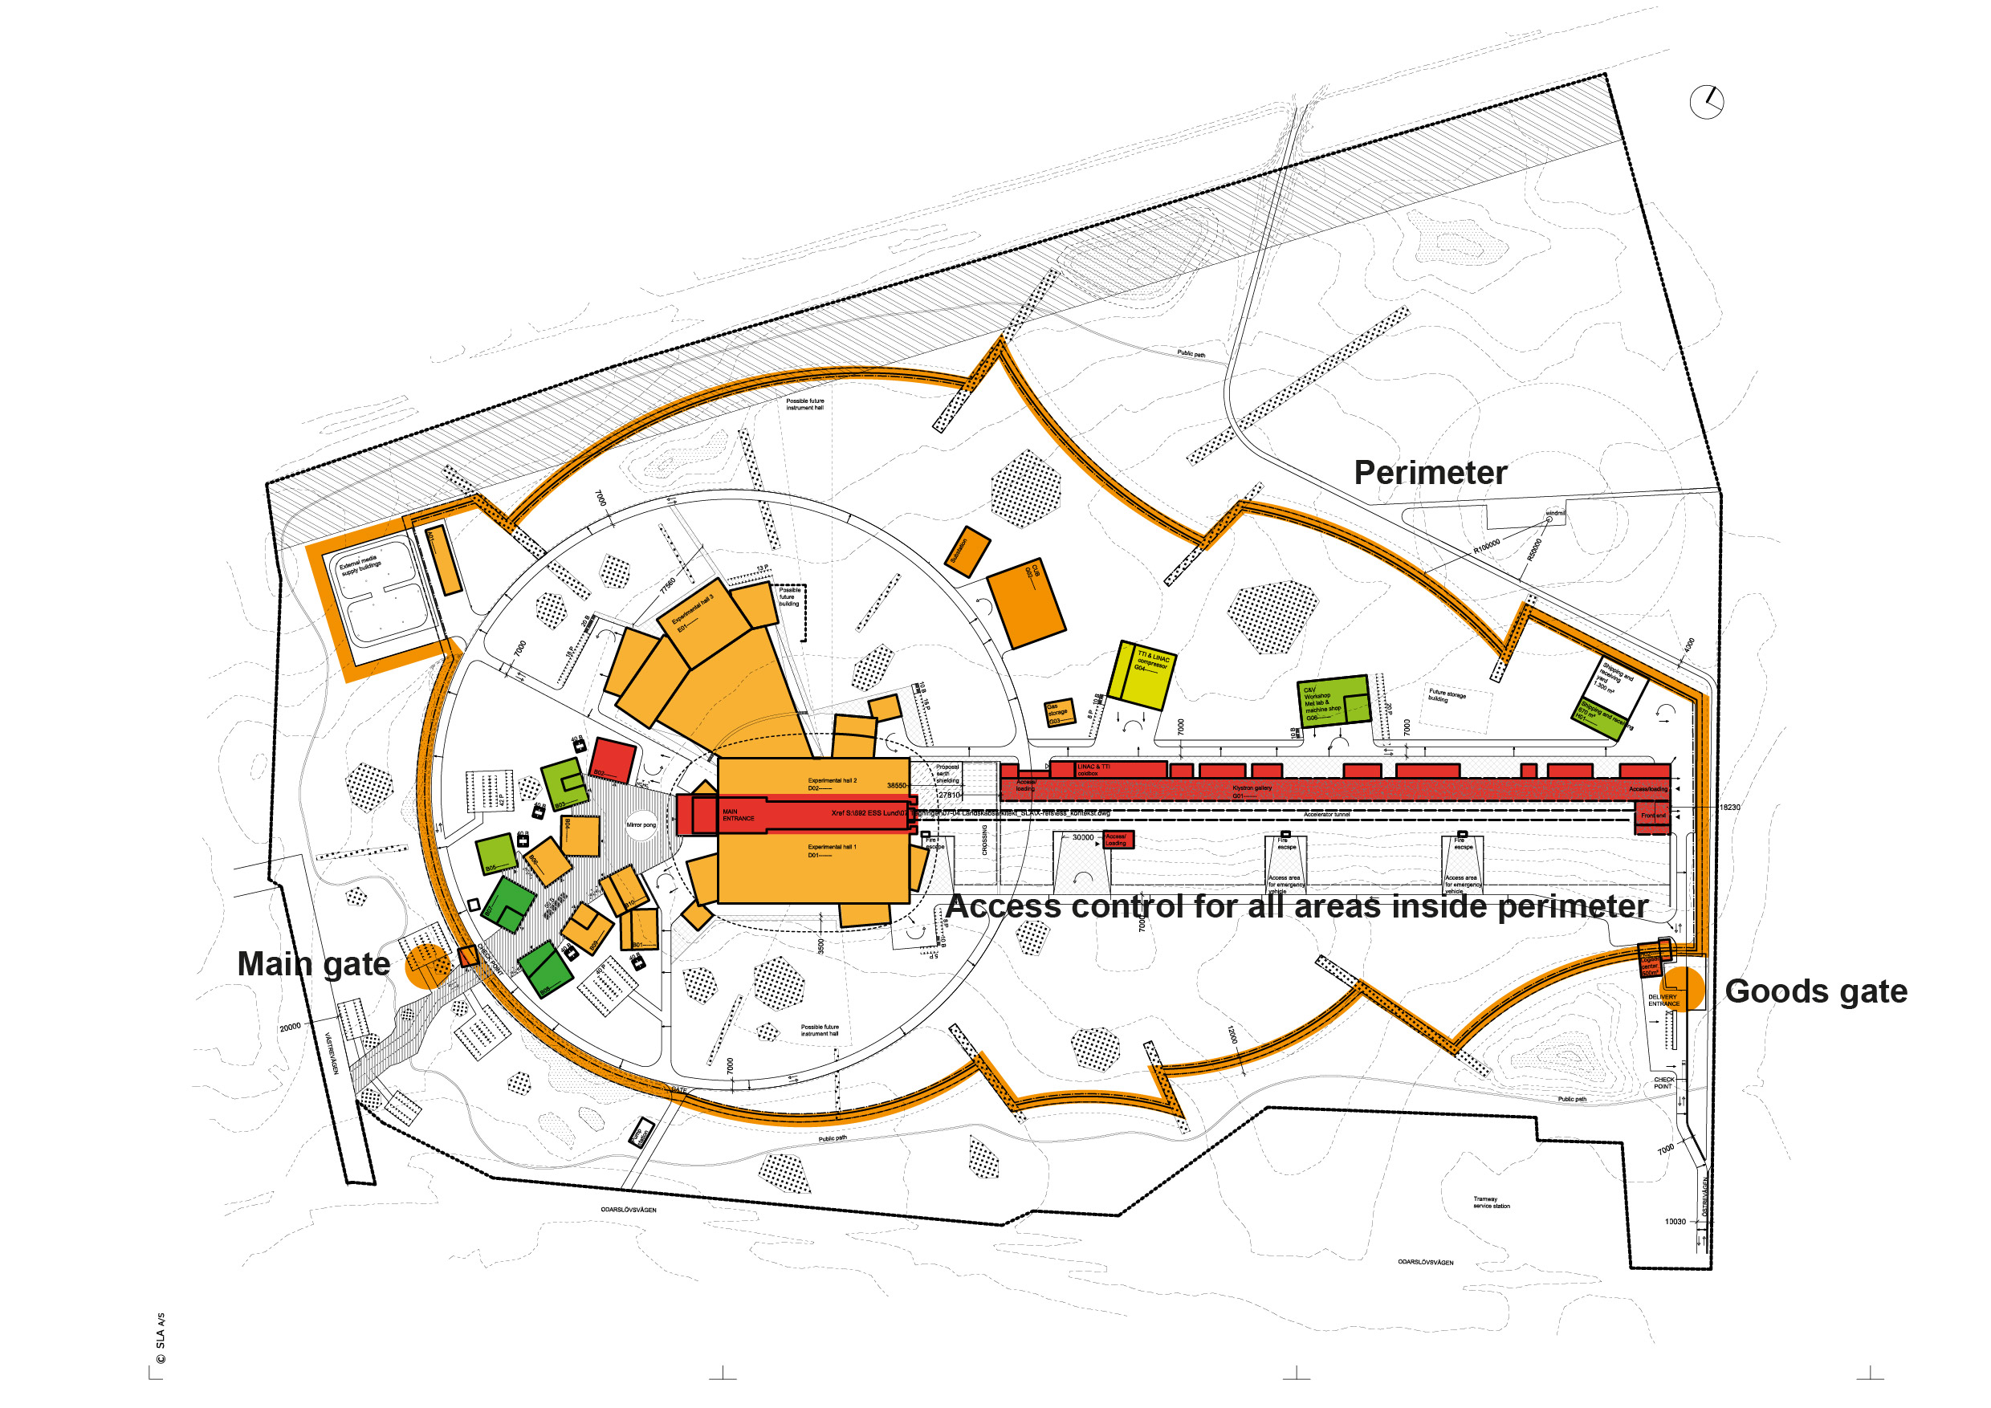
Site Plan

Slide 9
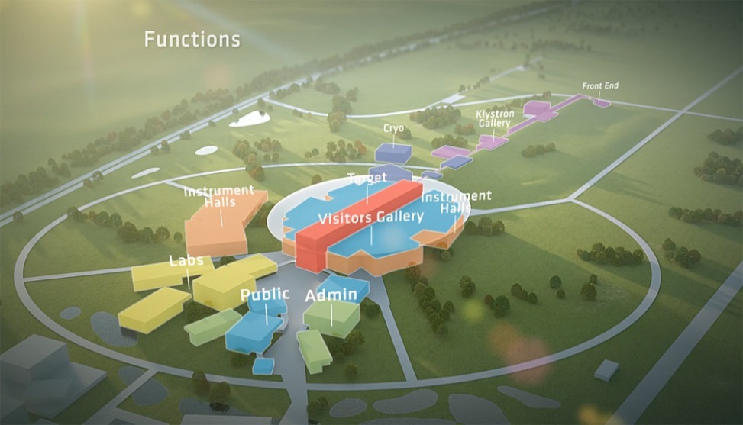
ESS accelerator
Design Drivers:
High Average Beam Power
5 MW
High Peak Beam Power
125 MW
High Availability
> 95%
Key parameters:
    -2.86 ms pulses
    -2 GeV
    -62.5 mA
    -14 Hz
    -Protons (H+)
    -Low losses
    -Minimize energy use
    -Flexible design for
    future upgrades

Slide 10
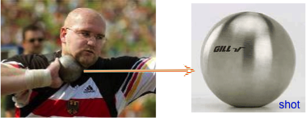
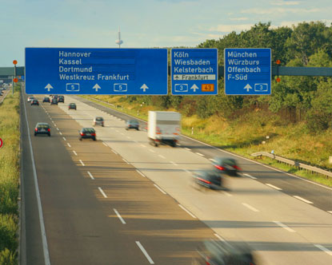
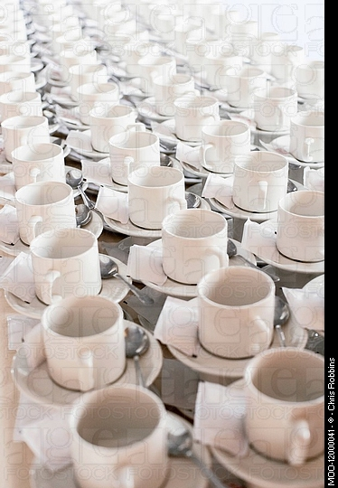
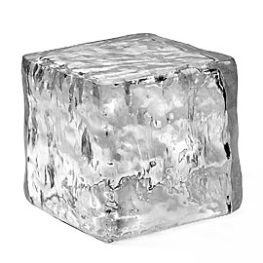
What is 5 MegaWatts?
At 5 MegaWatts,
  one beam pulse
    has the same energy as a 16 lb (7.2kg) shot traveling at
      1100 km/hour
      Mach 0.93
    Has the same energy as a 1000 kg car traveling at 96 km/hour
    Happens 14 x per second
  You boil 1000 kg of ice in 83 seconds
    A ton of tea!!!

Slide 11

THE ESS LINAC
352.21 MHz
704.42 MHz
2.4 m
4.6 m
3.8 m
39 m
56 m
77 m
179 m
Target
Source
LEBT
RFQ
MEBT
DTL
Spokes
Medium β
High β
HEBT & Contingency
75 keV
3.6 MeV
90 MeV
216 MeV
571 MeV
2000 MeV
 | Length (m) | W_in (MeV) | F (MHz) | β Geometric | No. Sections | T (K)
LEBT | 2.38 | 0.075 | -- | -- | 1 | ~300
RFQ | 4.6 | 0.075 | 352.21 | -- | 1 | ~300
MEBT | 3.81 | 3.62 | 352.21 | -- | 1 | ~300
DTL | 38.9 | 3.62 | 352.21 | -- | 5 | ~300
LEDP + Spoke | 55.9 | 89.8 | 352.21 | 0.50 (Optimum) | 13 | ~2
Medium Beta | 76.7 | 216.3 | 704.42 | 0.67 | 9 | ~2
High Beta | 178.9 | 571.5 | 704.42 | 0.86 | 21 | ~2
Contingency | 119.3 | 2000 | 704.42 | (0.86) | 14 | ~300 / ~2
Upgrade | 59.6 | 2000 | 704.42 | (0.86) | 7 | ~300 / ~2
M. Eshraqi
April 2-3

Slide 12
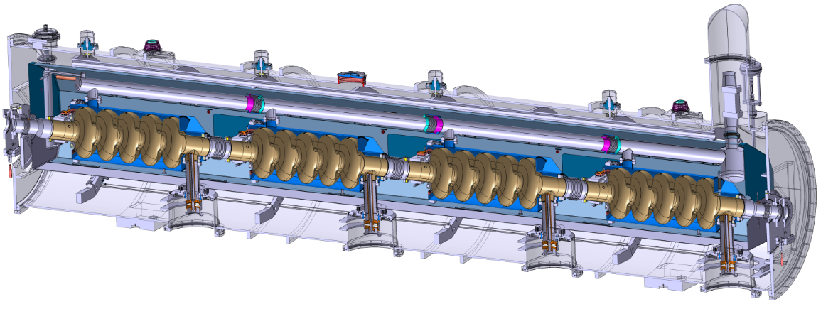



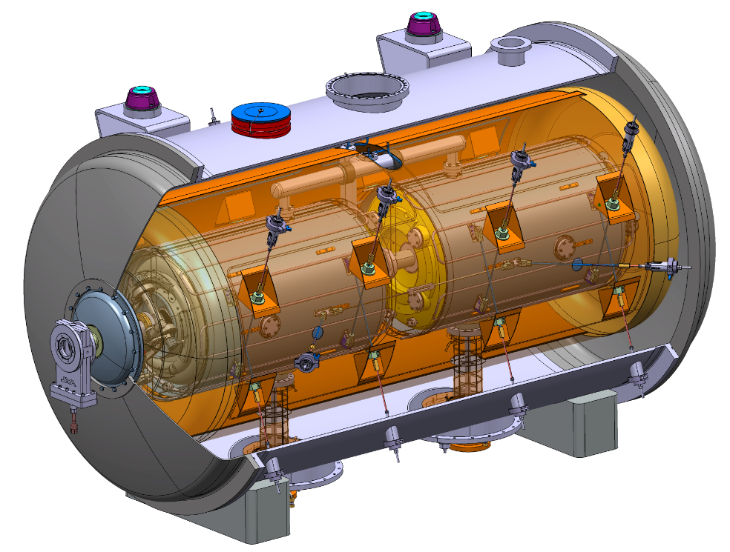
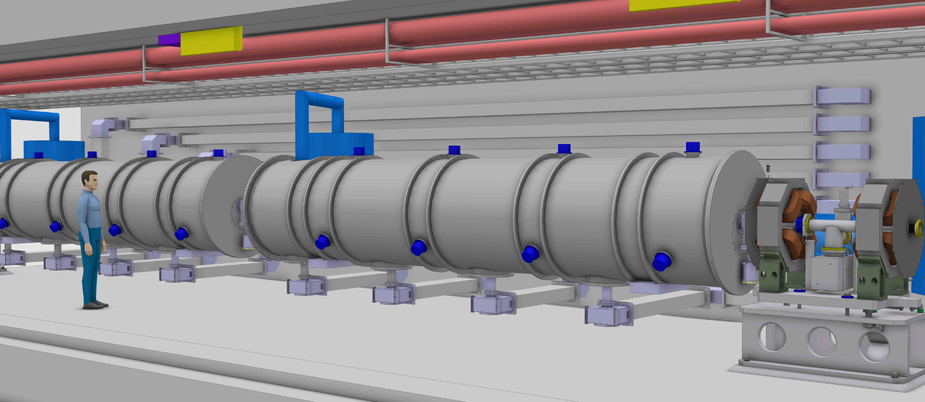

The Cavity Cryomodule Technology Demonstrators
Helium tank
Cold tuning System
5-cell elliptical cavity
Power coupler
Space frame
→ Cavities Cryomodule Technology Demonstrator results by 2016
Notes:
Accelerateur principe avec proton
Technologie de pointe supraconductice
Spoke – insatalle

Slide 13
Very high level Schedule

Slide 14
Installation Schedule

Slide 15
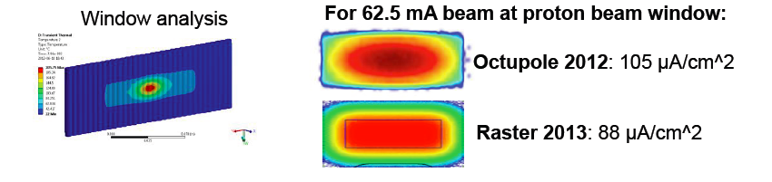
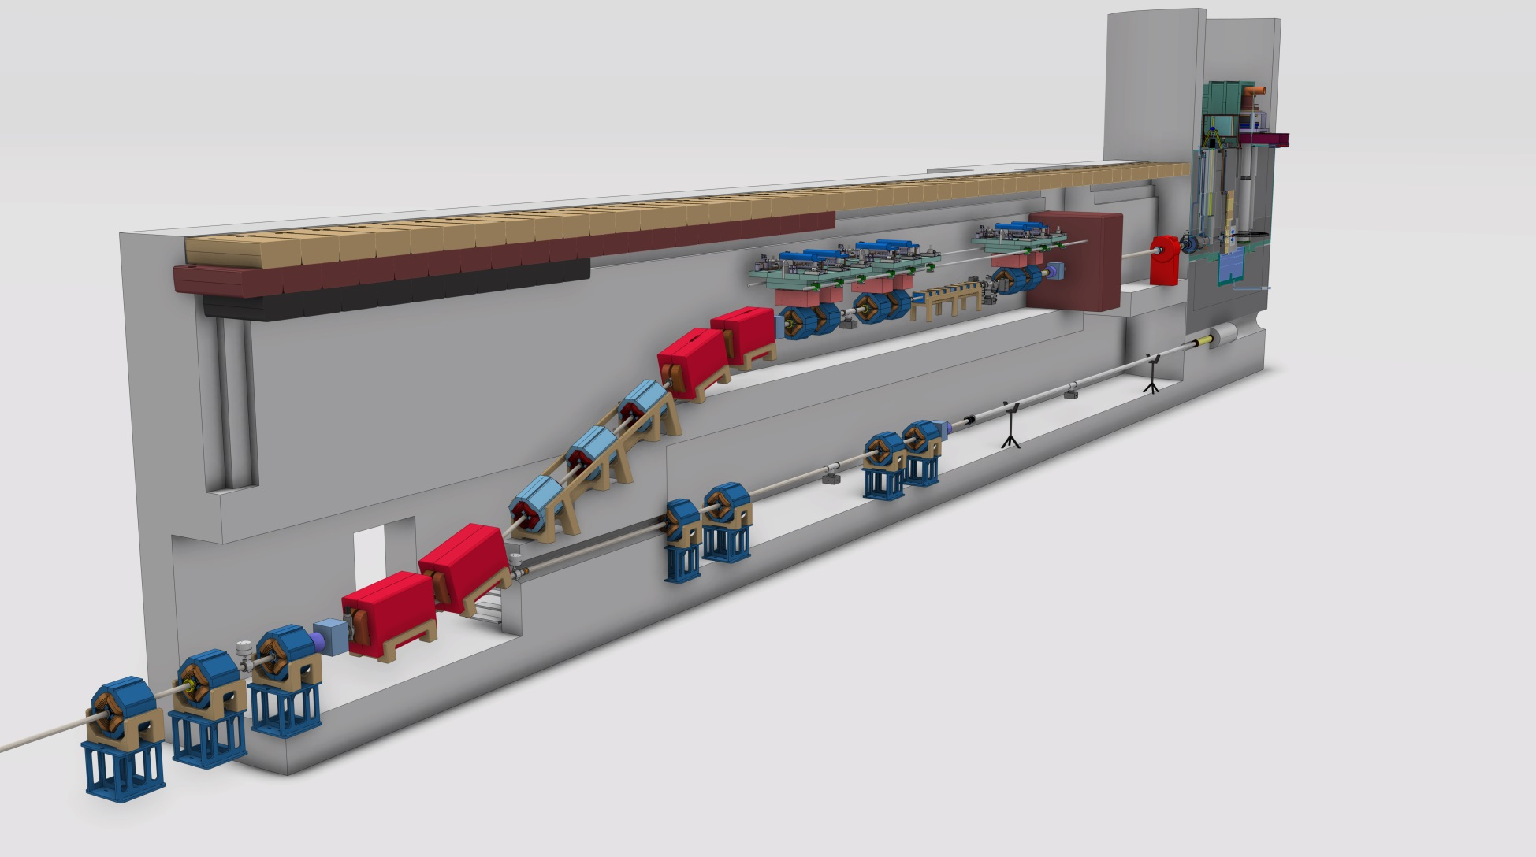
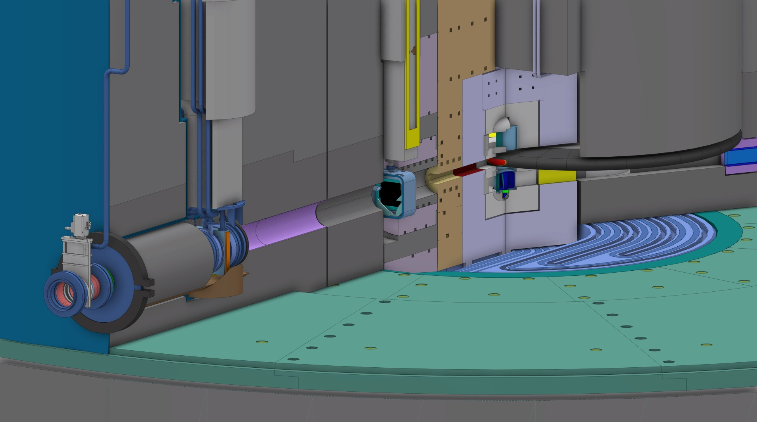
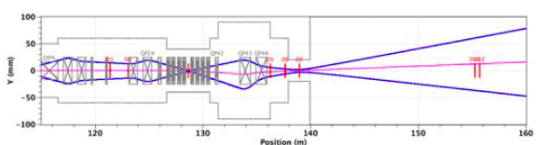
Rastering of beam on target

Slide 16
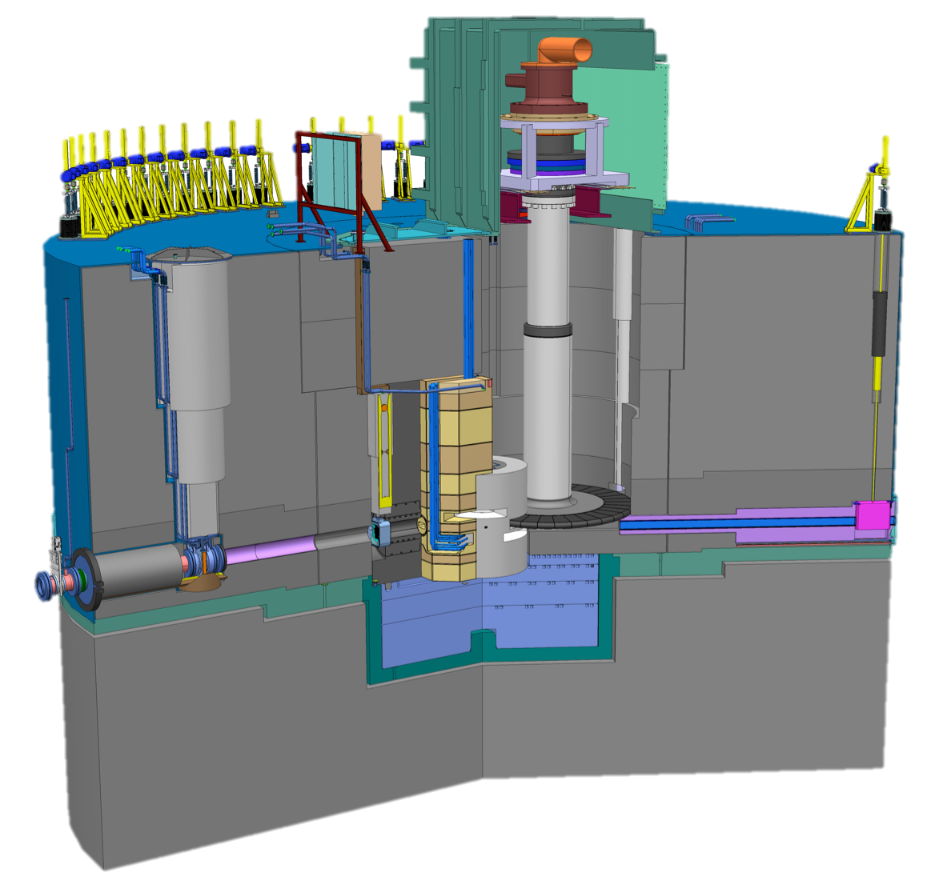
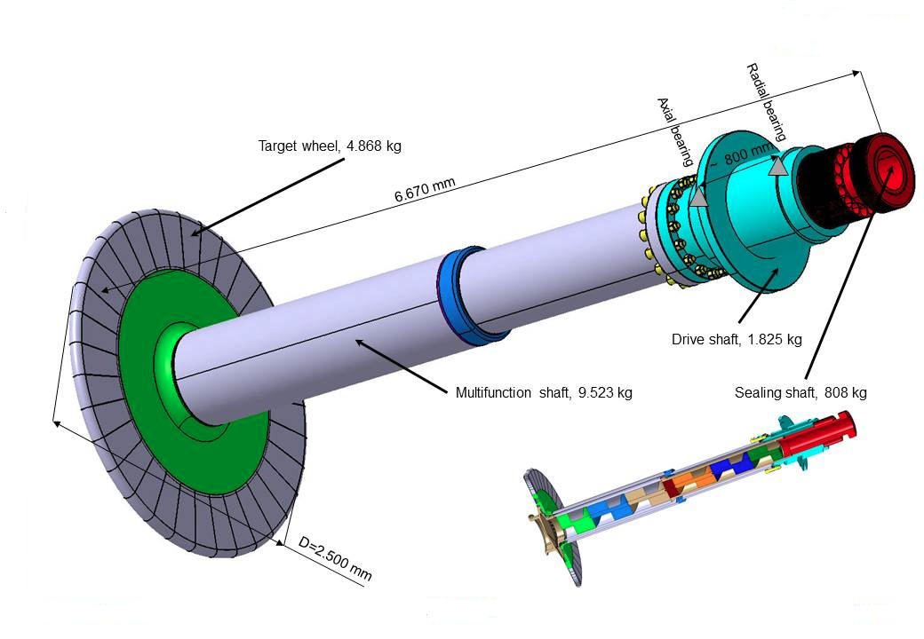
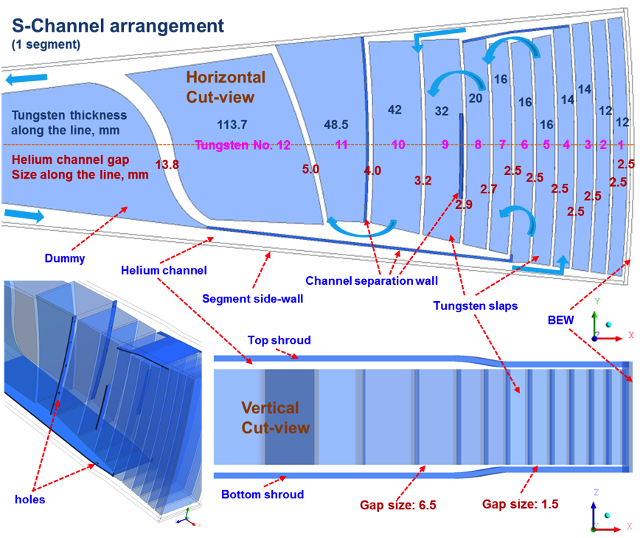
Target Wheel
Tungsten slabs in 33 sectors
Helium coolant
  Mass flow 3 kg/s
  Pressure 0,3 Mpa
  Inlet temperature 20 °C
  Outlet temperature 220 °C
Rotational speed 25,5 rpm
Wheel diameter 2,5 m
Shaft length > 5 m
Target drive housing
Target wheel

Slide 17
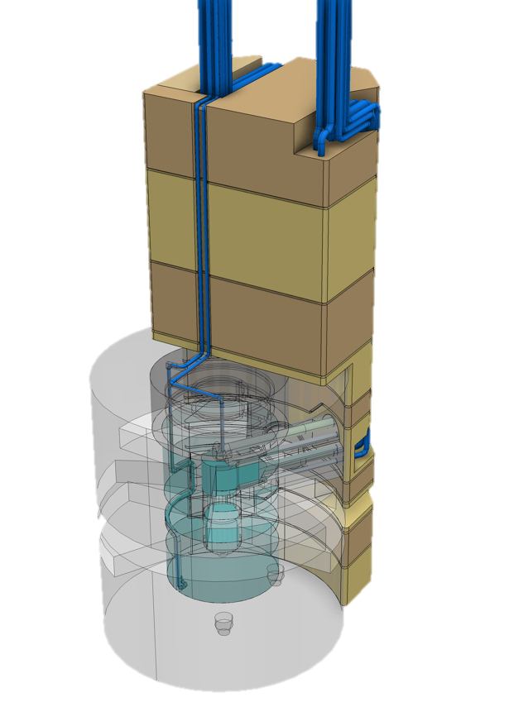
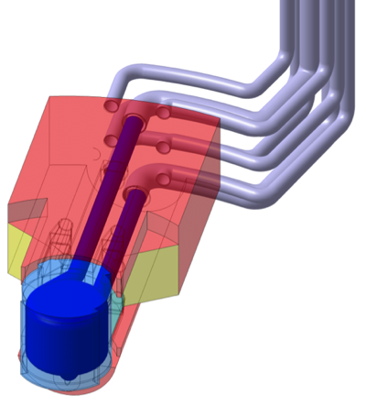
Moderators and Reflectors
Cold moderators
  Super-critical hydrogen at
  20 K and 1.5 MPa
  Vessel in aluminium alloy
Water moderator assemblies
  Vacuum jacket
  Thermal water
  Pre-moderator surrounding the cold moderator vessel
  Extended wings to facilitate thermal or bi-spectral beam extraction
Inner reflector
  Beryllium
  Complex “cylindrical” aluminium vessel
  Water cooled
Outer reflector
  Steel
  Water cooled
Cut-outs
  for the view path to the beam extraction
  for the wheel
Moderator and reflector plug

Slide 18
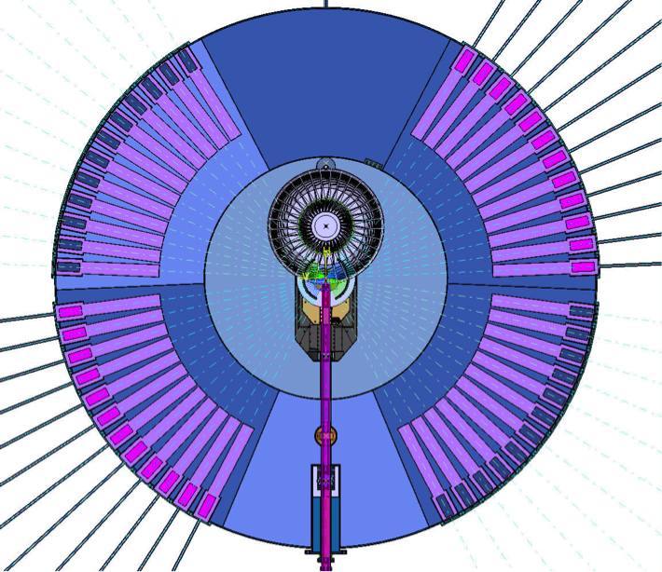
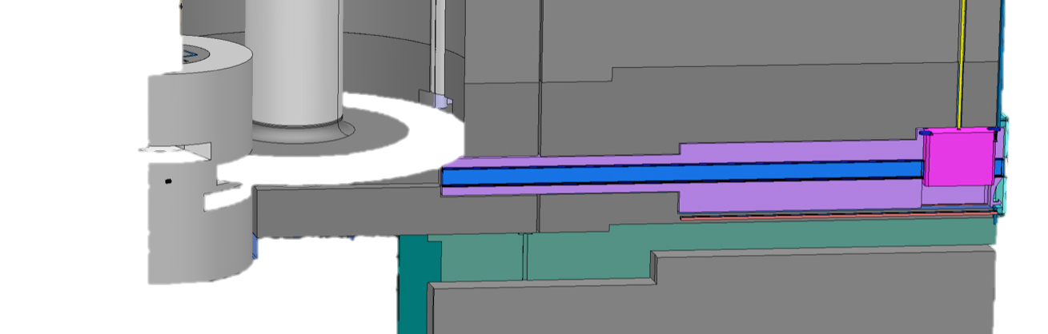
Neutron Beam Extraction
Neutron beam extraction system design
  Four 60 degree sectors, whereof
    Two sectors view the upper moderators
    Two sectors view the lower moderators
  In total 48 ports for potential neutron beam line location
  Neutron beam guide inserts can be located as close as 2 m from the surfaces of the moderators
  Cut outs in reflectors and shielding for view of the moderators by the neutron beam guide inserts
  Neutron beam windows separating the monolith helium atmosphere and the ambient atmosphere in the experimental halls
Moderator and reflector plug
Target wheel
Shutter
Four 60 degree sectors, each with 12 ports for potential neutron beam positions
Neutron beam guide inserts
Neutron beam window

Slide 19
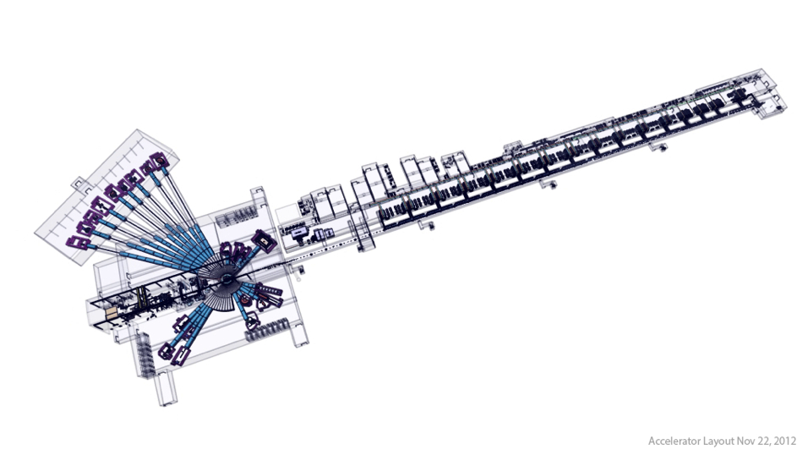
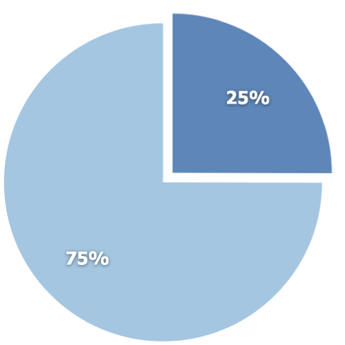
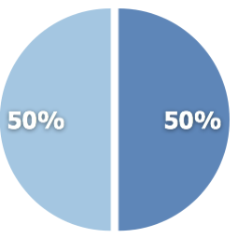
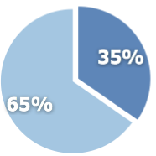
ESS In-kind contributions potential
Total construction cost:
€ 1,84 billion
Target station
€ 154M
Accelerator
€ 510M
In-kind
NSS/Instruments
€ 350M
Cash

Slide 20
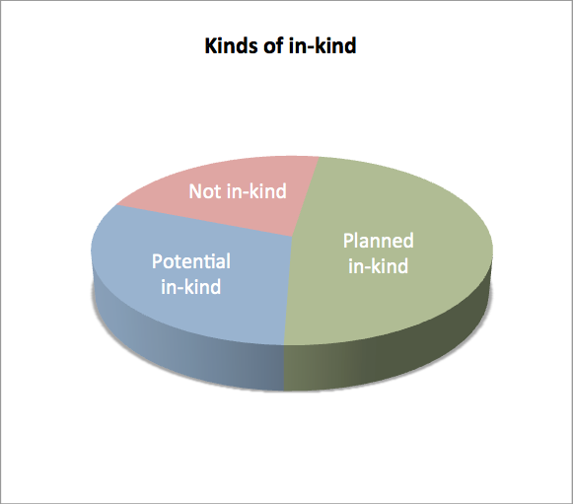
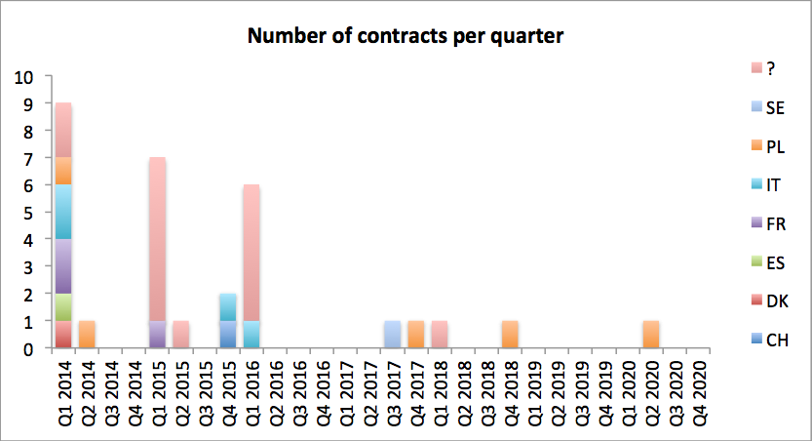
ACCSYS update in-kind discussions
Potential partners identified for 48% of the total value
Planned/potential in-kind is 78% of accelerator budget
Many activities start Q1 2014, reflecting the importance of reaching agreements soon

Slide 21

Collaborative projects
ESS is an emerging research laboratory with (still) very limited capacity in-house
Two possibilities:
  Limit the scope of the project so that it can be done with in-house resources
  Work in a collaboration where the scope of the project can be set by the total capacity (distributed) of the partners
The accelerator part of the project well suited for this as this community has a strong tradition of open collaboration
To keep cost down and to optimize schedule this requires that investments in required infrastructure is done at the partner with best capacity to deliver
21
Notes:
User driven innovation – external actor to be collective ownership

Slide 22
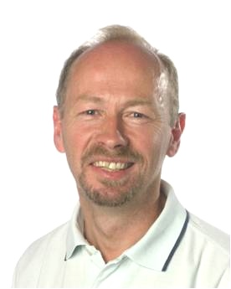
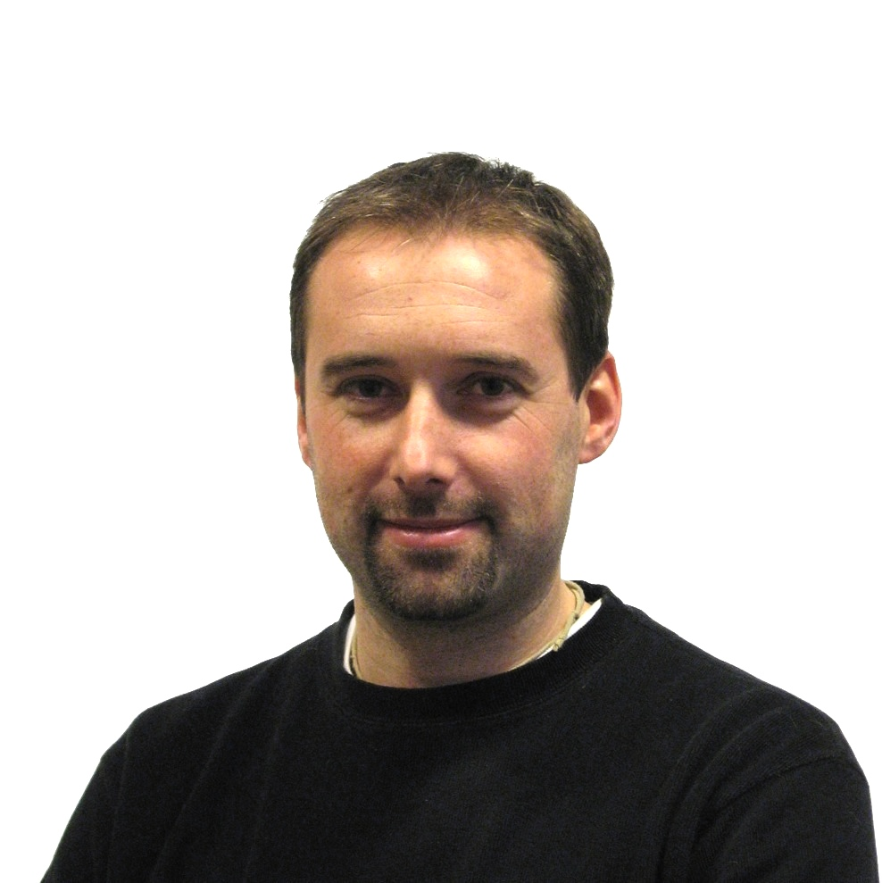

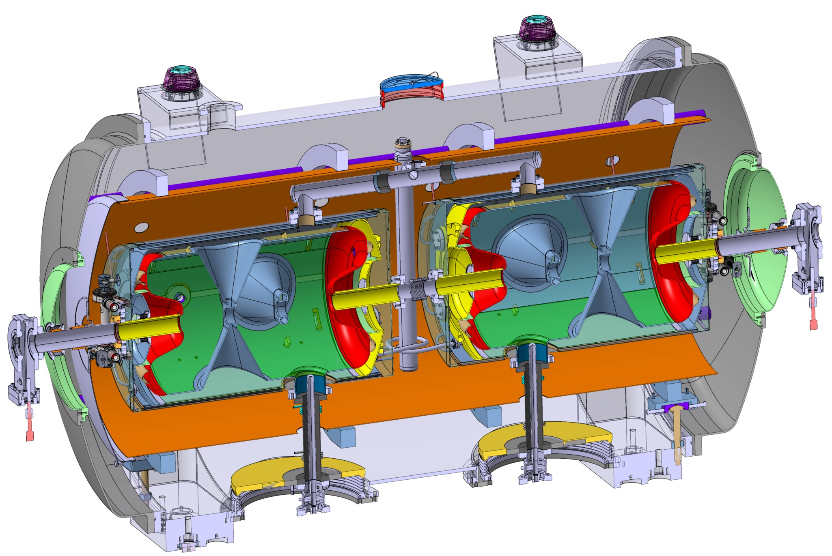
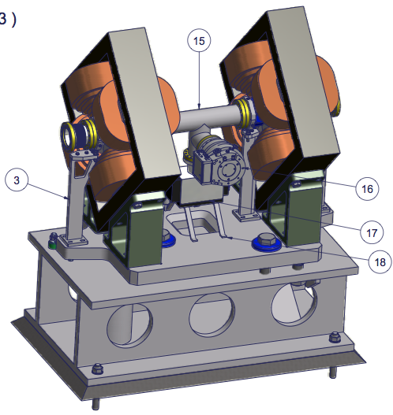
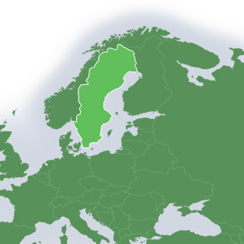
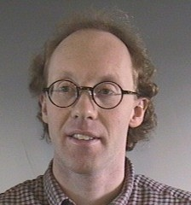
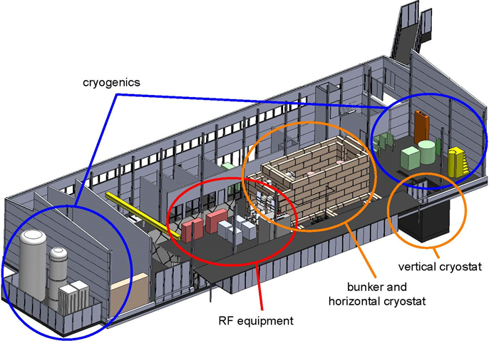
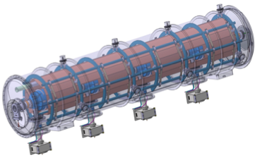

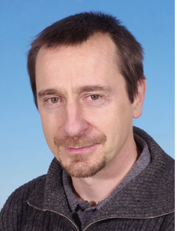
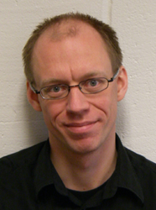
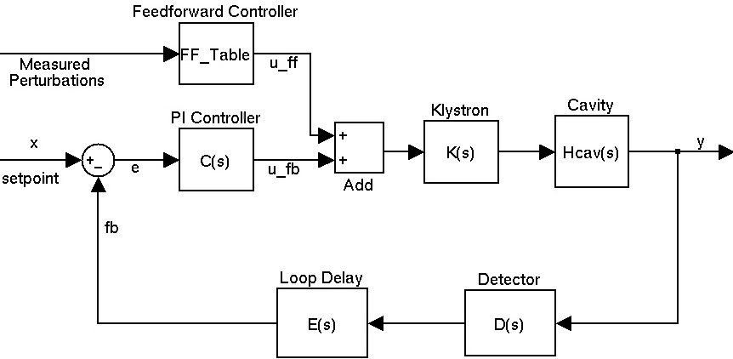
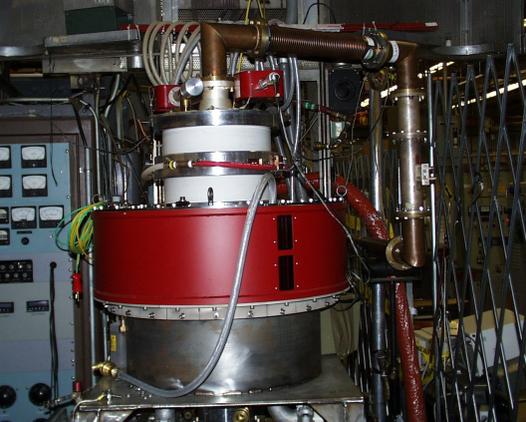


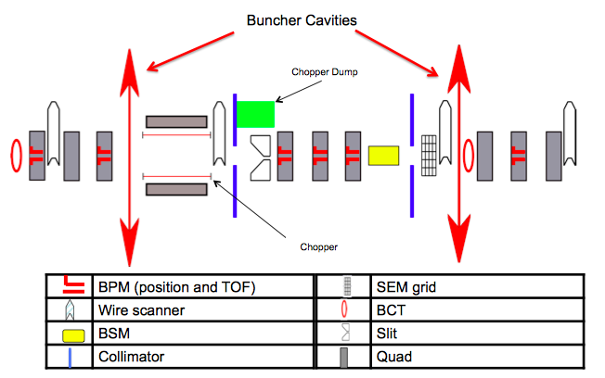
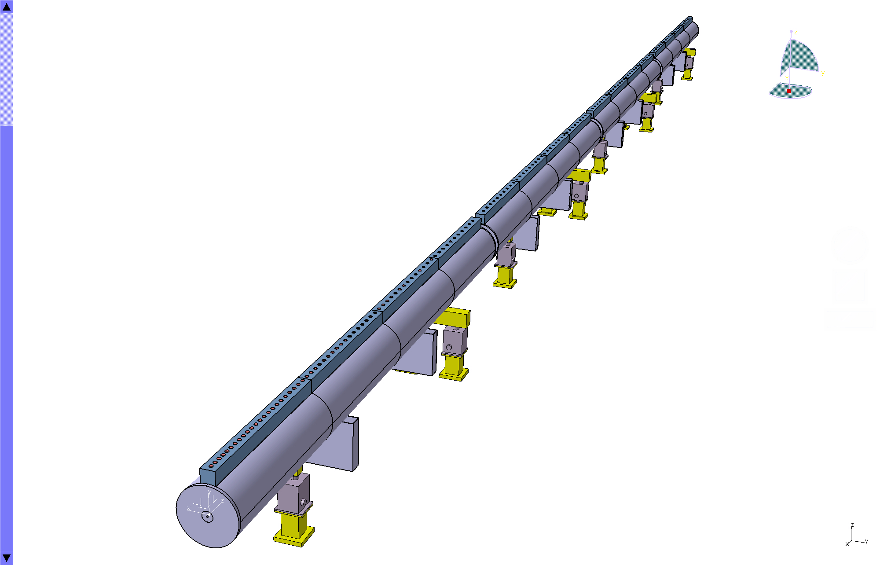
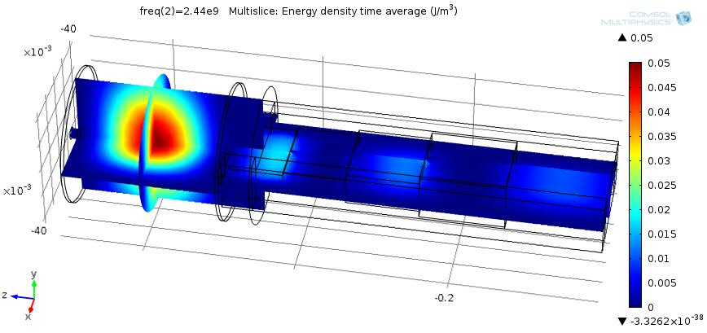
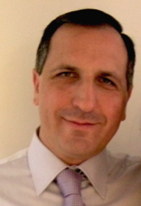


Prototyping the ESS accelerator
Søren Pape Møller
Sebastien Bousson
Roger Ruber
Pierre Bosland
Anders J
Johansson
CERN
The National Center for Nuclear Research, Swierk
Roger Barlow
Ibon Bustinduy
Santo Gammino

Slide 23
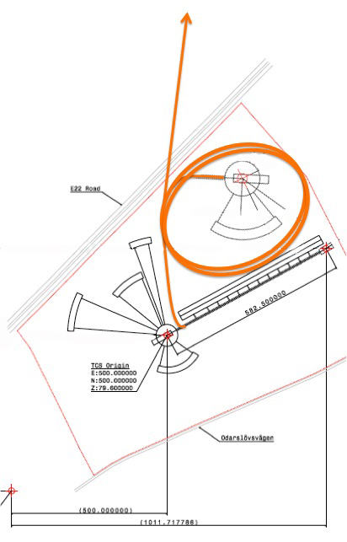

Ideas for ESS upgrade with ring
Neutrino beam
5 MW ring for a shorter pulse spallation neutron source
Four stacked permanent magnet rings, 2.5 GeV, 5 ms revolution time makes for a tune shift of less than 0.25
Staggered beam extraction using solid state switch driven ILC like strip line kickers of up to 100 pulses to match pulse length to moderators and simplify target design
Linac operated with H- and at 28 Hz to keep both target station operating at 5 MW
Neutrino beam extraction possible

Slide 24
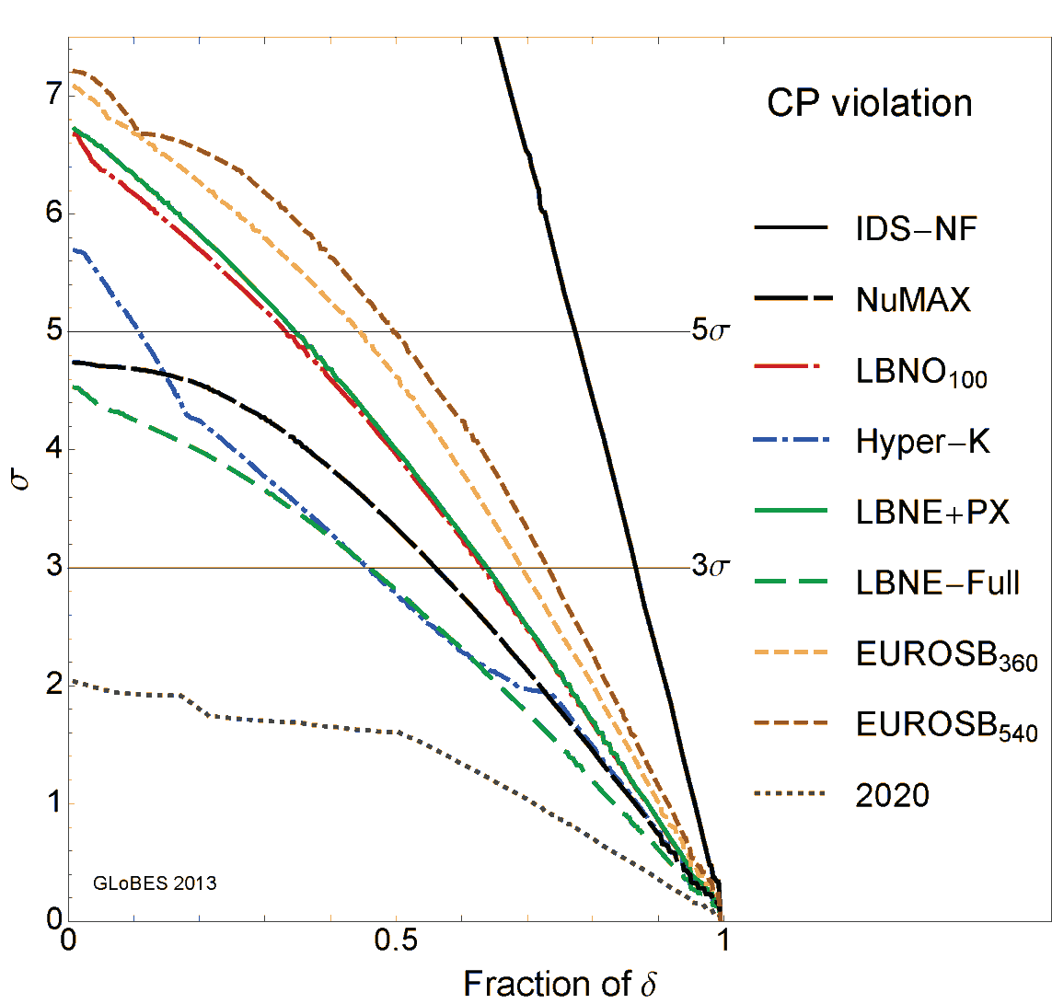
CPV Discovery Performance for Future SB projects, MH unknown, Snowmass comparison
IDS-NF Neutrino Factory
NuMAX are: 10 kton magnetized LAr detector, Baseline is 1300 km, and the parent muon energy is 5 GeV
LBNO100: 100 kt LAr, 0.8 MW,
2300 km
Hyper-K: 3+7 years, 0.75 MW,
500 kt WC
LBNE-Full 34 kt, 0.72 MW, 5/5 years
~ 250 MW*kt*yrs.
LBNE-PX 34 kt, 2.2 MW, 5/5 years ~750 MW*kt*yrs.
EUROSB: 2+8 years, 5 MW, 500 kt WC (2.5 GeV, 360 (upper)/540 km (lower))
2020 currently running experiments by 2020
ESS 2.5 GeV
Pilar Coloma

Slide 25
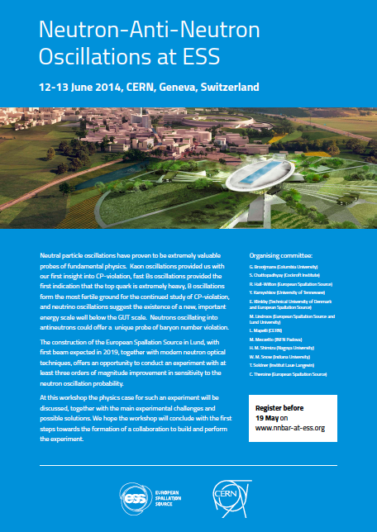
Neutron - antiNeutron oscillations
Provided new physics occurs beyond the Standard Model at the mass scale of the order of 10² to 10³ TeV the oscillation time could be in the region of 10⁸ s
The experimental search for neutron-antineutron oscillations was done at the ILL high flux reactor at Grenoble (1994). A neutron beam of intensity 10¹¹ n/s was propagated for a time t~-0.1 s in vacuum in a region shielded against the external magnetic field. No antineutron was detected in 2.4.10⁷ s running time.
ESS can probably do more than two orders of magnitude better

Slide 26
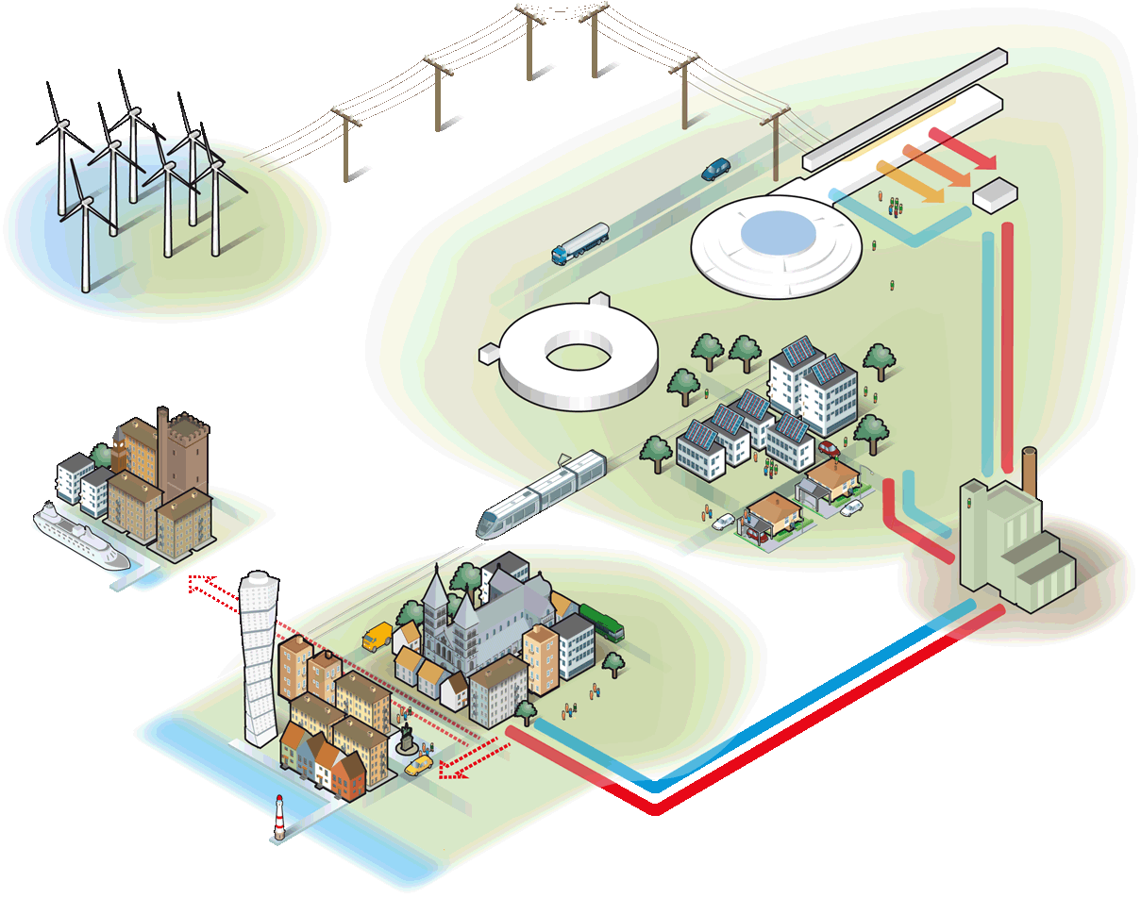
A sustainable research facility
Responsible
Carbondioxide:
- 30 000 ton/year
Renewable
Carbondioxide:
- 120 000 ton/year
Recyclable
Carbondioxide:
- 15 000 ton/year
Notes:
Högsta temp: 118 GWH
All värme: 215 GWh = 10 000 villor

Slide 27


Welcome

Slide 28


Short pulse neutron sources-SNS
SNS, SC LINAC/Storage ring, 2007, 1.4 MW, 1 GeV, 26 mA in linac, 627 ns long pulse, 60 Hz
Examples of challenges: Better understand stripping reaction in linac, accumulation in storage ring

Slide 29


Short pulse sources-LANCSE
LANCSE, NC LINAC /Storage ring, 1972, 100 kW, 800 MeV, 17 mA in linac, 600 ns, 20 Hz
Examples: Combined H- and H+ acceleration

Slide 30




Accelerated intensity at 800 MeV:
2.5x10¹³ ppp - 3.75x10¹³ ppp
(200 µA) (300 µA)
Neutron scattering facility
Two target stations
Muon facility
Examples of challenges: Ceramic vacuum chambers, high space charge synchrotron

Slide 31
Linac layout

Slide 32


Inductive Output Tubes or klystrons?
ESS
  Induction Output Tubes, IOTs
    Higher electrical efficiency
      They don’t conduct in the absence of input drive
    Compact
    Short MTTR
    Cheaper modulator (No high voltage switching)
  Why suddenly IOTs?
    Development of Pyrolytic graphite grids
    Solid state drivers
RF in
RF in
IOT
Density Modulation
Courtesy of Morten Jensen (ESS)
Klystron
Velocity Modulation

Slide 33

Planned In-Kind from Primavera
Summary of activities (work packages or work units) where at least one specific partner has been identified and discussions with this partner has started
Håkan Danared, IK manager ACCSYS

Slide 34

Potential In-Kind from Primavera
Summary of activities where no specific partner has been identified or, in the case of beam instrumentation, where the WP is being re-organized such that start dates and values cannot be assigned at the moment
Håkan Danared, IK manager ACCSYS

Slide 35
Number of Contracts per Quarter
Many activities start Q1 2014, reflecting the importance of reaching agreements soon

Slide 36
Final Remark on In-Kind
Planned in-kind contributions cover 48% of accelerator budget.
Many items still open.
Design phase is largely over – now hardware contributions are needed.
To reach >50% in-kind to accelerator, substantial commercial items must be obtained as in-kind.
Nevertheless, in-kind to construction is far from ”only procurement”.
In-kind is also an opportunity to local industry (study showed 80% of procurement budget spent within 100 km of large research facilities).
Håkan Danared, IK manager ACCSYS

