Slide 1
https://indico.esss.lu.se/indico/conferenceDisplay.py?confId=139
SPL R&D at CERN
R. Garoby for
S. Atieh, I. Aviles Santillana, G. Arnau Izquierdo, R. Bonomi, O. Brunner, S. Calatroni, O. Capatina, J. Chambrillon, F. Gerigk, M. Guinchard,
T. Junginger, M. Malabaila, L. Marques Antunes Ferreira, S. Mikulas,
V. Parma, F. Pillon, T. Renaglia, K. Schirm, T. Tardy, M. Therasse, A. Vacca, N. Valverde Alonso,
A. Vande Craen, M. Vretenar etc.

Slide 2
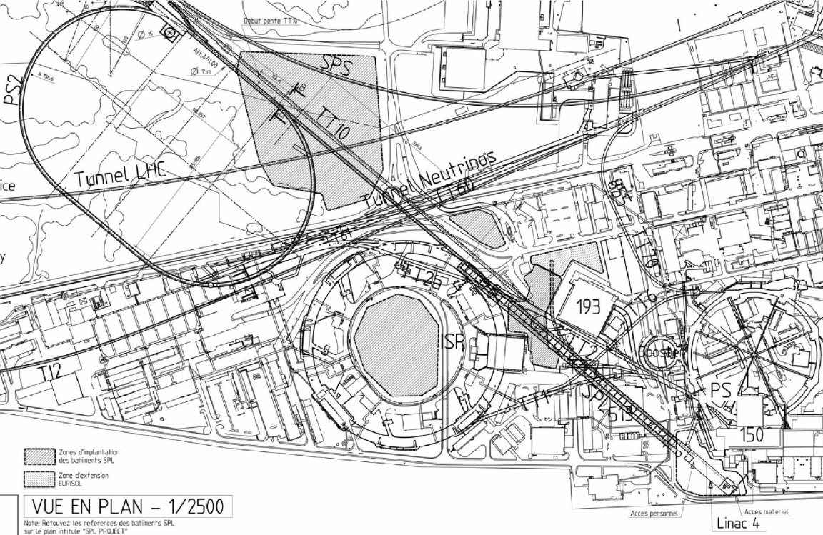
CERN Motivation for the SPL R&D (1/5)
Possibility of new injectors in the future (HE-LHC…)
Present
Typical Future
e.g.: Plan until 2010
1978
Proton flux / Beam power
50 MeV
Linac2
Linac4
SPS
160 MeV
1975
PS2
1.4 GeV
PSB
LP-SPL
4 GeV
1959
26 GeV
PS
PS2
PS
50 GeV
SPL
450 GeV
SPS
2008
LHC
7 TeV
LP-SPL: Low Power-Superconducting Proton Linac
PS2: High Energy PS (~ 5 to 50 GeV – 0.3 Hz)
LINAC4

Slide 3
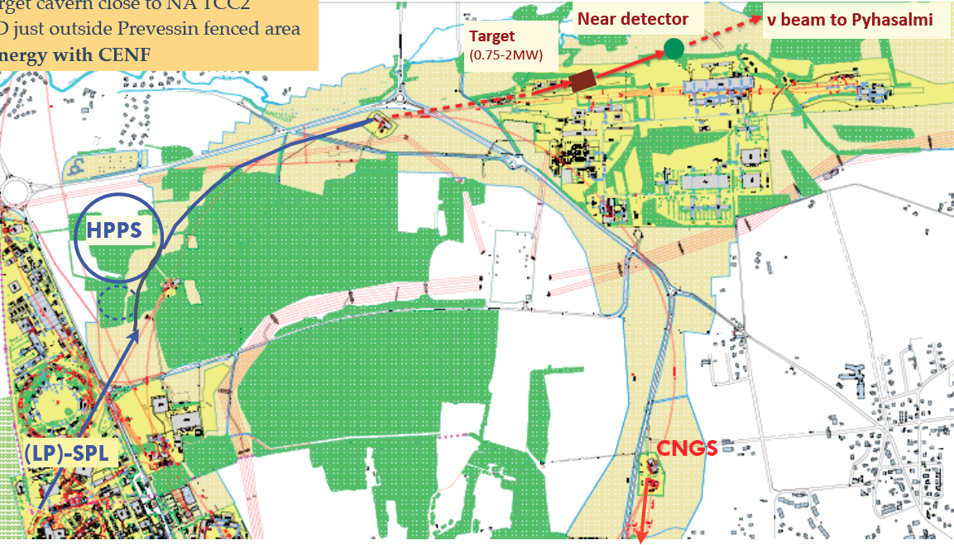
CERN Motivation for the SPL R & D (2/5)
Options for neutrino physics (Conventional n Superbeams)
Low energy ν beam
Medium energy ν beam
Accumulation of HP-SPL beam in a fixed energy Accumulator
(4-5 GeV, 4MW beam power)
Fast ejection onto target(s)
LP-SPL as 4 GeV injector of a High Power 50 GeV synchrotron
(50 GeV, 2 MW beam power)
Phase 1: SPS (400 GeV -700 kW)
Phase 2: HP-PS (50 GeV – 2 MW)

Slide 4
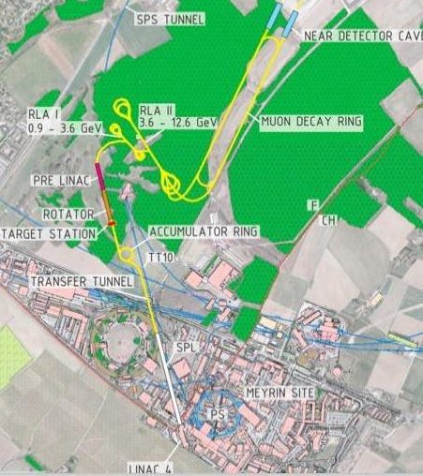
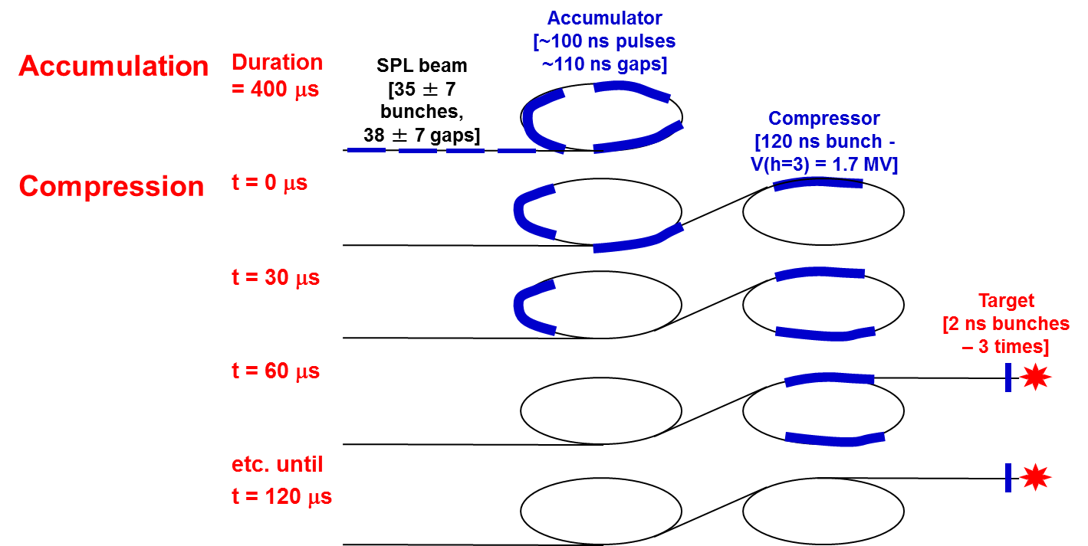
CERN Motivation for the SPL R & D (3/5)
Options for neutrino physics (n Factory)
Accumulation of beam from the High Power SPL in a fixed energy Accumulator (4-5 GeV, 4MW)
Bunch compression («rotation») in a separate Compressor ring
Fast ejection of few (3-6) short (2 ns) bunches to target

Slide 5
CERN Motivation for the SPL R & D (4/5)
Next generation Radioactive Ion Beam Facility (~EURISOL)
TARGETS
RADIOACTIVE IONS LINAC
EURISOL EXPERIMENTAL HALLS
ISOLDE OR
EURISOL HIGH ENERGY EXPERIMENTAL HALL
TRANSFER LINE SPL to ISOLDE
TRANSFER LINES SPL to EURISOL

Slide 6
CERN motivation for the SPL R&D (5/5)
Synergy with other applications at CERN (FCC-hh, -ee, -eh…) as well as outside of CERN (ESS, ADS…)
⇓
Need to update CERN capacity in superconducting RF:
Update of staff competencies
Upgrade of infrastructure (SM18 clean room, High Power RF, High Pressure Water Rinsing facility, Diagnostics for SC RF, New e-beam welding machine, Electro-polishing installation, etc.)

Slide 7
SPL main characteristics
General features
Required for low loss in accumulator
Ion species H⁻
Output Energy 5 GeV
Bunch Frequency 352.2 MHz
Repetition Rate 50 Hz
High speed chopper < 2 ns
(rise & fall times)
Required for muon production (Neutrino Factory)
Re-use of LEP RF components in Front-end (Linac4)
Required for flexibility and low loss in accumulator
Options
 | Option 1 | Option 2
Energy (GeV) | 2.5 or 5 | 2.5 and 5
Beam power (MW) | 2.25 MW (2.5 GeV) or 4.5 MW (5 GeV) | 5 MW (2.5 GeV) and 4 MW (5 GeV)
Protons/pulse (x 10¹⁴) | 1.1 | 2 (2.5 GeV) + 1 (5 GeV)
Av. Pulse current (mA) | 20 | 40
Pulse duration (ms) | 0.9 | 1 (2.5 GeV) + 0.4 (5 GeV)
RIB facility
ν facility
2 × beam current ⇒ 2 × nb. of klystrons etc .

Slide 8
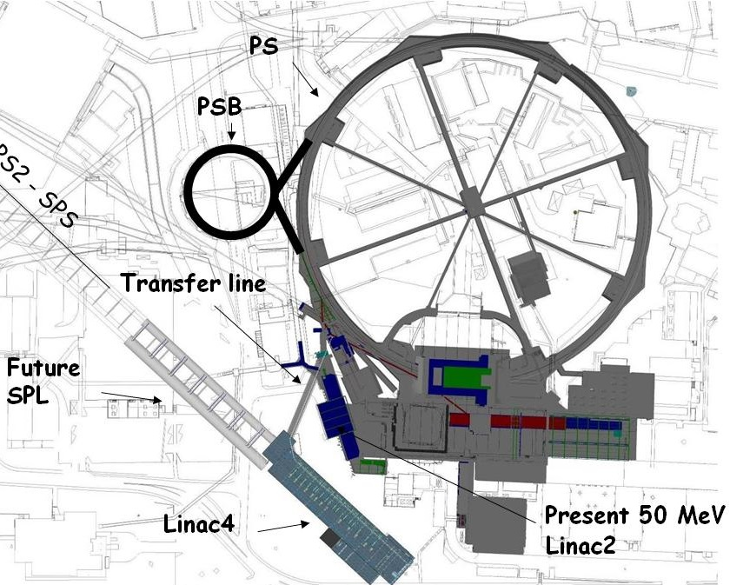
SPL potential front end: Linac4!
(Construction Project started in January 2008)
New 160 MeV H- linear accelerator, will replace Linac2 as injector to the PS Booster.
First step of the LIU upgrades.
Bunch Frequency 352.2 MHz
Max. Rep. Frequency 2 Hz
Max. Beam Pulse Length 0.4 ms
Max. Beam Duty Cycle 0.08 %
Chopper Beam-on Factor 65 %
Chopping scheme: 222 transmitted /133 empty buckets
Source current 80 mA
RFQ output current 70 mA
Linac pulse current 40 mA
Tr. emittance (source) 0.25 π mm mrad
Tr. emittance (linac exit) 0.4 π mm mrad
Max. repetition frequency for accelerating structures 50 Hz
Doubled beam brightness for LHC luminosity: reduced space charge (factor 2 in βγ² ) with a higher PSB injection energy
Long term reliability using modern design, (concerns for Linac2 vacuum ).
Flexible operation and reduced loss with new technologies (chopping, H⁻ injection).
Higher intensity for non-LHC users.
Prepare for a possible high-intensity upgrade (neutrino facility).
Test stand
Notes:
No space for energy upgrade – parallel to the present Linac2

Slide 9
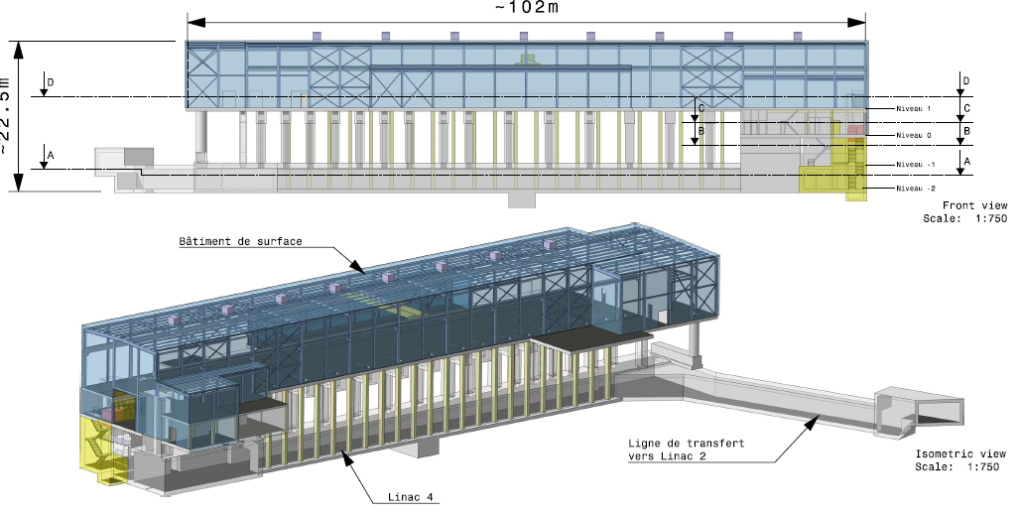
Linac4
45keV
3MeV
3MeV
50MeV
103MeV
160MeV
H-
RFQ
CHOPPER
DTL
CCDTL
PIMS
RF volume
source
(DESY)
45 kV
Extrac.
Radio
Frequency
Quadrupole
3 m
1 Klystron
550 kW
Chopper
& Bunchers
3.6 m
11 EMquad
3 cavities
Drift Tube
Linac
18.7 m
3 tanks
1+2 klystrons
4.7 MW
111 PMQs
Cell-Coupled Drift Tube
Linac
25 m
21 tanks
7 klystrons
7 MW
21 EMQuads
Pi-Mode Structure
22 m
12 tanks
4+4 klystrons
~12 MW
12 EMQuads
H⁻ ion current:
40 mA (avg.),
65 mA (peak)
Length: 80 m
19 klystrons [13 x 1.3 MW (LEP), 6 x 2.8 MW (new)]
Normal conducting accelerating structures of 4 types: RFQ, DTL, CCDTL, PIMS
Single frequency: 352.2 MHz
Duty cycle: 0.1% phase 1 (Linac4), 3-4% phase 2 (SPL), (design: 10%)

Slide 10
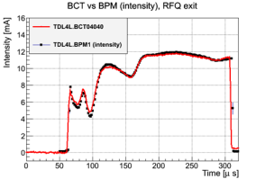
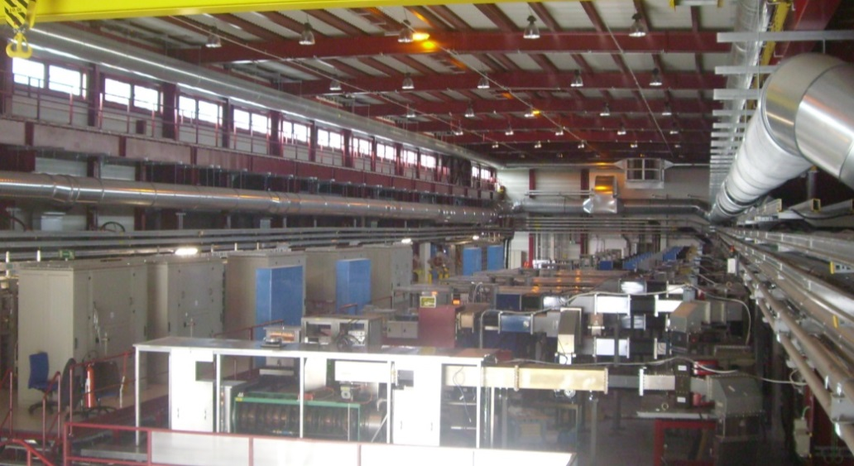
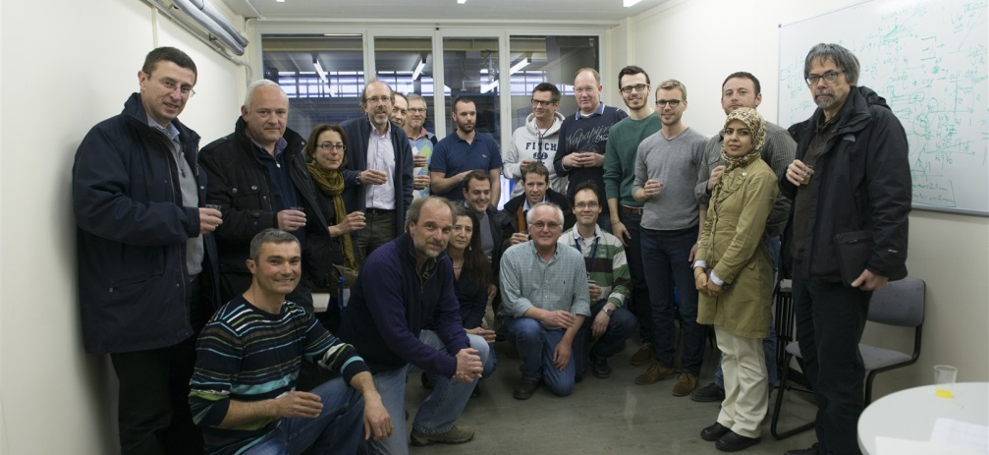
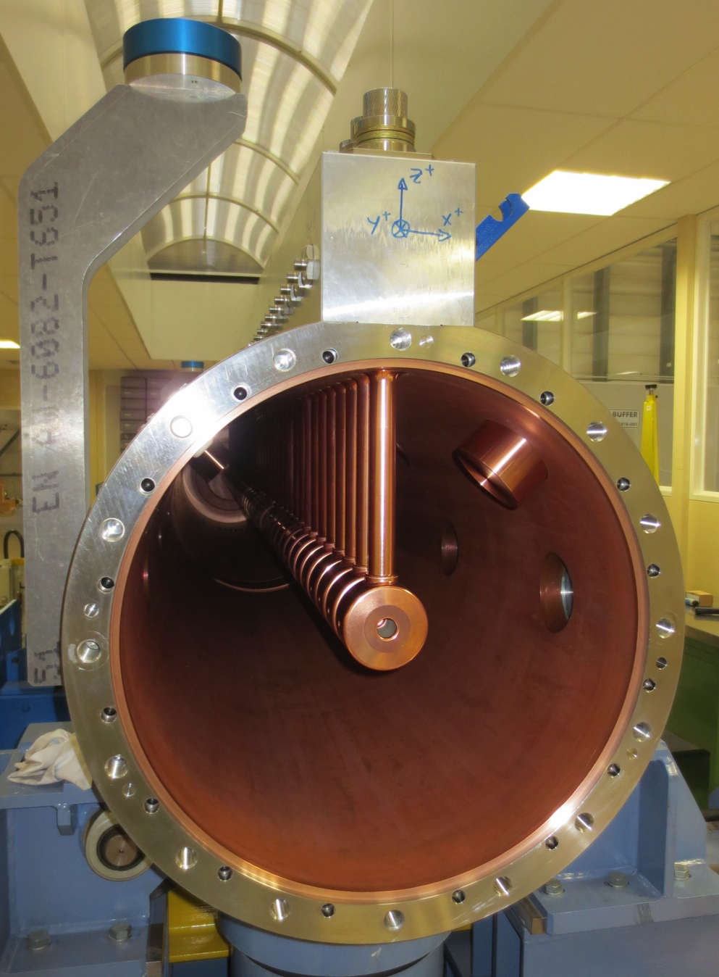
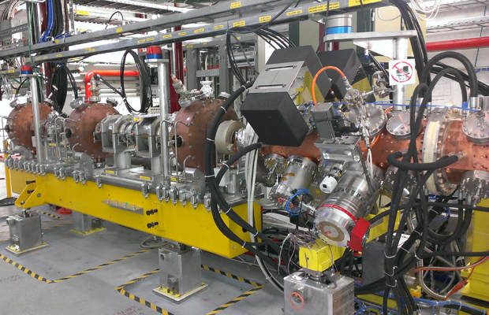
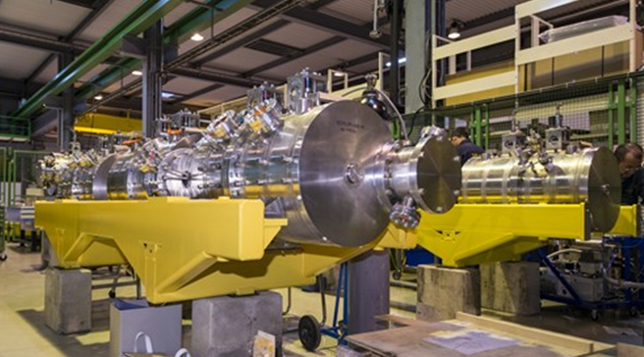
Linac4 status
Klystrons and modulators in the Linac4 Hall
Celebration of the first beam acceleration by the RFQ in the Test Stand (13.3.13)
DTL tank 1
CCDTL structures
RFQ & MEBT section in the Linac4 tunnel

Slide 11
SPL block diagram
SC-linac [160 MeV ® 5 GeV] with ejection at intermediate energy
Medium beta cavities: β = 0.65
High beta cavities: β = 1
“Up-to-date” CDR to be published in 2014
0 m
0.16 GeV
129 m
0.73 GeV
280 m
2.5 GeV
505 m
5 GeV
From Linac4
Medium β cryomodule
High β cryomodules
Ejection
High β cryomodules
Debunchers
5 GeV – 4 MW
20 x 3
β=0.65 cavities
10 x 8
β=1 cavities
13 x 8
β=1 cavities
2.5 GeV
Length: ~500 m

Slide 12
SPL cavities development
cf. J. Plouin, F. Peauger – 11:10 on Thursday 15/05
Collaboration with ESS (Lund) with contributions from IN2P3 and CEA and support from the E.U.
Medium beta cavities β = 0.65
1 designed and ordered from industry by IPN Orsay (Guillaume Olry et al.) to be tested in 2014 at CEA Saclay in vertical cryostat and later in Cryho-lab (Horizontal test cryostat)
High beta cavities β = 1
1 designed and ordered from industry by CEA Saclay (Guillaume Devanz et al.) to be tested in 2014 at CEA Saclay in vertical cryostat and later in Cryho-lab (Horizontal test cryostat)
5 designed and ordered (4 from industry, 1 from CERN workshop) by CERN for tests at CERN (SM18) in Short cryo-module of 4 cavities

Slide 13
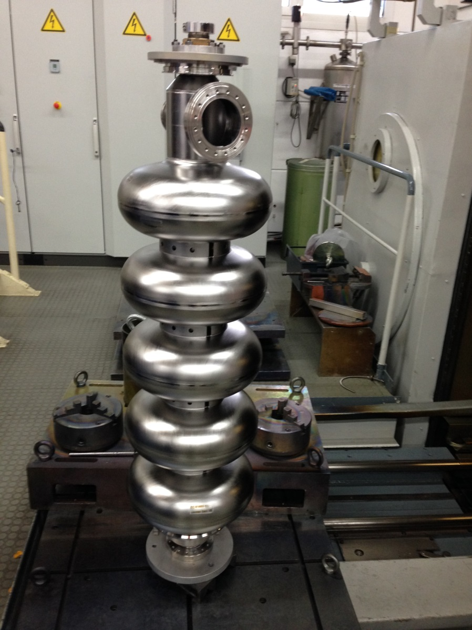
Niobium cavities from industry (RI)
cf. N. Valverde Alonso & I. Aviles Santillana – 14:00 on Friday 16/05
4 Niobium cavities fabricated and delivered by RI (December 2013)

Slide 14
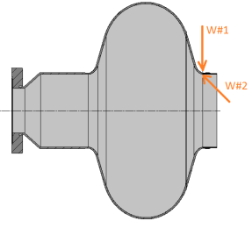
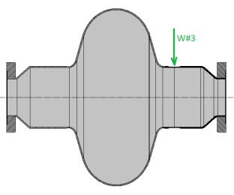
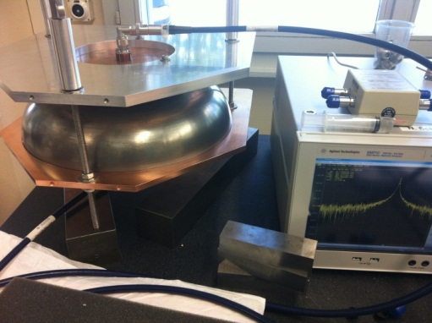
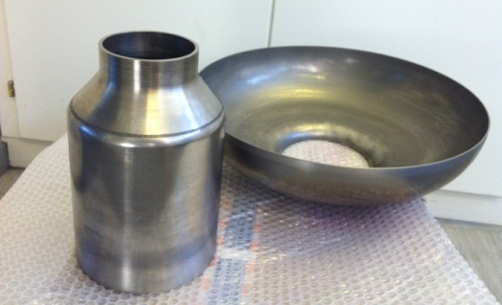
Niobium cavities at CERN
Repair of first monocell
Material defects observed after electro-polishing.
Repaired with new e-beam welding machine from outside (W#1 and W#3) and inside (W#2)
cavity fabrication at CERN
Tooling for EB welding of Nb cavity is fabricated.
Half-cells and beam tubes fabricated by spinning.
RF measurements.

Slide 15
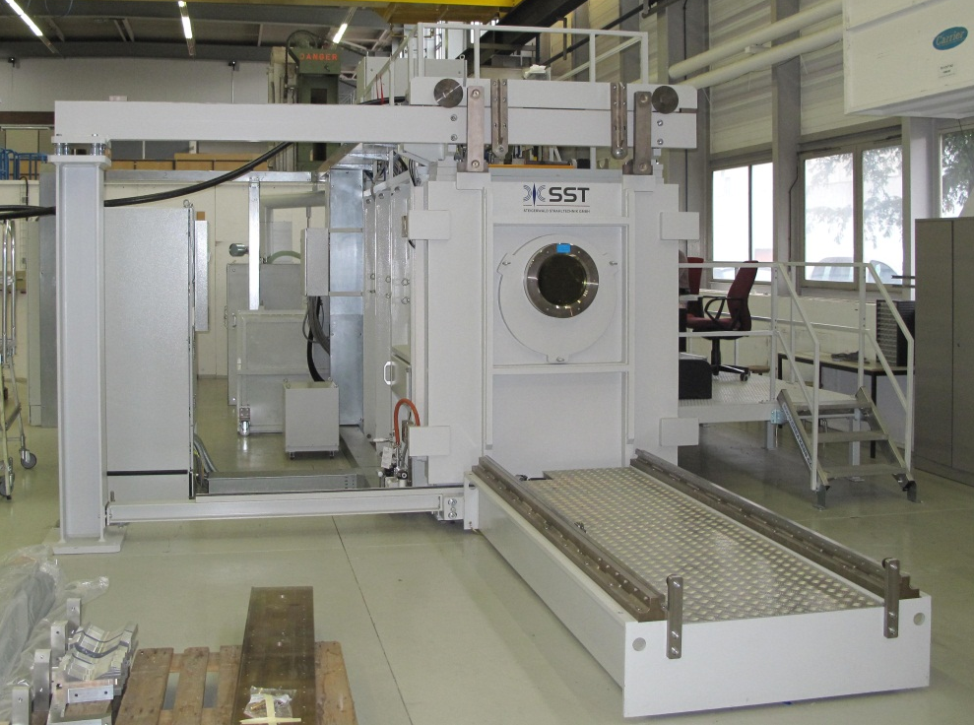
New e-beam welding machine

Slide 16
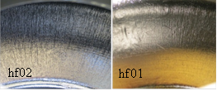
Electro-Polishing (EP)
cf. L. Ferreira – 14:20 on Friday 16/05
Tooling for EP
- 5 Cell electropolishing preparation:
Cathode and tooling manufacturing
Improve main pump flow control and compressed air connection
Allow crane direct acces to the electropolishing hut
- Monocell TESTS:
A second set of electropolishing sessions were done to bring the total removed thickness to 200 microns.
It was possible to set different working temperatures and compare them with the simulation data
Working at lower temperatures results in less pitting.
Cavity is currently undergoing RF test
Paper TUP047 bat SRF with all multiphysics simulation details
Temperature | Total current inward / A
 | Simulation | Real cavity
10 °C | 21 | 18
15 °C | 37 | 36
25 °C | 70 | 57

Slide 17
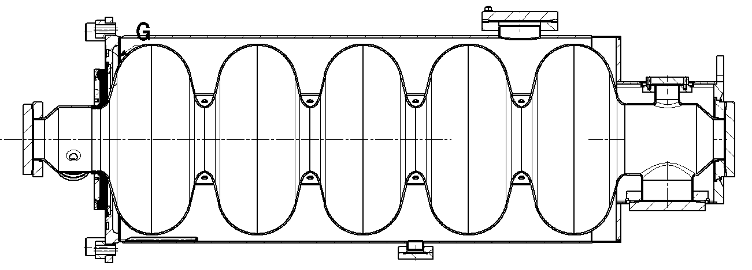
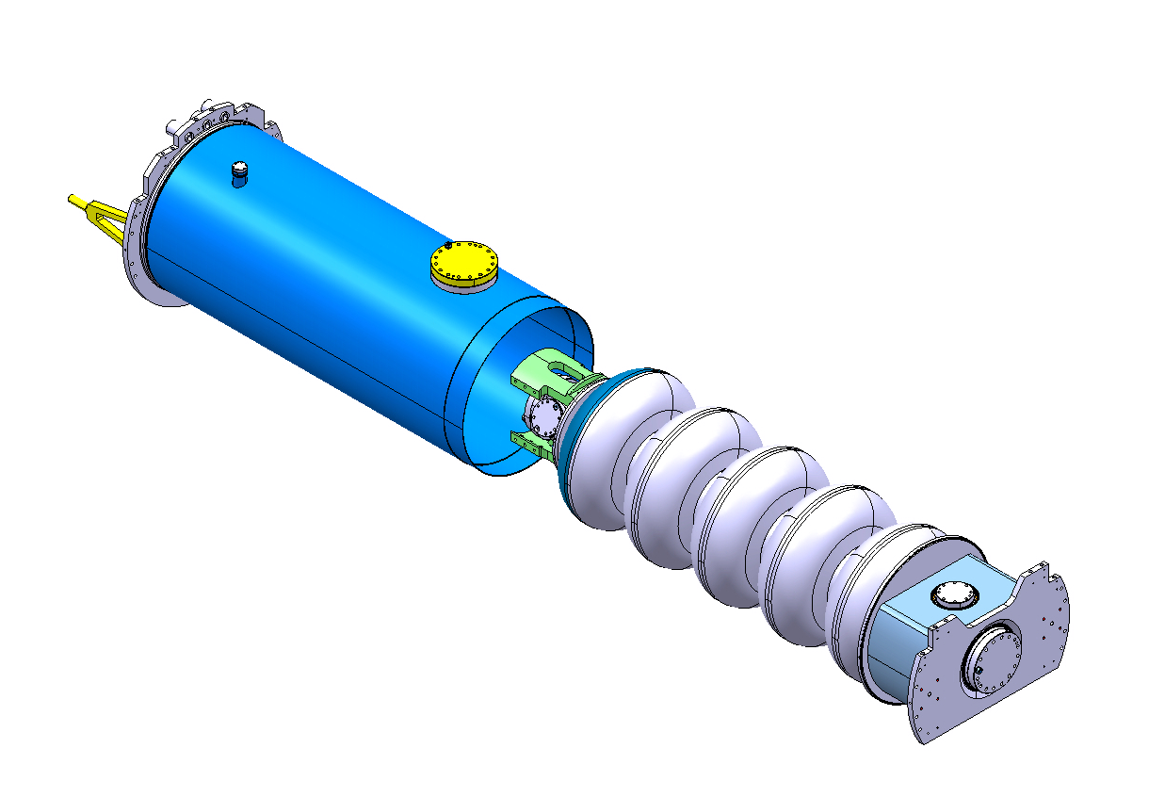
Helium tank
Stainless Steel He tank (CEA)
Helium tank designed by CERN (Stainless steel).
5 items under fabrication by CEA (with SDMS).

Slide 18
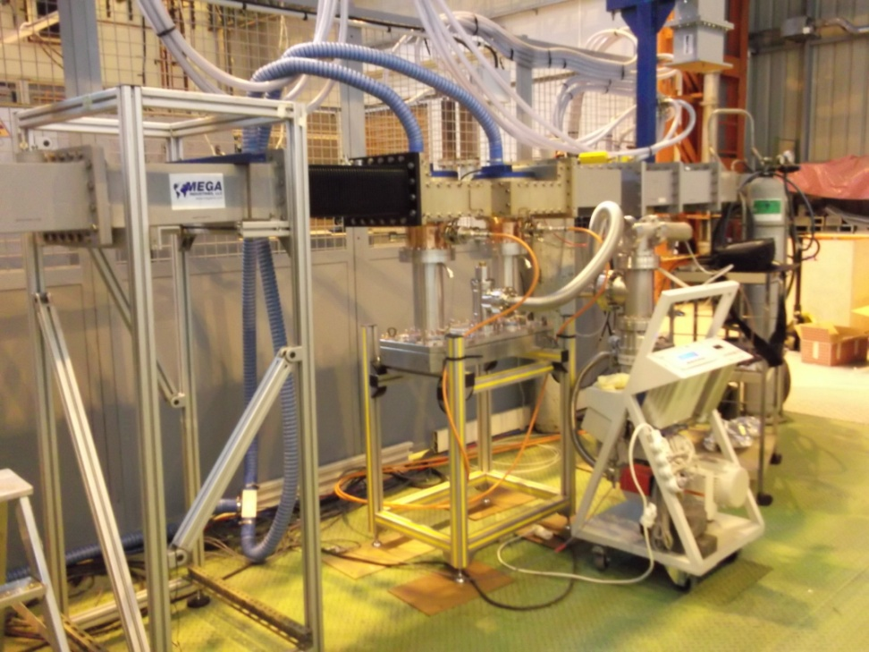
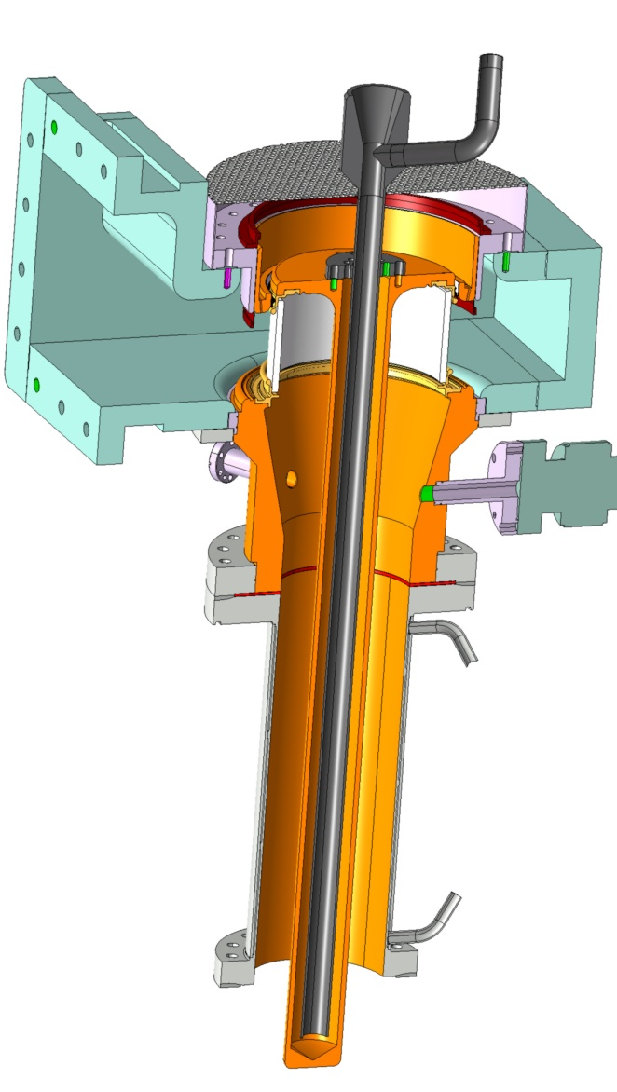
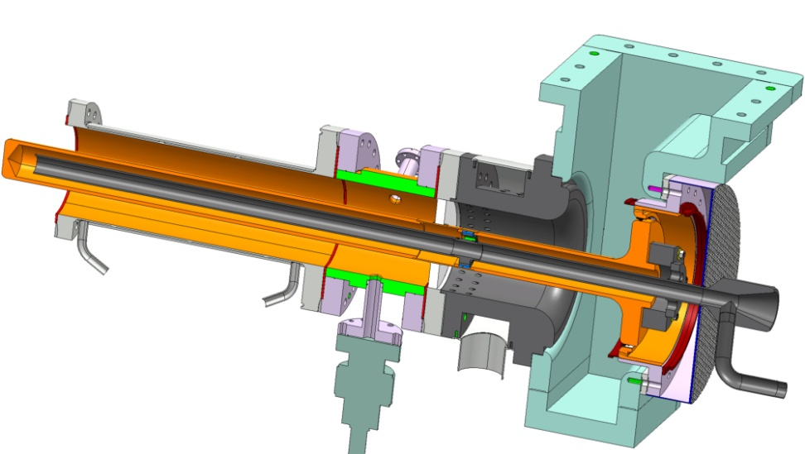
RF tests on couplers at CEA
cf. E. Montesinos – 8:30 on Friday 16/05
Test of RF couplers (CEA)
Development of
two types of couplers
Cylindrical
window
Disk
window
CEA test bench with
two SPL cylindrical window couplers,
Double Walled Tubes and Test Box cavity

Slide 19
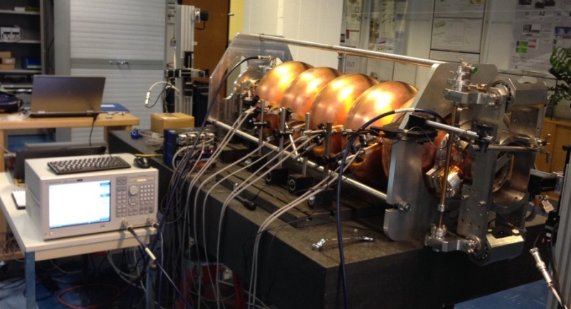
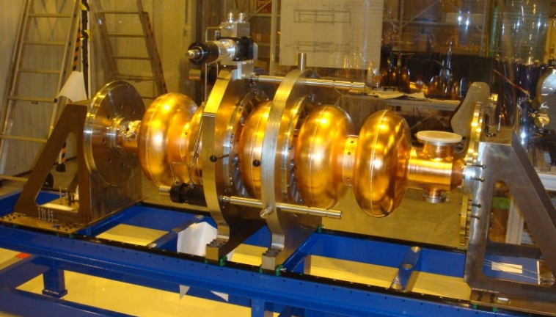
Tests systems and cavity reception area (Bdg. 252)
cf. A. Macpherson – 11:30 on Thursday 15/05
Reception area in bdg.252
Tooling for test in vertical cryostat: fabricated and available at CERN
Cavity tuner: measurement of cavity detuning versus mechanical deformation.
Cell-by-cell tuning system with RF bead-pull and mechanical measurements.

Slide 20
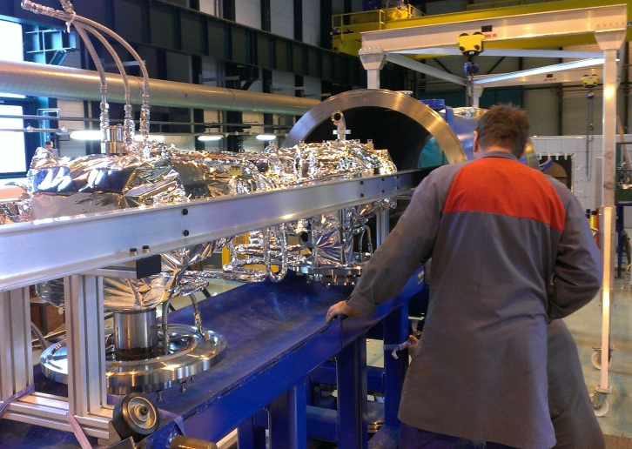
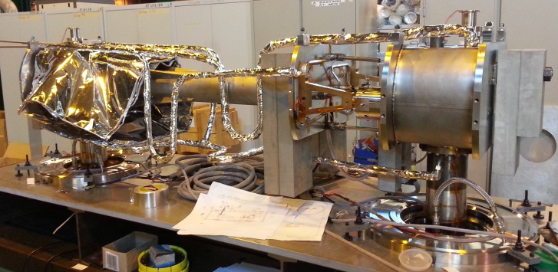
Cryomodule
cf. P. Duthil – 15:50 on Thursday 15/05
Collaboration with ESS (Lund) with contributions from IN2P3 and CEA
Cryogenic circuit
burst disk
Insulation vacuum
relief plate
Thermal shield
Cryogenic lines port
Vacuum vessel
Helium tank
Magnetic shielding
Two-phase pipe
He phase separator
Thermal shield tie-rod
Cavity tuner
RF coupler
Inter-cavity
support
Gate valve
Cold-to-warm
transition
Cavity
Double-walled
tube
cf. R. Bonomi – 16:05 on Thursday 15/05
Assembly of supporting system mock-up
Inner part of supporting system mock-up

Slide 21
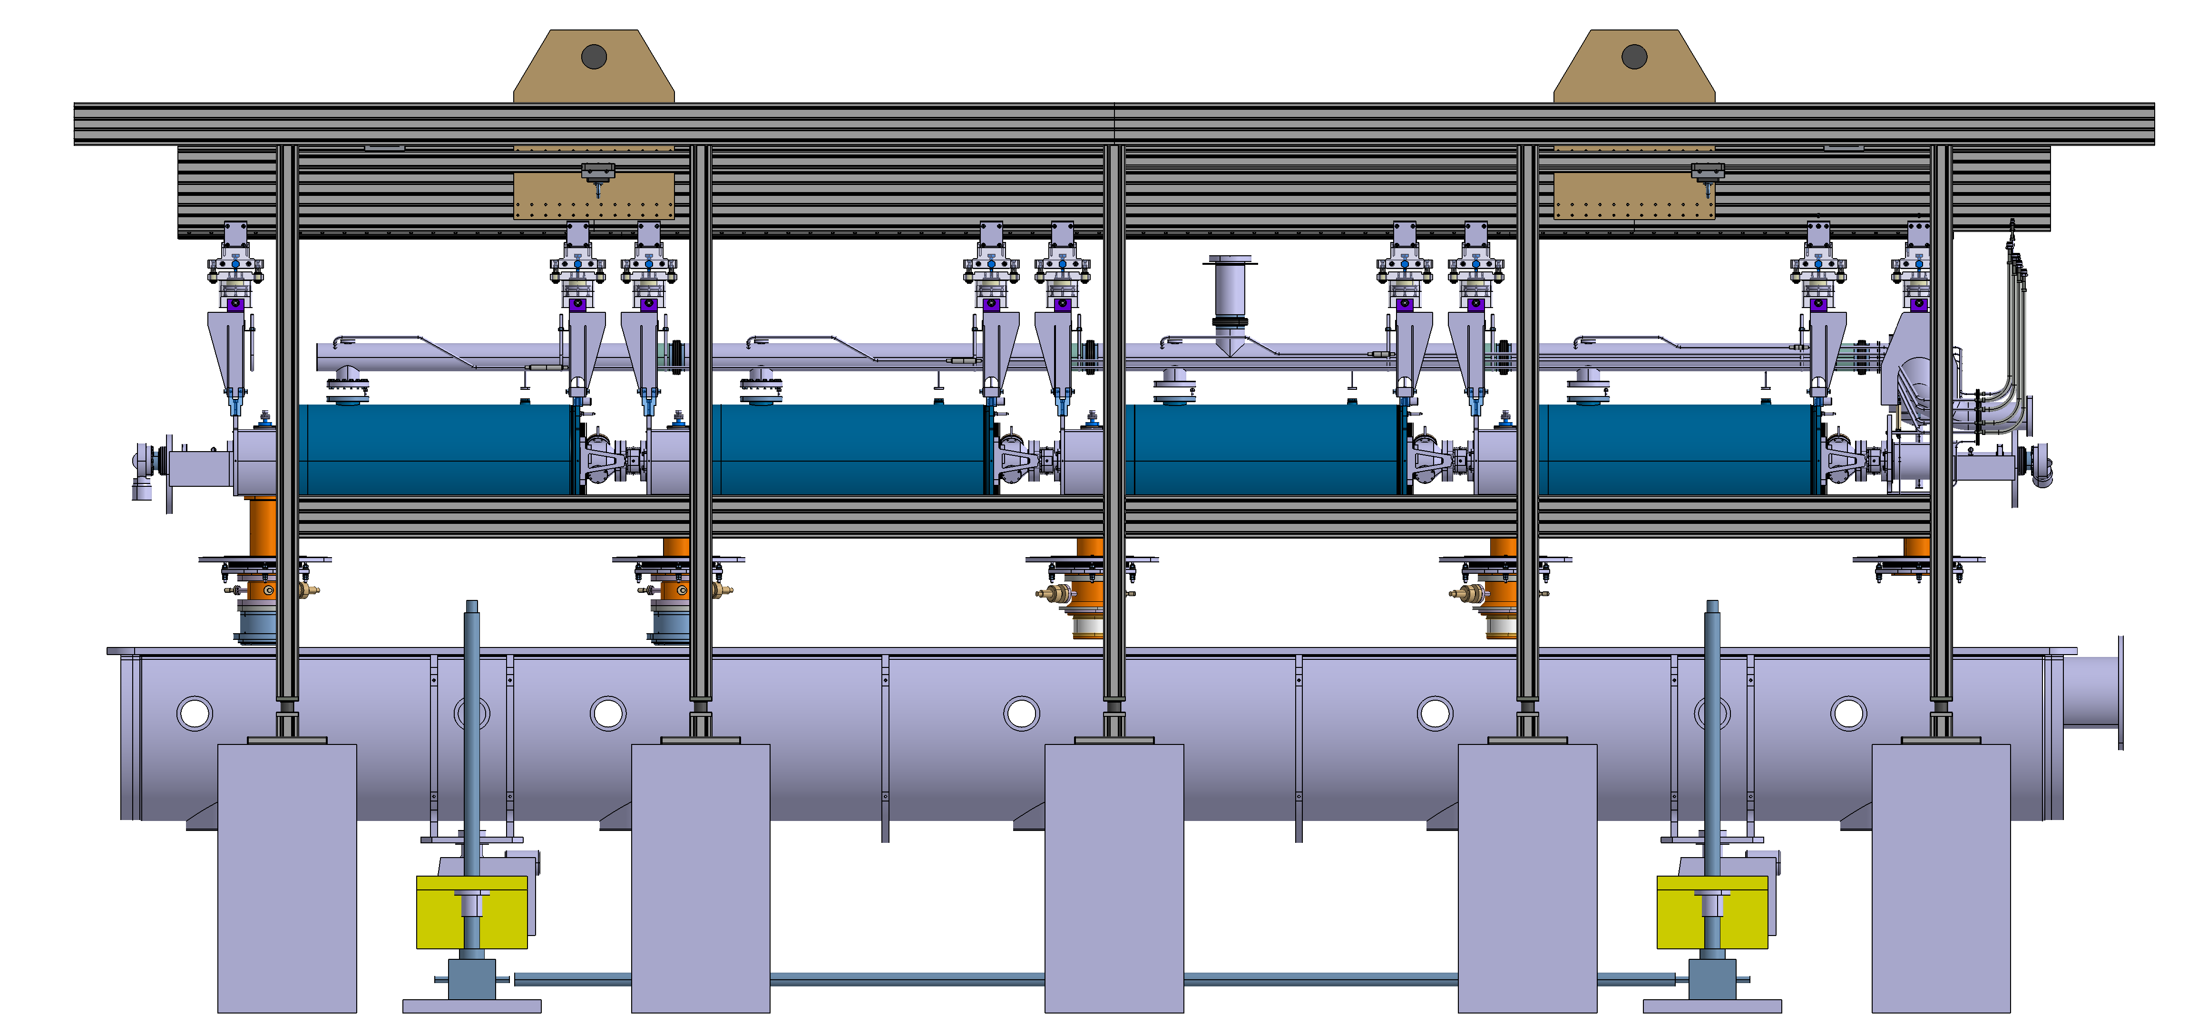
Cryo-module Assembly tooling
Supports de réglage
Poutre principale
Cadre de manutention
CNRS-IPNO
Système de levage
Vérins LHC
Blocs Bétons

Slide 22
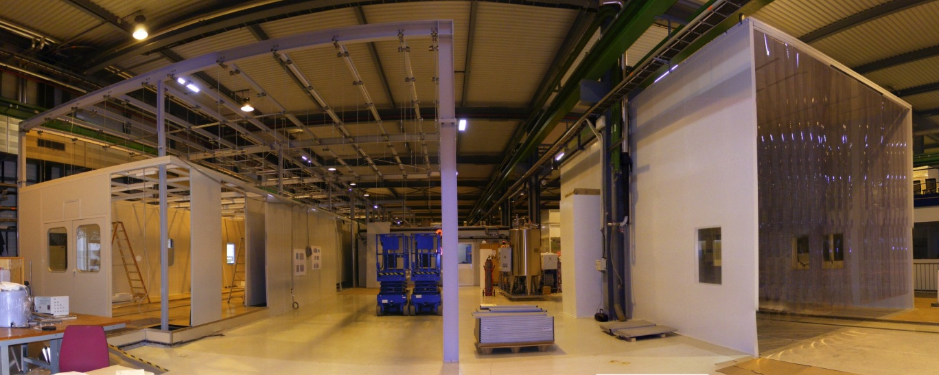
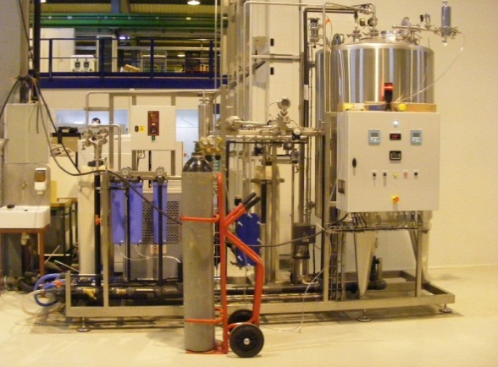
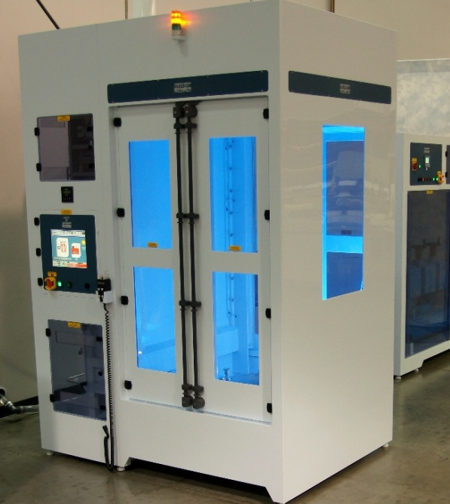
SM18 infrastructure upgrade
cf. P. Maesen – 14:40 on Thursday 15/05
Cryogenics
New cryogenic transfer line: commissioned December 2013
Modification of 2 Vertical Cryostats for 2K Operation: completed March 2013
Specifications of He distribution for Horizontal Cryostats (2K and 4.5 K operation) completed
SRF processing infrastructure
Main Clean Room Upgrade and Extension: to be finished in December 2013
Ultra-Pure Water Station delivered and commissioned: October 2013
Rinsing Cabinet delivered: October 2013
Diagnostics
2nd sound measurement by OSTs: operational (more work required for interpretation…)
Temperature mapping system for SPL cavities: work in progress…

Slide 23
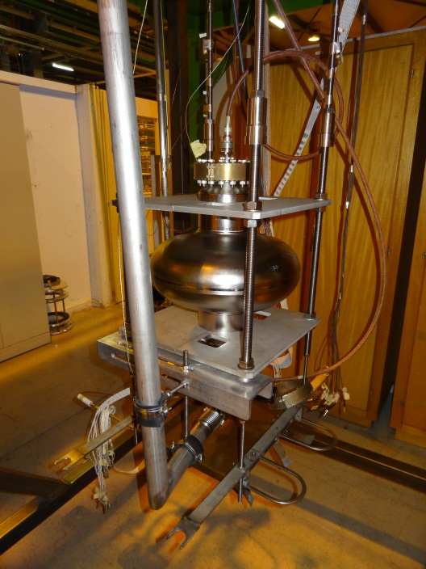
SM18 Bunker Infrastructure
RF
distribution
Cryo-module
Valve box
Cryo line interface
with support from program

Slide 24
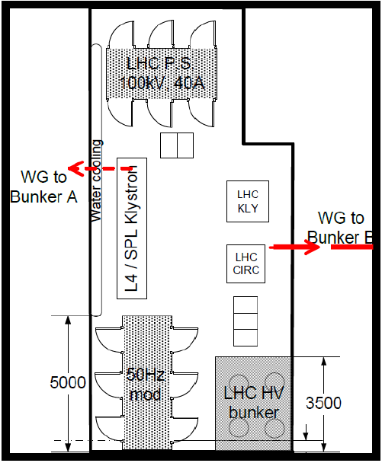
SM18 High Power RF upgrade (704 MHz)
cf. D. Nisbet – 9:30 on Friday 16/05
Collaboration with ESS (Lund)
1.5 MW Thales klystron – delivery beginning 2014
Klystron modulator – delivery beginning 2014
New Low Level RF at 704 MHz – by end of 2014

Slide 25
High Power IOT development (704 MHz)
cf. D. Mc Ginnis – 9:10 on Friday 16/05
Collaboration with ESS (Lund)
Two 1.5 MW IOTs being ordered by ESS
Test set-up in preparation at CERN
Full characterization in 2015-2016 (joint ESS-CERN)

Slide 26
SPL R&D schedule
Preparation of components
Assembly of CM
2014
2015

Slide 27
Summary
Linac4 in construction. Fully operational at the end 2016.
Design and development of a new type of multi-cavity cryomodule,
Design and development of “cheap” high power couplers (8 built; 2 successfully tested today).
Extensive investment for superconducting cavities fabrication and test (e-beam welding machine, ep bench, optical bench…)
2 five-cell copper cavities, one bulk-niobium monocell produced,
4 five-cell bulk Niobium manufactured by industry (RI),
One five-cell bulk Niobium in fabrication at CERN with an R&D approach,
Equipment for testing at high RF power (704 MHz) a string of 4 cavities cooled at 2 K in SM18
A string of four SPL 704 MHz β =1 cavities will start being tested in a short cryo-module at the end of 2015.
Update of CERN competencies
in superconducting RF.

Slide 28
THANK YOU
FOR YOUR ATTENTION!

