Slide 1
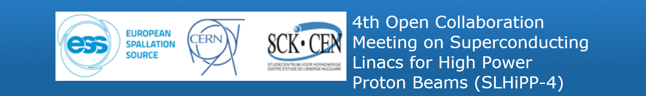


Comparison of SRF
(high-power hadron linac)
projects
J-Luc Biarrotte (CNRS, IPN Orsay)

Slide 2
General overview
Elliptical-based SRF proton linacs
Fully-SRF CW linacs
Summary

Slide 3
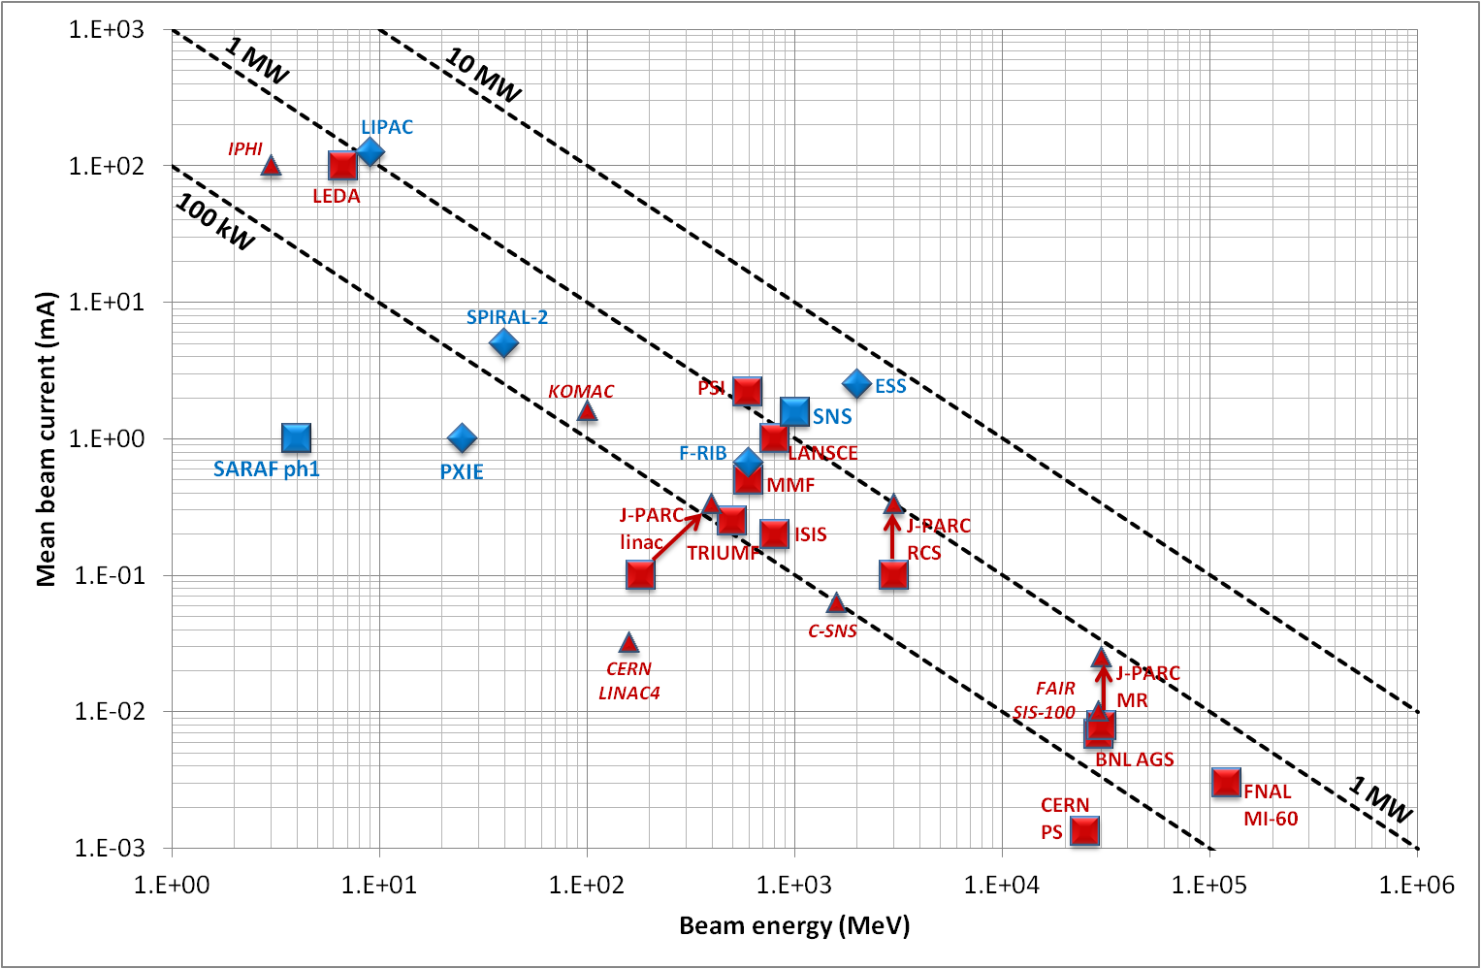
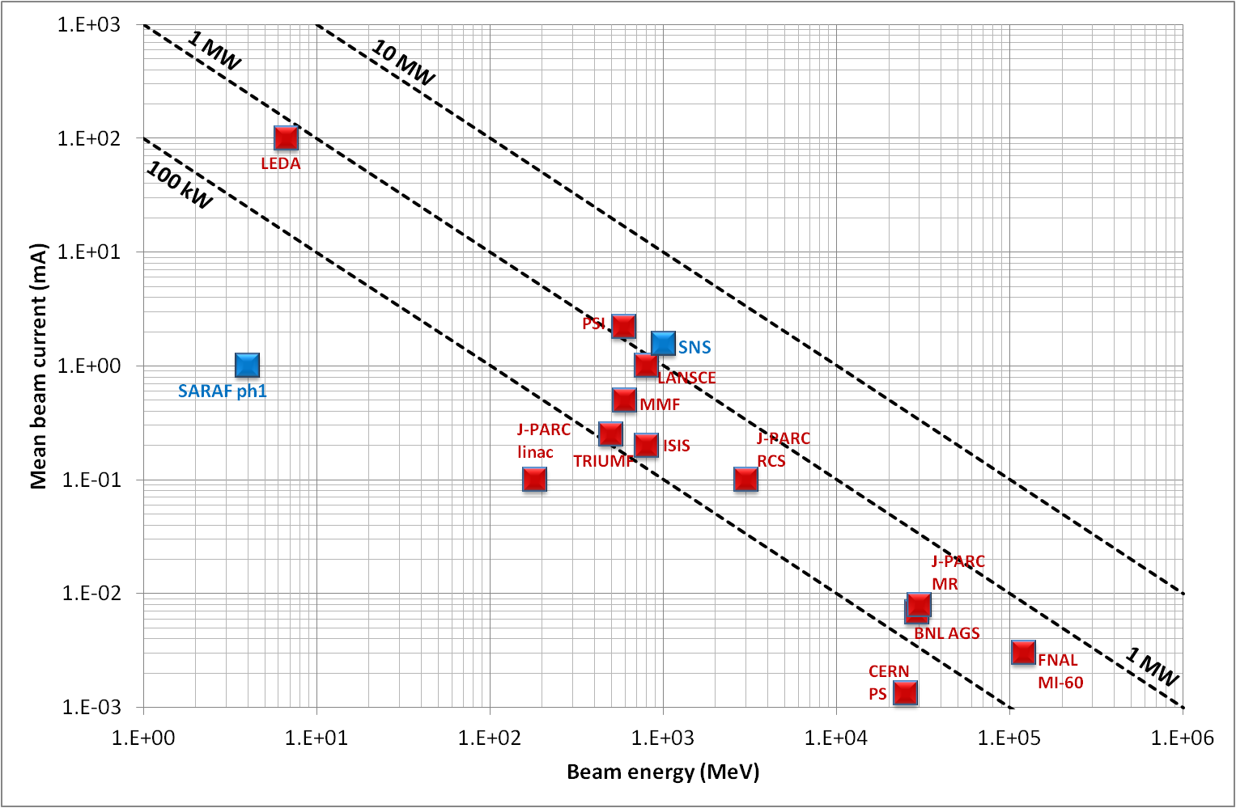
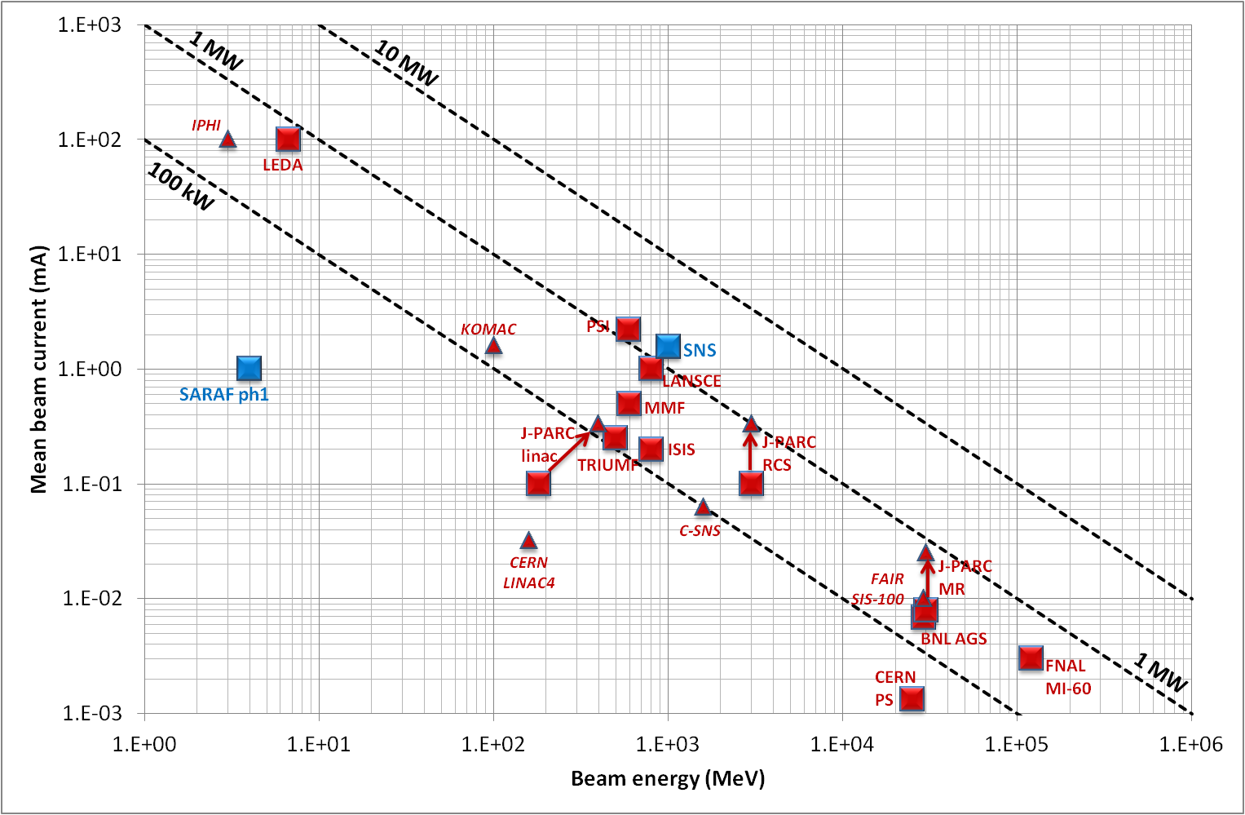
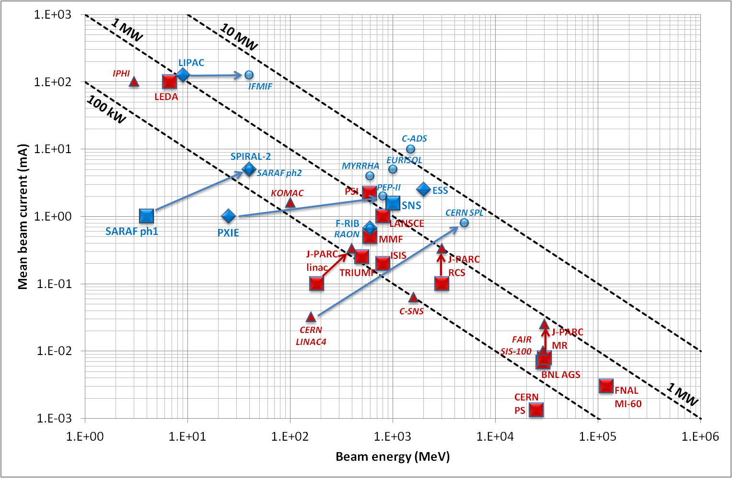
High power hadron beams around the world
Existing NC machines
Under construction NC machines
Existing SC machines
Under construction SC machines
Planned SC machines
Non exhaustive plot !
SRF-based high-power machines are to become more & more numerous

Slide 4
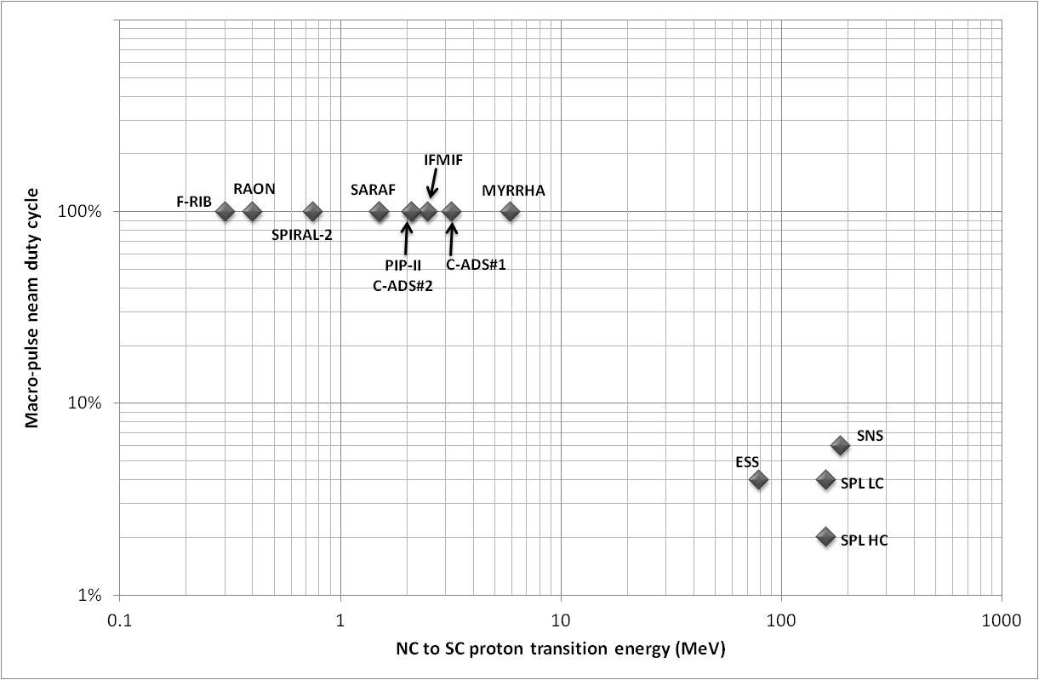
High power SRF linacs: NC to SC transition
NC/SC transition ideally minimizes overall power consumption ~ DC*(P_{cav}+P_{beam}) + P_{cryo}
For CW operation, “SRF As Low As Reasonable Achievable” (i.e. down to the RFQ) has become the worldwide rule
Light-ion CW machines
(H/D)
Non exhaustive plot !
Heavy-ion CW machines
(A/q=1 up to 7)
H+/H- pulsed machines
SRF made feasible the production of very high power CW beams
-> most SRF present ion projects are CW

Slide 5
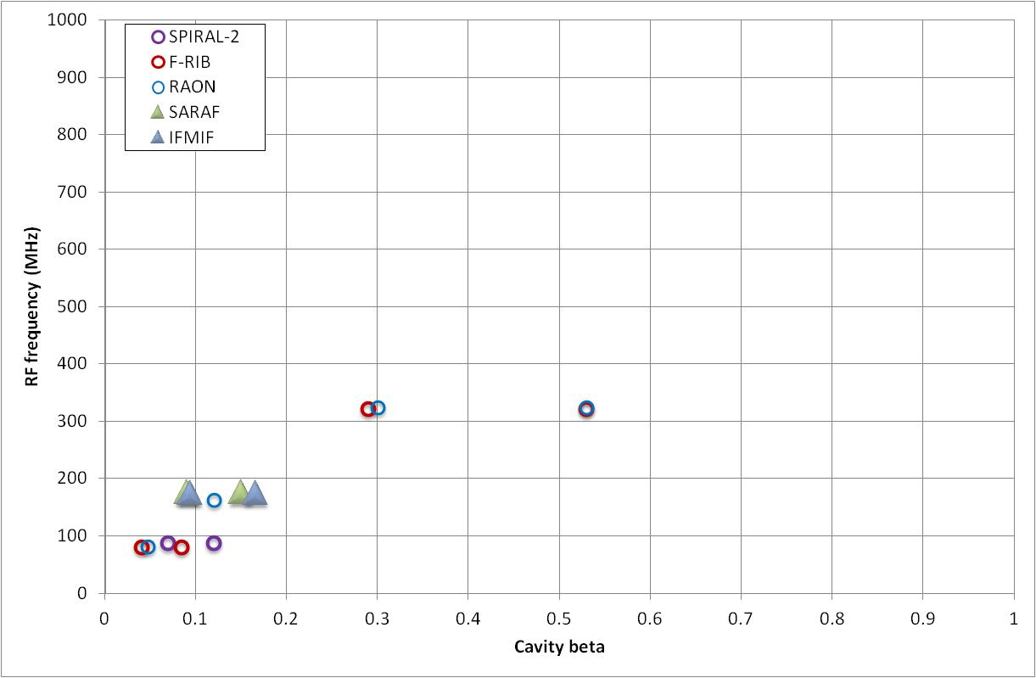
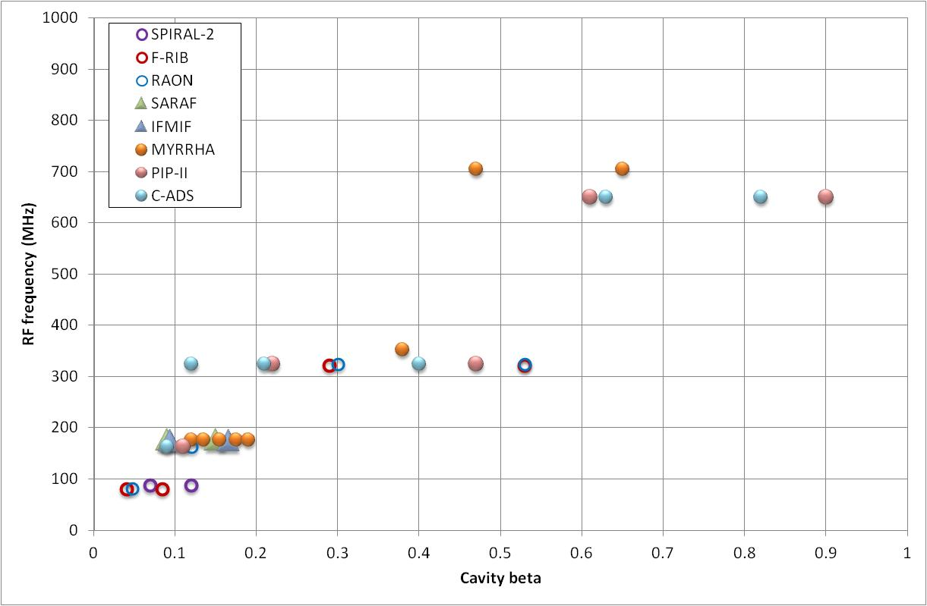
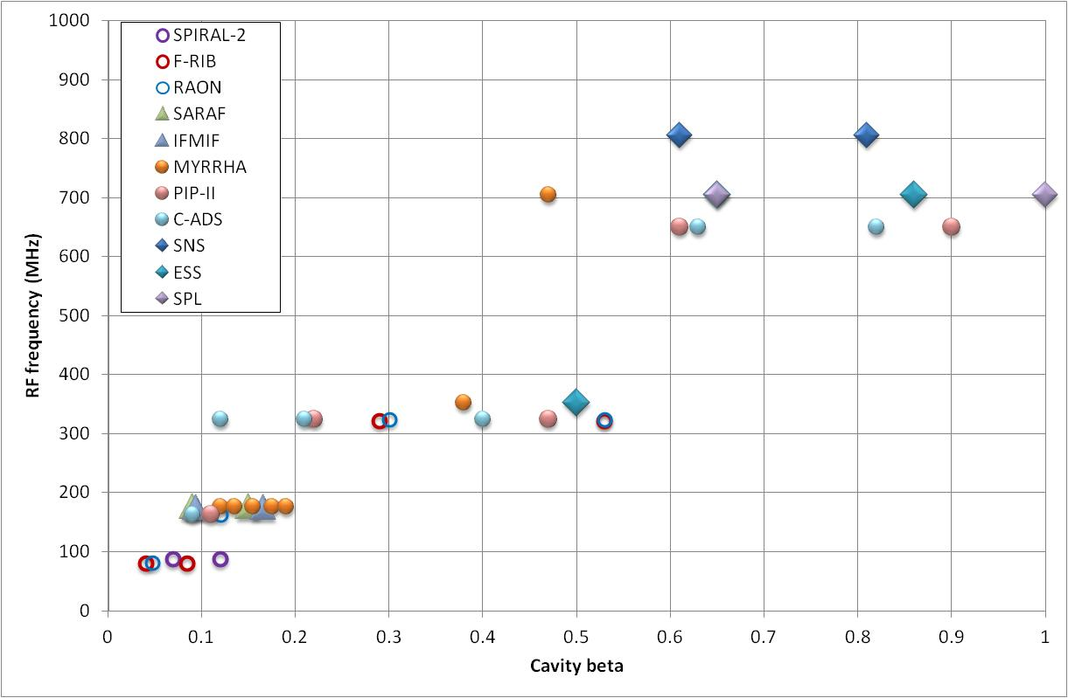
High power SRF linacs: RF structures
HI linacs
Elliptical cavities
D linacs
H linacs (cw)
H linacs (pulsed)
Non exhaustive plot !
HWR, Spoke & CH
QWR

Slide 6
General overview
Elliptical-based SRF proton linacs
Fully-SRF CW linacs
Summary

Slide 7
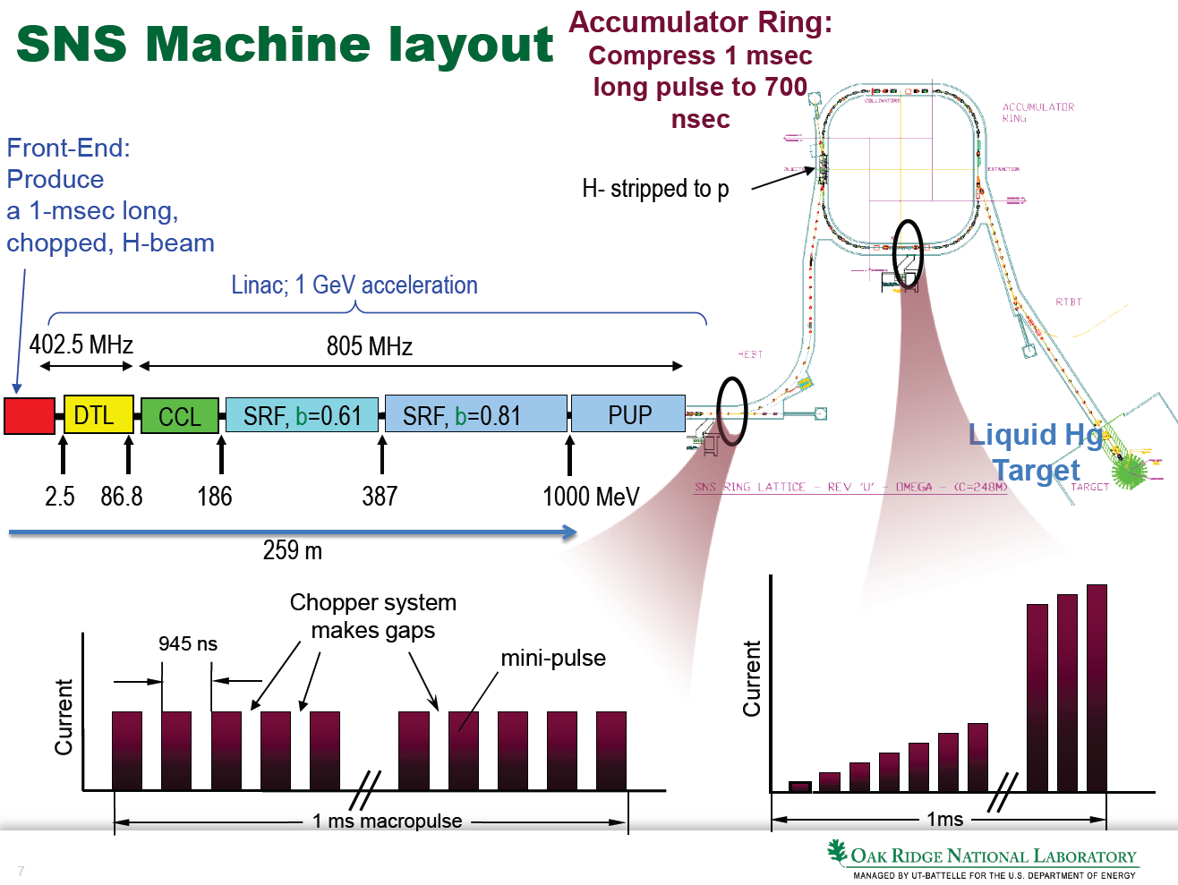
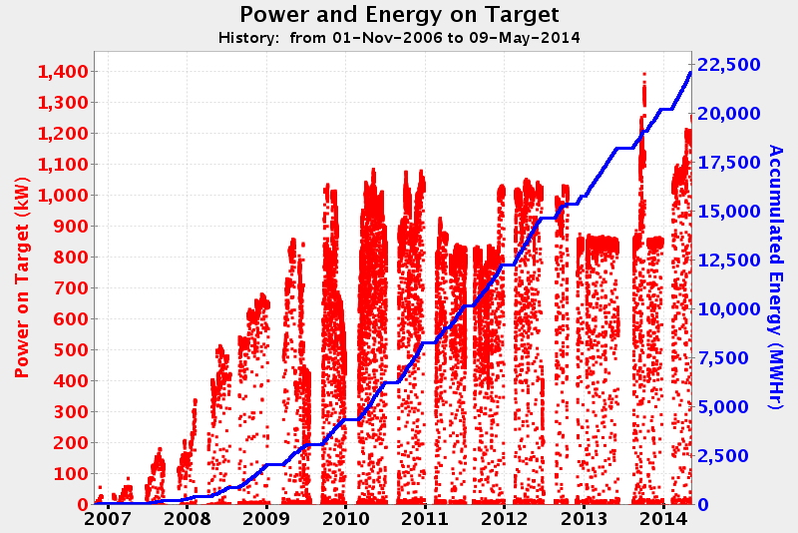
The SNS @ Oak Ridge
SNS = the first high-energy SRF linac for protons/H-
+ the first MW-class one (pulsed but at relatively high DC: 6%)
Listen to Sang-Ho Kim
Running well
(availability >90%)
3 years to ramp the beam power up to 1 MW
3 MW upgrade plan (PUP)
  1.3 GeV upgrade
  beam current upgrade
  @ constant gradients
Replacement of DTL+CCL
by SRF linac is considered

Slide 8
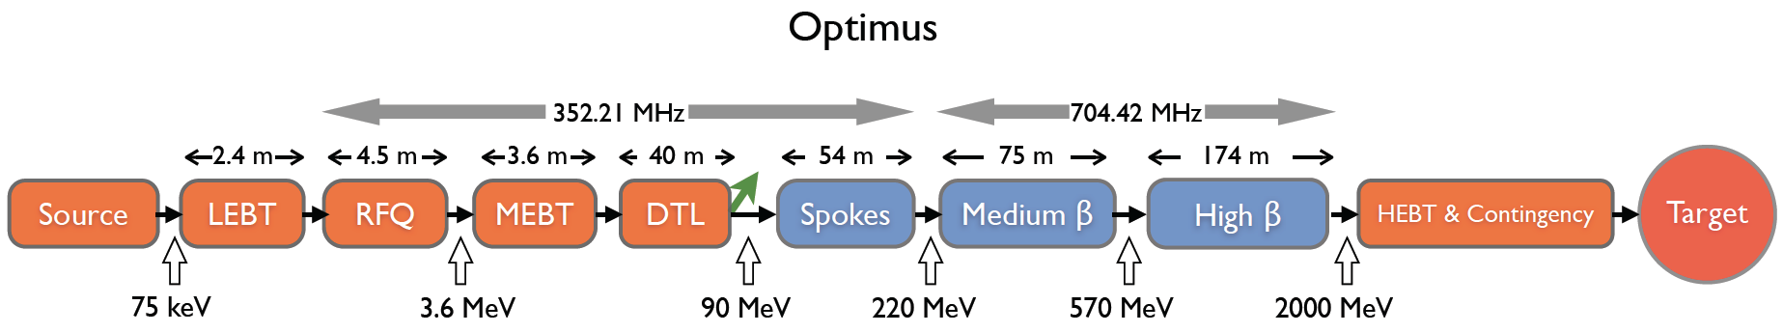
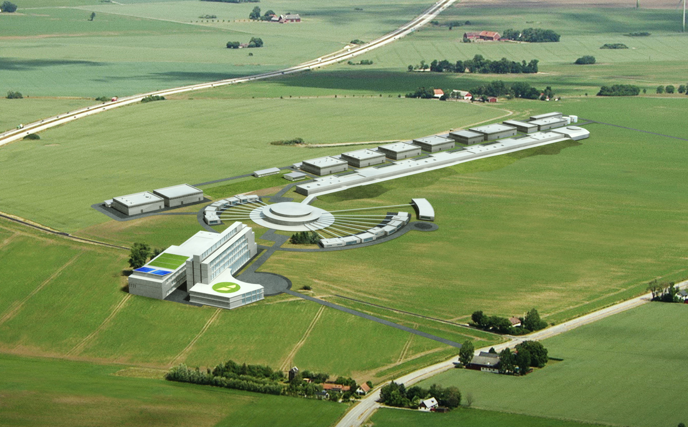
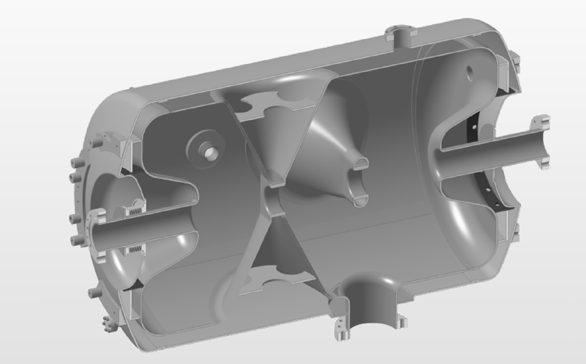
The ESS @ Lünd
5MW mean power, pulsed at 4% DC
Design very similar to SNS, except that CCL is replaced by SRF spoke cavities
  Technological innovation
“Optimus” 2 GeV new layout to reduce costs
  Higher current (50 -> 62.5mA), same DC
  Less cavities (-17 cryomodules)
  Higher gradients (+11.25%): E_{pk} = 45 MV/m
Construction is about to start
First beam planned in 2019

Slide 9
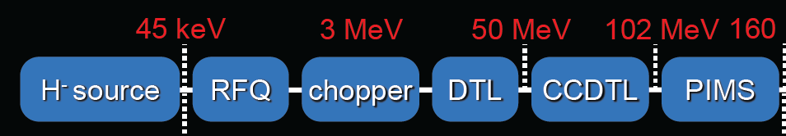
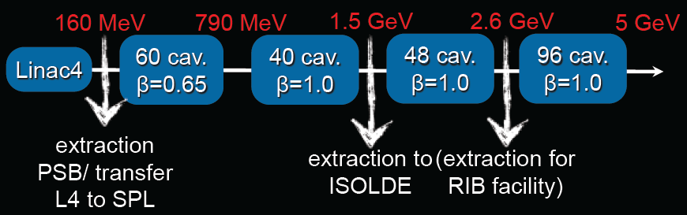
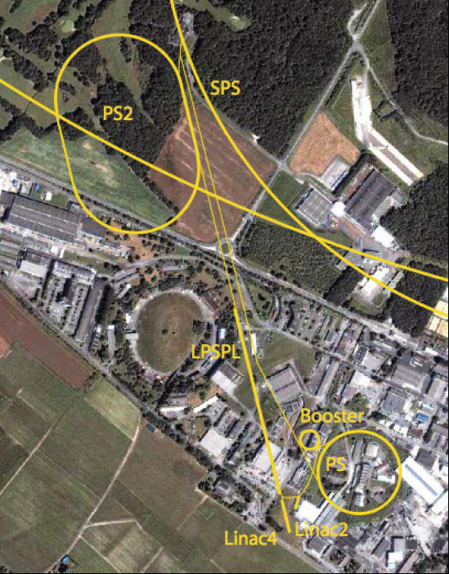
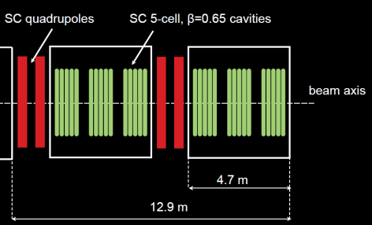
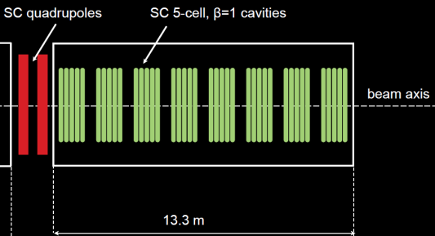
The SPL project @ CERN
4MW mean power, pulsed at 2% or 4% DC
Linac4 (= SPL front-end) is under installation
Linac4 connection to PS is planned in 2016
SPL status = R&D on elliptical cavities
Listen to J. Plouin, A. Macpherson & N. Valverde

Slide 10
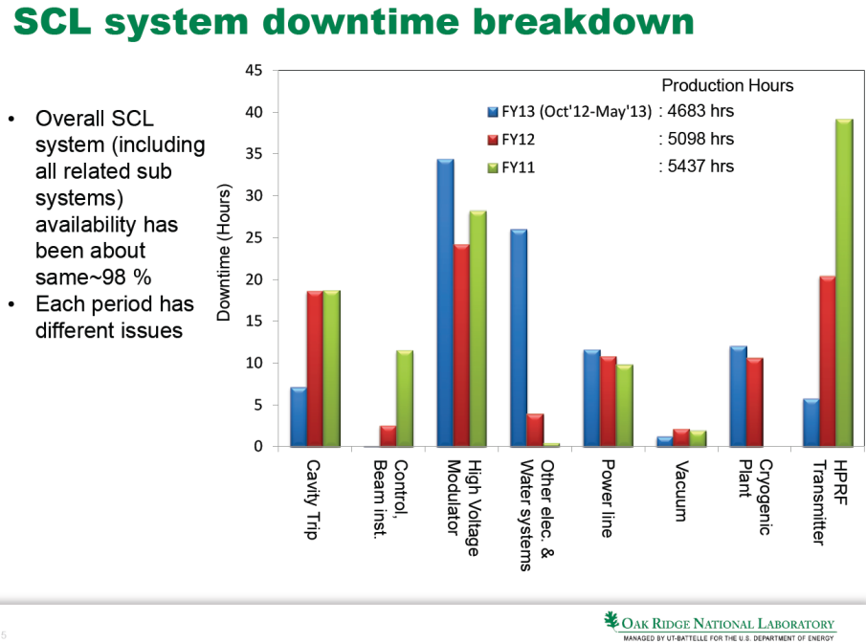

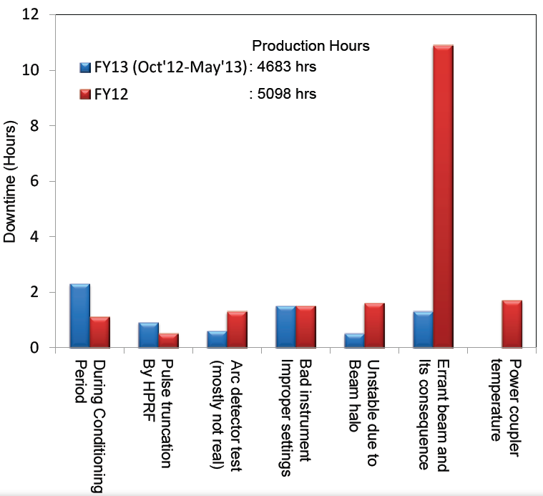
SNS operational feedback
Beam losses & SC linac activation
  Activation is well contained in the SNS, but unpredicted beam losses have been observed
  Losses recently explained by intra-beam stripping
  Use H+ instead of H- if possible !! (losses /30)
SC linac has proven to be substancially more reliable than the NC linac despite the high number of RF stations & the complexity of cryogenics
  Less than 1 trip of the SC linac per day
  Trips dominated by RF systems
  Trips due to cavities are mainly due to errant beam hitting cavity surface (BLM trips from discharge/arcing in warm linac)
  Cavity degradation is observed
  (usually recovered by thermal cycling)
  Multiple cryomodule repairs in house (coupler window leaks, He & vacuum leaks, tuner failures, HOM couplers…)

Slide 11

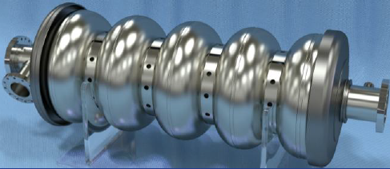
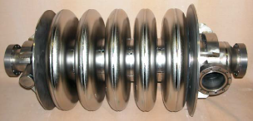
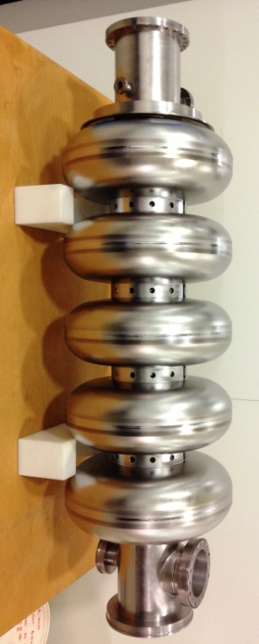
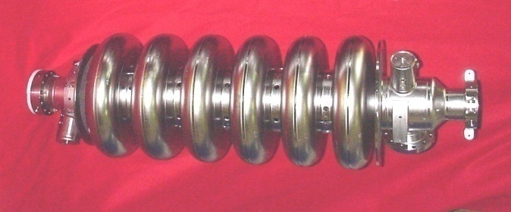
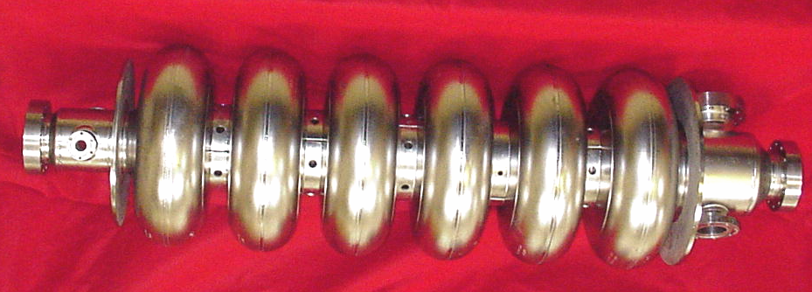
Design constraint #1: Cavity gradients
Cavity gradient is directly related to cost -> tendency to push the gradients
SNS experiences a huge gradient variability -> needs for margins & operational flexibility !!
  Almost every SNS run, a few cavities have problems, resulting in lower E_{acc} or turn-off -> linac retuning
  Achievable gradients are mainly limited by heating
  by electron activity at high duty factor (especially by induced collective limits)
SPL β 1.0: 25MV/m
SPL β 0.65: 19MV/m
ESS β 0.86: 20.0MV/m
FNAL β 0.9
ESS β 0.65: 16.7MV/m
PIP-II β 0.9: 17.0MV/m
PIP-II β 0.61: 16.6MV/m
SNS β 0.81: 15.8MV/m
MYRRHA nom β 0.65: 11MV/m
SNS β 0.61: 10.2MV/m
MYRRHA nom β 0.5: 8.2MV/m
INFN β 0.5
SNS β 0.81
SNS β 0.61
ESS β 0.86

Slide 12
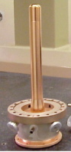
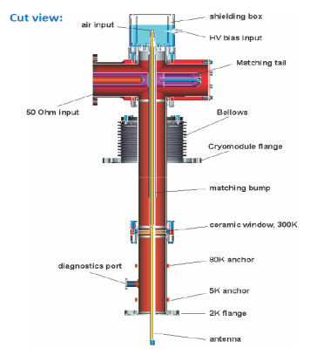
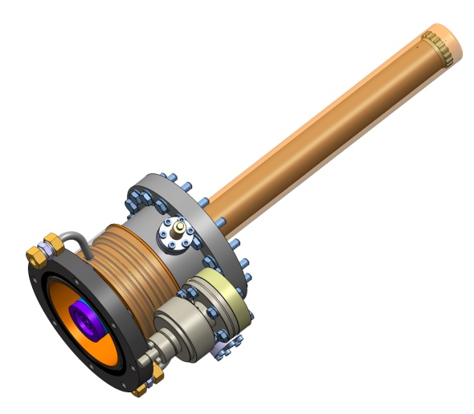
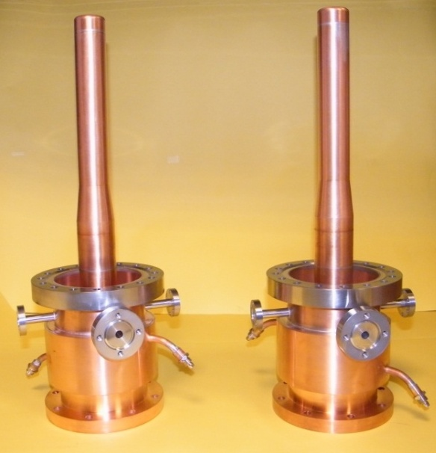
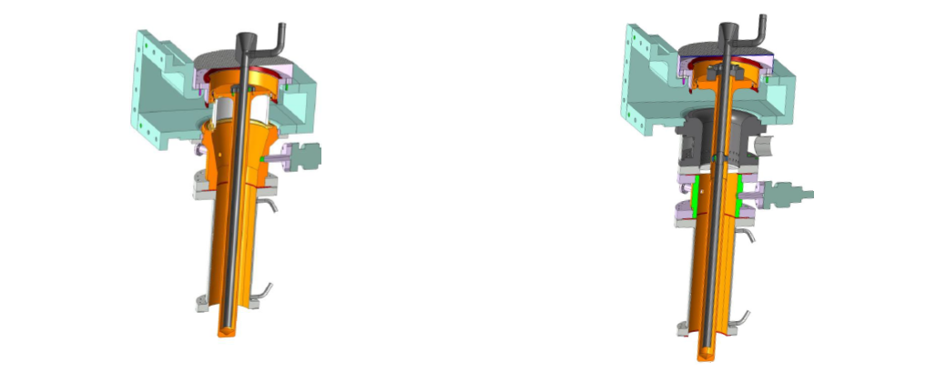
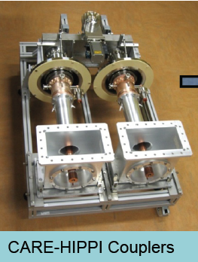
Design constraint #2: Power couplers
The maximal power given by the power coupler to the cavity is a clear limit for linac designers, especially for pulsed high-current machines
  SNS design limit: 550kW peak (48kW average), tested up to 2MW in test stand
  SPL design limit: 1.0 MW peak (about 100kW average)
  ESS design limit: 1.1MW peak (about 100kW average)
SNS
Most of the high-power couplers design are very similar
  Scaled from the original KEK 508 MHz coupler
  Coaxial, single warm window, fixed coupling
FNAL
Listen to E. Montesinos
ESS
CEA
SPL
(air-cooled)
MYRRHA
What about concentrating the R&D effort worldwide on a single design for all machines (1MW pulsed / 100kW CW) ?
  Would be then easier to push the limits towards higher powers (2MW…)

Slide 13
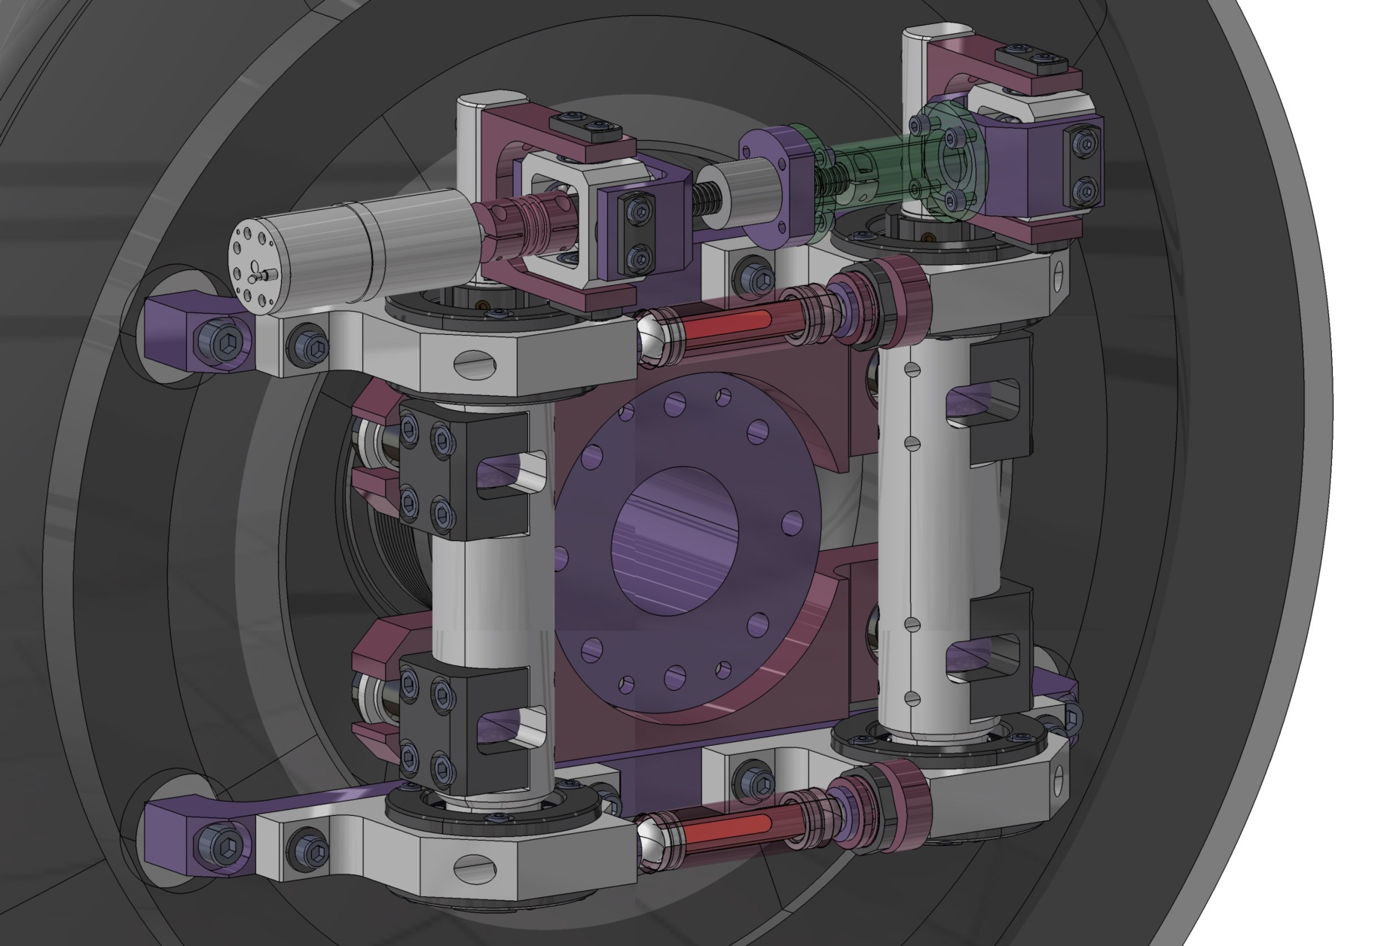
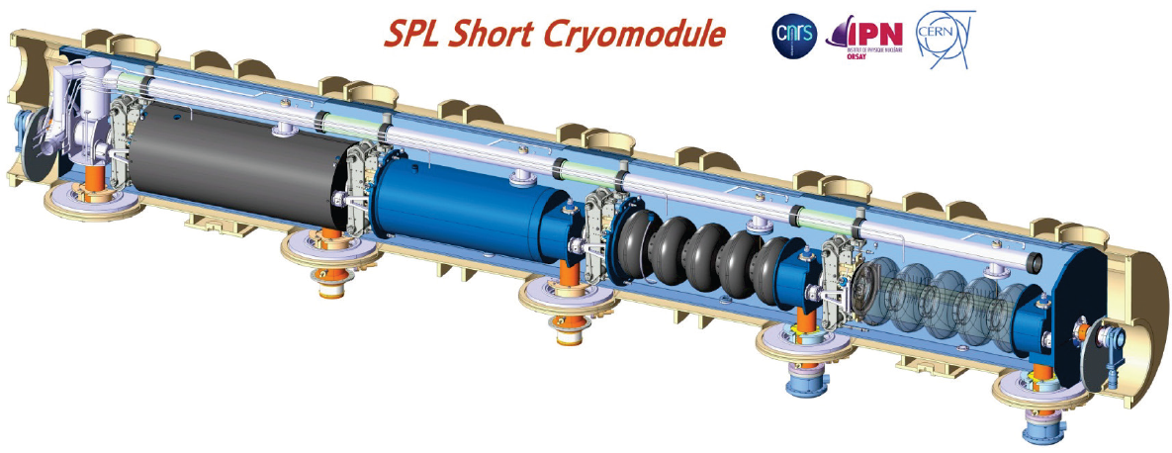
Others
HOM couplers are not mandatory (has become a general agreement)
  HOM voltages build-up is naturally damped (thanks to the high HOM frequency dispersion especially)
  Simple check that HOM are harmless & away from main machine lines (detuning/retuning can help if needed)
  SNS HOM feedthroughs are being taken out
  No HOM couplers foreseen for ESS, PIP-II & MYRRHA cavities
Tuners
  Most of the slow mechanical tuners are based on the CEA Saclay design
  Contrary to SNS, active detuning w/ piezo actuators are a necessity for ESS and SPL, due to higher gradients and therefore higher Lorentz dynamic detunings
Cryomodules
  Mostly from CEBAF-like or DESY-style concepts
  Innovative solutions are developped
  Minimize static heat loads is important for pulsed machines
  For CW machines -> the main concern is to minimize dynamic heat loads and therefore maximise Qo
Listen to G. Constanza
Listen to N. Gandolfo
Listen to G. Olivier

Slide 14
General overview
Elliptical-based SRF proton linacs
Fully-SRF CW linacs
Summary

Slide 15
Challenges for CW high power SRF machines
Peak beam current is lower but mean beam current is usually higher
  SNS = 1mA, ESS = 2.5mA, MYRRHA = 4mA, SPIRAL-2 = 5 mA, C-ADS = 10 mA, IFMIF = 125mA !!
  Beam loss mitigation and MPS management remain very high concerns
  Reinforced by SC structures at very low energies (“soft” beam, small apertures, RFQ tails…)
  Low peak beam current (except IFMIF) -> lowest RF coupling -> narrowest bandwidth
  -> management of microphonics is to be considered (a 2K bath helps!)
CW RF operation
  Dynamic heat loads dominates cryogenics -> Qo is an important cost driver
  General agreement for 2K operation down to 350 MHz spoke at least (FRIB, PIP-II, MYRRHA are even fully 2K)
  Thermal issues on room-temperature elements (couplers, RFQ is non trivial !!!)
  Solid-state amplifiers when possible !!
SC cavities at the RFQ output (or nearly)
  High compactness is required for SC injectors due to beam dynamics constraints, but compromise is to be found vs operational ease, maintenance, beam diagnostics…
  Low-beta SRF is not yet very mature for high current beams: the only SC operating cavities with a high-current beam are the HWR SARAF ones -> technology demonstration is required (and ON-GOING!!!)

Slide 16
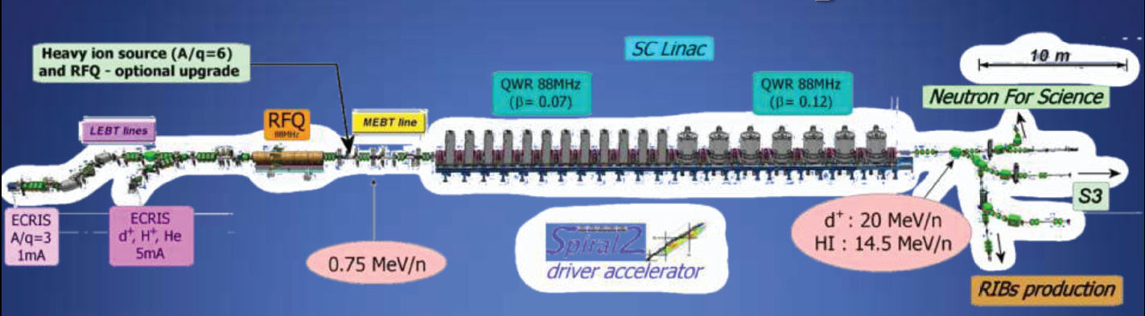
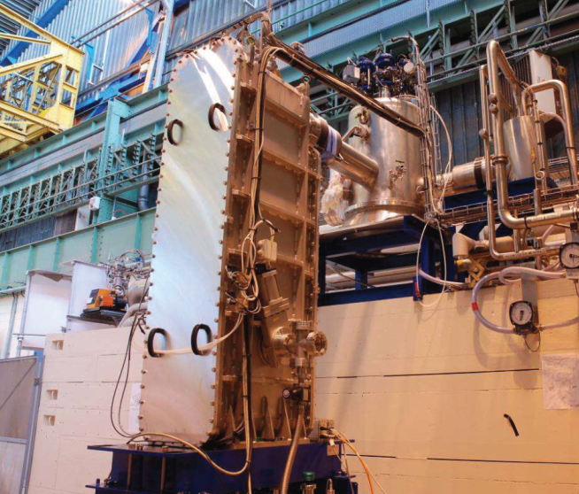
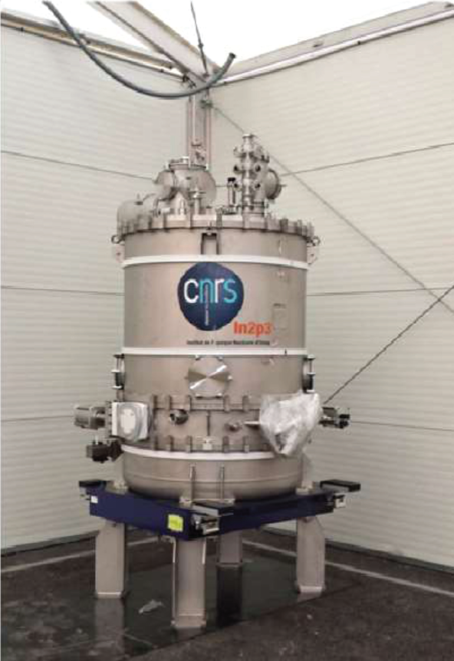
SPIRAL-2 @ GANIL
  SPIRAL-2 will be the world first CW high-power SRF linac for p, d & A/q=3 heavy ions
    5mA CW deuterons at 40 MeV (200 kW)
  5mA CW protons at 33 MeV
  1mA CW HI at 14.5 MeV/u
  26 QWR @88.05MHz (6.5MV/m)
Several challenges in parallel
  High-power beam
  CW operation
  Low energy SRF
  Huge number of different beams
Most of the components are ready
Installation has started in the tunnel
Beam commissioning at GANIL will start in September 2014
Cryomodule A β=0.07 (CEA Saclay)
Cryomodule B β=0.12 (IPN Orsay)

Slide 17
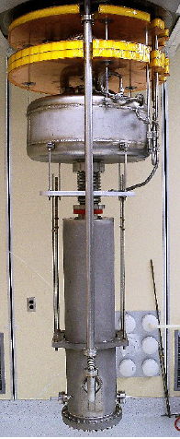
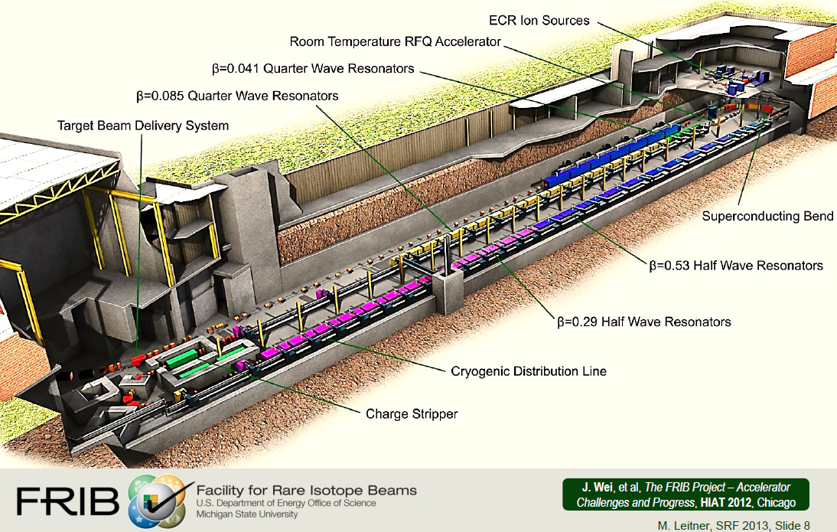
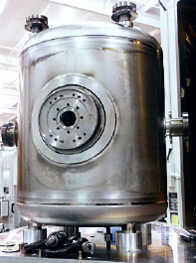
F-RIB @ MSU
  F-RIB should be the world’s largest SRF heavy ion driver
  200MeV/u (Oxygen to Uranium)
  Up to 400 kW CW on target
High number of SRF cavities
  100 QWR @80.5MHz
  216 HWR @322MHz
  Fully 2K !!!
23 cavity prototypes succesfully tested
Mass production will start in 2015 (contract is already awarded for the series cavities)
Civil construction is starting & completion is foreseen in 2020

Slide 18
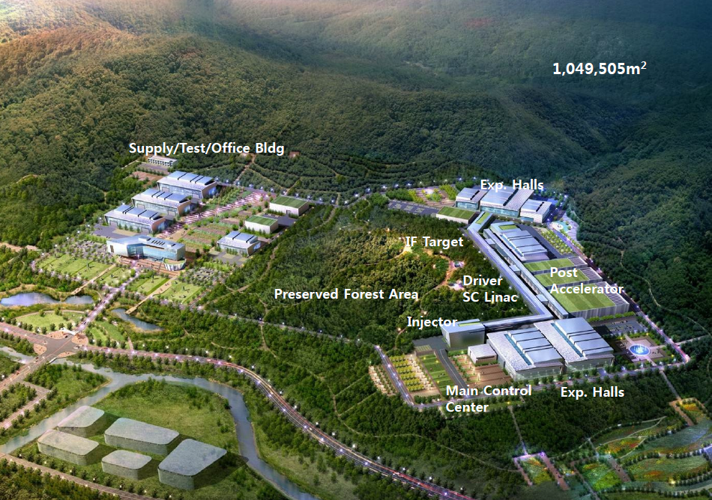
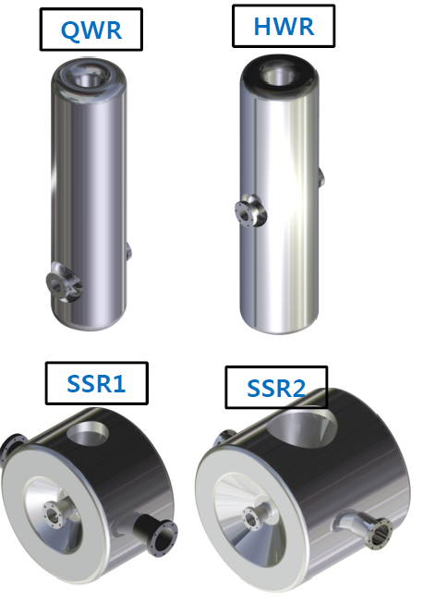
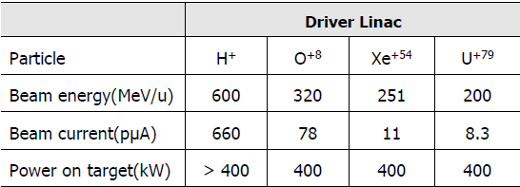
The RAON project in Korea
Project for SRF heavy ion linac
  200 MeV/u up to Uranium
  Up to 400 kW CW on target
  ISOL application
R&D is starting on SRF

Slide 19
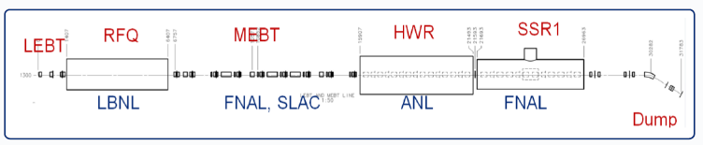
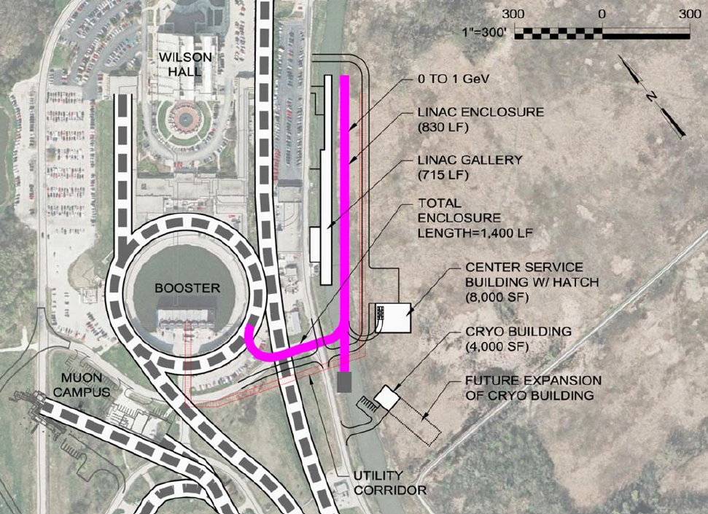
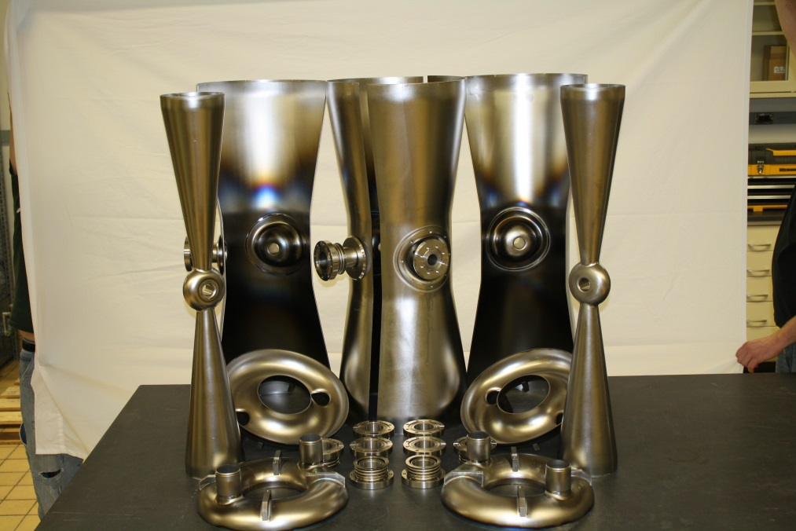
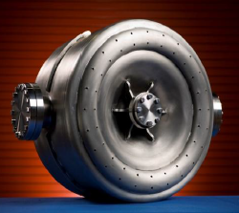
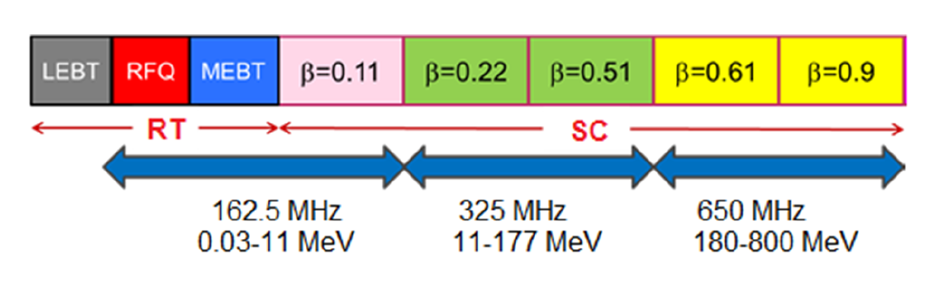
PIP-II linac project @ FNAL & the PXIE demonstrator
PIP-II is derived from Project X stage 1
  800 MeV SRF H- linac,
  2mA peak current, 1% dc (= 16 kW)
  BUT designed for CW upgrade
  (i.e. up to 1.6MW @800MeV)
SRF cavities from 2.1 MeV
  2K operation
  HWR, Spoke, Elliptical
Front-end CW SRF demonstrator PXIE is under construction (25 MeV)
  Goal = validate PIP-II concept & eliminate technical risks
  Beam operation planned between 2016 & 2018
  Cavities under fabrication

Slide 20
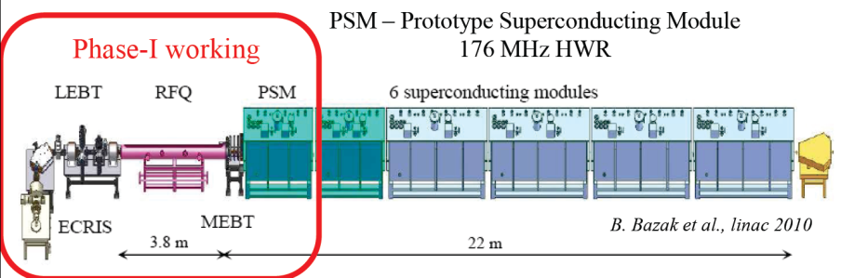
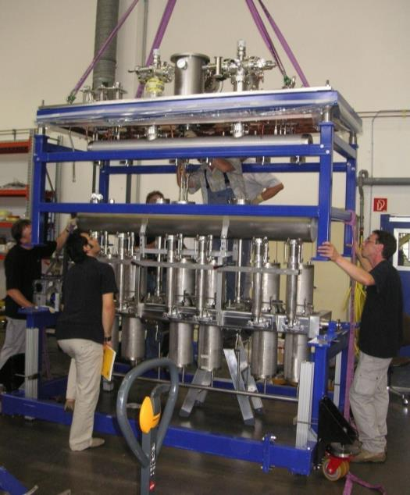


SARAF @ SOREQ
ANL conceptual design
Present operation performance
  1mA CW protons at 4 MeV (2.1mA at 2 MeV)
  4.8 MeV deuterons at 50% dc
World first HWR operation with (high-current) beam !!
Main present limitations of the (6 cav) PSM
  Simultaneous operation of all cavities at nominal field was not achieved for long period (despite efficient He processing)
  Heating of the power couplers (cold window)
  Microphonics management & piezo actuators degradation
New plan for 40MeV upgrade by 2019 = contract w/ vendor
CEA
conceptual design

Slide 21





The IFMIF project & the LIPAC demonstrator
IFMIF = 5MW D beam (40 MeV, 125mA CW)
LIPAC demonstrator: 1.1MW (9 MeV, 125mA )
  HWR concept similar to PXIE (but 4K)
  First beam in 2016
First HWR prototype qualified (VC)
Additional challenge compared to SARAF/PXIE
-> 50 times more beam current !!!
  Beam transport tuning, beam losses control…
  70kW CW per cavity !

Slide 22










The MYRRHA project, the European ADS demonstrator
2.4 MW CW proton beam @600 MeV
    Decision for construction 2015
Additional challenge = Reliability
(i.e. avoid beam interruptions)
R&D on redundant & compact injectors
R&D on fast fault-recovery schemes
  Compensate RF faults in SRF linac (<3sec)
  Margins required on operation points
  Fast piezo-based tuners
Injector demonstrator in construction @UCL/LPSC
    First beam produced in 2013

Slide 23




The Chinese-ADS project
Same reliability-oriented concepts as MYRRHA
Very ambitious ADS program
  Injectors by 2015
  ~ 1 GeV by 2022
  ~ 15 MW ADS by 2032
Active R&D on SRF cavities @IMP & IHEP
Listen to Y. He

Slide 24
General overview
Elliptical-based SRF proton linacs
Fully-SRF CW linacs
Summary

Slide 25
Summary (personal view)
High-power hadron accelerators have been made feasible thanks to SRF
(and to the TTF/ILC/XFEL collaboration !!)
  More & more SRF machines & projects, especially CW with SRF from RFQ on
2000-2030 will clearly be the “golden age” for SRF high-power linacs
-> Enjoy ! before new technologies appear (e.g. plasma acceleration)
Present main R&D challenges
  High gradients for pulsed machines (ESS, SPL) Vs high Qo for CW machines
  Demonstration of SRF-based injectors is required (SPIRAL-2, F-RIB,PXIE, SARAF, LIPAC…)
  Piezo-actuators base tuners become a necessity; reliability is to be improved
Clear & high potential for synergies & collaborations
  R&D on HWR and Spoke cavities
  Potential for common cavity and/or cryomodule designs (e.g. ESS/SPL/MYRRHA elliptical 0.65)
  Potential for a common high-power coupler design to overtake the present 1MW pulsed limit
  ADS R&D to improve reliability can be a potential benefit to all future projects
  Solid-state amplifiers revolution

Slide 26
Thank You !

