Slide 1
New Fermilab Plans (PIP II)
Slava Yakovlev
4th SLHiPP Meeting
May 15-16, 2014

Slide 2
Outline
Short History of Project X and Logic of its Development
Since Last Time
Motivation/Goals
Strategy
Preferred Option
R&D Strategy
PIP-II versus Project X Stage I
Requirements, problems and status
Summary

Slide 3
Short History of Project X and Logic of its Development
Proton Driver - 4 times larger flux than Booster
Ring based(end of 90th - ~2002)
Pulsed 8 GeV SC linac (~2001-2006)
Project X
Pulsed 8 GeV SC linac (2006)
Aligned with the ILC technology
CW SC 2 GeV linac and RCS (2009)
Aligned at experiments in the HEP intensity frontier
CW SC 3 GeV linac and 8 GeV Pulsed linac (2010)
Added kaon experiments and has potential to be used as a proton driver for muon collider
Project Staging (2012)
PIP-II
Utilizes technology developed for Project X

Slide 4
Since Last Time
CSS (Snowmass) Workshop
Project X “Book” released
New Fermilab Director
Established LBNE as laboratory flagship
Requested rework of Project X concept to provide significant enhancement to LBNE, at an affordable cost to DOE
Requested a new name
P5 formed to provide advice to DOE
Plan for the next ten years, within context of next twenty
PIP-II concept developed
Whitepaper published
Presentation to P5 at BNL meeting
Funding requirements to P5
Fermilab assumes major role in SRF cryomodule production for LCLS-II

Slide 5
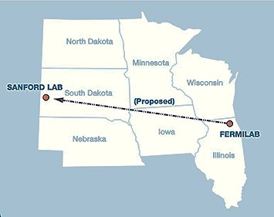
Motivation/Goals
Our goal is to construct & operate the foremost facility in the world for particle physics utilizing intense beams.
Neutrinos
MINOS+, NOvA @700 kW (now)
LBNE @ >1 MW (2025)
LBNE @ >2 MW (>2030)
Short baseline neutrinos
Muons
Muon g-2 @ 17 kW (2017)
Mu2e @ 8 kW (2020)
Mu2e @ 100 kW (>2023)
Longer term opportunities
This will require more protons!

Slide 6
Design Criteria
Support long term physics research goals by providing increased beam power to LBNE while providing a platform for the future
Design Criteria
Deliver 1.2 MW of proton beam power from the Main Injector to the LBNE target at 120 GeV, with power approaching 1 MW at energies down to 60 GeV, at the start of LBNE operations
Continue support for the current 8 GeV program, including Mu2e, g-2, and the suite of short-baseline neutrino experiments; provide upgrade path for Mu2e
Provide a platform for eventual extension of beam power to LBNE to >2 MW
Provide a platform for extension of capability to high duty factor/higher beam power operations
At an affordable cost to DOE

Slide 7
Strategy
Increase Booster/Recycler/Main Injector per pulse intensity by ~50%.
Requires increasing the Booster injection energy
Select 800 MeV as preferred Booster injection energy
30% reduction in space-charge tune shift w/ 50% increase in beam intensity
Provides margin for lower beam loss at higher intensities
Modest modifications to Booster/Recycler/Main Injector
To accommodate higher intensities and higher Booster injection energy
Cost effective solution: 800 MeV superconducting pulsed linac, extendible to support >2 MW operations to LBNE and upgradable to continuous wave (CW) operations
Building on significant existing infrastructure
Capitalizing on major investment in superconducting RF technologies
Eliminating significant operational risks inherent in existing linac
Siting consistent with eventual replacement of the Booster as the source of protons for injection into Main Injector

Slide 8
PIP-II versus Project X Stage I
What was changed?
Beam energy: 1 GeV→ 0.8 GeV. It is large enough
to avoid problems with beam space charge and
To have high enough efficiency of pion and muon production
Beam current: 1 mA → 2 mA
Reduces number of turns for Booster injection
Large enough to support ~ 100 kW for μ-to-e upgrade (long pulse)
At the beginning: a single purpose facility with the only goal
Support of power increase for LBNE by ~1.7 times
Operational mode: CW → Pulsed (15 Hz, 0.6 ms)
Why? - Cost reduction: Cryogenics & Use of existing infrastructure
Long-term goal is the same
CW operation for intensity frontier experiments
Design has to support future CW operation and >2 MW in MI

Slide 9
Project X → PIP-II (Structure changes)
The same as the Project X the PIP-II includes
warm front-end
MEBT chopper capable to chop out bunches coming to Booster at the RF buckets boundary
SC cryo-modules
pulsed operation
limited by power of the cryo-plant
~5% duty factor for cryo
Reduced number of HB-650 cryo-modules (7→4)

Slide 10
PIP-II Major Parameters
Performance Parameter | Requirement
Linac Beam Energy | 800 | MeV
Linac Beam Current | 2 | mA
Linac Beam Pulse Length | 0.6 | msec
Linac Pulse Repetition Rate | 15 | Hz
Linac Upgrade Potential | CW
Booster Protons per Pulse (extracted) | 6.4×10¹²
Booster Pulse Repetition Rate | 15 | Hz
Booster Beam Power @ 8 GeV | 120 | kW
8 GeV Beam Power to LBNE | 80‐120* | kW
Beam Power to 8 GeV Program | 40‐0* | kW
Main Injector Protons per Pulse (12 batches; extr.) | 7.5×10¹³
Main Injector Cycle Time @ 120 GeV | 1.2 | sec
Main Injector Cycle Time @ 60 GeV | 0.8 | sec
LBNE Beam Power @ 60 GeV | 0.9 | MW
LBNE Beam Power @ 120 GeV | 1.2 | MW
LBNE Upgrade Potential @ 60‐120 GeV | >2 | MW
*1st number refers to MI operations @ 120 GeV; 2nd number to 60 GeV. The PIP-II configuration is capable of maintaining 1.2 MW down to 80 GeV.

Slide 11
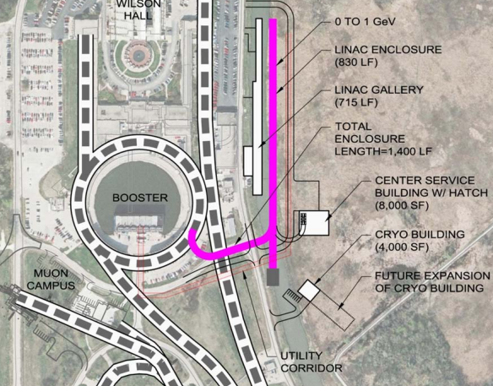
PIP-II Linac Requirements:
Linac Beam Energy | 800 | MeV
Linac Beam Current | 2 | mA
Linac Beam Pulse Length | 0.6 | msec
Linac Pulse Repetition Rate | 15 | Hz
Linac Upgrade Potential | CW
Low beam loading;
Long filling time compared to pulse length;
Low efficiency at pulse mode.

Slide 12
PIP II
SRF Linac Technology Map
SRF Cavity Type | Freq, MHz | Energy (MeV) | Cav/mag/CM | CM type, length
HWR (β_{G}=0.11) | 162.5 | 2.1-11 | 8 /8/1 | scscscscscscscsc, 5.3m
SSR1 (β_{G}=0.22) | 325 | 11-38 | 16 /8/ 2 | csccsccsccsc, 4.8m
SSR2 (β_{G}=0.51) | 325 | 38-177 | 35 /21/ 7 | sccsccsc, 6.5m
LB 650* (β_{G}=0.61) | 650 | 177-480 | 30 /20/5 | cccfdccc, 7.1m
HB 650 (β_{G}=0.9) | 650 | 480-800 | 24 /6/ 4 | cccccc, 9.5m
*3-cavity option is under consideration; CM has no focusing elements.

Slide 13
Accelerating cavity types and
characteristics for the SC linac.
Name | β_{G} | β_{opt} | Freq (MHz) | Type of cavity | B_{peak} (mT) | E_{peak} (MV/m) | E_{acc} (MV/m) | ΔE (MeV)
HWR | 0.094 | 0.112 | 162.5 | Half wave resonator | 41 | 38 | 8.2 | 1.7
SSR1 | 0.186 | 0.222 | 325 | Single‐spoke resonator | 58 | 38 | 10 | 2.05
SSR2 | 0.431 | 0.515 | 325 | Single‐spoke resonator | 70 | 40 | 11.2 | 5.32
LB650 | 0.61 | 0.647 | 650 | Elliptic 5‐cell | 70 | 37.5 | 16.5 | 11.6
HB650 | 0.9 | 0.95 | 650 | Elliptic 5‐cell | 64 | 35.2 | 17.5 | 17.7
E_{peak} ≤ 40 MV/m, for CW (Field emission);
B_{peak} ≤ 75 mT, for CW (medium field Q-slope)

Slide 14
Primary Technical Risks
Future CW operation → cryo-losses → high Q₀ is desired;
Low beam loading → microphonics;
High-Order Modes → “to damp, or not to damp?”
Lorentz Force Detune (LFD) may be an issue in a pulsed mode, and should be analyzed (addressed in Brian Chase’s presentation).

Slide 15
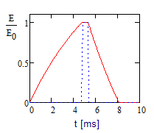
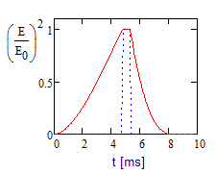
PIP-II Duty Factors
The average RF power has 2 contributions:
the energy transferred to the beam (~10%)
the energy required to fill and discharge the accelerating cavities (90%)
For a fixed average power the cost of RF increases with peak power
therefore its cost achieves minimum with minimum peak power
i.e. power equal to the power required for beam acceleration => duty factor for the RF power amplifiers ≈12%
In this case the cost savings associated with the pulsed power amplifiers is modest and therefore CW capable RF amplifiers are planned from the beginning
More details on cavity filling are in the B. Chase presentation

Slide 16
PIP-II Cryogenics
To minimize the cost a system will be assembled using existing Tevatron cryogenic infrastructure
including the Central Helium Liquefier (CHL)
transfer line
compressors
Cryogenic duty factor is ~5%
The total cryogenic heat load at 2K is dominated by the static load, and is about 16% of the CW load
Future upgrade to CW operation would require a new 2K cryogenic plant
Rms pressure fluctuations have to be <0.1 mbar!!!
Total CM Heat Loads [W]
 | 70 K | 5 K | 2 K
Pulsed | 2,860 | 895 | 256
CW | 2,860 | 895 | 1819

Slide 17
Limitations on Operation in Pulsed Regime
The Lorentz force detuning represent a problem which needs to be diligently addressed
Cavity design with suppressed sensitivity to microphonics and LFD
Fast tuner (piezo-based) & Low level RF
Over coupling and additional RF power
 | E_{acc} (MV/m) | LFD (Hz/(MV/m²) | Δf_{LFD} [Hz] | Q_{loaded} opt. for CW | Δf=f/2Q [Hz] | Microphonics ampl. [Hz]
HWR | 8.2 | - | - | 2.4∙10⁶ | 34 | 20
SSR1 | 10 | 1.5* | 150 | 3.6∙10⁶ | 45 | 20
SSR2 | 11.2 | No data |  | 6.0∙10⁶ | 27 | 20
LB 650 | 16.5 | <1♦ | <272 | 1.12∙10⁷ | 29 | 20
HB 650 | 17.5 | <1♦ | <306 | 1.05∙10⁷ | 31 | 20
* Measured
♦ Estimated

Slide 18
Limitations on Operation in Pulsed Regime (continue)
All cavities with the exception of HWRs will have fixed coupling
Operation in pulsed regime with coupling adjusted for CW requires ideally working fast tuner which suppresses the LFD
Adaptive digital feedback with feedforward controlling the fast tuner operation is the must
Presently we assume
that external stub tuners are used for Q_{loaded} decrease
Couplers are capable to operate at required (increased) power levels
Increased priority for the R&D directed at LFD compensation with fast tuner
Excessive RF power for LFD and microphonics compensation
Final adjustments of cavity coupling values and RF power requirements will be done later
More details on cavity filling are in the B. Chase presentation

Slide 19
Status of the PIP II cavity
and CM design
SSR1
10 SSR1 325 MHz, low-beta cavities are manufactured;
9 of them are processed, tested and qualified;
New He vessel with reduced df/dP is designed, one SSR1 cavity is dressed.
Tuner design is in progress;
RF coupler design is completed, 3 couplers will be ready for HP tests.
Design of the focusing solenoid is completed, the 1st solenoid is manufactured and is tested.
Concept design of the CM is ready, main parts (vacuum vessel, strong back and supports) are ordered.
SSR2
EM design is finished,
mechanical design is in progress.

Slide 20
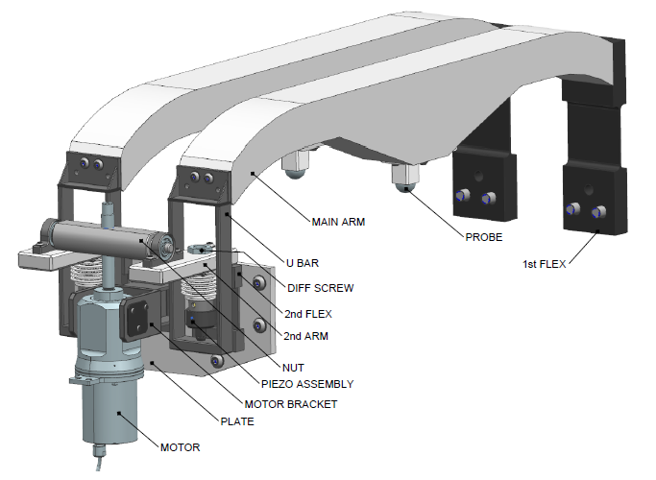
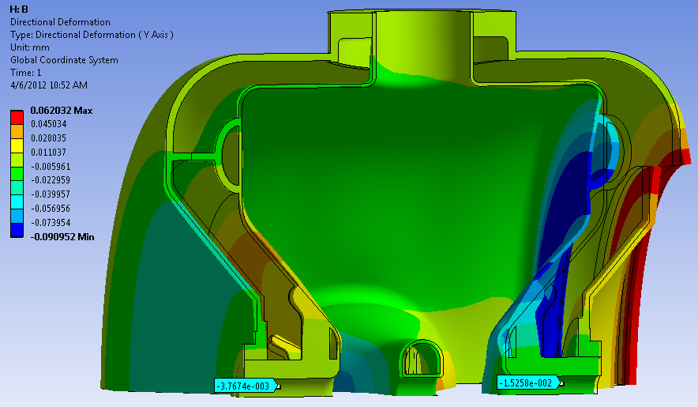
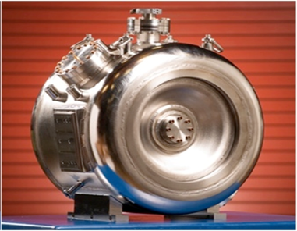
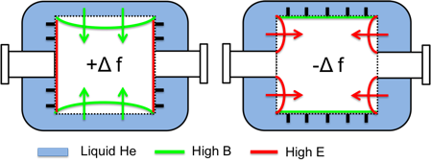
SSR1 He Vessel and tuner
Pressure of L_{He} can vary by ± 0.1 Torr in the cryomodule
SSR1 must operate within a small bandwidth ± 20 Hz
A self-compensating design was developed allowing low sensitivity
Despite non-negligible deformations (see picture), net shift is very low
Bare cavity ~ 600 Hz/Torr, with He vessel ~ 10 Hz/Torr (measured)
Ease of tuning 39 N/kHz (bare), 40 N/kHz (with He vessel)
Actuating elements of the tuning system
Dressed SSR1

Slide 21
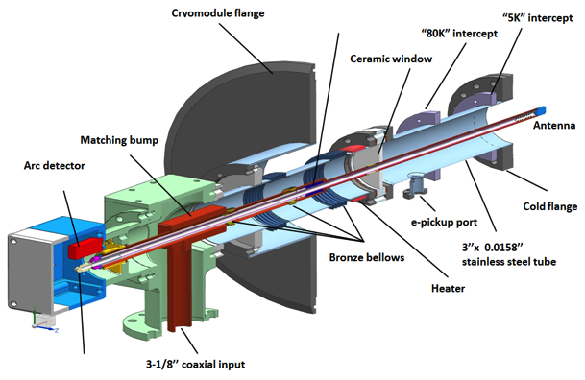
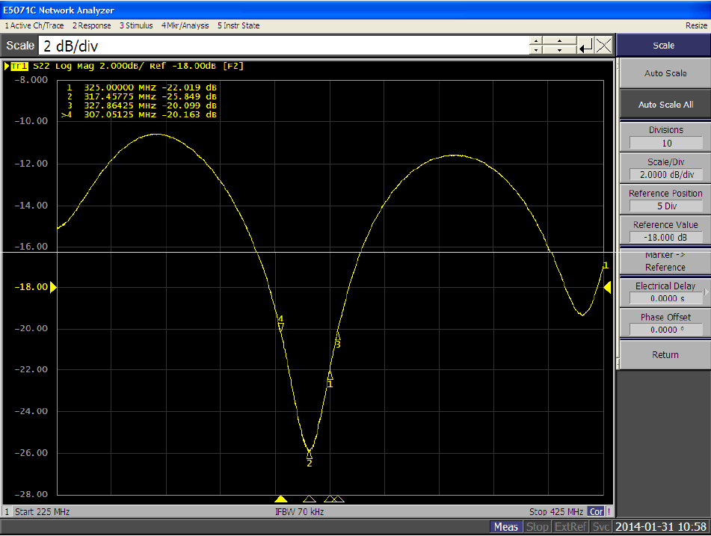
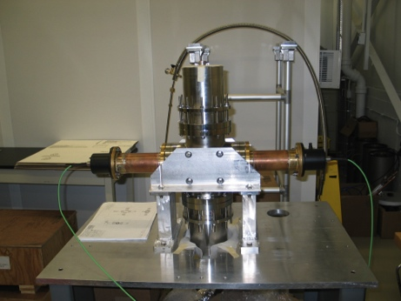
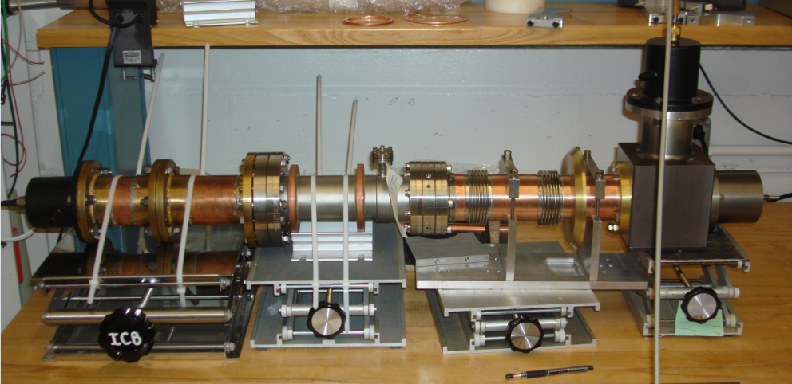
SSR1 Couplers:
Coupler test stand
The coupler is designed for 30 kW traveling wave (TW) at full reflection
Three couplers are manufactured, measured (reflection -22 dB at 325 MHz) and will be tested in few weeks.
The test stand is ready

Slide 22
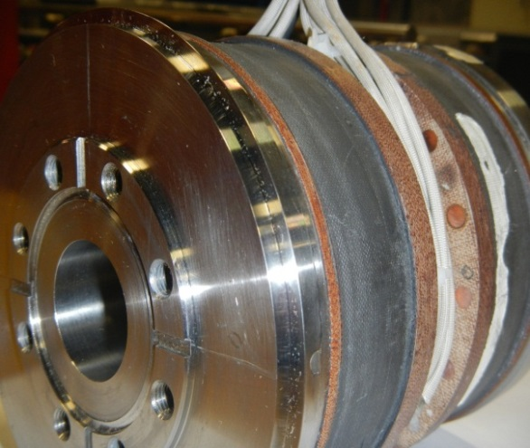
SSR1 Solenoids:
Number, total | 4
Operating temperature, K | 2
Maximum current, A | <100
∫B²dL, T²m | 4.0
Alignment precision, RMS: center position [mm] | ±0.5
Alignment precision, RMS: angle [mrad] | ±1
Magnetic field on the walls of the cold cavity should not decrease its quality factor by the factor of more than | 2
Prototype lens PXIE_SSR1_L01P has been tested for performance on February 5, 2014.
The lens reached quench current without training both at 4.58 K and 2.15 K. At 4.58 K, the quench current was 68 A. At 2.15 K, the quench current of ~92 A was measured. This coincides to the model prediction.

Slide 23
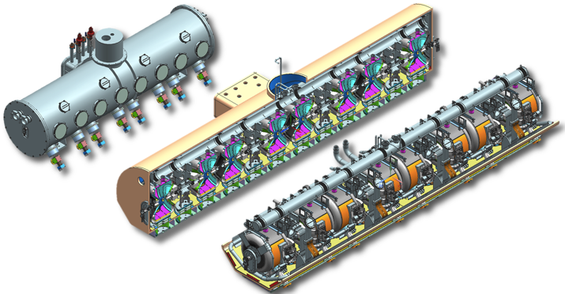
The SSR1 cryomodule
The concept design is complete
Procurement is started

Slide 24
SSR1 Schedule:

Slide 25
LB/ HB 650
EM design of both LB and HB 650 is ready.
Two singe-cell LB 650 cavities are manufactured, processed and tested (JLAB);
Six single-cell cavities HB 650 are manufactured by AES, processed and tested at Fermilab.
Two HB 650 cavities are processed and tested.
Four 5-cell HB 650 cavities are manufactured by AES and ready for processing and tests.
Five additional single cell and five five-cells HB cavities ordered from industry (PAVAC) on ARRA funds
Design of He vessel for HB 650 with low df/dP and the tuners (slow and fast) are completed.
Concept design of the CM for HB 650 is ready.

Slide 26
LCLS II: Fermilab participation
2014 - 2015 :
One 1.3 GHz pre-production cryo-module: ILC-type 8-cavity CM with minimal modifications for CW operation at 16 MeV/m
Extensive use of existing parts (vacuum vessel, cavities, couplers)
Design modifications (CM, He vessel, tuner, HOM coupler, main coupler)
Part procurement
CM assembly
CMTF and ASTA modifications to allow CW tests of full LCLS-II CM
R&D for Q0 improvement
2015-2018:
Production of LCLS II cryo-modules
Eighteen 1.3 GHz cryomodules (144 TESLA – type 9-cell cavities);
Two 3.9 GHz cryo-modules (16 FNAL- type 9-cell cavities).
Major new initiative for FNAL. Previous ILC work has positioned us very well
Care will be required to minimize impact on PIP II R&D effort

Slide 28
Conclusions
PIP-II is aimed at the long-time program in the accelerator based HEP intensity frontier
A required cost reduction at the first stage is achieved by
Reduction of CW linac energy,
transition to pulsed regime
and reuse of existing infrastructure
Reuse of Booster creates a cost effective way to increase power for the neutrino experiments
For LBNE it should yield a power increase of ~1.7 times
SC PIP-II will can be used for the μ-to-e upgrade with reasonably large duty factor
Transition to the CW regime will require new cryo-plant
All other major system will be CW compatible

